Slide 1
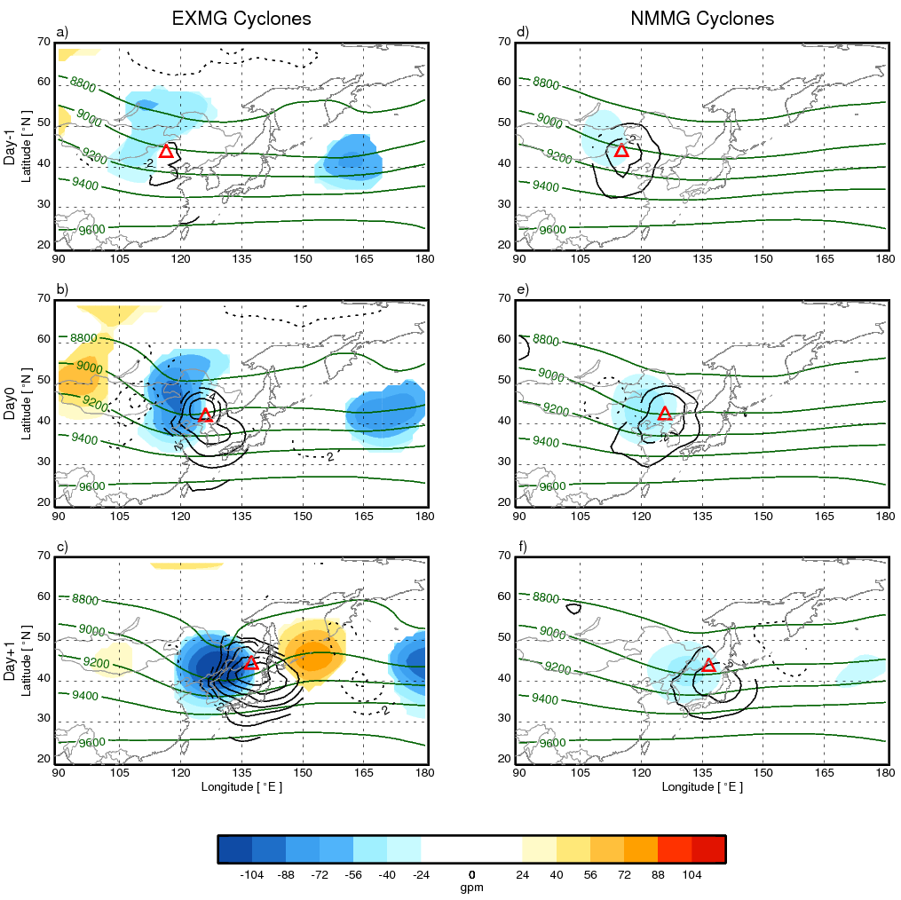
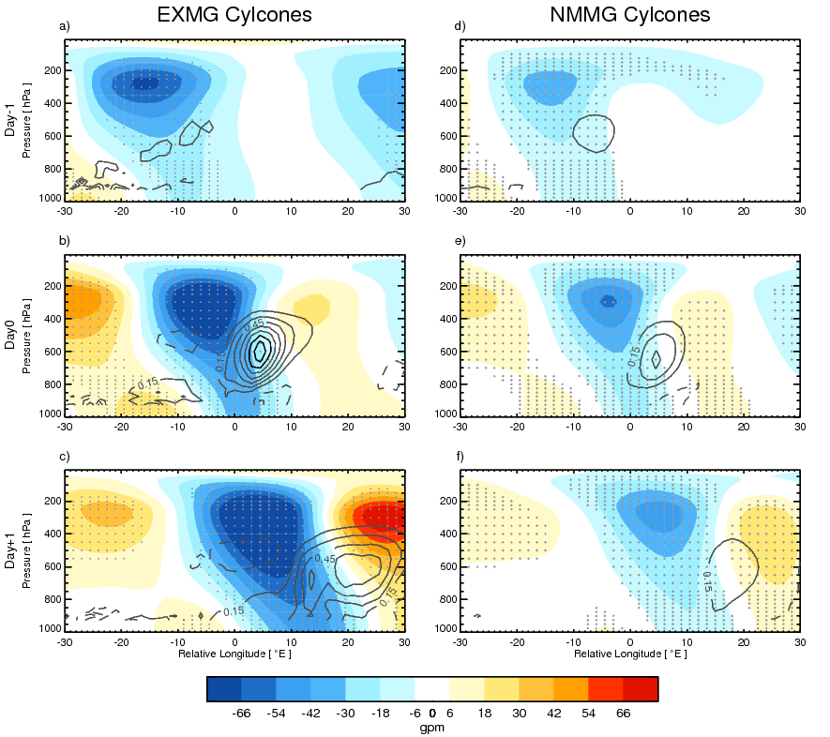
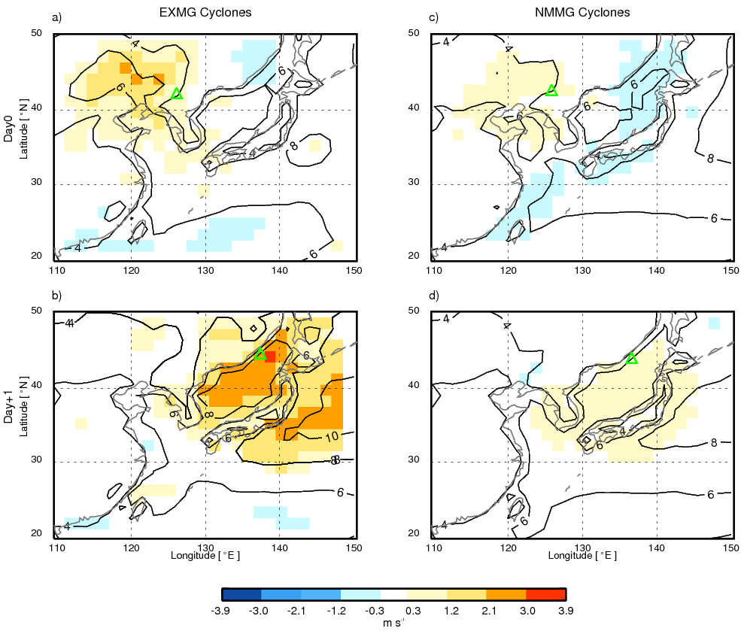
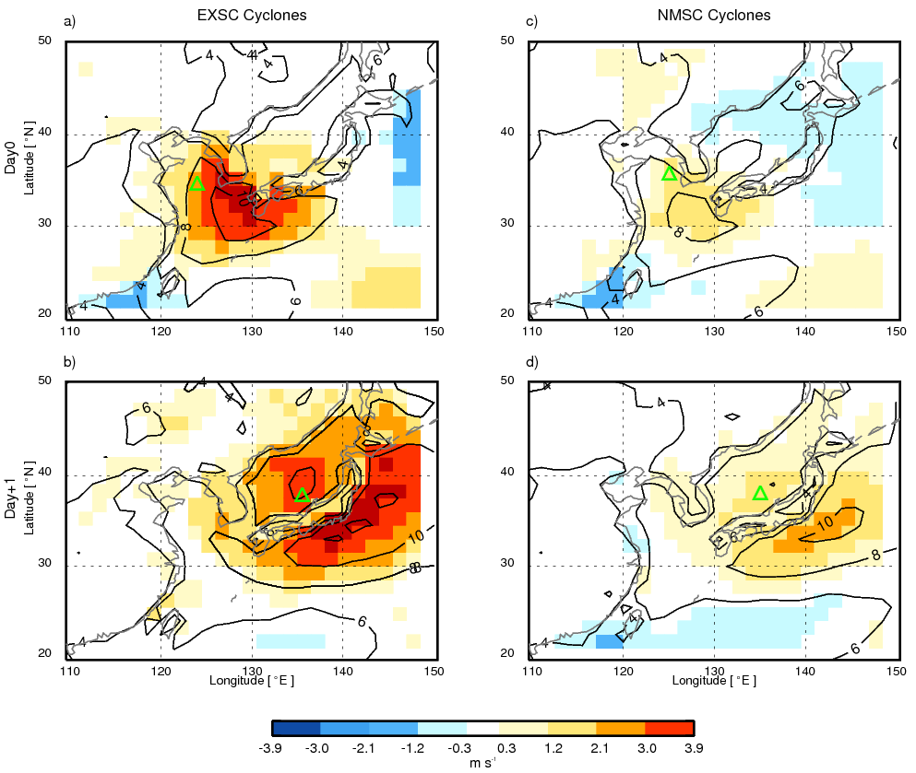
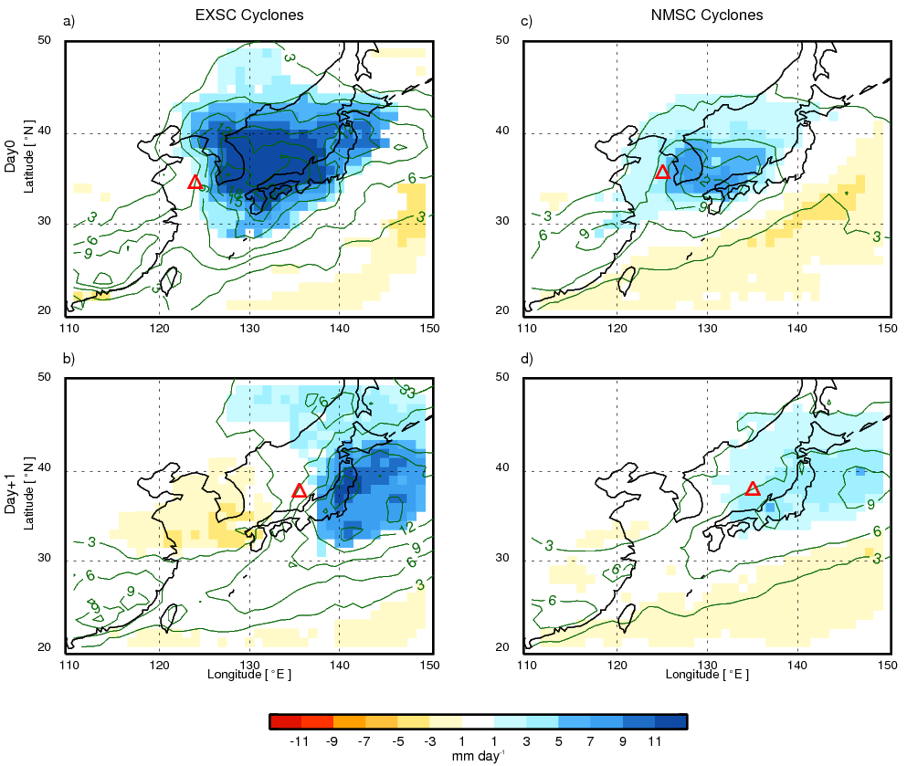
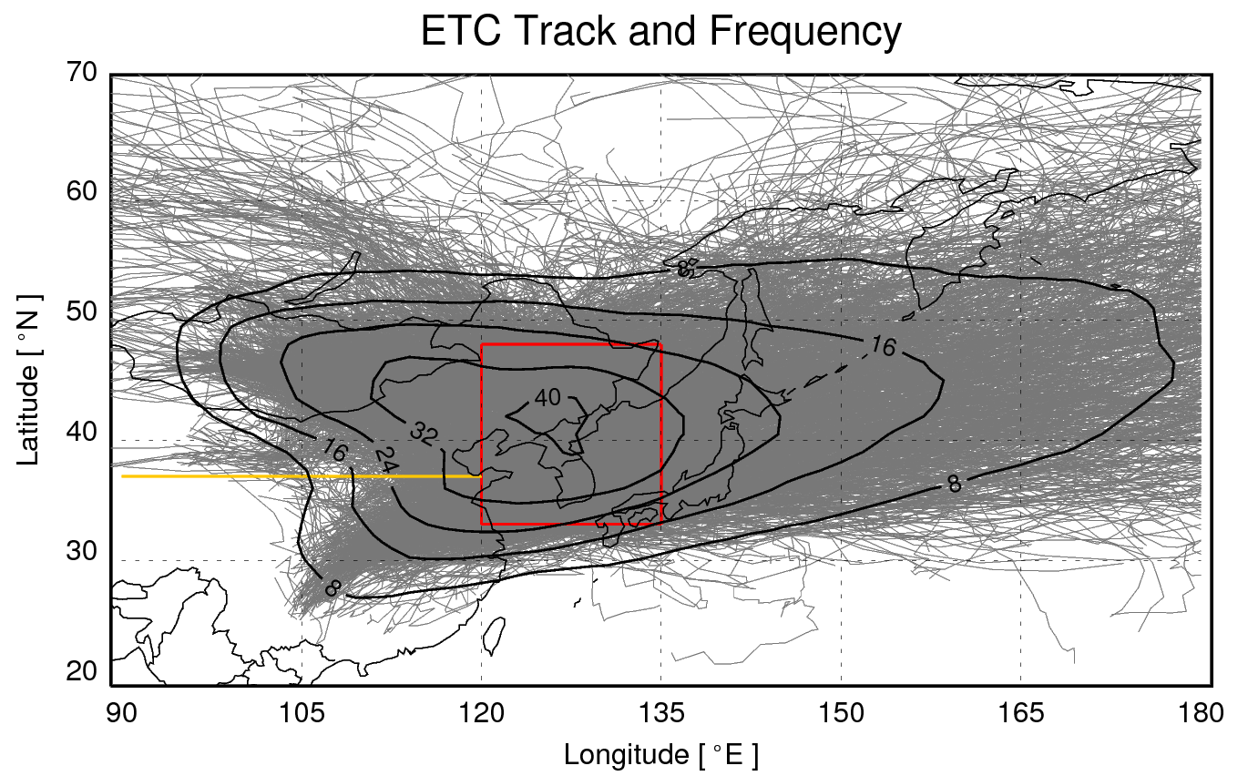
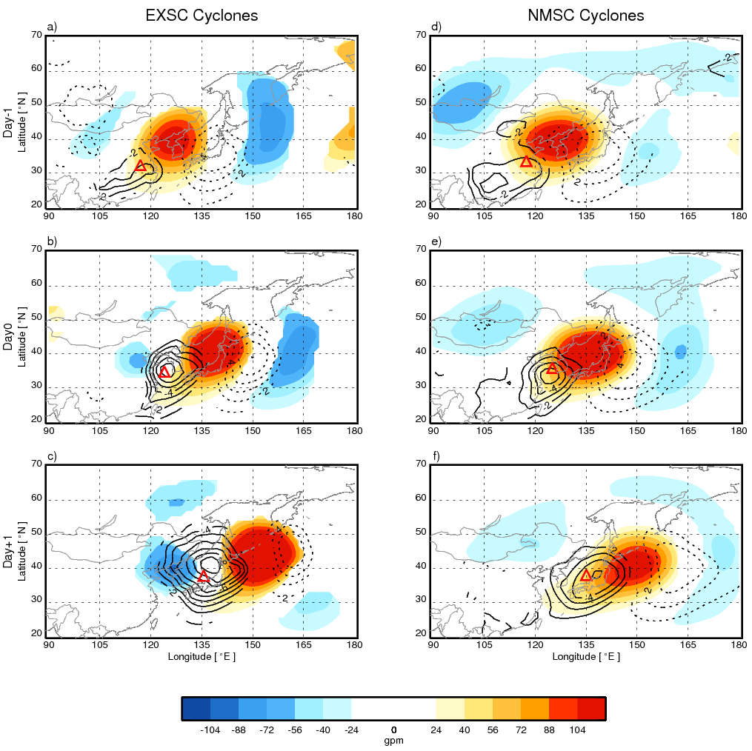
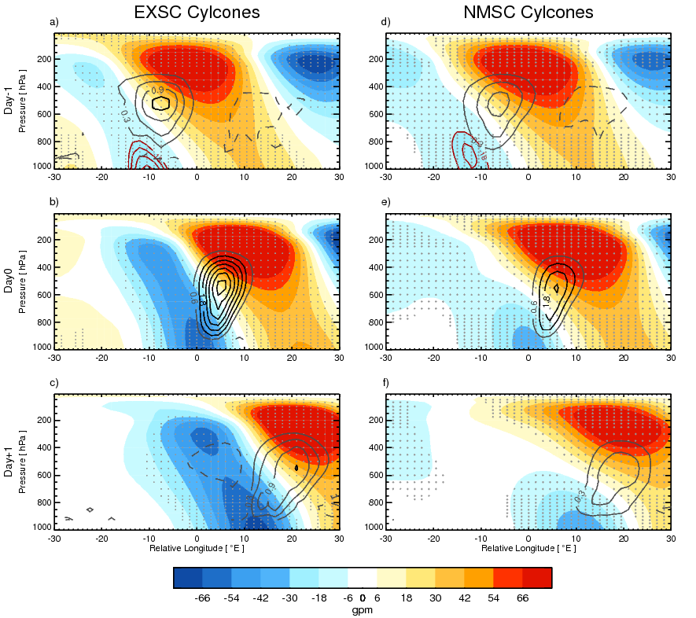
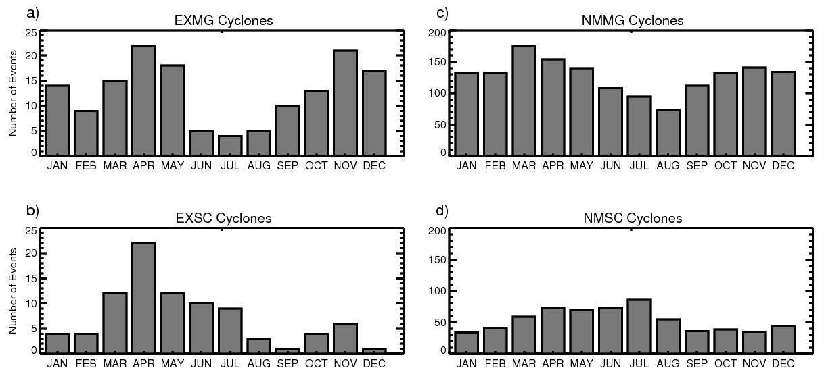
Explosive Cyclones over Northeast Asia: Synoptic Structure and Surface Impacts around the Korean Peninsula
Explosive Cyclones over Northeast Asia: Synoptic Structure and Surface Impacts around the Korean Peninsula
Joonsuk M. Kang¹, Jaeyeon Lee¹, Seok-Woo Son¹, Joowan Kim², and Deliang Chen³ ¹School of Earth and Environmental Sciences, Seoul National University, Seoul, South Korea
²Department of Atmospheric Sciences, Kongju National University, Kongju, South Korea
³Department of Earth Science, University of Gothenburg, Sweden
1
Introduction
4
Dynamic Structure
5
Surface Impacts
The extratropical cyclone (ETC) is one of the major weather systems affecting local hydrology in the midlatitudes. In particular, ETCs with rapid deepening, often referred to as explosive cyclones, are infamous for severe weather impacts that can inflict socioeconomic damage. The present study aims to re-examine and update the climatological features of the explosive cyclones near the Korean Peninsula using a Lagrangian tracking method. The synoptic structures, temporal development, and weather impacts are investigated through composite analyses over the last 39 years (1979–2017).
Composite analysis are performed with respect to the time of maximum GR (Day0) and days before and after Day0. (Day-1 and Day+1, respectively)
▶ EXMG versus NMMG cyclones
-Both EXMG and NMMG cyclones exhibit vertically well-organized structure from Day-1.
-The upper-level trough of EXMG cyclones are stronger than that of EXSC cyclones.
▶ EXSC versus NMSC cyclones
-Both EXSC and NMSC cyclones are shallow in the vertical with little interaction between surface and upper-levels.
-Stronger mid-tropospheric diabatic heating is observed from EXSC cyclones than NMSC cyclones from Day-1 , which facilitates the subsequent vertical coupling.
Do EXMG and EXSC cyclones have distinguished impacts on surface weather?
▶ EXMG versus NMMG cyclones
▶ EXSC versus NMSC cyclones
-On Day0 and Day+1, significant increase in surface wind speed is observed near the south western coast of Korea and the East Sea, respectively.
-The EXSC cyclones accompany more intense surface wind than NMSC cyclones.
-Precipitation over the Korean Peninsula at Day0, which is broader and stronger for EXSC cyclones.
-Enhanced wind speed are found over the East Sea at Day+1.
-The surface wind increase by EXMG cyclones are over three times larger than that of EXSC cyclones.
2
Data and Method
▶ Reanalysis Data
-ERA-Interim Reanalysis: Sea-level pressure, 10-m wind, relative vorticity, geopotential height, diabatic heating rate (6 hourly, 1.5º $×$1.5º, 1979–2017)
-GPCP Daily Precipitation Product: Precipitation (daily, 1º $×$1º, 1997–2017)
▶ ETC Detection and Tracking
-Automated tracking algorithm (Hodges, 1994,1995, 1999) is applied to 850-hPa relative vorticity field.
▶ Defining Explosive Cyclones
-The ETCs passing through the Korean Peninsula (33–48ºN, 120–135ºE) are sampled.
-The growth rate (GR) of an ETC at a specific time t is measured as the 12-hour $ζ_{850}$ tendency:
$GR\left(t\right)=\frac{ζ\left(t+6hrs\right)−ζ(t−6hrs)}{12 hrs}×\frac{24 hrs}{1 day}$
-The ETCs with the top 10% maximum GR (3.74 CVU day⁻¹) are defined as explosive (EX) cyclones and the remaining 90% are set as normal (NM) cyclones.
▶ Categorization of ETCs
- The ETCs generated northward of 37°N are
set as Mongolia (MG) cyclones and the others
are defined as South China (SC) cyclones.
-By considering the GR and genesis regions
Explosive Mongolia (EXMG) cyclones
Normal Mongolia (NMMG) cyclones
Explosive South China (EXSC) cyclones
Normal South China (NMSC) cyclones
Figure 7. Near-surface wind speed (contours) and anomalies with respect to long-term climatology (shadings) for EXMG and NMMG cyclones from Day0 to Day+1. Only the anomalies that are statistically significant at the 95% confidence level are shaded. The averaged center of cyclones is denoted with green triangle.
Figure 4. Vertical cross-section of geopotential height (shading) and diabatic heating anomalies (dark gray contours in intervals of 0.15 K hr⁻¹ and black for values greater than 1 K hr⁻¹) for EXMG and NMMG cyclones from Day-1 to Day+1. The x-axis denotes the relative longitude with respect to its center at Day0. The geopotential height anomalies that are statistically significant at the 95% confidence level are dotted in light gray. Only the statistically significant diabatic heating anomalies are contoured (solid/dashed contours for positive/negative anomalies).
Figure 3. Climatology (green contours) and anomalies (shading) of 300-hPa geopotential height, along with mean SLP anomalies (black solid/dotted contours for negative/positive anomalies) for EXMG and NMMG cyclones from Day-1 to Day+1. Only the values that are statistically significant at the 95% confidence level, based on two-tailed Student’s t-test, are depicted. The averaged center of cyclones is denoted with a red triangle.
[1 CVU = 10⁻⁵ s⁻¹]
Figure 8. Same as Figure 7, but for EXSC and NMSC cyclones.
Figure 9. Same as Figure 8, but for daily precipitation.
Figure 1. Tracks and frequencies of extratropical cyclones passing through the target domain.
3
Seasonality
6
Summary and Discussion
▶ Seasonal Cycle of ETCs
-Among four seasons, EX
Cyclones are most frequent in
boreal spring.
-A mid-winter suppression is
found for EXMG cyclones.
-Single peak is observed for
EXSC cyclones.
▶The EXMG and NMMG cyclones both have baroclinic vertical structure and the former are likely to occur in the presence of enhanced upper-level trough.
▶ The EXSC and NMSC cyclones initially are disturbances confined near-surface. However, the explosive development accompanies vertical coupling with an aid of mid-tropospheric diabatic heating.
▶ More severe surface weather impact is relevant with EX cyclones than NM cyclones, and especially in EXSC cyclones.
▶The region of influence differs among the surface weather variables and the development stages across the continent-ocean boundary.
Figure 6. Same as Figure 4, but for EXSC and NMSC cyclones. Diabatic heating anomalies are contoured every 0.3 K hr⁻¹ for Day-1 and Day+1 and 0.6 K hr⁻¹ for Day0. Note that complementary red contours are depicted in a) and d) at 2-gpm intervals.
Figure 5. Same as Figure 3, but for EXSC and NMSC cyclones.
Figure 2. Monthly variations in the number of cyclones for a) EXMG, b) EXSC, c) NMMG, and d) NMSC cyclones.

