Slide 1
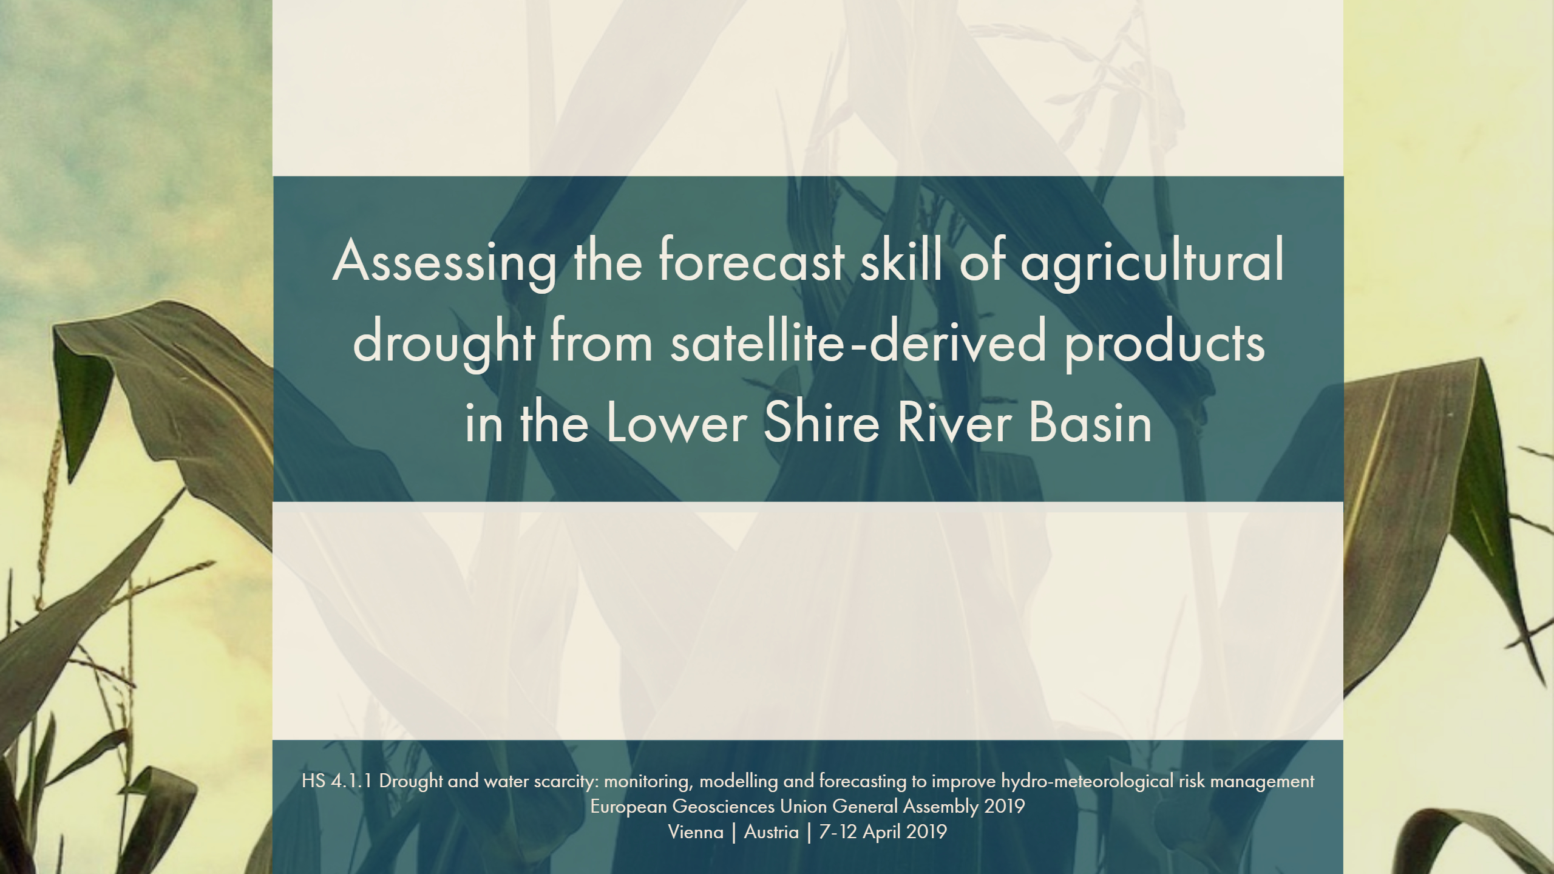


Marijke Panis TU Delft & 510
Marc van den Homberg 510
Aklilu Teklesadik 510
Hessel Winsemius TU Delft
Pieter van Gelder TU Delft
Gerrit Schoups TU Delft
Notes:
Happy to introduce my master research in assessing the forecast skill of agricultural drought from satellite-derived products in the Lower Shire River Basin

Slide 2


MOTIVATION
136M
+5%

Slide 3
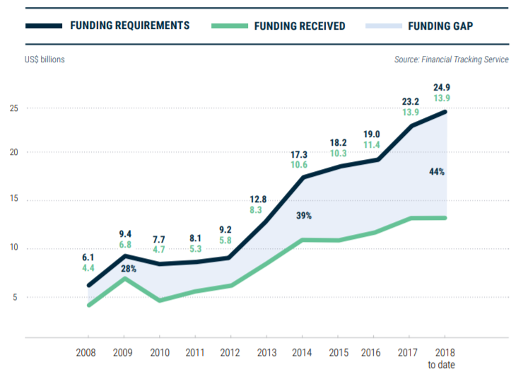
HUMANITARIAN AID SHORTAGE
Gap of 44%
Global humanitarian overview (UNOCHA, 2019)
Notes:
Op de vraag voorbereiden: moeten we die opvullen, humanitarian aid blijven geven. Waarom moeten we humanitarian aid blijven geven.

Slide 4









FBf: FORECAST based FINANCING

Slide 5
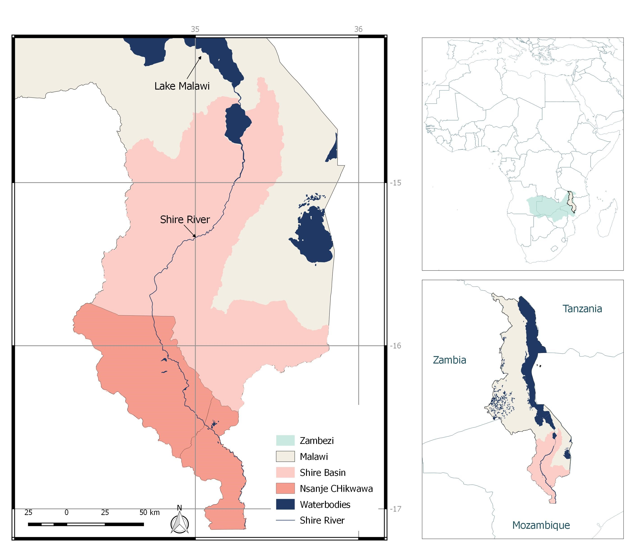
CASE STUDY MALAWI
Notes:
Dependancy makes them extremely vulnerable for natural hazards, changing weather patterns change the length of the growing season adn crop growith
80% of damages and losses in agriculture by droughts
No data available, remote areas

Slide 6

RESEARCH QUESTION
?
To what extent can machine learning and satellite-derived products be used to obtain agricultural drought forecast with high forecast skill in early warning early action ?
Notes:
Verschillende dingen uitlichten.
early- action early action is pro-active
Om dit te onderzoek

Slide 7

QUALITATIVE DATA COLLECTION
Qualitative data collection and analysis
Quantitative data collection and
analysis
Builds to
Interpretation
Notes:
Dusv oor jullie ga ik nu eerst het qualitative onderzoek bespreken en daarna quantitiative

Slide 8
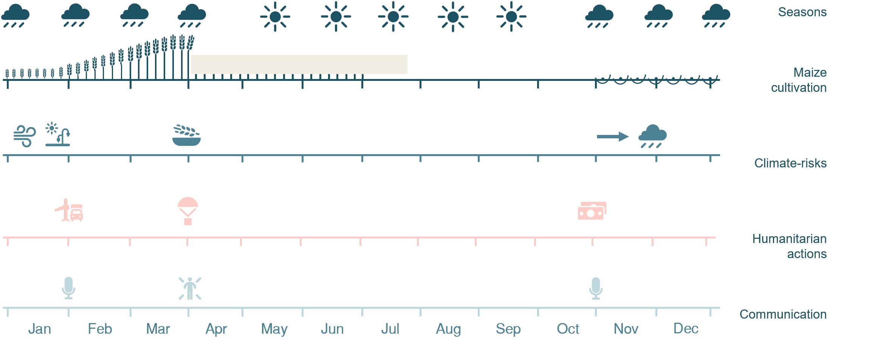
FORECAST CALENDAR
Mid
Start
Notes:
The outcome of the qualitative data analysis is shown in this figure presenting the wet/dry seasn, maize cultivation in relation with the main climate risks occuring mid-season in january and at the start with delayed precipitation. Followed by the time needed of humanitarian organisation to put in place logistical and operational acions at least 2-3 months before. Which provide the decision makers to communicate an expected drought at the end of the growing season at the start and mid-season. These two lead times with month 1 and month 3 is the forecast time used in the quantitative data anslysis.

Slide 9
METHODOLOGY
Combination between indigenous knowledge and scientific knowledge
Qualitative data collection and analysis
Quantitative data collection and
analysis
Builds to
Interpretation

Slide 10
MACHINE LEARNING ALGORITHM
FAST AND FRUGAL DECISION TREE
Simple
Accurate
Limited information
Without high-level statistical training
Humanitarian decision-making process
Agreed trigger levels and action
Implementation
Communication
Act quickly
NDVI
> -0.09
< -0.09
Low-Risk Drought
LST
<0.34
>0.34
SM
High-Risk Drought
>-0.06
<-0.06
Low-Risk Drought
High-Risk Drought
Notes:
Concept naar een voorbeeld zetten

Slide 11
DROUGHTS INDICATORS
Meteorological indicators
Precipitation
Land surface temperature
Dry spells
Oceanic Niño Index (ONI)
Soil moisture indicator
Soil moisture content
Vegetation indicators
Normalised Difference Vegetation Index (NDVI)
Vegetation Optical Depth (VOD)
Notes:
Meteo: provide information about duration and intensity of drought event, also including global patterns
Hydro: not taken into account
Soil moisture: amount of water present in the unsaturated zone, decline of soil moistur strongly related to both meteorological and hydrological factors
Vegetation: measure the vegetation conditions. Vegetation dynamics influenced by weather conditions. Understanding vegetation response to hydrological circumstances.
NDVI: Measure of greenness vegetation
VOD: total water content in the biomass

Slide 12
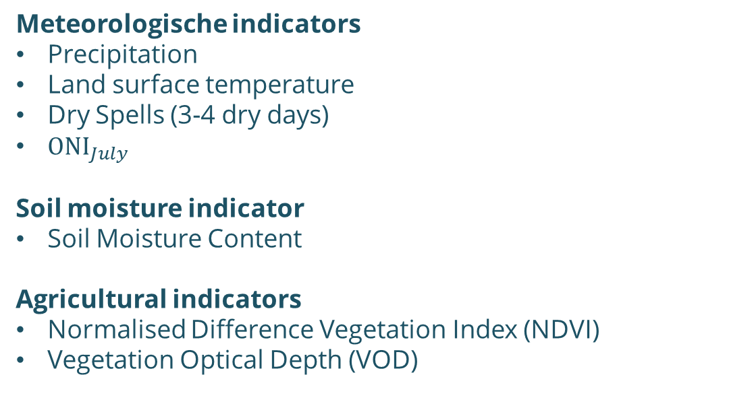

FEATURES
Predictors
Predictand
Meteorologische indicators
Precipitation
Land surface temperature
Dry Spells (3-4 dry days)
${ONI}_{July}$
Soil moisture indicator
Soil Moisture Content
Agricultural indicators
Normalised Difference Vegetation Index (NDVI)
Vegetation Optical Depth (VOD)
$${VOD}_{March}$$
$${ NDVI}_{March}$$
Notes:
Leg de luisteraar uit in machine learning zelfde predictors zetten tegenover het uiteindelijke resultaat van normalised standard deviation.
Binary classification
20th, 40th and 50 percentile
Feature selection
Identify feature threshold
Feature ranking
Developing decision rule (positive or negative)

Slide 13
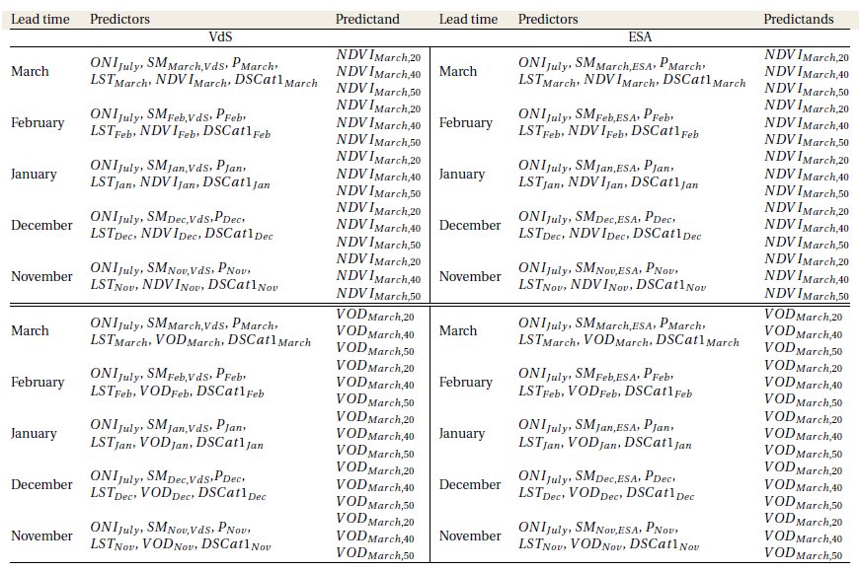
PREDICTORS AND PREDICTAND
Growing season
Notes:
Notes: Bij ELNINO Bij extreme droogt es is ONI belangrijk
Conclusies meer op’1 bladzijden
Verschill spatial distirbution

Slide 14
PREDICTORS AND PREDICTAND
Notes:
Notes: Bij ELNINO Bij extreme droogt es is ONI belangrijk
Conclusies meer op’1 bladzijden
Verschill spatial distirbution

Slide 15
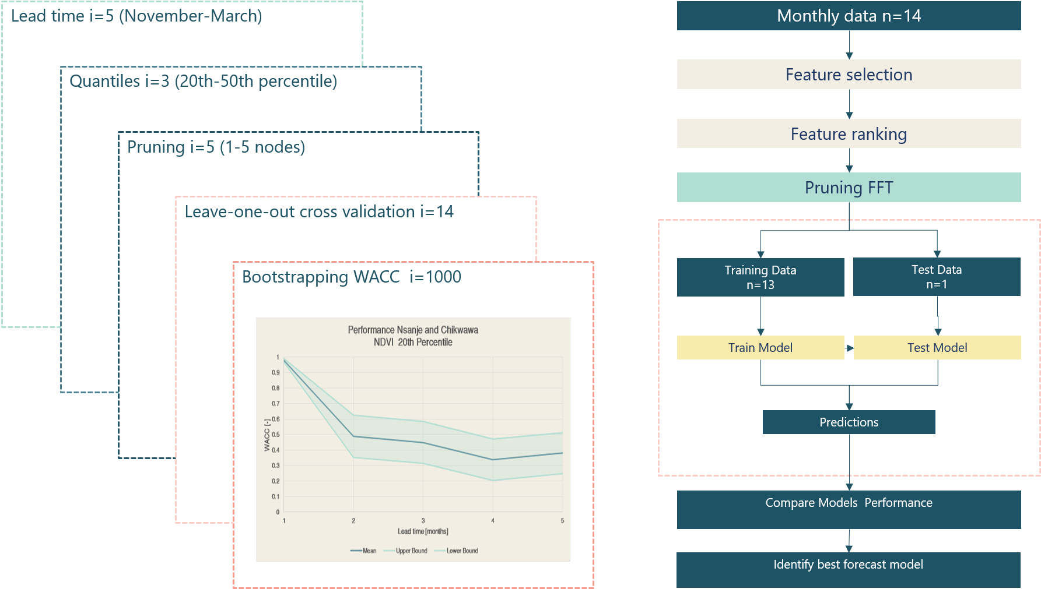
MACHINE LEARNING OUTLINE

Slide 16
CONFUSION MATRIX
 |  | Truth
 |  | Drought | No Drought
Decision | Drought | Hits | False alarm
 | No Drought | Misses | Correct rejection
Notes:
Binary classification
20th, 40th and 50 percentile
Uitschrijven hi, mi, fa, cr
Confusion matrix
Weighted accuracy balance the sensitivity and the specificity representing the error trade-off.
Consequences miss, potential loss of life resulting in a weighted factor above 0.5 → 0.75

Slide 17
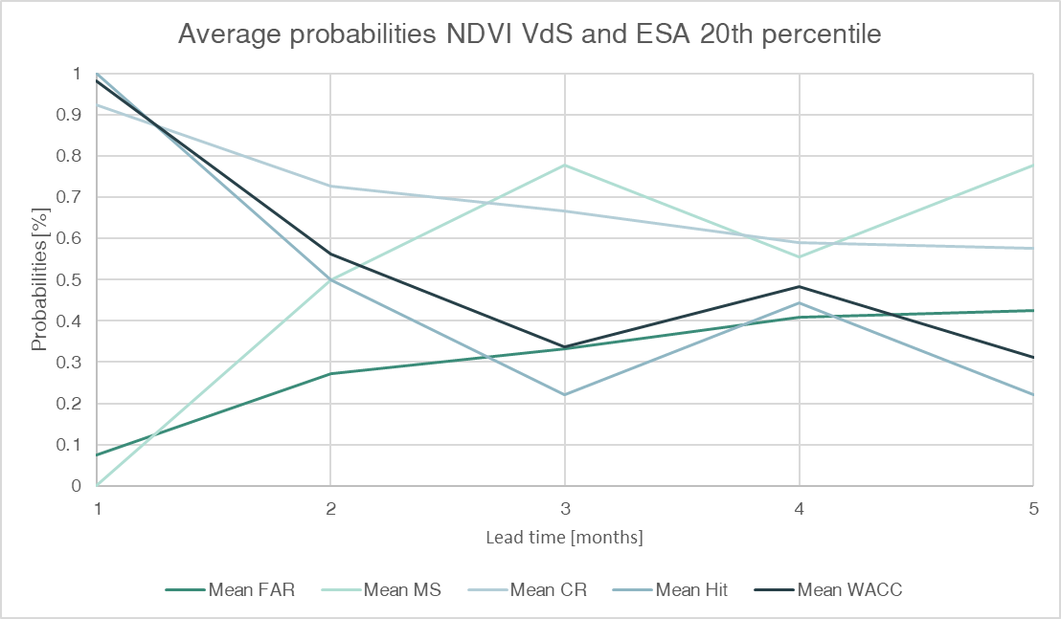
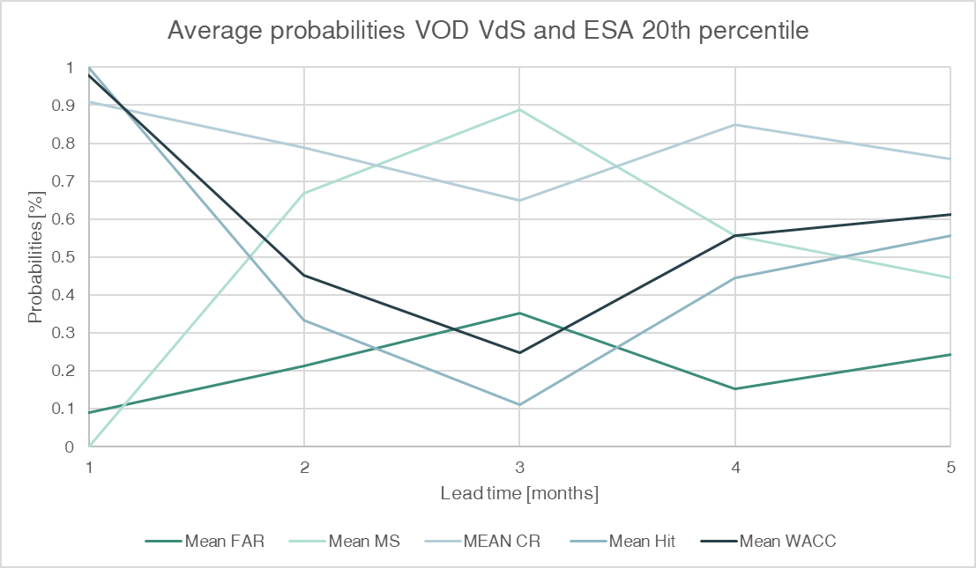
LEAD TIME GROWING SEASON
Miss rate related to the drop in model performance
Notes:
Uitleggen wat je in deze grafiek ziet
Donkere lijn wacc het resultaat van de formule
LT3 and LT5

Slide 18
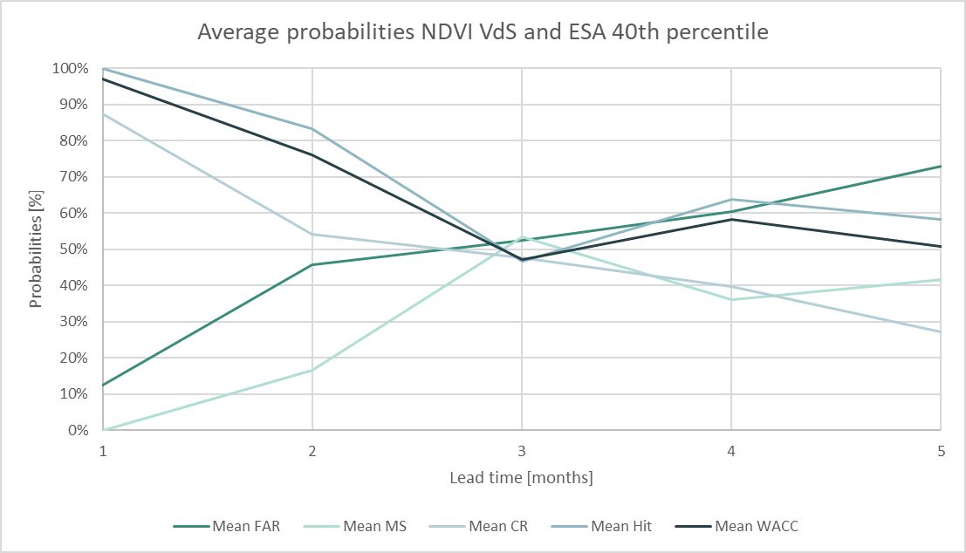
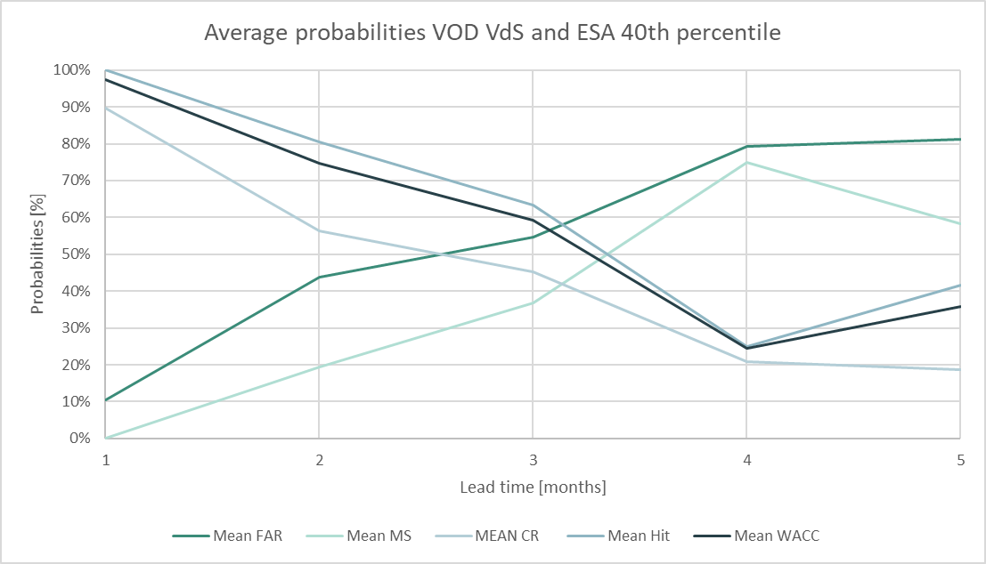
LEAD TIME GROWING SEASON
Mid-season VOD higher model performance
Start of the season NDVI higher model performance
Notes:
Uitleggen wat je in deze grafiek ziet
Donkere lijn wacc het resultaat van de formule
LT3 and LT5

Slide 19
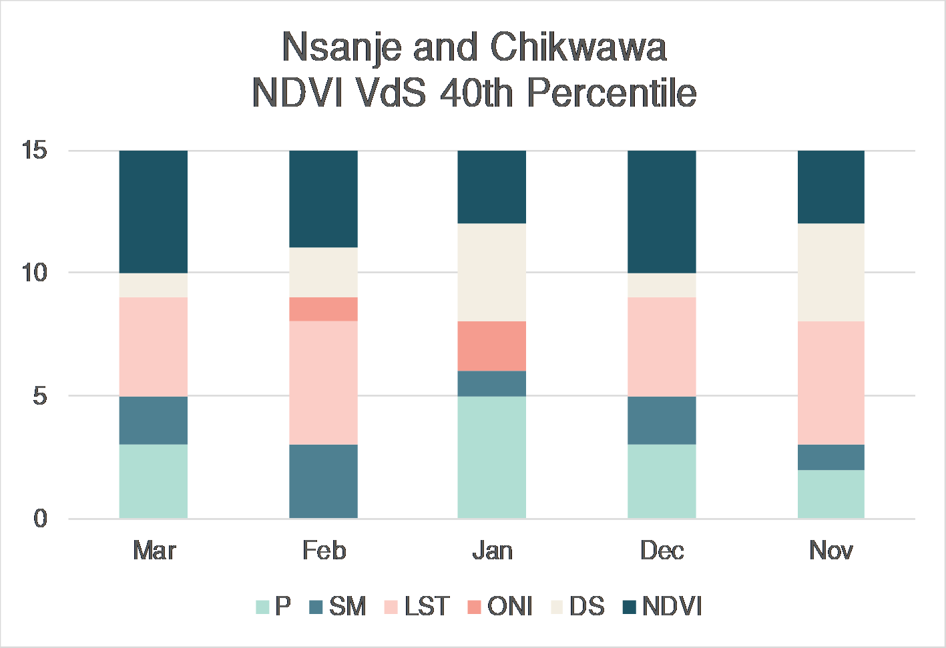
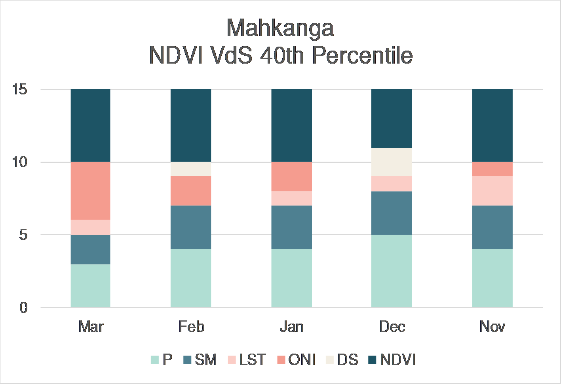
FEATURE SELECTION PER AREA
Soil type influence the feature ranking of dry spells
Over the season mid season dry spells more important, climate-risk occurs in January.
Notes:
Notes: Bij ELNINO Bij extreme droogt es is ONI belangrijk
Conclusies meer op’1 bladzijden
Verschill spatial distirbution

Slide 20
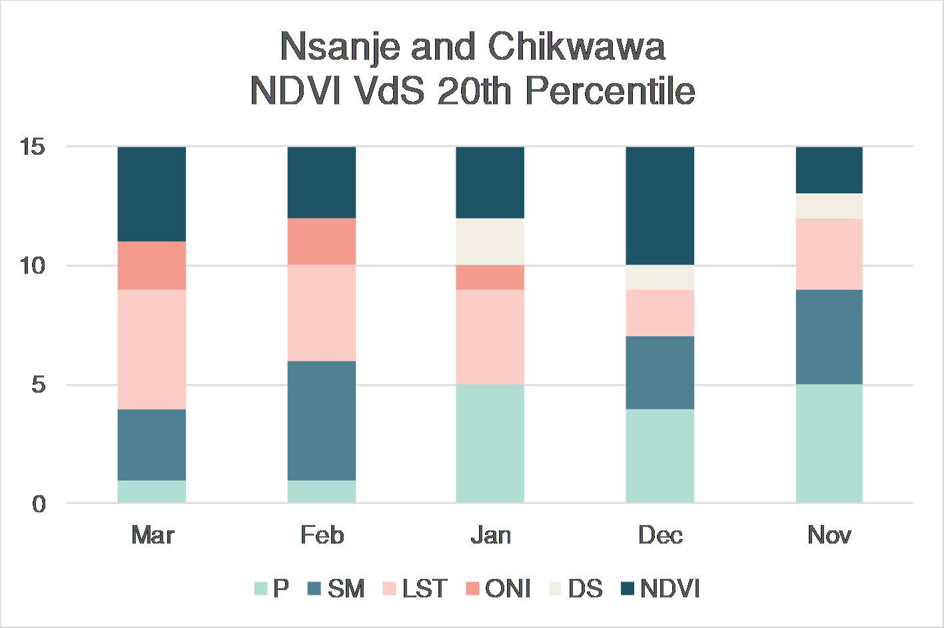
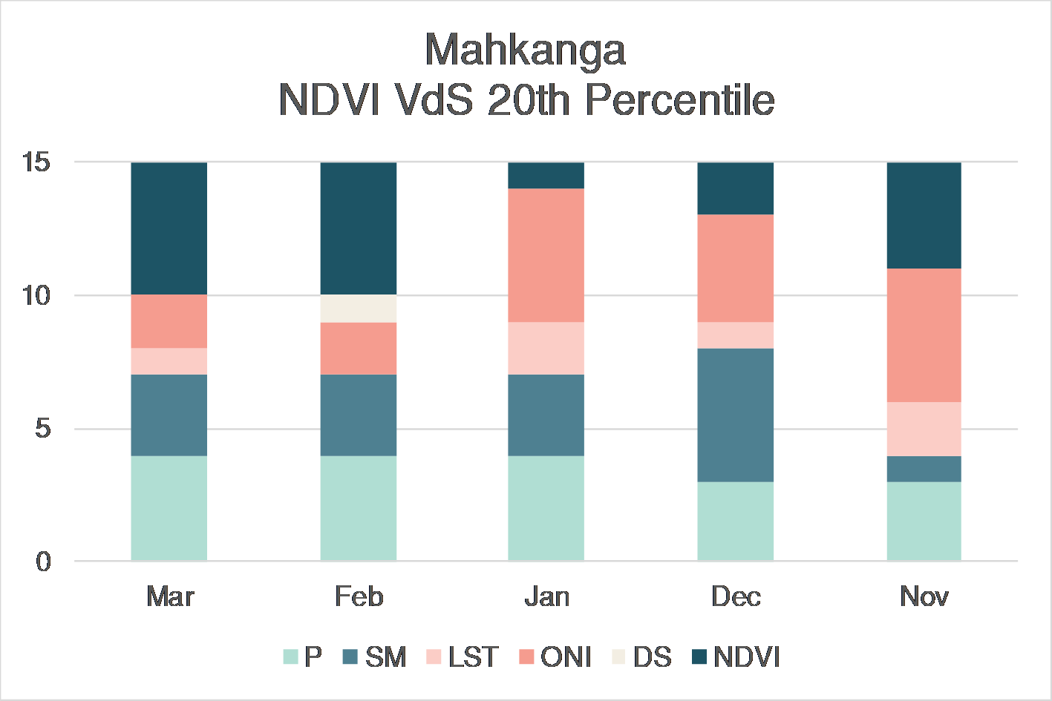
FEATURE SELECTION PER AREA
ONI more important for the more extreme drought events
Notes:
Notes: Bij ELNINO Bij extreme droogt es is ONI belangrijk
Conclusies meer op’1 bladzijden
Verschill spatial distirbution

Slide 21
KEY INSIGHTS
Best combination, strongly dependent on the spatial characteristics
Initial conditions at start and vegetation indicators mid-season
Influence El Niño stronger for extreme events
VOD slight better predictand than NDVI
Drop in model performance at mid-season trigger or bias?
Notes:
VOD slightly better than NDVI might be cuased by the resolution?
Relation with SM and LST
Conclusies zelfde volgorde als resultaten. Zlefde onderverdeling
Conclusions Qualitative research
Share forecast information at LT5 and LT3
Include indigenous knowledge in forecast models
Design decision trigger based on hazard, local capacity and vulnerability.

Slide 22
RESEARCH QUESTION
To what extent can machine learning and satellite-derived products be used to obtain agricultural drought forecast with high forecast skill in early warning early action ?
Notes:
VOD slightly better than NDVI might be cuased by the resolution?
Relation with SM and LST
Conclusies zelfde volgorde als resultaten. Zlefde onderverdeling
Conclusions Qualitative research
Share forecast information at LT5 and LT3
Include indigenous knowledge in forecast models
Design decision trigger based on hazard, local capacity and vulnerability.

Slide 23
FUTURE RESEARCH
Development Machine Learning Model
  Increase time interval
  Feature leave-one-out to distinguish the influence of the individual features
  Weight features over the growing season
  Test model with different Machine Learning algorithms, index based
  Spatial distribution
Cost-loss ratio in the decision making process (‘acting in vain’)
Model impact of a sequence of natural hazards on agricultural drought predictions
Relate agricultural drought forecast to a food security model
Notes:
Recommendations 510 and future research samen voegen

Slide 24
THANK YOU
?
Contact details:
MPanis@redcross.nl
Notes:
Recommendations 510 and future research samen voegen

