Slide 1
PICO spot 4.8
Photography: Nick Ford. CC BY-NC-ND 2.0
The impact of climate change on hydroecological response in a chalk stream River Nar, Norfolk, England
Limited change in the long-term mean masks changes in inter-annual variability;
In the past (on the baseline) there was a probability of a more varied response to low-probability events. In the future, response flatlines;
These changes are projected as early as 2021.
Start
Annie Visser-Quinn,
Lindsay Beevers and Sandhya Patidar
Water Academy Heriot-Watt University Scotland
A coupled modelling framework to assess the hydroecological impact of climate change. Visser et al. 2019. Environmental Modelling and Software, 114, 12–28.
The Impact of Climate Change on Hydroecological Response in Chalk Streams. Visser et al. 2019. Water, 11, 596.
2019

Slide 2
Menu
Definition of terms
Biodiversity matters
Modelling the hydroecological impact of climate change
Chalk streams
Case study
Findings: Long-term change
Findings: River health and ecosystem functionality
Implications
Previous
Next
Methods overview
Findings: Inter-annual variability
Wider applicability
How to interact with the slides
References
Click on the boxes with thick borders
Use the arrows to move forward and backwards
Press icons to interact
Press to return to the menu
≡

Slide 3
Definition of terms
Hydroecological response and river health
Flow is widely acknowledged as a major determinant of the health of the river ecosystem.
The term river health interchangeable with hydroecological response, and is, arguably, more useful for interpretation.
Proxy for river health
Lotic-invertebrate index for flow evaluation (LIFE), combines macroinvertebrate functional flow preferences with the (log) abundance of each taxa to determine flow scores, fs.
$$LIFE= \frac{\sum{fs}}{n}$$
Functional feeding groups
Describe macroinvertebrate resource consumption. It is their processing of organic matter which facilitates essential ecosystem processes.
Functional feeding group | Description
Collector | A broad grouping generally capturing both filterers and gatherers.
Filterer | Filter suspended FPOM from the water column.
Gatherer | Gather FPOM settled on the substrate.
Parasite | Taxa which do not fit into other groups.
Predator | Carnivorous macroinvertebrates which prey on smaller invertebrates.
Scraper | Consumers of food sources attached to the substrate; e.g. algae and biofilm.
Shredder | Shred and consume plant material such as leaf litter and wood.
Proxy for ecosystem functionality
Previous
Next
FPOM and CPOM, fine and coarse particulate organic matter.
≡

Slide 4
Biodiversity matters
Concerns about the long-term sustainability of our water resources
Biodiversity provides more than aesthetic, cultural and economic benefits. It improves redundancy, enhancing ecosystem resistance and resilience.
Population growth and climate change
Freshwater biodiversity is declining at twice the rate of terrestrial and marine ecosystems combined [1]
Biodiversity is the variability among living organisms, within & between species and ecosystems.
Convention on Biological Diversity
Previous
Next
Ecosystem functionality
Environmental pressures
Biodiversity
Human well-being
Ecosystem services
Freshwater is considered the most essential natural resource [2]
Photography: Nick Ford. CC BY-NC-ND 2.0
≡

Slide 5
Modelling the hydroecological impact of climate change
Level 1 – Climate
Climate change projections
Temperature
Precipitation
Level 2 – Hydrology
Hydrological modelling
Altered flow regime
Hydroecological impact, the impact of the flow regime on river ecology
Cascade of uncertainty
Previous
Level 3 – Ecology
Next
WT-ECO* model
Hydroecological model
Methods investigating hydroecological response have, typically, been qualitative in nature or quantitative with limited scope.
The effect of uncertainty (e.g. parameter, structural, emissions scenario) is rarely considered.
Hydroecological response
*Water temperature ecological model
Level 4 – Ecosystem services
Ecosystem services
≡

Slide 6
Chalk streams
Support uniquely “diverse and fecund ecosystems” [3]
English chalk streams
“remain in a shocking state of health” [3,4]
Chalk streams are unique to Southern England and Northern France
Chalk streams have a long memory. The impact of flow perturbation (i.e. flood and drought) is in part, determined by the health of the river ecosystem prior to an event.
Cretaceous chalk
Cretaceous chalk
Cretaceous chalk
Previous
Next
The chalk is one of England’s principle aquifers, providing 70% of the drinking water in south-east England [3]
Complex hydrological processes
Famous for…
Photography: Nick Ford. CC BY-NC-ND 2.0
≡

Slide 7
Case study River Nar, Norfolk
“technically infeasible” for the river to meet the ecological requirements of the Water Framework Directive [5,6]
Pressures on the river include:
Physical modification
Medieval navigation systems
Domesday mills
Ornamental estate lakes and water meadows
Agricultural drainage and more
Sediment ingress
Over-abstraction
Site of Special Scientific Interest (SSSI)
Chalk sub-catchment 153 km²
From source 24 km
English chalk aquifer
River Nar chalk sub-catchment
Ecology
Peaks of macroinvertebrate activity occur in spring (AMJ), the hatching season, as flow begins to recede, and autumn (OND), as detritus (food) enters the river system.
River Nar
Study sites
Canalised river banks
Previous
Next
Hydrology
Groundwater fed from a chalk aquifer
BFI 0.91
Aquifer recharge occurs in the autumn months with flow peaking in January and February
Impoundment: Historic mill
Water meadow
Ecology
Hydrology
Photography: Nick Ford. CC BY-NC-ND 2.0
≡

Slide 8
Methods
UKCP09 probabilistic climate projections
River health and ecosystem functionality
Coupled modelling framework
Weather generator. Able to represent climatic variability, allowing low probability events, vital to ecosystem functionality, to be captured more effectively.
A range of represented traits maximises the productivity and functionality of the ecosystem.
Previous
Next
The hydrological and hydroecological models were parameterised and validated in the course of the development of the coupled modelling framework.
Scenario. IPCC AR4 SRES A1F1 high emissions
A matrix of macroinvertebrate functional flow preferences (from the LIFE index) and functional feeding groups.
Time slices. 2030s (2021-2050), 2050s (2041-2070) and 2080s (2071-2099); 10,000 generations per time slice.
Spring species level macroinvertebrate data, observed from 1993-2014. The data covers periods of very high and low flows, ensuring that response to extremes are captured.
≡

Slide 9
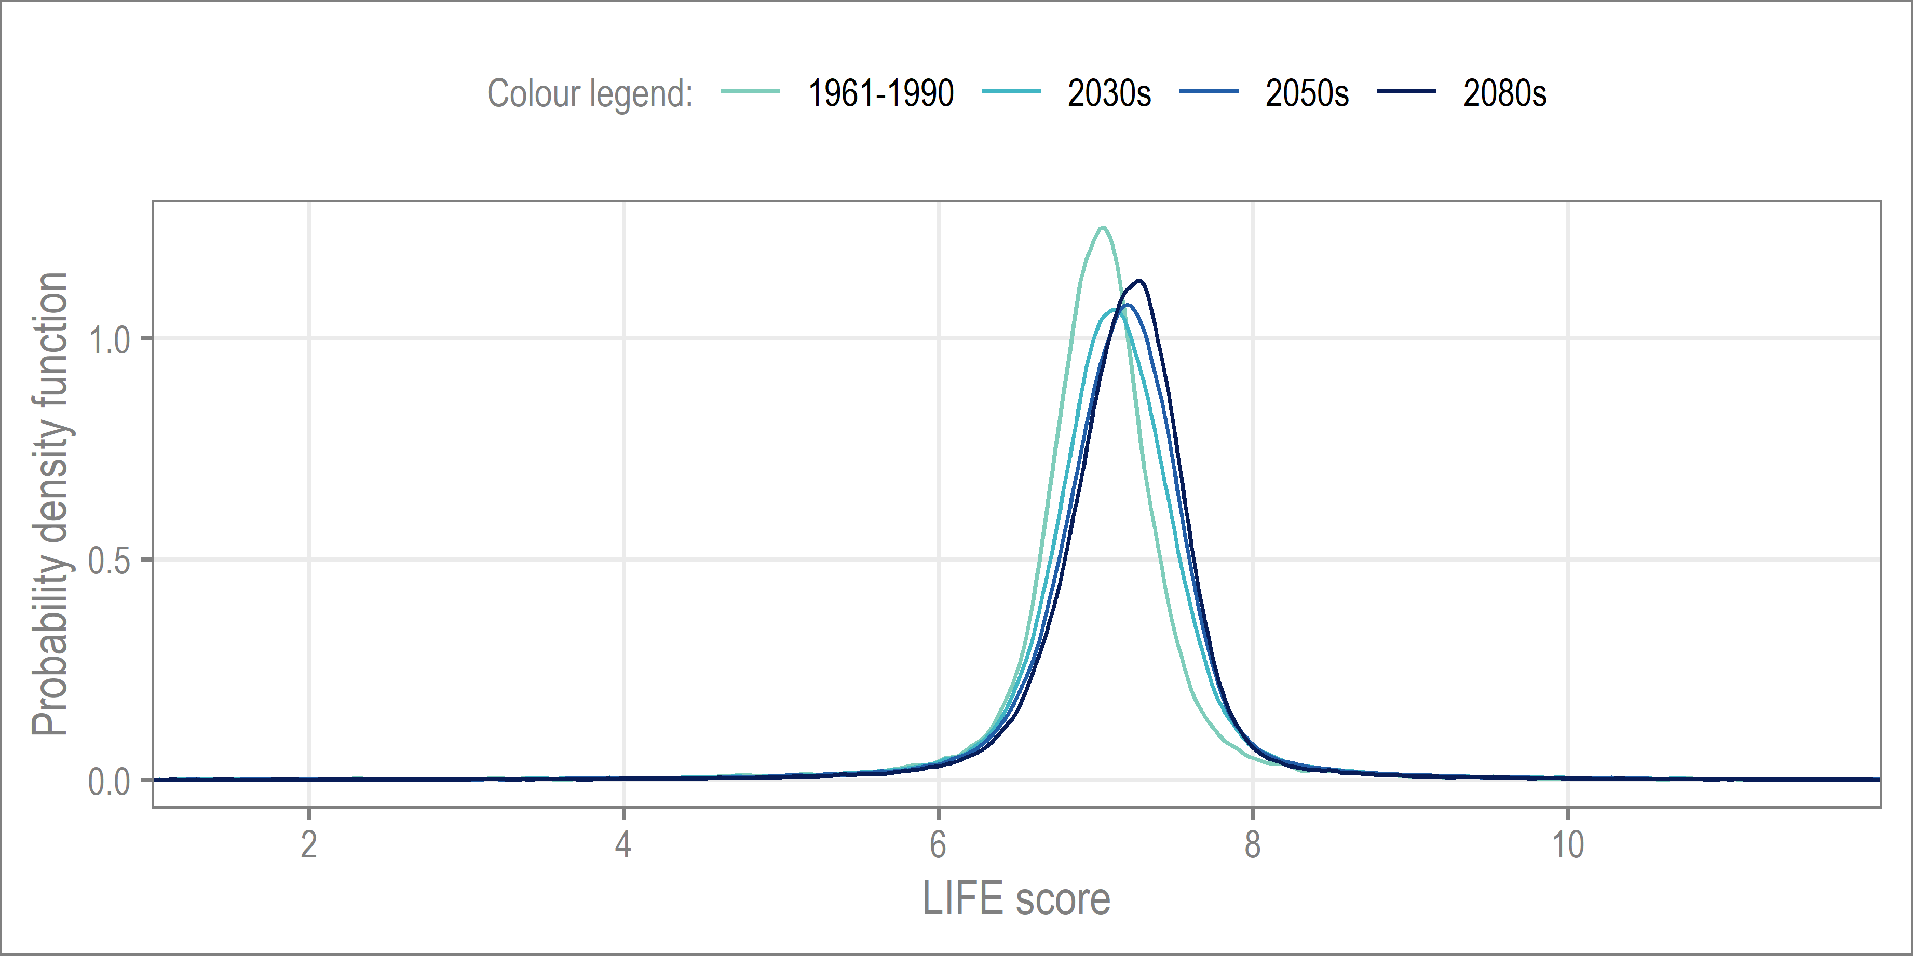
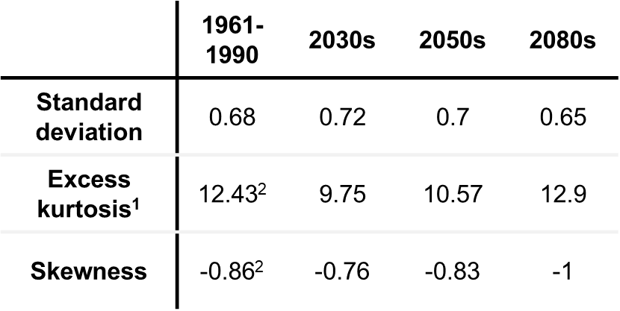
Findings: Long-term change
Distribution
Summary statistics
Summary
After an initial increase in variance (2030s), standard deviation falls to below the baseline level by the 2080s. This change is suggestive of a minor increase in low probability hydroecological responses by the end of the century.
Indicates the weight is not located in the tails (hence the observed clustering in the PDFs). The change in kurtosis from the 2030s to 2050s is more than half that of the 2050s to 2080s.
Summary
The aggregated projections indicate a very limited change in the mean hydroecological response under climate change, assuming a high emissions scenario.
The summary statistics suggest that, by the end-of-century, there may be a restructuring of the macroinvertebrate community response to low-probability events.
Note that, the smaller scale of change observed between the 2030s to 2050s may be explained by the overlap between these two time slices (2041-2050).
The long-term mean may mask significant changes in the inter-annual variability of hydroecological response.
The LIFE index is the proxy for hydroecological response and river health.
The long-term changes represents the aggregated LIFE scores over the 30-year time slices for a 99.5% probability of occurrence (assuming a high emissions scenario), a virtually certain outcome under the IPCC definition.
Click the buttons above to navigate.
Previous
For the baseline, LIFE scores are centred on ~7, i.e. macroinvertebrates have an average flow preference of slow to sluggish
The trend of increasing LIFE scores continues into the 2080s, where the clustering of LIFE scores can be seen to increase again
Next
By the 2030s the clustering of LIFE scores reduces, whilst the average LIFE score begins to increase, representing a moderate shift towards higher flow preferences
All four time-periods are right-skewed. The increase from 2050s to 2080s is almost 3 times that of 2030s to 2050s.
¹Excess kurtosis is a measure of the combined weight of the tails relative to the normal distribution; for example, a negative value means that more of the dataset is located in the tails than the normal distribution. (Kurtosis is often misinterpreted as a measure of peakedness.)
²For excess kurtosis and skewness, comparisons from baseline to future are not possible, due to differences in sample size (n = 1000 on baseline, n = 10,000 for projections).
≡

Slide 10
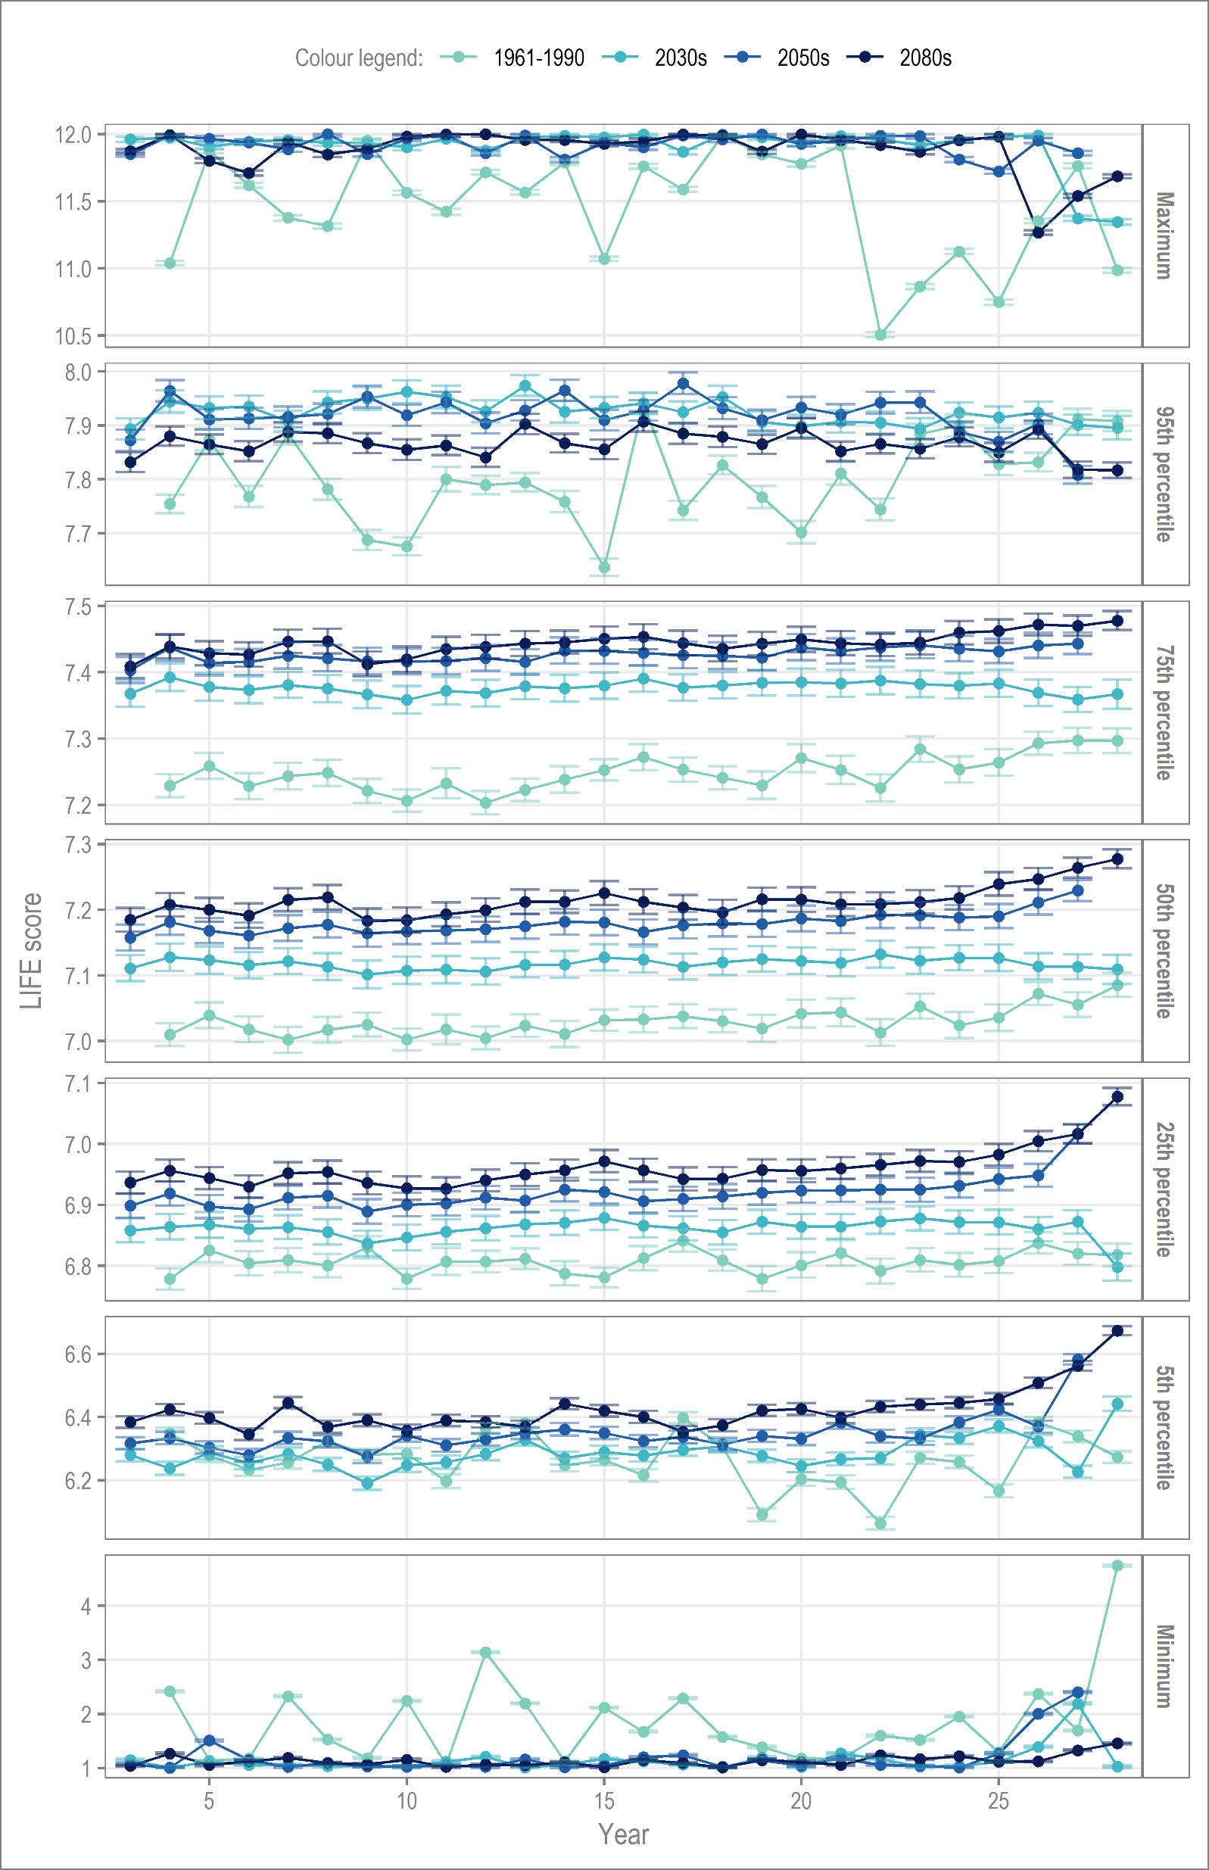
Findings: Inter-annual variability
The change in variance relative to the baseline stands out. The reduction in variance may reach 92% as early as the 2030s.
Right: Vertical cross-sections (at specific quantiles) through annual PDFs of LIFE score; the error bars represent the range of values possible for a virtually certain outcome (99.5% probability, assuming a high emissions scenario).
The y-axis (LIFE score) is not fixed.
Examination of the year-on-year change in hydroecological response provides further clarification on the subtle changes observed over the long-term.
The timing of these major changes in hydroecological response could occur as early as the 2030s, 2021-2050.
This suggests that a major high or low flow event, in the very near future, could result in a hydroecological response very different to the past (baseline period), where there was the probability of a more varied response. By considering the associated uncertainty, we can be virtually certain of this outcome, based on the available information.
Given a potentially highly limited period of preparation, this is of concern for the future health of the River Nar.
∆ Variance (%) | 2030s | 2050s | 2080s
5th percentile | -65 | -52 | -31
Minimum | -92 | -84 | -98
On the baseline, LIFE scores can be seen to vary from 10.5 to the maximum of 12.
However, the projections for all three future time slices show a plateau at LIFE scores of 12; a varied response becomes almost impossible.
A large change occurs between baseline and the 2030s, while the change from the 2050s to 2080s is almost negligible.
LIFE scores plateau to a value of 1, with almost no variance. This change coincides with a notable reduction in the range of values.
Previous
A small shift in LIFE scores (by time slice) indicates the increased presence of taxa with higher flow scores, though the variability of LIFE score remains broadly unchanged.
LIFE score
The tails are essentially the hydroecological response to lower probability extreme events.
∆ Variance (%) | 2030s | 2050s | 2080s
95th percentile | -92 | -81 | -91
Maximum | -84 | -97 | -83
Next
≡

Slide 11
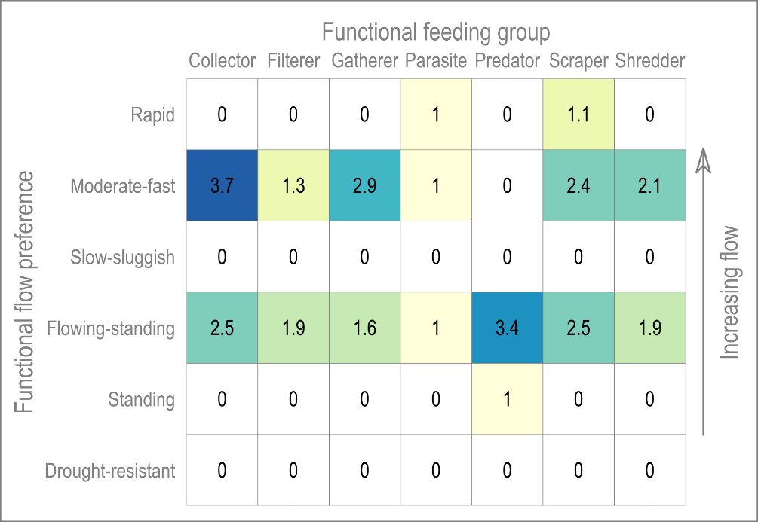
Findings: River health and ecosystem functionality
The hydrological projections indicated an increase in the probability of both very high and low LIFE scores; this corresponds with standing waters, drought and rapid flows in the functional matrix.
This is a functional matrix, a matrix of the functional feeding groups and functional flow preferences. The values indicate the spring annual average number of species fulfilling a given niche.
In terms of functional feeding group, only a limited number of taxa with a range of flow preferences are observed, e.g. scrapers species which may tolerate anything from very low to rapid flows.
It is evident that almost none of the taxa previously observed in the River Nar would be able to perform their functional roles, long-term, under such environmental conditions.
Previous
Next
Several functional feeding group traits potentially unrepresented under extreme conditions.
Press the buttons below for more information.
With this reduction in biodiversity, the concomitant decrease in macroinvertebrate adaptability may significantly impact the resilience of the riverine system.
Baseline observations
Despite these observations, in the short-term, the ecosystem has been able to successfully recover.
Future projections
X Close
X Close
≡

Slide 12
Implications
The functional matrix revealed that all functional flow preferences are only met at intermediate flows (LIFE 6-8). Under more extreme conditions, they are effectively ‘knocked out’.
Projections indicate an increasingly vulnerable riverine ecosystem
Future projections suggest that variation is greatly reduced, raising real concerns over the resilience of the river ecosystem.
Sediment ingress
Despite the limited range of the functional feeding groups on the baseline, the River Nar has, to date, been able to adapt to extreme events due to inter-annual variation.
Impacts projected as early as the 2030s
Previous
Next
Analysis of the distributions indicate an increased probability and magnitude of extreme responses, with less internal variability.
Historic mill
A large part of this low resilience may be attributed to the pressures on the river.
Photography: Nick Ford. CC BY-NC-ND 2.0
≡

Slide 13
Wider applicability
The decline in river health is not, and should not, be considered a foregone conclusion, there remains the opportunity to intervene via improved river management.
Framework applicable to a wide variety of case studies and flow regimes
The Impact of Climate Change on Hydroecological Response in Chalk Streams. Visser et al. 2019. Water, 11, 596.
The River Nar is not alone in this, overall, English chalk streams are in a poor state of health, largely for similar reasons. Therefore, our findings are likely to be more widely applicable to the 200+ chalk streams in England.
Right: Pink catchments regularly fall below environmental flow limits.
[3]
Previous
Return to start
A coupled modelling framework to assess the hydroecological impact of climate change. Visser et al. 2019. Environmental Modelling and Software, 114, 12–28.
Further reading
≡

Slide 14
References
[1] WWF. Living Planet Report 2016. Risk and Resilience in a New era; WWF International: Gland, Switzerland, 2016.
[2] Vörösmarty, C.J.; McIntyre, P.B.; Gessner, M.O.; Dudgeon, D.; Prusevich, A.; Green, P.; Glidden, S.; Bunn, S.E.; Sullivan, C.A.; Liermann, C.R.; et al. Global threats to human water security and river biodiversity. Nature 2010, 467, 555.
[3] O’Neill, R.; Hughes, K. The State of England’s Chalk Streams; WWF-UK: Surrey, UK, 2014.
[4] Environment Agency; English Nature. The State of England’s Chalk Rivers: A Report by the UK Biodiversity Action Plan Steering Group for Chalk Rivers; Environment Agency: Bristol, UK, 2004.
[5] Norfolk Rivers Trust. The River Nar—A Water Framework Directive Local Catchment Plan; Norfolk Rivers Trust: Norfolk, UK, 2014.
[6] Rangeley-Wilson, C. The River Nar—A Water Framework Directive Local Catchment Plan; Norfolk Rivers Trust: Norfolk, UK, 2012.
≡

