Slide 1
Stochastic generation of spatio-temporal compound events
- for Flood Risk Assessment
Dirk Diederen and Ye Liu

Slide 2
Workflow
Generator
Inspection
10 years
3. Statistical model
100 years
Return levels (POT+GPD)
2. observed
descriptors
C. Multivariate statistics
4. synthetic
descriptors
Descriptors
B. Event Description
D. Event Reconstruction
1. observed
events
Events
5. synthetic
events
A. Event Identification
E.
STP and GF
Continuous
0. observed data
6. synthetic
data

Slide 3
Generator - 0. Observed data
Precipitation
rate
0. observed data
1. observed
events
2. observed
descriptors
Low
pressure
4. synthetic
descriptors
5. synthetic
events
6. synthetic
data
Wind
speed
Return levels (POT+GPD)
CFSR (hourly)

Slide 4
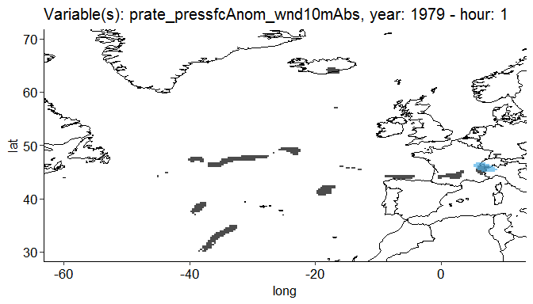
Generator - 1. Observed events
0. observed data
1. observed
events
2. observed
descriptors
4. synthetic
descriptors
5. synthetic
events
6. synthetic
data
- Event identification is a subjective procedure. (discussion?)
Method: (global) thresholds
Return levels (POT+GPD)
Black: precipitation rate
Orange: low pressure
Blue: wind speed

Slide 5
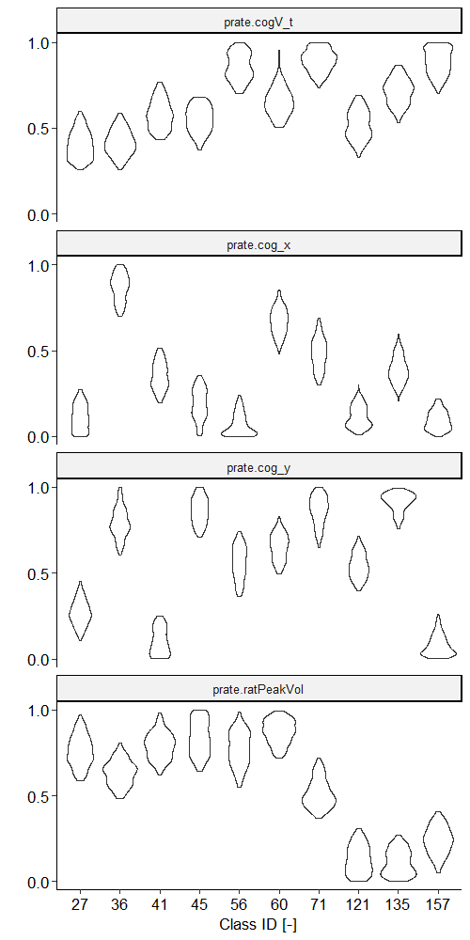
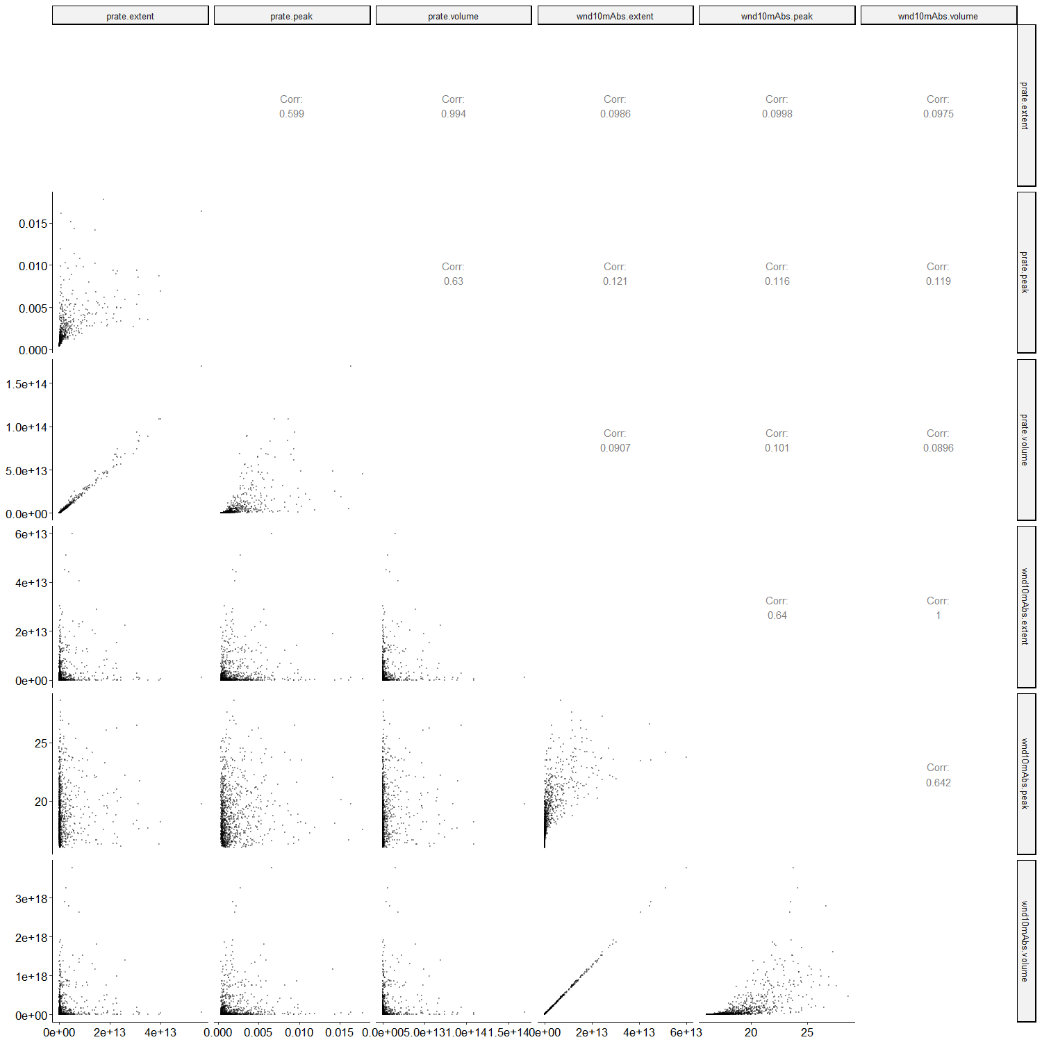
Generator - 2. Observed descriptors
Classification
Per class
0. observed data
1. observed
events
2. observed
descriptors
4. synthetic
descriptors
5. synthetic
events
6. synthetic
data
A matrix of observed descriptors per class (for multivariate analysis)
Return levels (POT+GPD)
Each class should contain events that can be compared
(e.g. cyclones or drizzle or tropical storms, etc)

Slide 6
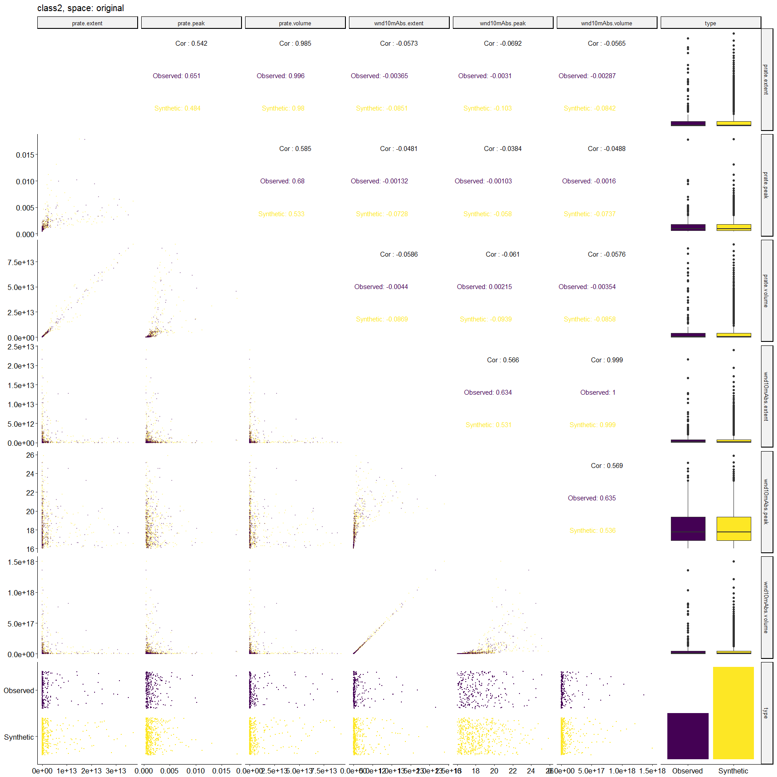
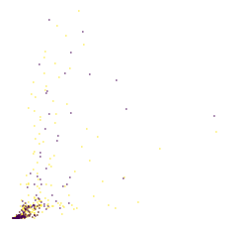
Generator - 4. Synthetic descriptors
Synthetic descriptors are sampled from a multivariate statistical model
0. observed data
1. observed
events
2. observed
descriptors
4. synthetic
descriptors
5. synthetic
events
6. synthetic
data
Stochastic process:
the observed descriptors (purple) should be a likely subset of the synthetic (yellow)
Return levels (POT+GPD)

Slide 7
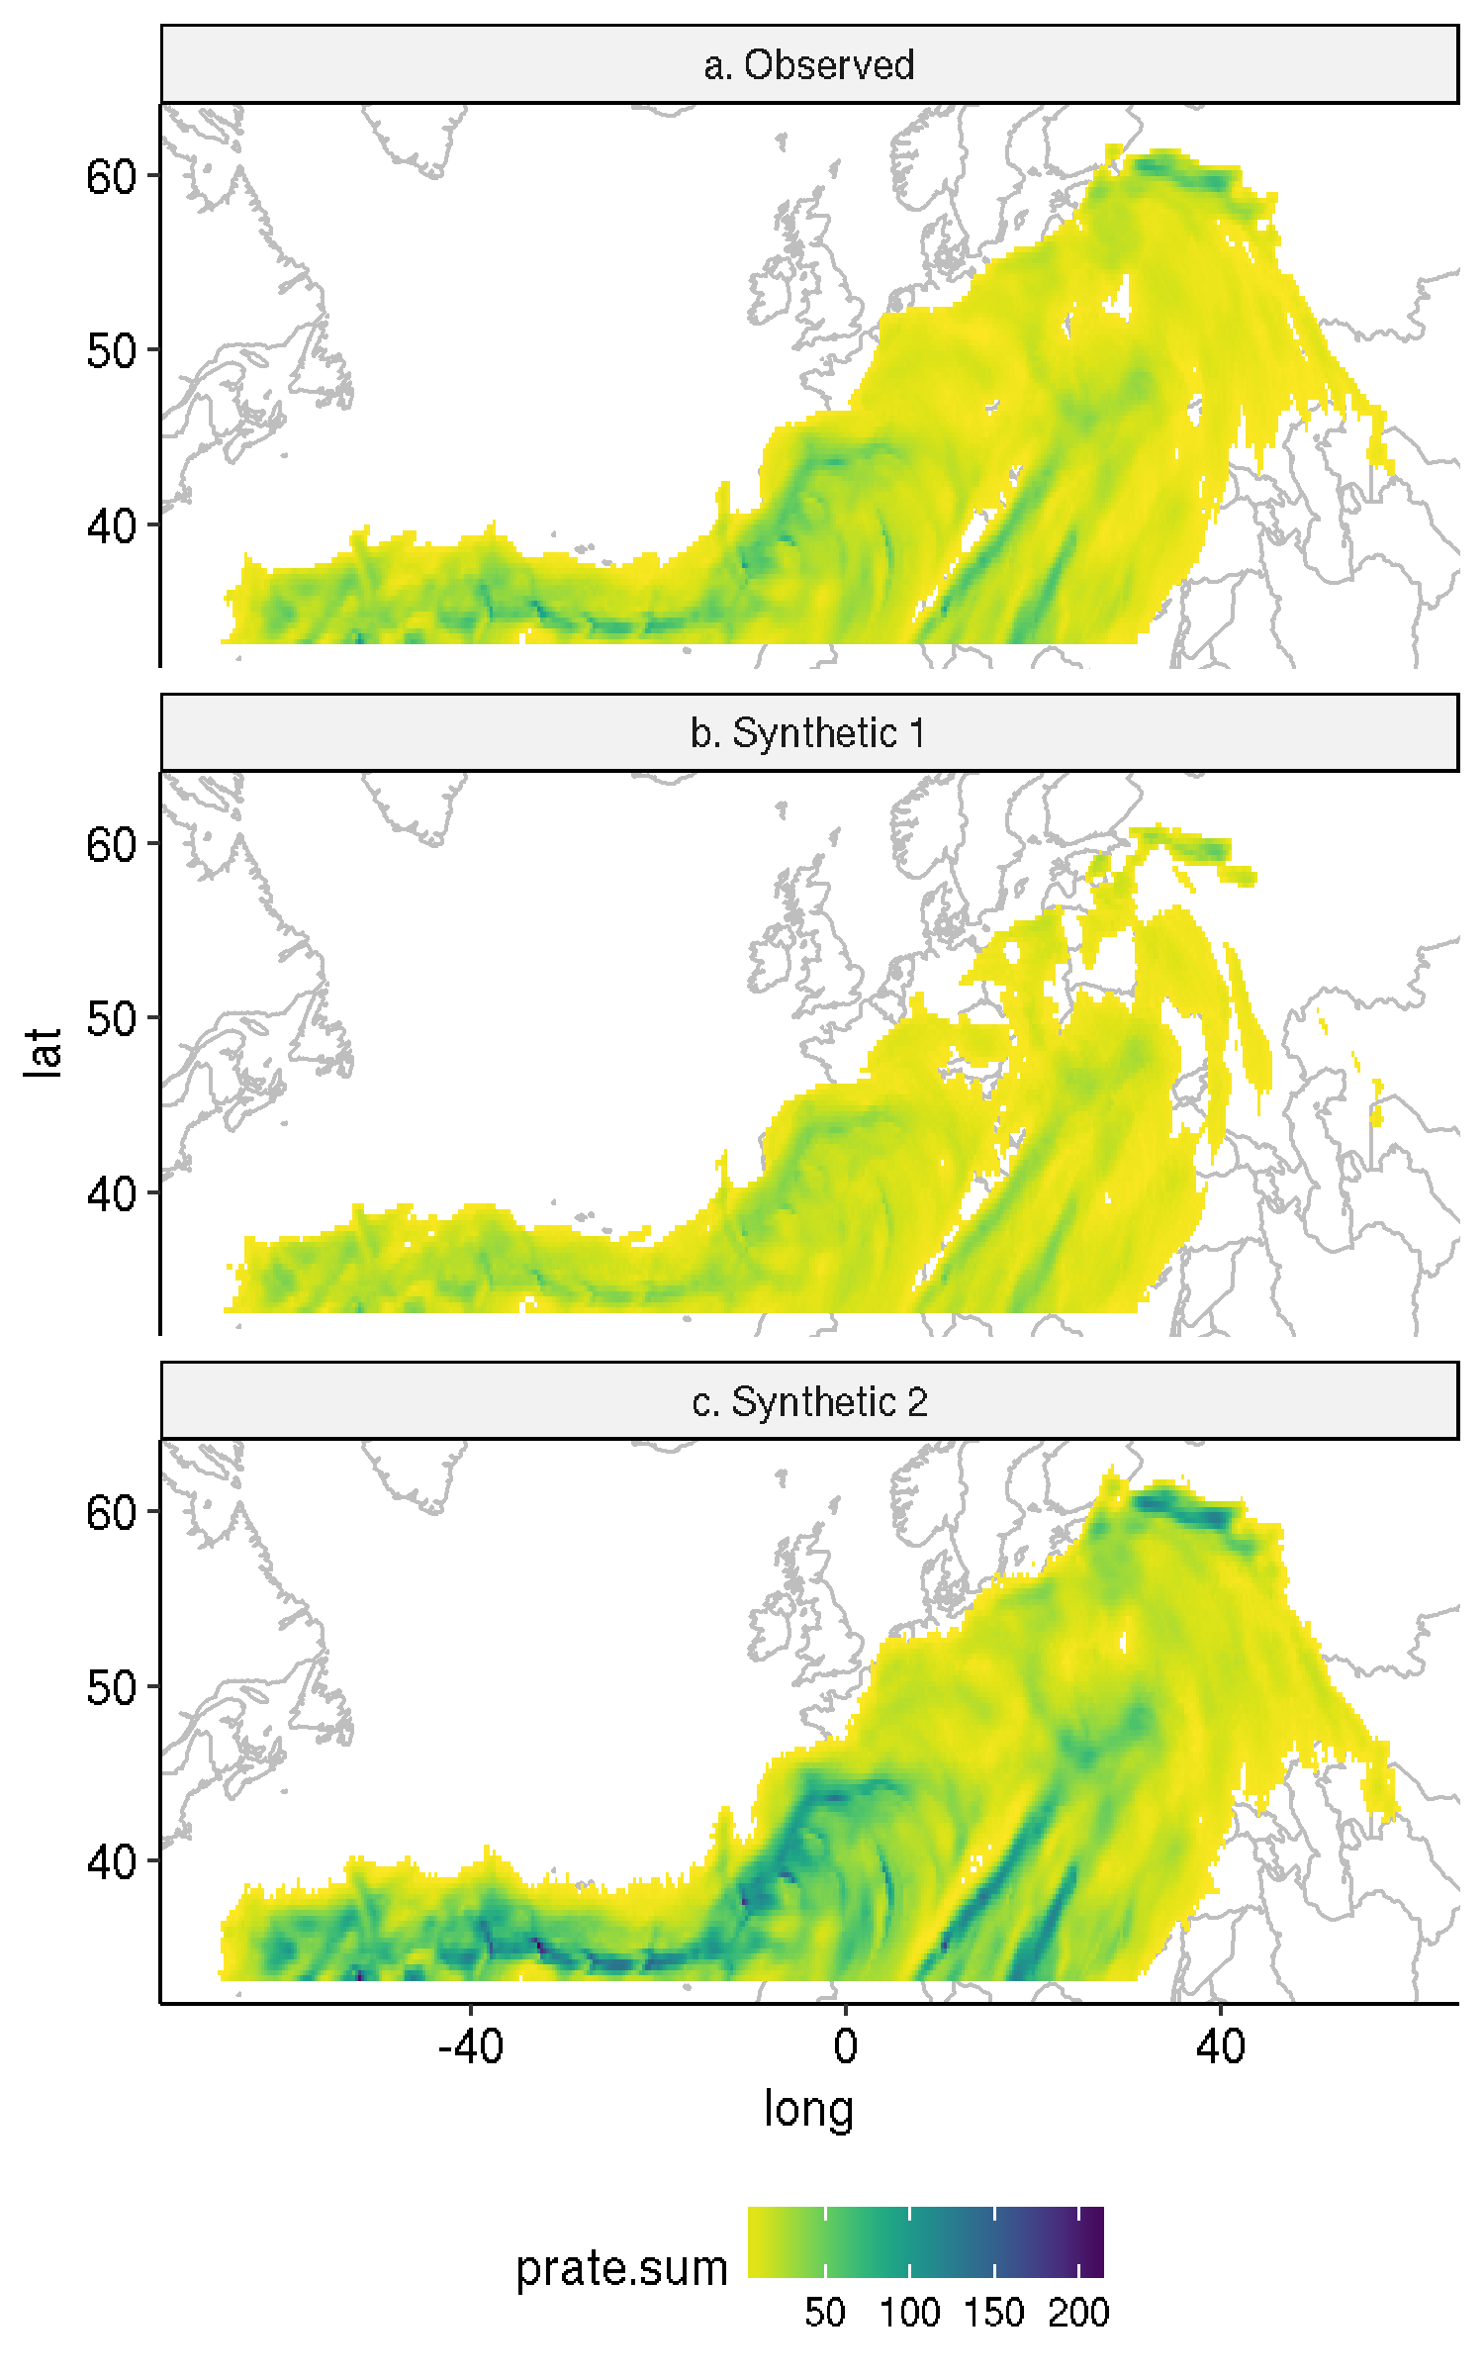
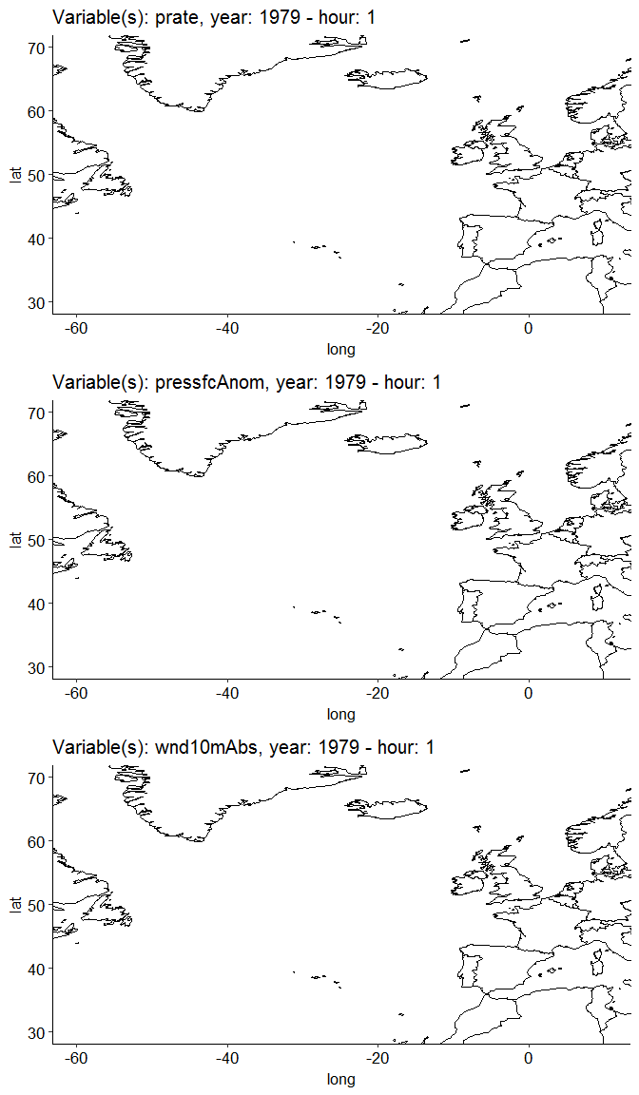
Generator - 5. Synthetic events
Event reconstruction
Result:
synthetic events
0. observed data
Start from the observed event.
Make it smaller.
Or bigger.
1. observed
events
2. observed
descriptors
4. synthetic
descriptors
5. synthetic
events
6. synthetic
data
Return levels (POT+GPD)
The reconstructed synthetic events respect the synthetic descriptors

Slide 8
Generator - 6. Synthetic data
Original data
0. observed data
1. observed
events
2. observed
descriptors
Synthetic data
4. synthetic
descriptors
5. synthetic
events
6. synthetic
data
Difference
Return levels (POT+GPD)
(Precipitation, similar results for wind and pressure)

Slide 9
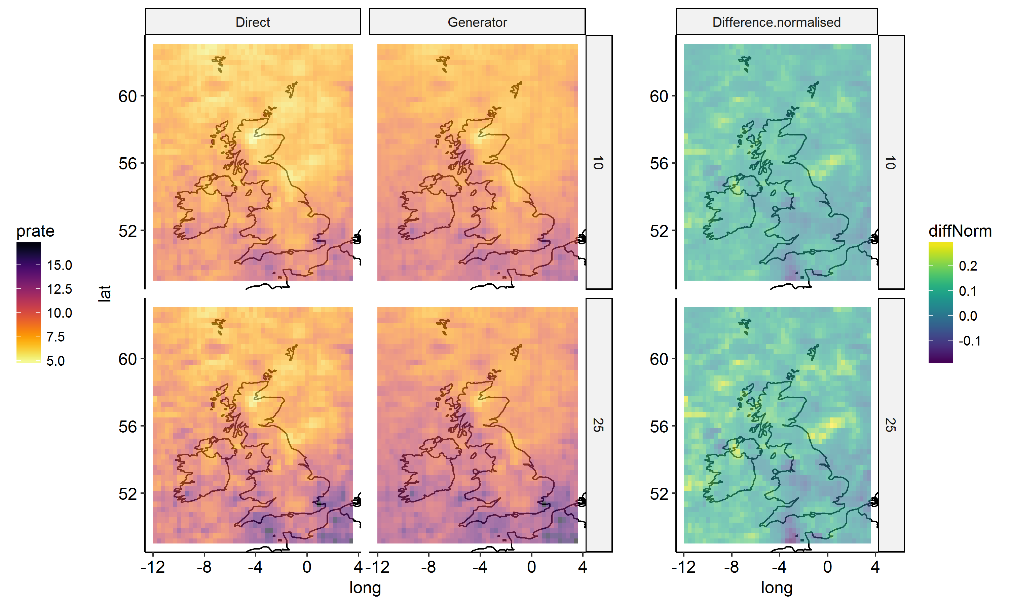
Inspection – Return Levels
RL calculated from:
observed
data (10 yr)
synthetic
data (100 yr)
RL.syn-RL.obs
Diff =
mean(RL.syn,RL.obs)
0. observed data
1. observed
events
2. observed
descriptors
4. synthetic
descriptors
5. synthetic
events
6. synthetic
data
Return levels (POT+GPD)
Peaks-Over-Threshold
+
Generalised Pareto Distribution)

