Slide 1
Evaluation of Gridded Snow Products Using CloudSat Snowfall Estimates
Fraser King, Christopher Fletcher - University of Waterloo

Slide 2
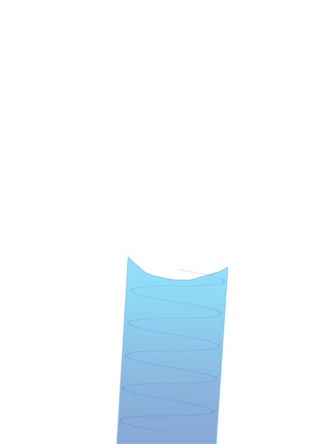
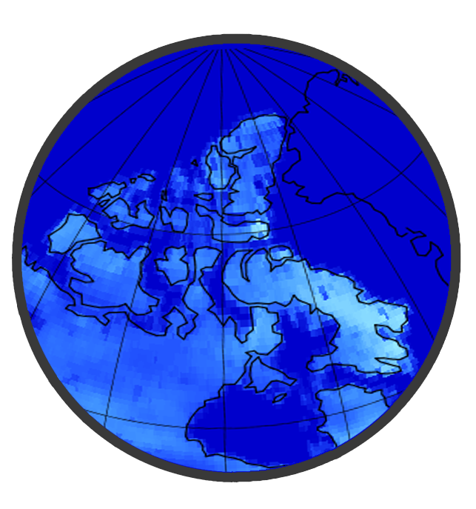
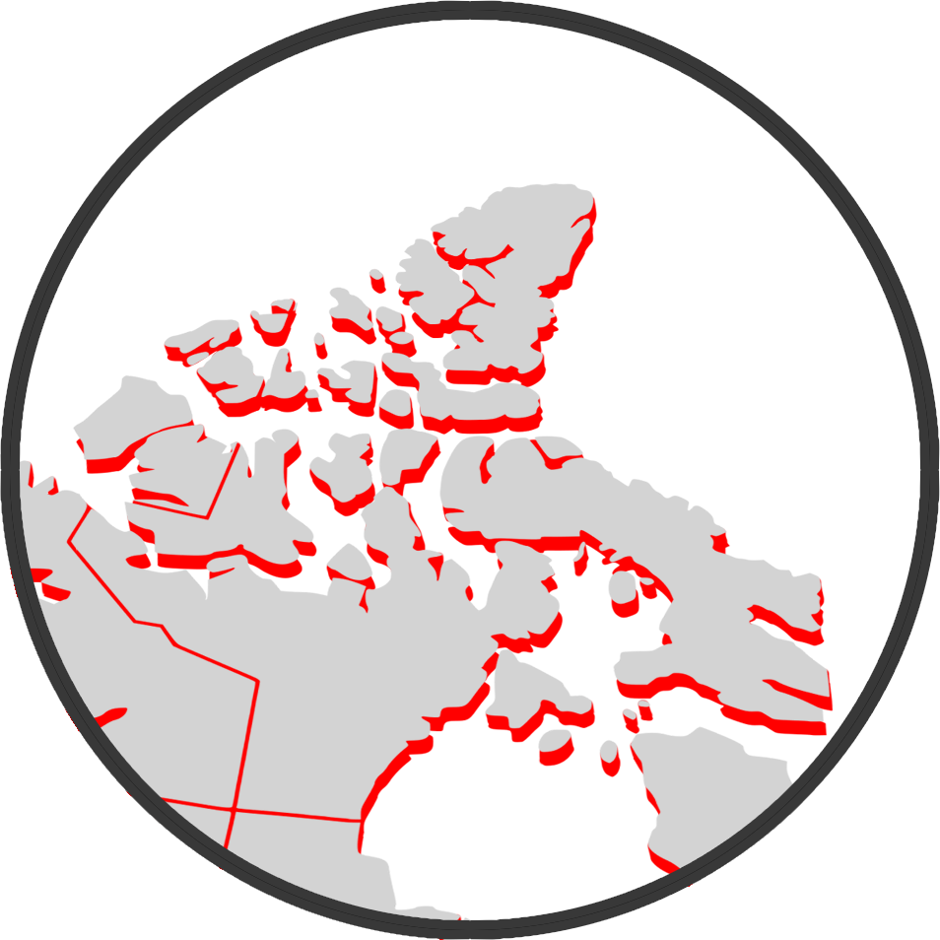
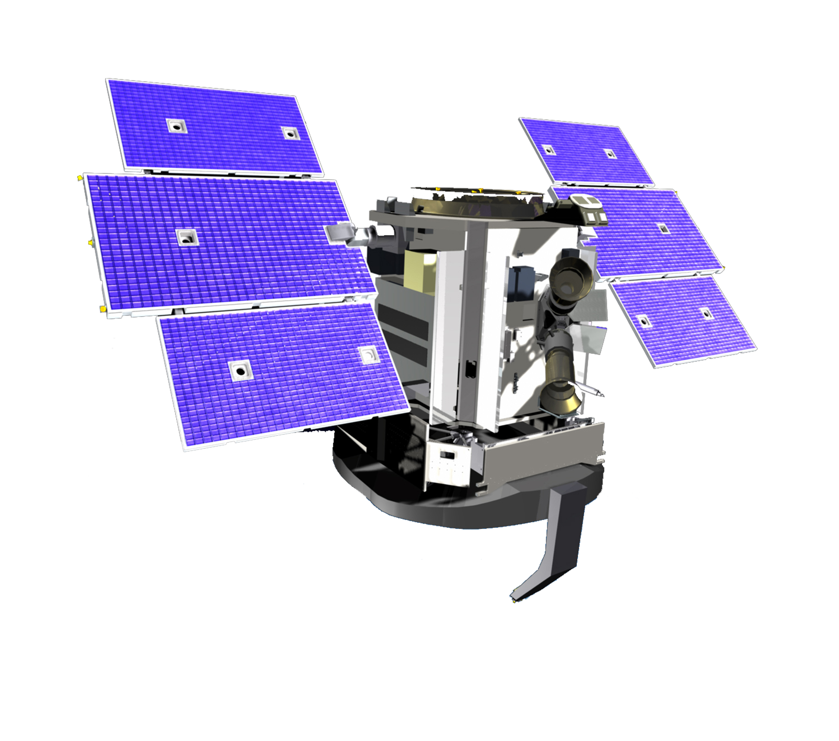
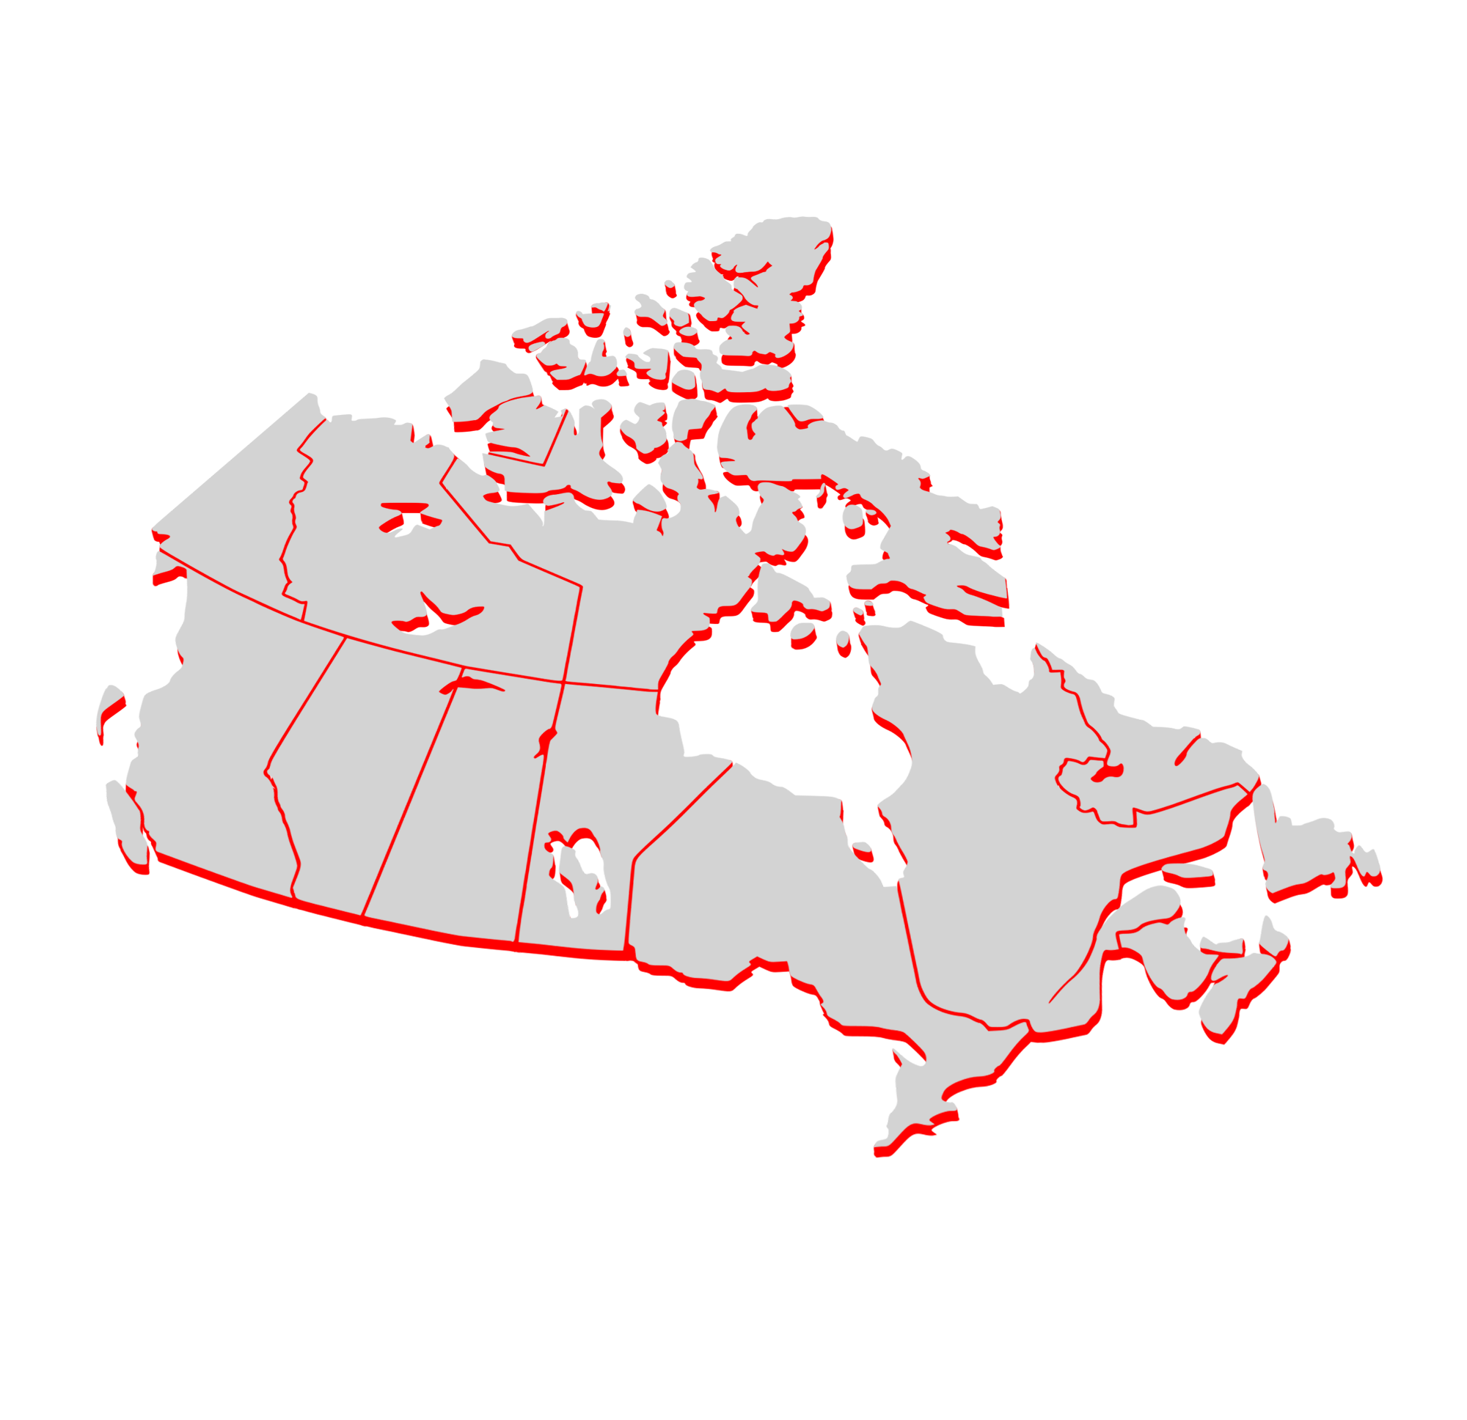
Estimating Arctic Snow
?
?
CPR – Cloud
Profiling Radar

Slide 3
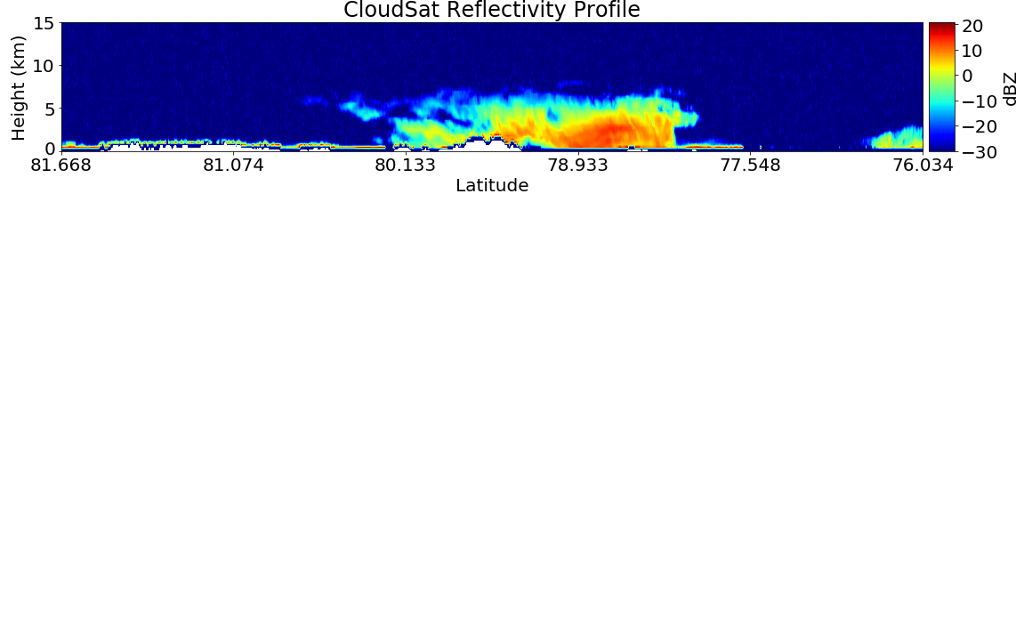
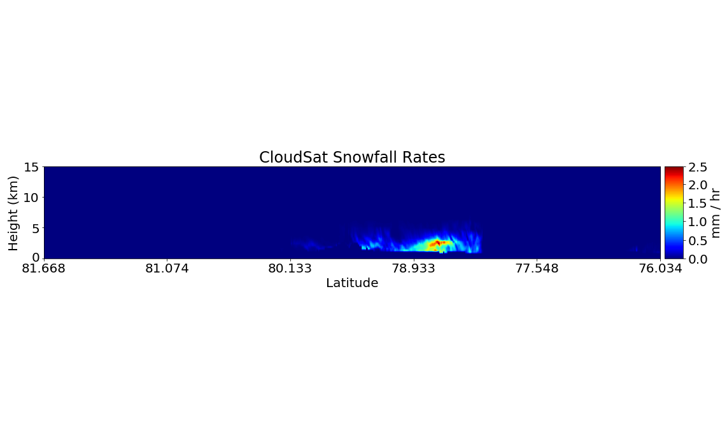
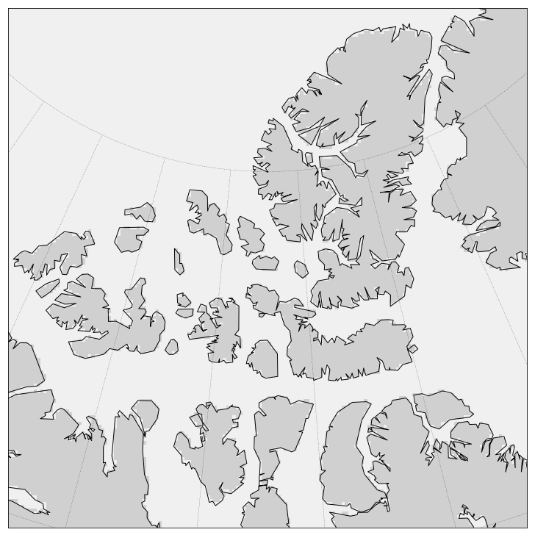
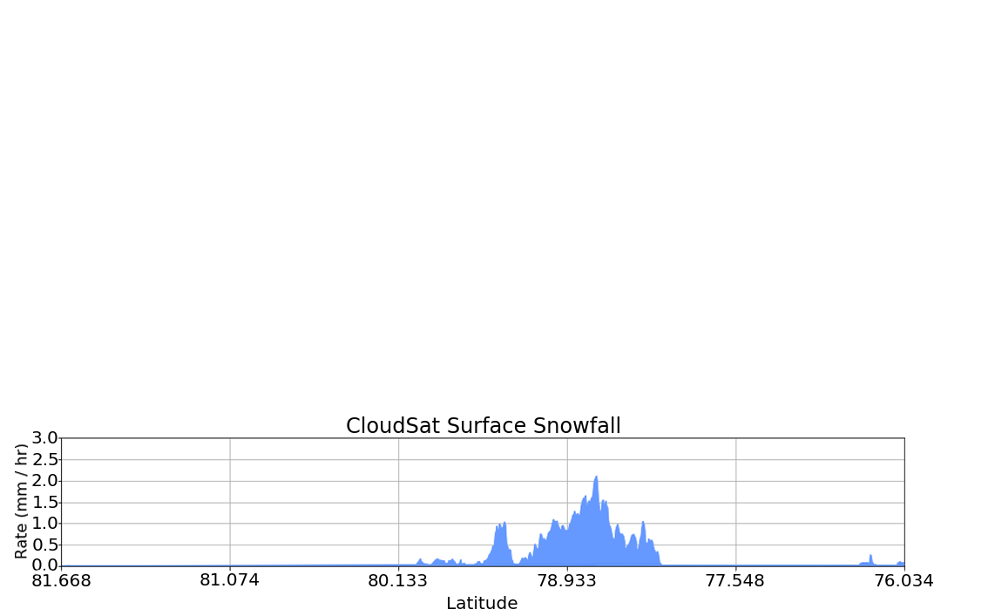
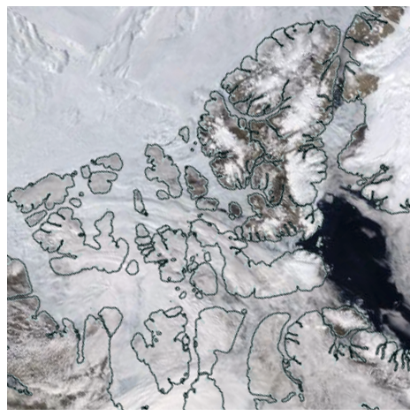
Introducing CloudSat
CloudSat Overpass:
CPR Data
King et al. 2019
The CloudSat Snow Proﬁle product: 2C-SNOW-PROFILE

Slide 4
Overview
Q: Can we use CloudSat to enhance current gridded snow products?
1. Initial validation against ground station observations
2. Comparison with
gridded data products
Notes:
Notes:
- This is a high level overview of my research plan for the work we are doing with CloudSat.
- The past year has been spent primarily on part 1 and we are now focusing on part 2 (which is the majority of the content in this presentation) wrt dSWE

Slide 5
Data Products
The data used in this study came from two sources:
ECCC Stations
Blended-4 SWE
Daily precipitation from automatic weighing gauges
Collected from four sites across the Canadian Arctic
Daily 1° NH gridded terrestrial SWE product
Crocus, MERRA-2, GlobSnow and Brown’s SSM
Mudryk et al. 2015
January 2007 to December 2015
Notes:
Notes of potential interest:
CloudSat does well (stronger correlations) at a 1 degree monthly timescale at estimating snow accumulation at our high Arctic stations (and performs worse as we move further South)
We can expand from just a few stations to the full NH using this 1 degree gridding method to compare against other gridded reanalysis products over this region

Slide 6
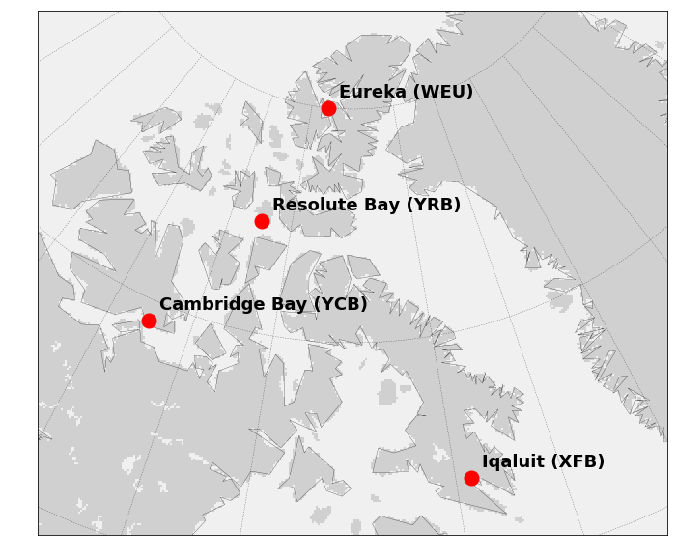
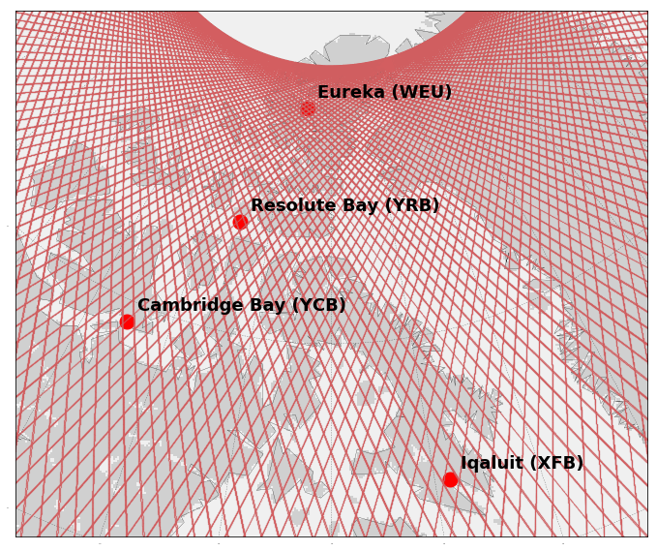
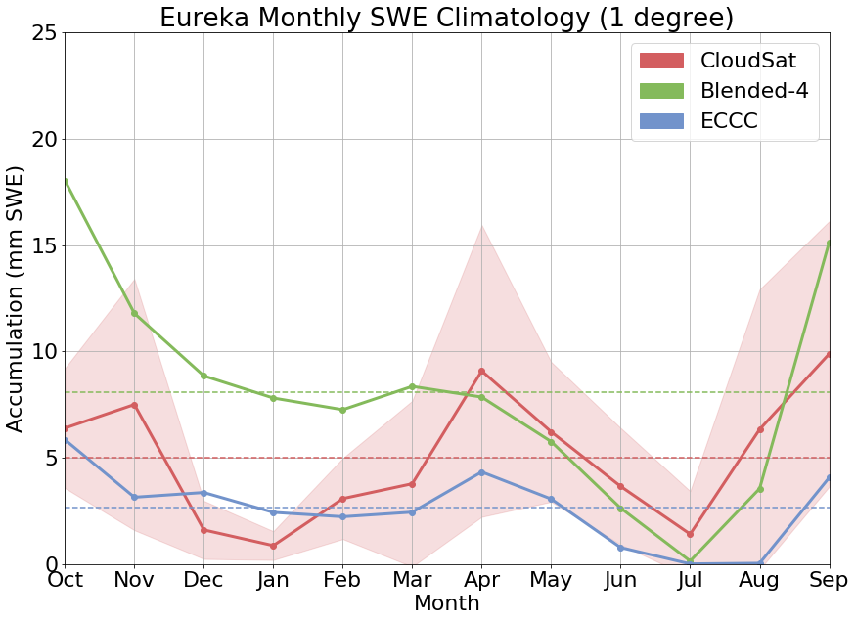
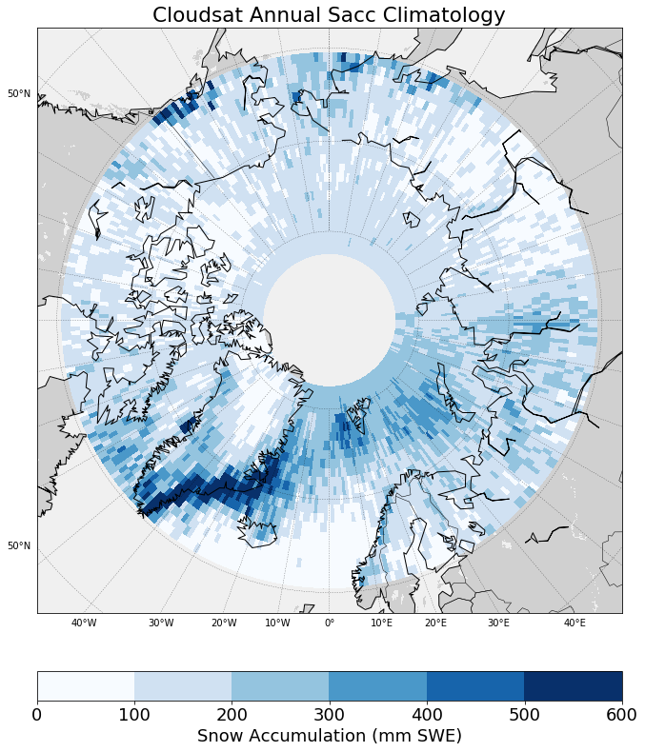
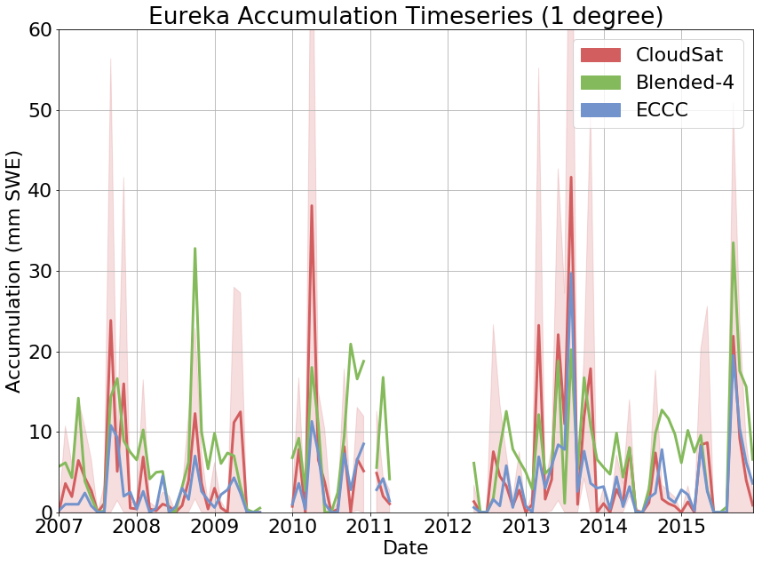
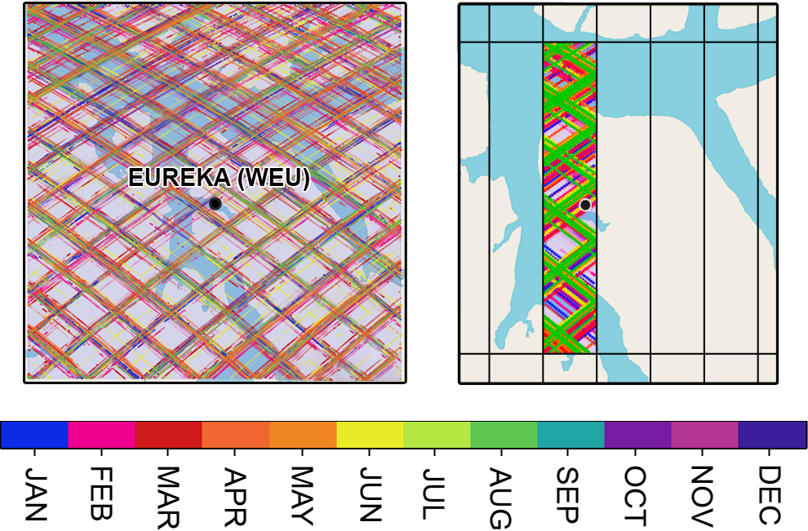
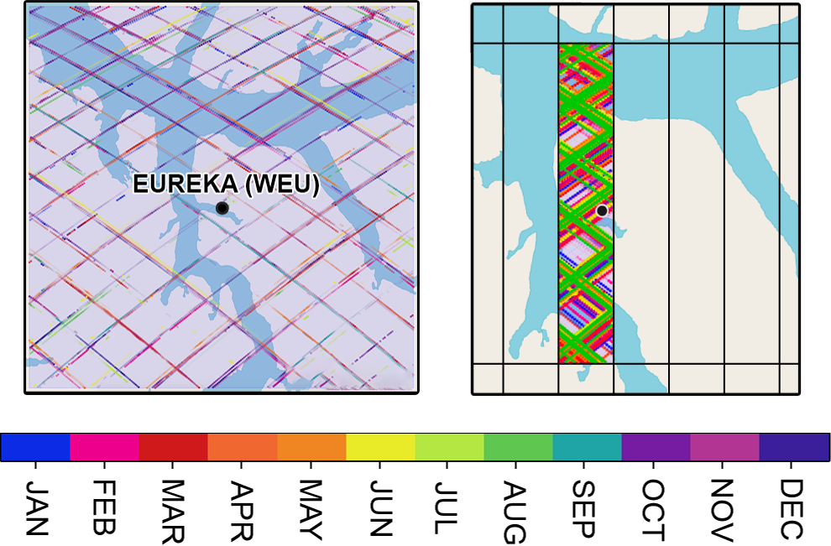
Initial Validation
1. Station selection:
3. CloudSat validation:
4. CloudSat gridded product:
CloudSat Accumulation Grid
2. Overpass gridding:
5. NH comparison against other
gridded SWE products
King et al. 2019
Hiley et al. 2010
Notes:
Notes of potential interest:
CloudSat does well (stronger correlations) at a 1 degree monthly timescale at estimating snow accumulation at our high Arctic stations (and performs worse as we move further South)
We can expand from just a few stations to the full NH using this 1 degree gridding method to compare against other gridded reanalysis products over this region

Slide 7
Monthly Changes in SWE
dSWE (Blended-4)
CloudSat Average SWE
-
Δ Feb =
Feb =
Avg (
,
)
The difference in average SWE between 2 consecutive months
The average CloudSat snowfall
over the same 2 month period
How well do
these agree?
Notes:
Note: dSWE calculated as dSWE = (avg(mon2) – avg(mon1)) from Blended-4 (ie. The change in average SWE noted between two consecutive months)
Note: CloudSat deltas used here calculated as csat avg = mean(mon1, mon2) (ie. The average amount of snowfall observed by CloudSat over the same two consecutive months)

Slide 8
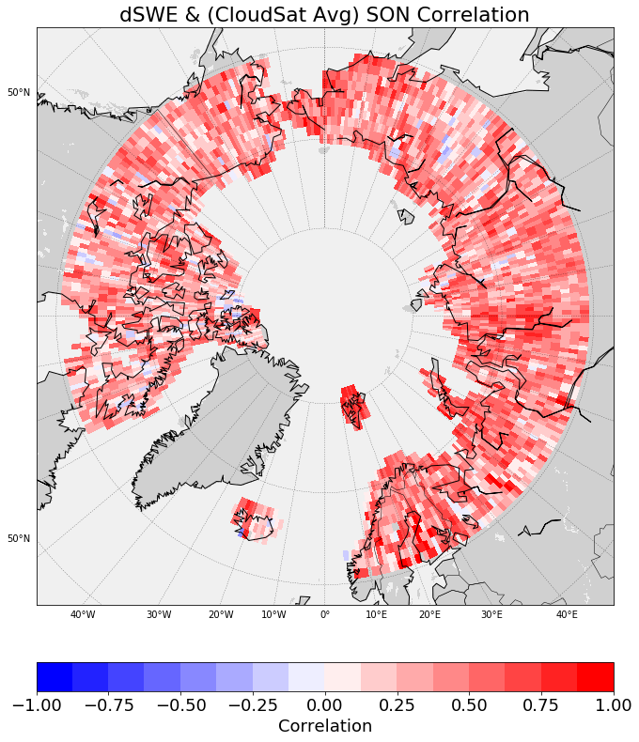
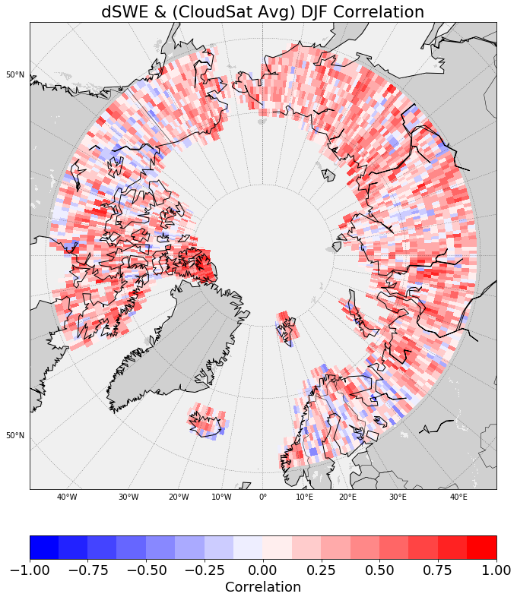
Seasonal Correlations
King et al. 2019
Notes:
Notes:
This is the correlation between the 2-month dSWE from Blended-4 and the 2-month average snowfall from CloudSat
We note low correlations when we look at all seasons together, however when we break this down into each individual season, we can start to see some patterns
For instance, during JJA (when there is little accumulation and mostly ablation) there is a large discrepancy between the datasets since CloudSat is unable to see the melting snow. On the other hand SON (when accumulation begins to generally dominate)
This fixed version also now shows stronger correlations during DJF and March/April
The very high Arctic (>80 N) appears to have high correlations across all periods (including JJA)

Slide 9
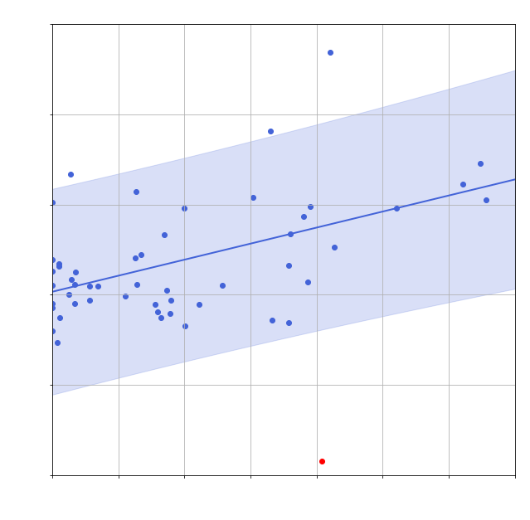
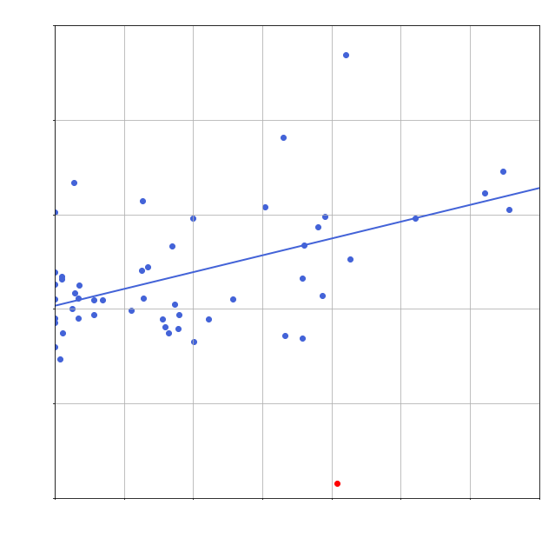
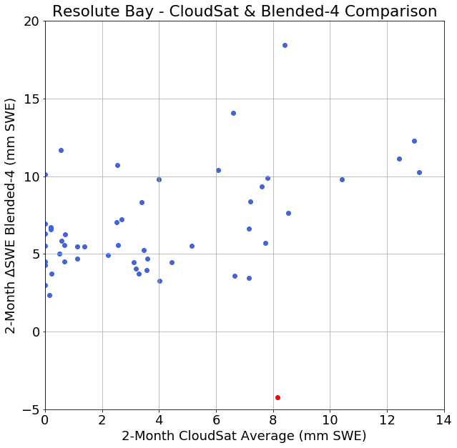
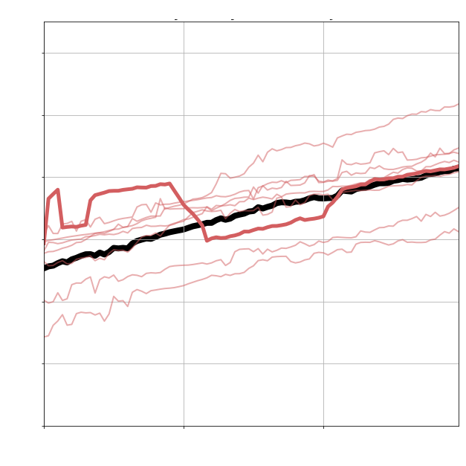
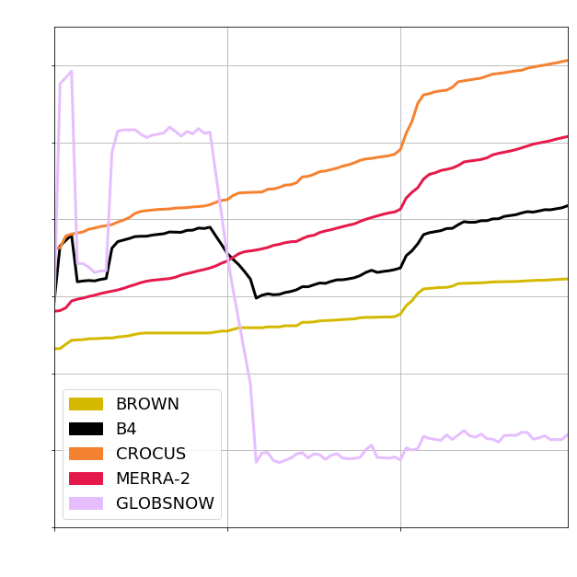
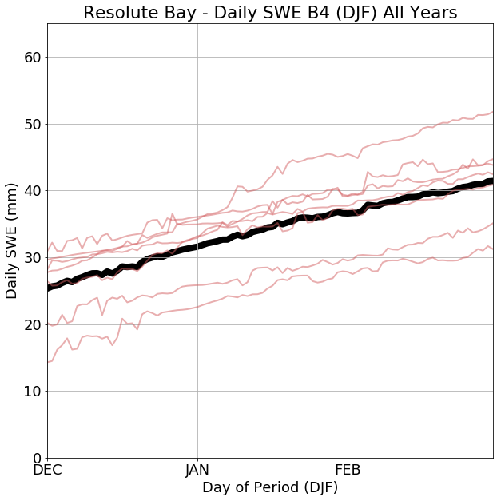
Outlier Detection
ECCC Data:
Location: Resolute Bay
Dec avg Max Temp = -24.5 °C
Jan avg Max Temp = -28.3 °C
Station avg snowfall = 6 mm SWE
No recorded liquid precipitation
Δ = (Jan 2008 – Dec 2007)

Slide 10
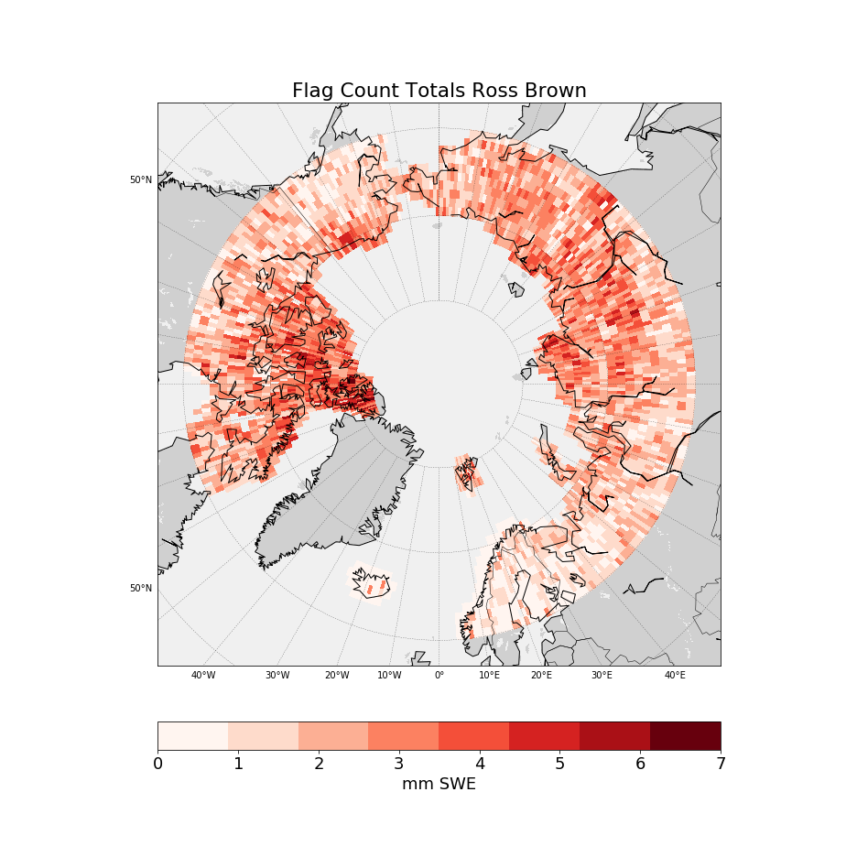
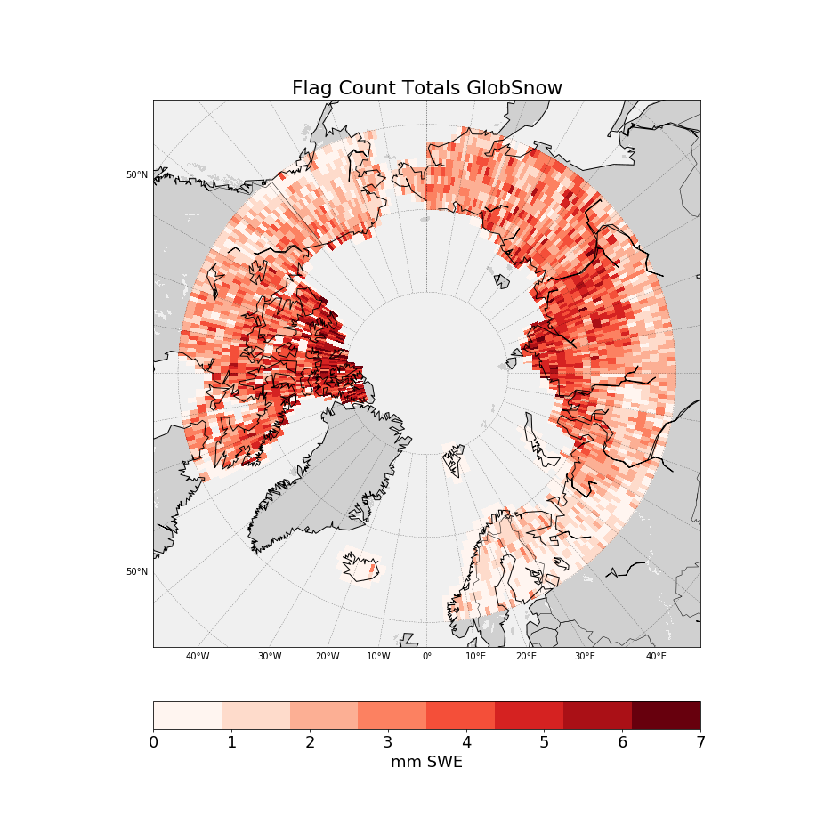
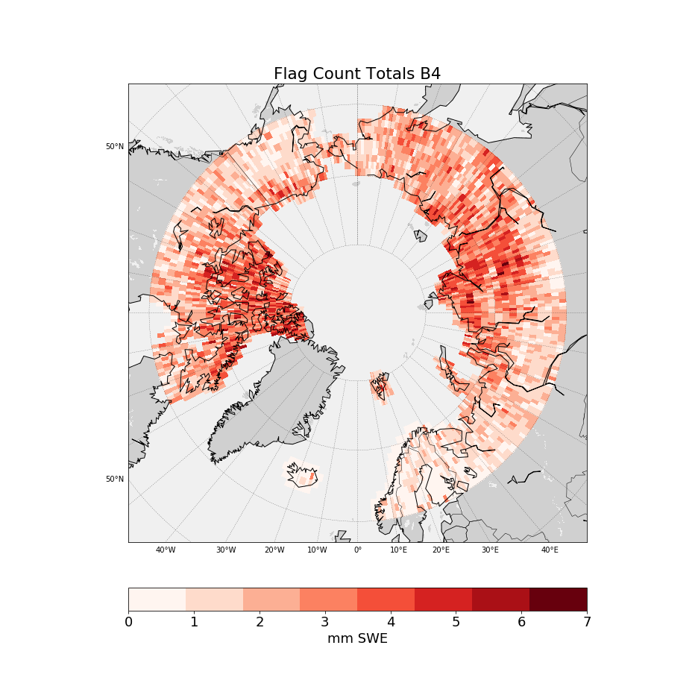
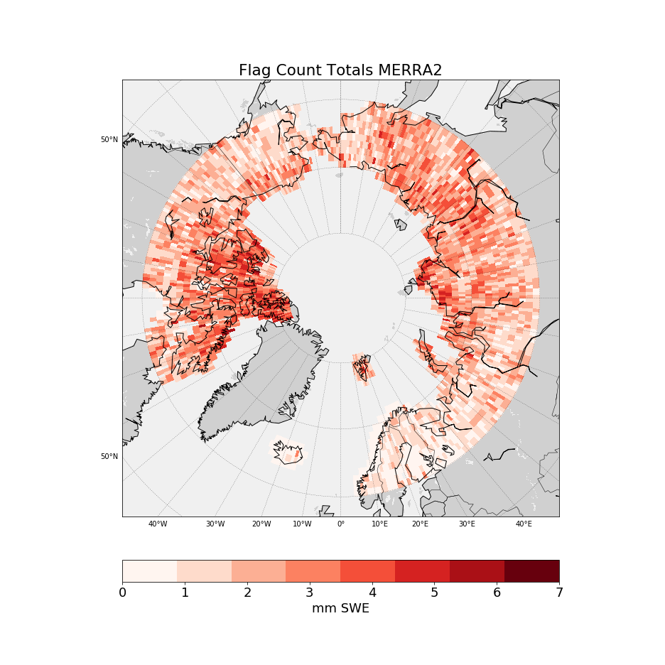
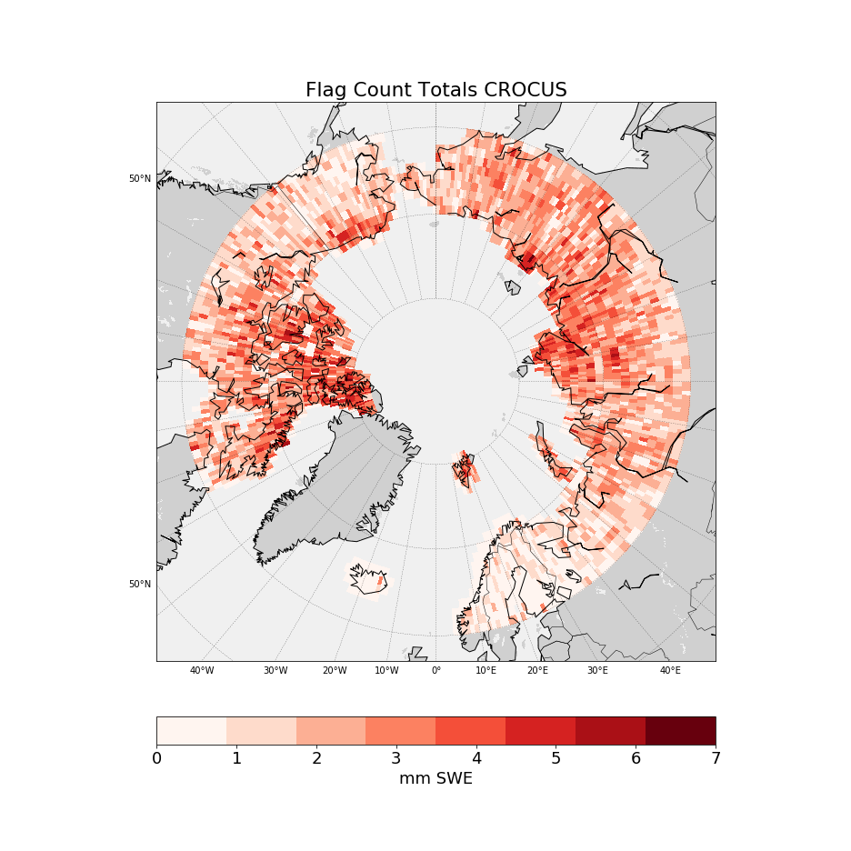
Outlier Count Totals
Count
Count
Count
Count
Count
King et al. 2019
Notes:
To combat this noise, we look at total counts for all freezing periods over 2007-2015.
We can really start to see the influence of GlobSnow on the B4 error flag totals over the CAA and Eurasia. Similar patterns of higher errors appear in the CAA over the other components as well.

Slide 11
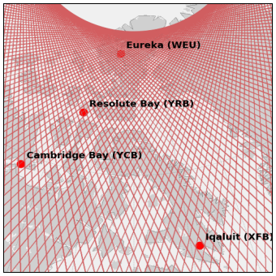
Summary
Q: Can we use CloudSat to enhance current gridded snow products?
High Latitude Performance
Accumulation
Period Agreement
Outlier Detection
Techniques
Notes:
To combat this noise, we look at total counts for all freezing periods over 2007-2015.
We can really start to see the influence of GlobSnow on the B4 error flag totals over the CAA and Eurasia. Similar patterns of higher errors appear in the CAA over the other components as well.

Slide 12
Questions?

Slide 13
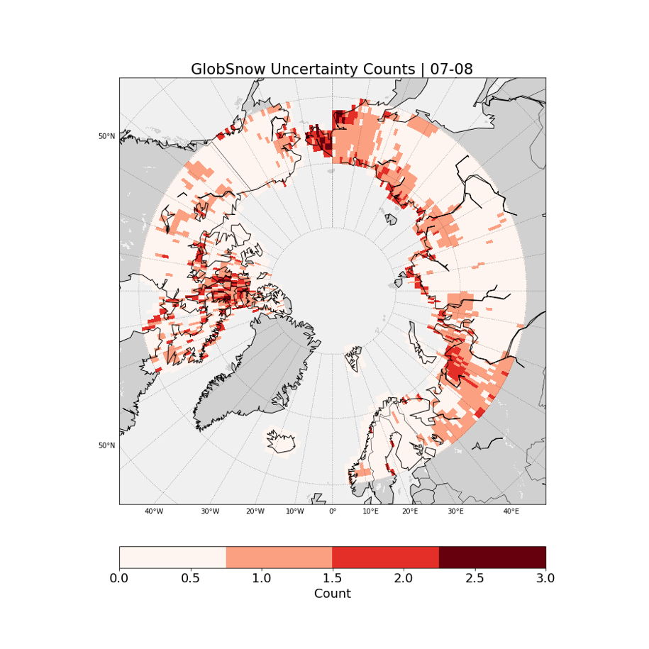
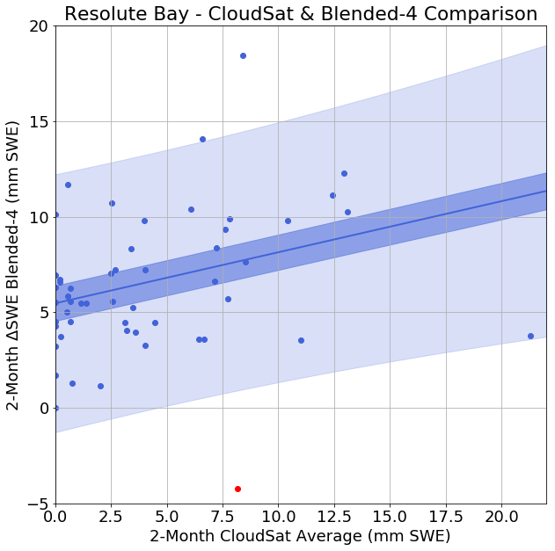
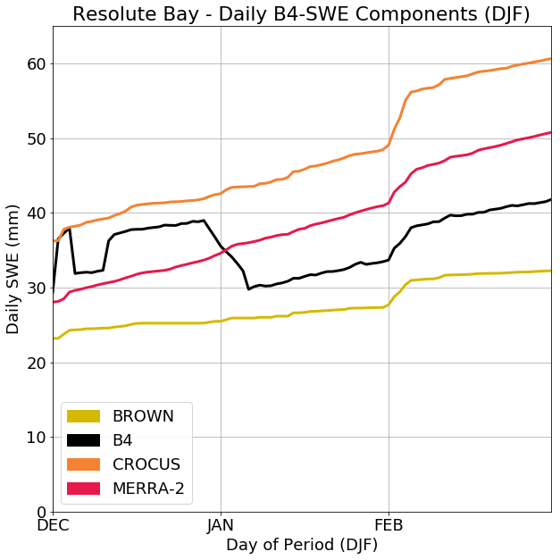
Blended-4 Component Analysis
Notes:
Uncertainty Flag Counts between csat and B4 & components over the full NH for DJF. We also show the Resolute Bay case component breakdown and the influence of GlobSnow.
It is a bit hard to see in the component breakdowns on the right, but only GlobSnow is showing this January issue on the grid cell at Resolute Bay (it also appears with a higher error flag count here).
Also to note: Other patterns start appear in the component products over parts of CAA and Russia. However, still a fair bit of noise.

Slide 14
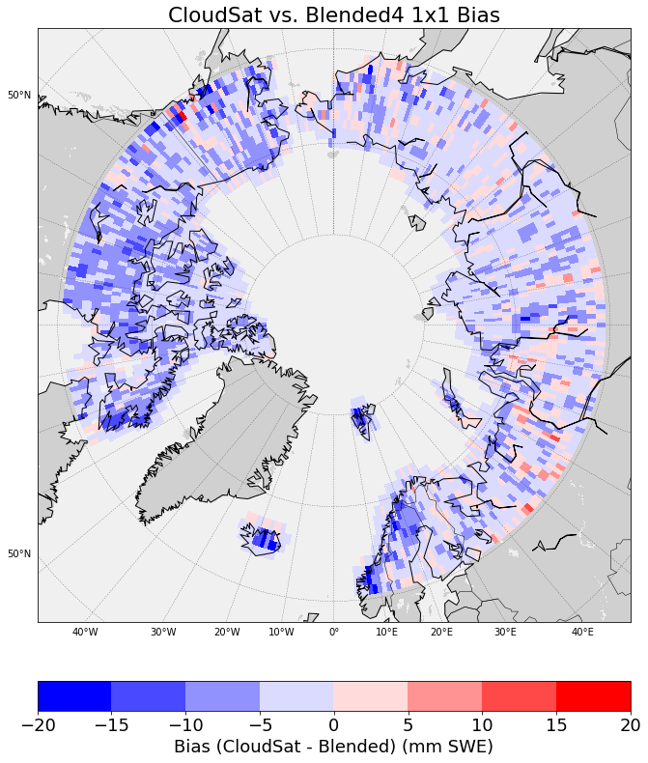
Northern Hemisphere Expansion

Slide 15
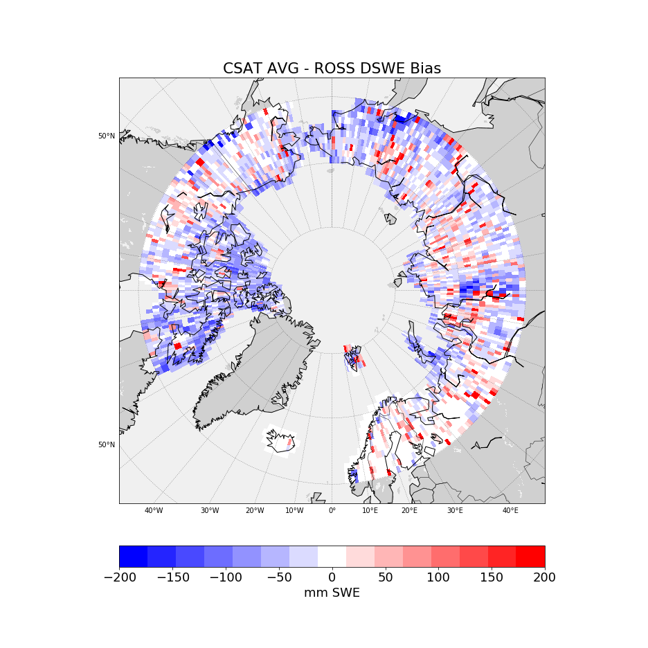
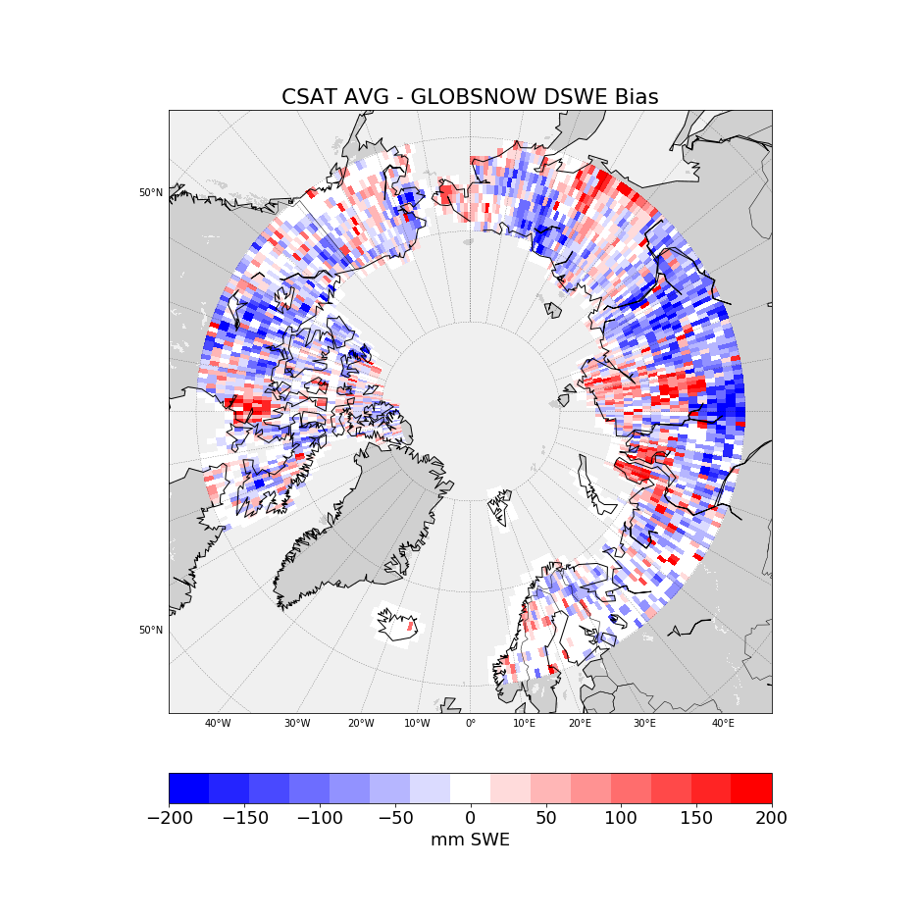
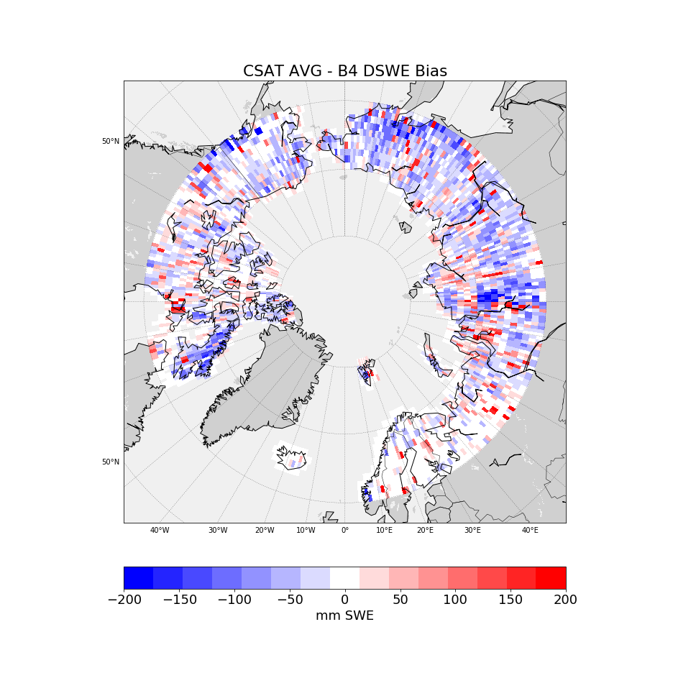
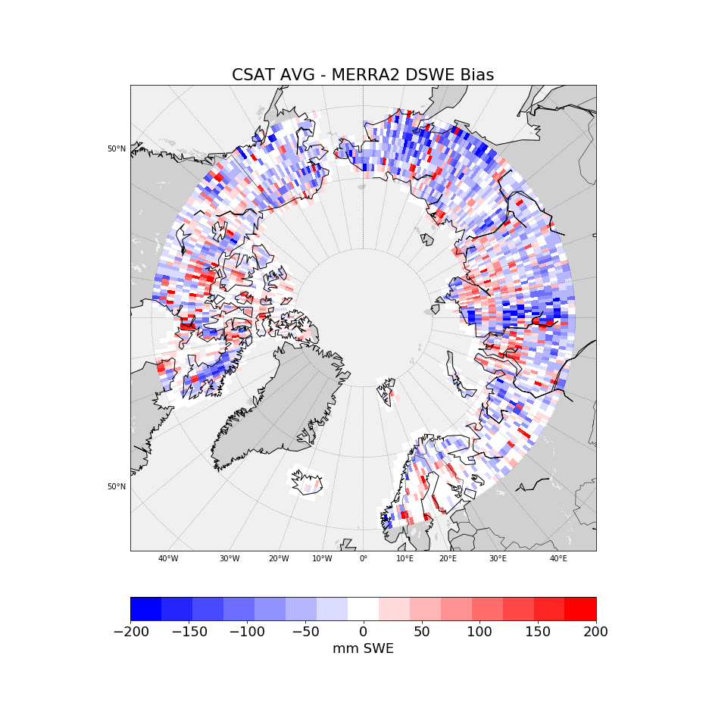
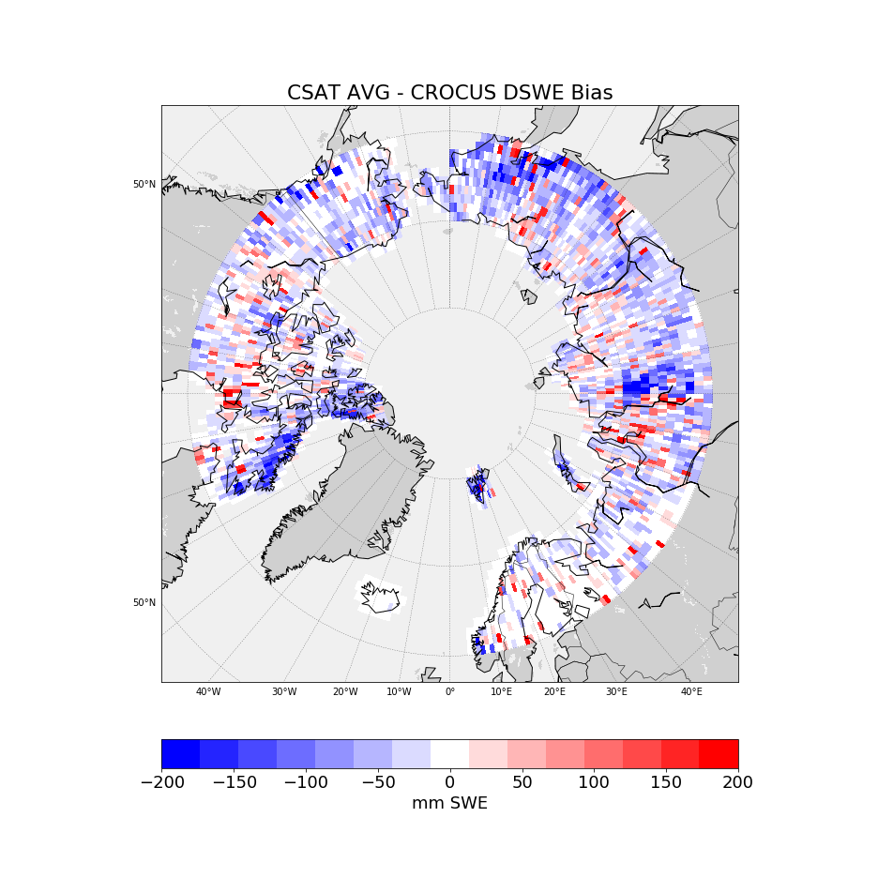
Bias (CloudSat – dSWE)
Notes:
We also wanted to check to see what the bias between the two looked like.
When a delta is flagged, we record the SWE estimate from the product and csat and then calculate the sum for both csat and the products over all error flagged periods.
Then we calculate the difference between these sums as CloudSat – Reanalysis to get an idea of the general bias which we see here.
Overall a slight negative bias is noted with some interesting areas over Eurasia (especially in GlobSnow)

Slide 16
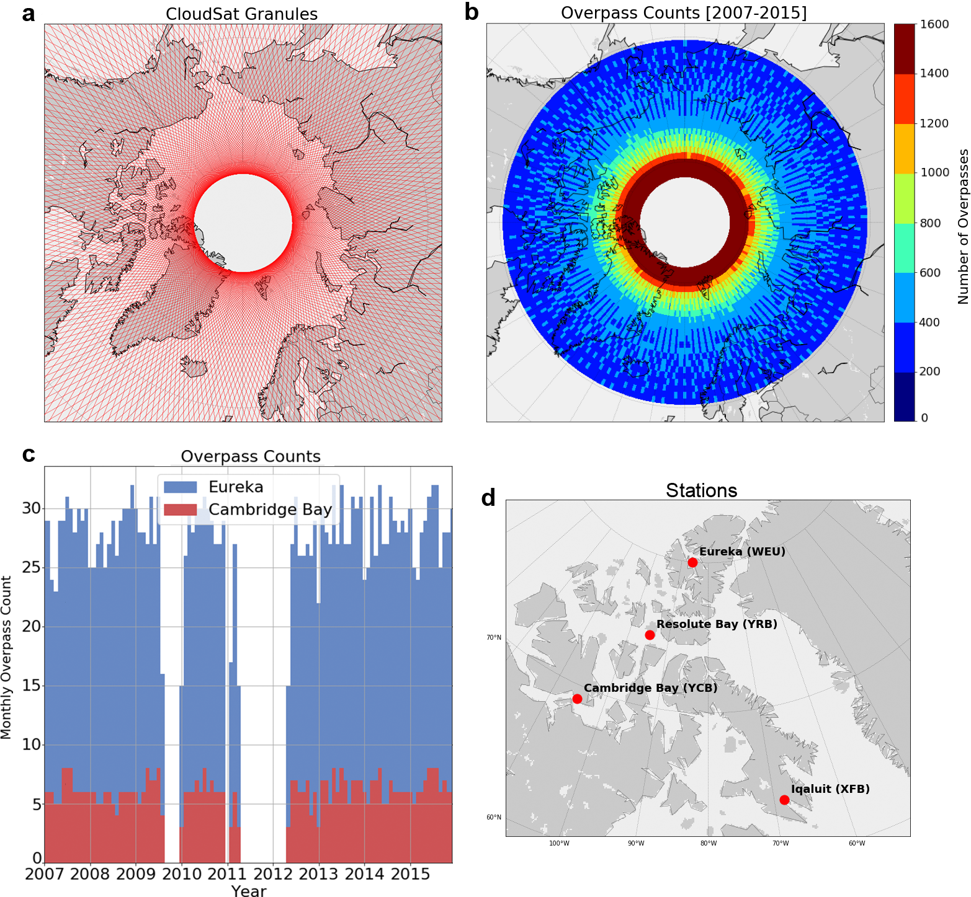
Counts

