Slide 1
The DC and AC global atmospheric electric circuits as central tenets in Earth system science today
Michael J. Rycroft
CAESAR Consultancy, Cambridge, U.K.
Presentation at EGU General Assembly
Vienna
7 to 12 April 2019

Slide 2

“Our true lover of knowledge naturally strives for truth”, Plato, 380 BC

Slide 3
Some key references, 2007 - 2018
K.L. Aplin, R.G. Harrison and M.J. Rycroft, Investigating Earth’s atmospheric electricity: a role model for planetary studies, Space Sci. Rev. 137, 11-27, 2008
A.J.G. Baumgartner, J. P. Thayer, R. R. Neely III and G. Lucas, Toward a comprehensive global electric circuit model: Atmospheric conductivity and its variability in CESM1(WACCM) model simulations, J. Geophys. Res. 118, 9221-9232, doi:10.1002/jgrd.50725, 2013
V. Bayona, N. Flyer, G. M. Lucas and A. J. G. Baumgaertner, A 3-D RBF-FD solver for modeling the atmospheric global electric circuit with topography (GEC-RBFFD v1.0), Geosci. Model Dev. 8, 3007–3020, 2015
V. V. Denisenko, M. J. Rycroft and R. G. Harrison, Mathematical simulation of the ionospheric electric field as a part of the global electric circuit, Surv. Geophys. 39, 1-35, 2018
R. P. Feynman, Electricity in the atmosphere, Feynman lectures on physics, volume 2, chapter 9,
J. Jansky and V. P. Pasko, Charge balance and ionospheric potential dynamics in time-dependent global electric circuit model, J. Geophys. Res. 119, doi: 10.1002/2014JA020326, 2014
J. Jansky and V. P. Pasko, Effects of conductivity perturbations in time-dependent global electric circuit model, J. Geophys. Res. 120, 10654-10668, 2015
J. Jansky, G.M. Lucas, C. Kalb, V. Bayona, M.J. Peterson, W. Deierling, N. Flyer and V.P. Pasko, Analysis of the diurnal variation of the global electric circuit obtained from different numerical models, J. Geophys. Res. 122, 12,906-12,917, 2017
I.G. Kudintseva, A.P. Nickolaenko, M.J. Rycroft and A. Odzimek, AC and DC global electric circuit properties and the height profile of atmospheric conductivity, Annals of Geophysics 59, 5, A0545, doi:10.4401/ag-6870, 2016

Slide 4
Some more key references, 2007 - 2018
E.A. Mareev and E.M. Volodin, Variation of the global electric circuit and ionospheric potential in a global circulation model, Geophys. Res. Lett. 41, 9009-9016, 2014
A. Odzimek, M. Lester and M. Kubicki, EGATEC: A new high‐resolution engineering model of the global atmospheric electric circuit—Currents in the lower atmosphere, J. Geophys. Res. 115, D18207, doi:10.1029/2009JD013341, 2010
M.J. Rycroft, A. Odzimek, N.F. Arnold, M. Fullekrug, A. Kulak and T. Neubert, New model simulations of the global atmospheric electric circuit driven by thunderstorms and electrified shower clouds: the roles of lightning and sprites, J. Atmos. Solar-Terr. Phys. 69, 2485-2509, 2007
M.J. Rycroft and R.G.Harrison, Electromagnetic atmosphere-plasma coupling: The global atmospheric electric circuit, Space Sci. Rev. 168, 363-384, 2012a
M.J. Rycroft, K.A. Nicoll, K.L. Aplin and R.G. Harrison, Recent advances in global electric circuit coupling between the space environment and the troposphere, J. Atmos. Solar-Terr. Phys. 90-91, 198-211, 2012b
B.A. Tinsley, The global atmospheric electric circuit and its effects on cloud microphysics, Reports on Progress in Physics 71, 066801, 2008
M.A. Uman, The Earth and its atmosphere as a leaky spherical capacitor, American Journal of Physics, 42, 1033-1035, 1974
E.R. Williams, The global electrical circuit: A review, Atmospheric Research 91, 140-152, 2009
E.R. Williams and E.A. Mareev, Recent progress on the global electrical circuit, Atmos. Res. 135-136, 298-227, 2014

Slide 5
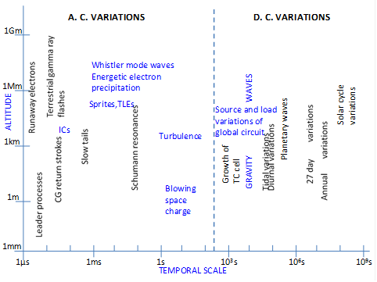
Earth system science
Considers the Earth’s atmosphere, biosphere, surface and oceans - supporting humankind - as a closely interacting system
G. Bloschl, H. Thybo and H. Savenije, A voyage through scales: The Earth system in space and time, EGU, 2015, ISBN 978-3-901753-84-8
M. J. Rycroft and R. G. Harrison, Electromagnetic atmosphere-plasma coupling: The global electric circuit, Space Sci. Rev. 168, 363-384, 2012
J. E. Borovsky and J. A. Valdivia, The Earth’s magnetosphere: A systems science overview and assessment, Surv. Geophys. 39, 817-859, 2018

Slide 6
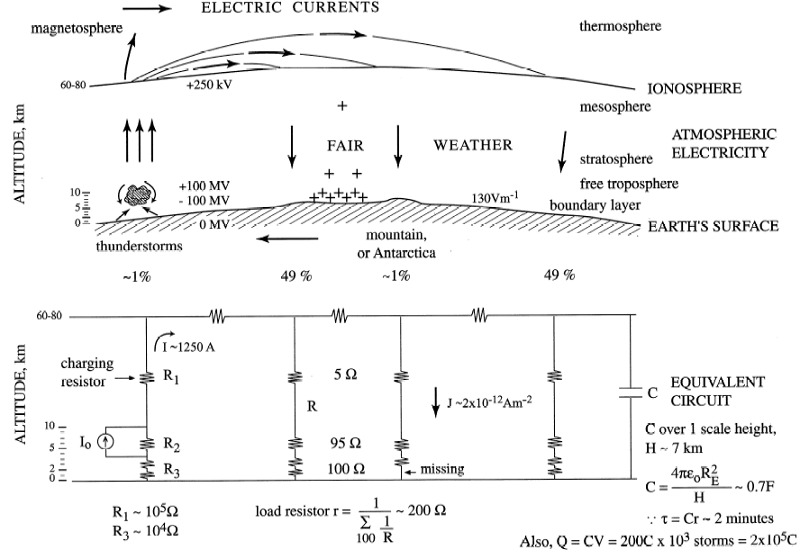
Model of DC global atmospheric electric circuit
Rycroft et al., JASTP, 62, 1563-1576, 2000

Slide 7
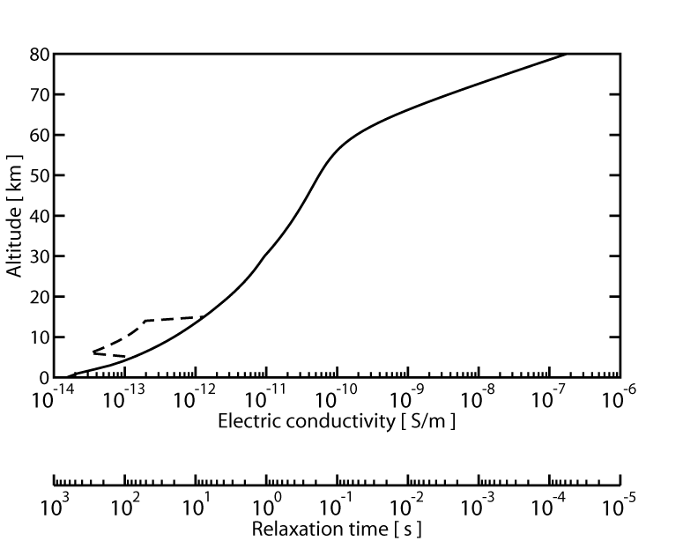
Average model of the height profile of the night-time atmospheric electric conductivity
Rycroft et al. JASTP, 69, 2485-2509, 2007

Slide 8
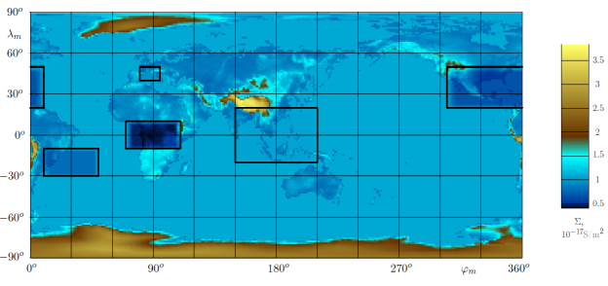
Conductance of the Earth’s atmosphere
Denisenko, Rycroft and Harrison, Surv. Geophys. 40, 1-39, 2019

Slide 9
Modifying the ionosphere above thunderstorms
Sprites and elves (transient luminous events) modify the ionospheric electron density
X.-M. Shao, E.H. Lay and A.R. Jacobson, Reduction of electron density in the night-time lower ionosphere in response to a thunderstorm, Nature Geoscience 2012, doi: 10.1038/NGEO1668
C.J. Rodger, M. Cho, M.A. Clilverd and M.J. Rycroft, Lower ionospheric modification by lightning-EMP: Simulation of the nighttime ionosphere over the United States, Geophys. Res. Lett. 28, 199-202, 2001
Electron density increases
M.A. Salem, N. Liu and H.K. Rassoul, Modification of the lower ionospheric conductivity by thunderstorm electrostatic fields, Geophys. Res. Lett. 2015, doi: 10.1002/2015GL066933
Conductivity decreases but electron density increases
Is ionospheric sporadic-E layer enhanced? Investigations by Rastogi (1962), Davis and Johnson (2005), Davis and Lo (2008), Lay et al. (2013), Barta et al. (2015, 2017), Haldoupis (2018)

Slide 10
Ionospheric conductance, 19 UT, July, active Sun
Top panel: integral Pedersen conductance
Bottom panel: Hall conductance

Slide 11
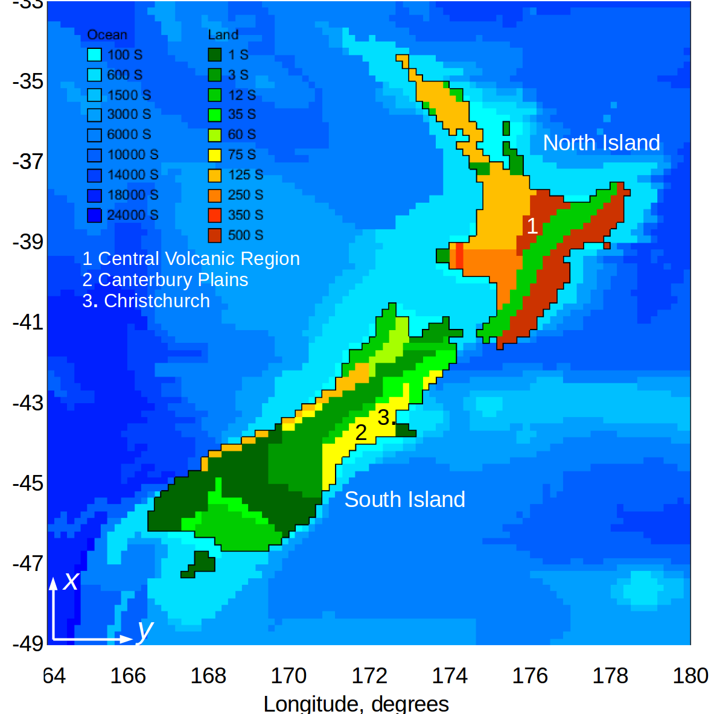
Return part of global circuit, land/ocean surface, with spatially varying conductivity
T. Divett et al., Space Weather 15, 1396-1412, 2017

Slide 12
AC global atmospheric electric circuit
Schumann resonances of Earth-ionosphere cavity (8, 14, 20 …Hz) (Rycroft, 1965; Simoes et al., 2008)
Lowest energy photons in the Universe
“There is music in the spacing of the spheres”, Pythagoras
Geo-location of strong lightning discharges
Need few observing stations around Earth (Whitley et al., 2011)
“Q bursts” (Ogawa, 1967) produced by the strongest lightning discharges and by sprites
Atmospherics (sferics, kHz radiation): lightning detection networks, e.g., WWLLN
Hutchins et al. (2014) study thunderstorm contribution to global circuit current using WWLLN data: they estimated 1.1 kA
Mezuman et al. (2014) study thunderstorm centres in relation to Carnegie curve, and over oceans
Rapid “teleconnection” of electrical phenomena around global circuit: time constant, tau ~ minutes (DC), 0.1 s (AC)

Slide 13
The DC and AC (fundamental Schumann resonance) global circuit models are consistent
R.K. Cole and E.T. Pierce, Electrification in the Earth's atmosphere for altitudes between 0 and 100 kilometers, JGR 70, 2735-2749, 1965. Used ELF radio wave data
I.G. Kudintseva, A.P. Nickolaenko, M.J. Rycroft and A. Odzimek, AC and DC global electric circuit properties and the height profile of atmospheric conductivity, Annals of Geophysics 59, 5, A0545, doi:10.4401/ag-6870, 2016. Propose new hybrid model

Slide 14
What is the power available in these circuits ?
Power of thunderstorms ~ 100 MV x 1,250 A ~ 10¹¹ W
Lightning: global energy dissipation rate ~ 10¹¹ W, according to Sellers (1965)
DC circuit
Power = 250,000 V x 1,250 A ~ 3 x 10⁸ W, ~ 300 MW
AC circuit
Energy flux, Poynting vector S = E x B/μ_{o} = c ϵ₀ E²
With E_{ELF} ~ 1 mV/m, S ~ 3 x 10⁻⁹ Wm⁻²
Over area = Earth’s diameter x height of ionosphere,
energy ~ 1 kW

Slide 15
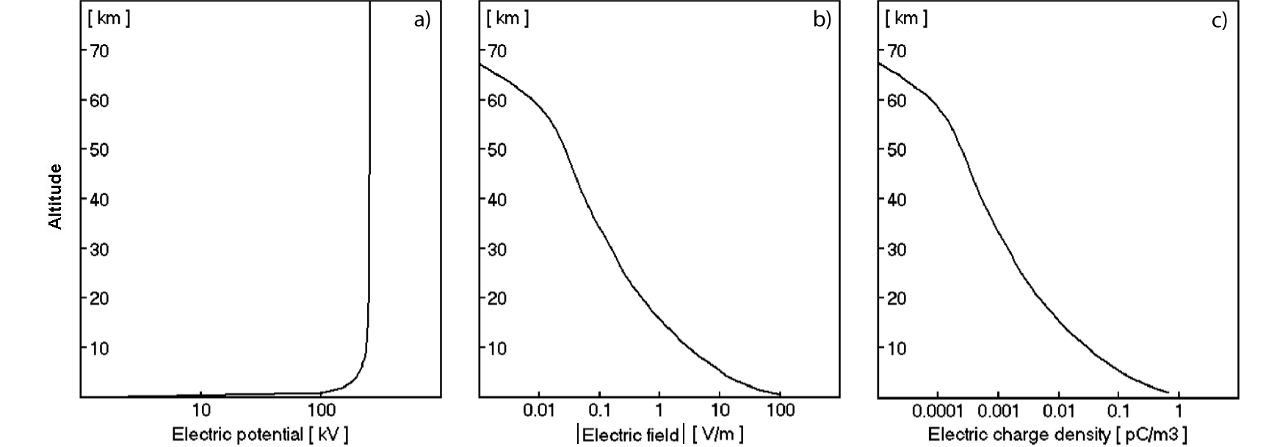
Fair (and semi-fair) weather model results
Rycroft et al., JASTP, 69, 2485-2509,2007
1. Apply Gauss’ law of electrostatics: in b), E_{surface} ~ 130 V/m
2. In c), note that ~ 90% of the positive electric charge in the atmosphere lies at altitudes BELOW 4 km

Slide 16
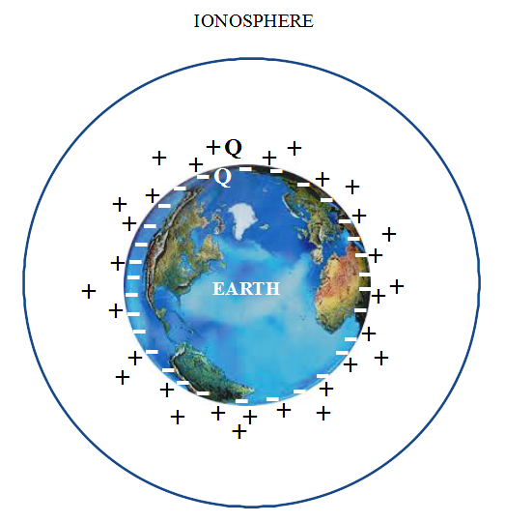
C. Haldoupis, M. Rycroft, E. Williams and C. Price
Is the “Earth-ionosphere capacitor” a valid component in the atmospheric global electric circuit? JASTP 164, 127–131, 2017
NO, it is not
Positive charge is NOT
on the ionosphere; it is
distributed through the
atmosphere
Most charge is near the
Earth’s surface
It is the “Earth-atmosphere
capacitor” that is important
Also see Uman (1974)

Slide 17
The Earth-atmosphere capacitor
Charge on Earth’s surface, Q = 4 π R_{E}² ϵ₀ E_{surface}
With E_{surface} ~ 130 V/m, Q ~ 5.9 x 10⁵ C
Charge density on Earth’s surface ~ 1 nC m⁻²
C = Q/V = 5.9 x 10⁵ C / 2.5 x 10⁵ V ~ 2 F
From electrostatics theory,
C = 4 π ϵ₀ ab/(b-a) = 4 π ϵ₀ R_{E}²/h, where h = (b-a)
For ionosphere, with h = 70 km, C = 0.066 F
To have C = 2 F, h = 1 / 4 π ϵ₀ R_{E}², which is ~ 2 km
So it is the Earth-atmosphere capacitor which is important, not the Earth-ionosphere capacitor

Slide 18
Where are the positive charges on the upper plate of the DC global circuit capacitor?
On water droplets at tops of stratiform (or layer) clouds, at altitude < 3 km; typically there are ~ 10 electronic charges/droplet
Measurements: mean cloud top space charge ~ 30 pC/m³ (Nicoll and Harrison, Q.J.R.Met.S. 142, 2679-2691, 2016)
Also charge in clouds themselves (at heights ~ 1 to 4 km)
These clouds cover about 40% of the Earth’s surface
The total charge in these clouds can be shown to be equal and opposite to the charge on the Earth’s surface (Harrison et al., in preparation, 2019)
Greater charge for lower altitude clouds, with lower conductivity due to reduced cosmic ray ionisation there
Link between electrical properties of clouds and cloud microphysics, radiative properties and precipitation, and hence with climate

Slide 19
Climate models including atmospheric electricity
L.J. Gray et al., Solar influences on climate, Rev. Geophys. 48, RG4001, 1-53, 2010
E.A. Mareev, Global electric circuit research: achievements and prospects, Phys.-Usp. 53, 504, 2010
E.A. Mareev and E. M. Volodin, Variation of the global electric circuit and ionospheric potential in a general circulation model, Geophys. Res. Lett. 41, 9009–9016, doi:10.1002/2014GL062352, 2014
G. M. Lucas, A. J. G. Baumgaertner and J. P. Thayer, A global electric circuit model within a community climate model, J. Geophys. Res. Atmos. 120, 12,054-12,066, doi:10.1002/2015JD023562, 2015
M.M. Lam and B.A. Tinsley, Solar wind-atmospheric electricity-cloud microphysics connections to weather and climate, J. Atmos. Sol.-Terr. Phys. 149, 277-290, 2016
What are the effects of nuclear explosions, aerosols and dust from volcanoes, and space weather events, on the DC global electric circuit?

Slide 20
Earthquakes, and precursor effects
Electrostatic, electrodynamic, electromagnetic or gravity wave effect?
R.G. Harrison, K.L. Aplin and M.J. Rycroft, Atmospheric electricity coupling between earthquake regions and the ionosphere J. Atmos. Sol.-Terr. Phys. 72, 376-381, 2010 http://dx.doi.org/10.1016/j.jastp.2009.12.004
L. P. Korsunova, V. Hegai, Y. Mikhailov and S. Smirnov, Regularities in the Manifestation of Earthquake Precursors in the Ionosphere and Near-Surface Atmospheric Electric Fields in Kamchatka, Geomagnetism and Aeronomy 53, 227-233, 2013
R.G. Harrison, K.L. Aplin, M.J. Rycroft, Brief Communication: Earthquake–cloud coupling through the global atmospheric electric circuit, Nat. Hazards Earth Syst. Sci. 14, 773-777, doi:10.5194/nhess-14-773-2014
A.P. Nickolaenko and M.Hayakawa, Localized ionospheric disturbance over the earthquake epicentre and modifications of Schumann resonance electromagnetic fields, Geomatics, Natural Hazards and Risk, 5, DOI: 10.1080/19475705.2013.809557, 2014
S. A. Pulinets, D. P. Ouzounov, A. V. Karelin, and D. V. Davidenko, Physical Bases of the Generation of Short Term Earthquake Precursors: A Complex Model of Ionization Induced Geophysical Processes in the Lithosphere–Atmosphere–Ionosphere–Magnetosphere System, Geomagnetism and Aeronomy 55, 521-538, 2015
D. Ouzounov, S. Pulinets, K. Hattori and P. Taylor (eds), Pre-earthquake processes: A multidisciplinary approach to earthquake prediction studies, AGU Geophysical Monograph number 234, John Wiley & Sons Inc., 2018

Slide 21
Heliobiology
What is the relationship of ELF radio waves to animal and human health?
S. J. Palmer, M. J. Rycroft and M. Cermak, Solar and geomagnetic activity, extremely low frequency magnetic and electric fields and human health at the Earth’s surface, Surv. Geophys. 27, 557-595, 2006
N. Filipovic et al., Electromagnetic field investigation on different cancer cell lines, Cancer Cell International 14, DOI: 10.1186/s12935-014-0084-x, 2014
M. Destefanis et al., Extremely low frequency electromagnetic fields affect proliferation and mitochondrial activity of human cancer cell lines, International Journal of Radiation Biology 91, 1-9, 2015, DOI: 10.3109/09553002.2015.1101648
Atmospheric ELF fields protect cells in rats under stress conditions
G. Elhalel, C. Price, D. Fixler and A. Shainberg, Cardioprotection from stress conditions by weak magnetic fields in the Schumann Resonance band, Scientific Reports 2019. DOI: 10.1038/s41598-018-36341-z

Slide 22
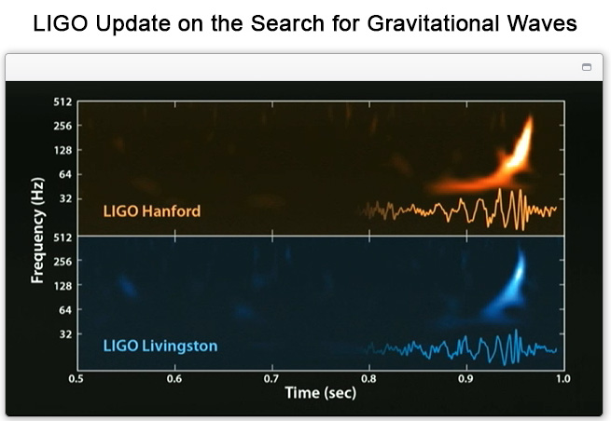
Gravitational waves due to two colliding black holes, observed 26 December 2015
Gravitational waves are of
comparable frequencies to
Schumann resonances
Can they couple?
Z. K. Silagadze, Schumann
resonance transients and the
search for gravitational waves,
Modern Physics Letters A 33,
1850023, 2018
E. Thrane, N. Christensen and
R.M.S. Schofield, Correlated
magnetic noise in global
networks of gravitational-wave
detectors: Observations and implications, Phys. Rev. D 87, 123009,2013
I. Kowalska-Leszczynska et al., Class. Quantum Grav. 34, 074002, 2017

Slide 23
Summary and conclusions
The DC (powered by thunderstorms and rain clouds) and AC (powered by lightning) electric circuits are central tenets of atmospheric electricity
We have consistency between DC and AC global circuit models
Huge variability having spatial scales of 1 mm to 1 Gm, and temporal scales of 1 μs to 30 years
High resolution three dimensional computer models with conductivities varying in space and time in the atmosphere, ionosphere, land, ocean and below thunderstorms are now possible, and should be attempted
In what ways is the ionosphere above thunderstorms modified? And how?
There is an Earth- atmosphere capacitor, with positive charges being distributed throughout atmosphere, mostly in troposphere, not an Earth-ionosphere capacitor
Upper plate of capacitor at height ~ 2 km, at top of stratiform clouds
What is the charge on the Earth’s surface? Is it – 6 x 10⁵ C?
Climate models can now include atmospheric electricity
Do earthquakes, and their precursors, affect the global electric circuit? How?
Do AC electric fields (Schumann resonances) affect human health?
Are there links between Schumann resonances and gravitational waves?
There are many puzzles, and research opportunities, remaining

