Slide 1

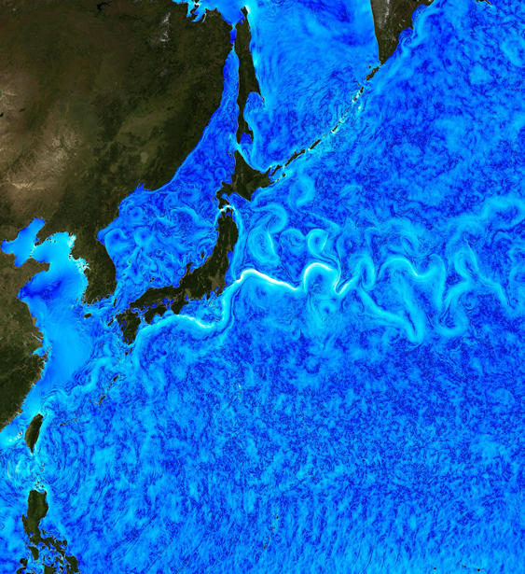






ANALYSIS OF THE KUROSHIO EXTENSION DECADAL VARIABILITY :
Internal Mechanisms and External Forcings
^{1,2} Fedele G. (giusy.fedele@unive.it),
³ Penduff T., ⁴ Pierini S., ² Bellucci A., ² Masina S.
¹ Ca’ Foscari University of Venice ² Centro Euro-Mediterraneo sui Cambiamenti Climatici, CMCC, Bologna
³ Institut des Géosciences de l'Environnement, IGE, Grenoble ⁴ Parthenope University of Naples
Credit: C. Henze, NASA Advanced Supercomputing Division

Slide 2
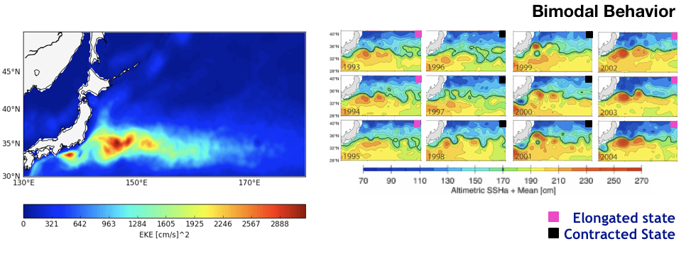
Introduction
Why study the Kuroshio Extension (KE) from a Climatic Point of View?
Highest eddy kinetic energy level (EKE) in the North Pacific Ocean. EKE changes lead to high temperature anomalies that are capable of enhancing the variability of the midlatitude coupled ocean–atmosphere system.
The KE is known to undergo relevant variations on the decadal time scale. The mechanisms that generate the mean structure of the KE and its low frequency variability (LFV) are still under debate.
(Figures Adapted from Qiu and Chen, 2005)

Slide 3
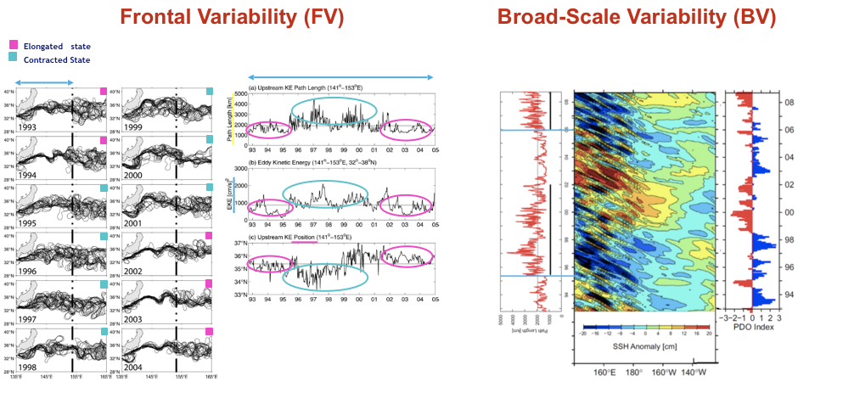
Introduction
LKE
EKE
Pacific Decadal Oscillation (PDO)
Latitude
LKE
Synchronization with external forcings (Qiu and Chen, 2005,2010).
Many authors have suggested that nonlinear intrinsic oceanic mechanisms can play a fundamental role in the phenomenon (Pierini, 2006).
The KE LFV is interpreted as a case of intrinsic climate variability paced by external forcing through the coherence resonance mechanism (Pierini, 2014).
(Figures Adapted from Qiu and Chen, 2005, 2010)

Slide 4
QUESTION
What is the role of the intrinsic variability and external forcing in driving the KE LFV?

Slide 5
QUESTION
What is the role of the intrinsic variability and external forcing in driving the KE LFV?
METHOD
To explore a large ensemble of ocean-only eddy-permitting model simulations: OCCIPUT

Slide 6
OCCIPUT*
Simulation | EXTENT AND RESOLUTION | MEMBERS AND DURATION | Forcing | SIMULATED VARIABILITY | Time sampling
OCCITENS | Global 1/4° | 50-members ENSEMBLE 1980-2015 | Full variability (ERA-interim) | Forced and intrinsic variability | 5 days
OCCICLIM | Global 1/4° | 1 member 300 years | Climatological Seasonal Cycle | Pure intrinsic variability | 5 days
*Penduff et al. (2014) and Bessières et al. (2017)

Slide 7
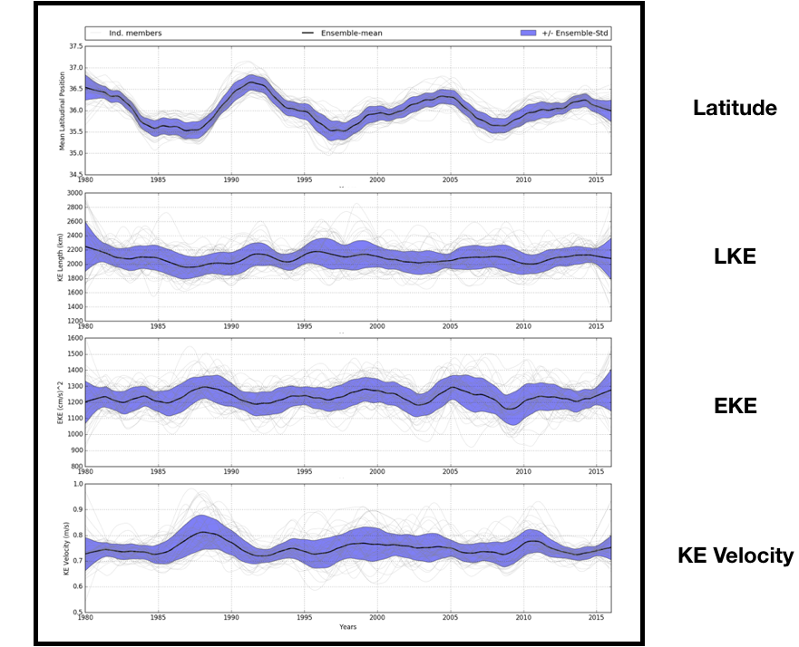
KE LFV Indices after post-processing (Nonlinear detrending filter and Lowess Low Pass Filter)
OCCITENS
Reference SSH isoline of the jet 0.7 meters
Average in the box (141-153°E, 32-38°N)
Max total geost. velocity in the box
(141-153°E,30-40°) integrated zonally
Time

Slide 8
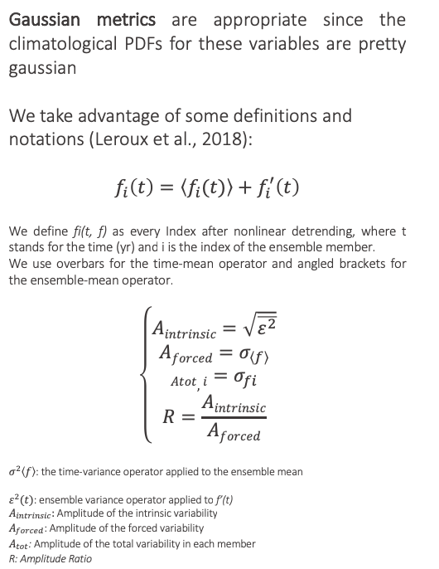
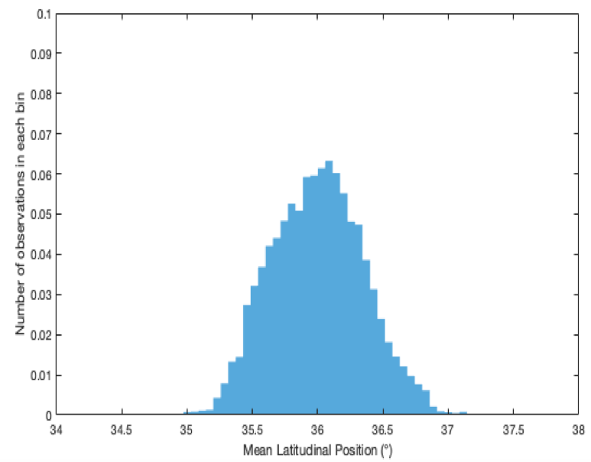
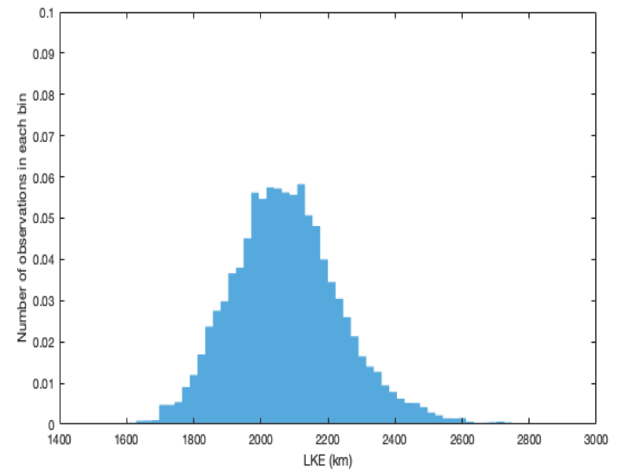
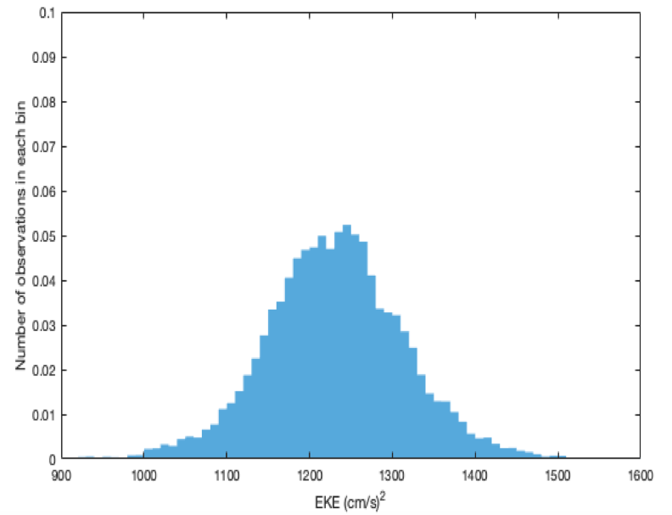
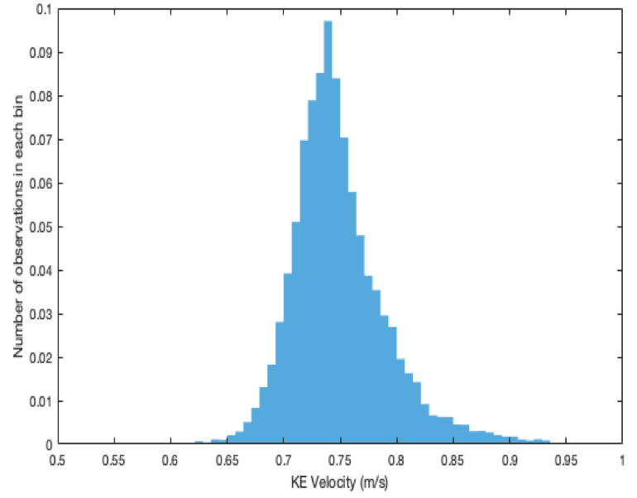
OCCITENS
Time

Slide 9
OCCITENS
A_{f} > A_{i}
A_{i} > A_{f}
Latitude
R=0.6
LKE
R=2.82
EKE
R=2.6
KE Velocity
R=2
Time

Slide 10
OCCICLIM
Pure intrinsic variability | EXTENT AND resolution | MEMBERS AND DURATION | Forcing | Time sampling
 | Global 1/4° | 1 member 300 yrs | Climatological Seasonal Cycle | 5 days
STRATEGY:
TO CREATE A PSEUDO-ENSEMBLE FROM OCCICLIM
50 members x 36 yrs have been built randomly from the indices already computed, in order to compare the pure intrinsic variability with the total one given by OCCITENS.

Slide 11
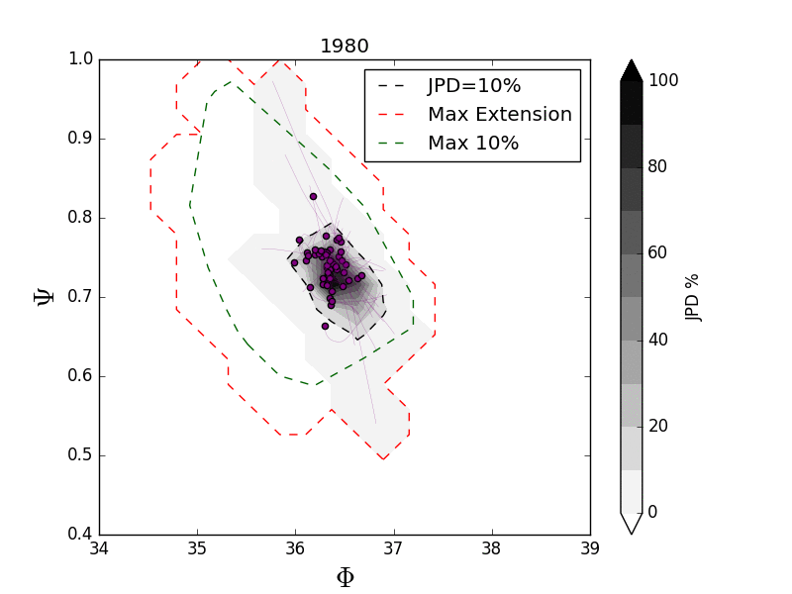
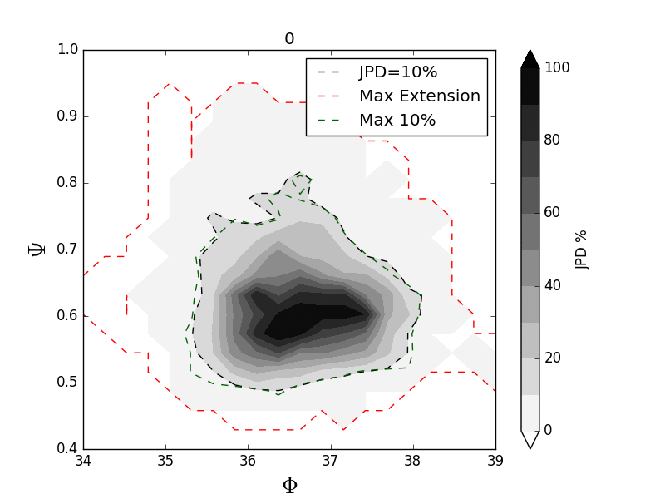
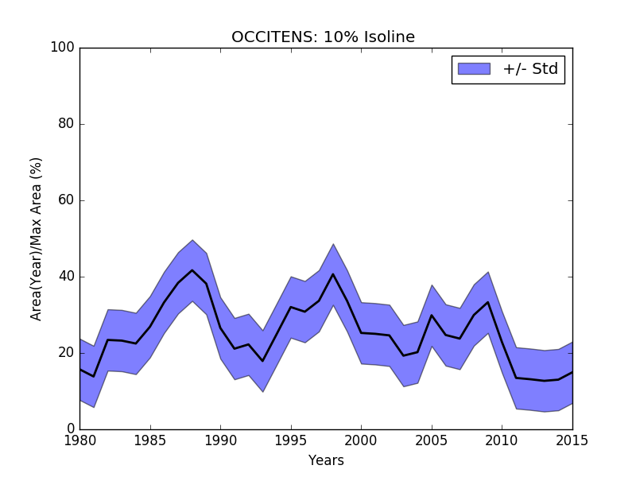
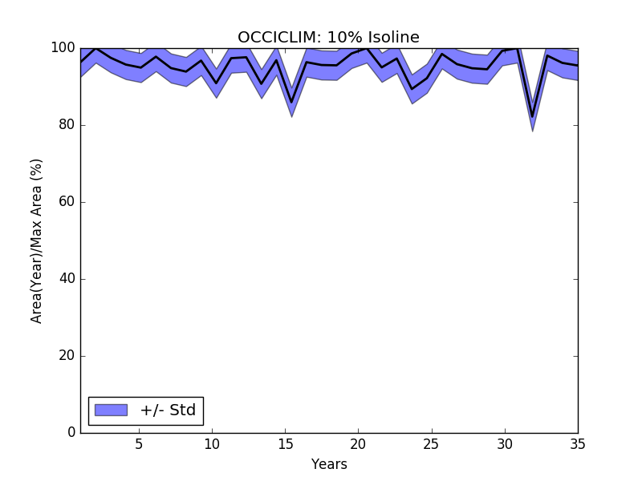
OCCITENS
OCCICLIM
Velocity
Velocity
Latitude
Latitude
OCCITENS: 10% isoline
OCCICLIM: 10% isoline
Latitude
Area(Year)/Max Area (%)
Area(Year)/Max Area (%)
$Φ$,$Ψ$: Latitude and Velocity Indices. Changing the Y-axis variable we always get the same footprint of the attractor.

Slide 12
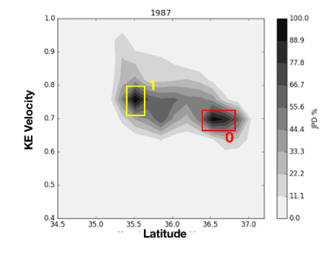
OCCITENS
OCCICLIM
Velocity
Velocity
X X
TWO
MODES
Latitude
Latitude
OCCITENS: 10% isoline
OCCICLIM: 10% isoline
Area(Year)/Max Area (%)

Slide 13
OCCITENS
OCCICLIM
Velocity
Velocity
Latitude
Latitude
OCCITENS: 10% isoline
OCCICLIM: 10% isoline
Area(Year)/Max Area (%)
Area(Year)/Max Area (%)

Slide 14
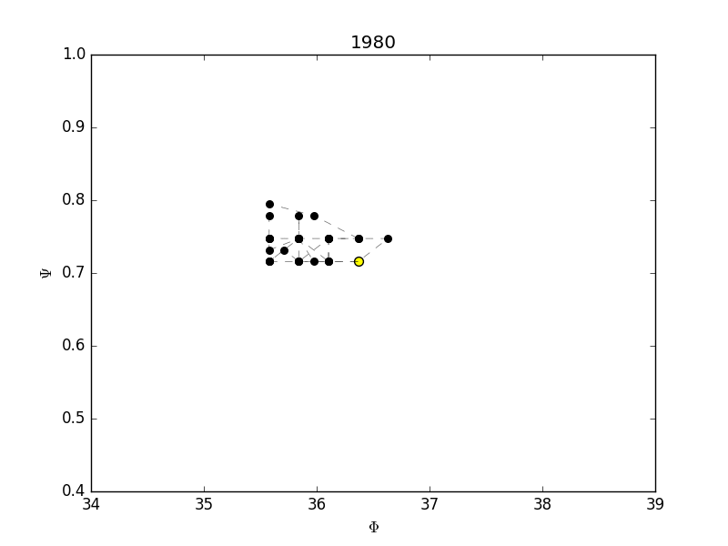
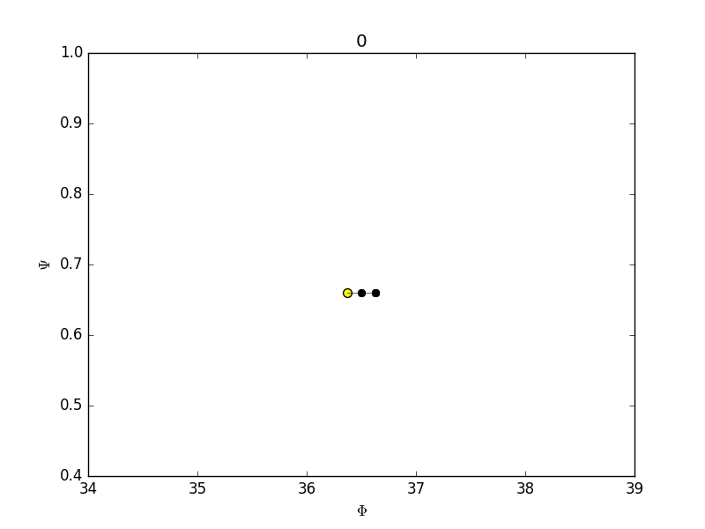
OCCITENS
OCCICLIM
Velocity
Velocity
Latitude
Center of Gravity
Latitude
Velocity
Velocity
Latitude
Latitude

Slide 15
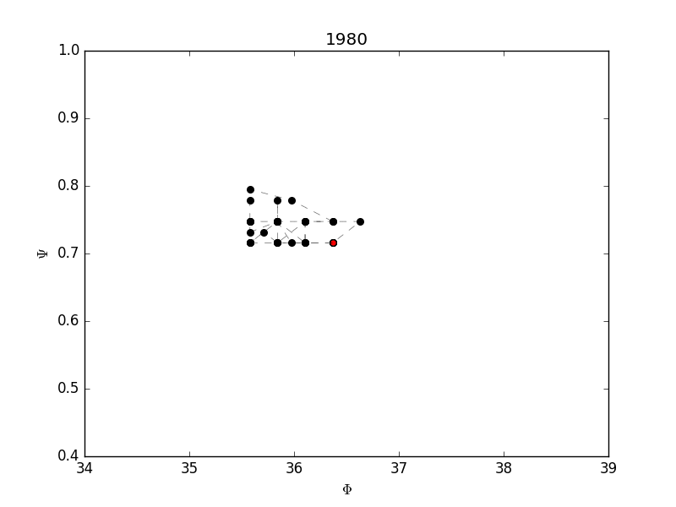
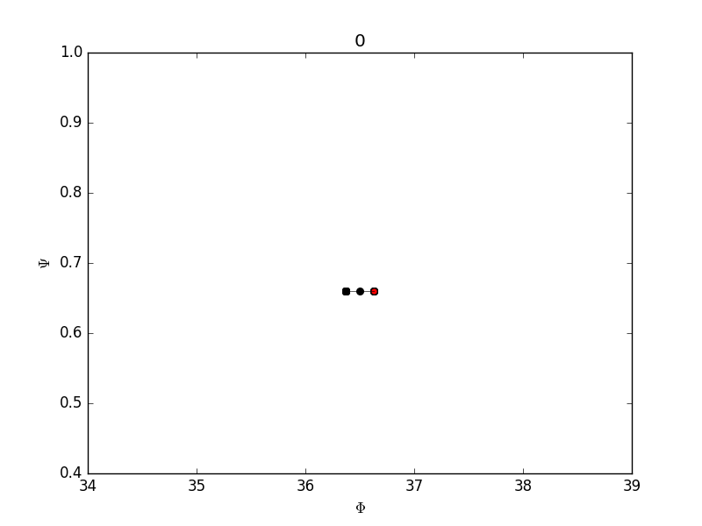
INTRINSIC VARIABILITY
PACED BY AN EXTERNAL FORCING
OCCITENS
OCCICLIM

Slide 16
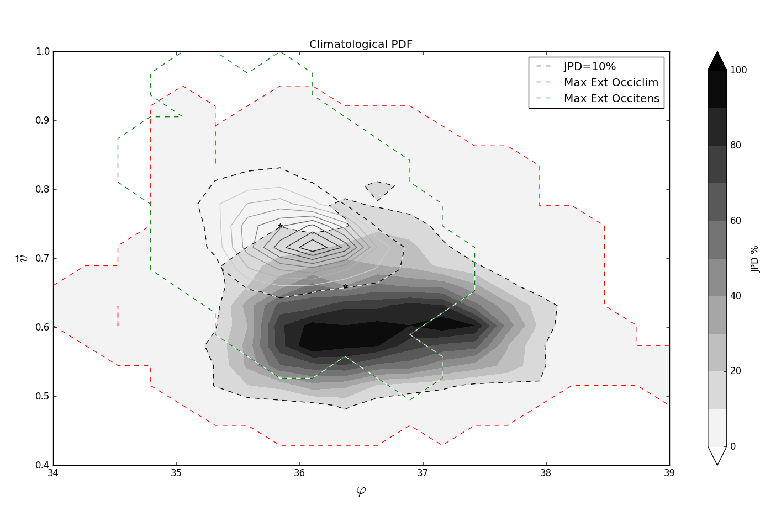


Velocity
$$Ψ$$
$$Φ$$
Latitude
The external forcing acts reducing the entropy of the dynamical system

Slide 17
CONCLUSIONS
OCCIPUT ensemble simulation : disentangle the intrinsic and forced variabilities
The KE LFV is a case of intrinsic variability paced by an external forcing
The external forcing acts reducing the entropy of the dynamical system

Slide 18
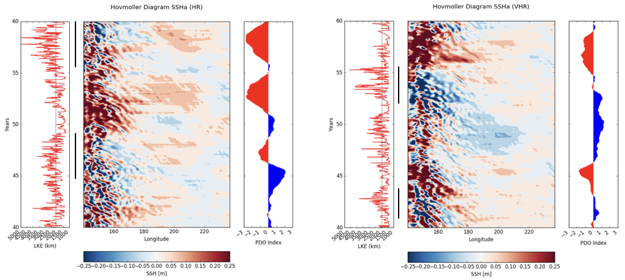
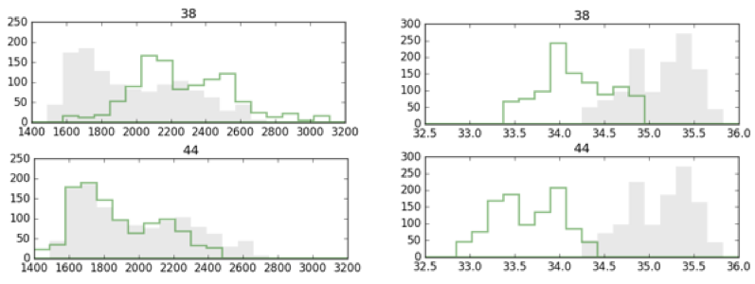
WORK IN PROGRESS
What is the ability of state of the art models in reproducing the observed KE LFV: the role of horizontal resolution -PRIMAVERA project- Model data from HIGHRESMIP-CMIP6
HR
VHR
LKE
Latitude
Fedele et al., in preparation

Slide 19
THANKS FOR YOUR ATTENTION
Fedele G. (giusy.fedele@unive.it)
Credit: C. Henze, NASA Advanced Supercomputing Division

