Slide 1


Assessment of the GOES-16 Geostationary Lightning Mapper for global severe convection aviation applications
Graeme Anderson
EGU 2019, Vienna
12th April 2019
Notes:
Good morning everyone. My name is Graeme Anderson, and I work in Piers Buchanan and Teil Howard's Aviation Science team in the Business Group area of the UK Met Office. I'm going to be talking this morning about the US Geostationary Lightning Mapper instrument, or GLM, and how it can be used for aviation applications.

Slide 2
What is a GLM?
What can it do?
What are the issues?
How can it be used?
Notes:
I'm going to split my talk into four main sections:
What is a GLM?
What can it do?
What are the issues?
How can it be used?

Slide 3
What is a GLM?
Notes:
So what is a GLM?

Slide 4
The GLM
Instrument on US geostationary weather satellites.
Optically locates lighting.
Notes:
The GLM is an instrument which will appear on the GOES-R series of geostationary weather satellites operated by NASA and NOAA in the US. It is an optical lightning location instrument, in that it looks for the visible flash in the top of the cloud caused by a lightning discharge.

Slide 5
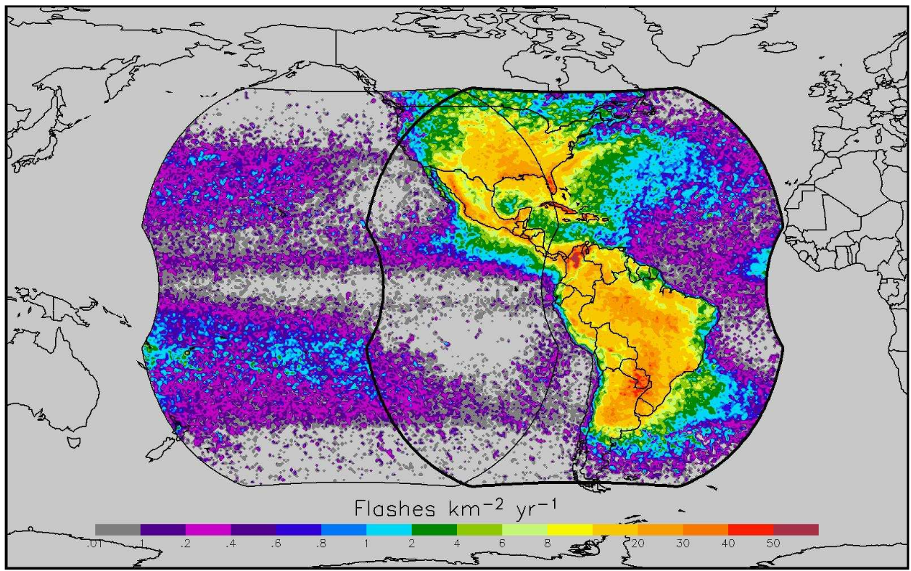
From Goodman, Steven J., et al. "The GOES-R geostationary lightning mapper (GLM)." Atmospheric research 125 (2013): 34-49.
Notes:
This image shows the field of view once two GLM instruments are in orbit. The data is from predecessor low earth orbit instruments. The first GLM went operational on the GOES-16 satellite in late 2017 in the GOES East position, and the second went operational in February 2019 on the GOES-17 satellite in the GOES-West position. Between them, they will provide coverage from the southern tip of south America to the south of Canada, and from the mid-Atlantic to the mid-Pacific.

Slide 6
The GLM instrument
From Goodman, Steven J., et al. "The GOES-R geostationary lightning mapper (GLM)." Atmospheric research 125 (2013): 34-49.
Notes:
Each GLM instrument works as an imager with a very high frame rate. Each instrument consists of a 1300 by 1372 pixel sensor array, which is sensitive to a narrow band of near-infrared light of around 777nm. The density of pixels gives the GLM a resolution of around 8km at the sub-satellite point, up to around 14km at the edge of its field of view.
The GLM builds up a background image of the what its field of view looks like over the course of a few tens of seconds. Once this background image is built up, it starts comparing its instantaneous view with this background image 500 times per second. If any pixel becomes brighter than the background image by a certain threshold, an 'event' is recorded at that pixel.

Slide 7
GLM Events, Groups and Flashes
= Triggered pixel
+
t
+
y
x
Event
Group
Flash
Notes:
Lightning flashes will often extend beyond the limits of a single pixels, and so a clustering algorithm is used to connect up perpendicularly and diagonally connected events in the sensor plane, to create new objects referred to as 'groups'. Lightning discharges will also frequently last longer than a single time frame, and so groups within certain spatial and temporal criteria can be grouped together again to create new objects called 'flashes', which are analogous to what we would describe as a single lightning flash.

Slide 8
What can it do?
Notes:
The Met Office has been receiving data from the GOES-16 GLM since May 2018. In order to determine the suitability of the GLM for Met Office applications, an assessment has been undertaken to look at the data quality. Data was assessed between May 2018 and January 2019, inclusive.

Slide 9
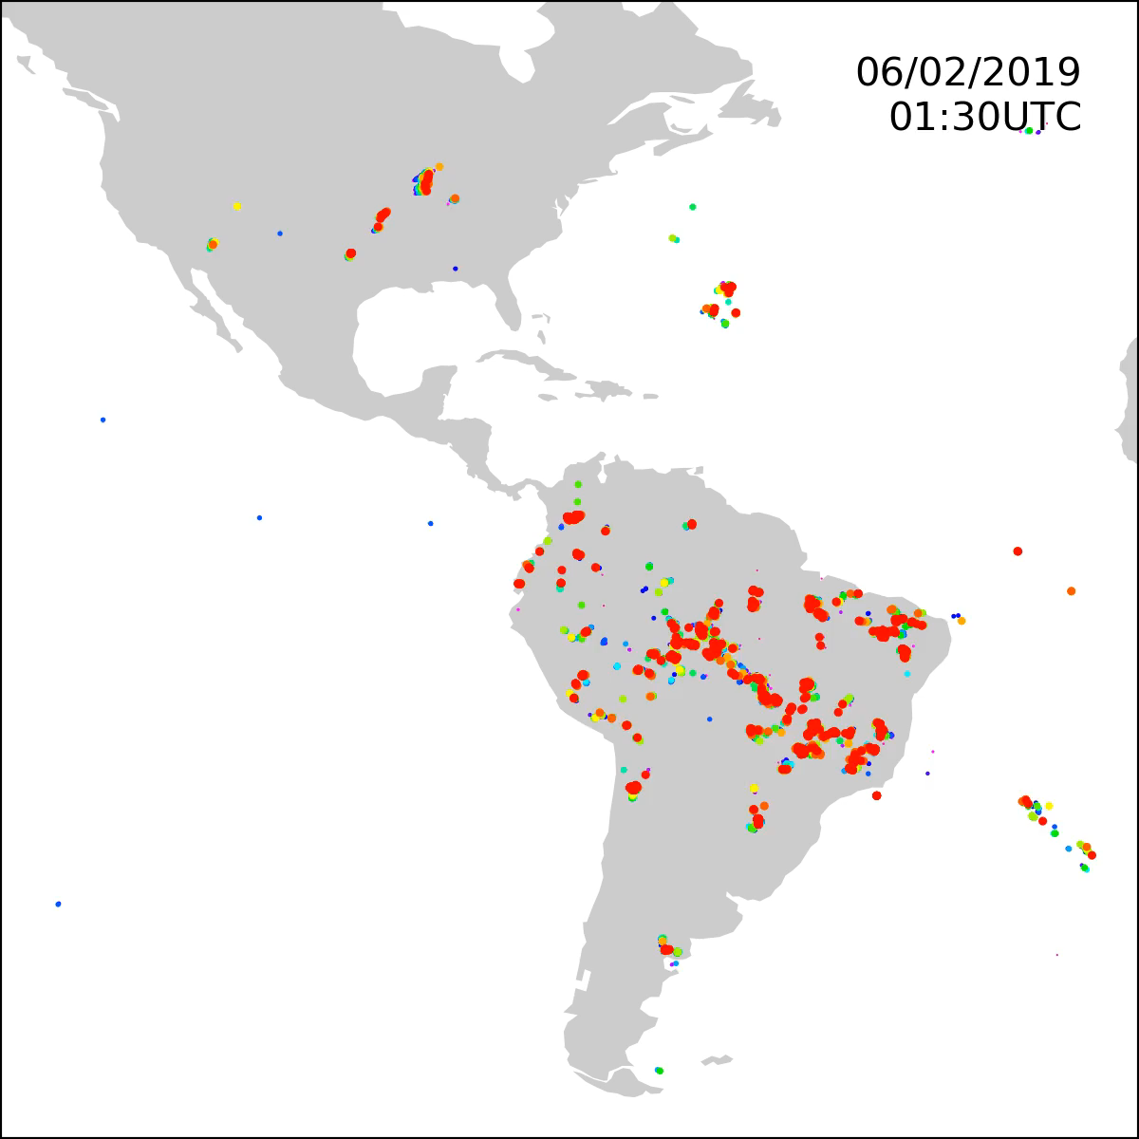
GLM data
Notes:
This video shows a snapshot of some GLM data from single day.

Slide 10
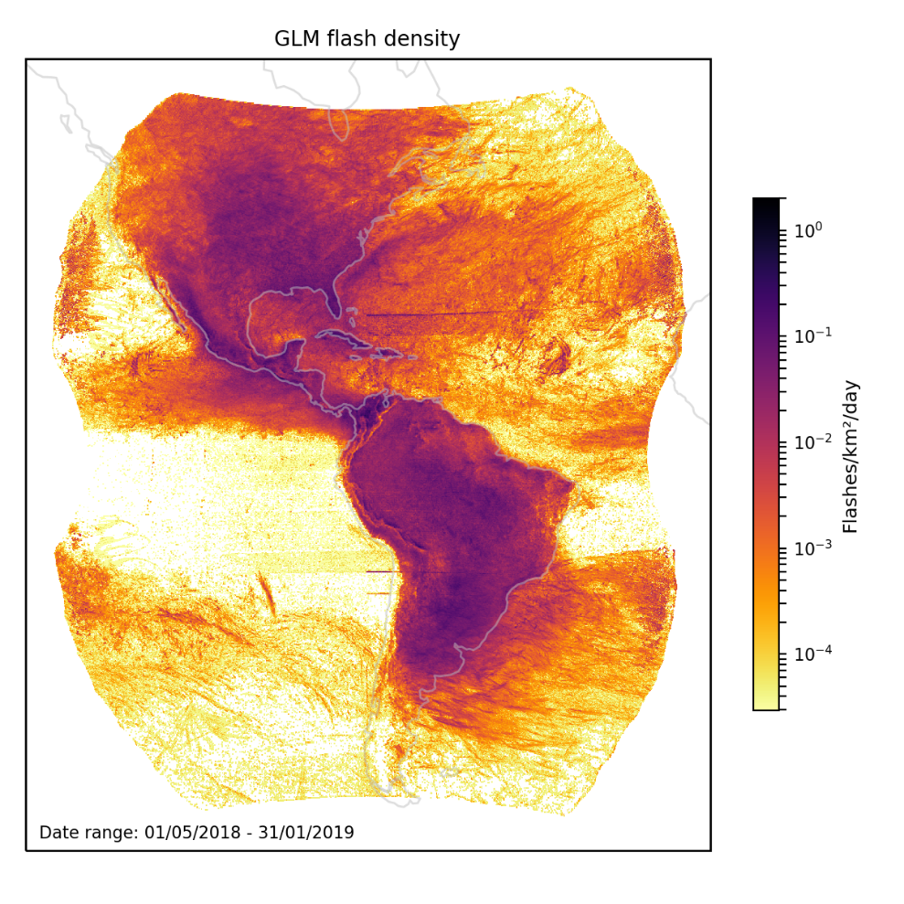
GLM data
Notes:
Over the nine months of the assessment period, the GLM detected over one million flashes per day on average. This figure shows the distribution of flashes observed over those nine months. Flashes are clearly more focussed over the continents than the oceans, although the warm water of the Gulf of Mexico and the Gulf Stream do lead to high densities in these areas. Cool waters in the East Pacific lead to suppressed convection and low lightning densities in this region. The shape of the Andes is clearly distinguishable in the lightning data. Tracks of individual intense storms are also visible over the oceans.

Slide 11
What are the issues?
Notes:
So, are there any issues with the data?

Slide 12
Sensitivity issues
Diurnal changes in sensitivity
  90% at night
  70% during the day
High energy particles
Notes:
As with any observation system, the GLM has limitations. The fact that it looks for the visible flash from lightning means that it is less sensitive during the day time than at night, with detection efficiency (that is, the fraction of flashes detected relative to the number that actually occurred) dropping from 90% to 70%, respectively. False flashes can also be introduced by high energy particles impacting on the sensor.

Slide 13
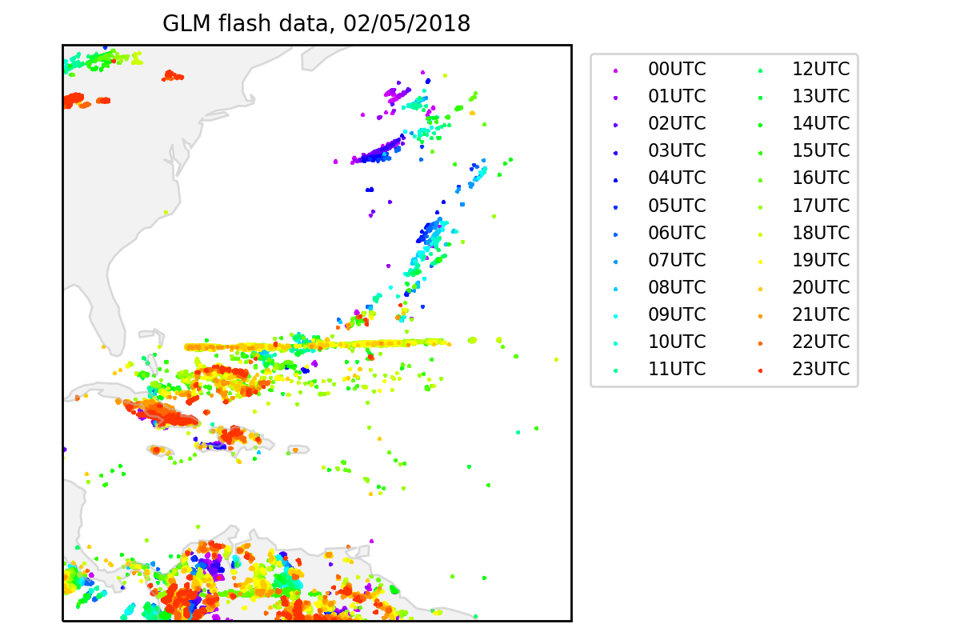
‘Stripes’
Notes:
Uncharacteristically straight lines of flashes are also apparent in the data, off the coast of Chile and to the east of the Bahamas. These are caused by oversensitivity at the edges of a couple of subarrays within the sensor array. The instrument scientists are working to rectify these issues.

Slide 14
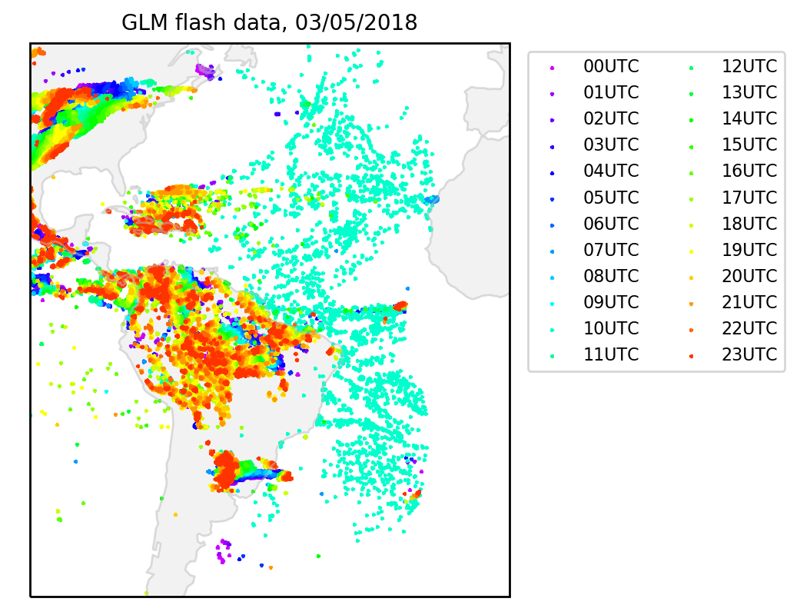
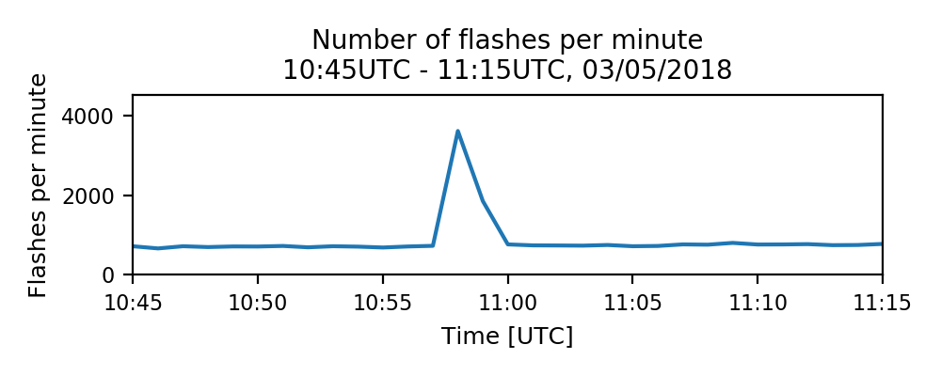
Widespread bursts of erroneous flashes
Notes:
Short-lived bursts of flashes across the GLM field of view have also been noted on occasion. These appear as flashes over a very wide area for a period of only a minute or two. These have been attributed to satellite orientation correction manoeuvres, leading bright cloud edges to move into the field of view of previously dark pixels. These sorts of manoeuvres are being carried out at night now, to try to reduce their impact.

Slide 15
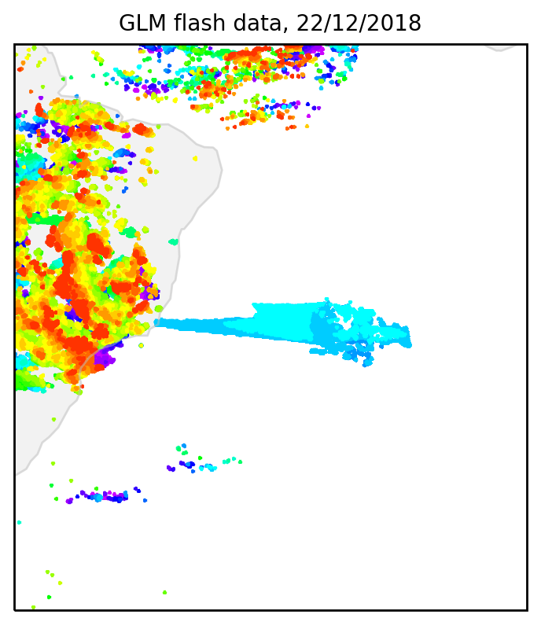
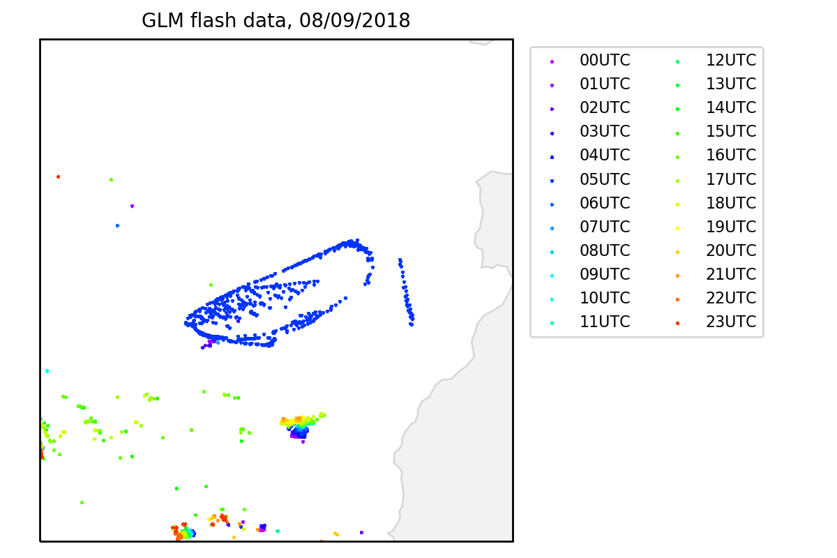
Sunglint and solar intrusion
Notes:
Sun glint and solar intrusion have led to unusual patterns appearing in GLM flash data. The pattern of flashes in the plot on the left is suspected to be caused by sunglint, and this issue seems to be worst around the summer and winter solstices. The pattern of flashes on the right is representative of an effect suspected to be caused by solar intrusion into the GLM baffle, and these issues become worse around the spring and autumn equinoxes.

Slide 16
How can it be used?
Notes:
The advantage of the GLM is that it will provide new lightning location data in a region that has previously had limited coverage from lightning location systems.

Slide 17
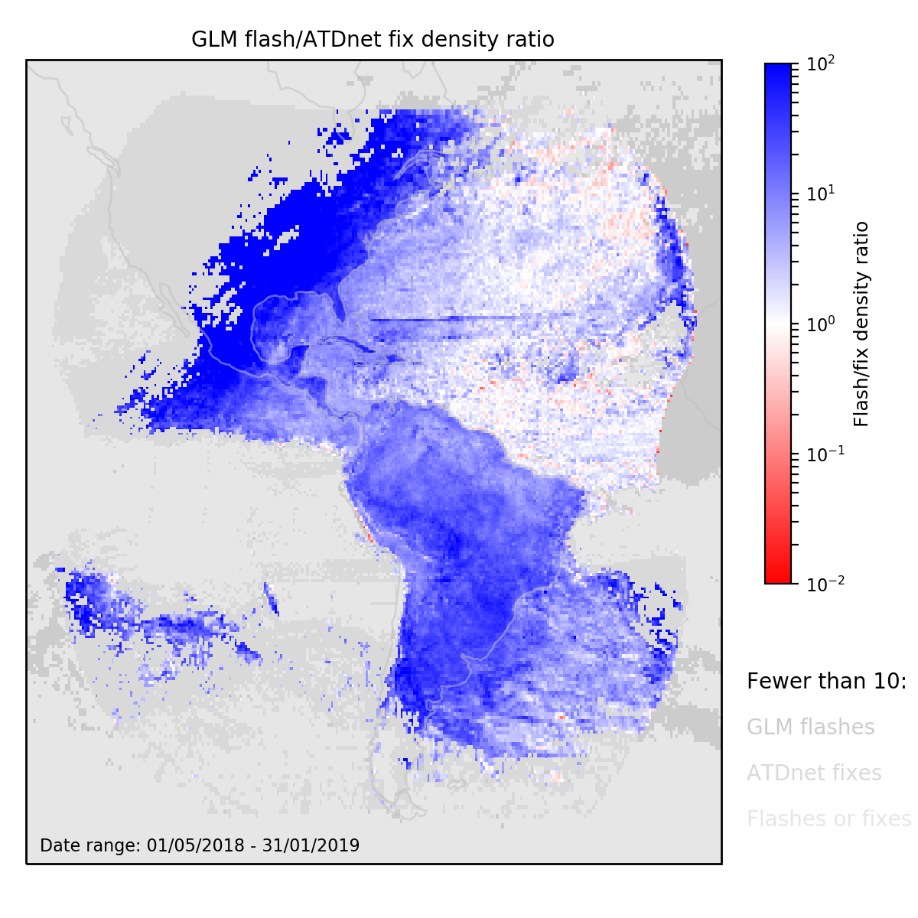
Comparison with ATDnet
Notes:
This figure shows the ratios of the densities of flashes detected by the GLM and the Met Office ATDnet lightning location system. ATDnet only uses ground-based sensors sited in Europe, and so is not designed to detect lightning over the whole Atlantic or over the Americas. Clearly the addition of GLM data for Met Office purposes greatly increases the amount of lightning detection data we have for this region.

Slide 18
Applications
Forecasting
Climatology
Verification
Notes:
This data will be useful for forecasters monitoring and providing forecasts for the regions covered by the GLM.
The continuous long-term monitoring of lightning will allow for the development of more reliable lightning climatologies.
With respect to the Met Office's role as a World Area Forecast Centre, the data will be useful in verifying our forecasts of convection. Gridded GLM data can be used for matching whether convection did or did not occur for a given forecast location. Additionally, the reliability and high sensitivity of the GLM means that the intensity of storms can also fairly reliably be diagnosed, with can be used for assessment of convection severity forecasts.

Slide 19
Summary
GLM provides lightning location data over the Americas and much of the Atlantic and Pacific.
It detects over 1 million flashes per day on average.
There are some issues with the data, but it is still beneficial.
The Met Office will use the data for convection verification.
Acknowledgement: Work funded by the CAA
Notes:
So, to summarise my presentation:
the GLM is a new satellite-based lightning location instrument, providing coverage of the Americas, along with some of the Atlantic and Pacific
it detects over a million flashes per day, on average
there are some issues and limitations with the data, but it appears to be generally beneficial
and we will be using the data for various applications at the Met Office, including convection forecast verification.
I should just briefly acknowledge that this piece of work was funded by the UK Civil Aviation Authority. Thank you for listening, are there any questions?

