Slide 1


Neo-Tethyan slabs beneath Iran: reconstructing Cenozoic subduction
Reuben Creighton¹
Gordon Lister¹
Wim Spakman^{2,3}
¹ Earth Dynamics, Research School of Earth Sciences, Australian National University, Australia
²Faculty of Geosciences, Utrecht University, Vening Meineszgebouw A, , 3584 CB Utrecht, Netherlands.
³ Centre of Earth Evolution and Dynamics (CEED), University of Oslo, 0316 Oslo, Norway
Notes:
Intro points (3)

Slide 2
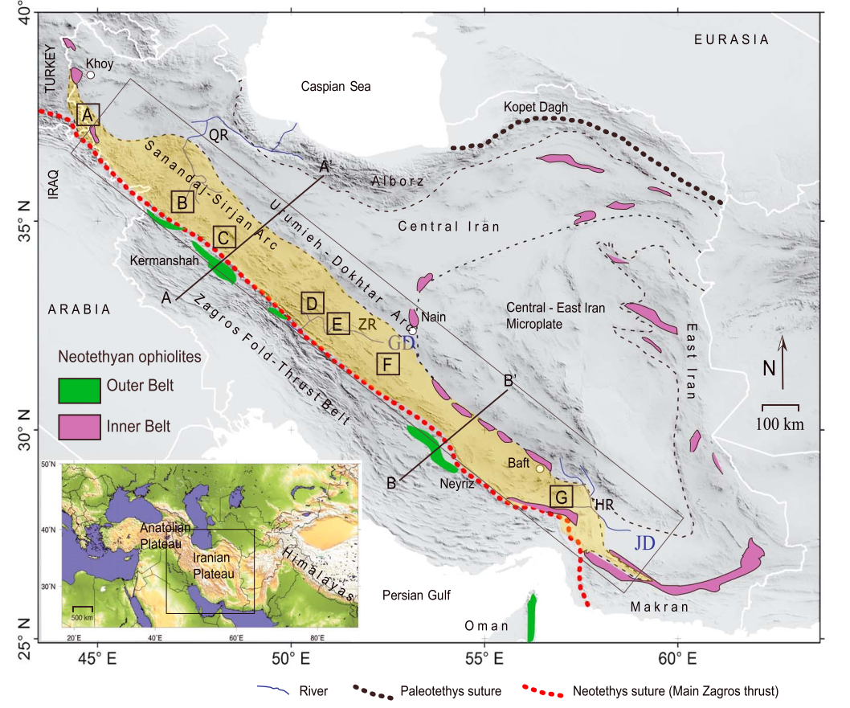
Figure from Hassanzadeh, J., and Wernicke, B.P. (2016)

Slide 3
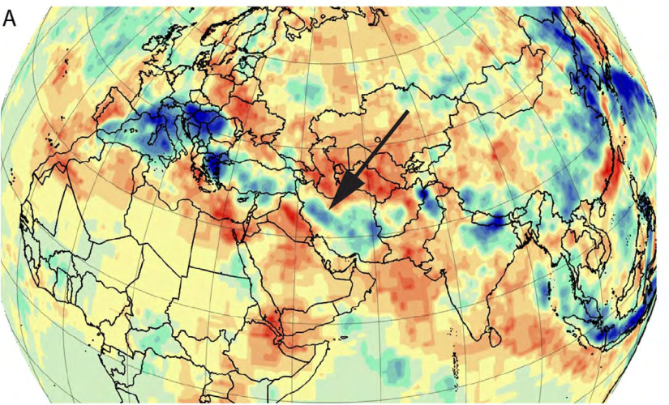
van der Meer, D.G., van Hinsbergen, D.J.J., and Spakman, W., 2018, Atlas of the underworld: Slab remnants in the mantle, their sinking history, and a new outlook on lower mantle viscosity: Tectonophysics, v. 723, p. 309–448
https://www.atlas-of-the-underworld.org/
UU-P07

Slide 4
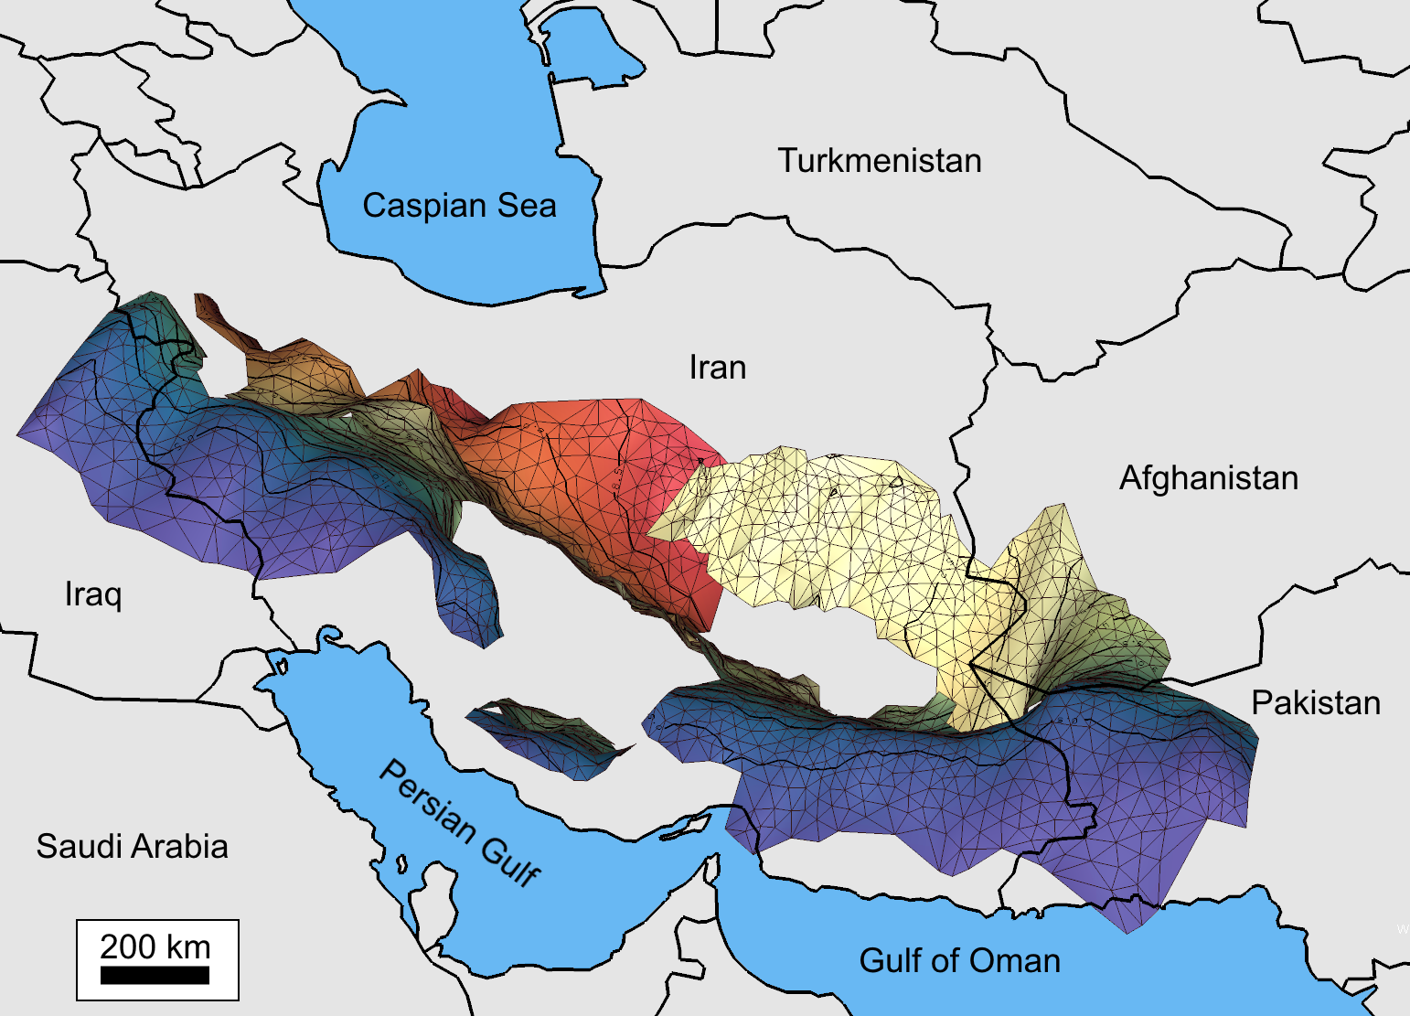
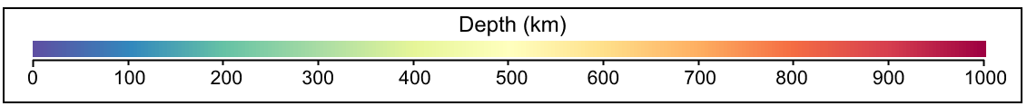
N
Notes:
NOTES: THE seismicity is confusing, I also need to have a slide where I transition from surface geopolitical boundaries (with labels) to +slab, to just slab without boundaries

Slide 5
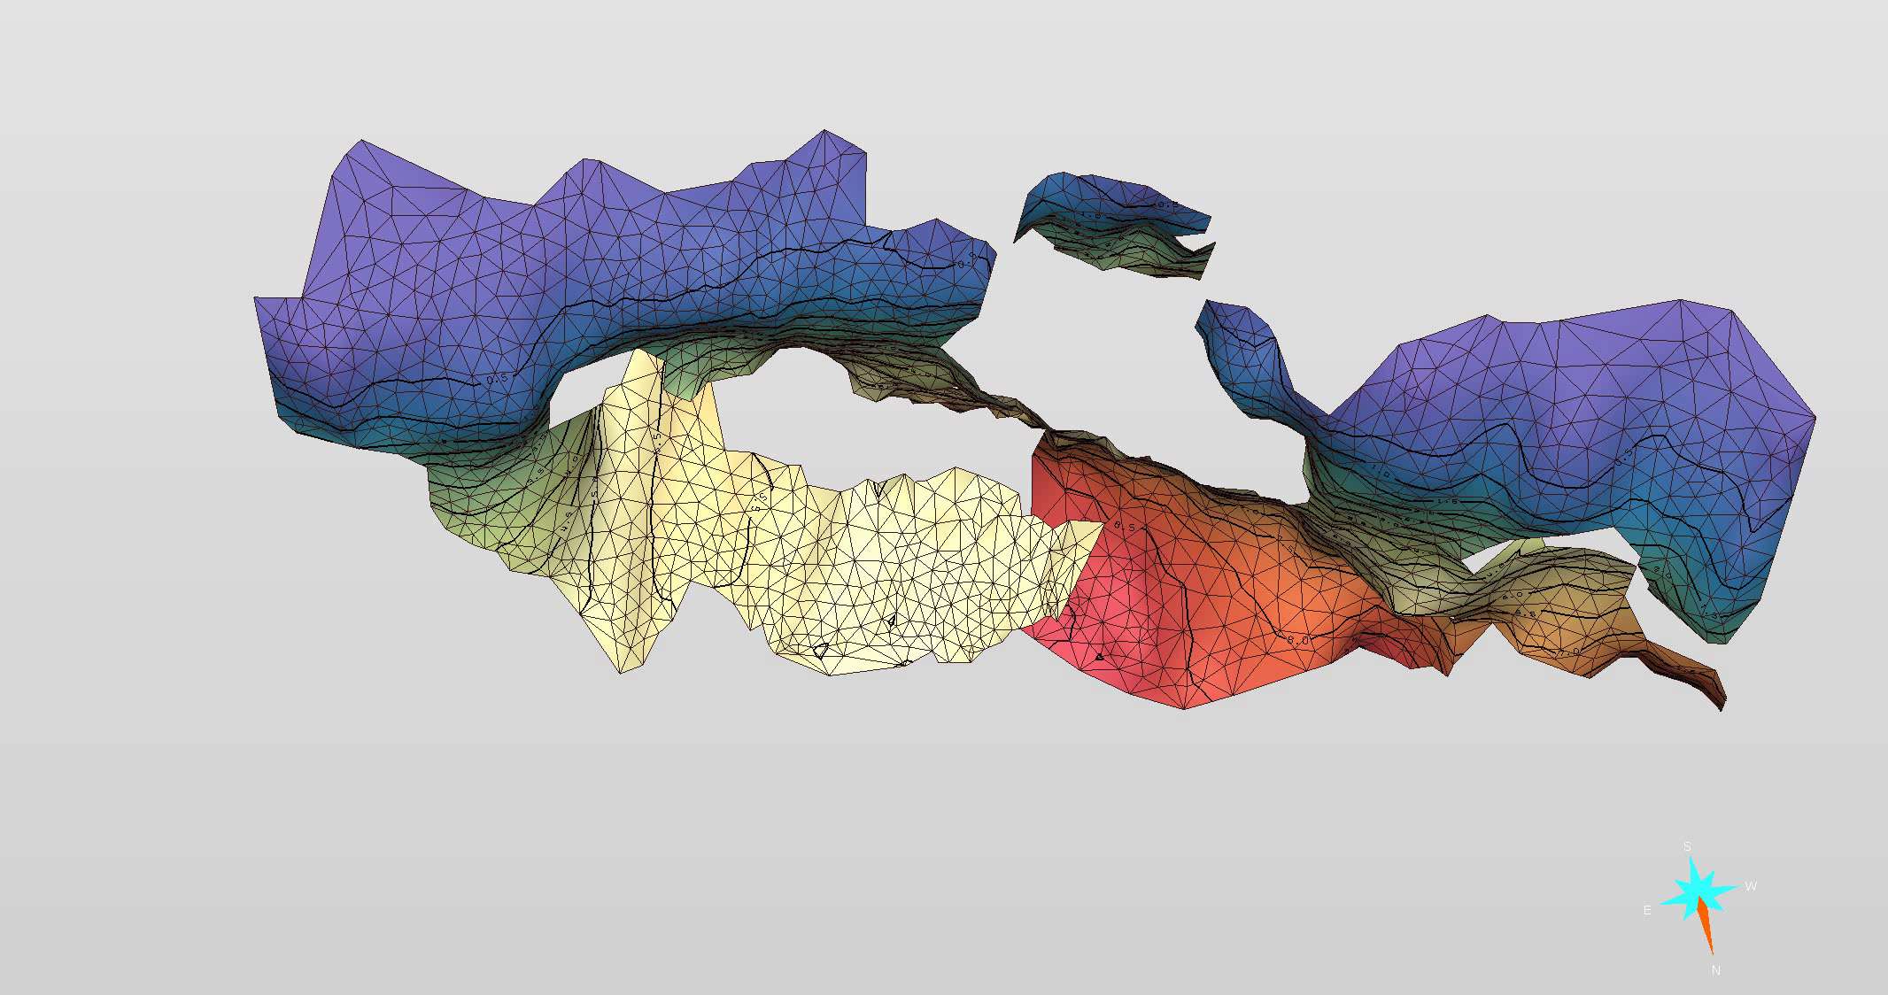
Notes:
INTRO

Slide 6
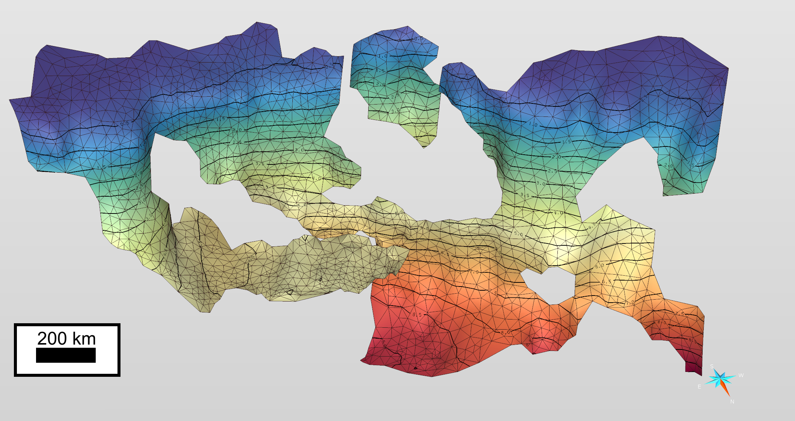

Slide 7
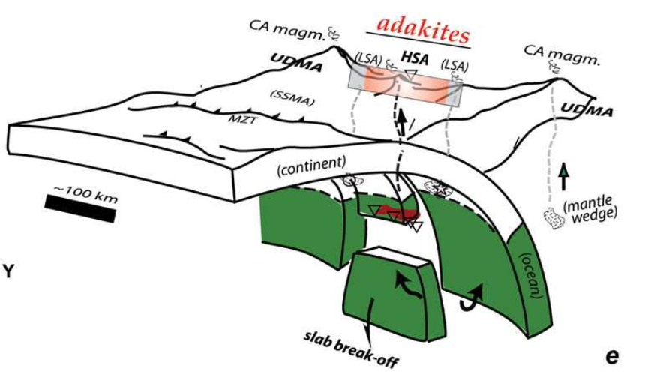
Omrani, J., Agard, P., Whitechurch, H., Benoit, M., Prouteau, G., and Jolivet, L., 2008, Arc-magmatism and subduction history beneath the Zagros Mountains, Iran: A new report of adakites and geodynamic consequences: Lithos, v. 106, p. 380–398
Notes:
Question about the right place for this slide? Needs to be before I talk about slab drop off

Slide 8
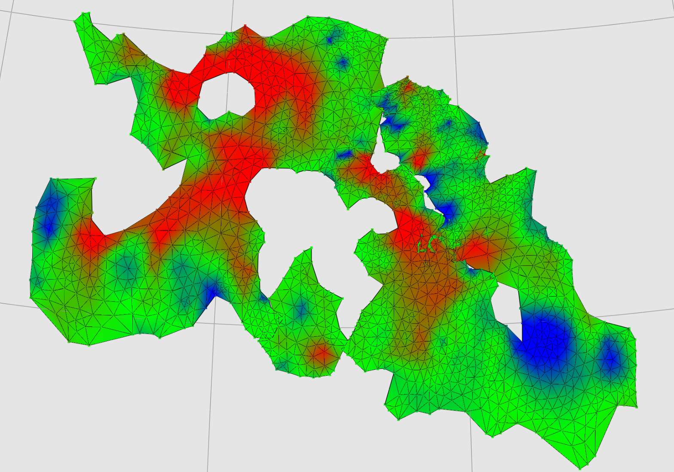

Pplates
Contraction
Extension

Slide 9
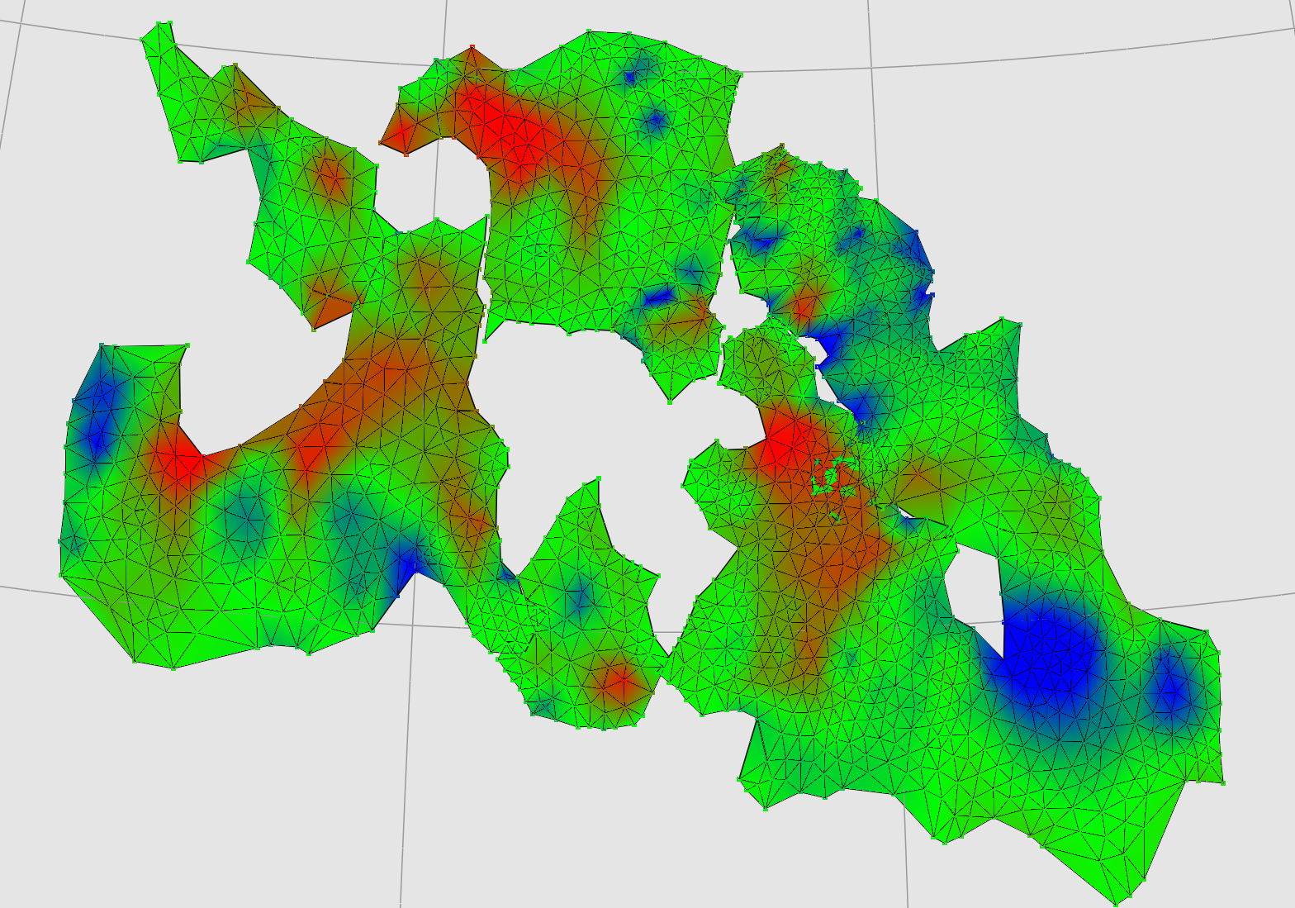
Pplates
Contraction
Extension

Slide 10
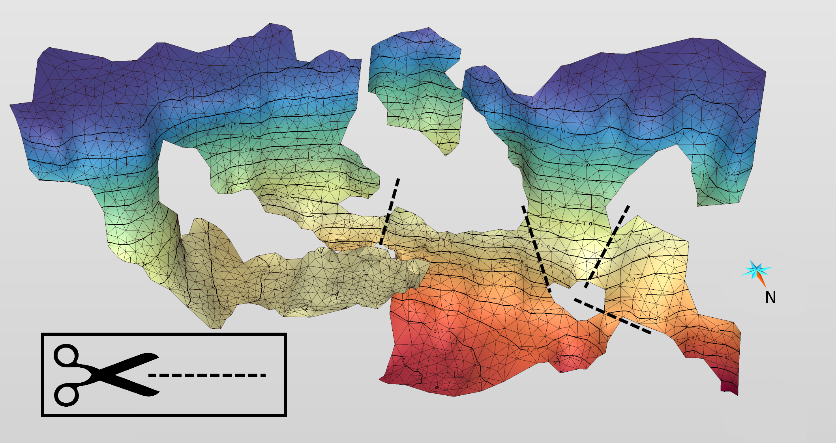

Slide 12
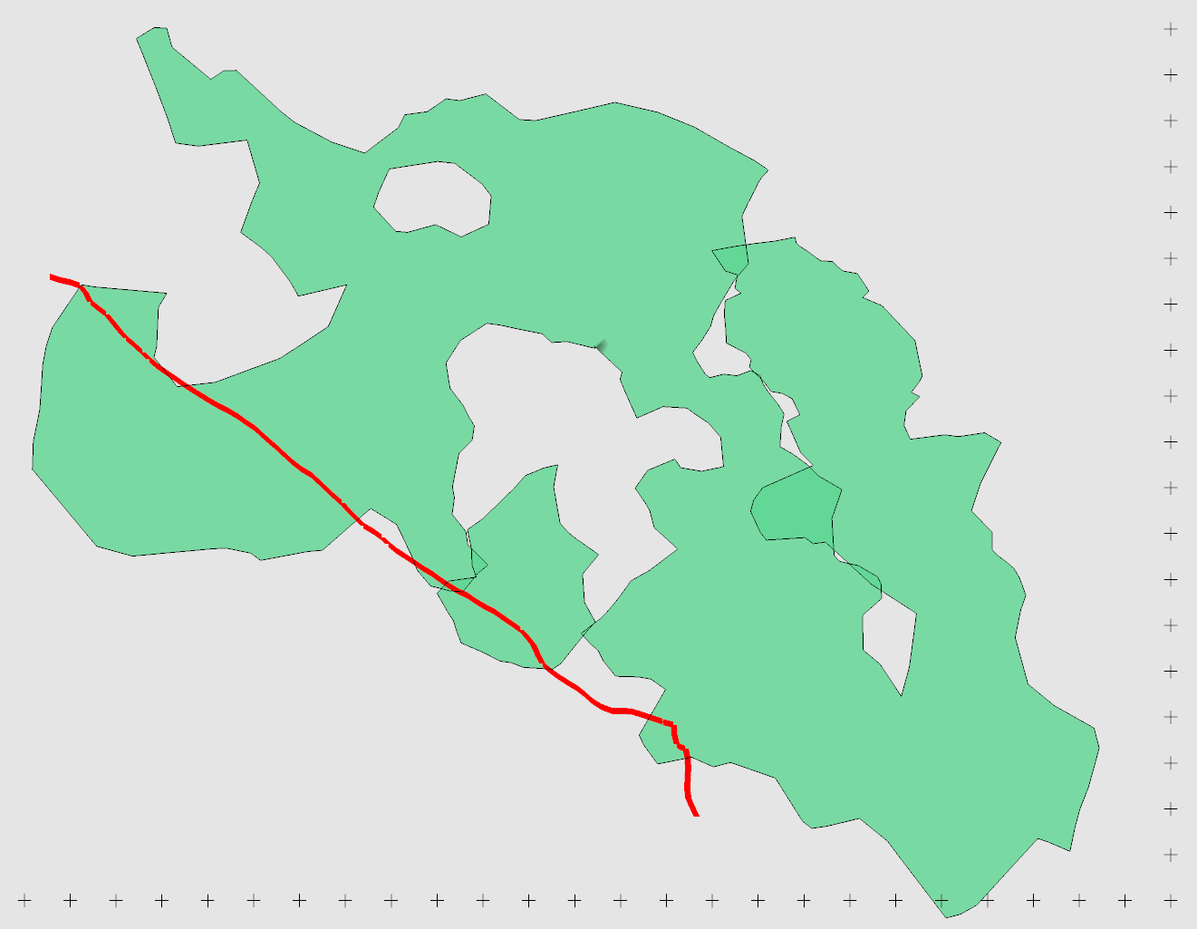
40°
30°
50°
60°

Slide 13
40°
30°
50°
60°

Slide 14
40°
30°
50°
60°

Slide 15
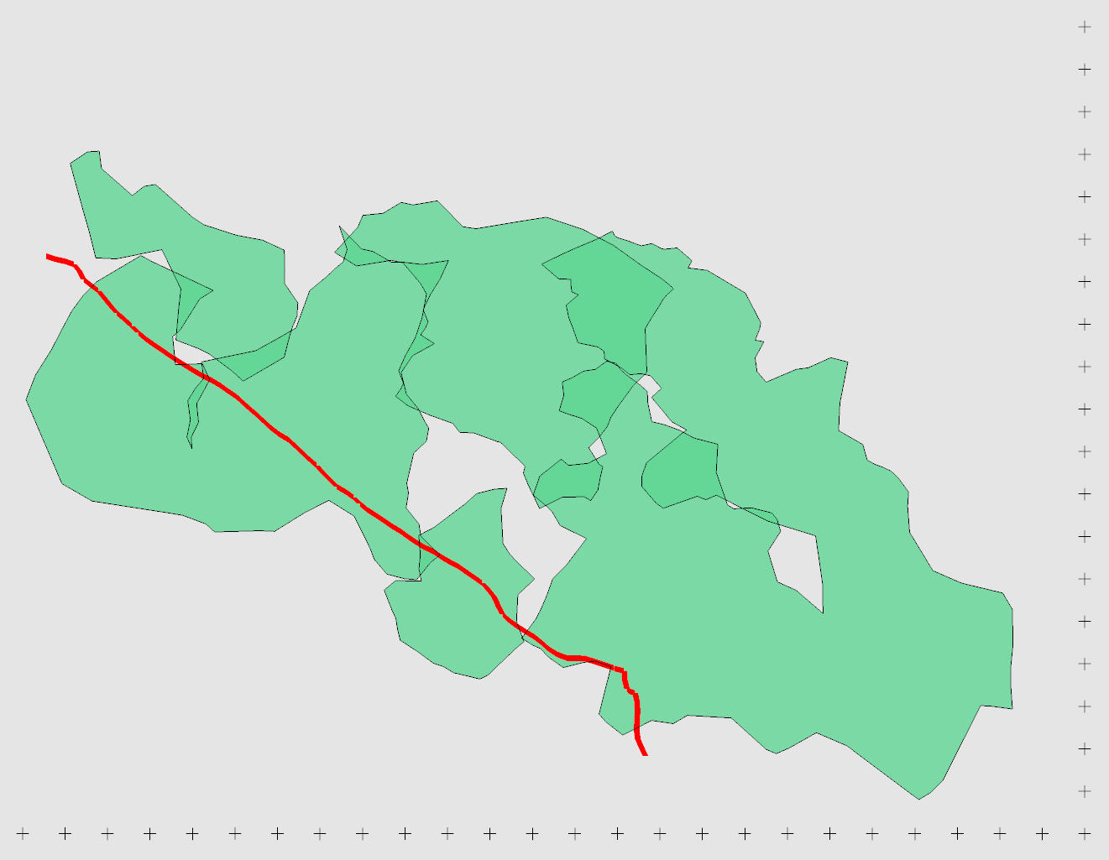
40°
30°
50°
60°

Slide 16
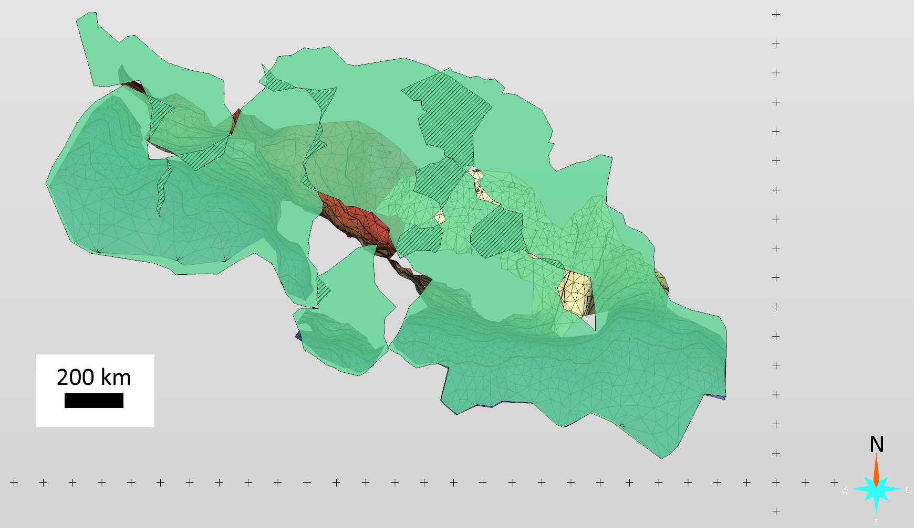

40°
*
*
30°
50°
60°
Overlap
*
Position modified
Notes:
Have a version where they haven’t been moved, and then slide into this.

Slide 17
40°
~680 km
~1100 km
30°
50°
60°
Notes:
Make the extent more prominent.

Slide 18
40°
Late Paleocene Slab-Breakoff
60-55 Ma
Continental Collision
28-23 Ma
30°
50°
60°
Requires subduction rates of 25-40 km/Ma

Slide 19
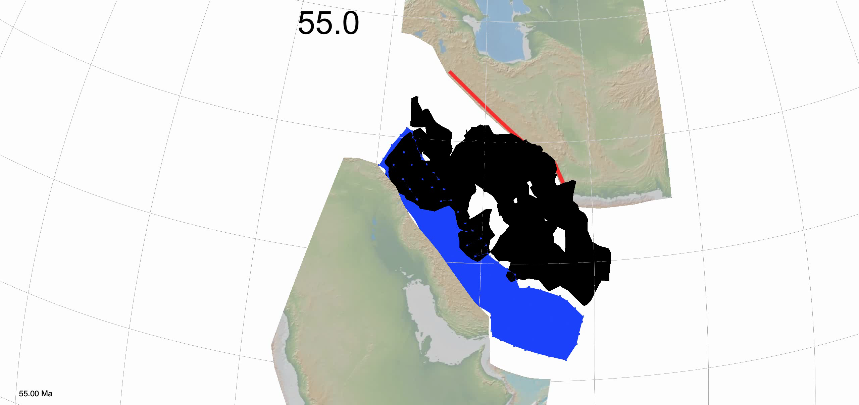
McQuarrie, N., and Van Hinsbergen, D.J.J., 2013, Retrodeforming the Arabia-Eurasia collision zone: Age of collision versus magnitude of continental subduction: Geology, v. 41, p. 315–318, doi:10.1130/G33591.1.

Slide 20
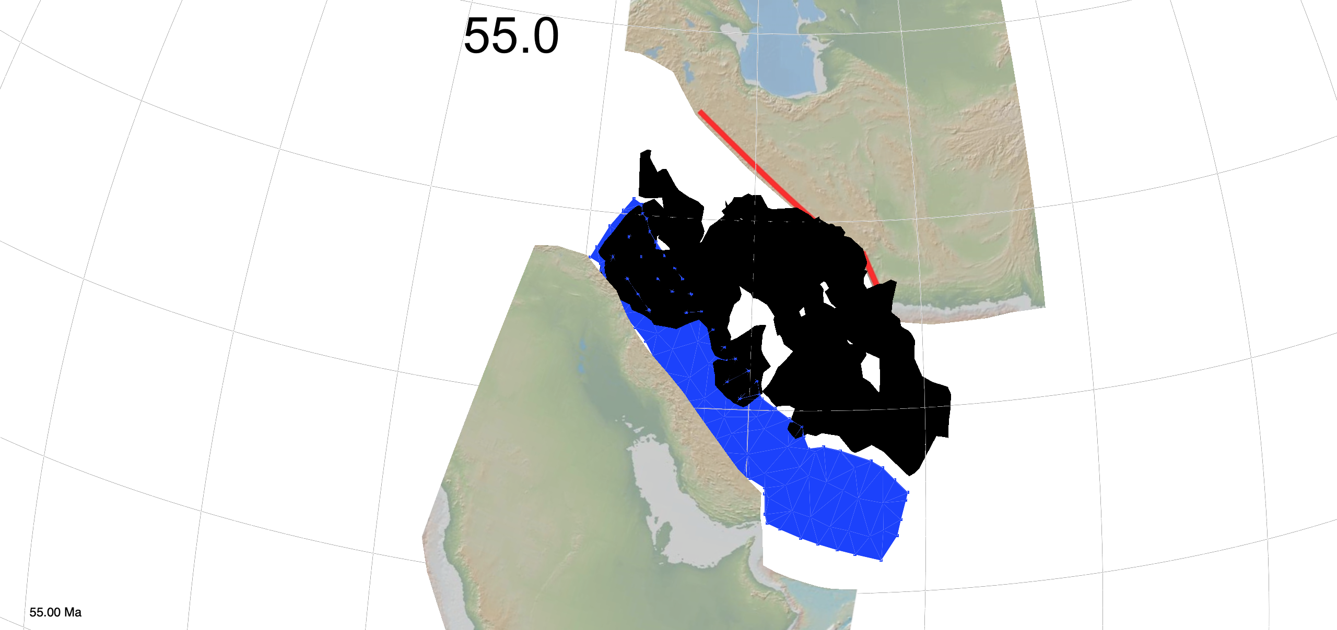
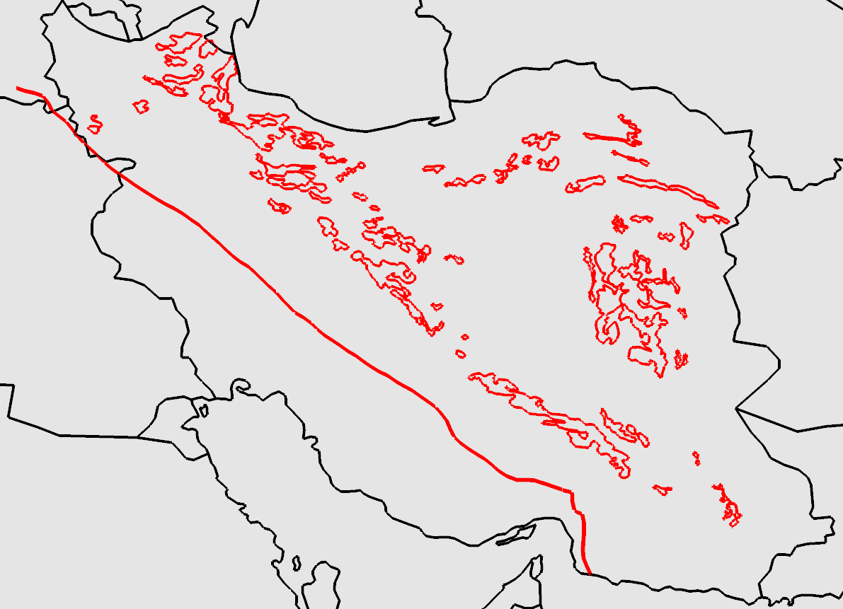
56-34
Magmatism data from Agard et. al. 2011, after Geological Survey of Iran (1: 250 000 maps.)

Slide 21
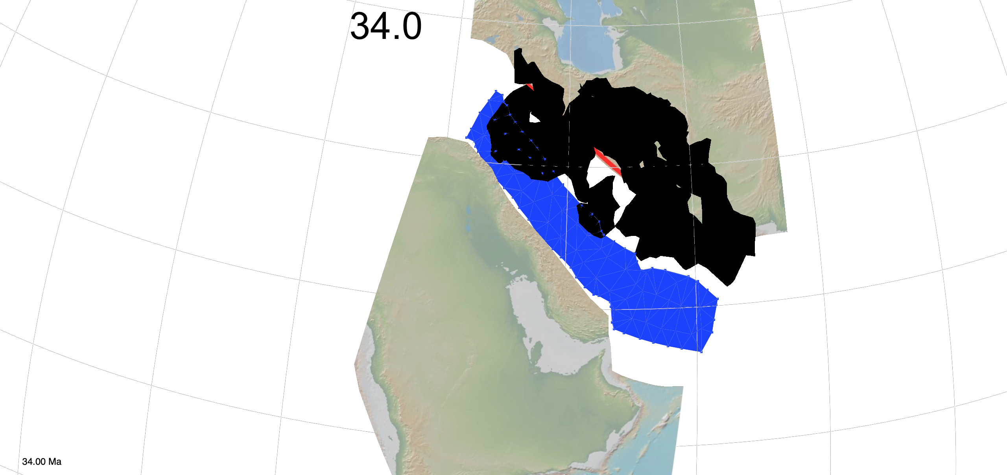
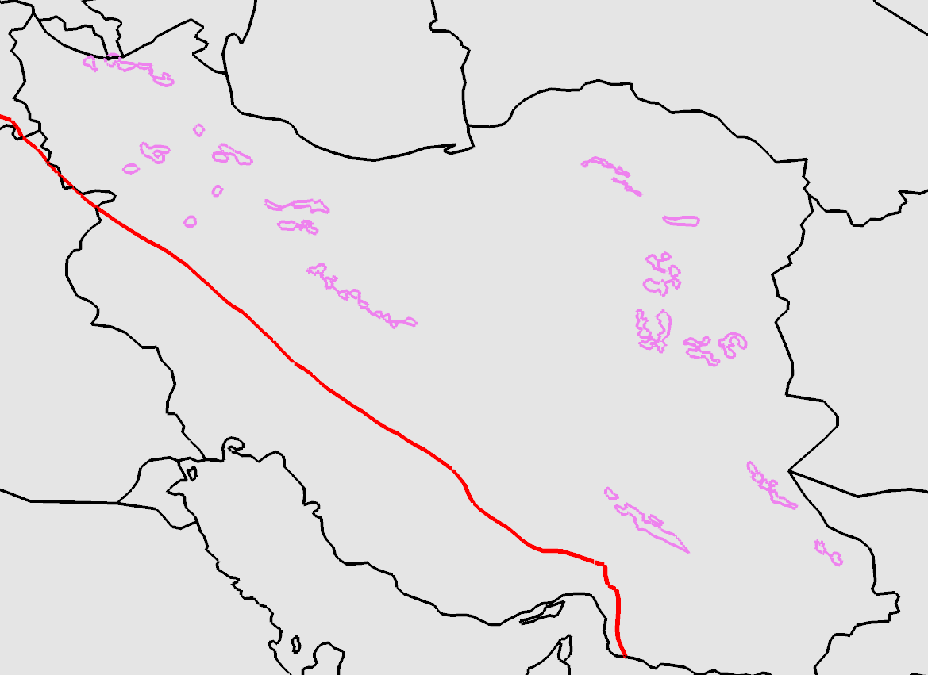
34-23
Magmatism data from Agard et. al. 2011, after Geological Survey of Iran (1: 250 000 maps.)

Slide 22
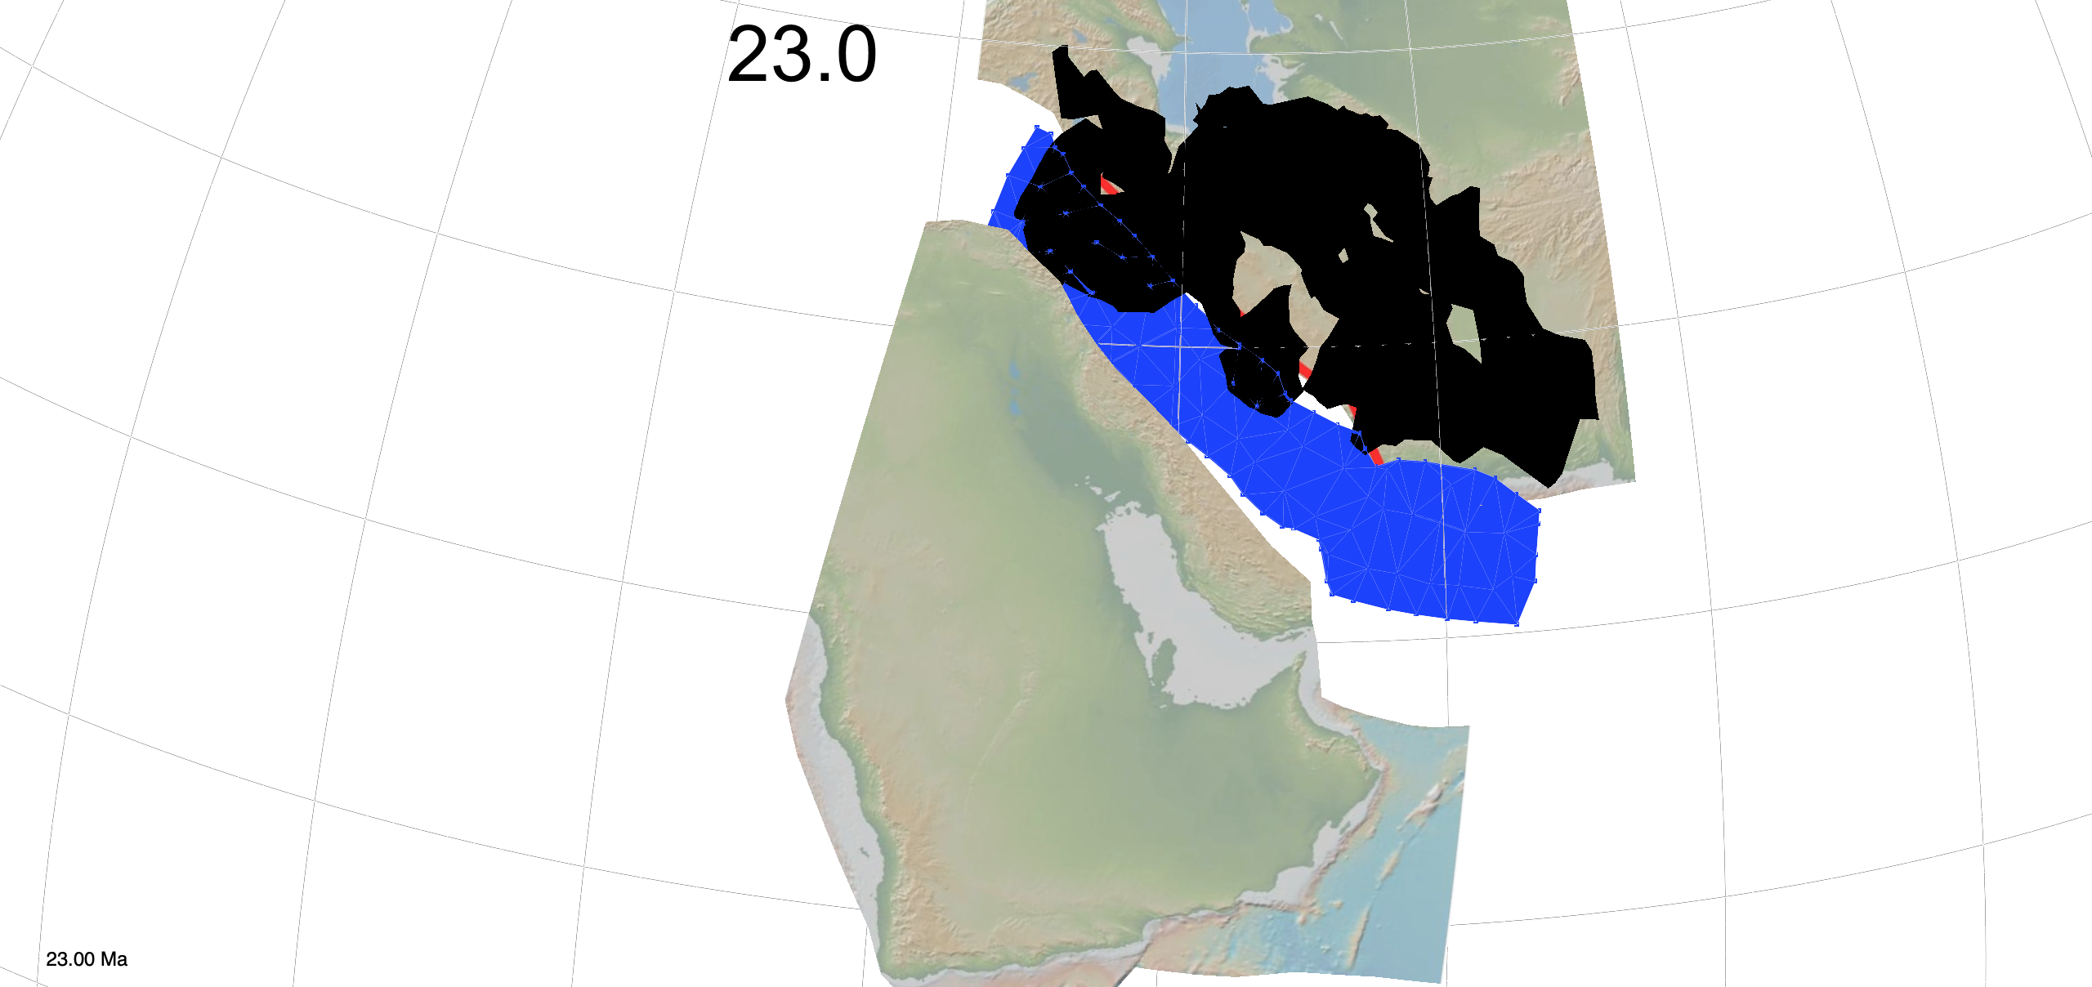
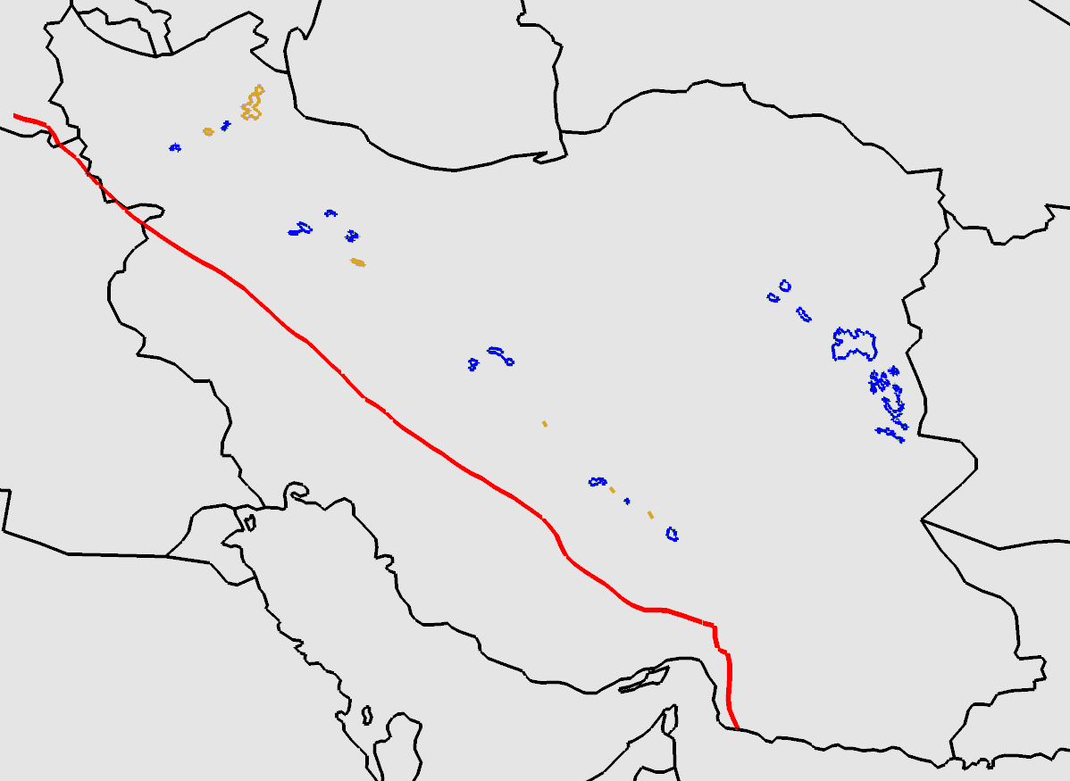
23-5.3
Magmatism data from Agard et. al. 2011, after Geological Survey of Iran (1: 250 000 maps.)

Slide 23
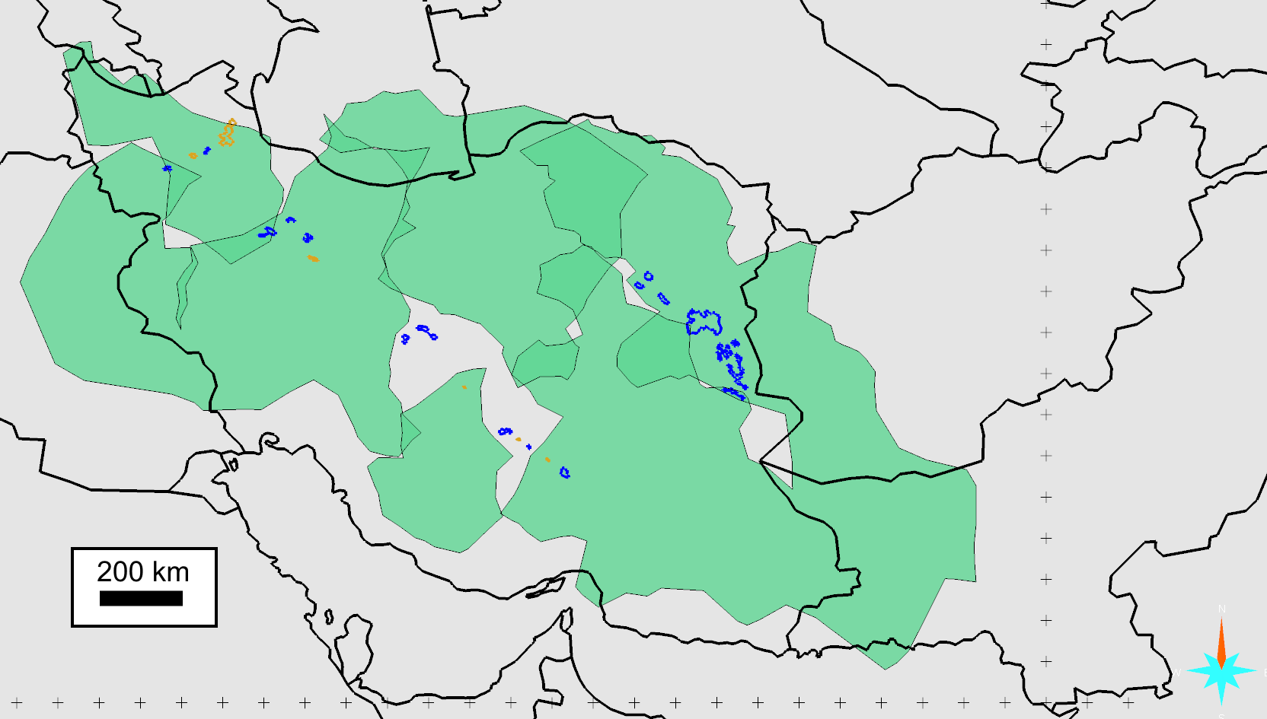
Regional Magmatic Changes:
22 - 12 Ma
18 - 11 Ma
Mid to Late Miocene:
Eu anomaly
Adakitic
Aghazadeh et. al. (2015)
Chiu et. al. (2013)
Simmonds et. al. (2017)
Zarasvandi et. al. (2015)
Magmatism data from Agard et. al. 2011, after Geological Survey of Iran (1: 250 000 maps.)
Notes:
OligoMiocene (blue)
Miocene (Tan)

Slide 24
Implied Sinking Rates
11.5 - 14 km/Ma
13.5 – 17.5 km/Ma

Slide 25
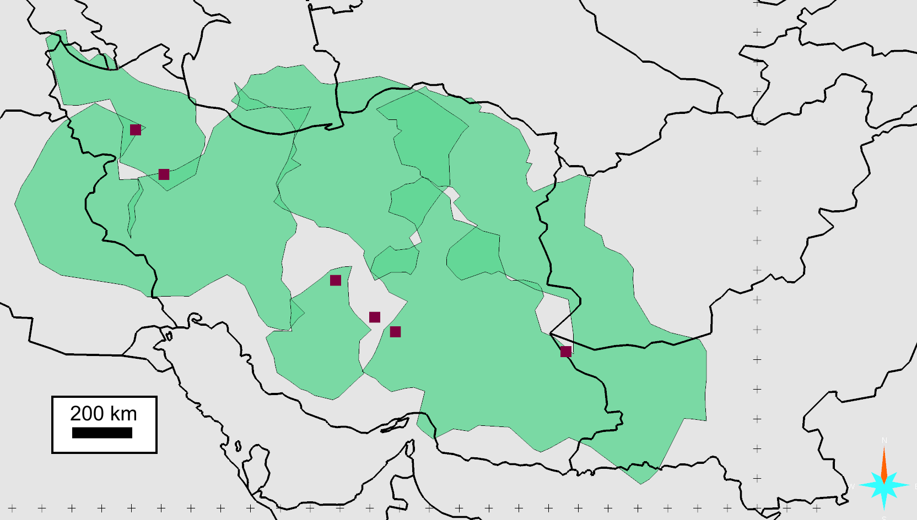
Magmatic-Hydrothermal Ore Deposits
14.2 Ma ¹
11.7 Ma ²
16.7-16.1 Ma ³
12.5 Ma ⁴
12.1-10.9 Ma ⁴
13-11.8 Ma ⁵
1 Mehrabi et al. (1999)
2 Richards et al. (2006)
3 Zarasvandi et al (2007)
4 McInnes et al (2005)
5 Razique et al. (2014)
Notes:
Significant porphyry and epithermal deposits.

Slide 26
