Slide 1







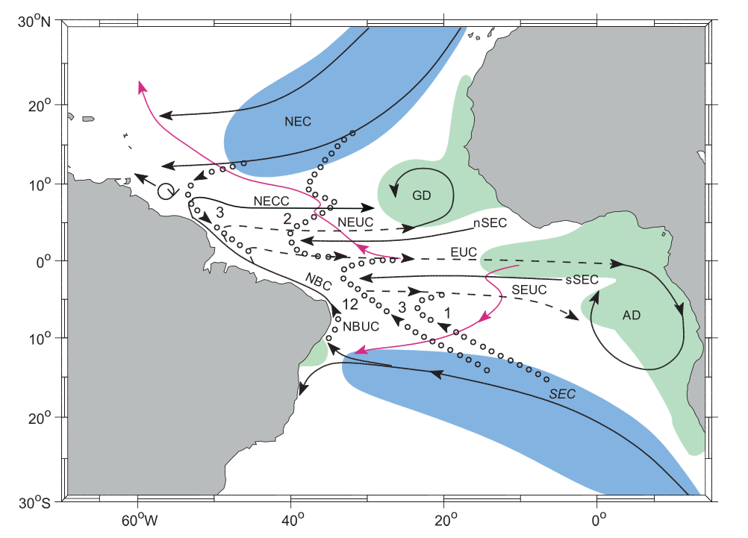
The Atlantic Subtropical Cells inferred from observations
Franz Philip Tuchen ¹, Joke F. Lübbecke ^{1,2}, Sunke Schmidtko ¹, Rebecca Hummels ¹, and Claus W. Böning ^{1,2}
¹ GEOMAR Helmholtz Centre for Ocean Research, Kiel, Germany , ² Christian-Albrechts-Universität zu Kiel, Germany
Surface poleward flow
Thermocline equatorward flow
Upwelling
Subduction
from Schott et al. (2004)

Slide 2
The Atlantic Subtropical Cells inferred from observations
Franz Philip Tuchen ¹, Joke F. Lübbecke ^{1,2}, Sunke Schmidtko ¹, Rebecca Hummels ¹, and Claus W. Böning ^{1,2}
¹ GEOMAR Helmholtz Centre for Ocean Research, Kiel, Germany , ² Christian-Albrechts-Universität zu Kiel, Germany
@ PICO screen 4.3

Slide 3
The Atlantic Subtropical Cells inferred from observations
Franz Philip Tuchen ¹, Joke F. Lübbecke ^{1,2}, Sunke Schmidtko ¹, Rebecca Hummels ¹, and Claus W. Böning ^{1,2}
¹ GEOMAR Helmholtz Centre for Ocean Research, Kiel, Germany , ² Christian-Albrechts-Universität zu Kiel, Germany
Summary
Data
Surface layer
Thermocline layer
STC schematic
Outlook
”Short Tour”
Pathways?
Layer boundaries?
Transport strength?

Slide 4
The Atlantic Subtropical Cells inferred from observations
Franz Philip Tuchen ¹, Joke F. Lübbecke ^{1,2}, Sunke Schmidtko ¹, Rebecca Hummels ¹, and Claus W. Böning ^{1,2}
¹ GEOMAR Helmholtz Centre for Ocean Research, Kiel, Germany , ² Christian-Albrechts-Universität zu Kiel, Germany
Summary
Data
Surface layer
Thermocline layer
STC schematic
Outlook
What are STCs?
STCs matter because …
Main results

Slide 5
The Atlantic Subtropical Cells inferred from observations
Franz Philip Tuchen ¹, Joke F. Lübbecke ^{1,2}, Sunke Schmidtko ¹, Rebecca Hummels ¹, and Claus W. Böning ^{1,2}
¹ GEOMAR Helmholtz Centre for Ocean Research, Kiel, Germany , ² Christian-Albrechts-Universität zu Kiel, Germany
Summary
Data
Surface layer
Thermocline layer
STC schematic
Outlook
What are STCs?
STCs are shallow (upper 300 m) overturning circulations that connect subtropical subduction sites with tropical upwelling regions
This is accomplished via generally poleward water mass transport in the surface layer (Ekman transport) and equatorward transport at thermocline level (geostrophic transport)
In reality, the meridional pathways are distorted by zonal currents
Equator

Slide 6
The Atlantic Subtropical Cells inferred from observations
Franz Philip Tuchen ¹, Joke F. Lübbecke ^{1,2}, Sunke Schmidtko ¹, Rebecca Hummels ¹, and Claus W. Böning ^{1,2}
¹ GEOMAR Helmholtz Centre for Ocean Research, Kiel, Germany , ² Christian-Albrechts-Universität zu Kiel, Germany
Summary
Data
Surface layer
Thermocline layer
STC schematic
Outlook
STCs matter because …
they participate in the subtropical-tropical water mass exchange and maintain the tropical thermocline
they supply water mass to equatorial currents (e.g. EUC, NECC)
they are suggested to impact tropical sea surface temperature (SST) on interannual to decadal time scales by advecting water mass anomalies from the subtropics to the tropics

Slide 7
The Atlantic Subtropical Cells inferred from observations
Franz Philip Tuchen ¹, Joke F. Lübbecke ^{1,2}, Sunke Schmidtko ¹, Rebecca Hummels ¹, and Claus W. Böning ^{1,2}
¹ GEOMAR Helmholtz Centre for Ocean Research, Kiel, Germany , ² Christian-Albrechts-Universität zu Kiel, Germany
Summary
Data
Surface layer
Thermocline layer
STC schematic
Outlook
Main results
The interface between the equatorward and poleward branches of the STCs is defined (seasonally varying Ekman depth) as well as the lower boundary of the equatorward branches (26 kg m⁻³ isopycnal) at two sections along 10°N/S.
Asymmetric transport convergence in the thermocline layer (~11 Sv) is accompanied by symmetric Ekman divergence (~20 Sv) and geostrophic transport convergence (~7 Sv) in the surface layer.
Mean transport estimates from ARGO based observations are able to reproduce and confirm earlier results and allow for more detailed picture.

Slide 8
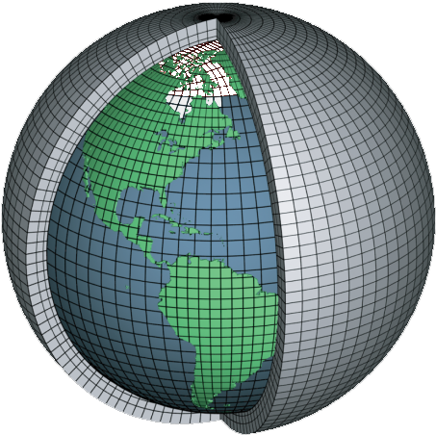
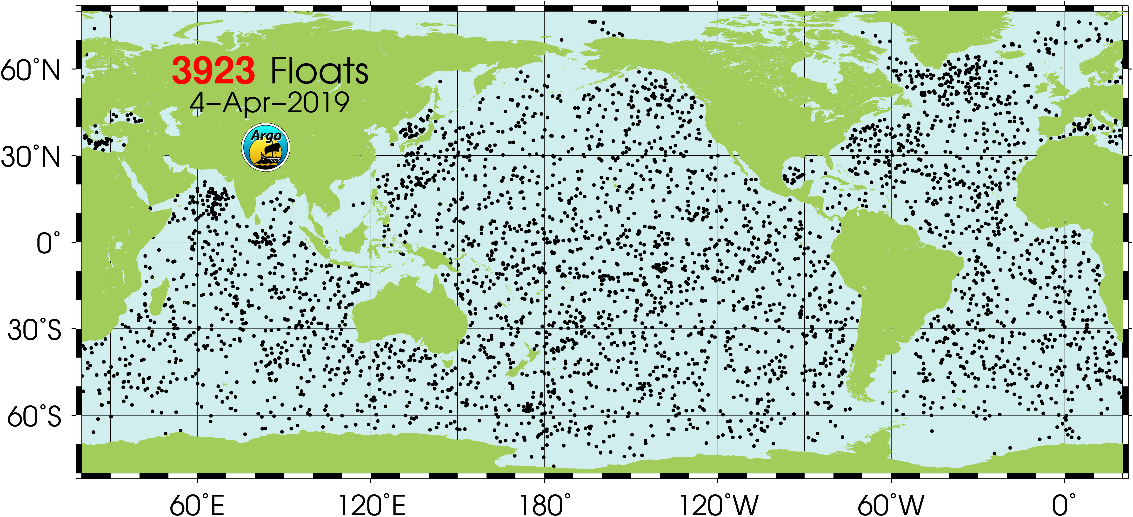

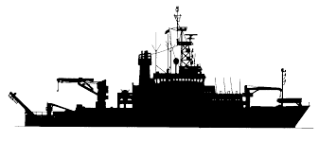
The Atlantic Subtropical Cells inferred from observations
Franz Philip Tuchen ¹, Joke F. Lübbecke ^{1,2}, Sunke Schmidtko ¹, Rebecca Hummels ¹, and Claus W. Böning ^{1,2}
¹ GEOMAR Helmholtz Centre for Ocean Research, Kiel, Germany , ² Christian-Albrechts-Universität zu Kiel, Germany
Summary
Data
Surface layer
Thermocline layer
STC schematic
Outlook
Data sets
Absolute Salinity
Conservative Temperature
Geostrophic velocity
11.5°S ship section
Ocean Reanalysis (ECMWF ORA-S4)
ARGO based climatologies
Wind products
Ship sections

Slide 9

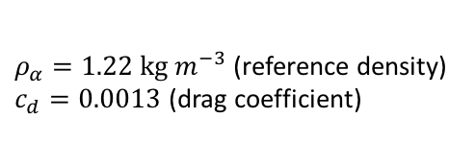
The Atlantic Subtropical Cells inferred from observations
Franz Philip Tuchen ¹, Joke F. Lübbecke ^{1,2}, Sunke Schmidtko ¹, Rebecca Hummels ¹, and Claus W. Böning ^{1,2}
¹ GEOMAR Helmholtz Centre for Ocean Research, Kiel, Germany , ² Christian-Albrechts-Universität zu Kiel, Germany
Summary
Data
Surface layer
Thermocline layer
STC schematic
Outlook
Data sets
Absolute Salinity
Conservative Temperature
Geostrophic velocity
11.5°S ship section
Wind products
Product | Horizontal resolution | Time Period
ASCAT | 25 km | 2007-2018
JRA-55 | 1.25° | 2000-2012
NCEP | 0.2° | 2011-2018
The wind products provide zonal and meridional surface wind velocity ($u$) from which wind stress ($τ$) is derived via Bulk formula:
$$τ=ρ_{α}∗c_{d}∗u^{2}$$
$ρ_{α}=1.22 kg m^{−3}$ (reference density)
$c_{d}=0.0013$ (drag coefficient)

Slide 10
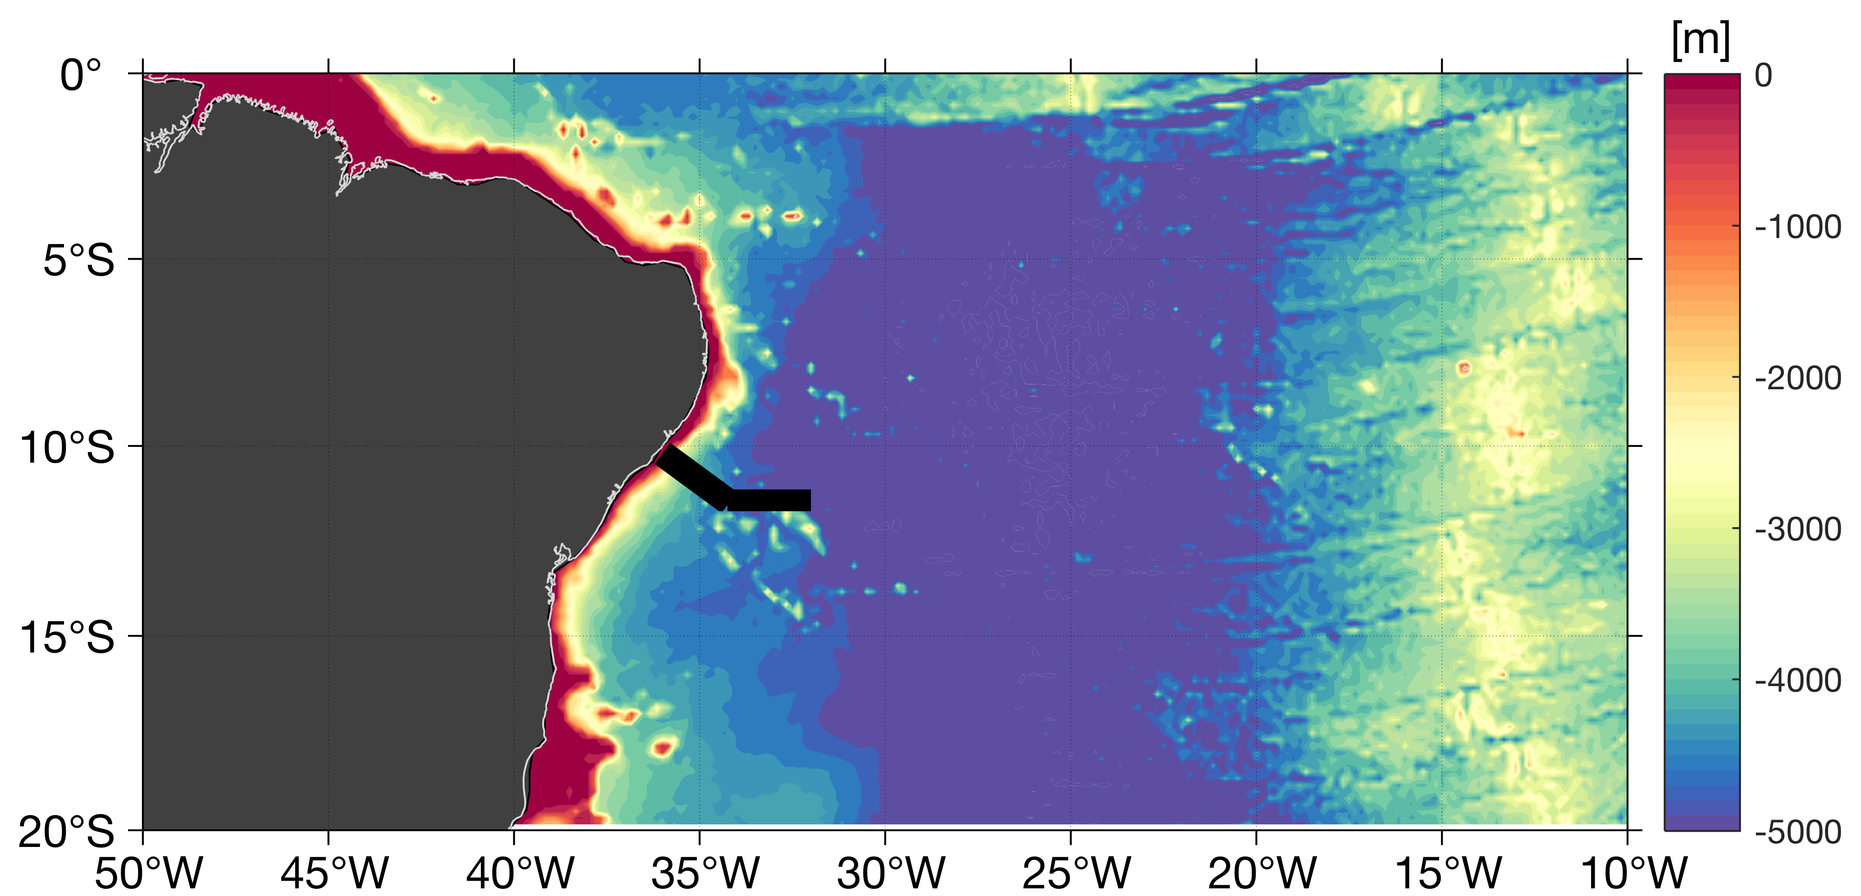
The Atlantic Subtropical Cells inferred from observations
Franz Philip Tuchen ¹, Joke F. Lübbecke ^{1,2}, Sunke Schmidtko ¹, Rebecca Hummels ¹, and Claus W. Böning ^{1,2}
¹ GEOMAR Helmholtz Centre for Ocean Research, Kiel, Germany , ² Christian-Albrechts-Universität zu Kiel, Germany
Summary
Data
Surface layer
Thermocline layer
STC schematic
Outlook
Data sets
Absolute Salinity
Conservative Temperature
Geostrophic velocity
11.5°S ship section
Research cruise | Time
RV Meteor 98 | July 2013
RV Meteor 106 | May 2014
RV Meteor 119 | October 2015
RV Meteor 130 | September 2016
RV Meteor 145 | March 2018
A total of 5 ship sections is used to derive a mean section of hydrographic properties and alongshore velocity along the cruise track below:
Brasil
Ship sections

Slide 11
The Atlantic Subtropical Cells inferred from observations
Franz Philip Tuchen ¹, Joke F. Lübbecke ^{1,2}, Sunke Schmidtko ¹, Rebecca Hummels ¹, and Claus W. Böning ^{1,2}
¹ GEOMAR Helmholtz Centre for Ocean Research, Kiel, Germany , ² Christian-Albrechts-Universität zu Kiel, Germany
Summary
Data
Surface layer
Thermocline layer
STC schematic
Outlook
Data sets
Absolute Salinity
Conservative Temperature
Geostrophic velocity
11.5°S ship section
Product | Horizontal resolution | Covered Time Period
Roemmich-Gilson-Climatology (RG-clim) | 1° | (a) climatological mean (2004-2016) (b) monthly anomalies (2004-2016) Practical Salinity, Temperature
Monthly Isopycnal and Mixed-Layer Ocean Climatology (MIMOC) | 0.5° | climatological monthly means (Jan – Dec) Practical Salinity, Potential Temperature
ARGO based climatologies
See zonal sections of absolute salinity, conservative temperature and geostrophic velocity at 10°N/S

Slide 12
The Atlantic Subtropical Cells inferred from observations
Franz Philip Tuchen ¹, Joke F. Lübbecke ^{1,2}, Sunke Schmidtko ¹, Rebecca Hummels ¹, and Claus W. Böning ^{1,2}
¹ GEOMAR Helmholtz Centre for Ocean Research, Kiel, Germany , ² Christian-Albrechts-Universität zu Kiel, Germany
Summary
Data
Surface layer
Thermocline layer
STC schematic
Outlook
Data sets
Absolute Salinity
Conservative Temperature
Geostrophic velocity
11.5°S ship section
Ocean Reanalysis (ECMWF ORA-S4)
Our analysis is complemented by ocean reanalysis data from ORA-S4. Reanalysis data is especially useful as it provides velocity data which we use to derive the interface between the poleward and the equatorward branches of the STCs.
Vertical levels | Horizontal resolution | Temporal resolution | Time period used | Parameters
42 | 1° | monthly | 2000-2017 | Practical Salinity, Potential Temperature, Zonal Velocity, Meridional Velocity
See zonal sections of absolute salinity, conservative temperature and geostrophic velocity at 10°N/S

Slide 13
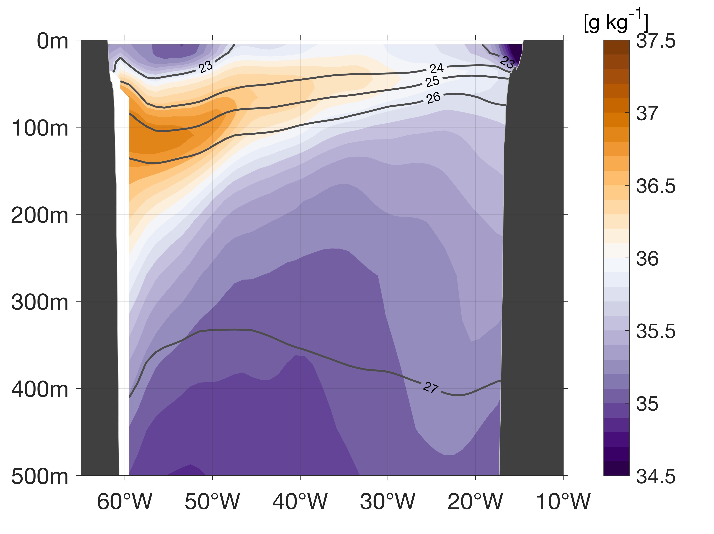
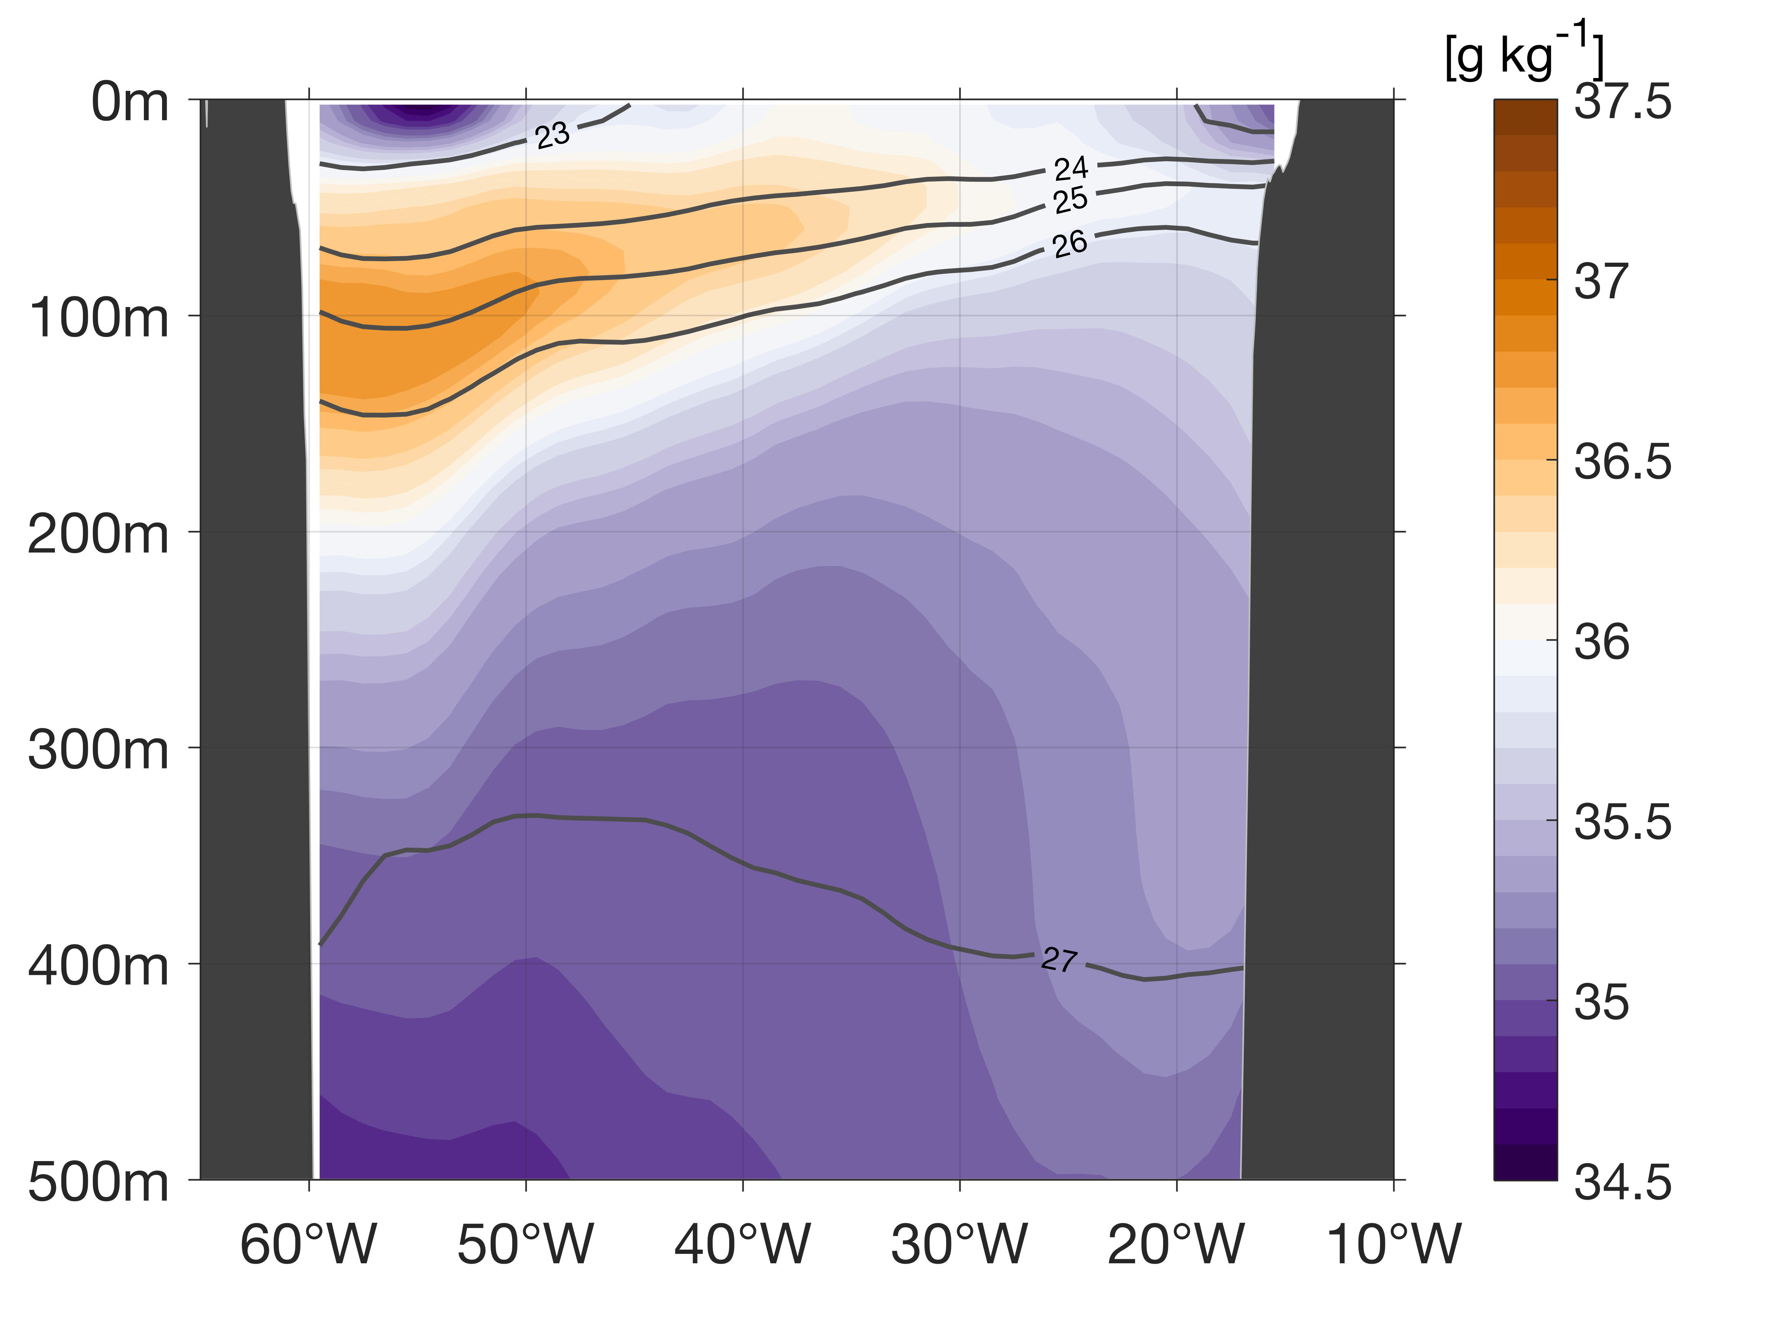
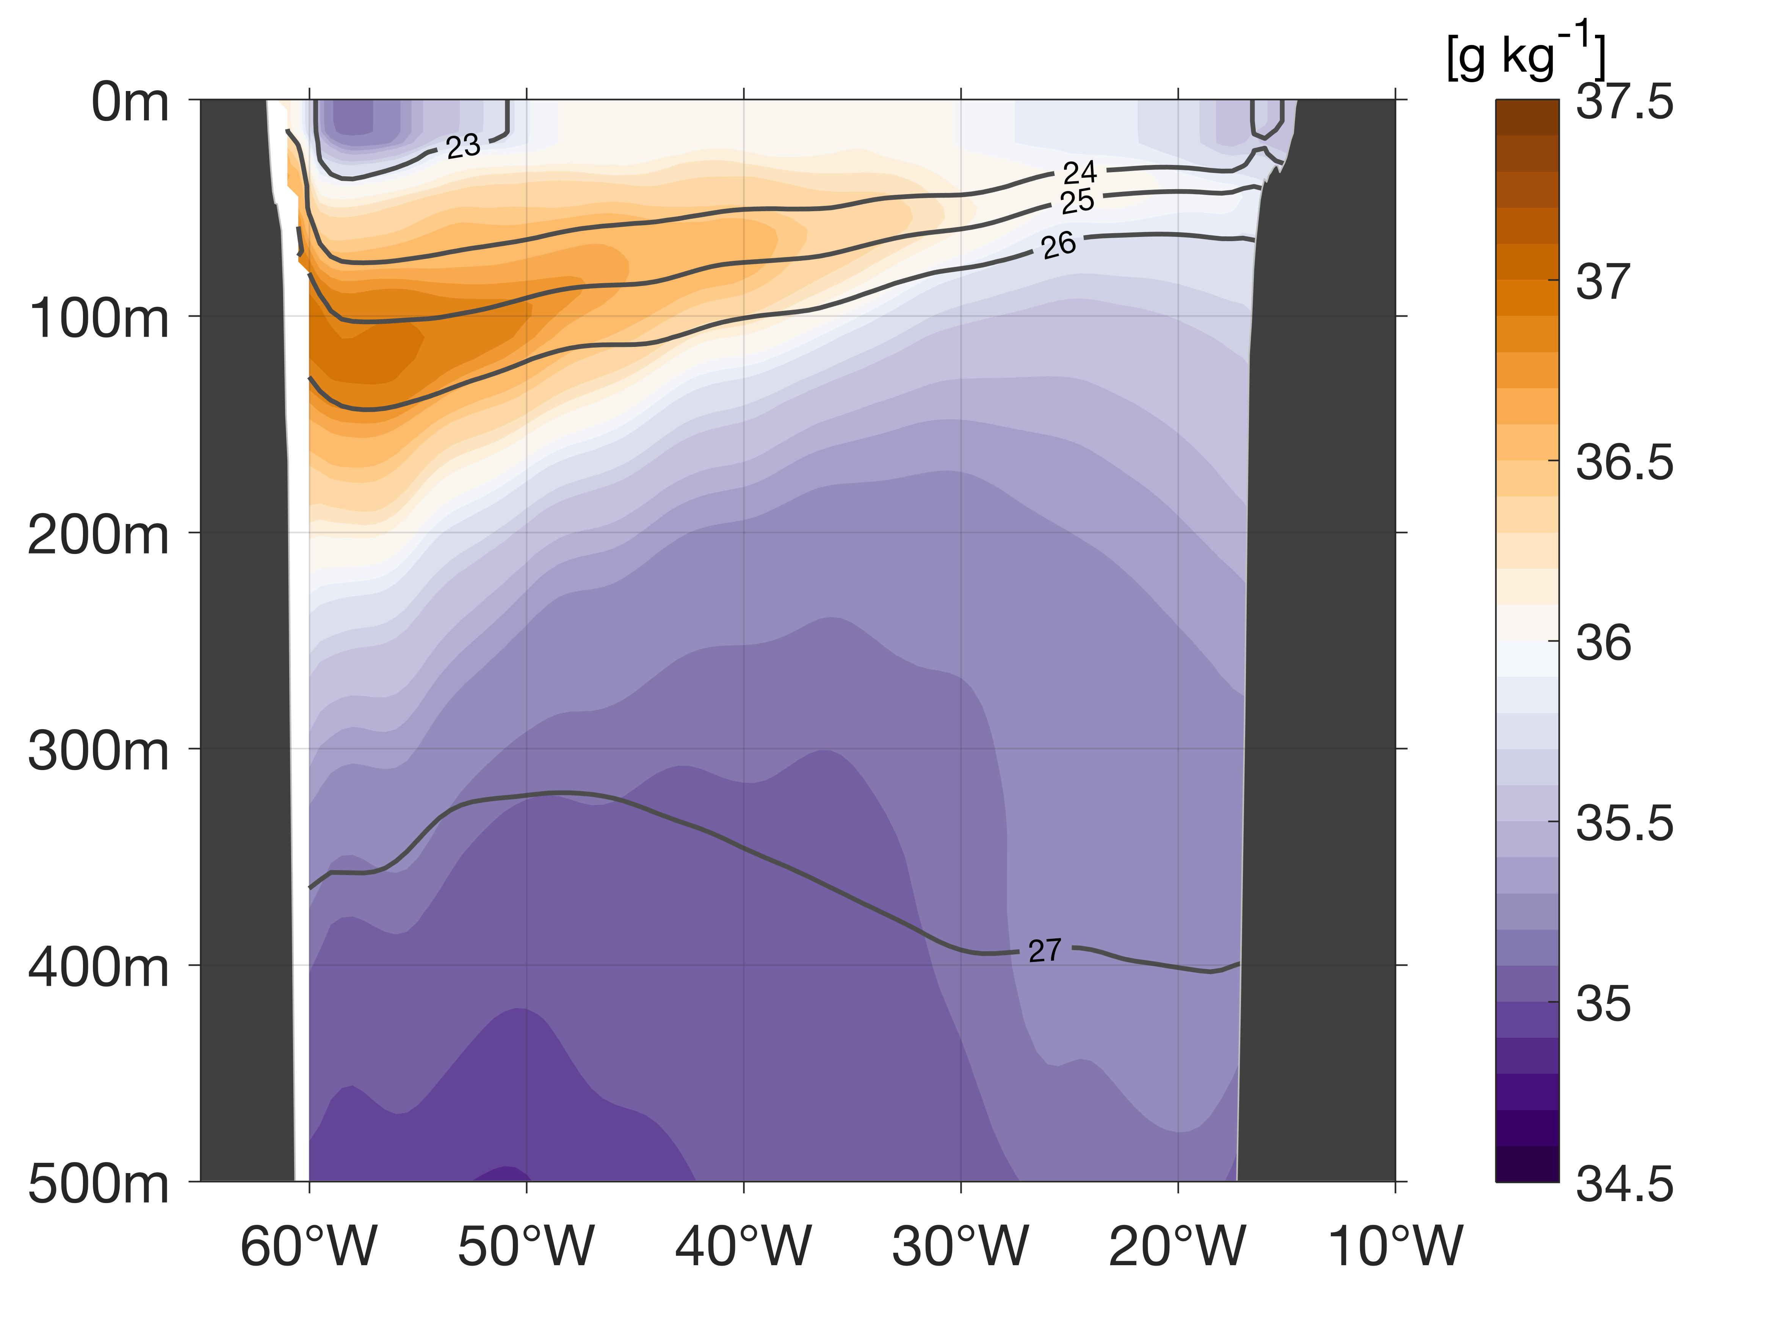
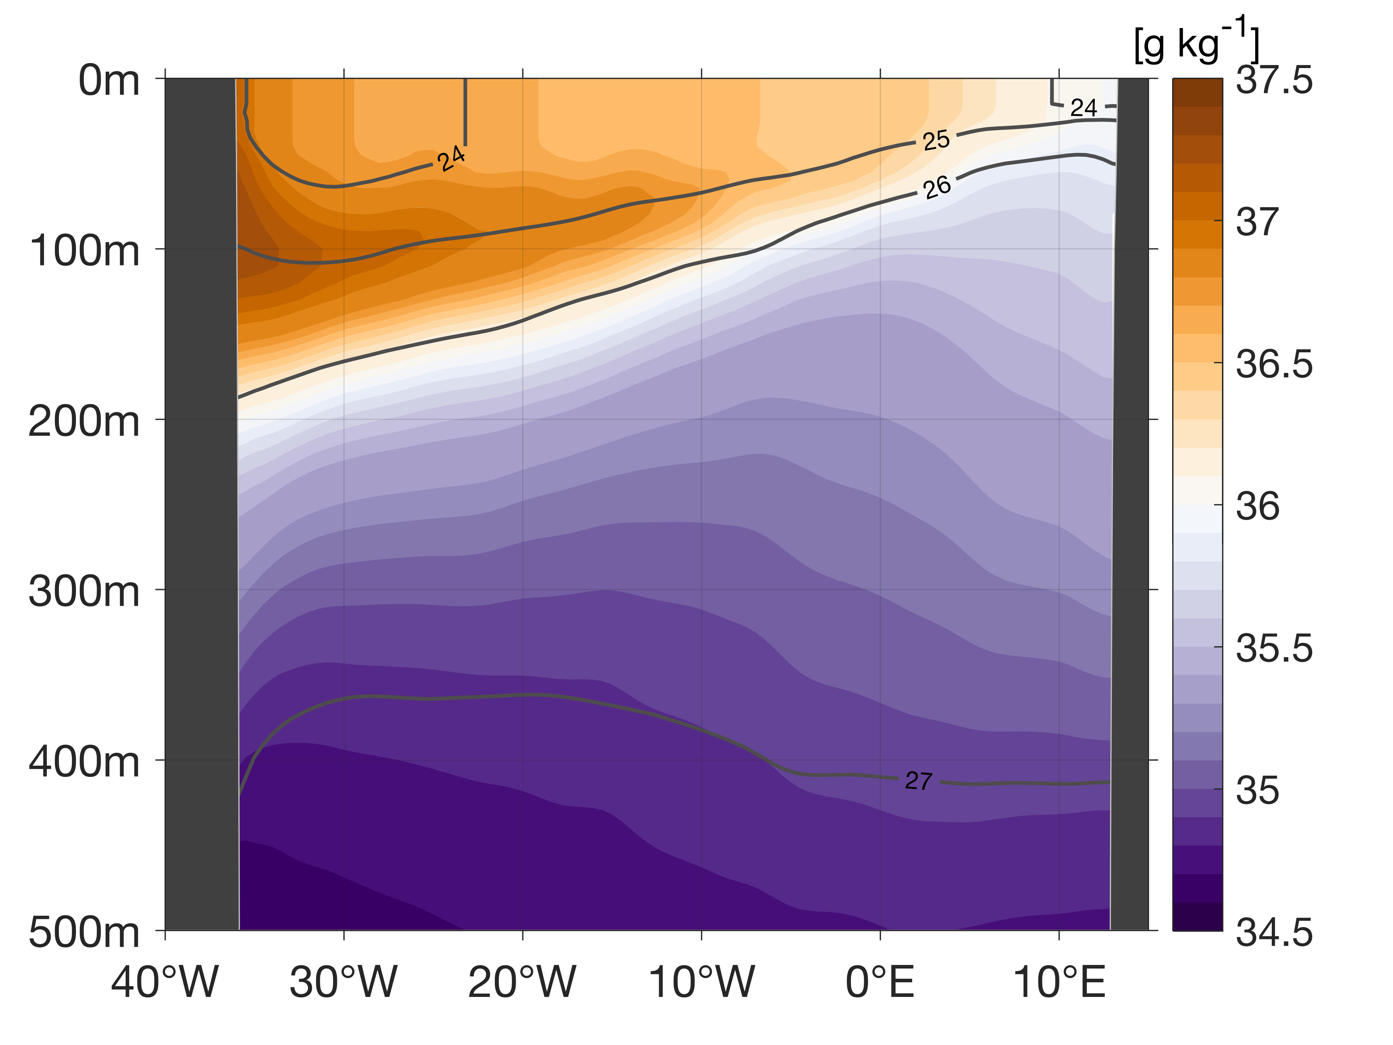
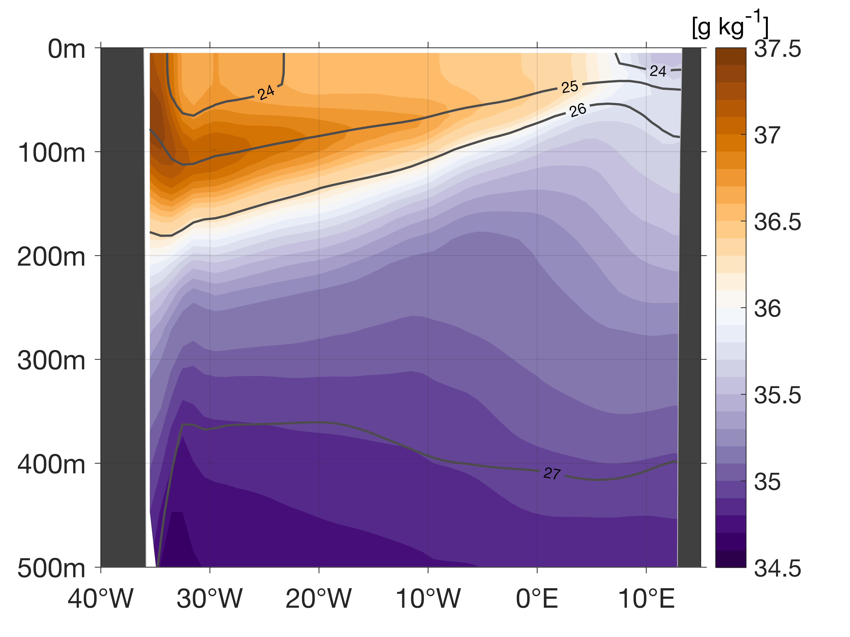
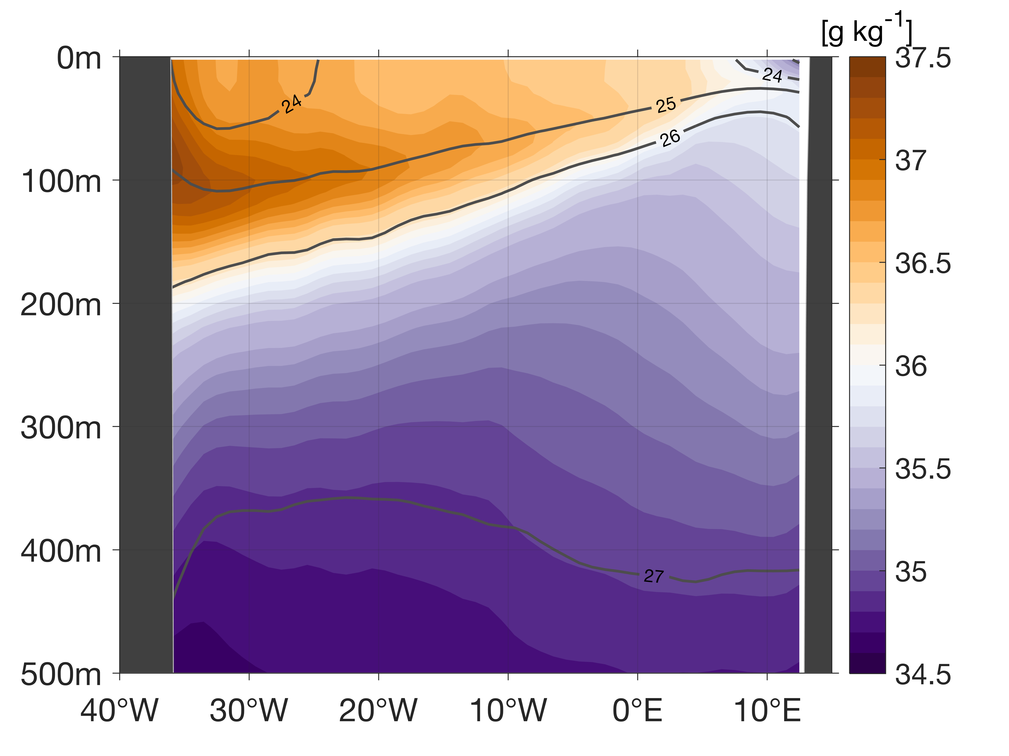
The Atlantic Subtropical Cells inferred from observations
Franz Philip Tuchen ¹, Joke F. Lübbecke ^{1,2}, Sunke Schmidtko ¹, Rebecca Hummels ¹, and Claus W. Böning ^{1,2}
¹ GEOMAR Helmholtz Centre for Ocean Research, Kiel, Germany , ² Christian-Albrechts-Universität zu Kiel, Germany
Summary
Data
Surface layer
Thermocline layer
STC schematic
Outlook
Data sets
Absolute Salinity
Conservative Temperature
Geostrophic velocity
11.5°S ship section
RG-clim (2004-2016 mean)
MIMOC (climatological mean)
ORA-S4 (2000-2017 mean)
10°N
10°S

Slide 14
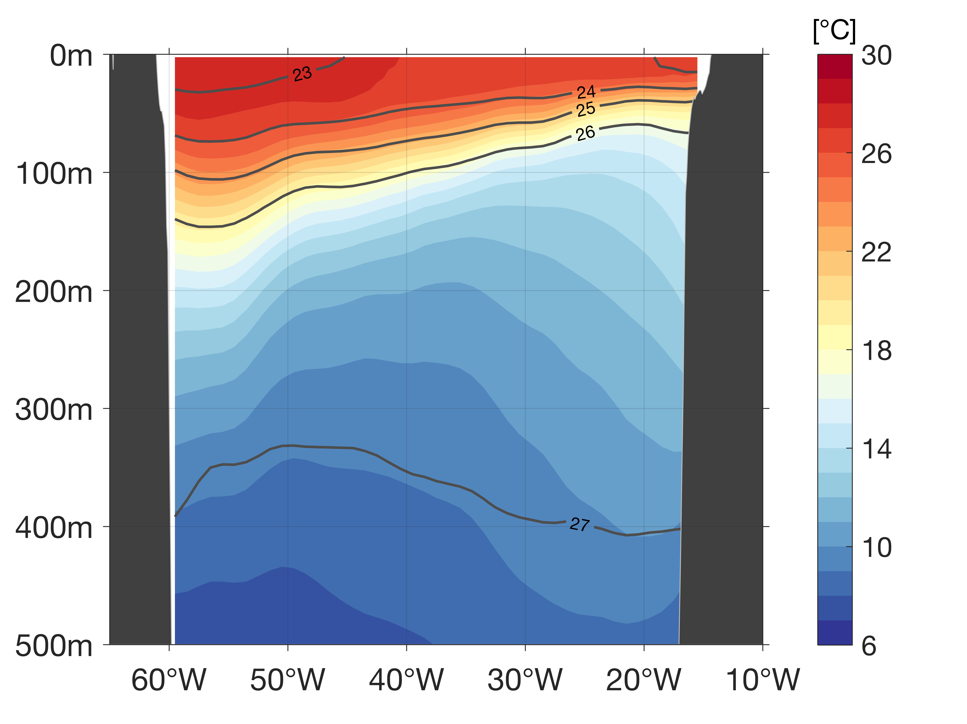
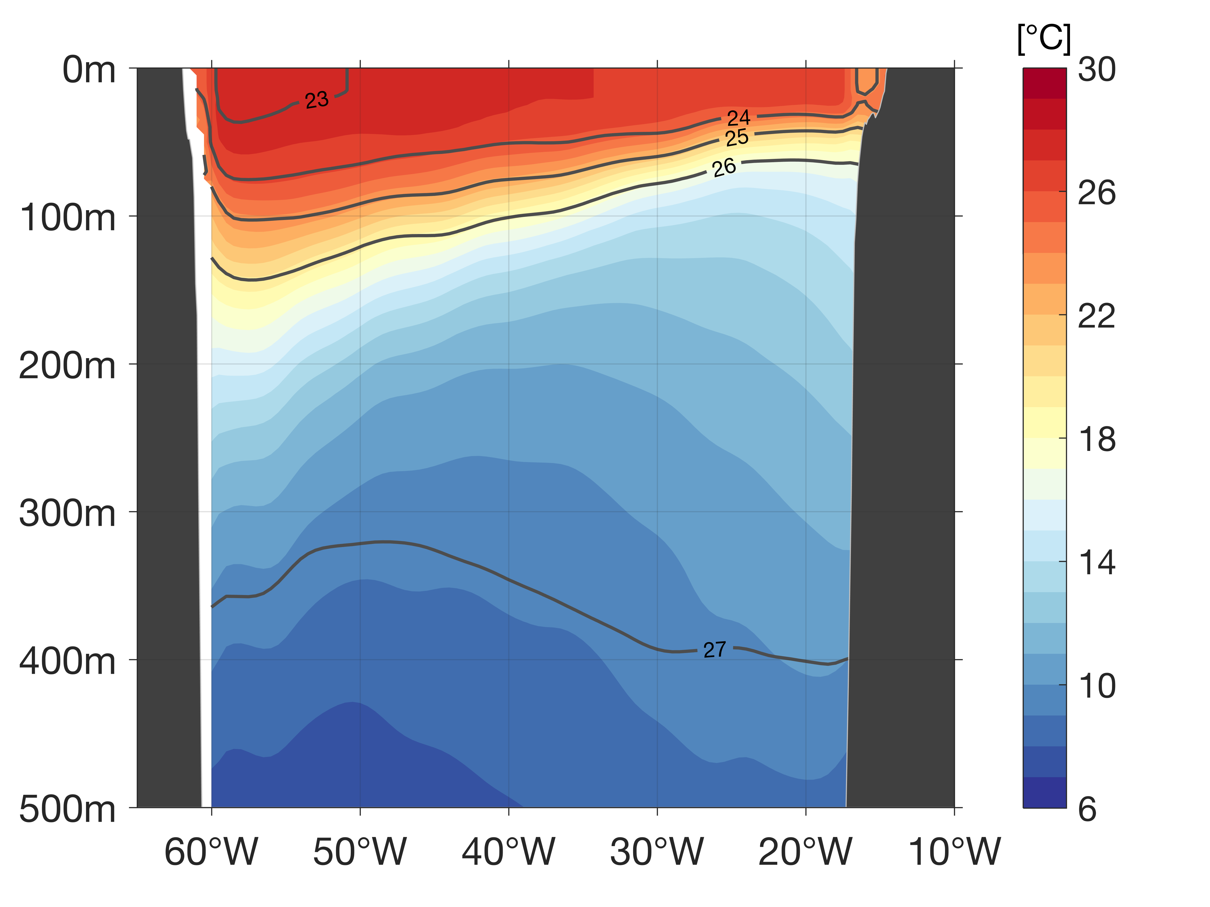
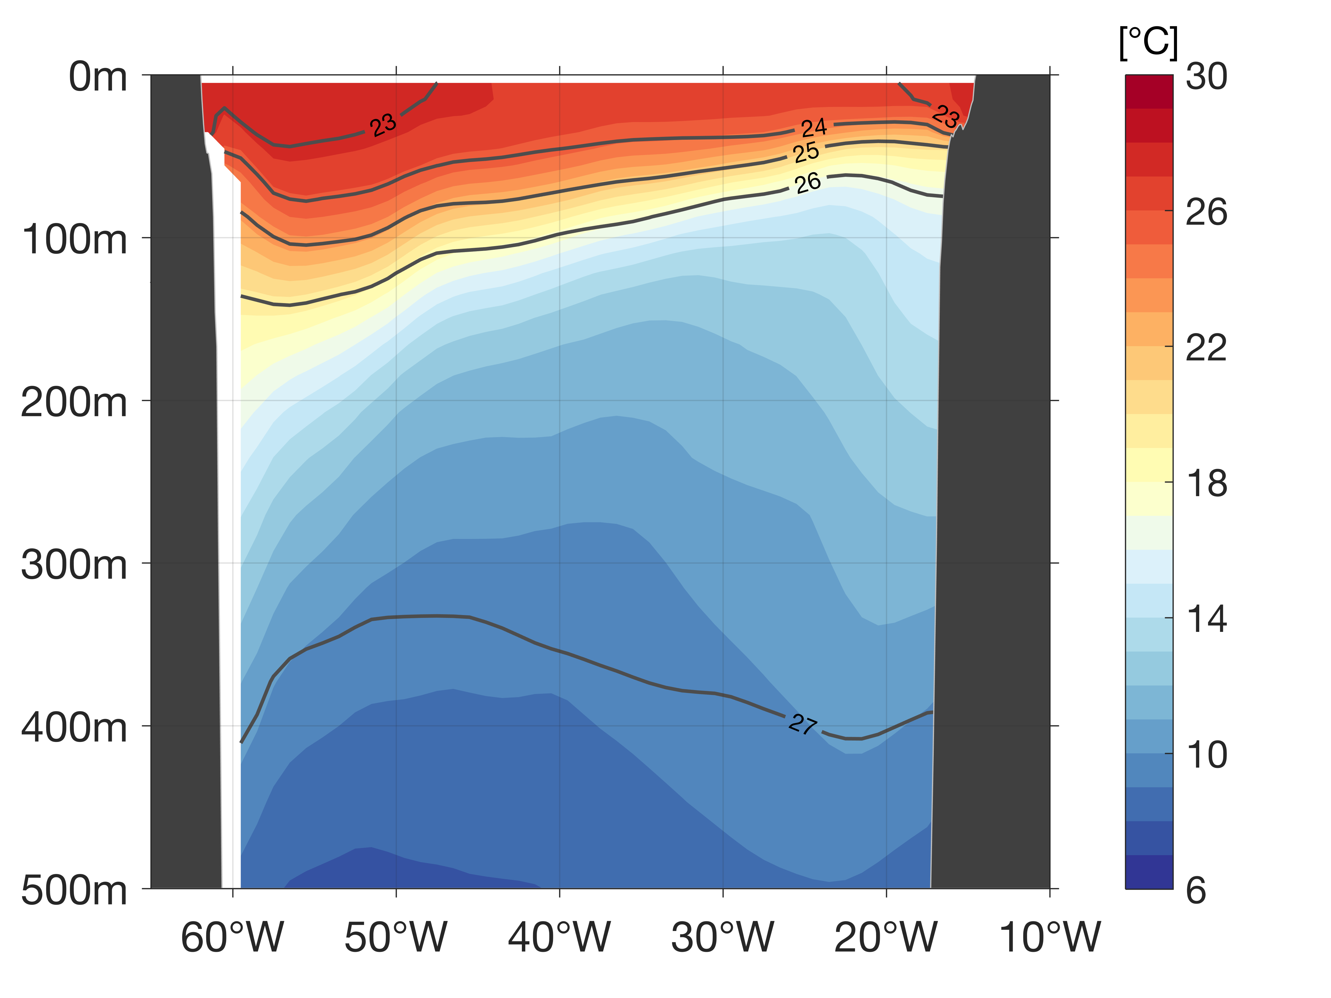
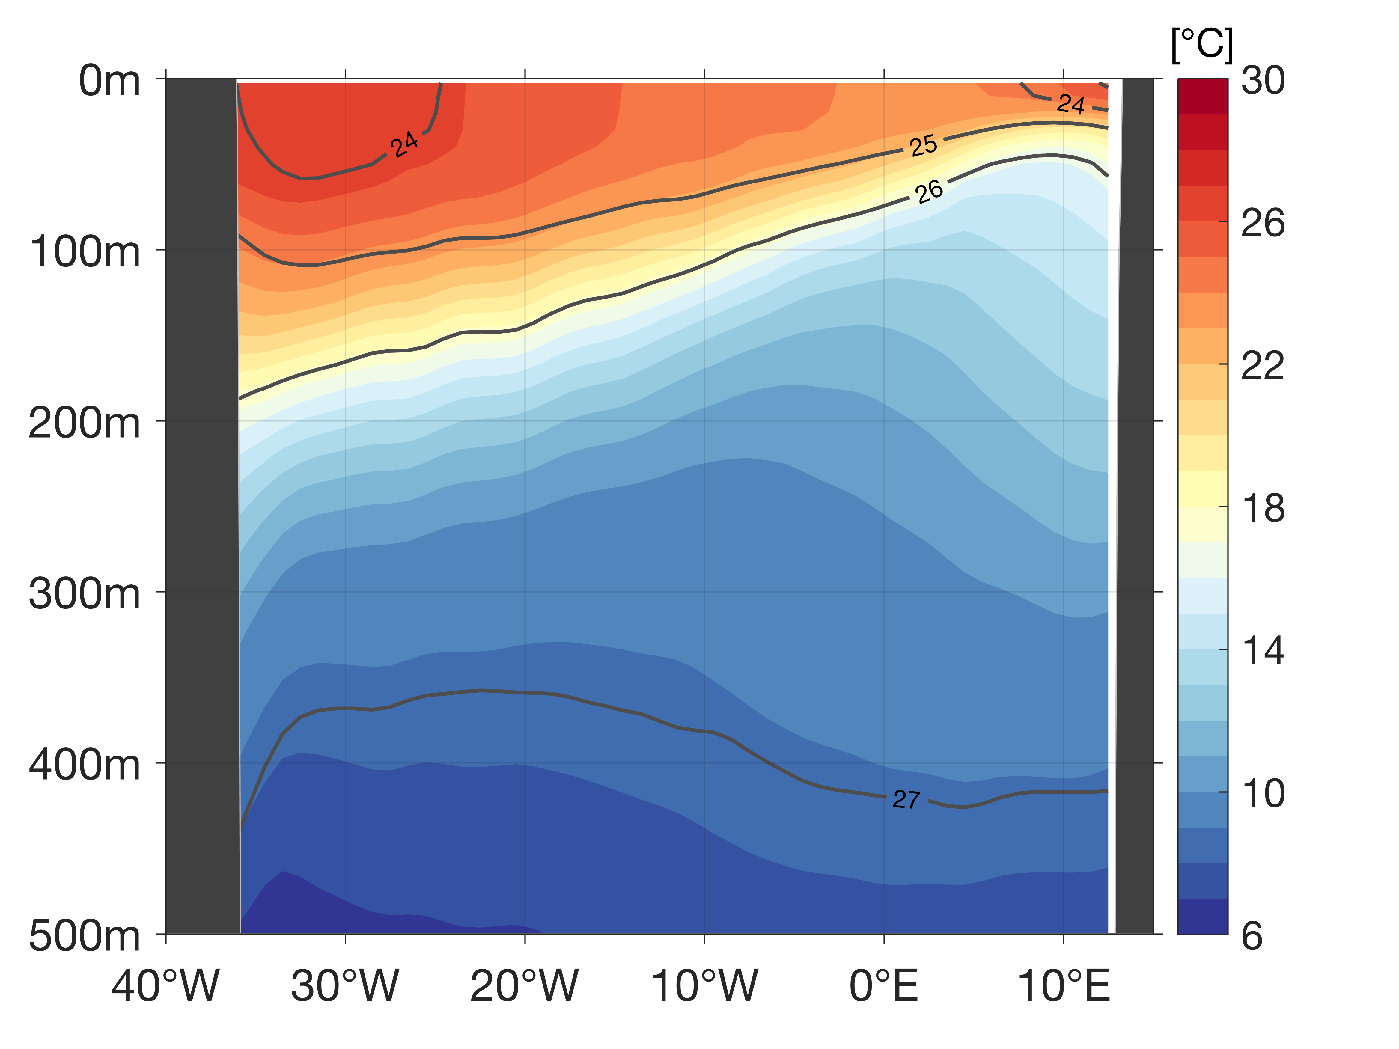
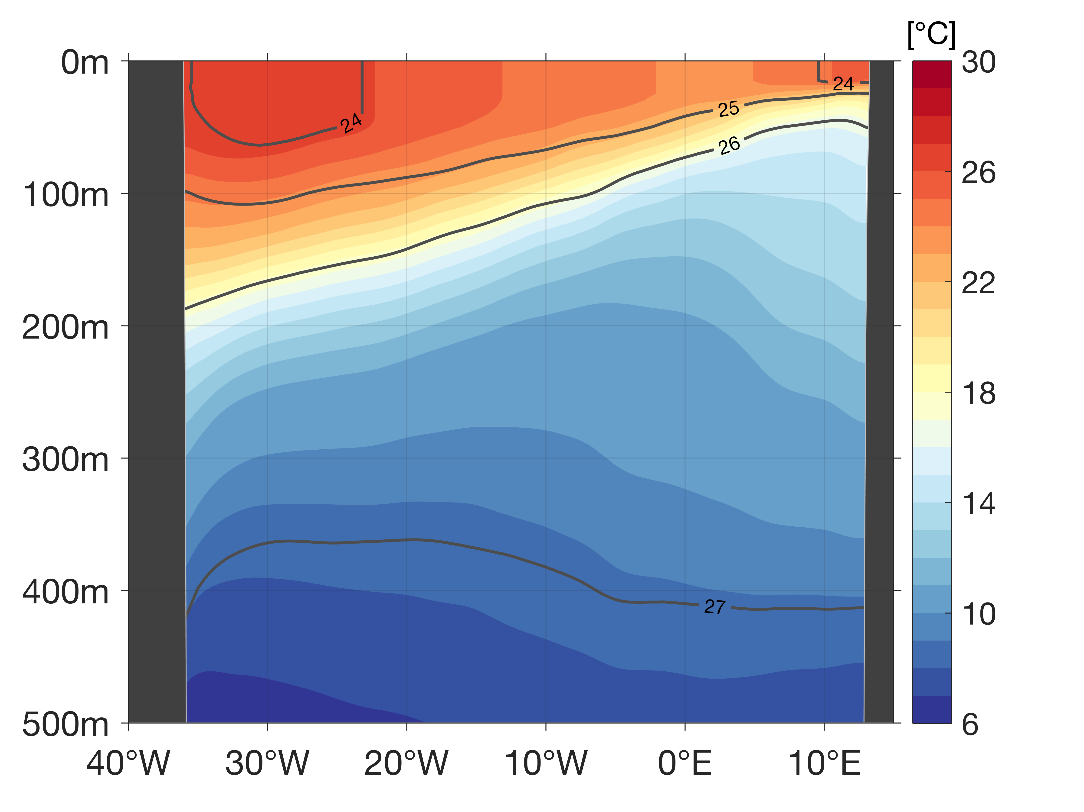
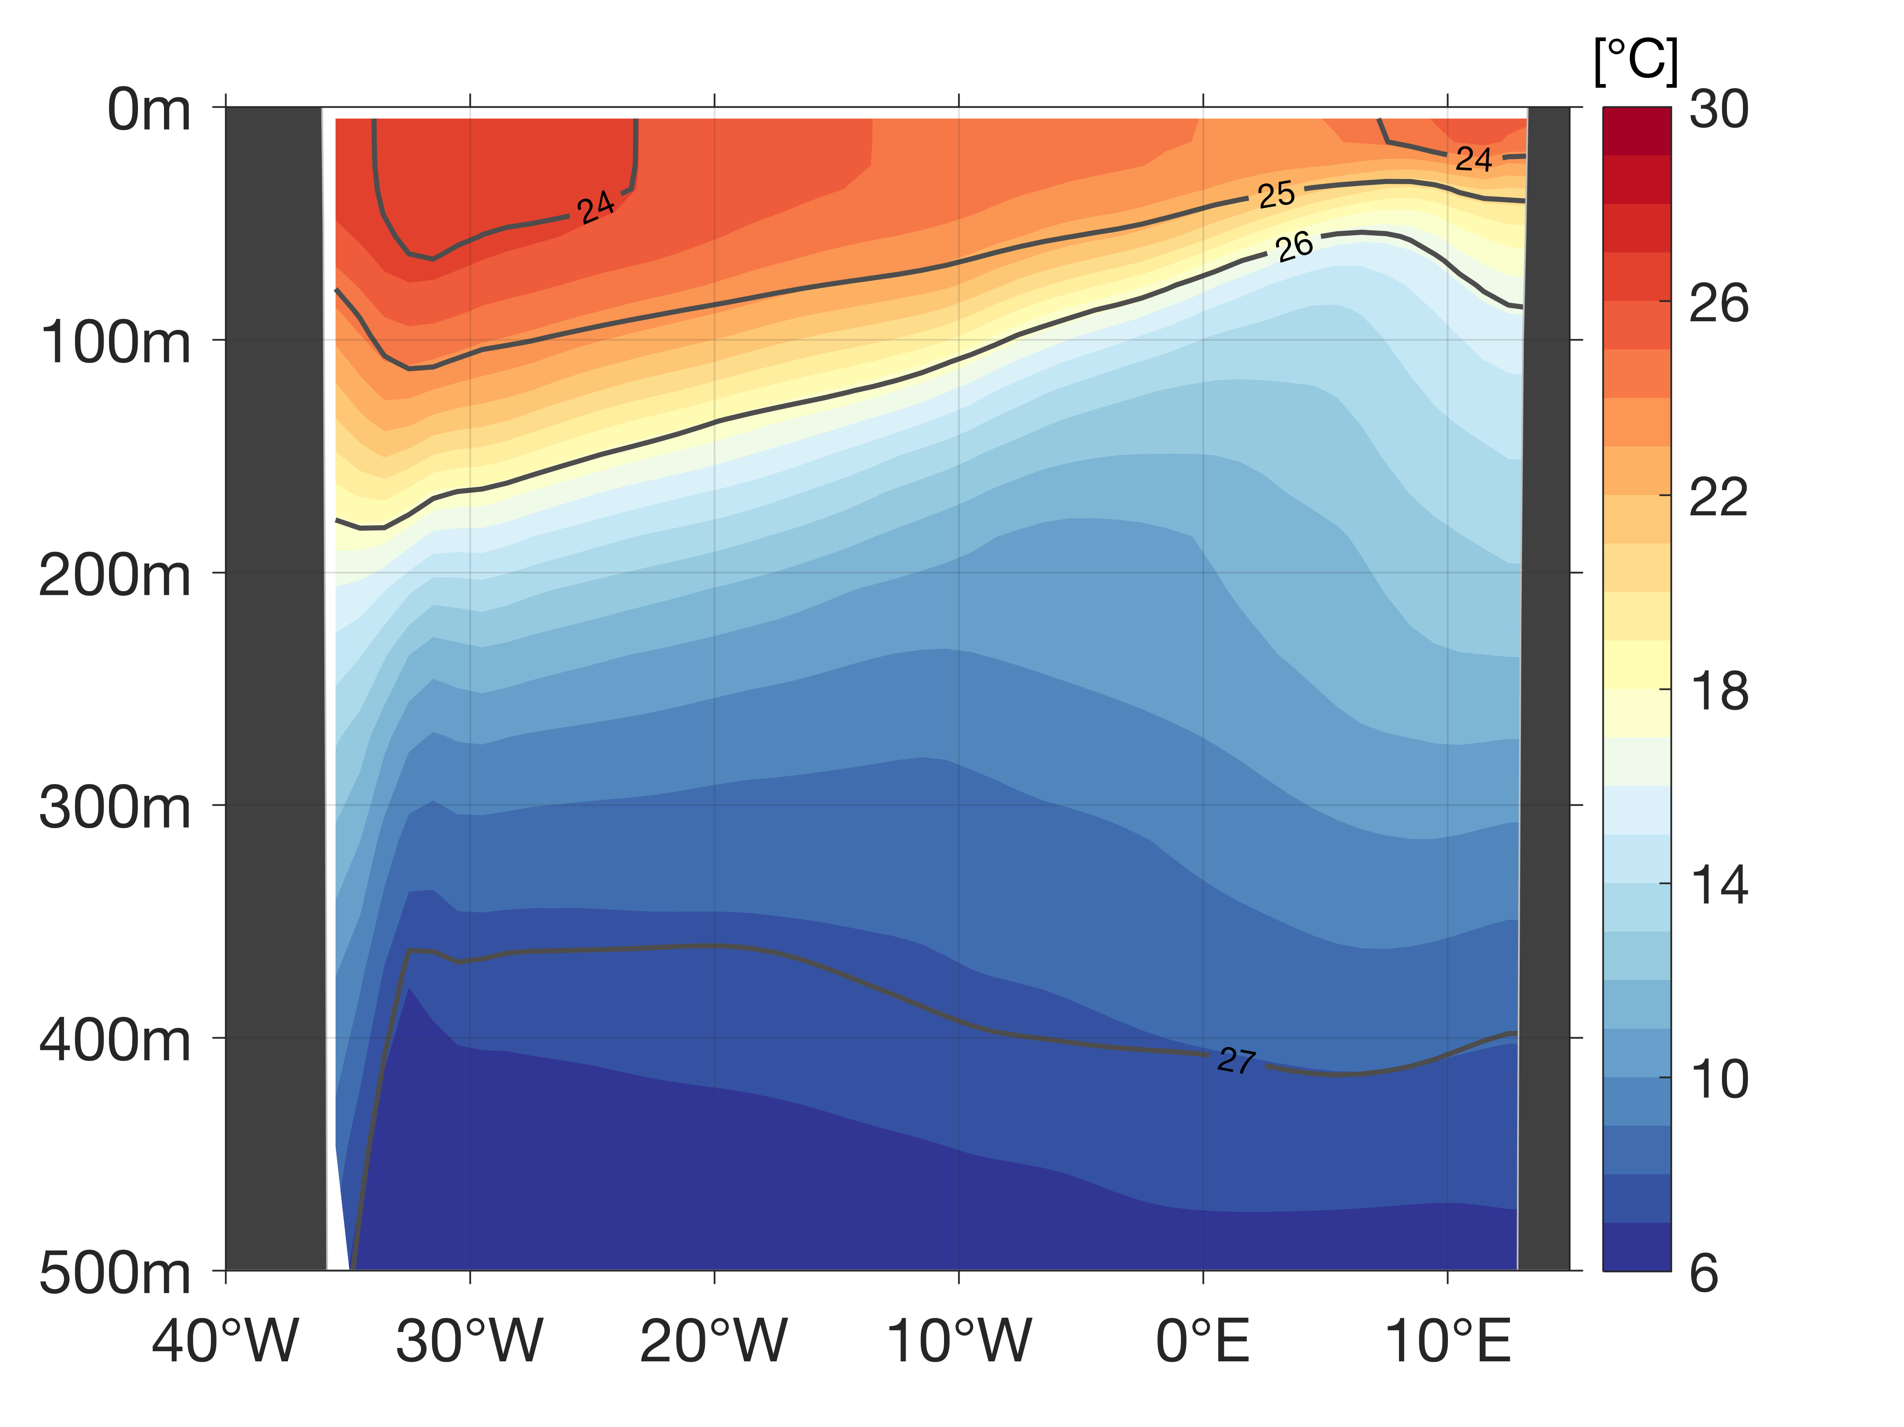
The Atlantic Subtropical Cells inferred from observations
Franz Philip Tuchen ¹, Joke F. Lübbecke ^{1,2}, Sunke Schmidtko ¹, Rebecca Hummels ¹, and Claus W. Böning ^{1,2}
¹ GEOMAR Helmholtz Centre for Ocean Research, Kiel, Germany , ² Christian-Albrechts-Universität zu Kiel, Germany
Summary
Data
Surface layer
Thermocline layer
STC schematic
Outlook
Data sets
Absolute Salinity
Conservative Temperature
Geostrophic velocity
11.5°S ship section
RG-clim (2004-2016 mean)
MIMOC (climatological mean)
ORA-S4 (2000-2017 mean)
10°N
10°S

Slide 15
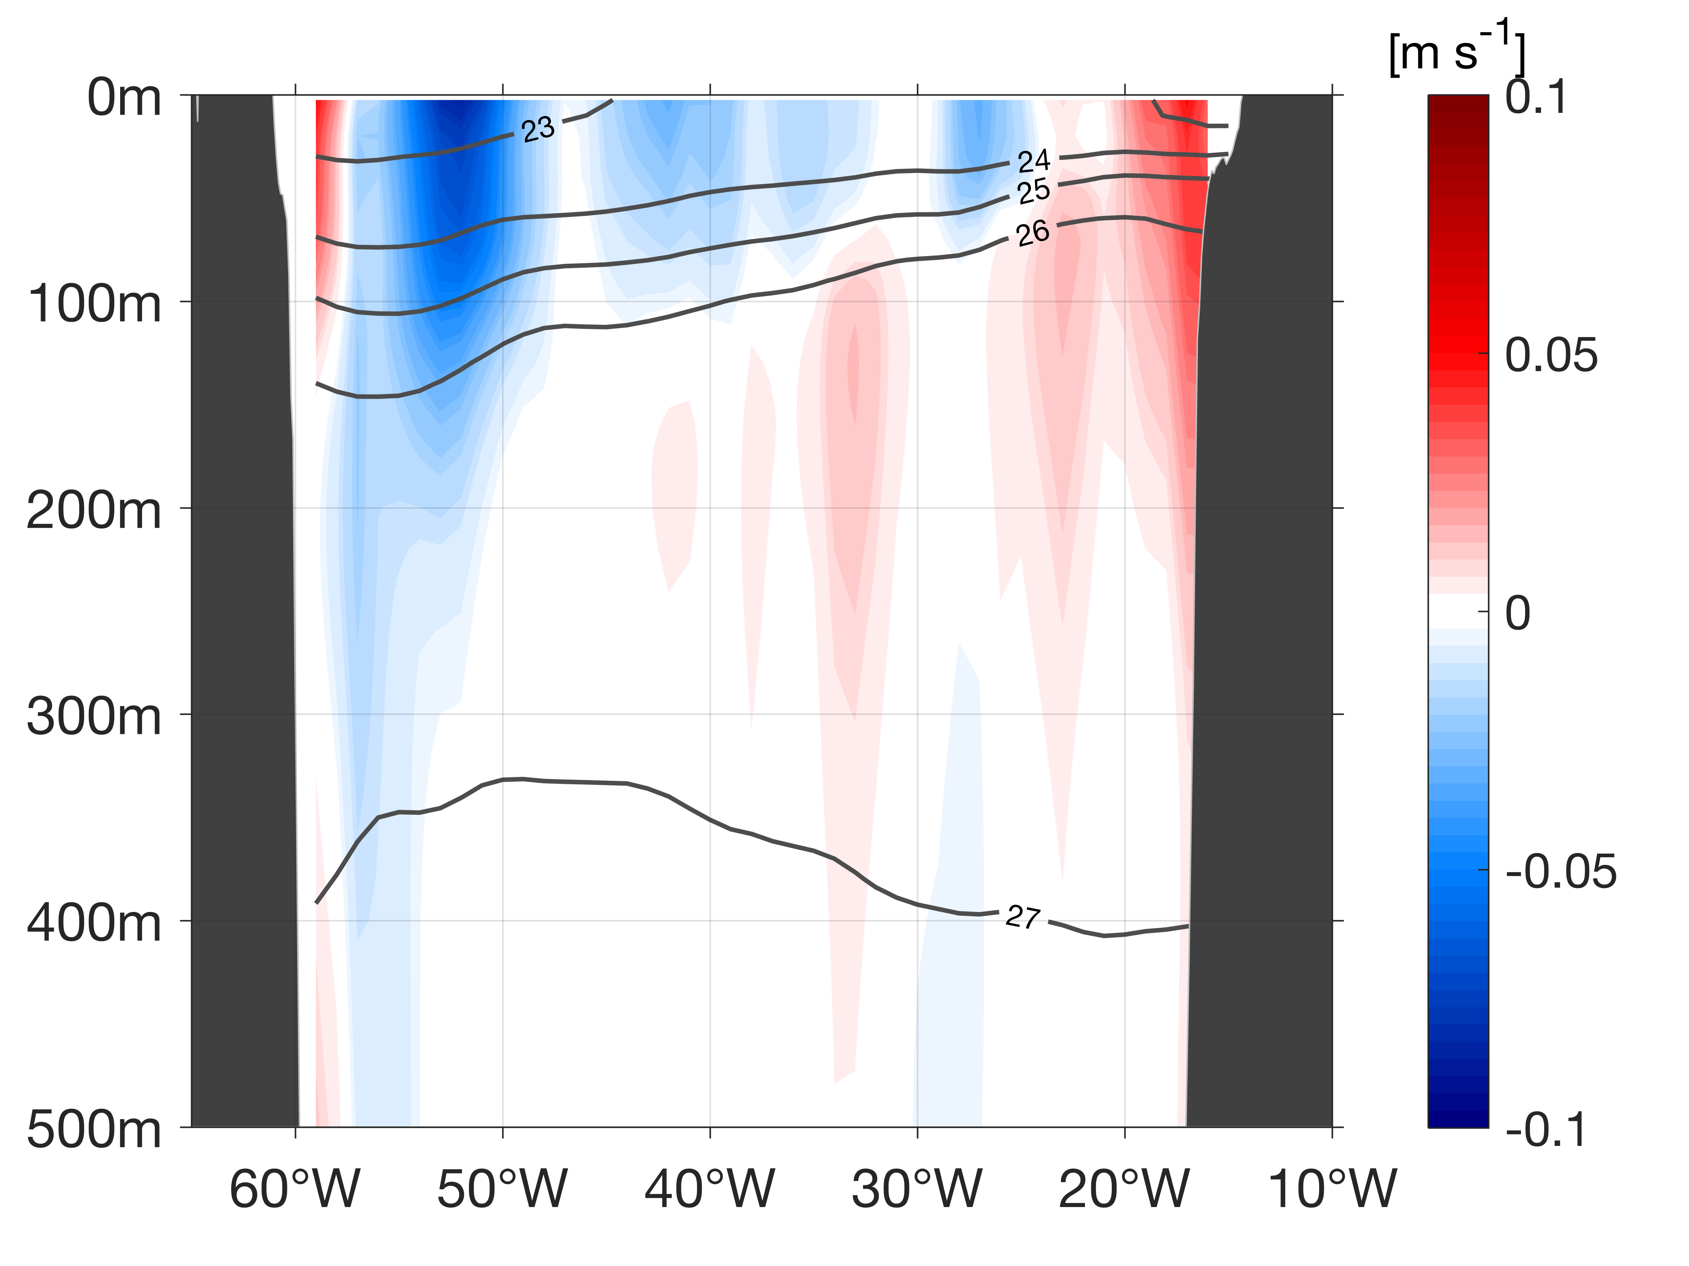
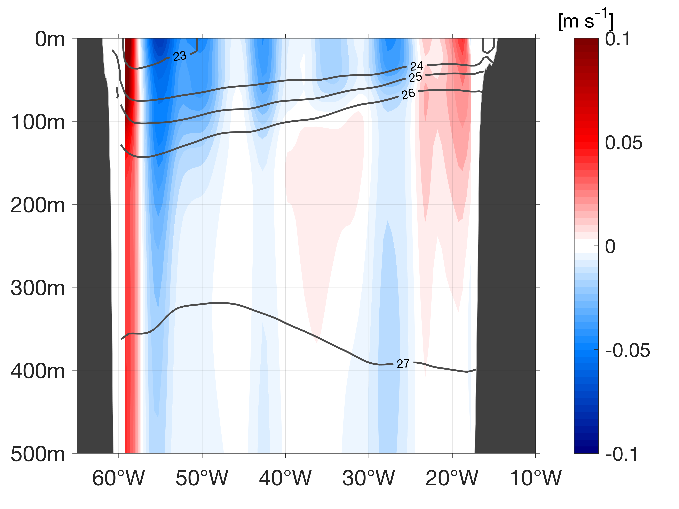
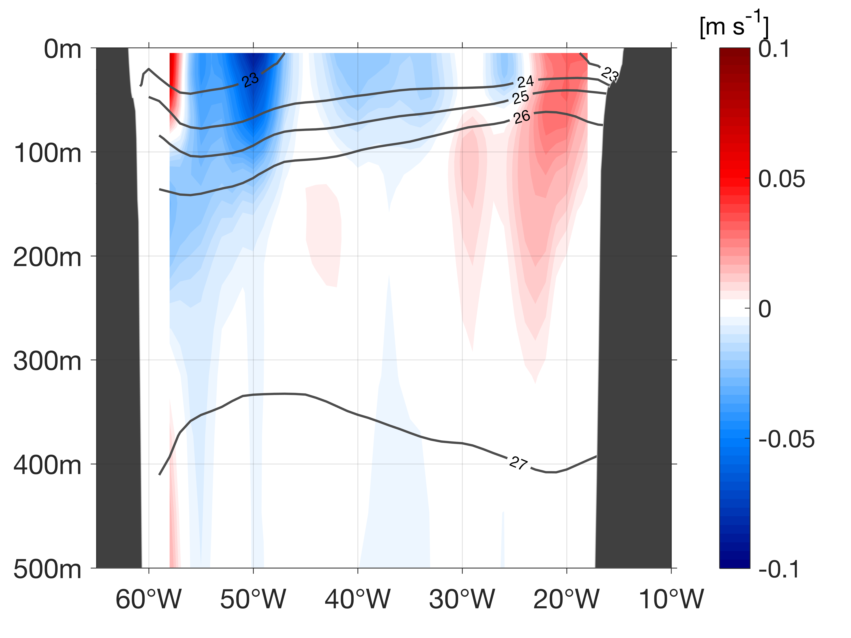

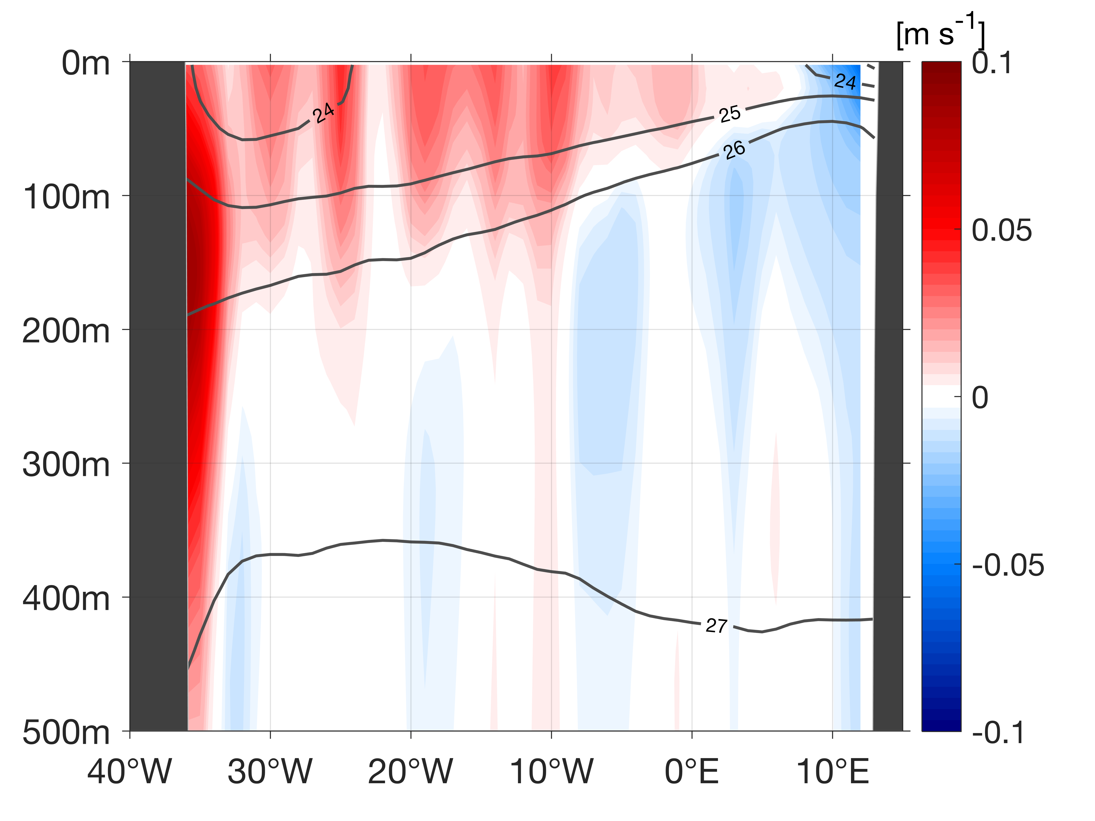
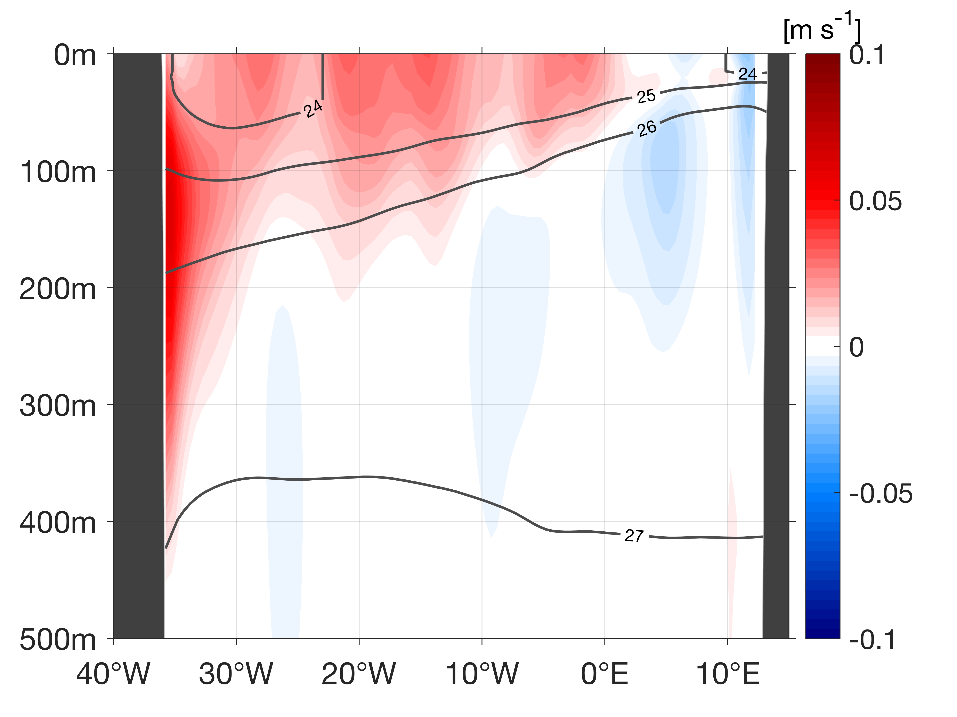
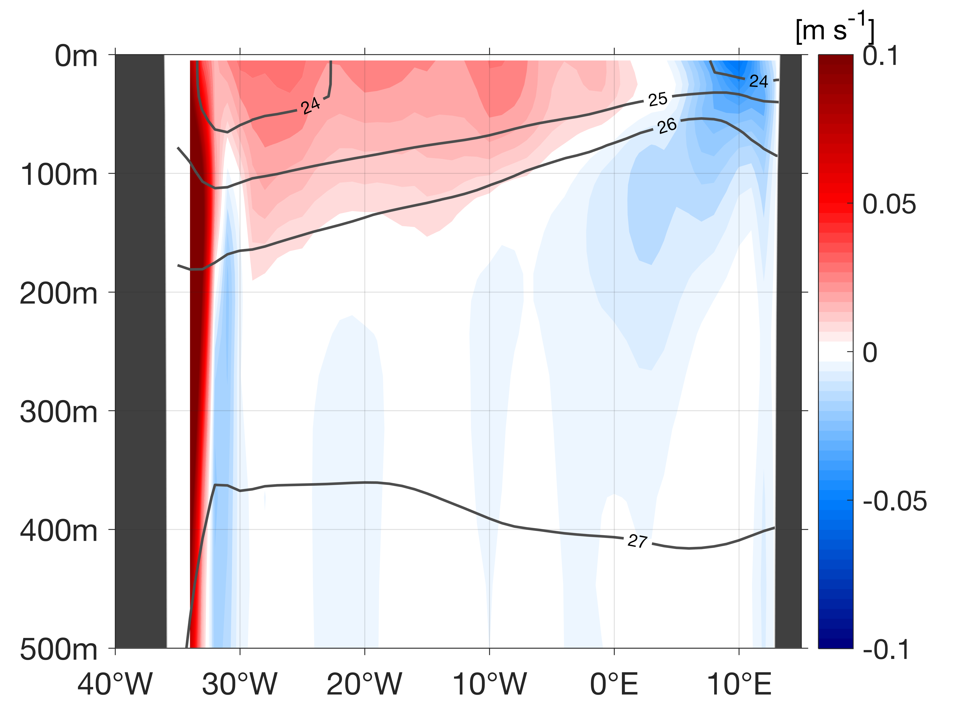
The Atlantic Subtropical Cells inferred from observations
Franz Philip Tuchen ¹, Joke F. Lübbecke ^{1,2}, Sunke Schmidtko ¹, Rebecca Hummels ¹, and Claus W. Böning ^{1,2}
¹ GEOMAR Helmholtz Centre for Ocean Research, Kiel, Germany , ² Christian-Albrechts-Universität zu Kiel, Germany
Summary
Data
Surface layer
Thermocline layer
STC schematic
Outlook
Data sets
Absolute Salinity
Conservative Temperature
Geostrophic velocity
11.5°S ship section
RG-clim (2004-2016 mean)
MIMOC (climatological mean)
ORA-S4 (2000-2017 mean)
10°N
10°S

Slide 16

The Atlantic Subtropical Cells inferred from observations
Franz Philip Tuchen ¹, Joke F. Lübbecke ^{1,2}, Sunke Schmidtko ¹, Rebecca Hummels ¹, and Claus W. Böning ^{1,2}
¹ GEOMAR Helmholtz Centre for Ocean Research, Kiel, Germany , ² Christian-Albrechts-Universität zu Kiel, Germany
Summary
Data
Surface layer
Thermocline layer
STC schematic
Outlook
Data sets
Absolute Salinity
Conservative Temperature
Geostrophic velocity
11.5°S ship section
RG-clim (2004-2016 mean)
MIMOC (climatological mean)
ORA-S4 (2000-2017 mean)
Detour: Geostrophic velocity ($v$) from hydrographic properties ($S_{A},CT$):
From absolute salinity and conservative temperature profiles the specific volume anomaly (reciprocal of density) can be derived. Integrating this from a reference level (here: assumption of level of no motion at 1200 m) gives profiles of dynamic height anomalies from which a zonal pressure gradient ($p_{x}$) is calculated. With the Coriolis parameter $f$ and a reference density, meridional geostrophic velocity is derived:
$$−fv=−\frac{1}{ρ_{0}}p_{x}$$
10°N
10°S

Slide 17
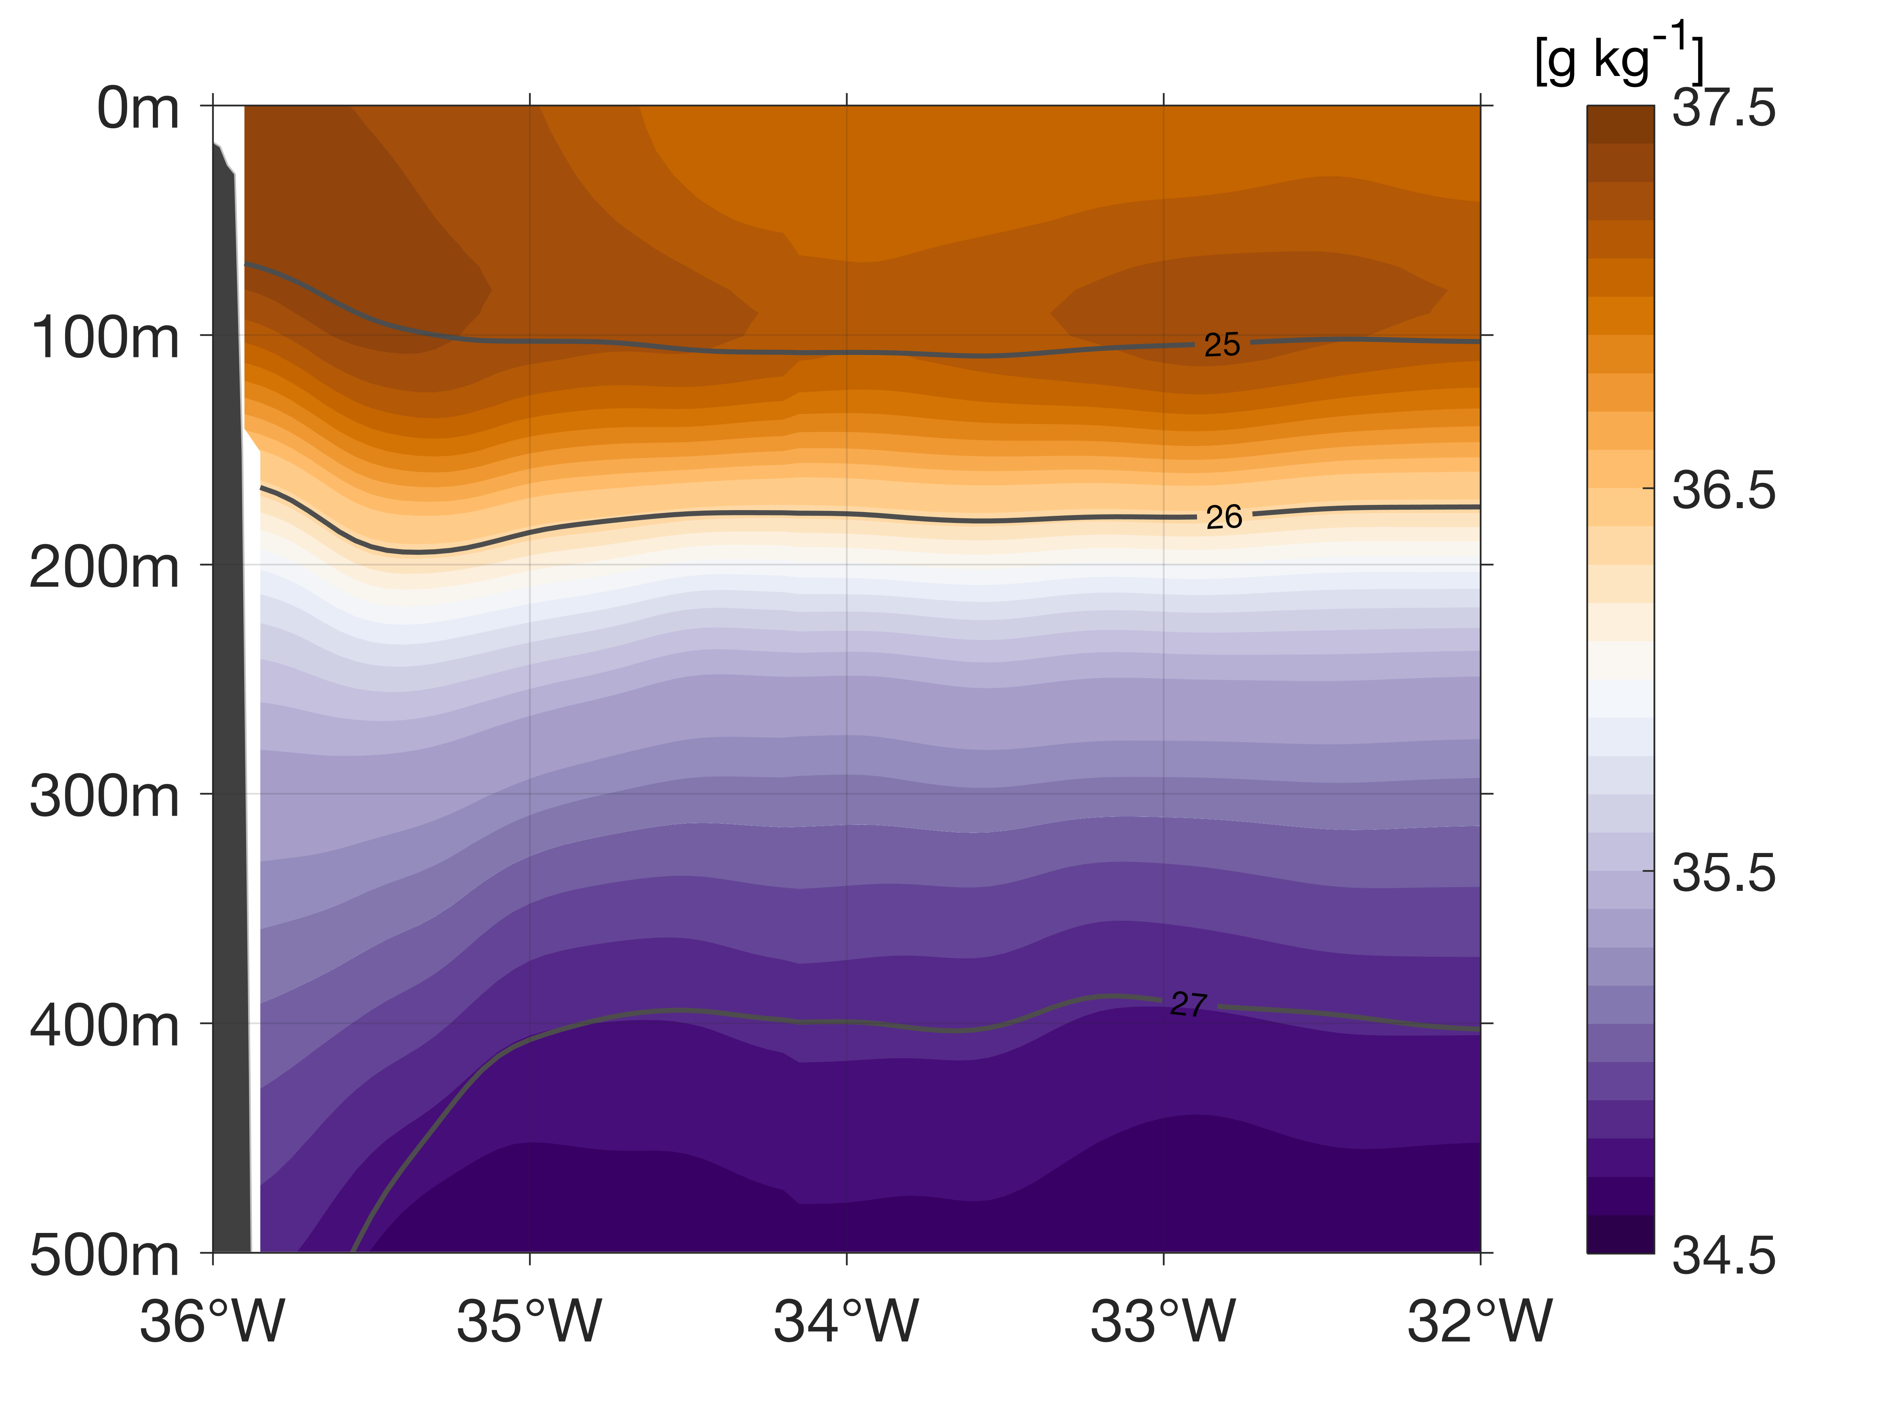
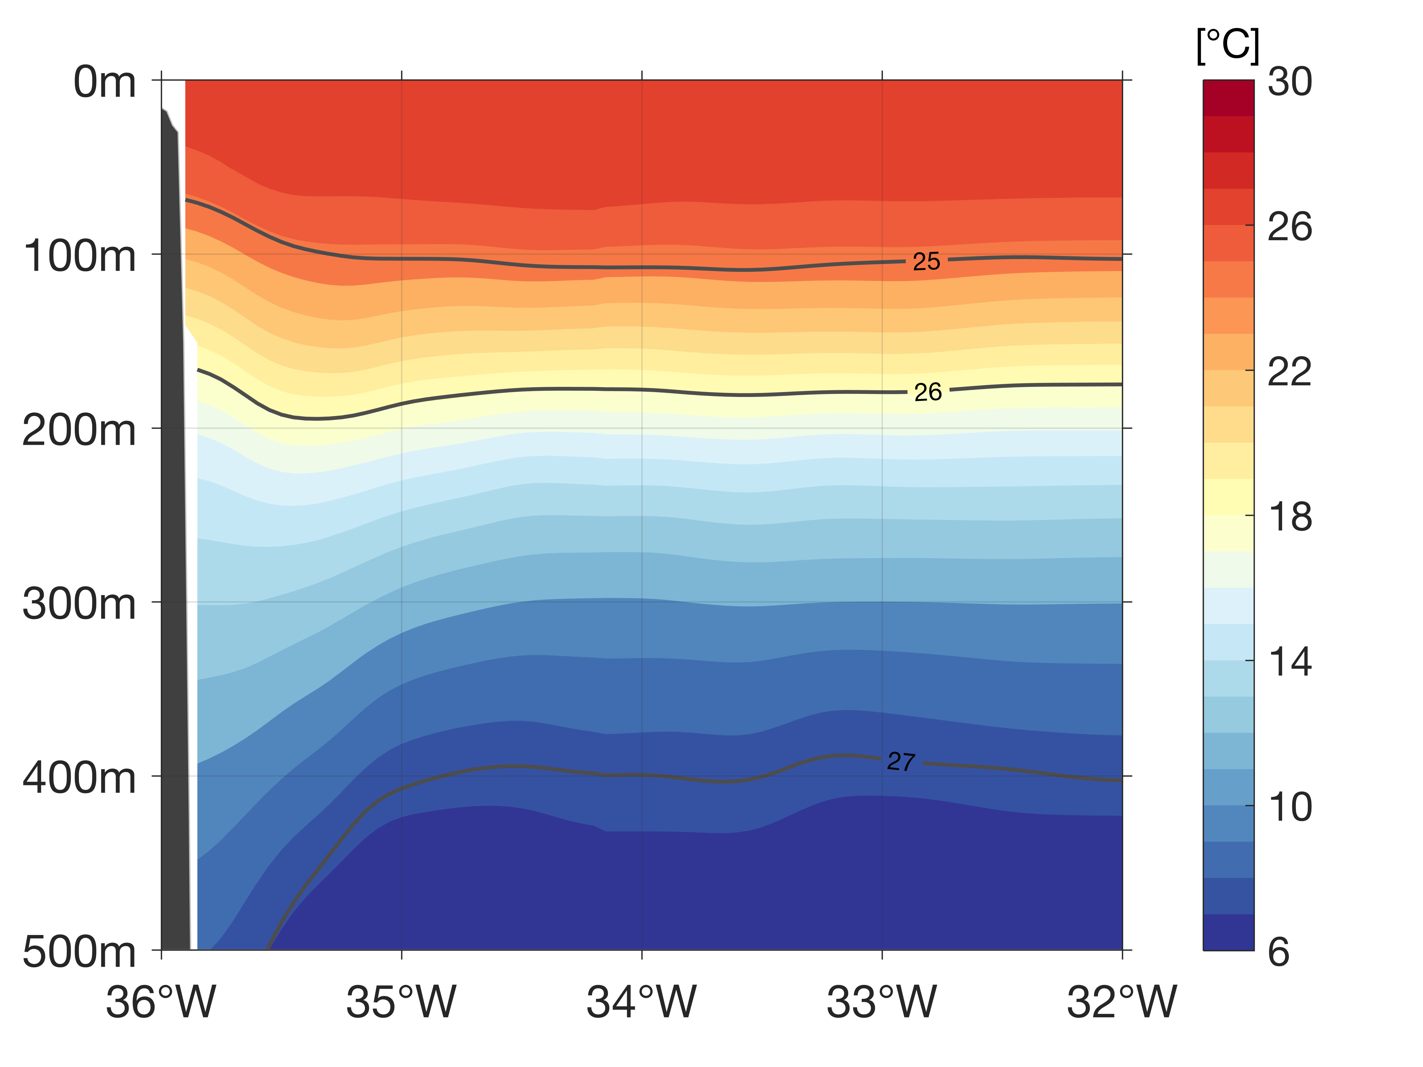
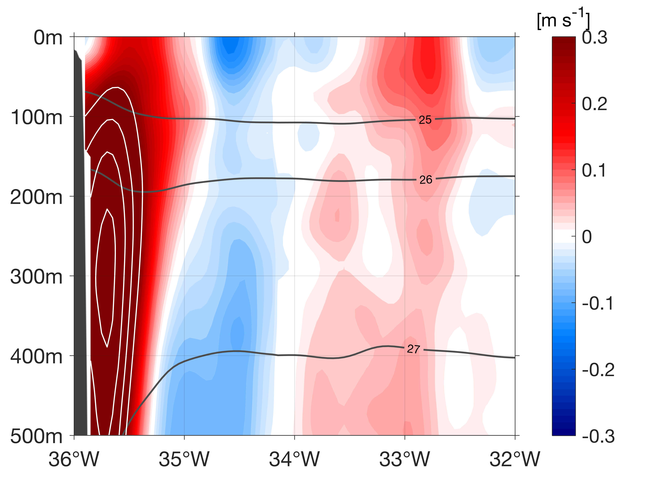
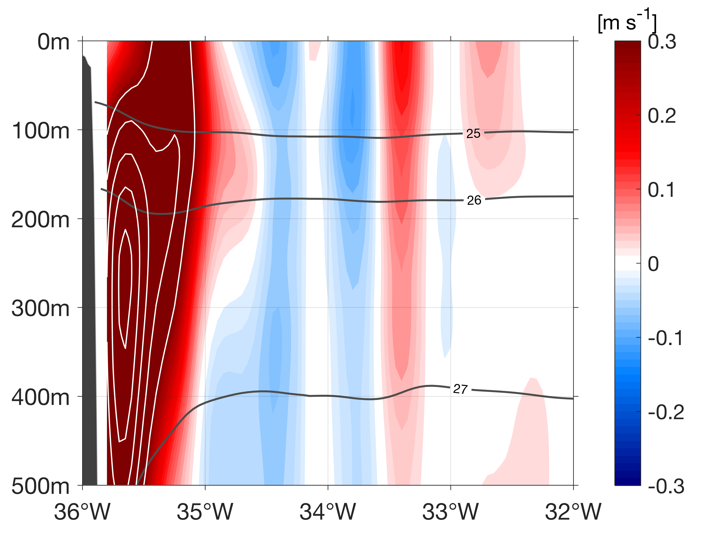
The Atlantic Subtropical Cells inferred from observations
Franz Philip Tuchen ¹, Joke F. Lübbecke ^{1,2}, Sunke Schmidtko ¹, Rebecca Hummels ¹, and Claus W. Böning ^{1,2}
¹ GEOMAR Helmholtz Centre for Ocean Research, Kiel, Germany , ² Christian-Albrechts-Universität zu Kiel, Germany
Summary
Data
Surface layer
Thermocline layer
STC schematic
Outlook
Data sets
Absolute Salinity
Conservative Temperature
Geostrophic velocity
11.5°S ship section
Mean ship sections of different properties (averaged over 5 research cruises between 2013 - 2018)
Alongshore
geostrophic velocity
Absolute Salinity
Conservative Temperature
Alongshore velocity (36°T)

Slide 18
The Atlantic Subtropical Cells inferred from observations
Franz Philip Tuchen ¹, Joke F. Lübbecke ^{1,2}, Sunke Schmidtko ¹, Rebecca Hummels ¹, and Claus W. Böning ^{1,2}
¹ GEOMAR Helmholtz Centre for Ocean Research, Kiel, Germany , ² Christian-Albrechts-Universität zu Kiel, Germany
Summary
Data
Surface layer
Thermocline layer
STC schematic
Outlook
Layer boundaries
Ekman divergence
Geostrophic contribution
Net transport
Estimating the Ekman depth from velocity data
Meridional Ekman transport derived from wind products
Meridional geostrophic transport within the surface layer
Meridional net transport derived from velocity data

Slide 19
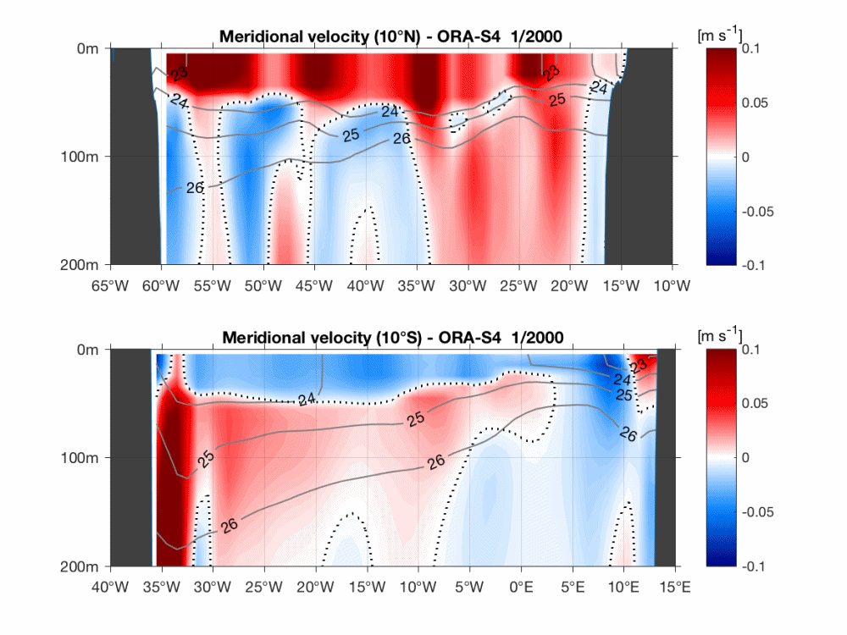
The Atlantic Subtropical Cells inferred from observations
Franz Philip Tuchen ¹, Joke F. Lübbecke ^{1,2}, Sunke Schmidtko ¹, Rebecca Hummels ¹, and Claus W. Böning ^{1,2}
¹ GEOMAR Helmholtz Centre for Ocean Research, Kiel, Germany , ² Christian-Albrechts-Universität zu Kiel, Germany
Summary
Data
Surface layer
Thermocline layer
STC schematic
Outlook
Layer boundaries
Ekman divergence
Geostrophic contribution
Net transport
We therefore use seasonal means of Ekman depth as the interface between the upper and lower branch of the STCs which are estimated individually at each latitude.
The depth at which the sign of meridional velocity changes from poleward to equatorward varies remarkably throughout the year.

Slide 20
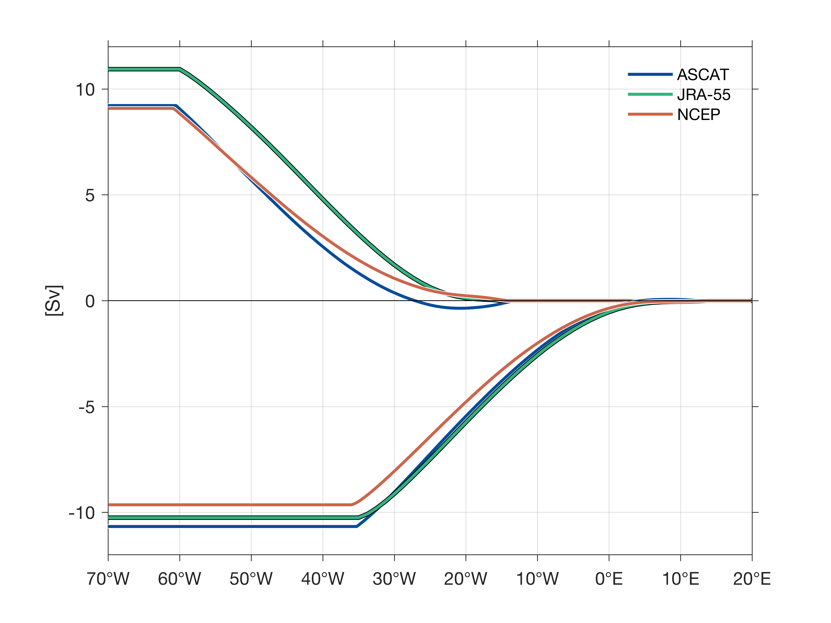
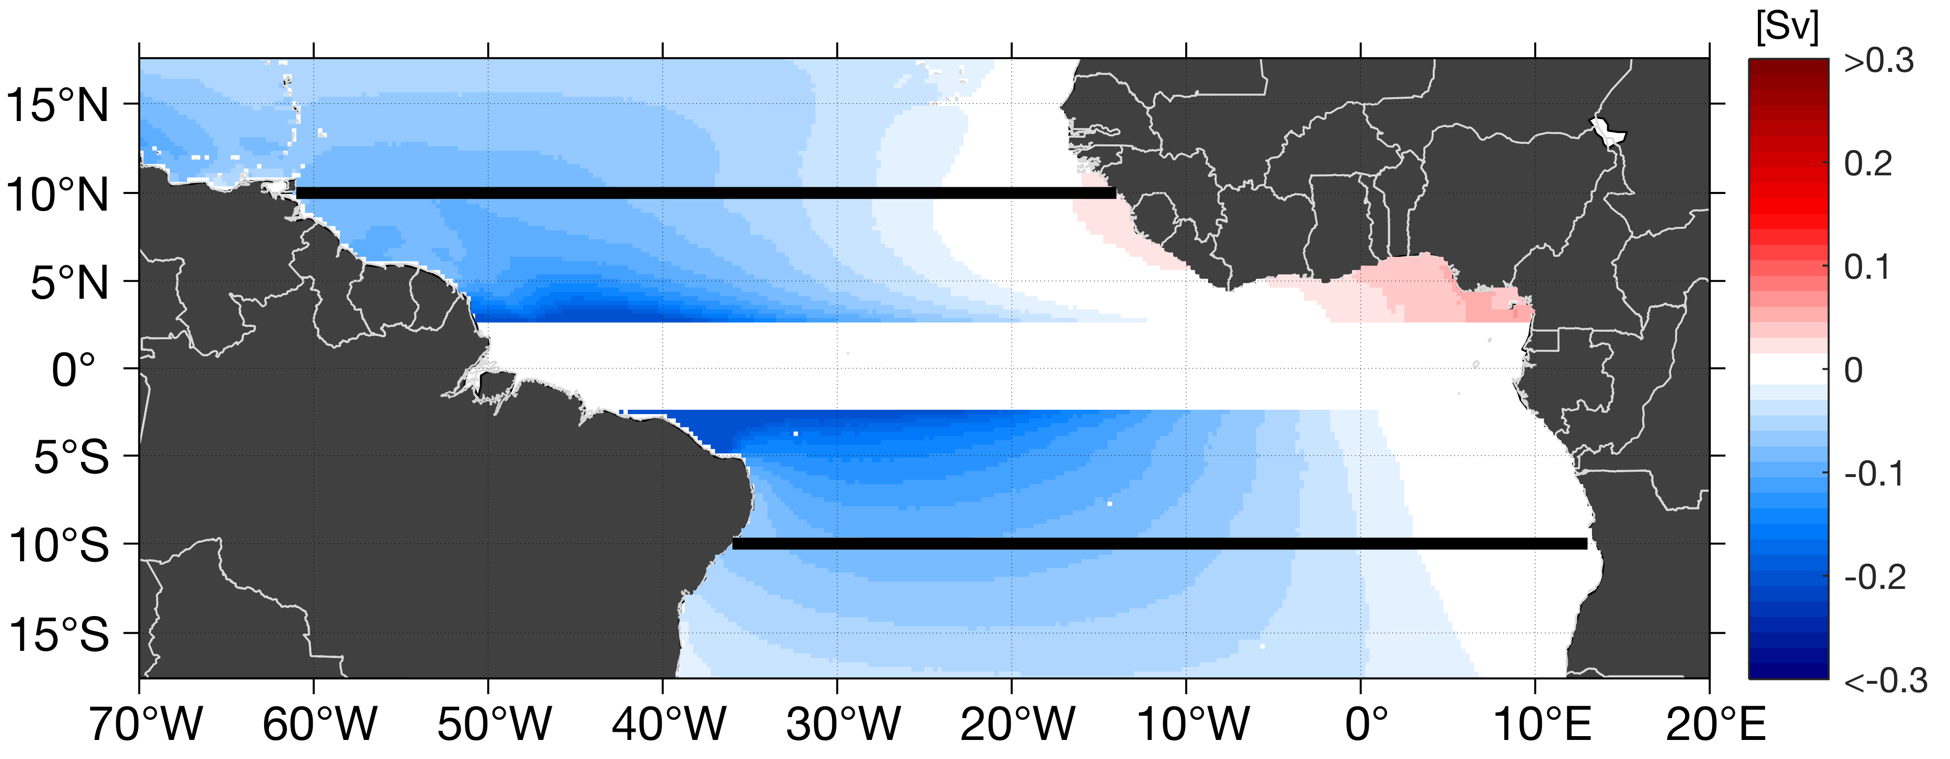
The Atlantic Subtropical Cells inferred from observations
Franz Philip Tuchen ¹, Joke F. Lübbecke ^{1,2}, Sunke Schmidtko ¹, Rebecca Hummels ¹, and Claus W. Böning ^{1,2}
¹ GEOMAR Helmholtz Centre for Ocean Research, Kiel, Germany , ² Christian-Albrechts-Universität zu Kiel, Germany
Summary
Data
Surface layer
Thermocline layer
STC schematic
Outlook
Layer boundaries
Ekman divergence
Geostrophic contribution
Net transport
10°N
10°S
Symmetric Ekman divergence about 10°N to 10°S of approximately 20 Sv (small spread for different products with different horizontal resolution covering different time periods).
Intensified poleward Ekman transport at the western boundary but close to zero and equatorward at the eastern boundary (Figure generated with ASCAT wind data)

Slide 21

The Atlantic Subtropical Cells inferred from observations
Franz Philip Tuchen ¹, Joke F. Lübbecke ^{1,2}, Sunke Schmidtko ¹, Rebecca Hummels ¹, and Claus W. Böning ^{1,2}
¹ GEOMAR Helmholtz Centre for Ocean Research, Kiel, Germany , ² Christian-Albrechts-Universität zu Kiel, Germany
Summary
Data
Surface layer
Thermocline layer
STC schematic
Outlook
Layer boundaries
Ekman divergence
Geostrophic contribution
Net transport
Detour: Ekman transport ($T_{E}$) from wind stress data ($τ$):
Ekman transport is the net transport within the surface layer of a fluid forced by wind stress at the surface. Due to the Coriolis force this transport is 90° deflected towards the right (left) in the northern (southern) hemisphere. The meridional component of the Ekman transport depends on the zonal wind stress $τ_{x}$, the Coriolis parameter $f$ at a given latitude and a reference density $ρ_{0}:$
$$T_{E}=−\frac{1}{ρ_{0}}\frac{τ_{x}}{f}$$
Symmetric Ekman divergence about 10°N to 10°S of approximately 20 Sv (small spread for different products with different horizontal resolution covering different time periods).
Intensified poleward Ekman transport at the western boundary but close to zero and equatorward at the eastern boundary (Figure generated with ASCAT wind data)

Slide 22
The Atlantic Subtropical Cells inferred from observations
Franz Philip Tuchen ¹, Joke F. Lübbecke ^{1,2}, Sunke Schmidtko ¹, Rebecca Hummels ¹, and Claus W. Böning ^{1,2}
¹ GEOMAR Helmholtz Centre for Ocean Research, Kiel, Germany , ² Christian-Albrechts-Universität zu Kiel, Germany
Summary
Data
Surface layer
Thermocline layer
STC schematic
Outlook
Layer boundaries
Ekman divergence
Geostrophic contribution
Net transport
Layer | ORA-S4 | RG-clim
Surface | 2.1 Sv | 2.6 Sv
Thermocline | 2.6 Sv | 2.3 Sv
Combined | 4.7 Sv | 4.9 Sv
10°N
Layer | ORA-S4 | RG-clim
Surface | 4.1 Sv | 4.3 Sv
Thermocline | 7.0 Sv | 6.9 Sv
Combined | 11.1 Sv | 11.2 Sv
10°S
Zonally accumulated meridional geostrophic transport for the surface layer (Surface to Ekman depth), thermocline layer (Ekman depth to 26 kg m⁻³) and the sum.

Slide 23
The Atlantic Subtropical Cells inferred from observations
Franz Philip Tuchen ¹, Joke F. Lübbecke ^{1,2}, Sunke Schmidtko ¹, Rebecca Hummels ¹, and Claus W. Böning ^{1,2}
¹ GEOMAR Helmholtz Centre for Ocean Research, Kiel, Germany , ² Christian-Albrechts-Universität zu Kiel, Germany
Summary
Data
Surface layer
Thermocline layer
STC schematic
Outlook
Layer boundaries
Ekman divergence
Geostrophic contribution
Net transport
At 10°N, 9 Sv of wind-driven Ekman transport are facing ~2.5 Sv of geostrophic equatorward transport (see previous slide). The difference (6.5 Sv) is the theoretical net transport confirmed by ORA-S4 velocity data.
At 10°S, an Ekman transport of about 11 Sv is counteracted by geostrophic transport of 4.5 Sv. The remaining difference of 6.5 Sv is in good agreement with the net transport from velocity data from ORA-S4 which shows a poleward transport of about 6 Sv.
10°N
10°S
Zonally accumulated meridional net transport in the surface layer (red) and meridional Ekman transport from the ASCAT mean (green)

Slide 24
The Atlantic Subtropical Cells inferred from observations
Franz Philip Tuchen ¹, Joke F. Lübbecke ^{1,2}, Sunke Schmidtko ¹, Rebecca Hummels ¹, and Claus W. Böning ^{1,2}
¹ GEOMAR Helmholtz Centre for Ocean Research, Kiel, Germany , ² Christian-Albrechts-Universität zu Kiel, Germany
Summary
Data
Surface layer
Thermocline layer
STC schematic
Outlook
Layer boundaries
Thermocline transport map
Accumulated transport
Estimating the lower boundary of the thermocline layer from geostrophic velocity data
Horizontal view of meridional geostrophic transport within the thermocline layer
Cumulative equatorward transport within the thermocline layer along zonal sections

Slide 25
The Atlantic Subtropical Cells inferred from observations
Franz Philip Tuchen ¹, Joke F. Lübbecke ^{1,2}, Sunke Schmidtko ¹, Rebecca Hummels ¹, and Claus W. Böning ^{1,2}
¹ GEOMAR Helmholtz Centre for Ocean Research, Kiel, Germany , ² Christian-Albrechts-Universität zu Kiel, Germany
Summary
Data
Surface layer
Thermocline layer
STC schematic
Outlook
Layer boundaries
Thermocline transport map
Accumulated transport
10°N
At 26 kg m⁻³ the sign of zonally averaged meridional transport changes at both zonal sections. Below, poleward transport is observed.
Within the surface layer, the wind-driven flow counteracts the equatorward geostrophic flow (see the difference between the red dashed and solid lines at lower density). Here, the net transport is poleward.
10°S
Zonally averaged meridional transport per density unit. At 10°S, the contribution of the western boundary is neglected.

Slide 26
The Atlantic Subtropical Cells inferred from observations
Franz Philip Tuchen ¹, Joke F. Lübbecke ^{1,2}, Sunke Schmidtko ¹, Rebecca Hummels ¹, and Claus W. Böning ^{1,2}
¹ GEOMAR Helmholtz Centre for Ocean Research, Kiel, Germany , ² Christian-Albrechts-Universität zu Kiel, Germany
Summary
Data
Surface layer
Thermocline layer
STC schematic
Outlook
Layer boundaries
Thermocline transport map
Accumulated transport
Intensified equatorward transport at the western boundary in both hemispheres.
In the interior ocean an absence of equatorward transport is observed at 10°N.
Closer to the equator equatorward transport at 10°N is most likely associated with the Tropical Cell and therefore not part of the subtropical-tropical water mass exchange.
This is in contrast to 10°S where interior transport is seen westward of 10°W.
Equatorward transport within the thermocline layer. Near the equator the Coriolis force vanishes and geostrophy does not hold (grey area). The -1000 m isobath is shown in black contour. The two zonal section at 10°N/S are also marked.

Slide 27
The Atlantic Subtropical Cells inferred from observations
Franz Philip Tuchen ¹, Joke F. Lübbecke ^{1,2}, Sunke Schmidtko ¹, Rebecca Hummels ¹, and Claus W. Böning ^{1,2}
¹ GEOMAR Helmholtz Centre for Ocean Research, Kiel, Germany , ² Christian-Albrechts-Universität zu Kiel, Germany
Summary
Data
Surface layer
Thermocline layer
STC schematic
Outlook
Layer boundaries
Thermocline transport map
Accumulated transport
Extremely low to zero interior transport at 10°N. Most of the transport (~2-3 Sv) is observed at the western boundary as part of the recirculation cell of the North Brazil Current.
At 10°S substantial interior transport is observed (~4 Sv). Western boundary transport derived from the 11°S ship section mean accounts for ~5 Sv which is in agreement with results from velocity data from ORA-S4.
10°N
10°S
Cumulative meridional transport along the two zonal sections. At 10°S, the 32°W longitude marks the boundary between interior and western boundary which is the most eastern longitude of the ship sections.

Slide 28
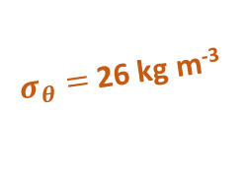
The Atlantic Subtropical Cells inferred from observations
Franz Philip Tuchen ¹, Joke F. Lübbecke ^{1,2}, Sunke Schmidtko ¹, Rebecca Hummels ¹, and Claus W. Böning ^{1,2}
¹ GEOMAR Helmholtz Centre for Ocean Research, Kiel, Germany , ² Christian-Albrechts-Universität zu Kiel, Germany
Summary
Data
Surface layer
Thermocline layer
STC schematic
Outlook
Thermocline layer geostrophic transports
Surface layer geostrophic transports
Ekman transports (derived from wind products)
Surface layer net transports (ORA-S4)
10°S
Eq.
10°N
d_{E}
$σ_{θ}=$26 kg m⁻³

Slide 29
The Atlantic Subtropical Cells inferred from observations
Franz Philip Tuchen ¹, Joke F. Lübbecke ^{1,2}, Sunke Schmidtko ¹, Rebecca Hummels ¹, and Claus W. Böning ^{1,2}
¹ GEOMAR Helmholtz Centre for Ocean Research, Kiel, Germany , ² Christian-Albrechts-Universität zu Kiel, Germany
Summary
Data
Surface layer
Thermocline layer
STC schematic
Outlook
Thermocline layer geostrophic transports
Surface layer geostrophic transports
Ekman transports (derived from wind products)
Surface layer net transports (ORA-S4)
10°S
Eq.
10°N
d_{E}
5
Western boundary
2
Western boundary
4
Interior
0
Interior
$σ_{θ}=$26 kg m⁻³
Sv (10⁶ m³ s⁻¹)

Slide 30
The Atlantic Subtropical Cells inferred from observations
Franz Philip Tuchen ¹, Joke F. Lübbecke ^{1,2}, Sunke Schmidtko ¹, Rebecca Hummels ¹, and Claus W. Böning ^{1,2}
¹ GEOMAR Helmholtz Centre for Ocean Research, Kiel, Germany , ² Christian-Albrechts-Universität zu Kiel, Germany
Summary
Data
Surface layer
Thermocline layer
STC schematic
Outlook
Thermocline layer geostrophic transports
Surface layer geostrophic transports
Ekman transports (derived from wind products)
Surface layer net transports (ORA-S4)
10°S
Eq.
10°N
4
3
d_{E}
$σ_{θ}=$26 kg m⁻³
Sv (10⁶ m³ s⁻¹)

Slide 31
The Atlantic Subtropical Cells inferred from observations
Franz Philip Tuchen ¹, Joke F. Lübbecke ^{1,2}, Sunke Schmidtko ¹, Rebecca Hummels ¹, and Claus W. Böning ^{1,2}
¹ GEOMAR Helmholtz Centre for Ocean Research, Kiel, Germany , ² Christian-Albrechts-Universität zu Kiel, Germany
Summary
Data
Surface layer
Thermocline layer
STC schematic
Outlook
Thermocline layer geostrophic transports
Surface layer geostrophic transports
Ekman transports (derived from wind products)
Surface layer net transports (ORA-S4)
10°S
Eq.
10°N
10
10
d_{E}
$σ_{θ}=$26 kg m⁻³
Sv (10⁶ m³ s⁻¹)

Slide 32
The Atlantic Subtropical Cells inferred from observations
Franz Philip Tuchen ¹, Joke F. Lübbecke ^{1,2}, Sunke Schmidtko ¹, Rebecca Hummels ¹, and Claus W. Böning ^{1,2}
¹ GEOMAR Helmholtz Centre for Ocean Research, Kiel, Germany , ² Christian-Albrechts-Universität zu Kiel, Germany
Summary
Data
Surface layer
Thermocline layer
STC schematic
Outlook
Thermocline layer geostrophic transports
Surface layer geostrophic transports
Ekman transports (derived from wind products)
Surface layer net transports (ORA-S4)
10°S
Eq.
10°N
7
6
d_{E}
The net transport is derived by using meridional velocity data from ORA-S4 within the surface layer. Theoretically, Ekman transports (derived from wind data) and geostrophic transports add up to this value.
$σ_{θ}=$26 kg m⁻³
Sv (10⁶ m³ s⁻¹)

Slide 33
The Atlantic Subtropical Cells inferred from observations
Franz Philip Tuchen ¹, Joke F. Lübbecke ^{1,2}, Sunke Schmidtko ¹, Rebecca Hummels ¹, and Claus W. Böning ^{1,2}
¹ GEOMAR Helmholtz Centre for Ocean Research, Kiel, Germany , ² Christian-Albrechts-Universität zu Kiel, Germany
Summary
Data
Surface layer
Thermocline layer
STC schematic
Outlook
Thermocline layer geostrophic transports
Surface layer geostrophic transports
Ekman transports (derived from wind products)
Surface layer net transports (ORA-S4)
10°S
Eq.
10°N
4
3
d_{E}
5
Western boundary
2
Western boundary
4
Interior
0
Interior
$σ_{θ}=$26 kg m⁻³
Sv (10⁶ m³ s⁻¹)

Slide 34
The Atlantic Subtropical Cells inferred from observations
Franz Philip Tuchen ¹, Joke F. Lübbecke ^{1,2}, Sunke Schmidtko ¹, Rebecca Hummels ¹, and Claus W. Böning ^{1,2}
¹ GEOMAR Helmholtz Centre for Ocean Research, Kiel, Germany , ² Christian-Albrechts-Universität zu Kiel, Germany
Summary
Data
Surface layer
Thermocline layer
STC schematic
Outlook
Thermocline layer geostrophic transports
Surface layer geostrophic transports
Ekman transports (derived from wind products)
Surface layer net transports (ORA-S4)
10°S
Eq.
10°N
10
10
d_{E}
5
Western boundary
2
Western boundary
4
Interior
0
Interior
$σ_{θ}=$26 kg m⁻³
Sv (10⁶ m³ s⁻¹)

Slide 35
The Atlantic Subtropical Cells inferred from observations
Franz Philip Tuchen ¹, Joke F. Lübbecke ^{1,2}, Sunke Schmidtko ¹, Rebecca Hummels ¹, and Claus W. Böning ^{1,2}
¹ GEOMAR Helmholtz Centre for Ocean Research, Kiel, Germany , ² Christian-Albrechts-Universität zu Kiel, Germany
Summary
Data
Surface layer
Thermocline layer
STC schematic
Outlook
Thermocline layer geostrophic transports
Surface layer geostrophic transports
Ekman transports (derived from wind products)
Surface layer net transports (ORA-S4)
10°S
Eq.
10°N
7
6
d_{E}
The net transport is derived by using meridional velocity data from ORA-S4 within the surface layer. Theoretically, Ekman transports (derived from wind data) and geostrophic transports add up to this value.
5
Western boundary
2
Western boundary
4
Interior
0
Interior
$σ_{θ}=$26 kg m⁻³
Sv (10⁶ m³ s⁻¹)

Slide 36
The Atlantic Subtropical Cells inferred from observations
Franz Philip Tuchen ¹, Joke F. Lübbecke ^{1,2}, Sunke Schmidtko ¹, Rebecca Hummels ¹, and Claus W. Böning ^{1,2}
¹ GEOMAR Helmholtz Centre for Ocean Research, Kiel, Germany , ² Christian-Albrechts-Universität zu Kiel, Germany
Summary
Data
Surface layer
Thermocline layer
STC schematic
Outlook
Thermocline layer geostrophic transports
Surface layer geostrophic transports
Ekman transports (derived from wind products)
Surface layer net transports (ORA-S4)
10°S
Eq.
10°N
4
10
10
3
d_{E}
$σ_{θ}=$26 kg m⁻³
Sv (10⁶ m³ s⁻¹)

Slide 37
The Atlantic Subtropical Cells inferred from observations
Franz Philip Tuchen ¹, Joke F. Lübbecke ^{1,2}, Sunke Schmidtko ¹, Rebecca Hummels ¹, and Claus W. Böning ^{1,2}
¹ GEOMAR Helmholtz Centre for Ocean Research, Kiel, Germany , ² Christian-Albrechts-Universität zu Kiel, Germany
Summary
Data
Surface layer
Thermocline layer
STC schematic
Outlook
Thermocline layer geostrophic transports
Surface layer geostrophic transports
Ekman transports (derived from wind products)
Surface layer net transports (ORA-S4)
10°S
Eq.
10°N
4
7
6
3
d_{E}
The net transport is derived by using meridional velocity data from ORA-S4 within the surface layer. Theoretically, Ekman transports (derived from wind data) and geostrophic transports add up to this value.
$σ_{θ}=$26 kg m⁻³
Sv (10⁶ m³ s⁻¹)

Slide 38
The Atlantic Subtropical Cells inferred from observations
Franz Philip Tuchen ¹, Joke F. Lübbecke ^{1,2}, Sunke Schmidtko ¹, Rebecca Hummels ¹, and Claus W. Böning ^{1,2}
¹ GEOMAR Helmholtz Centre for Ocean Research, Kiel, Germany , ² Christian-Albrechts-Universität zu Kiel, Germany
Summary
Data
Surface layer
Thermocline layer
STC schematic
Outlook
Thermocline layer geostrophic transports
Surface layer geostrophic transports
Ekman transports (derived from wind products)
Surface layer net transports (ORA-S4)
10°S
Eq.
10°N
7
10
10
6
d_{E}
The net transport is derived by using meridional velocity data from ORA-S4 within the surface layer. Theoretically, Ekman transports (derived from wind data) and geostrophic transports add up to this value.
$σ_{θ}=$26 kg m⁻³
Sv (10⁶ m³ s⁻¹)

Slide 39
The Atlantic Subtropical Cells inferred from observations
Franz Philip Tuchen ¹, Joke F. Lübbecke ^{1,2}, Sunke Schmidtko ¹, Rebecca Hummels ¹, and Claus W. Böning ^{1,2}
¹ GEOMAR Helmholtz Centre for Ocean Research, Kiel, Germany , ² Christian-Albrechts-Universität zu Kiel, Germany
Summary
Data
Surface layer
Thermocline layer
STC schematic
Outlook
Thermocline layer geostrophic transports
Surface layer geostrophic transports
Ekman transports (derived from wind products)
Surface layer net transports (ORA-S4)
10°S
Eq.
10°N
4
10
10
3
d_{E}
5
Western boundary
2
Western boundary
4
Interior
0
Interior
$σ_{θ}=$26 kg m⁻³
Sv (10⁶ m³ s⁻¹)

Slide 40
The Atlantic Subtropical Cells inferred from observations
Franz Philip Tuchen ¹, Joke F. Lübbecke ^{1,2}, Sunke Schmidtko ¹, Rebecca Hummels ¹, and Claus W. Böning ^{1,2}
¹ GEOMAR Helmholtz Centre for Ocean Research, Kiel, Germany , ² Christian-Albrechts-Universität zu Kiel, Germany
Summary
Data
Surface layer
Thermocline layer
STC schematic
Outlook
Thermocline layer geostrophic transports
Surface layer geostrophic transports
Ekman transports (derived from wind products)
Surface layer net transports (ORA-S4)
10°S
Eq.
10°N
4
7
10
10
6
3
d_{E}
The net transport is derived by using meridional velocity data from ORA-S4 within the surface layer. Theoretically, Ekman transports (derived from wind data) and geostrophic transports add up to this value.
$σ_{θ}=$26 kg m⁻³
Sv (10⁶ m³ s⁻¹)

Slide 41
The Atlantic Subtropical Cells inferred from observations
Franz Philip Tuchen ¹, Joke F. Lübbecke ^{1,2}, Sunke Schmidtko ¹, Rebecca Hummels ¹, and Claus W. Böning ^{1,2}
¹ GEOMAR Helmholtz Centre for Ocean Research, Kiel, Germany , ² Christian-Albrechts-Universität zu Kiel, Germany
Summary
Data
Surface layer
Thermocline layer
STC schematic
Outlook
Thermocline layer geostrophic transports
Surface layer geostrophic transports
Ekman transports (derived from wind products)
Surface layer net transports (ORA-S4)
10°S
Eq.
10°N
7
10
10
6
d_{E}
The net transport is derived by using meridional velocity data from ORA-S4 within the surface layer. Theoretically, Ekman transports (derived from wind data) and geostrophic transports add up to this value.
5
Western boundary
2
Western boundary
4
Interior
0
Interior
$σ_{θ}=$26 kg m⁻³
Sv (10⁶ m³ s⁻¹)

Slide 42
The Atlantic Subtropical Cells inferred from observations
Franz Philip Tuchen ¹, Joke F. Lübbecke ^{1,2}, Sunke Schmidtko ¹, Rebecca Hummels ¹, and Claus W. Böning ^{1,2}
¹ GEOMAR Helmholtz Centre for Ocean Research, Kiel, Germany , ² Christian-Albrechts-Universität zu Kiel, Germany
Summary
Data
Surface layer
Thermocline layer
STC schematic
Outlook
Thermocline layer geostrophic transports
Surface layer geostrophic transports
Ekman transports (derived from wind products)
Surface layer net transports (ORA-S4)
10°S
Eq.
10°N
4
7
6
3
d_{E}
The net transport is derived by using meridional velocity data from ORA-S4 within the surface layer. Theoretically, Ekman transports (derived from wind data) and geostrophic transports add up to this value.
5
Western boundary
2
Western boundary
4
Interior
0
Interior
$σ_{θ}=$26 kg m⁻³
Sv (10⁶ m³ s⁻¹)

Slide 43
The Atlantic Subtropical Cells inferred from observations
Franz Philip Tuchen ¹, Joke F. Lübbecke ^{1,2}, Sunke Schmidtko ¹, Rebecca Hummels ¹, and Claus W. Böning ^{1,2}
¹ GEOMAR Helmholtz Centre for Ocean Research, Kiel, Germany , ² Christian-Albrechts-Universität zu Kiel, Germany
Summary
Data
Surface layer
Thermocline layer
STC schematic
Outlook
Thermocline layer geostrophic transports
Surface layer geostrophic transports
Ekman transports (derived from wind products)
Surface layer net transports (ORA-S4)
10°S
Eq.
10°N
4
7
10
10
6
3
d_{E}
The net transport is derived by using meridional velocity data from ORA-S4 within the surface layer. Theoretically, Ekman transports (derived from wind data) and geostrophic transports add up to this value.
5
Western boundary
2
Western boundary
4
Interior
0
Interior
2
2 Sv are needed to balance the thermocline convergence of 11 Sv and the net surface layer divergence 13 Sv. The warm water return flow of the thermohaline circulation enters the thermocline layer in the tropics but previous studies suggested it to be between 6-10 Sv. Possibly, at 10°N a better resolved western boundary would also help to close the budget.
$σ_{θ}=$26 kg m⁻³
Sv (10⁶ m³ s⁻¹)

Slide 44
The Atlantic Subtropical Cells inferred from observations
Franz Philip Tuchen ¹, Joke F. Lübbecke ^{1,2}, Sunke Schmidtko ¹, Rebecca Hummels ¹, and Claus W. Böning ^{1,2}
¹ GEOMAR Helmholtz Centre for Ocean Research, Kiel, Germany , ² Christian-Albrechts-Universität zu Kiel, Germany
Summary
Data
Surface layer
Thermocline layer
STC schematic
Outlook
Seasonal to interannual variability
Influence on equatorial currents
Impact on tropical SST variability

Slide 45
The Atlantic Subtropical Cells inferred from observations
Franz Philip Tuchen ¹, Joke F. Lübbecke ^{1,2}, Sunke Schmidtko ¹, Rebecca Hummels ¹, and Claus W. Böning ^{1,2}
¹ GEOMAR Helmholtz Centre for Ocean Research, Kiel, Germany , ² Christian-Albrechts-Universität zu Kiel, Germany
Summary
Data
Surface layer
Thermocline layer
STC schematic
Outlook
Seasonal to interannual variability
The layer boundaries as defined in this study substantially vary on seasonal time scales. Possible variability on longer time scales has to be considered in time series of transport estimates
Future research will focus on interannual to decadal variability of the STC transport, transported water mass property anomalies (absolute salinity, conservative temperature) and layer boundaries

Slide 46
The Atlantic Subtropical Cells inferred from observations
Franz Philip Tuchen ¹, Joke F. Lübbecke ^{1,2}, Sunke Schmidtko ¹, Rebecca Hummels ¹, and Claus W. Böning ^{1,2}
¹ GEOMAR Helmholtz Centre for Ocean Research, Kiel, Germany , ² Christian-Albrechts-Universität zu Kiel, Germany
Summary
Data
Surface layer
Thermocline layer
STC schematic
Outlook
Influence on equatorial currents
A substantial part of STC water (especially from the southern hemisphere) is fed into equatorial currents (e.g. the Equatorial Undercurrent)
Anomalies in equatorward transport or water mass properties are propagated along the equator with the current and might impact their transport variability or their water mass characteristics

Slide 47
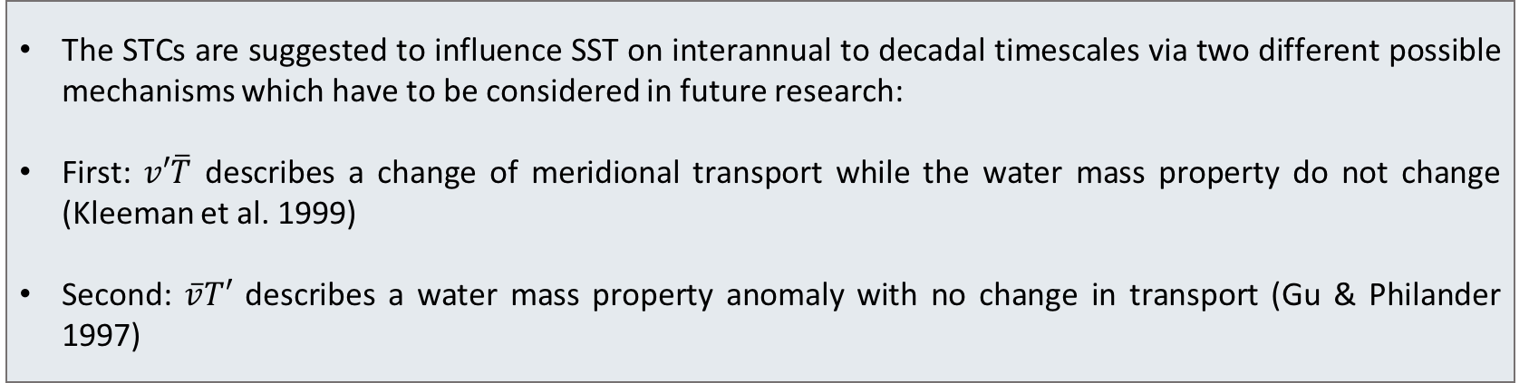
The Atlantic Subtropical Cells inferred from observations
Franz Philip Tuchen ¹, Joke F. Lübbecke ^{1,2}, Sunke Schmidtko ¹, Rebecca Hummels ¹, and Claus W. Böning ^{1,2}
¹ GEOMAR Helmholtz Centre for Ocean Research, Kiel, Germany , ² Christian-Albrechts-Universität zu Kiel, Germany
Summary
Data
Surface layer
Thermocline layer
STC schematic
Outlook
Impact on tropical SST variability
The STCs are suggested to influence SST on interannual to decadal timescales via two different possible mechanisms which have to be considered in future research:
First: $v′\overline{T}$ describes a change of meridional transport while the water mass property do not change (Kleeman et al. 1999)
Second: $\overline{v}T′$ describes a water mass property anomaly with no change in transport (Gu & Philander 1997)

