Slide 1
Github and Open Data in the Eurasian Modern Pollen Database Philipp S. Sommer, Basil A. S. Davis, Manuel Chevalier

Slide 2
What I will show you now is…
A transparent database
An accessible database
A community-based database
Without any costs and without an own server
Limitations:
less than ~200MB?
ASCII-format
point-data (no matter how many)

Slide 3
Pollen research for Paleoclimate
Once upon a time
Today

Slide 4
Lake Pollen Samples
Modern
Fossil

Slide 5
EMPD1
Davis et. al, 2013
Started in 2011
Around 5000 samples
43 contributors
Published in 2013

Slide 6
Me
No palynology
Never built a database
Physicist
Climate modeler
Software developer
Version control
Automated tests
Transparent and open source development
Online collaborations
Extensive documentation
Looking for a job after November 2019…

Slide 7
Transparency
Accessibility
Extendibility

Slide 8
Transparency
Accessibility
Extendibility
Github: Online platform for the version control system git (more than 100 million repositories)
EMPD v2 on Github:
https://github.com/EMPD2
https://empd2.github.io
Data repository: https://github.com/EMPD2/EMPD-data

Slide 9
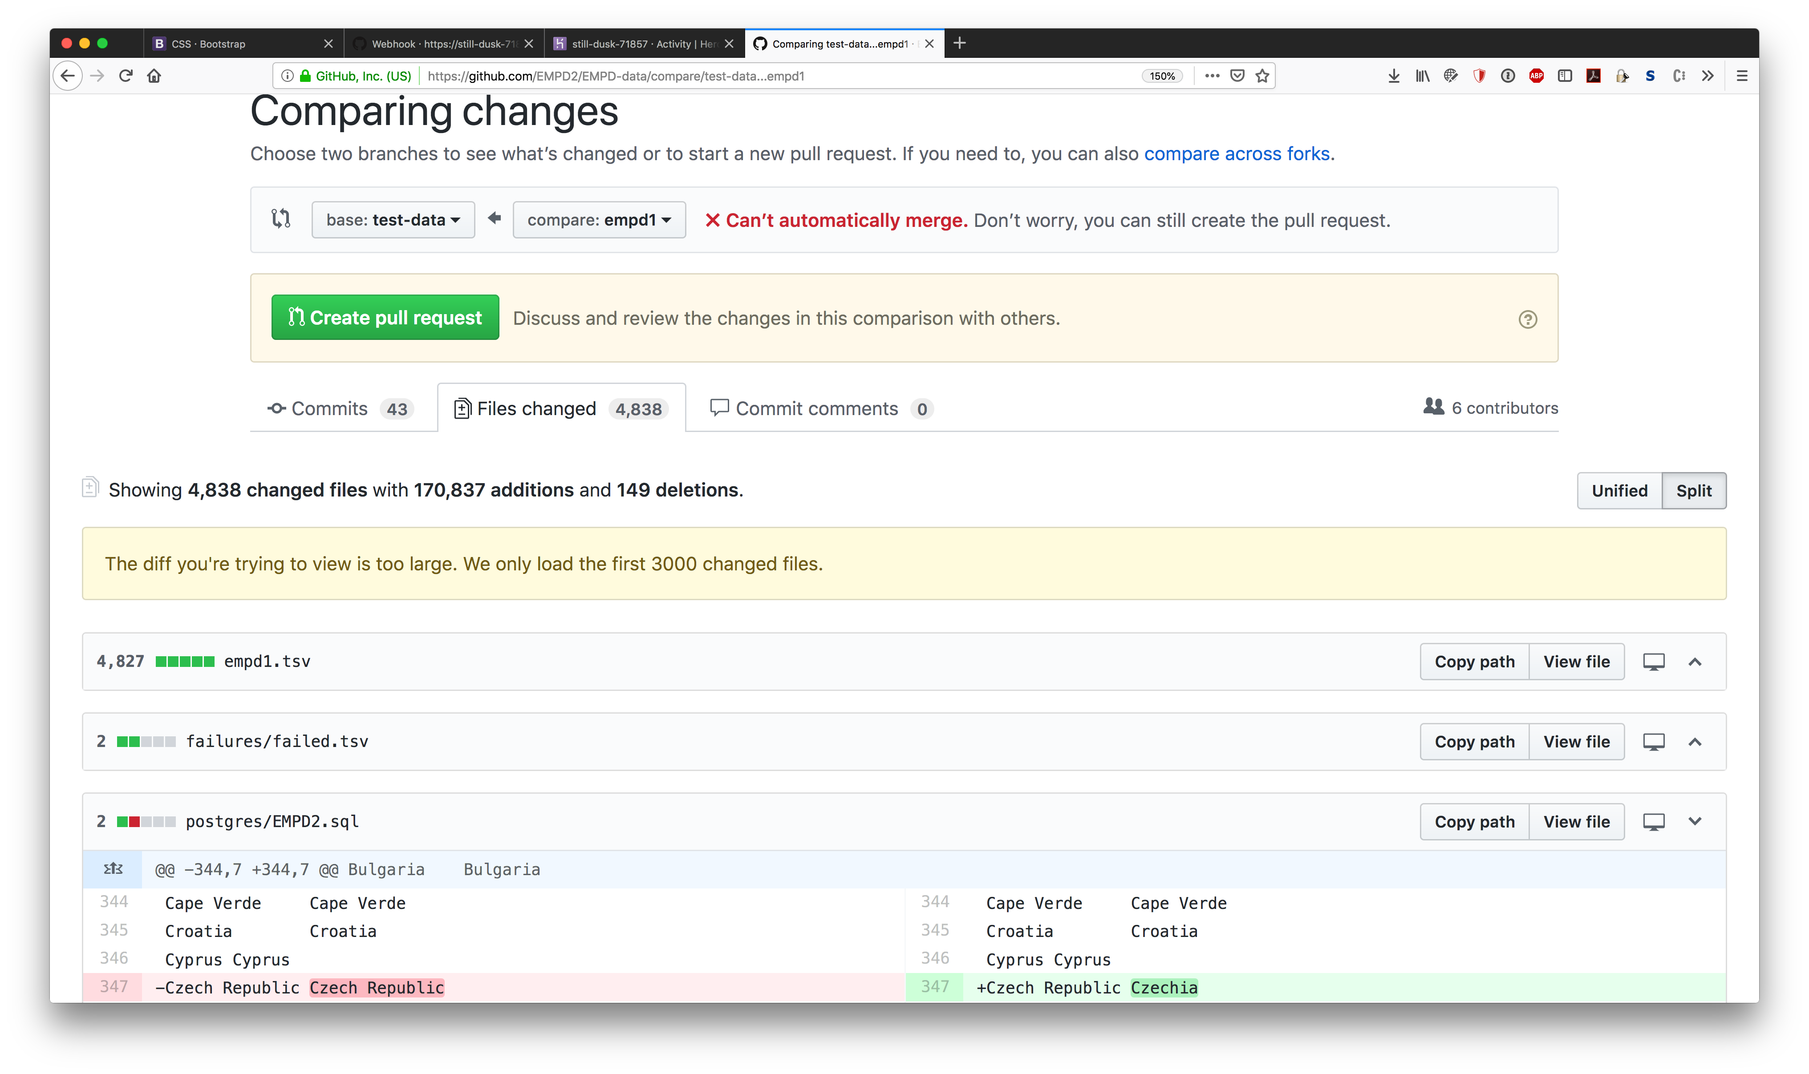
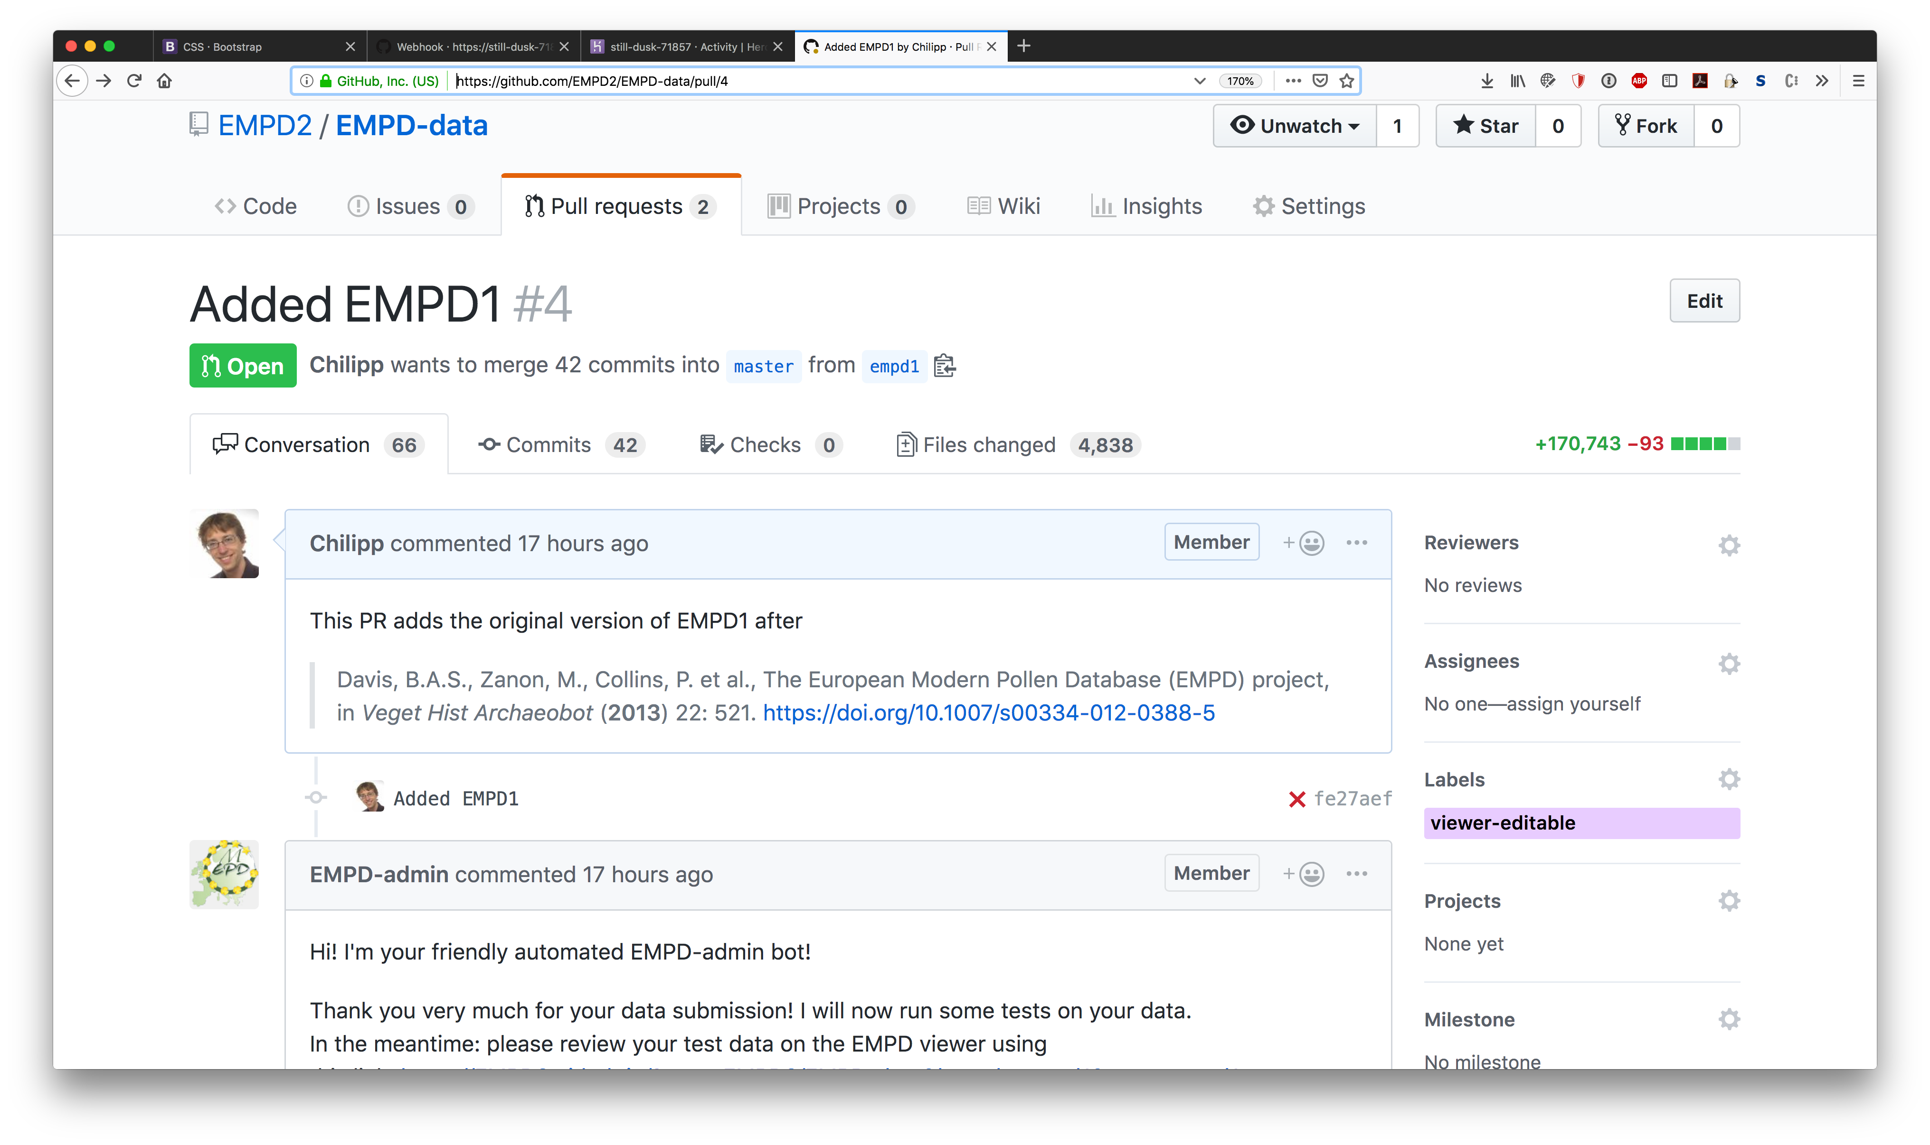
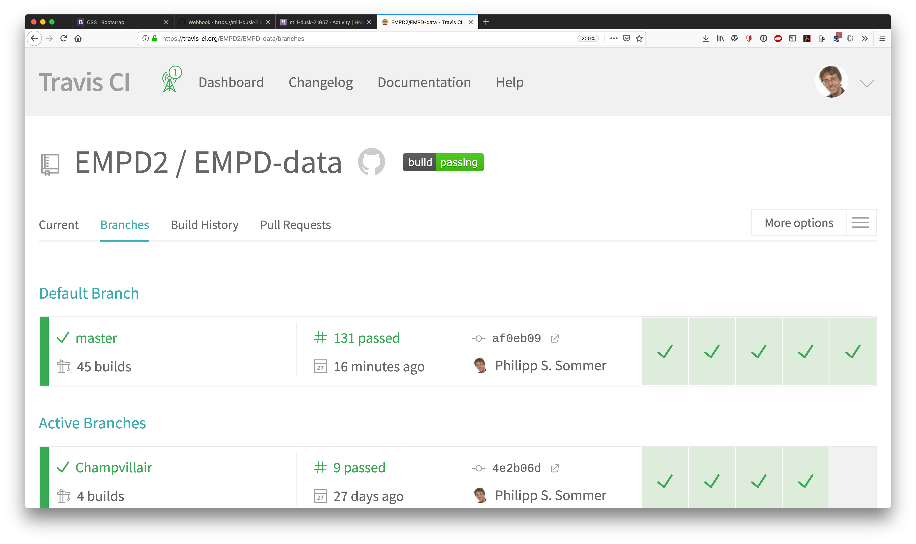
Transparency
Accessibility
Extendibility
Compare changes
Contribute through pull requests
Test the database
Works amazing with ASCII
Open Data
Open Data Science

Slide 10
Transparency
Accessibility
Extendibility
Many scientist do not want to register on Github just to use the EMPD!
Desktop app?
Google maps?
Own webpage?

Slide 11
Transparency
Accessibility
Extendibility
Climate Proxies Finder
http://climateproxiesfinder.ipsl.fr

Slide 12
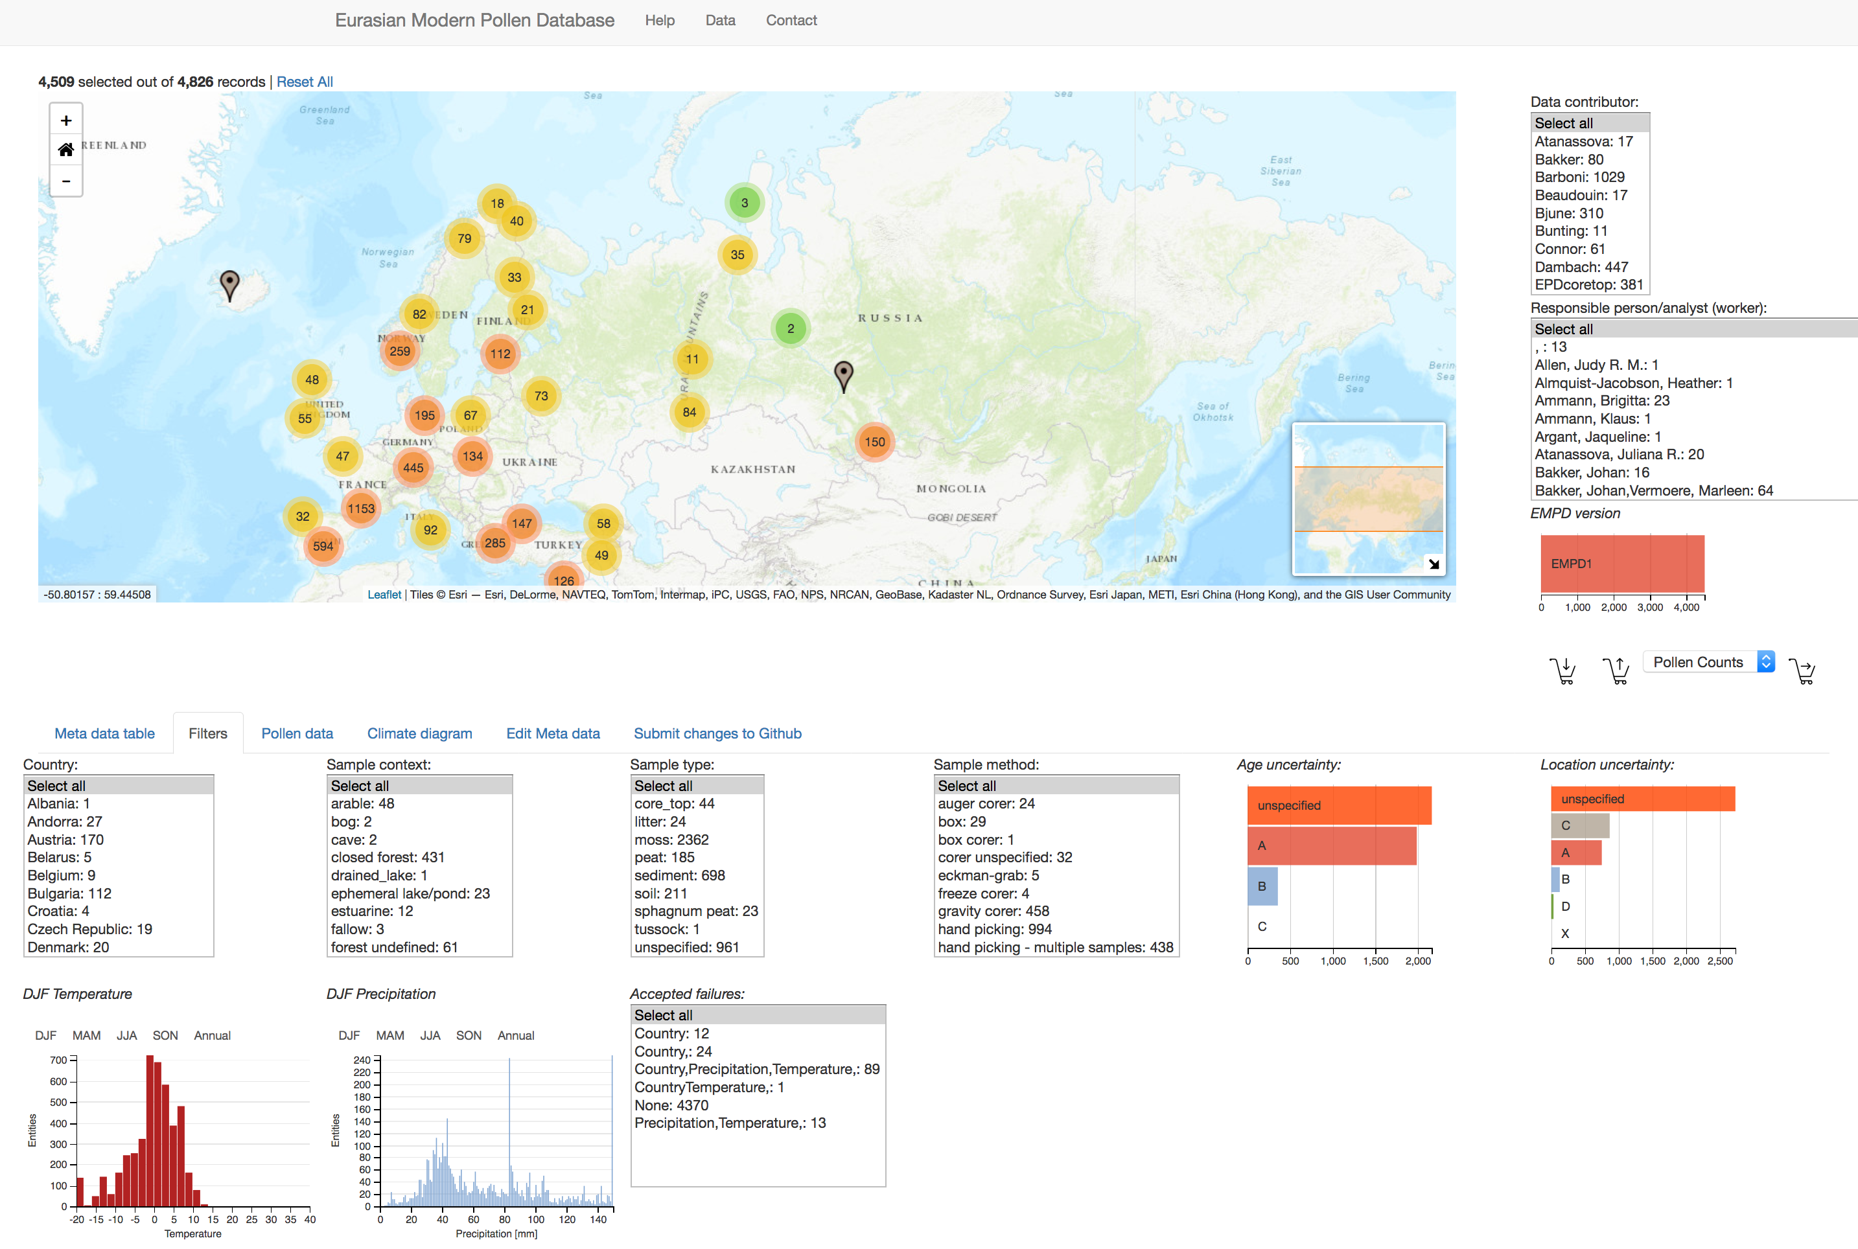
Transparency
Accessibility
Extendibility
Free EMPD viewer
https://EMPD2.github.io

Slide 13
Transparency
Accessibility
Extendibility
Do we really want to wait another 6 years for new samples?
No, but who should maintain it?
https://conda.io
conda-forge
Developer community with >1000 contributors and >6000 packages

Slide 14
Transparency
Accessibility
Extendibility
@conda-forge-admin
github.com/conda-forge-admin
Web
hook
@EMPD-admin
github.com/EMPD-admin
@conda-forge-admin rerender
@conda-forge-admin add noarch
@conda-forge-admin lint
@EMPD-admin test # test PR
@EMPD-admin fix # fix PR
@EMPD-admin query # query db
@EMPD-admin help # show help
@EMPD-admin finish # merge PR
heroku.com
Provides free webserver with up to 1000 hours per month
Integrates with Github

Slide 15
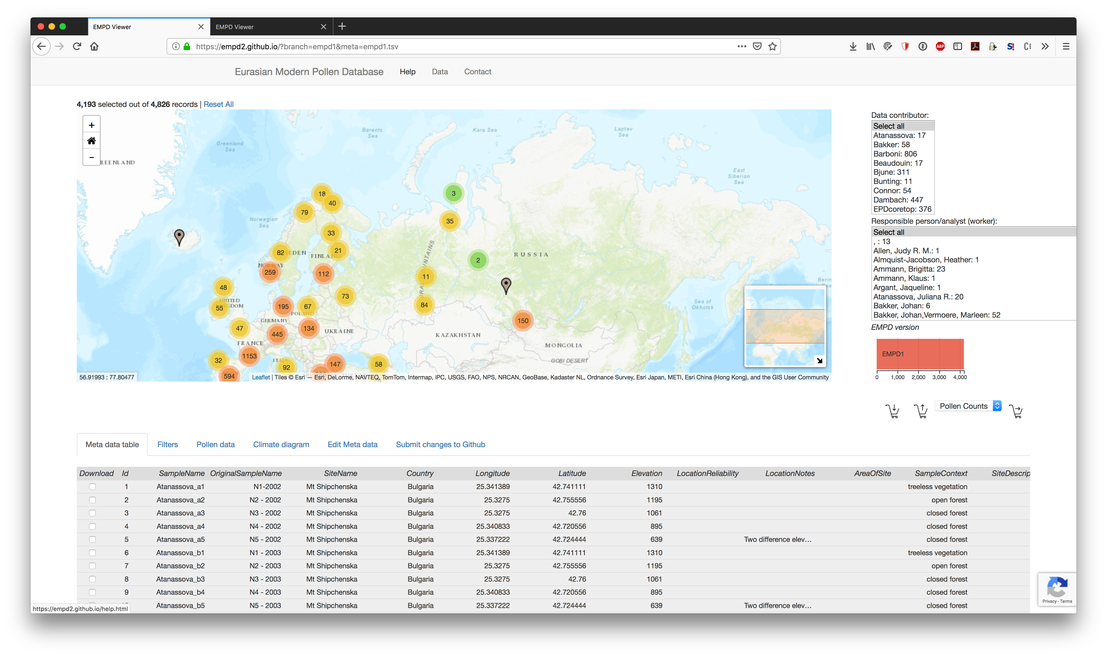
Transparency
Accessibility
Extendibility
Look at the PR in the viewer
https://empd2.github.io/?branch=empd1&meta=empd1.tsv

Slide 16
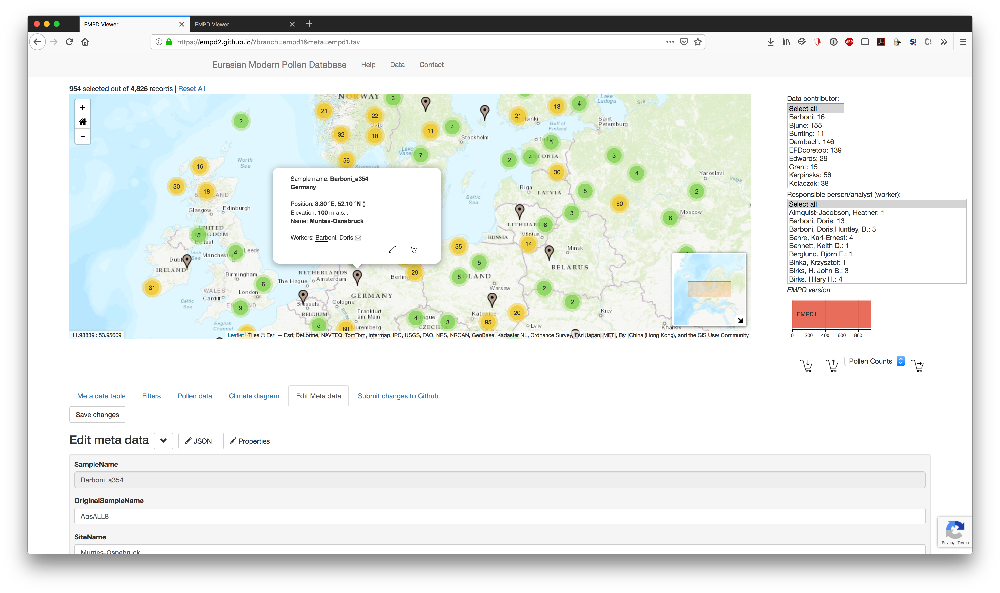
Transparency
Accessibility
Extendibility
Edit the meta data and submit through EMPD-admin

Slide 17
Transparency
Accessibility
Extendibility
Pushes, tests and manages
submits
loads
EMPD-admin Webapp
Version control
Javascript viewer

Slide 18
So this is what you can do!
Make your data workflow transparent through version control on Github
Make an interactive viewer hosted on Github
Make a webapp for automated administration of your database and it’s contributions
All this can be done for free without having to maintain your own server!
See our example at https://empd2.github.io

Slide 19
References
Davis, B.A.S., Zanon, M., Collins, P. et al. Veget Hist Archaeobot (2013) 22: 521. https://doi.org/10.1007/s00334-012-0388-5
Bolliet, T., Brockmann, P., Masson-Delmotte, V., Bassinot, F., Daux, V., Genty, D., Landais, A., Lavrieux, M., Michel, E., Ortega, P., Risi, C., Roche, D. M., Vimeux, F., and Waelbroeck, C.: Water and carbon stable isotope records from natural archives: a new database and interactive online platform for data browsing, visualizing and downloading, Clim. Past, 12, 1693-1719, https://doi.org/10.5194/cp-12-1693-2016, 2016.
Icons provided by icons8: https://icons8.com

