Slide 1
Understanding Mississippi’s moisture sources in present and future climate
Atmospheric rivers related to extreme precipitation over Norway
(Benedict et al., 2019, Mon. Wea. Rev.)
Imme Benedict, Chiel van Heerwaarden, Ruud van der Ent, Albrecht Weerts, Wilco Hazeleger

Slide 2
For the Mississippi basin studies focus on..
.. Change of E, P and circulation towards the future
.. Moisture tracking in present climate (re-analysis)
Mississippi’s moisture sources in a future climate
New here:

Slide 3
Research question
How will climate change affect the moisture source regions of the Mississippi?

Slide 4
Climate data: EC-Earth
Hazeleger et al. (2010,2012)
Tracking method: WAM-2layers
Van der Ent, 2010

Slide 5
Climate data: EC-Earth
Hazeleger et al. (2010,2012)
Tracking method: WAM-2layers
Van der Ent, 2010
30-years present
30-years future
increased SST
increased GHG (RCP4.5)
Spatial resolution: 25 by 25 km
E, P, q, u, v

Slide 6
Climate data: EC-Earth
Hazeleger et al. (2010,2012)
Tracking method: WAM-2layers
Van der Ent, 2010
$$E, P$$
30-years present
30-years future
increased SST
increased GHG (RCP4.5)
Eulerian Approach
= Solves water balance for every grid cell
Tracking on two layers (mixed layer assumed)
Originally applied to ERA-Interim
Spatial resolution: 25 by 25 km
E, P, q, u, v

Slide 7
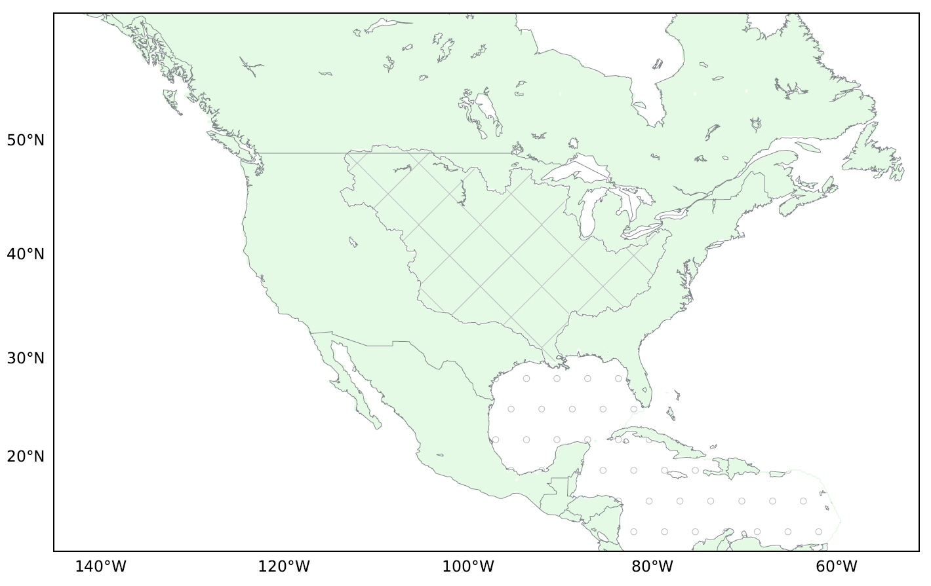
Climate data: EC-Earth
Hazeleger et al. (2010,2012)
Tracking method: WAM-2layers
Van der Ent, 2010
$$E, P$$
30-years present
30-years future
increased SST
increased GHG (RCP4.5)
Eulerian Approach
= Solves water balance for every grid cell
Tracking on two layers (mixed layer assumed)
Originally applied to ERA-Interim
Spatial resolution: 25 by 25 km
E, P, q, u, v

Slide 8
Climate data: EC-Earth
Hazeleger et al. (2010,2012)
Tracking method: WAM-2layers
Van der Ent, 2010
$$E, P$$
30-years present
30-years future
increased SST
increased GHG (RCP4.5)
Eulerian Approach
= Solves water balance for every grid cell
Tracking on two layers (mixed layer assumed)
Originally applied to ERA-Interim
Spatial resolution: 25 by 25 km
E, P, q, u, v
Precipitation (P)

Slide 9
Climate data: EC-Earth
Hazeleger et al. (2010,2012)
Tracking method: WAM-2layers
Van der Ent, 2010
$$E, P$$
30-years present
30-years future
increased SST
increased GHG (RCP4.5)
Eulerian Approach
= Solves water balance for every grid cell
Tracking on two layers (mixed layer assumed)
Originally applied to ERA-Interim
Spatial resolution: 25 by 25 km
E, P, q, u, v
Precipitation (P)
Moisture flux $\int{qV}$ dp

Slide 10
Climate data: EC-Earth
Hazeleger et al. (2010,2012)
Tracking method: WAM-2layers
Van der Ent, 2010
$$E, P$$
30-years present
30-years future
increased SST
increased GHG (RCP4.5)
Eulerian Approach
= Solves water balance for every grid cell
Tracking on two layers (mixed layer assumed)
Originally applied to ERA-Interim
Spatial resolution: 25 by 25 km
E, P, q, u, v
Precipitation (P)
Moisture flux $\int{qV}$ dp
Evaporation (E)

Slide 11
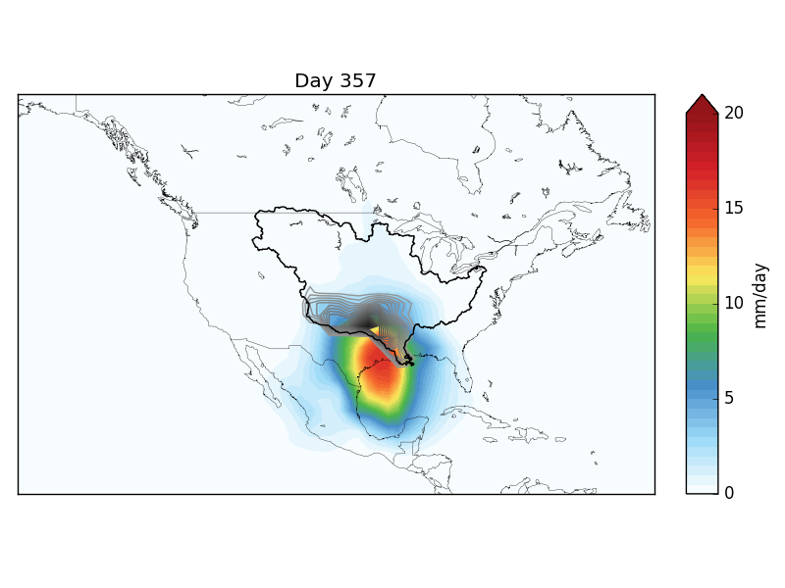
Tracking moisture from the Mississippi basin Backward - per timestep
Grey/black contours = precipitation
Colours = tracked moisture
Notes:
Backward or forward?!?

Slide 12
Tracking moisture from the Mississippi basin Backward - per timestep
Grey/black contours = precipitation
Colours = tracked moisture
Notes:
Backward or forward?!?

Slide 13
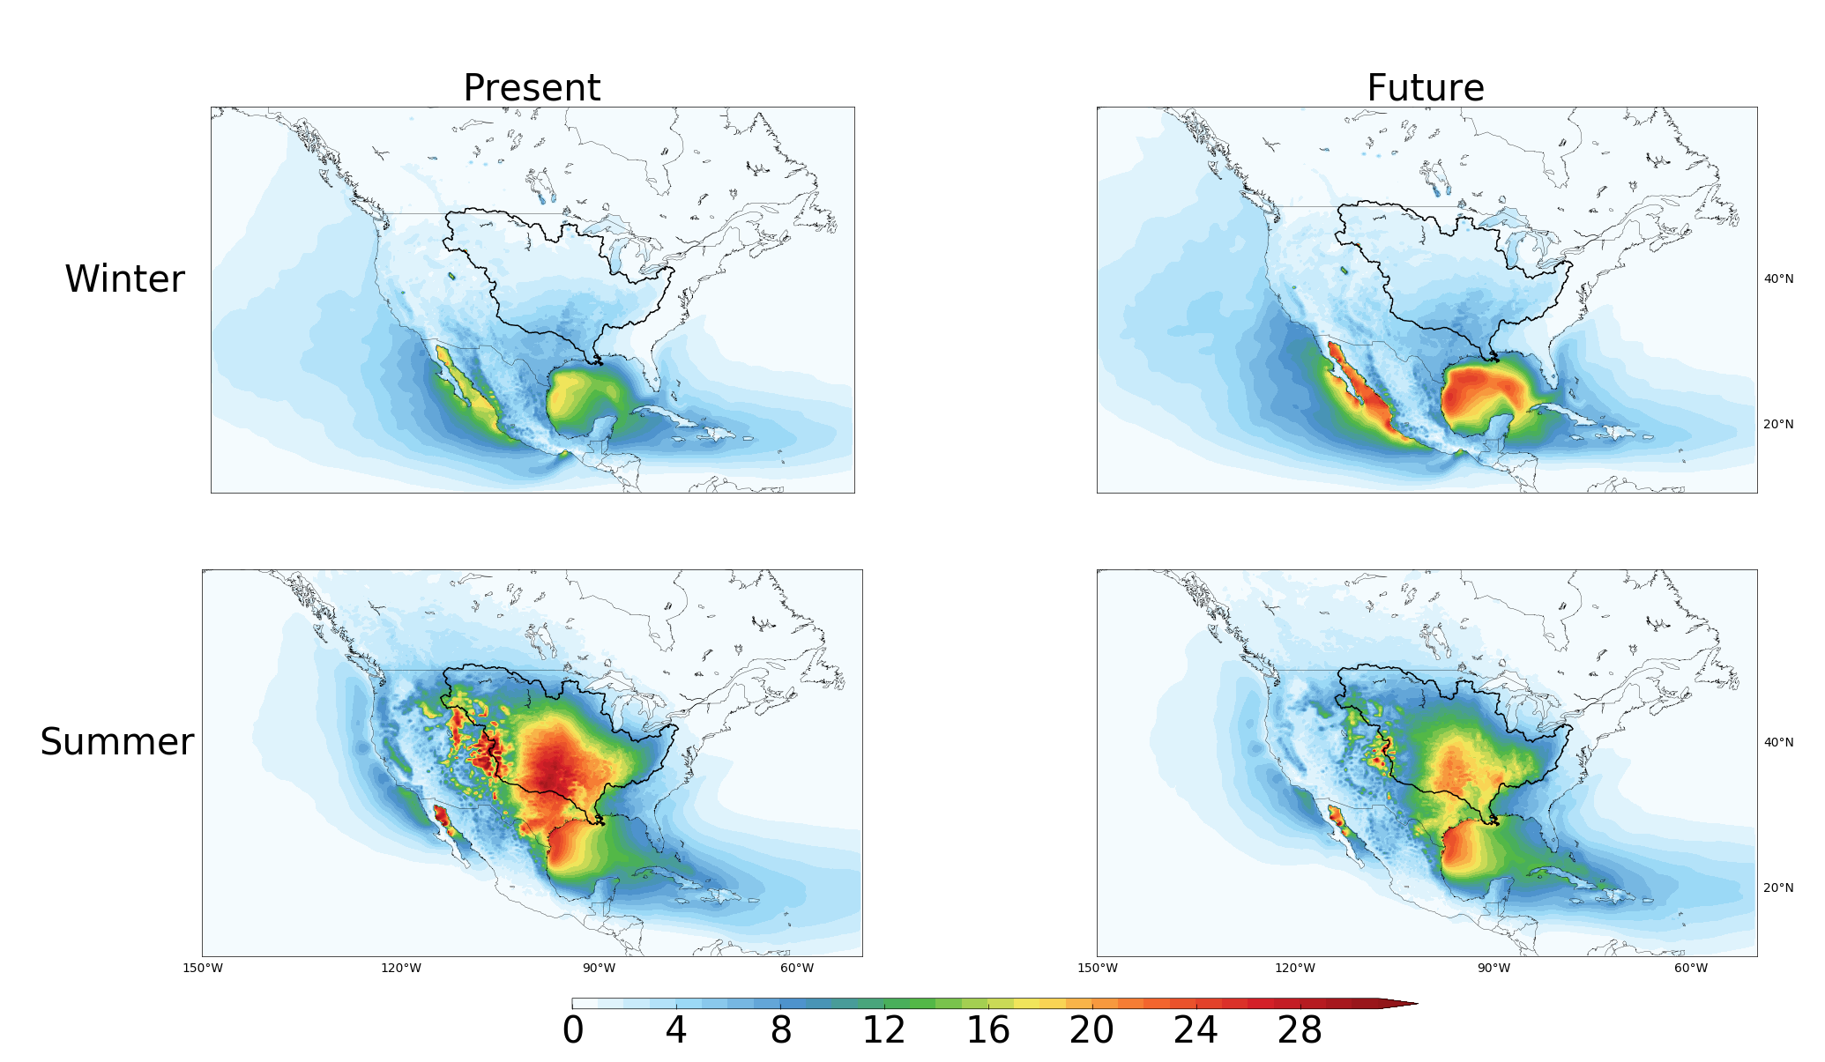
Absolute moisture sources Mississippi basin Seasons - Present vs. future climate
P = 55.4
P = 72.3
mm/month
Notes:
Start new region from zero again

Slide 14
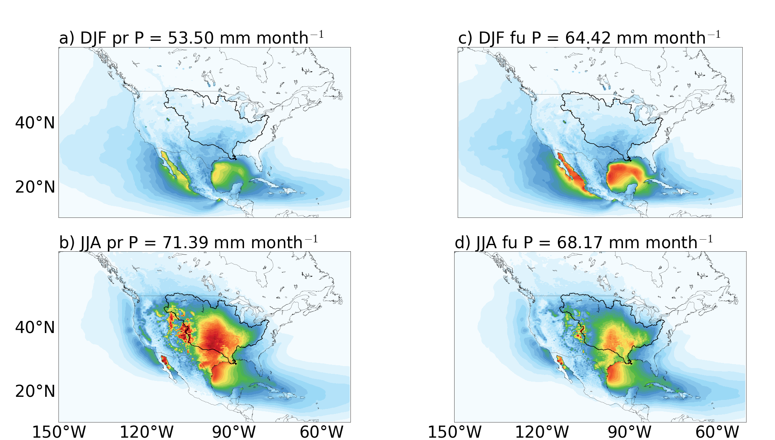
Absolute moisture sources Mississippi basin Seasons - Present vs. future climate
P = 55.4
P = 66.5
Winter: Increase of moisture source over the Gulf of Mexico
Summer: Decrease of moisture source over land
P = 72.3
P = 68.8
mm/month
Notes:
Start new region from zero again

Slide 15
Relative moisture sources Mississippi basin Yearly averaged
Mississippi
Pacific
Atlantic
Continental
Caribbean

Slide 16
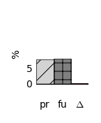
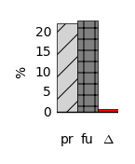
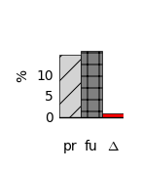
Relative moisture sources Mississippi basin Yearly averaged
Mississippi
Pacific
Atlantic
Continental
Caribbean

Slide 17
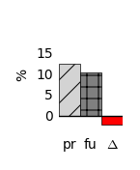
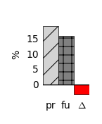
Relative moisture sources Mississippi basin Yearly averaged
Mississippi
Pacific
Atlantic
Continental
Caribbean

Slide 18
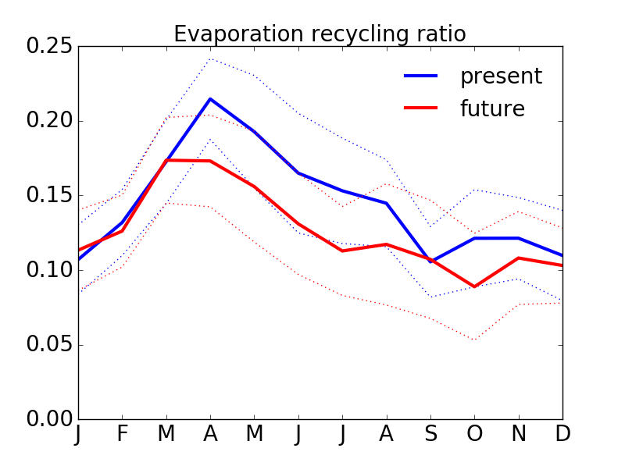
Regional recycling decreases in summer in future climate
Evaporation
Recycling ratio

Slide 19
How will climate change affect the moisture source regions of the Mississippi?
Mississippi
Pacific
Atlantic
Continental
Caribbean
Mississippi’s moisture sources shift from land to ocean in a future climate
imme.benedict@wur.nl

Slide 20
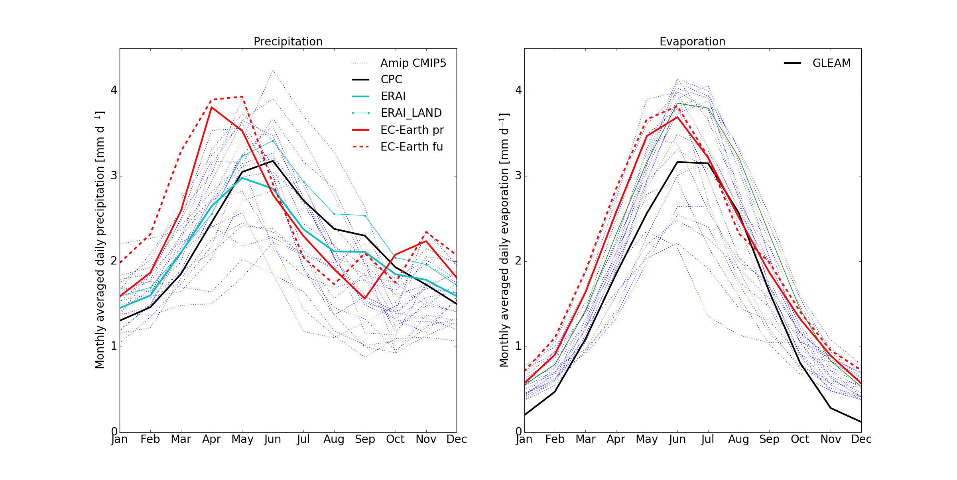
Model validation: P and E over the Mississippi basin in EC-Earth and CMIP5 models
P
E
Present simulated evaporation and precipitation from EC-Earth falls within the variability of CMIP5
Notes:
Kies tussen deze of de volgende

Slide 21
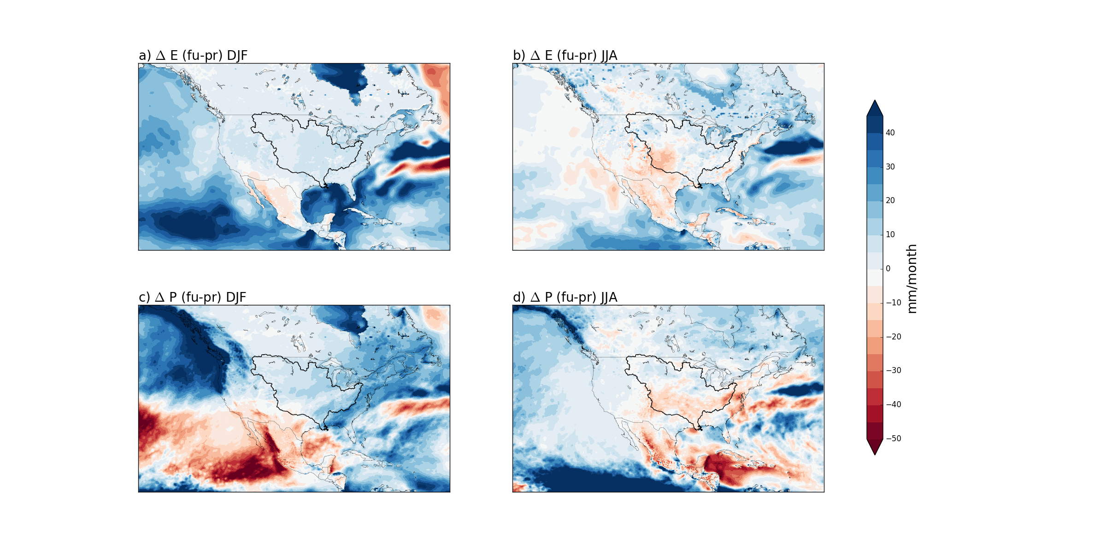
Spatial change of E and P towards future
More evaporation over the oceans in winter
Drying of SouthWestern North America in future (as found by Seager et al.)
ΔE
winter
summer
Mississippi basin; more precipitation in winter and less in summer
ΔP

