Slide 1
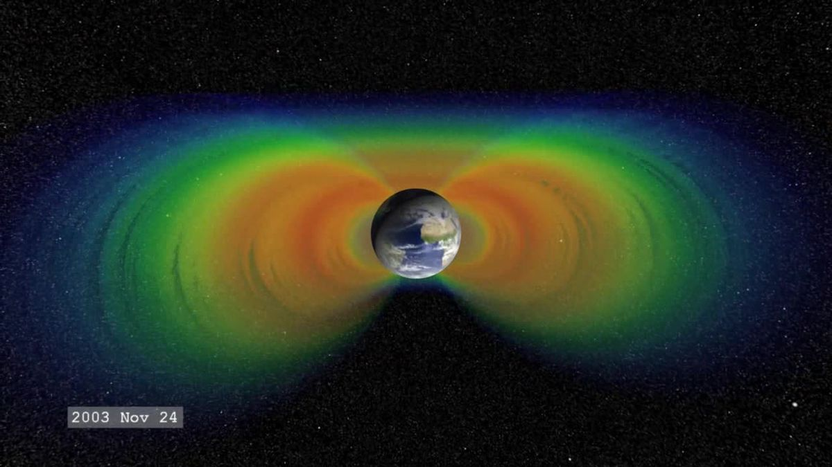



M. Piersanti⁽¹⁾ and M. Martucci ⁽¹⁾ on behalf of the CSES-Limadou collaboration mirko.piersanti@roma2.infn.it
1) INFN – sezione di Roma «Tor Vergata».
On the variations of the
magnetospheric field line resonance frequency
during solar and seismic activity.

Slide 2

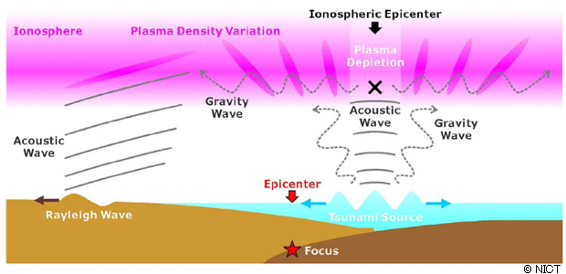
Introduction – Idea
The Idea is based on three steps:
1) The earthquake generates an AGW, propagating through the atmosphere;
2) The AGW interacts with the ionosphere generating local instability in the plasma distribution through a pressure gradient
The ionospheric plasma variation generates EM waves propagating through the magnetosphere that interact with the magnetospheric field
3) The interaction causes a FL eigen-frequency change.
Since the FL is stretched, its eigen-frequency has to lower.
Change of the FLR
3)
EM - Emission
2)
1)

Slide 3
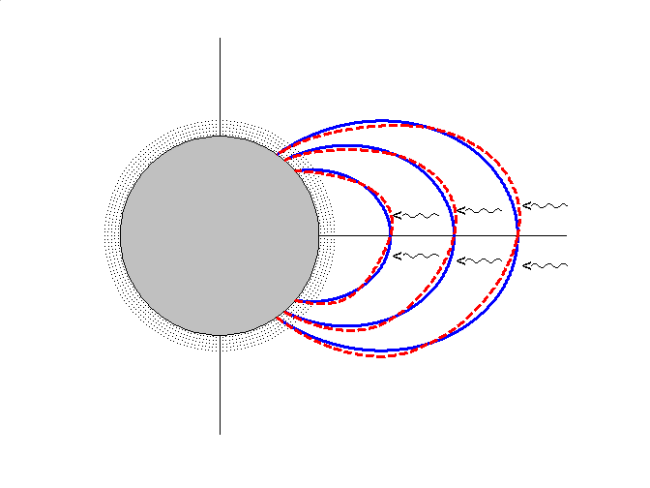
Geomagnetic Field Line Resonances (FLR)
IONOSPHERE
STANDING WAVE
P₁
COMPRESSIVE
MHD WAVES
V_{A}: Alfvén velocity
EARTH
P₂

Slide 4

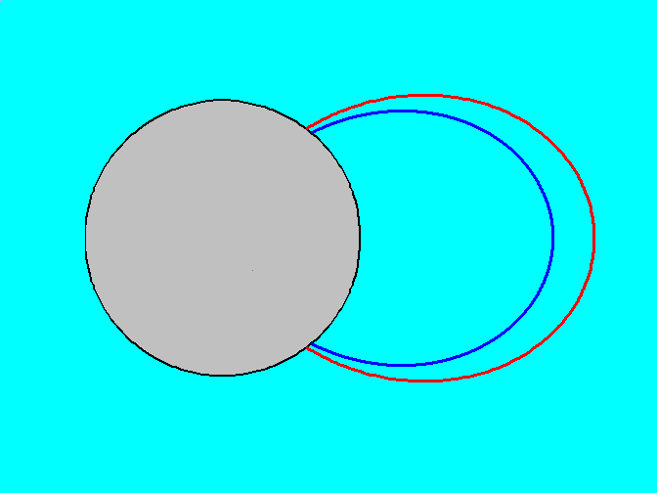
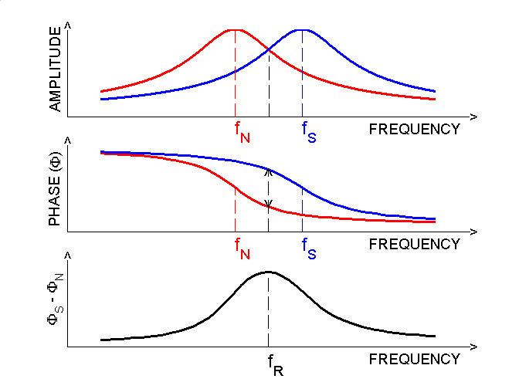
GRADIENT METHOD FOR DETECTING FIELD LINE RESONANCES
FROM GROUND-BASED ULF MEASUREMENTS
FREQUENCY RESPONSE OF TWO OSCILLATORS
N
S
EARTH
Separation: 1° - 3°
Higher latitude field line → Lower resonance frequency ( f_{N} )
Lower latitude field line → Higher resonance frequency ( f_{S} )
CROSS-PHASE TECHNIQUE
Resonance frequency at the middle point.
Identified by a maximum in the phase difference

Slide 5
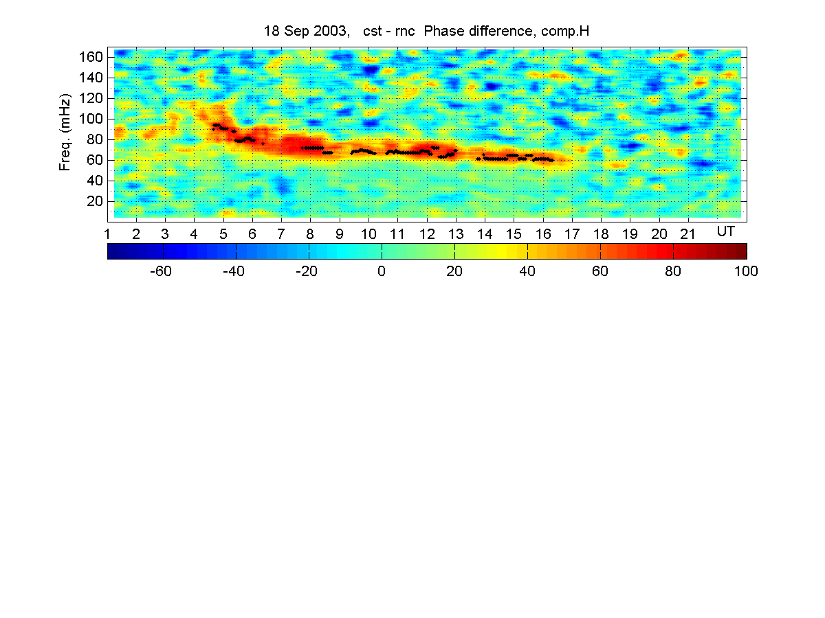
Example of FLR detection over middle Italy

Slide 6
Particle bursts
Particle Bursts (PB) have been registered by many satellites in recent years (GAMMA-1, ARINA & SAMPEX, etc..)
Mostly electrons/protons precipitating from Van Allen Belts
Shape & duration are peculiar → depending on their sources
  Transmitters
  Solar Energetic Particles (SEPs) during solar events
  Earthquakes
  Others
Discriminate between sources is impossible by considering only Energetic Particles
We need a way to distinguish from internal sources (i.e. Earthquakes) and external sources (SEPs etc)

Slide 7
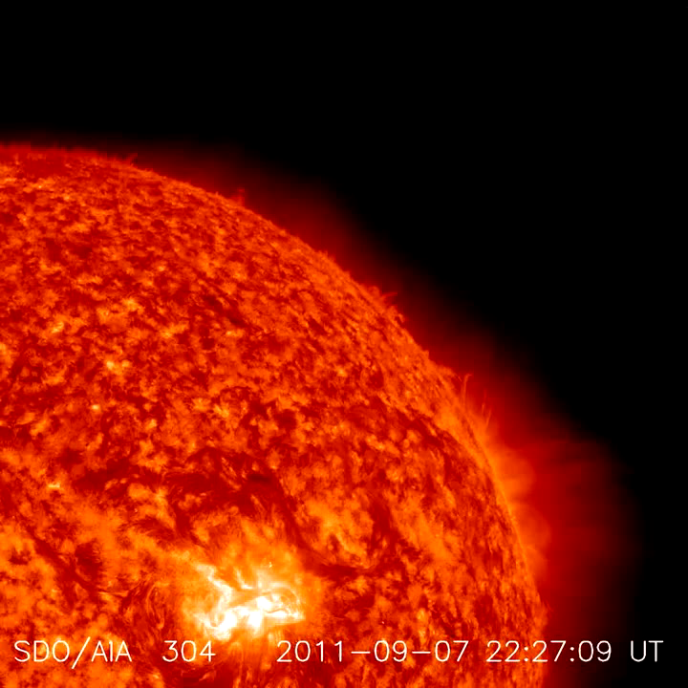
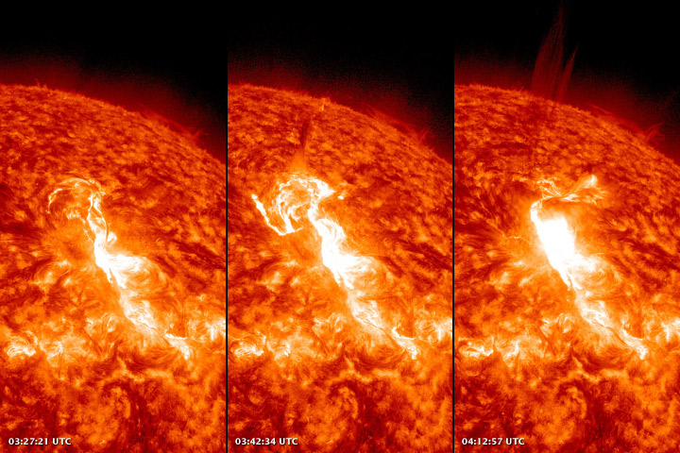
Solar Events
SOLAR FLARE
Solar flares are sudden explosions that happen in the solar corona
They can emit Solar Energetic Particles (SEPs) with energies up-to 1 GeV and being associated with Coronal Mass Ejections (CMEs)
CMEs are bubbles of plasma with an embedded magnetic field that travel along the interplanetary space

Slide 8
PB from solar events as seen by PAMELA
Sudden increase in particle counts from PAMELA in the low energy channels
Particle bursts
Particle bursts
Notes:
GeV=GeV/carica

Slide 9
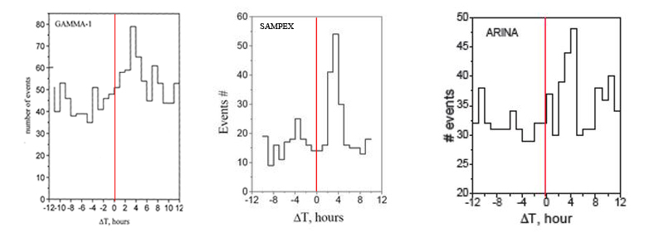
PB from earthquakes
Anomalous increase of low-energy electron and proton counting rate was observed several hours before the occurrence of moderate and large-magnitude earthquakes
A spatial and temporal statistical correlation between seismic activity and the charged particle precipitation from the lower limit of the Van Allen radiation belts has been reported [Aleksandrin, 2008; Sgrigna 2005; Battiston, 2013 and references therein]
Time Difference Distribution. Zero is the current time of the particle burst
ΔT is the time difference between earthquake and the detected electron burst.

Slide 10
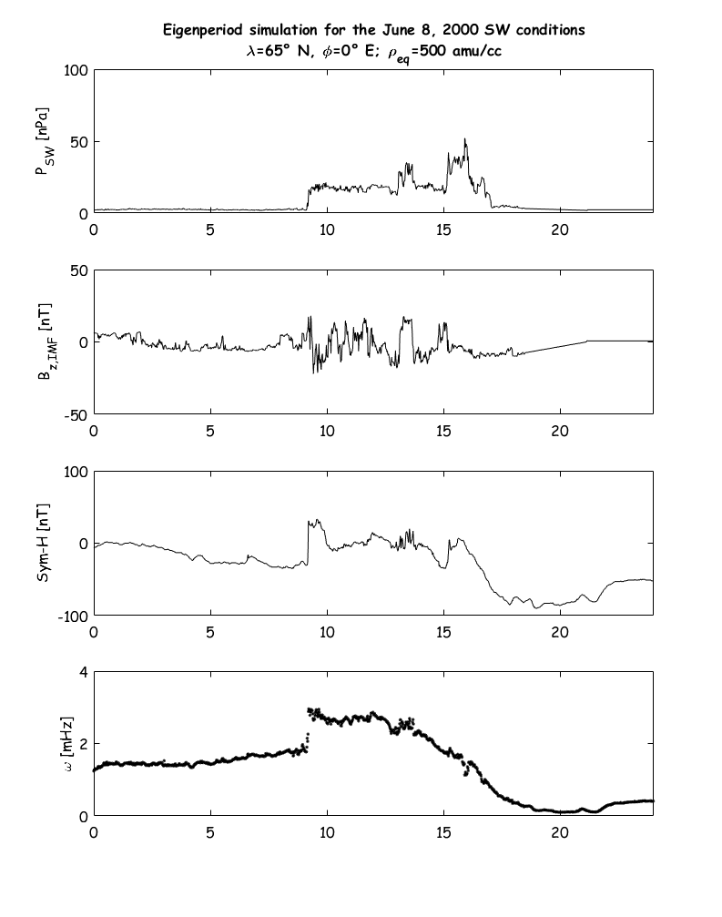
FLR and PB
Let’s now test the reliability and the validity of our idea connecting EQ activity to magnetospheric field line geometry modification.
We first test it for a Solar Flare, where we expect (simulation on the right): a sudden increase of the field line eigen-frequency.
Simulation using SW data of June 6, 2000 [Tsyganenko, 2017].
A clear jump in the f* of a field line at 65° of latitude and 0° of longitude [Piersanti et al., 2012].

Slide 11
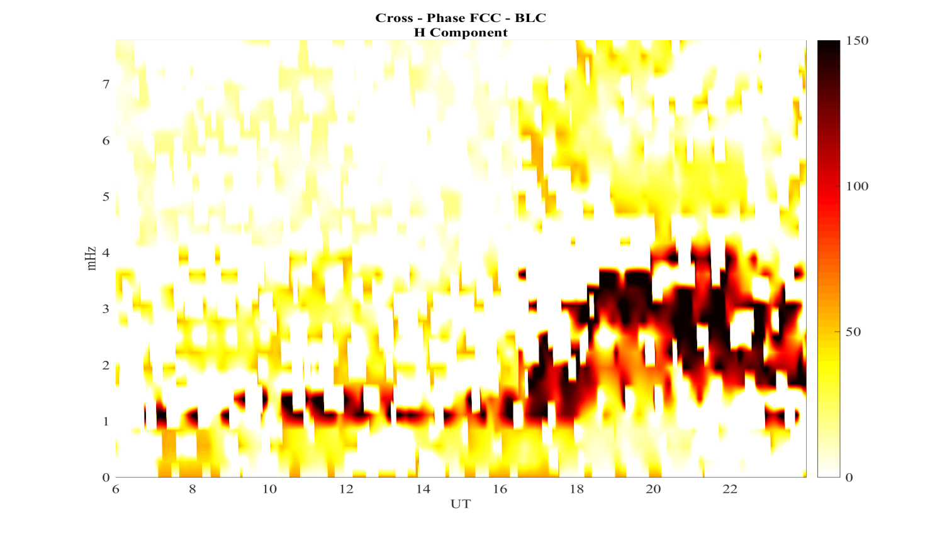
FLR and PB
Test 1:
We used PB from PAMELA data relative to a Solar Flare;
We evaluated the FLR frequency by using ground magnetometers located at the PAMELA footprint and calculating the diurnal cross-spectrum.
We obtained:
A clear increase of f* in concomitance of a Flare;
f*

Slide 12
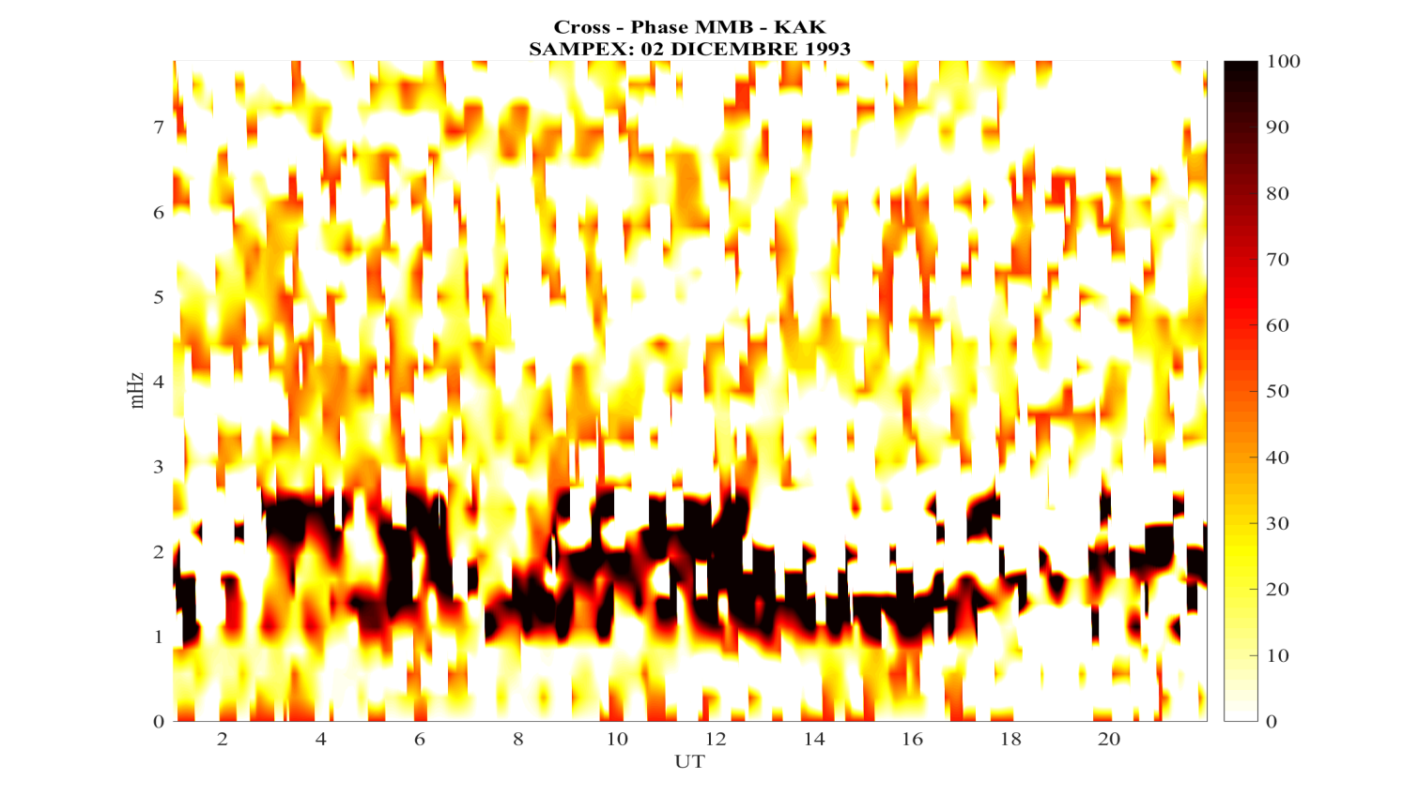
FLR and PB
Test 2:
We used PB from SAMPEX data relative to 02/12/1993 Earthquake;
We evaluated the FLR frequency by using ground magnetometers located close to the SAMPEX footprint and calculating the diurnal cross-spectrum.
We obtained:
A clear decrease of f* in concomitance of an Earthquake.
f*

Slide 13
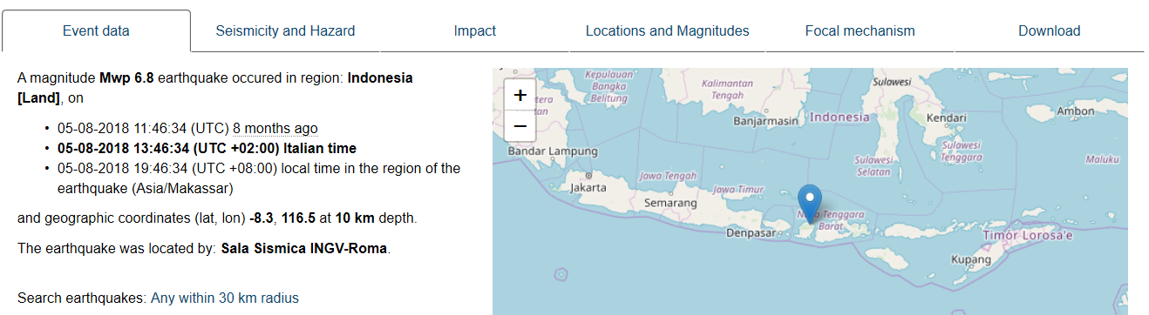
Test 3: August 5, 2018 – EQ
On August 5, 2018 an earthquake strike Indonesia.
Mw= 6.8;
λ=-8.3 °N - φ=116.5 °E;
UT=11:46,34.
Notes:
Sostituire!!

Slide 14
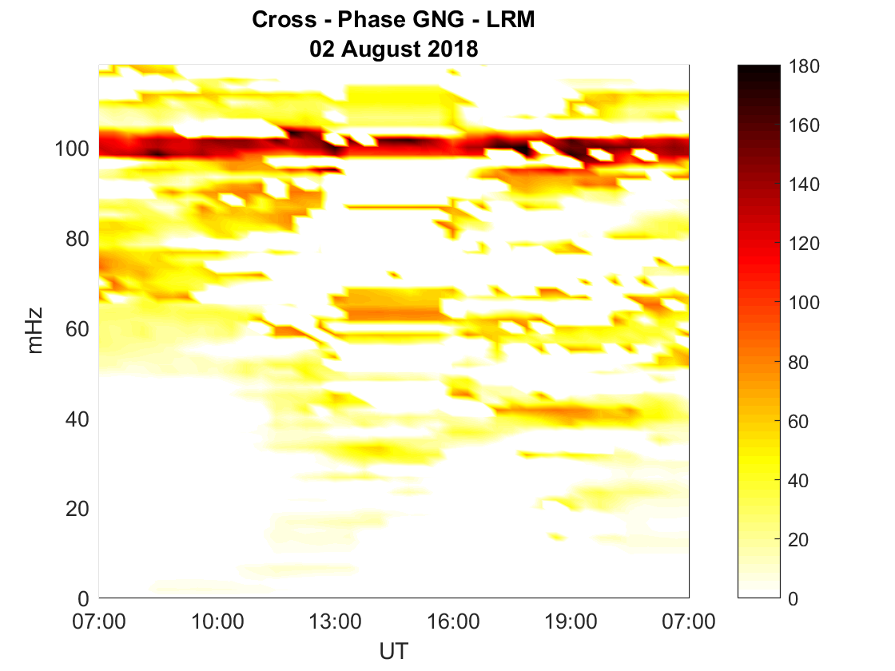
FLR evaluation over the EQ location
We started from a quiet period before the EQ.
No Sun activity during the first 10 days of August 2018.
No EQ with M>2.0 during the entire August 2, 2018.
We choose two ground stations magnetically connected with CSES footprint evaluated at the moment of the anomalous fluctuation identified.
We evaluated the Cross-spectra and look for possible modification of the frequency.
The eigen frequency is around 100 mHz

Slide 15
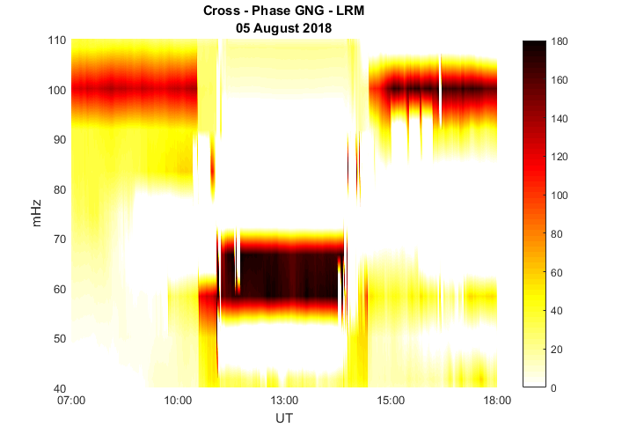
FLR evaluation over the EQ location
We made the same analysis during the EQ.
As expected, the eigen-frequency (f) is around 100 mHz (close equatorial station).
There are an interesting modification of f:
Around 11:48 UT, there is a collapse from 100 to 64 mHz.

Slide 16
Conclusions
We showed two EQ events in which the eigen-frequency of the magnetospheric field decreases as expected from an electro-magnetic perturbation coming from ground.
We interpreted this FLR frequency modification as a possible consequence of an electromagnetic pressure generated by the ionospheric E-layer, when perturbed by a pressure gradient associated to the atmospheric-gravity wave caused during the earthquake.
We found a possible direct connection between the earthquake event and the magnetospheric field response in terms of a modification of the geometry of the field line.
A possible evidence of a magnetosphere-ionosphere-lithosphere coupling has never been reported so far.
Notes:
Inserire che manca la teoria sul LAIC model

Slide 17

THE END

Slide 18
BACK-UP Slides

Slide 19

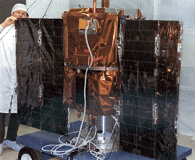
The SAMPEX instrument
The Solar Anomalous Magnetospheric Particle EXplorer (SAMPEX) was the first in NASA's relatively low-budget, fast-track series of Small Explorer class of spacecraft
It was launched on July 3, 1992, to provide cosmic ray fluxes at the polar cap and radiation belts fluxes
Particle bursts registered by the Proton/Electron Telescope (PET) sub-detector
PET had
  electron channel in the range 0.4-30 MeV
  Proton channel in the range 18-270 MeV/nucleon
More info can be found in Baker et al (1993) and Cook et al. (1993)

Slide 20
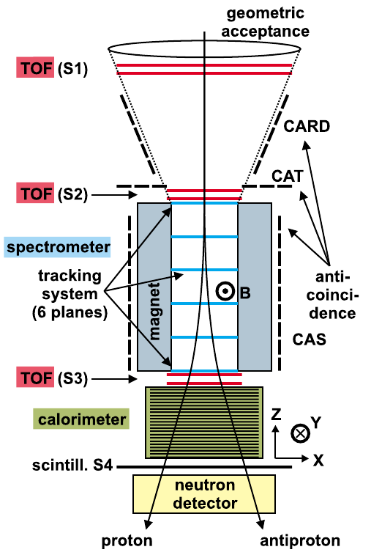
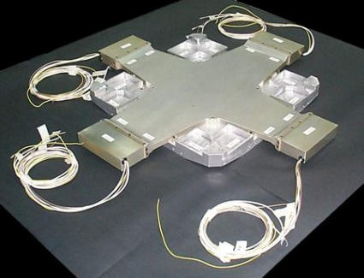
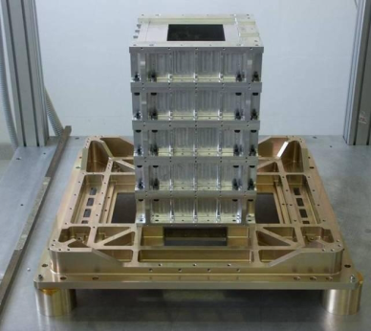
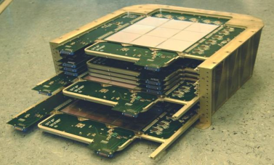
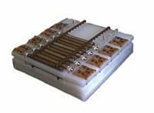
The PAMELA instrument
Time-Of-Flight
plastic scintillators + PMT:
- Trigger
- Albedo rejection;
- Mass identification up to 1 GeV;
- Charge identification from dE/dX.
p
Spectrometer
microstrip silicon tracking system
- Magnetic rigidity → R = pc/Ze
– Charge sign
– Charge value from dE/dx
+ permanent magnet
Electromagnetic calorimeter
W/Si sampling (16.3 X₀, 0.6 λ_{I})
- Discrimination e+ / p, anti-p / e-
(shower topology)
- Direct E measurement for e-,e+
Neutron detector
3He tubes + PMT:
- High-energy e/h
discrimination

Slide 21

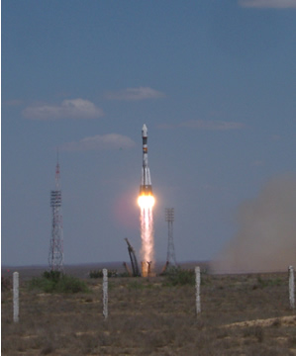
PAMELA Mission
Launch on June 15th of 2006 on-board the Resurs-DK1 russian satellite
Soyuz rocket
Quasi-polar and elliptical orbit
Inclination ~70°
Altitude 300 – 600 km
After 2010 → circular orbit (stable @ ~500 km)

Slide 22
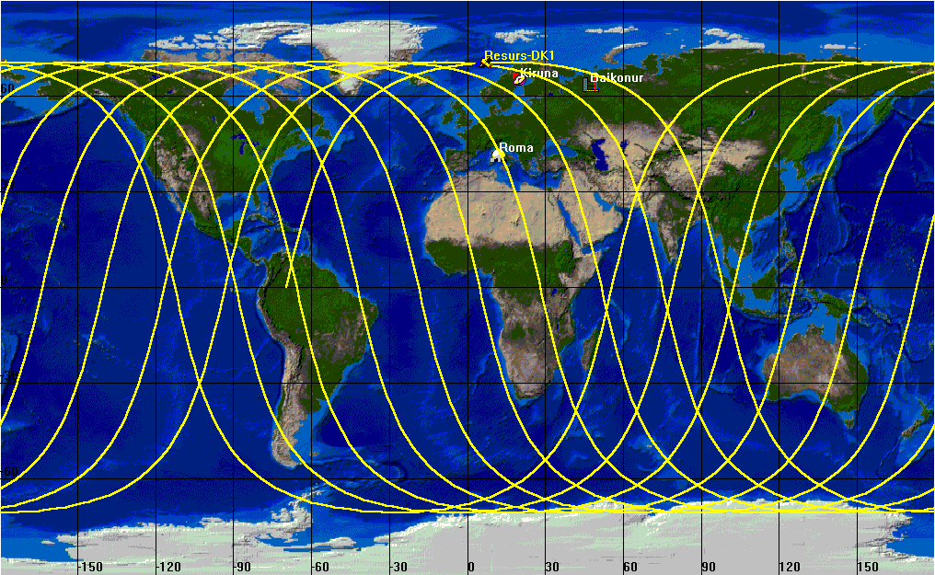
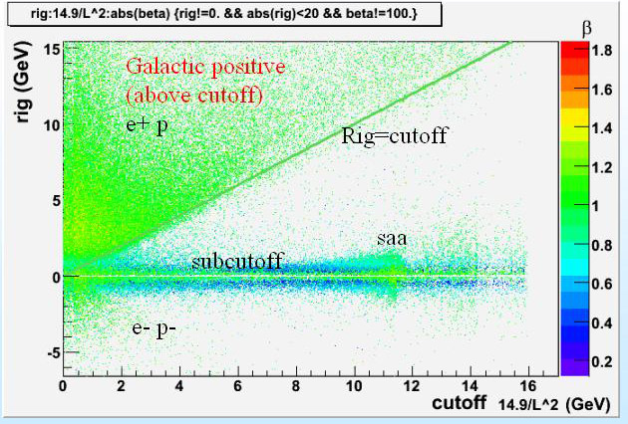
The orbit of PAMELA
PAMELA had an orbit of about 90 minutes (15 orbits per day)
Could register low energy particles coming from the Sun @higher latitudes where the cutoff is lower
Particle population accross PAELA orbit as a function of cutoff rigidity (GV)
SAA

