Slide 1
Reconstructing the propagation of Whistlers observed in ELF during ASM burst sessions from the lightning strikes to their detection and validation of IRI model
P. Coïsson, G. Hulot, L. Brocco, P. Vigneron, O. Bonnot, R. Madelon (IPGP)
V. Truhlik, D. Buresova, J. Chum, (IAP)
J. Mlynarczyk, A. Kulak, P. Rzonca (AGH)

Slide 2
Whistlers in Swarm ASM burst sessions
$$D=\sqrt{f}\left(t−t_{0}\right)$$
ASM on Alpha and Bravo collect 250 Hz burst scalar data one week per month since 2019.
Few additional days have also been collected in 2014 and 2018.
Whistler are characterised by their dispersion: $D=\sqrt{f}\left(t−t_{0}\right)$
$D$ depends on the propagation through the ionosphere.
$t_{0}$ allows to determine the time when lightning signal entered the ionosphere.
Run the video on top to listen to an example.

Slide 3
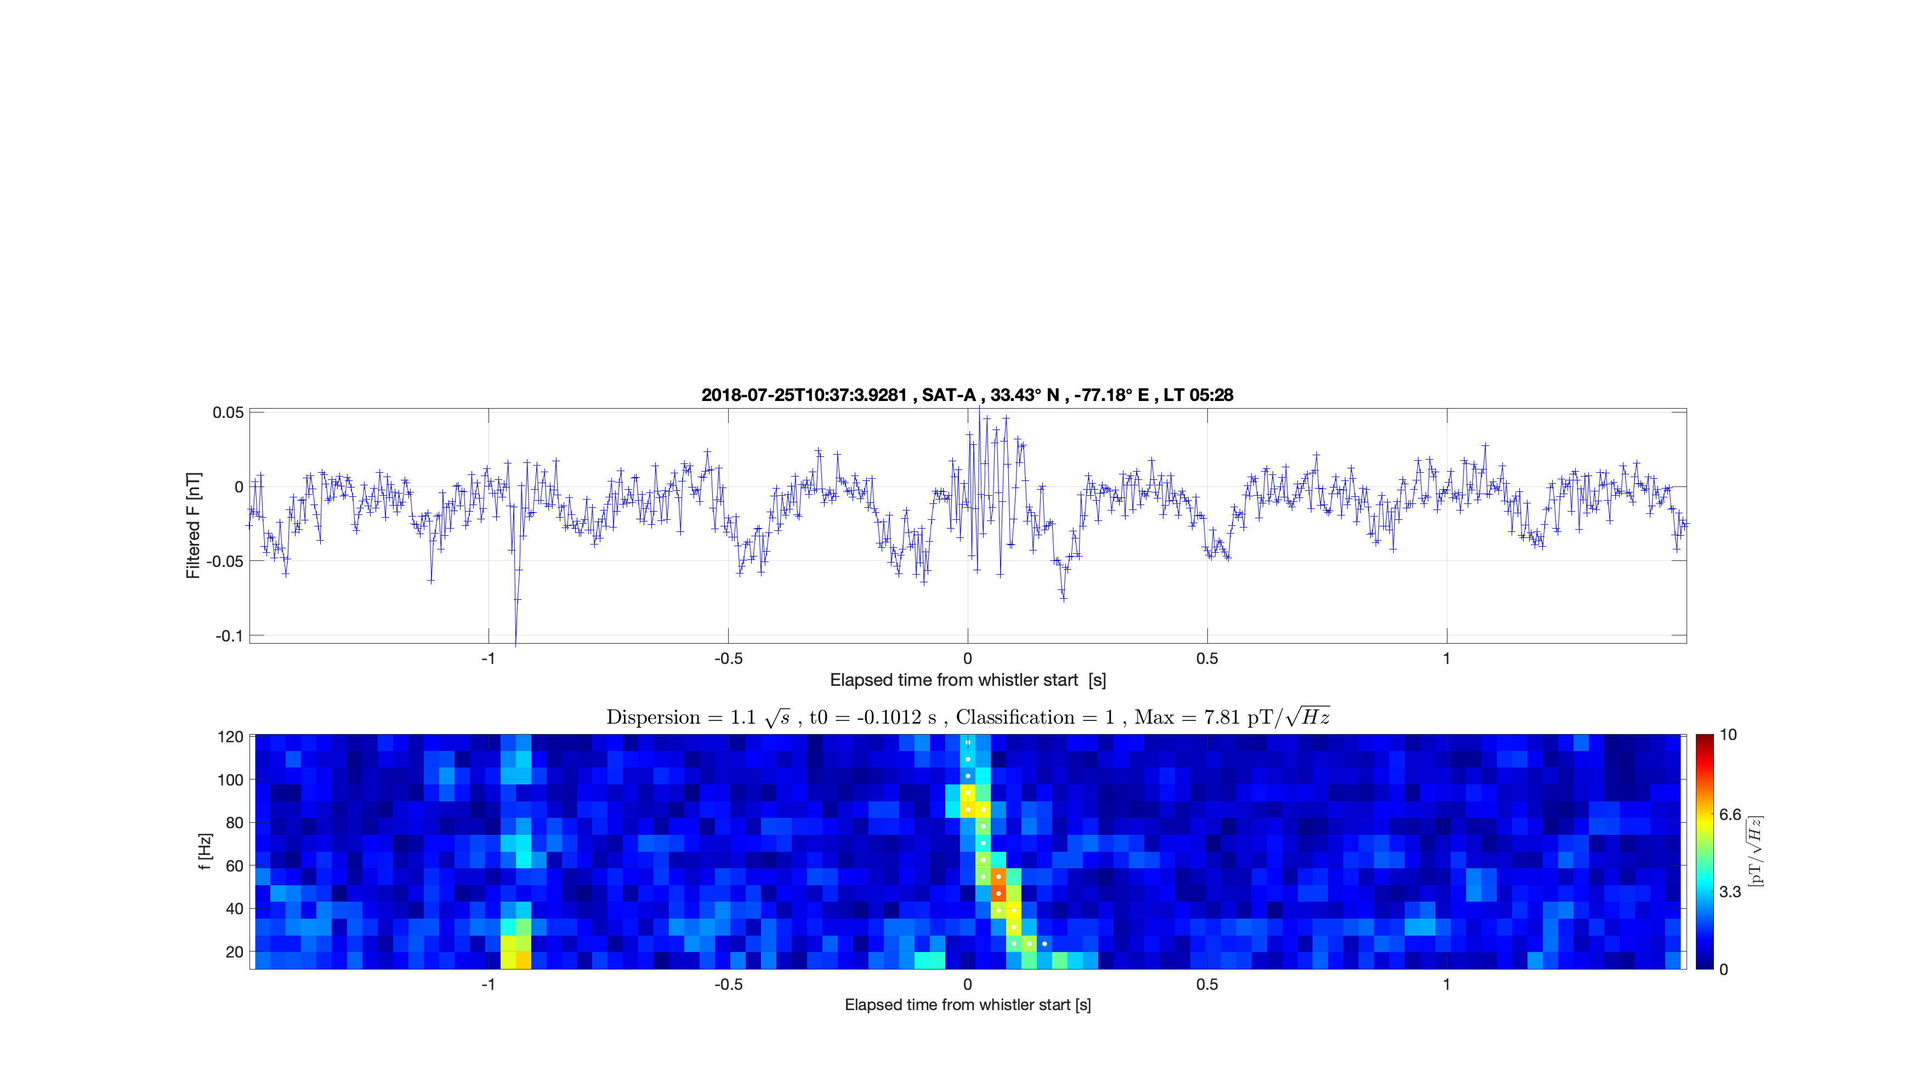
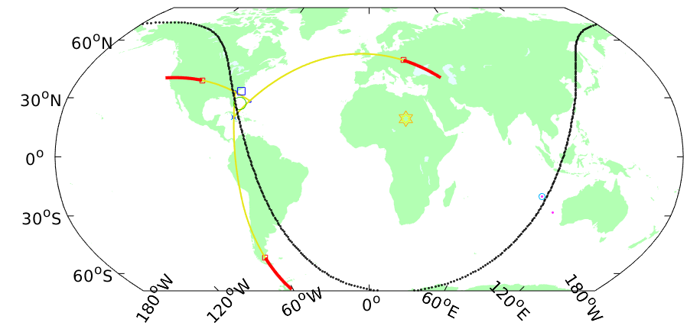
Localisation of lightning strike
Knowing $t_{0}$, Ground ELF magnetic antennas of WERA network allow to identify:
The ELF waveform of the lightning strike
Its location
Its charge moment
○ Lightning location inferred from the ELF signals
☐ Swarm location
☐ WERA stations

Slide 4
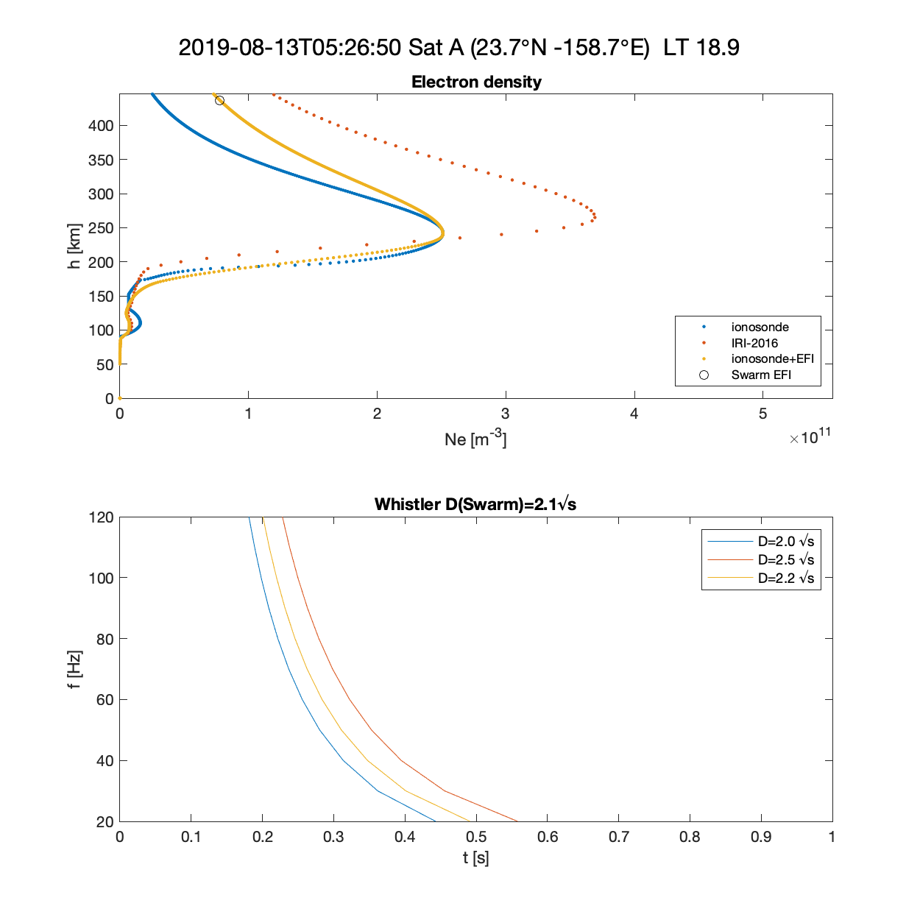
Reconstruction of whistler propagation
Ray-tracing calculation from 90 km height up to Swarm location:
Background ionosphere from IRI model:
Climatological IRI-2016
Adjusted to ionosonde parameters for cases when Swarm is < 600 km from ionosonde
With topside adapted to Swarm EFI in-situ measurement
Synthetic dispersion is compared with Swarm ASM whistler.

Slide 5
Conclusions
New regular burst sessions from 2019 allow to detect whistler events, corresponding to powerful lightning strikes.
The dispersion of these whistlers depend on the ionospheric background conditions along the propagation path.
Ionosonde data and in-situ electron density make it possible to allow constrain the propagation and compute the expected dispersion
Whistler occurring far away from ionosonde locations can conversely be used to constrain the profile of the ionosphere.
For more information and future data access: https://ilgew.ipgp.fr

