Slide 1


Strong changes in the relationship between storage and discharge during a period of thawing soils and climate warming in Northern Sweden
May 4th-8th, 2020
Alexa Hinzman, Ylva Sjöberg, Steve Lyon, Stephen Ploum and Ype van der Velde

Slide 2

Introduction
Thawing soils leads to enhanced hydrologic connectivity
As frozen soils thaw, catchment flow pathways open, allowing enhanced hydrologic connectivity between groundwater and rivers. Increasing hydrologic connectivity changes the storage-discharge relationship of a watershed, which can be perceived within a hydrograph.
(A.M. Hinzman et al. (Submitted), EGU2020)
(A.M. Hinzman et al., EGU2020)

Slide 3
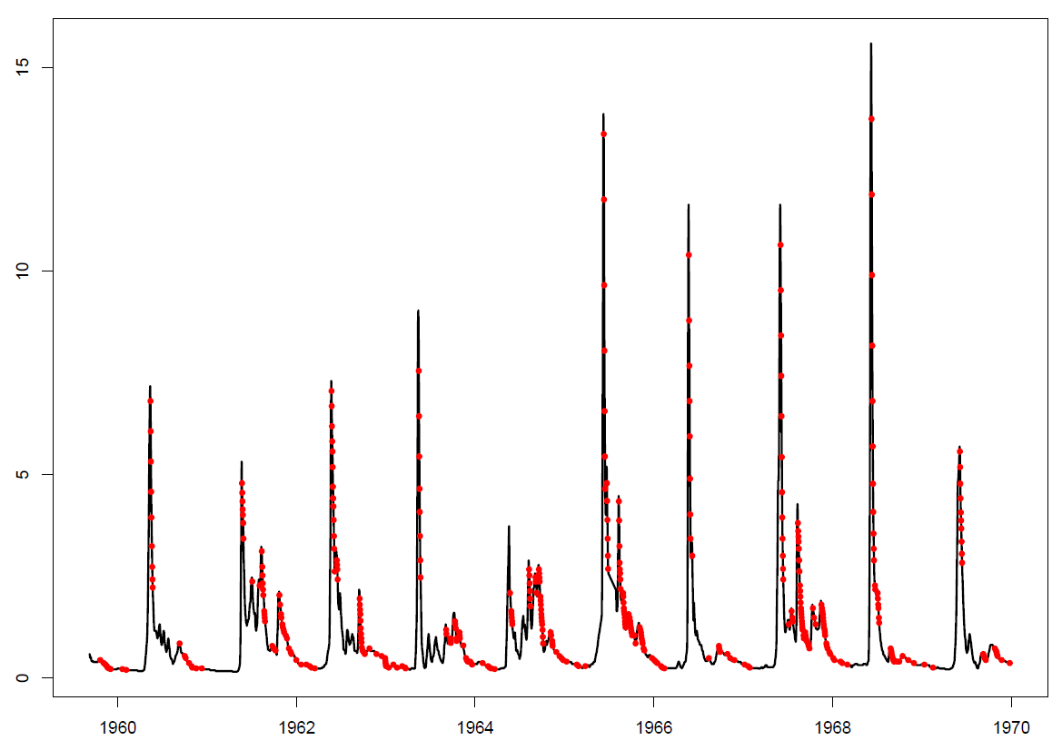
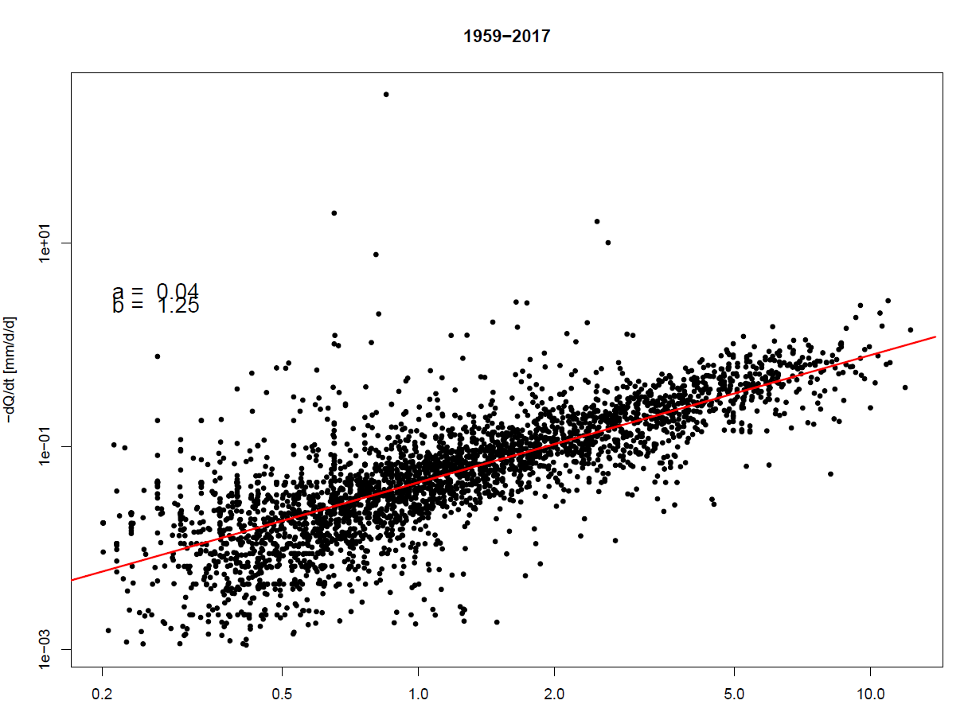
How can hydrologic connectivity be quantified?
A hydrograph is a continuous plot of instantaneous discharge over time. While the hydrograph is falling (in recession), discharge points are plotted on a log-log scale to show Δ discharge/Δ time (y-axis) vs. discharge (x-axis). The red line gives the recession slope.
1959-2017
1e+01
log(dQ/dt) (mm/d²)
Q (mm/d)
1e-01
1e-03
0.2
0.5
1.0
2.0
5.0
10.0
Year
Log(Q) (mm/d)
(A.M. Hinzman et al. (Submitted), EGU2020)
(A.M. Hinzman et al., EGU2020)

Slide 4
Introduction
Storage-discharge relationships can be quantified by recession slopes
Previous studies hypothesized that storage-discharge relationships are relatively linear when soils are frozen and become increasingly non-linear as the landscape thaws.
Our analysis uses 16 Northern Swedish watersheds during the years of 1951 and 2018.
(A.M. Hinzman et al. (Submitted), EGU2020)

Slide 5
Introduction
Does soil thaw impact the storage-discharge relationship?
The objective is to cement the assumption that soil thaw leads to increasingly non-linear storage-discharge relationships by quantifying trends and spatio-temporal differences of this relationship.
(A.M. Hinzman et al. (Submitted), EGU2020)

Slide 6
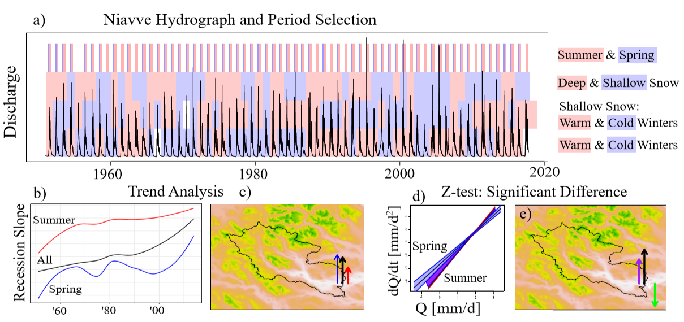
Data period selection and statistical analyses
Comparison of statistical analyses provides valuable insight
(A.M. Hinzman et al. (Submitted), EGU2020)

Slide 7
Trend analysis and Z-test analysis
Separating the datasets into different time periods or groups by seasons or winter conditions for analysis
Trends analysis gives significance in change of recession slopes over time while the z-test analysis compares two groups for significant differences. The antecedent winter conditions were selected due to their relationship to the depth of the frozen layer.
(A.M. Hinzman et al. (Submitted), EGU2020)
(A.M. Hinzman et al., EGU2020)

Slide 8
Trend Analysis – Mann Kendall & Theil Sen
Time periods were analysed to determined if there was significant change of the recession slope over time.
All trend analyses used 3-year increments to track change in the recession slope over time. Seasonal trend analysis was performed to establish which season was undergoing the greatest change.
(A.M. Hinzman et al. (Submitted), EGU2020)
(A.M. Hinzman et al., EGU2020)

Slide 9
Z-test analysis
Groups sorted by winter conditions or seasons are compared to determine significant differences.
Ascertaining significant difference leading understanding if the increasing recession curve slopes come from meteorological factors or from the thawing of frozen soil and increasing hydrologic connectivity.
Upward arrows denote results that agree with the hypotheses, downwards arrows represent results contrary to the hypotheses.
(A.M. Hinzman et al. (Submitted), EGU2020)
(A.M. Hinzman et al., EGU2020)

Slide 10
Results – Trend Analysis
12 of 16 watersheds have an overall significant increase in recession slope over time
  1 watershed has a significant decreasing trend*
7 watersheds have significant increasing trends during spring
  2 watersheds have significant decreasing trends during spring
10 watersheds have significant increasing trends during summer
*Due to a change in the location of the river’s bifurcation from downstream to upstream.
(A.M. Hinzman et al. (Submitted), EGU2020)
(A.M. Hinzman et al., EGU2020)

Slide 11
Results – Z-test Analysis
12 watersheds have significant difference between spring and summer.
  15 watersheds have a larger recession slope in summer.
10 watersheds have significant difference between cold and warm winters.
  12 watersheds have a larger recession slope after warm winters.
11 watersheds have a significant difference between shallow and deep snow.
  No preference in either group for higher recession slope.
6 watersheds have significant differences for shallow snow periods in cold & warm winters.
  12 watersheds have a higher recession slope for warm winters.
(A.M. Hinzman et al. (Submitted), EGU2020)
(A.M. Hinzman et al., EGU2020)

Slide 12
Discussion – Trend Analysis
An overwhelming amount of watersheds have increasing non-linear recession slopes.
  Proof the storage-discharge relationship is changing.
More summer recession slopes are significant and increasing, but spring trends (increasing or decreasing in recession slopes over time) have the greatest change over time.
(A.M. Hinzman et al. (Submitted), EGU2020)
(A.M. Hinzman et al., EGU2020)

Slide 13
Discussion – Z-test Analysis pt.1
Spring and summer have different recessions. As summers have increasing number of flow paths, higher recession slopes are expected and were confirmed.
Cold/warm winters are a proxy for deeper/shallow frozen soils.
Antecedent winter conditions that allow deep soil frost lead to more linear storage-discharge relationships for 10 watersheds.
(A.M. Hinzman et al. (Submitted), EGU2020)
(A.M. Hinzman et al., EGU2020)

Slide 14
Discussion – Z-test Analysis pt.2
Snow acts as insulation, therefore shallow snow depths imply deeper frozen soils.
  A difference is found between shallow and deep snow, but it does not impact the recession slope in a predictive pattern.
Combining winter temperatures and shallow snow depth is to verify when the ground was most influenced by temperature and estimate the deep and shallow depths of frozen soil.
(A.M. Hinzman et al. (Submitted), EGU2020)
(A.M. Hinzman et al., EGU2020)

Slide 15
Conclusions pt.1
Overall, we find that thawing soil leads to a more non-linear storage-discharge relationship which implies river runoff in the Arctic becomes more unpredictable.
(A.M. Hinzman et al. (Submitted), EGU2020)
(A.M. Hinzman et al., EGU2020)

Slide 16
Conclusions pt.2
Spring is undergoing the greatest change over time.
The change in recession slope is driven by the depth of frozen soil, which in turn is influenced by antecedent winter conditions.
(A.M. Hinzman et al. (Submitted), EGU2020)
(A.M. Hinzman et al., EGU2020)

Slide 17


Acknowledgements
I would like to express my deep gratitude to my advisor Ype van der Velde, my co-advisor Ylva Sjöberg, Steve Lyon and Stephan Ploum for everything; all the revisions they have looked at, the enlightening discussions from different continents, and without whom my first article would not be possible. Another thanks to Jim Boonman for being available to chat whenever I needed him.
If anyone has questions/comments
please feel free contact me:
a.m.h.hinzman@vu.nl

