Slide 1
OCO-3 Snapshot Area Mapping Mode: Early Results
Robert R. Nelson¹, Annmarie Eldering¹, Thomas Kurosu¹, Matthäus Kiel¹, Brendan Fisher¹, Ryan Pavlick¹, Gary Spiers¹, Rob Rosenberg¹, David Crisp¹, Christopher O’Dell², Peter Somkuti², Thomas Taylor², Eric Kort³, Tomohiro Oda⁴⁵, Ray Nassar⁶, Thomas Lauvaux⁷ and the entire OCO-3 team
1 - Jet Propulsion Laboratory, California Institute of Technology, USA
2 - Colorado State University, Fort Collins, CO, USA
3 - University of Michigan, Ann Arbor, MI, USA
4 - Goddard Earth Sciences Technology and Research, Universities Space Research Association, Columbia, MD, USA
5 - Global Modeling and Assimilation Office, NASA Goddard Space Flight Center, Greenbelt, MD, USA
6 - Environment and Climate Change Canada, Toronto, ON
7 - Le Laboratoire des Sciences du Climat et de l'Environnement, Saint-Aubin, France
EGU General Assembly 2020, 6 May 2020
© 2020. All rights reserved.

Slide 2
Introduction
The Orbiting Carbon Observatory-3 (OCO-3) makes measurements of column-mean CO₂ (XCO₂) using reflected sunlight in three near-infrared bands
Spare OCO-2 instrument
Sent to the International Space Station on May 4, 2019 for a 3 year mission
Goal of improving our understanding of carbon sources and sinks
But with a focus on emission hot spots!

Slide 3
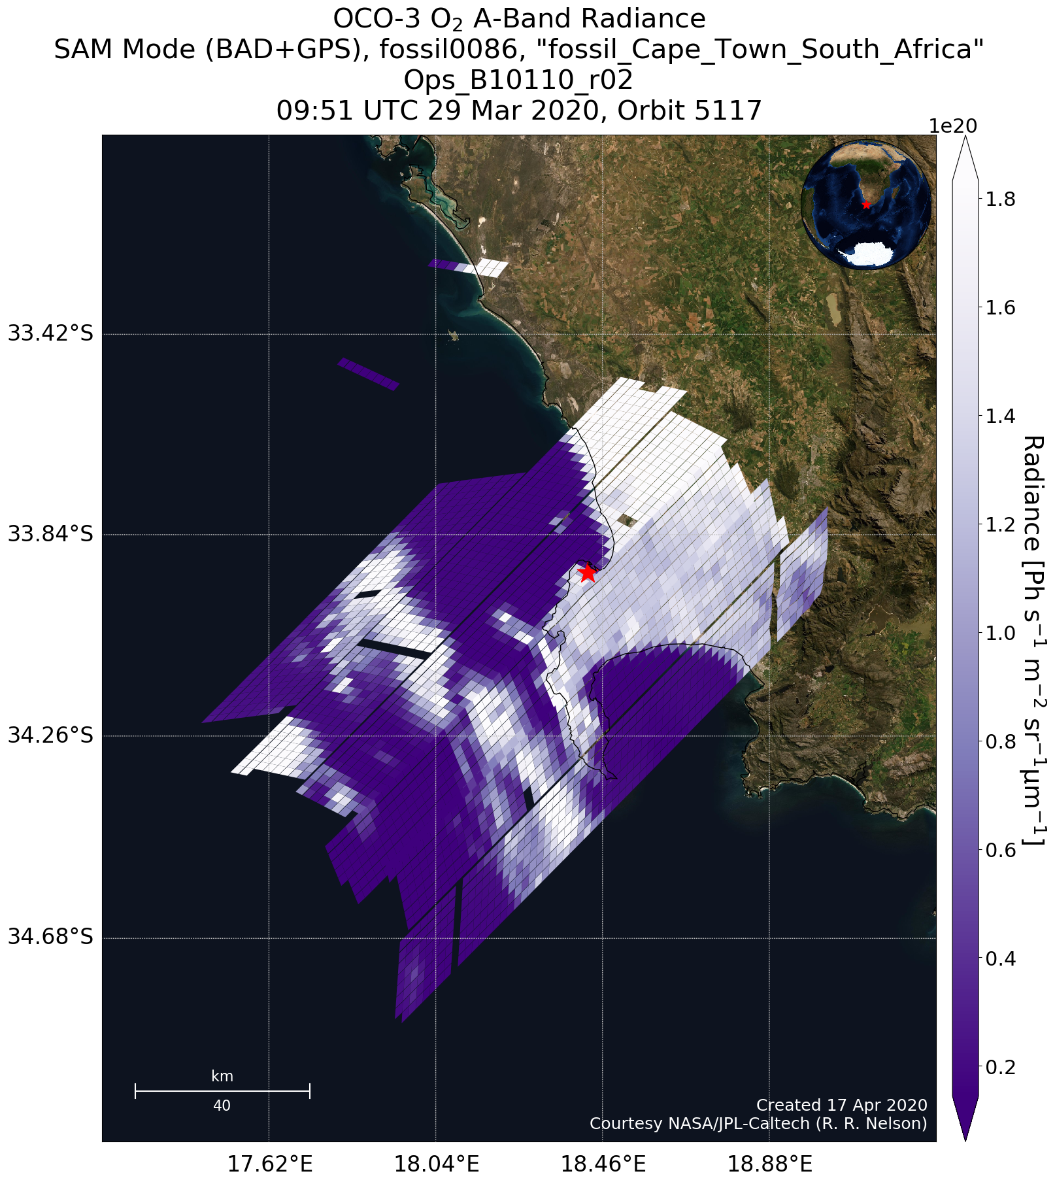
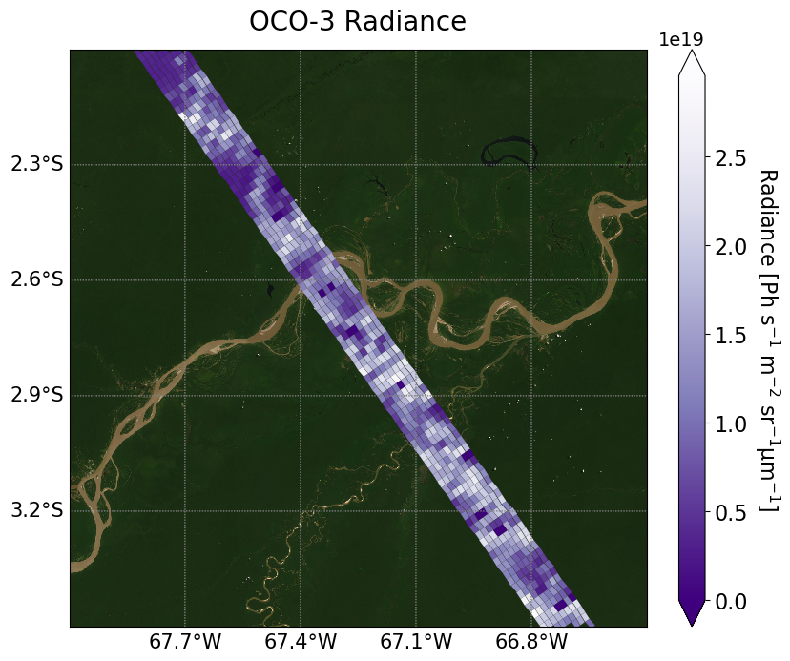
Introduction
OCO-3 can take Snapshot Area Mapping (SAM) mode measurements
On the order of 80 km x 80 km
OCO-3 Radiance (SAM mode)
OCO-3 Radiance (Nadir mode)
Notes:
Left: San Jose, 7 Aug, orbit 1483

Slide 4
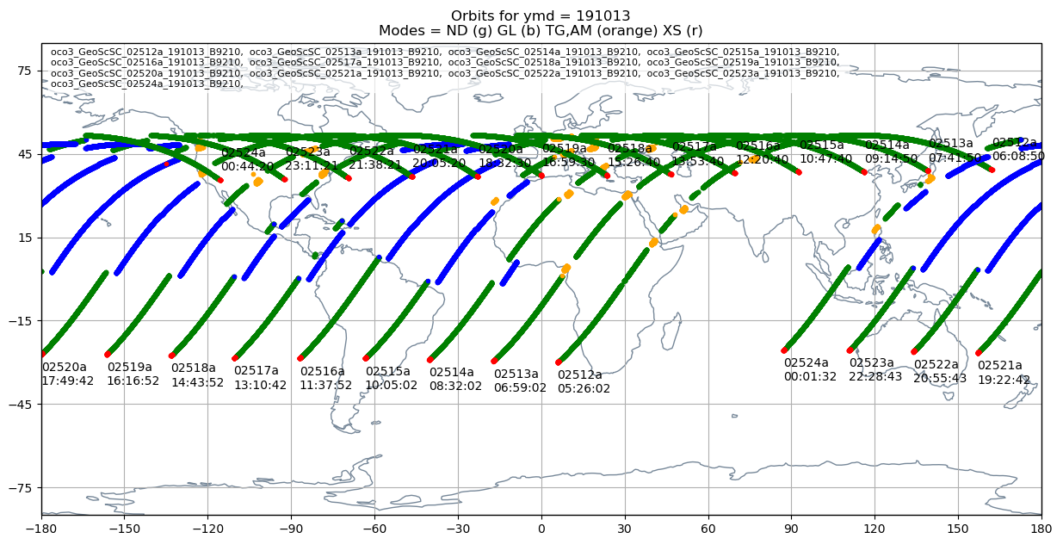
Introduction
OCO-3 can take Snapshot Area Mapping (SAM) mode measurements
Multiple SAMs/Targets possible each orbit
Figure courtesy of Aronne Merrelli

Slide 5
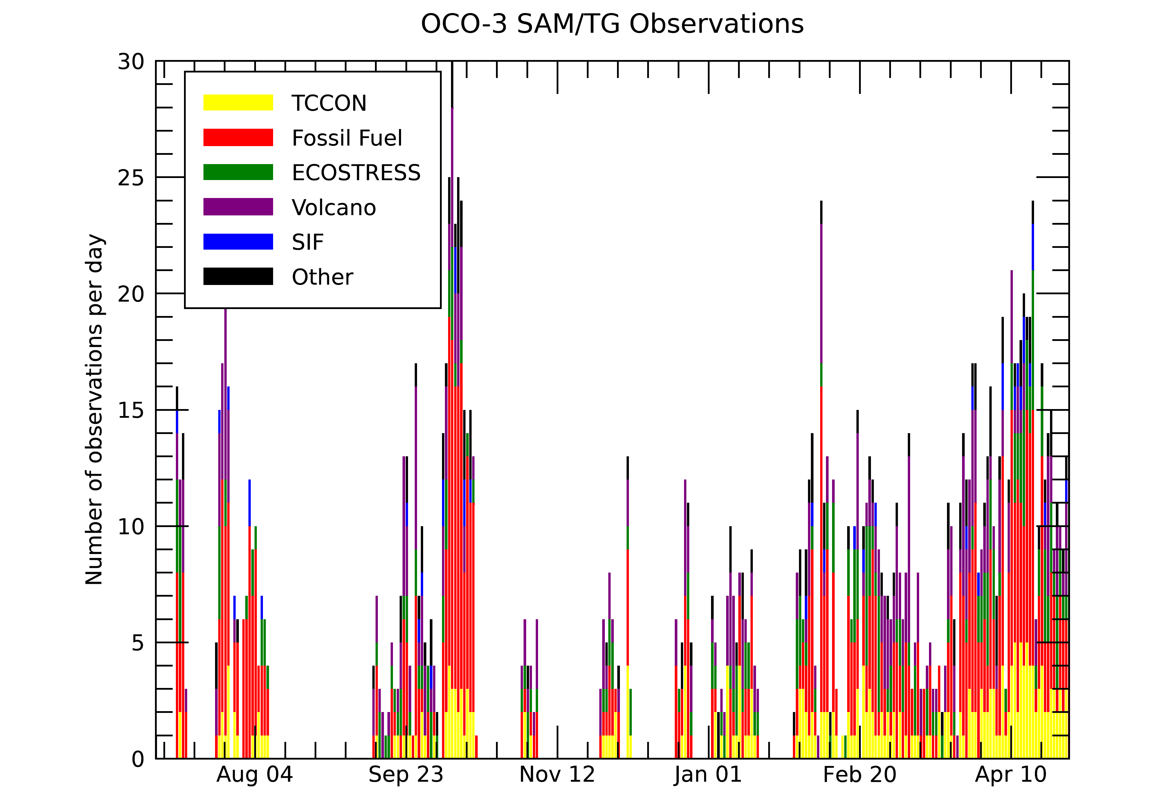
Introduction
OCO-3 can take Snapshot Area Mapping (SAM) mode measurements
>1400 collected so far!
Figure courtesy of Brendan Fisher
Notes:
Data gaps from docking events, spacewalks, pointing violations, etc.
First gap = payload safe (overshooting?)
Jul 15 gap = ???
Aug 24 gap = docking on ISS + fear of overshooting (?)
Oct 23 gap = ???

Slide 6
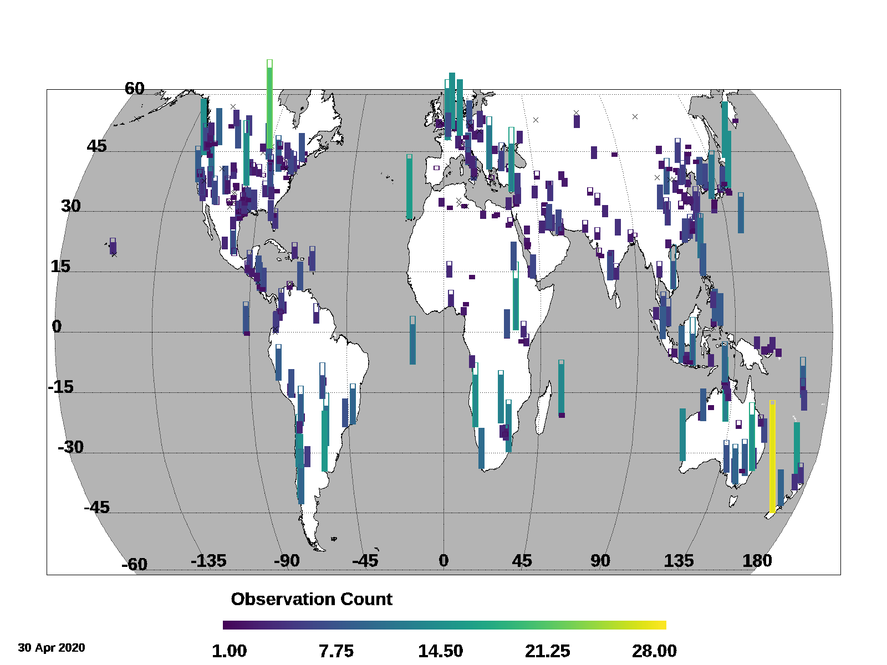
Introduction
Large list of targets including cities, power plants, volcanoes, TCCON sites, SIF sites, and field campaigns
Additional locations can be added and prioritized!
Figure courtesy of Brendan Fisher

Slide 7
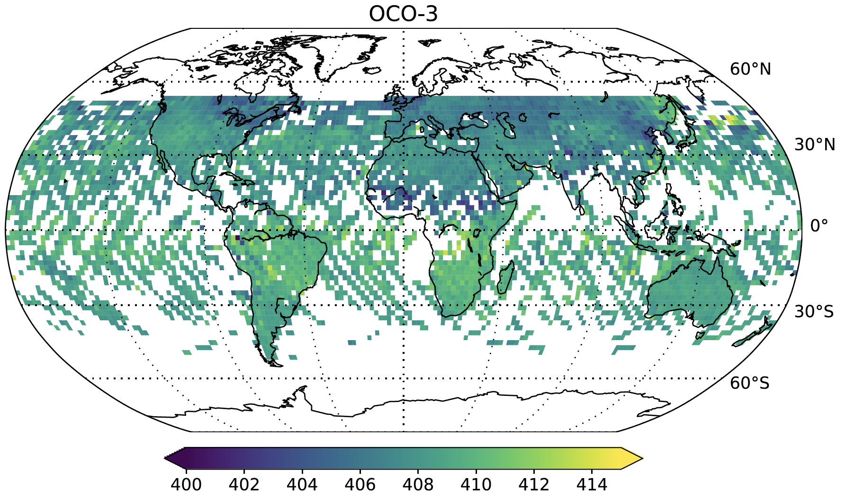
Public Data Release
“vEarly” XCO₂ product released on 30 April 2020 to the GES-DISC!
Still some remaining geolocation and radiometric errors that will be fixed in the full release this fall
Data quality statement and user’s guide available; updated ATDBs coming soon
Bias corrected and filtered “Lite” files to be delivered later in May
Figure courtesy of
Matthäus Kiel
XCO₂

Slide 8
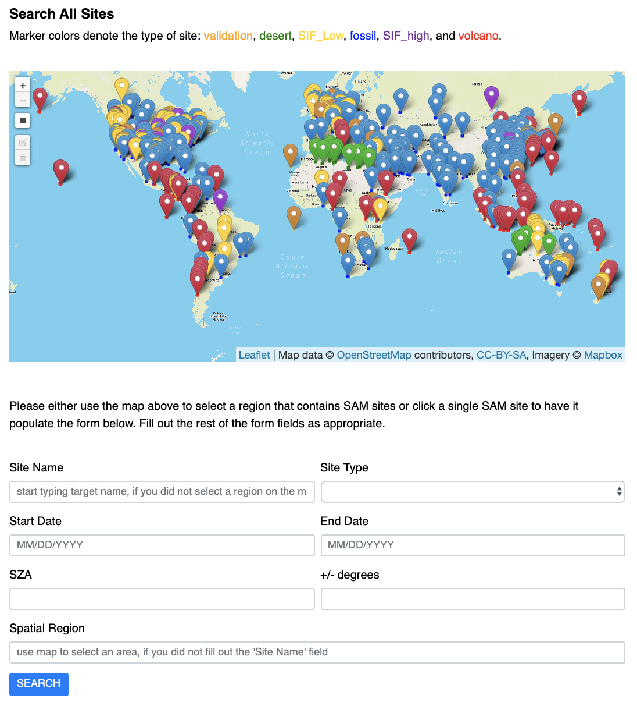
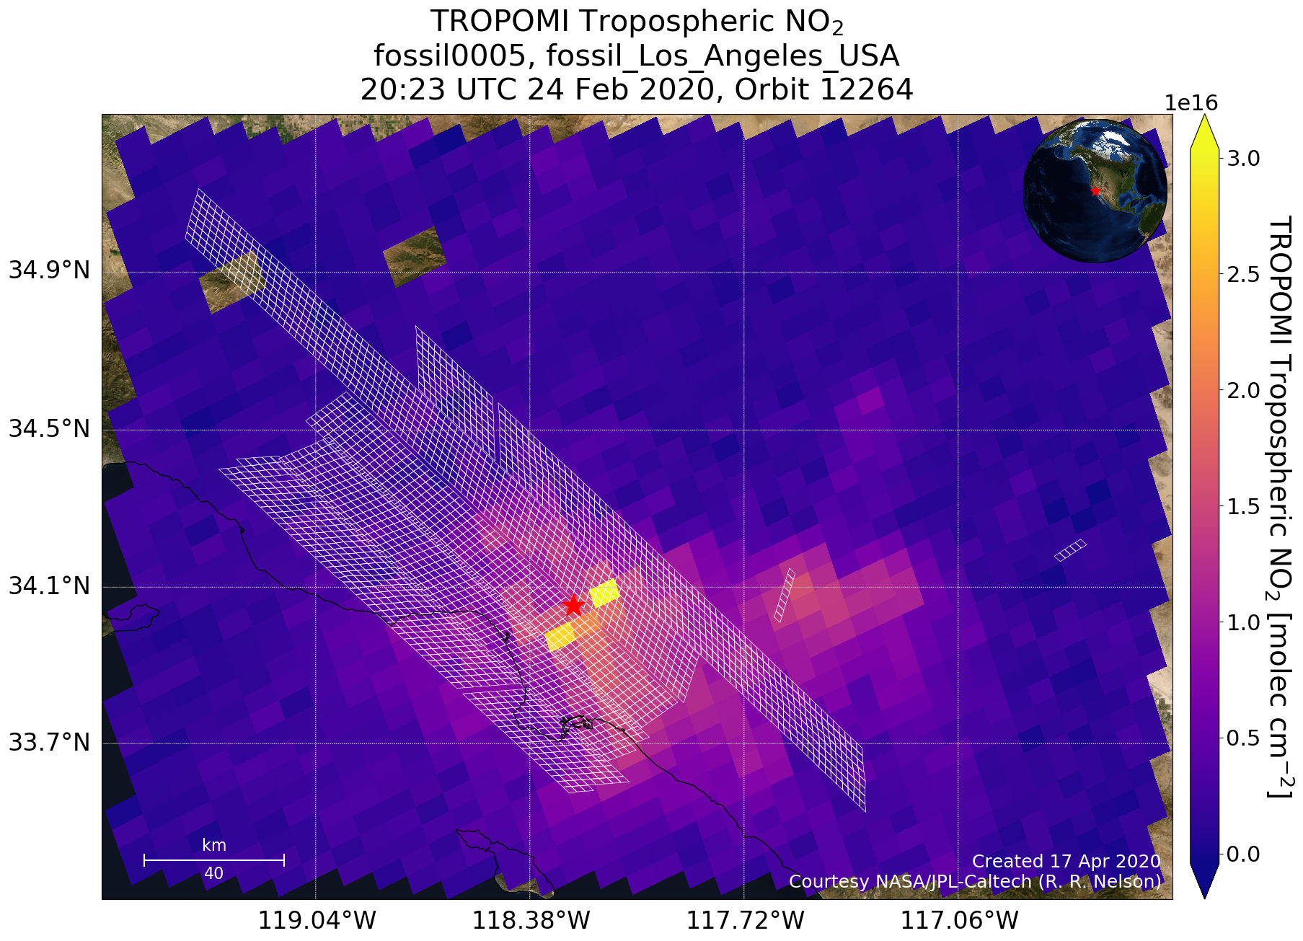
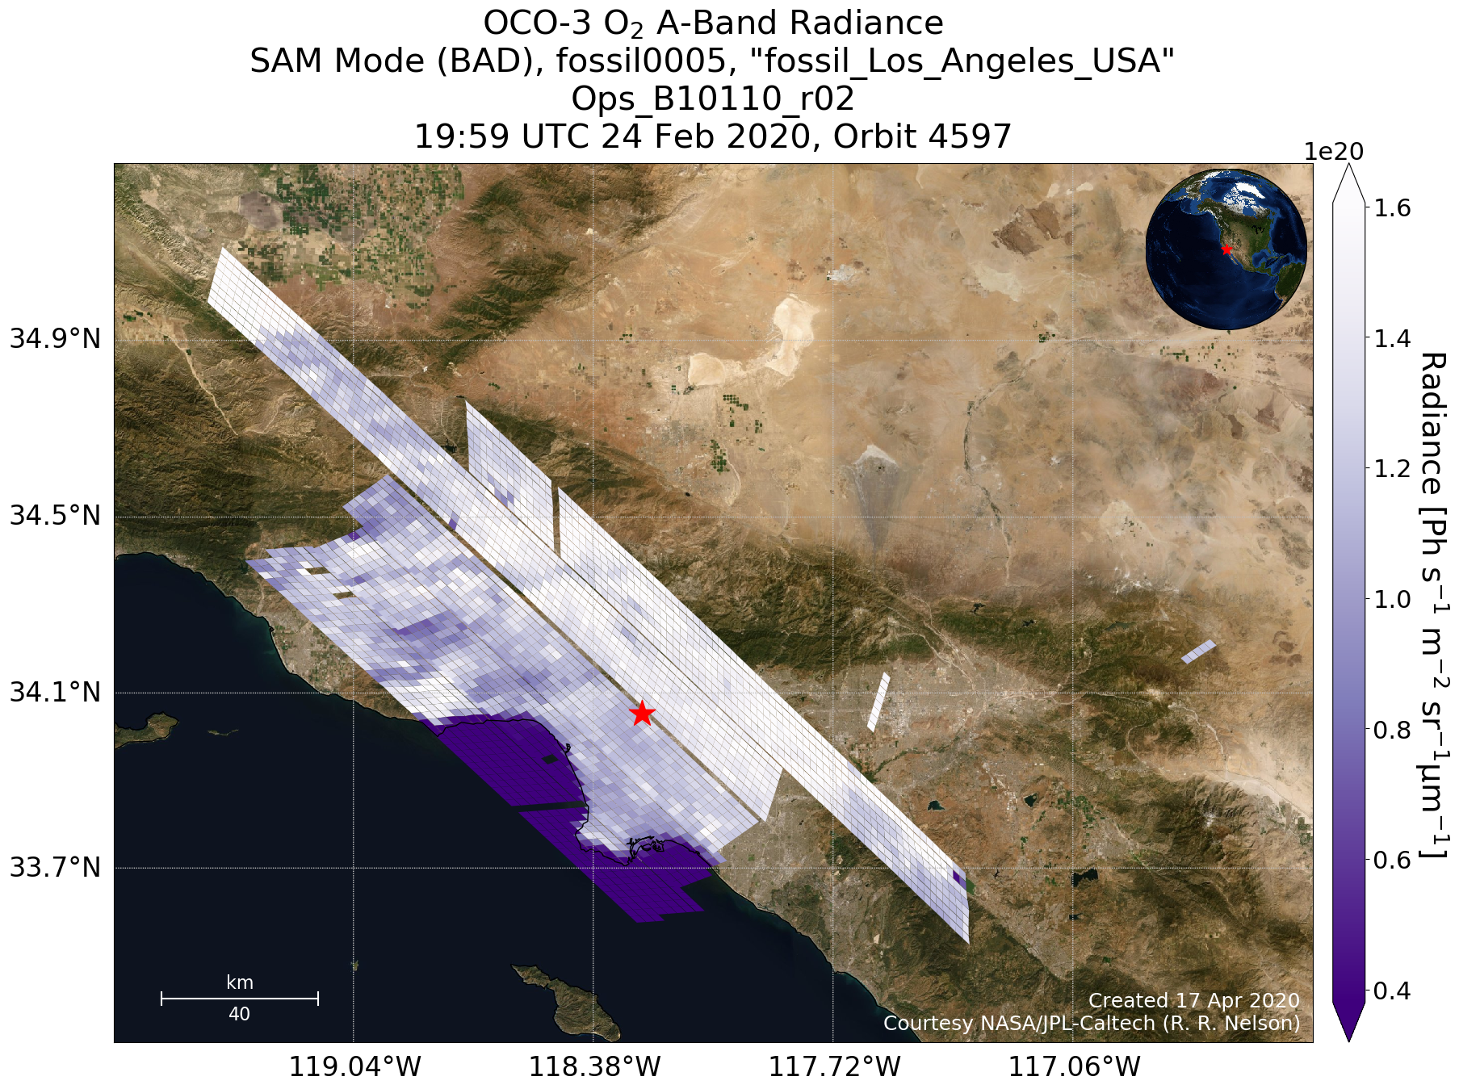
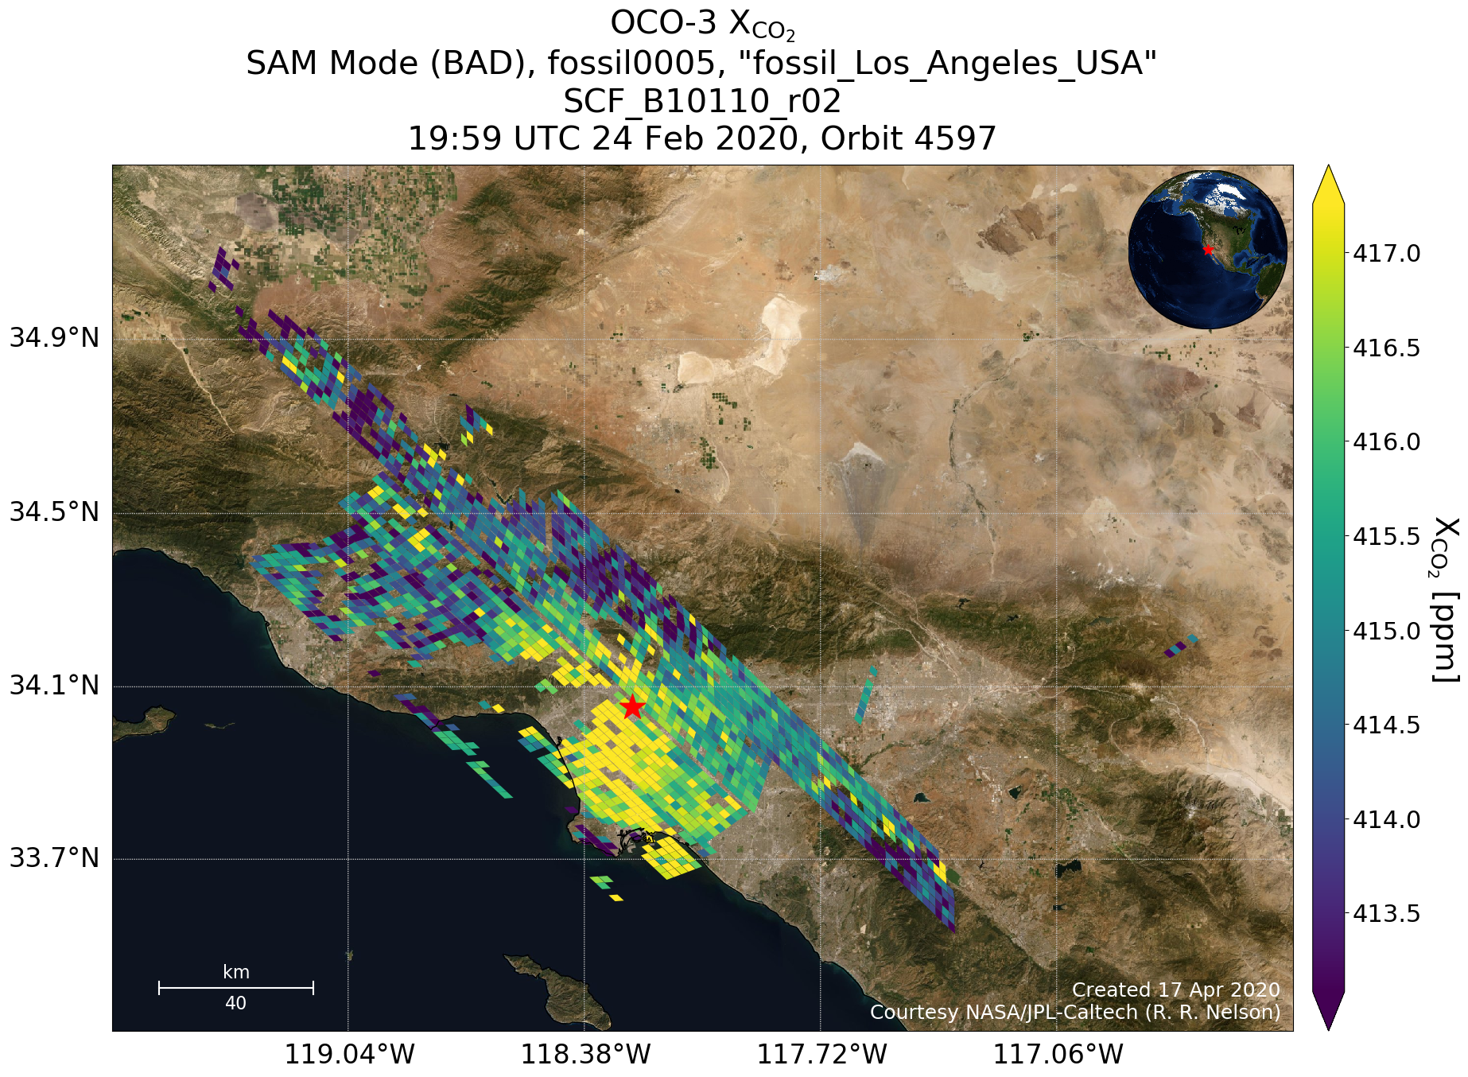
New Website: https://ocov3.jpl.nasa.gov/sams/index.php
SAM/Target searching, quicklook plots, and subsetting OCO-3 data!

Slide 9
Los Angeles, USA
OCO-3 XCO₂
TROPOMI NO₂
Notes:
22 Sept, orbit 2194

Slide 10
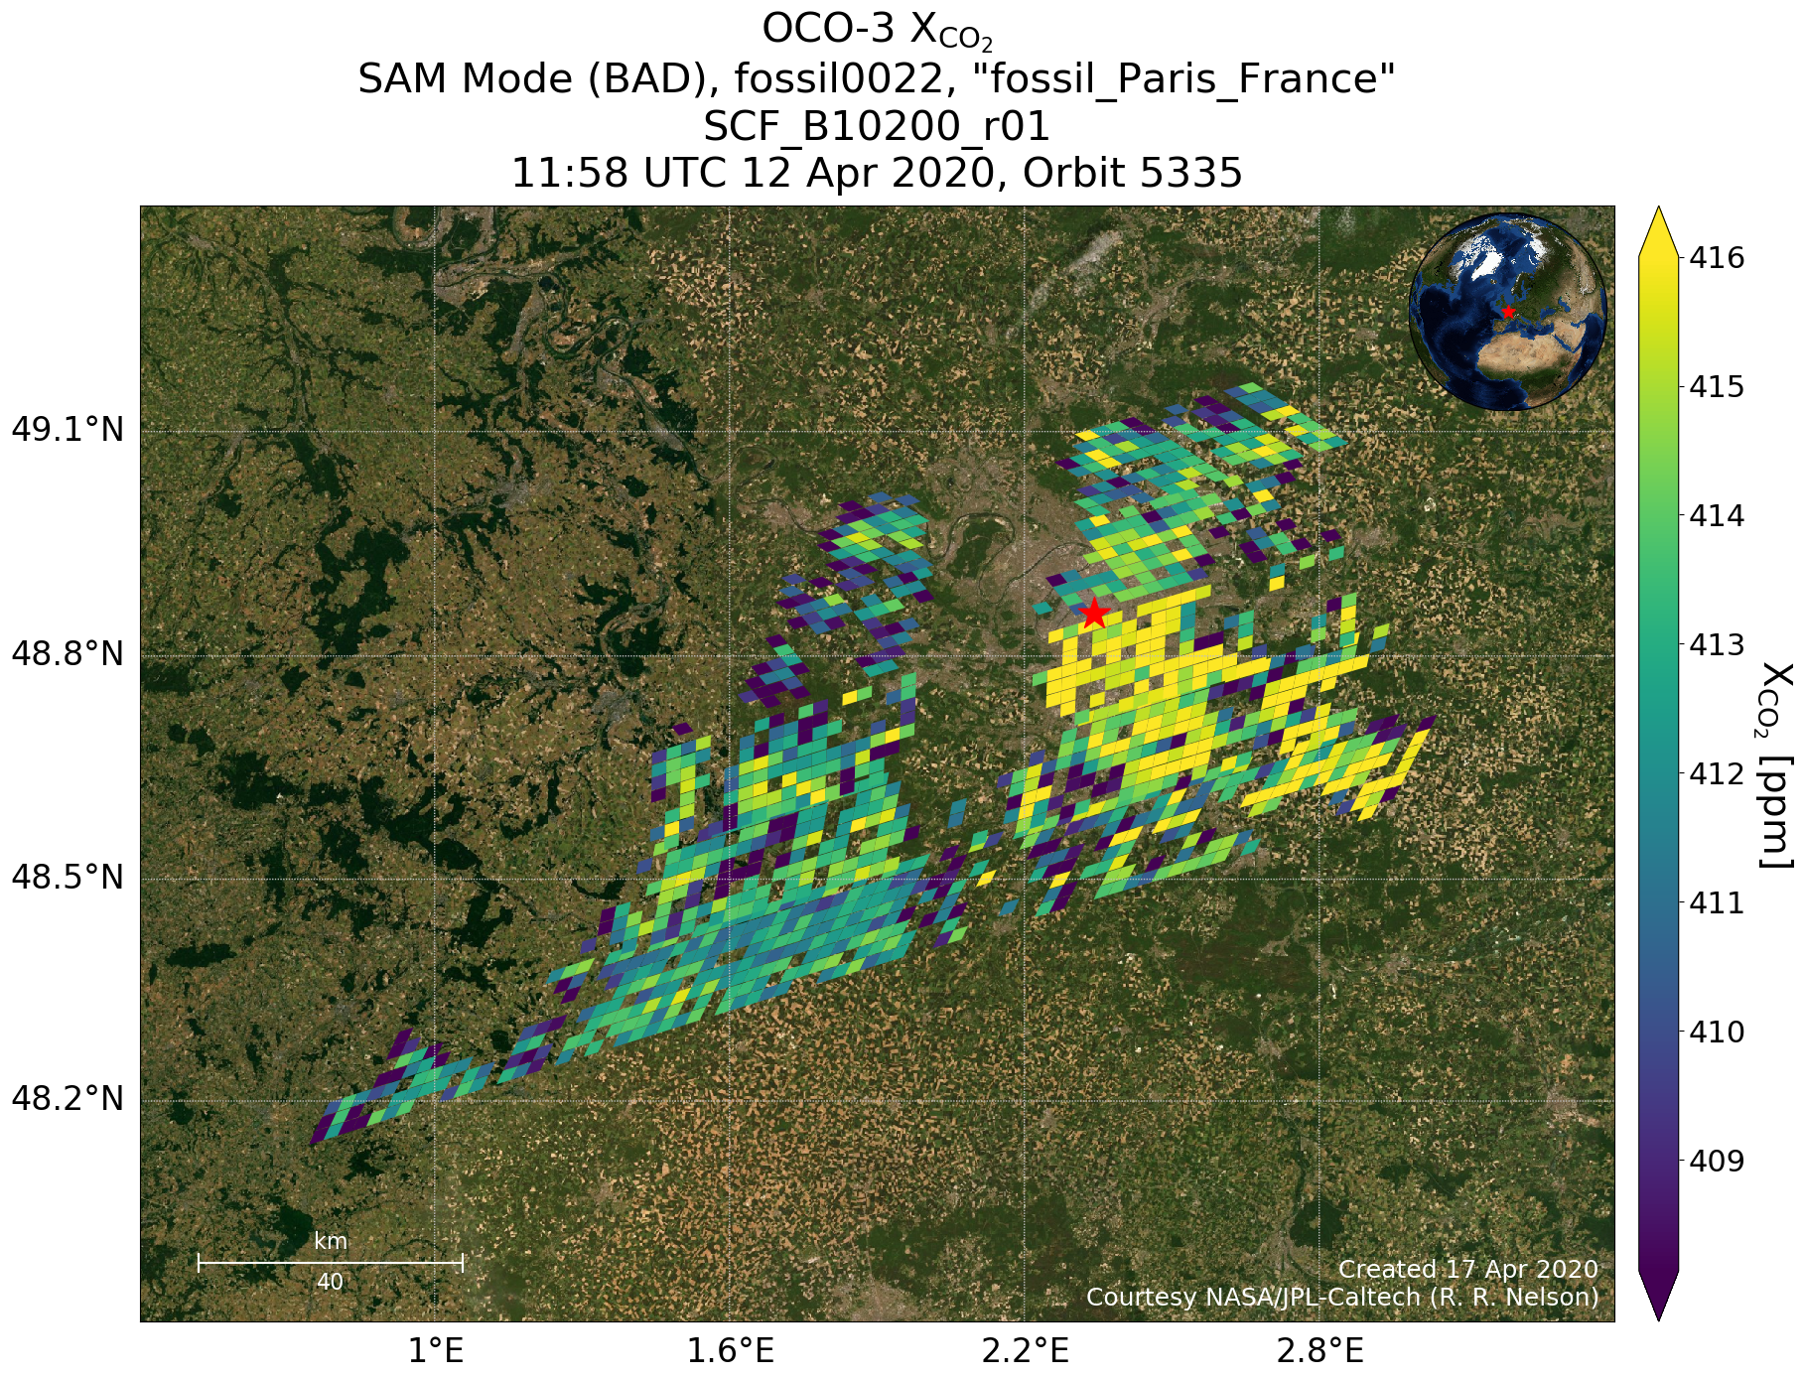
Paris, France
Notes:
22 Sept, orbit 2194

Slide 11
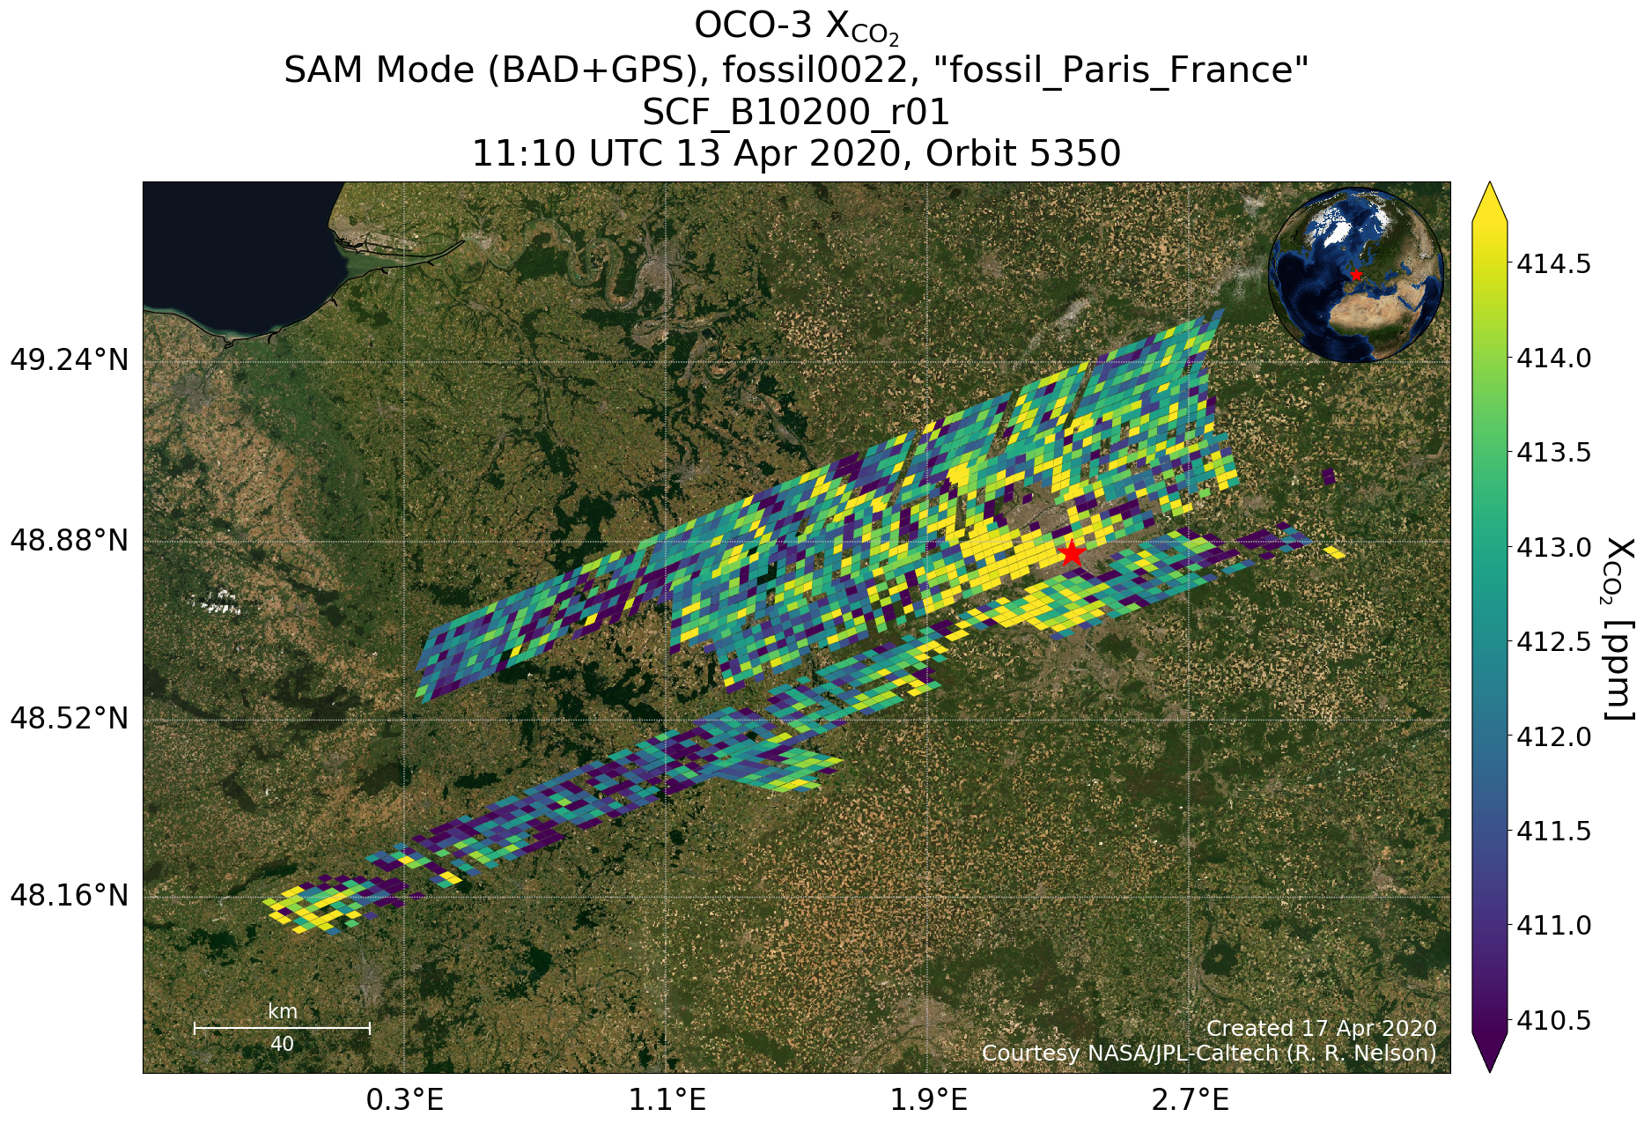
Paris, France
Notes:
22 Sept, orbit 2194

Slide 12
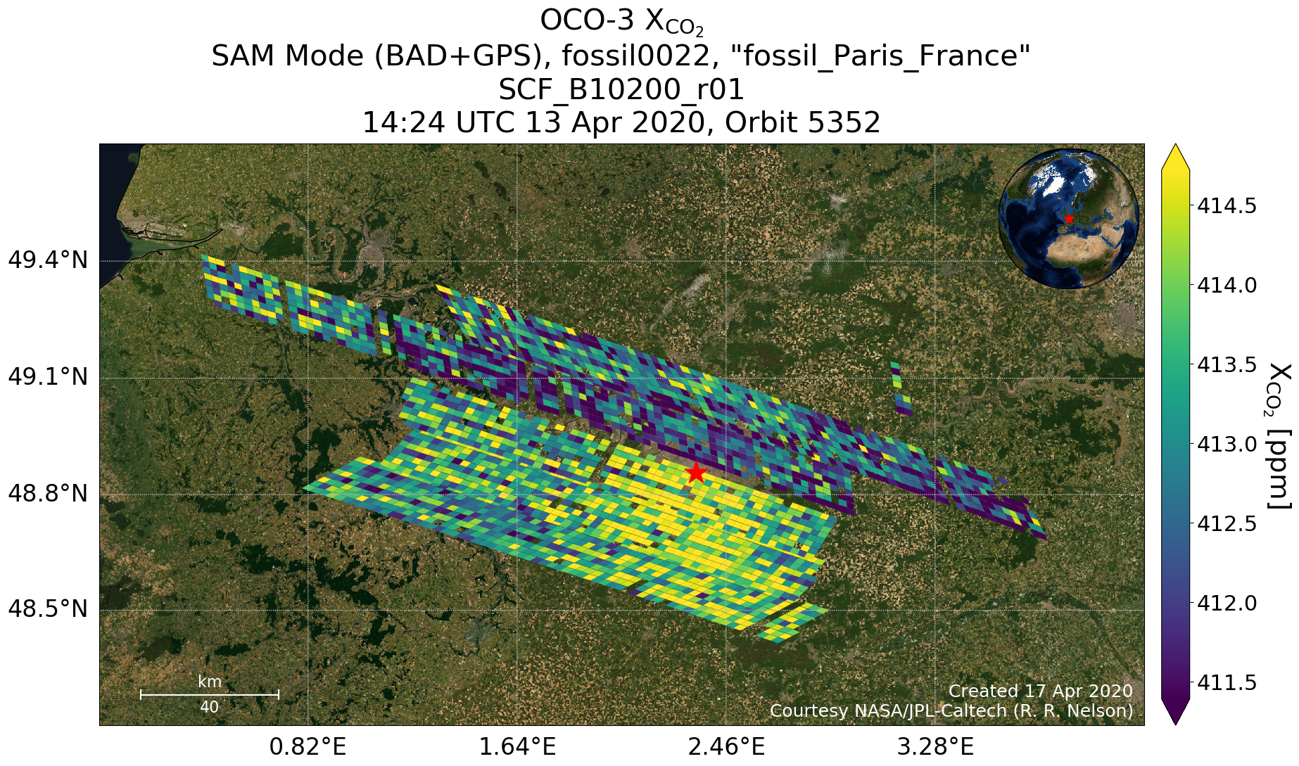
Paris, France
3 hours after previous slide!
Notes:
22 Sept, orbit 2194

Slide 13
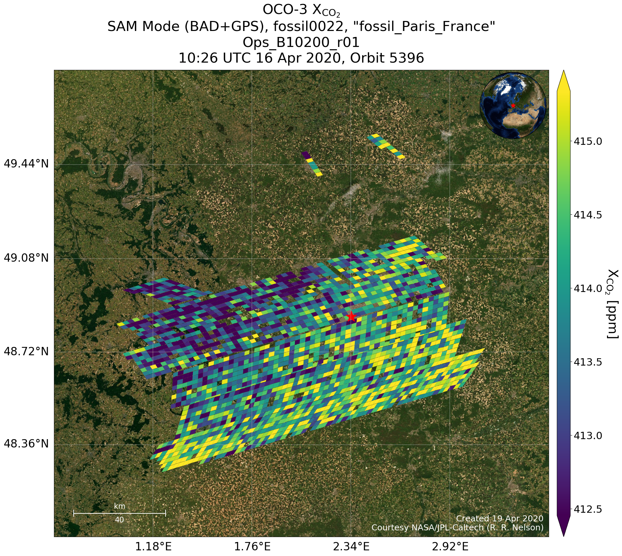
Paris, France
Notes:
22 Sept, orbit 2194

Slide 14
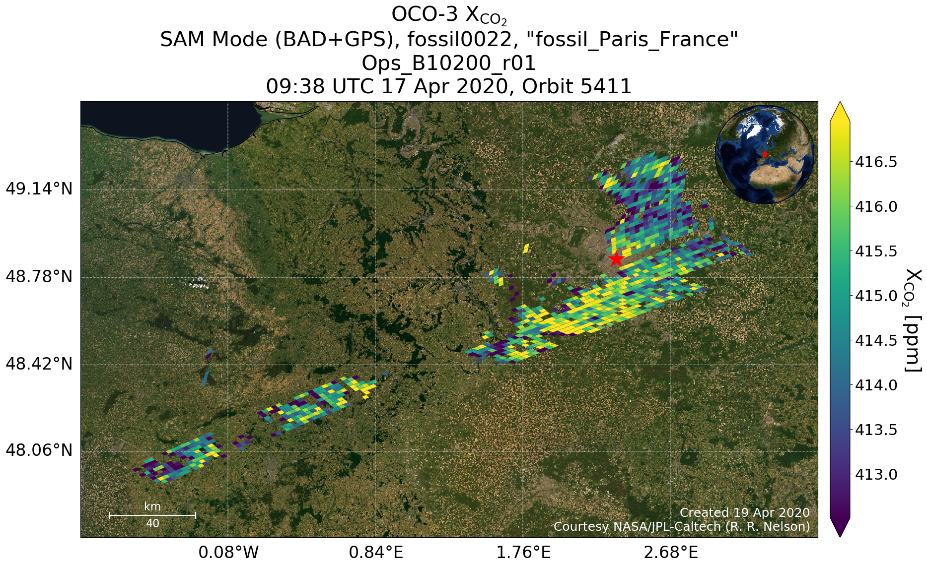
Paris, France
Notes:
22 Sept, orbit 2194

Slide 15
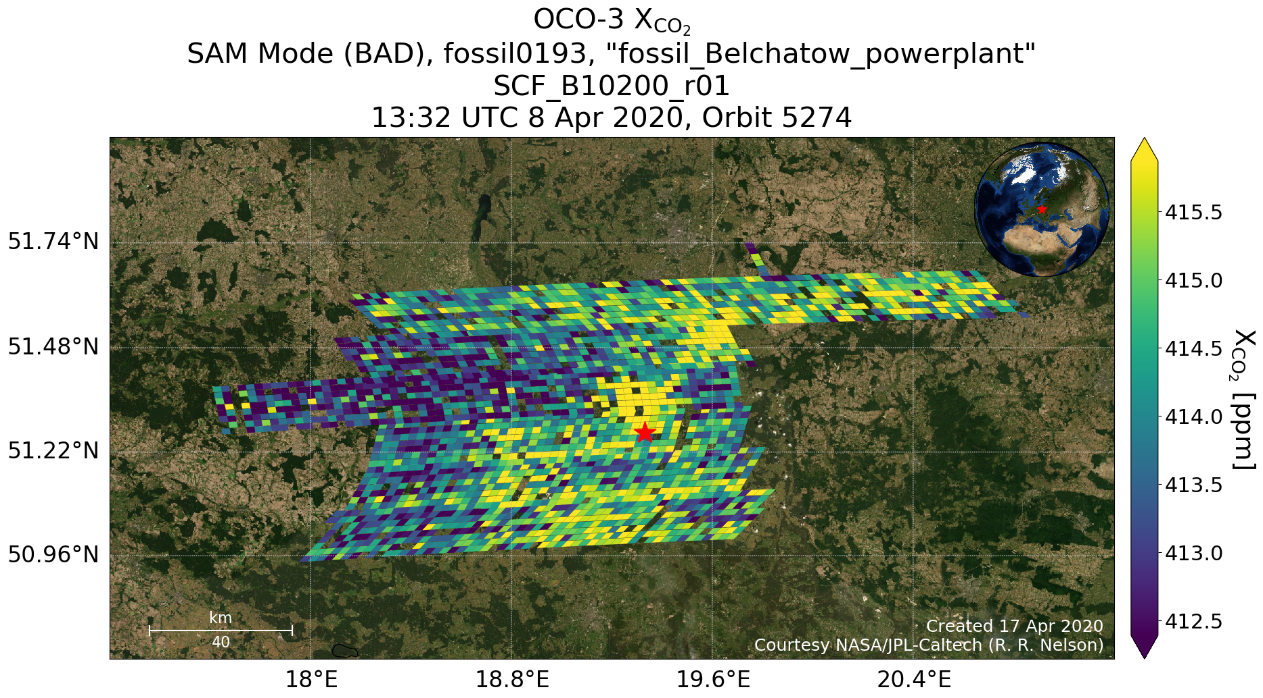
Bełchatów Power Station, Poland
Notes:
22 Sept, orbit 2194

Slide 16
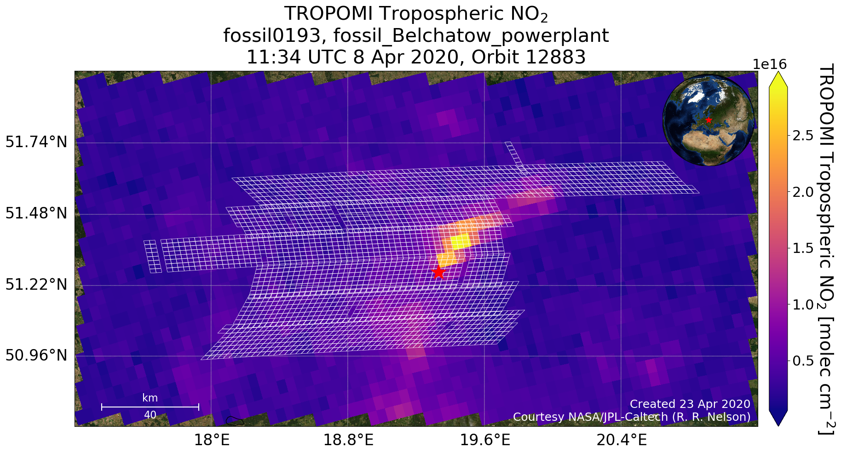
Bełchatów Power Station, Poland
Notes:
22 Sept, orbit 2194

Slide 17
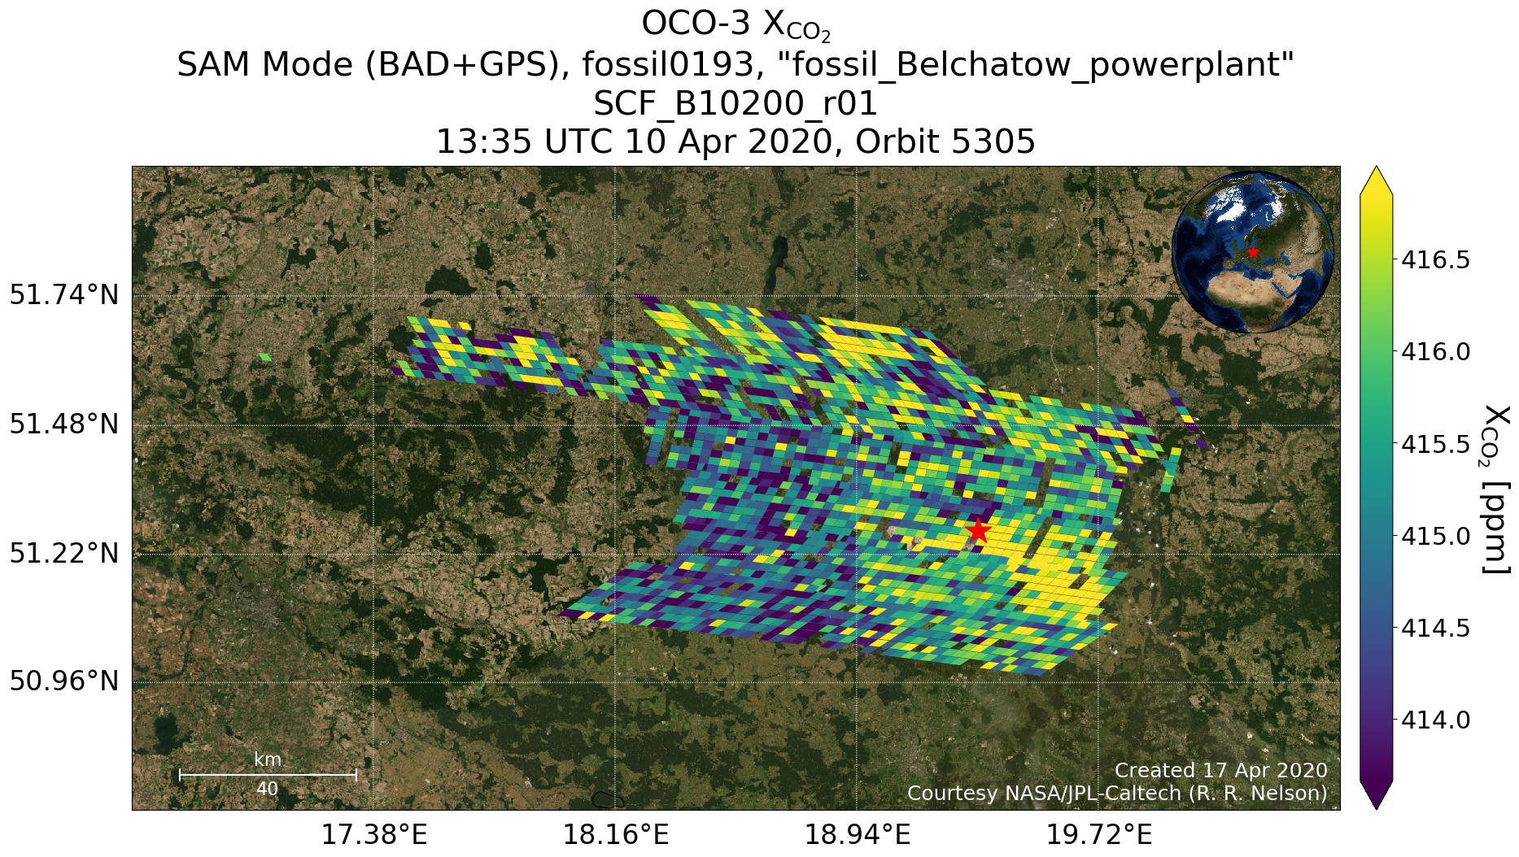
Bełchatów Power Station, Poland
Notes:
22 Sept, orbit 2194

Slide 18
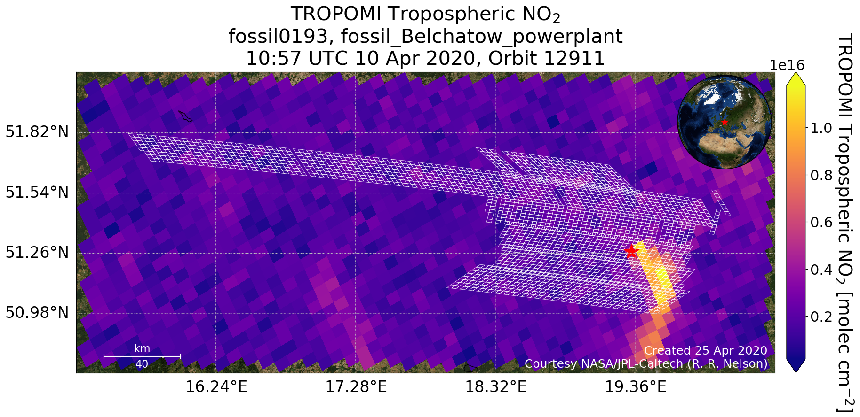
Bełchatów Power Station, Poland
Notes:
22 Sept, orbit 2194

Slide 19
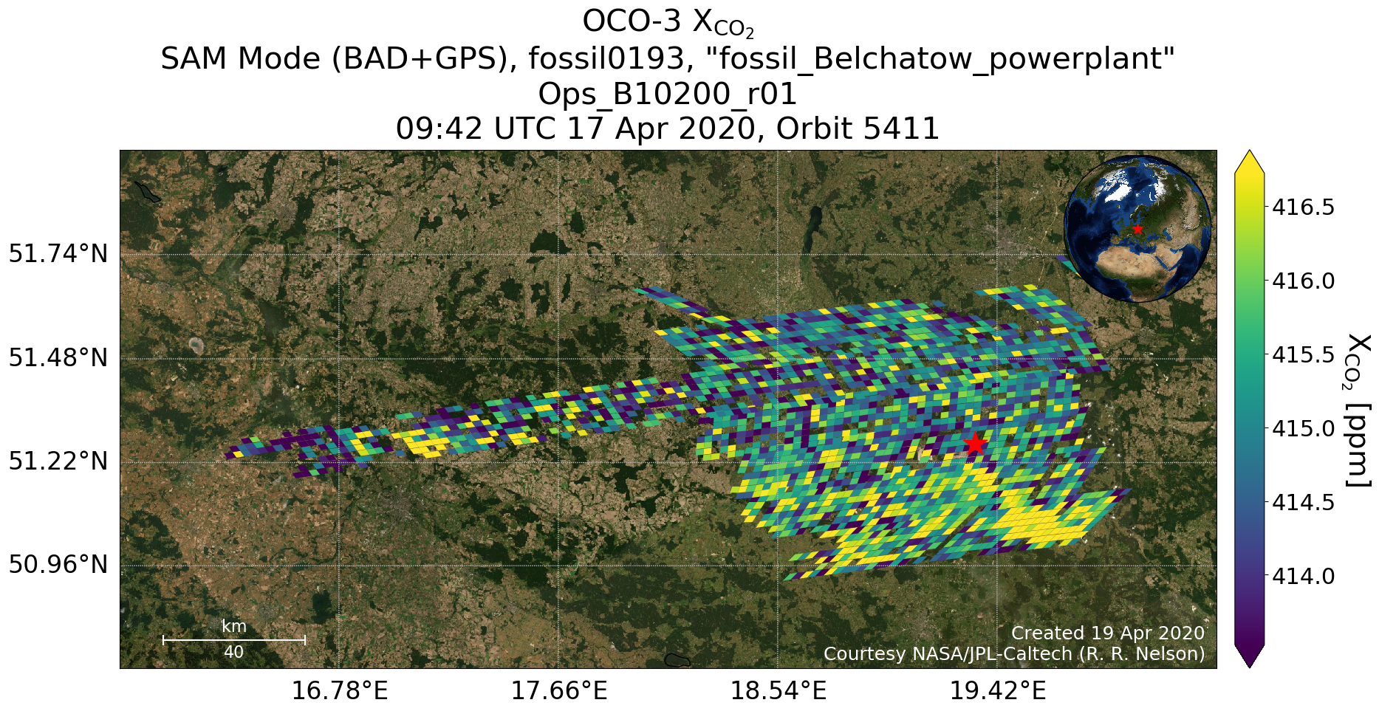
Bełchatów Power Station, Poland
Notes:
22 Sept, orbit 2194

Slide 20
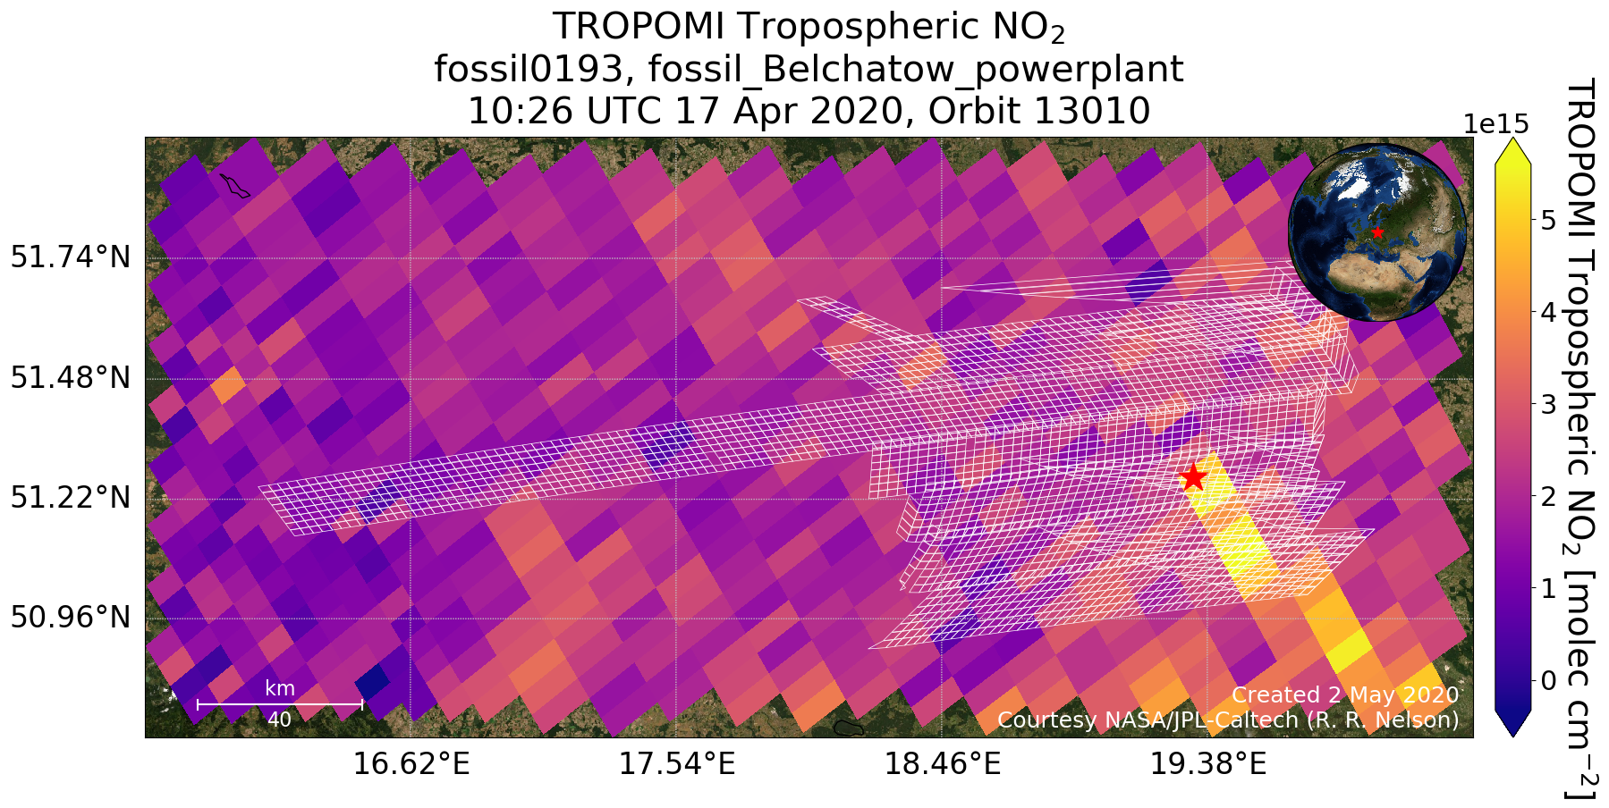
Bełchatów Power Station, Poland
Notes:
22 Sept, orbit 2194

Slide 21
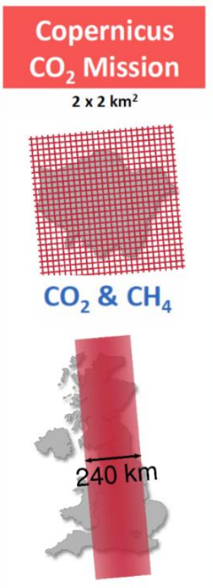
Conclusions & Future Plans
Many promising OCO-3 Snapshot Area Mapping and Target mode measurements
We have begun collaborating with many scientists, but please contact us if you’re interested in our data!
Big picture: OCO-3 SAMs will be a proof-of-concept for future wide-swath CO₂ missions
GeoCarb, CO2M, etc.
Thank you!
Buchwitz, et al.
Notes:
CO2M = global coverage every 3 days

