Slide 1
«The soil loss by water erosion at the European part of Russia»
K.A.MALTSEV, O.P. YERMOLAEV
Institute of Environmental Sciences, Kazan Federal University, Kazan, Russia
The study is supported by grants from the Russian Science Foundation:
Project № 19-17-00064 «Природно-антропогенная эрозия в бассейновых геосистемах Европейской части России»

Slide 2
Previous mapping studies in the European territory of Russia:
"Soil-erosion map of the USSR" scale 1: 5 000 000 (S.S. Sobolev and I.F. Sadovnikov);
"Map of erosion of agricultural lands of scale 1: 2 500 000 (Soil Science Institute named after V.V. Dokuchaev);
The map "Erosion-hazardous lands of Russia" of scale 1: 1 500 000 (MSU);
"Erosion-hazardous land of the agricultural zone of Russia" scale 1:5 000 000 (MSU);
Map "Soil erosion" of scale 1:10 000 000 (MSU).
The map of spatial variation of soil erosion by water (Van Oost et al., 2007);
Global Land Degradation Information System (GLADIS) (Nachtergaele et al., 2011);
The goal is to develop the modern map model of the intensity of soil erosion processes in the arable lands of the European Territory of Russia with a higher spatial detail (to a scale of 1:500,000).

Slide 3
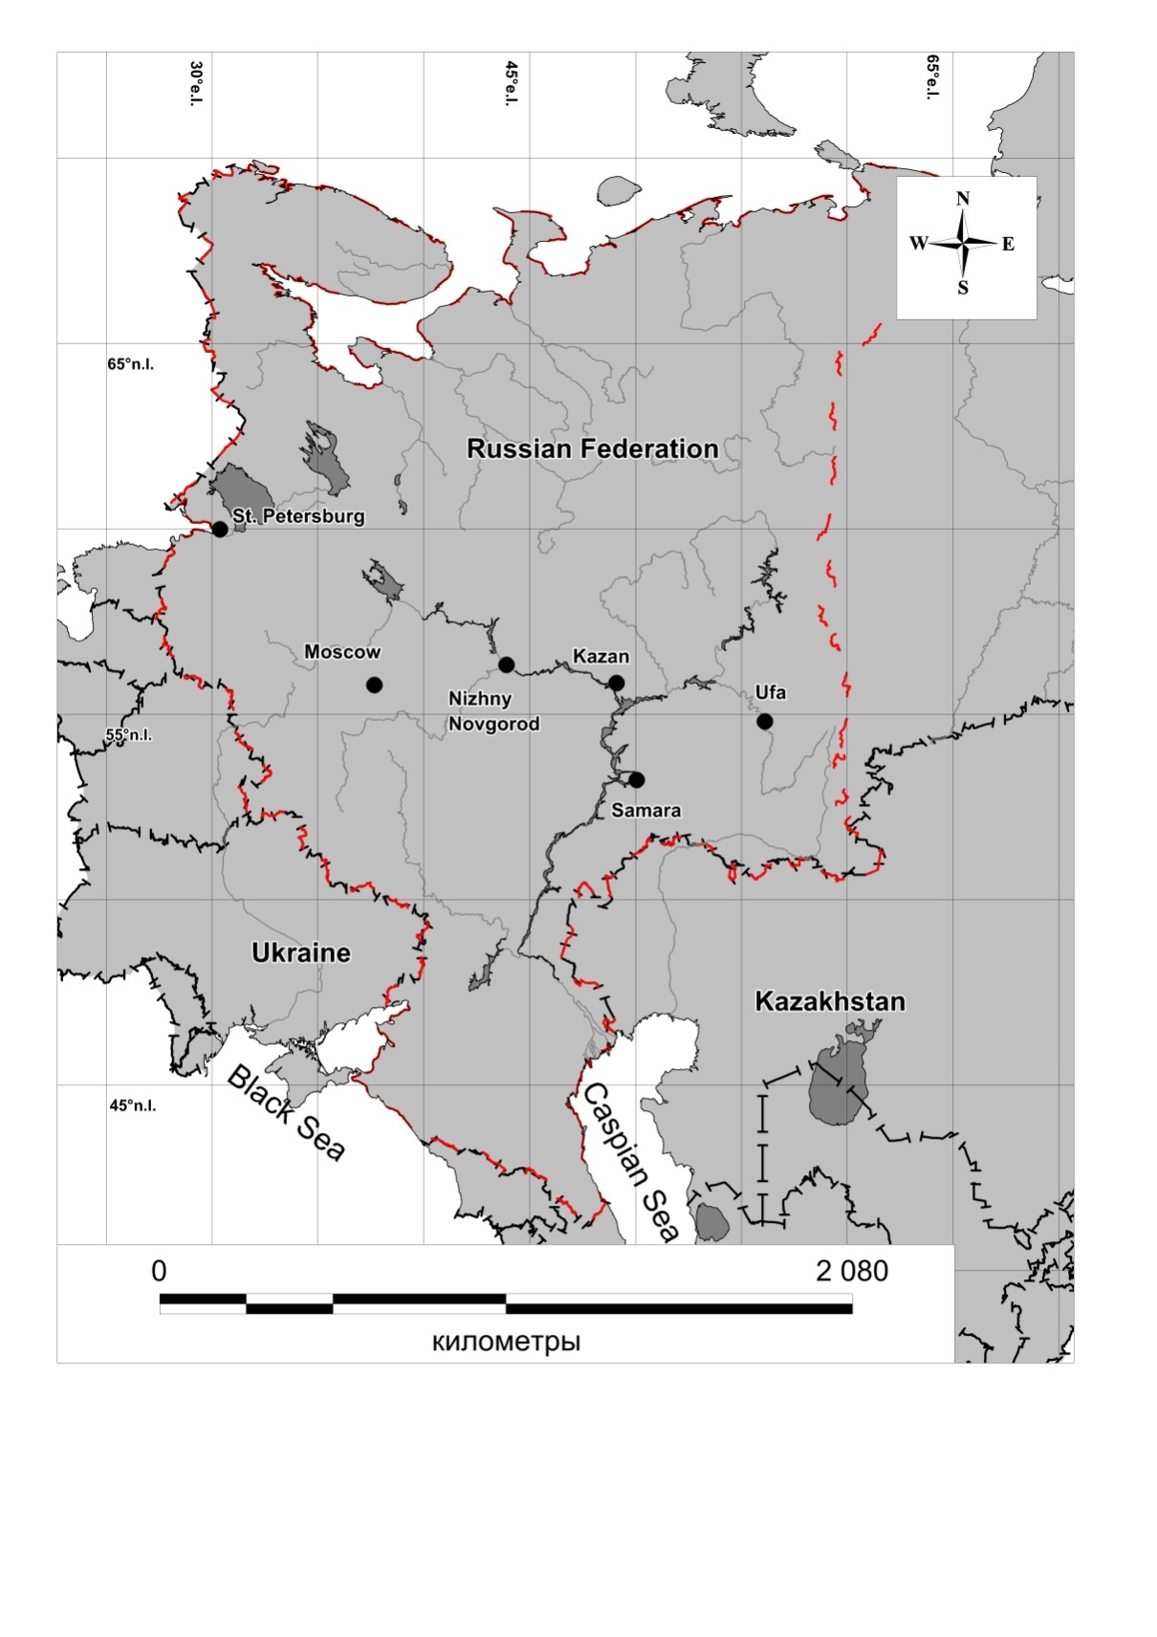
Study Region: European part of Russia
Total area:
about 3.8 mln.sq.km
This territory is located in several landscape areas: tundra, forest, forest-steppe, steppe, semi-desert. The population of this territory is about 95 million people.
Scale of the study: regional (1: 500 000)
Object of the study: arable land of the European part of Russia
.

Slide 4
Method
The annual soil loss for study territory is determined by the formula
С_{year}=С_{rainstorm}+С_{snowmelt}
where: С_{rainstorm}, С_{snowmelt,} - soil loss from the rain and melt waterflow, respectively, t / ha per year.
С_{rainstorm} =f(R, K, L,I, P, К) – USLE modified by erosion laboratory of MSU (Larionov, 1993);
where: R - rainfall erosivity factor, K - soil erodibility factor, I – slope; L - slope length; P - mean annual cropping coefficient.
С_{snowmelt} = f(K, h, L, I, P) - developed by State Hydrology Institute and modified by erosion laboratory of MSU;
where: K - soil erodibility facto, h - the annual layer of the runoff during the snow melting period; I – slope; L - slope length; P - mean annual cropping coefficient .

Slide 5
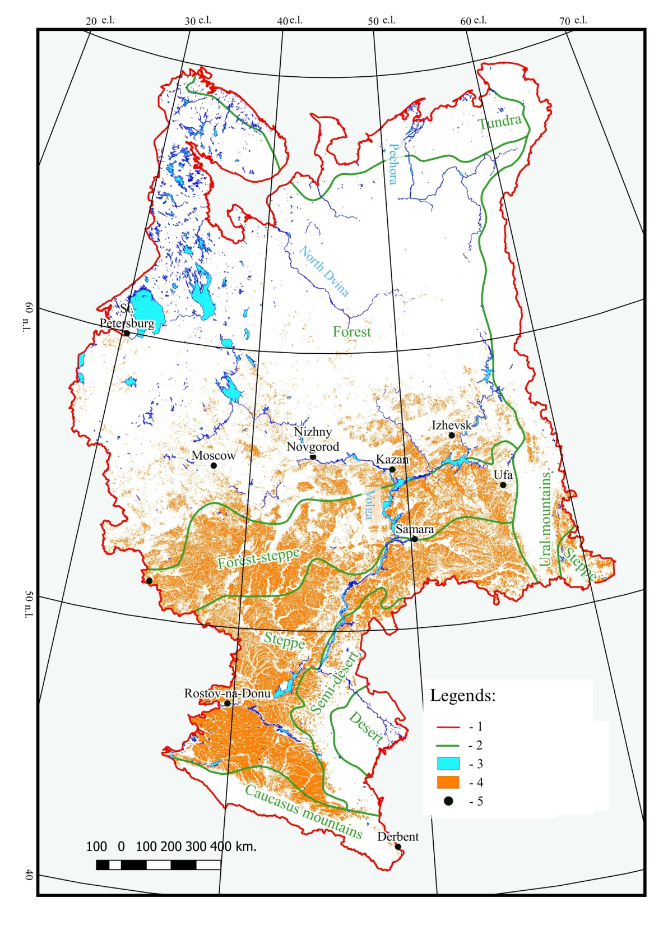
Input data: land use
Input data: land use
The arable land location on the model "TerraNorte RLC v.3“.
This model is updated annually, and we used the version of the model for 2014.
The total area of arable land in this region is about 600,000 sq. km.
Arable lands - 16.8% of the European part of Russia.
- Arable land

Slide 6
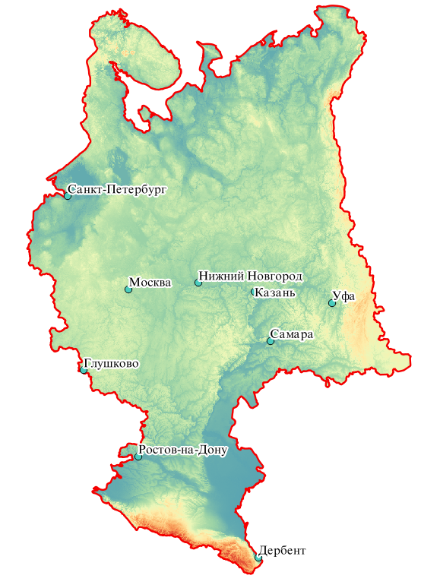
Input data: terrain parameters
The global terrain model GMTED2010 was used for calculate the slopes and slope length .
GMTED2010 was created using 11 different sources of Earth relief data, including SRTM. We used version of the model with resolution of 250 m. Based on the obtained DEM in the GIS ARCGIS, such relief characteristics as slope and slope length were calculated.

Slide 7
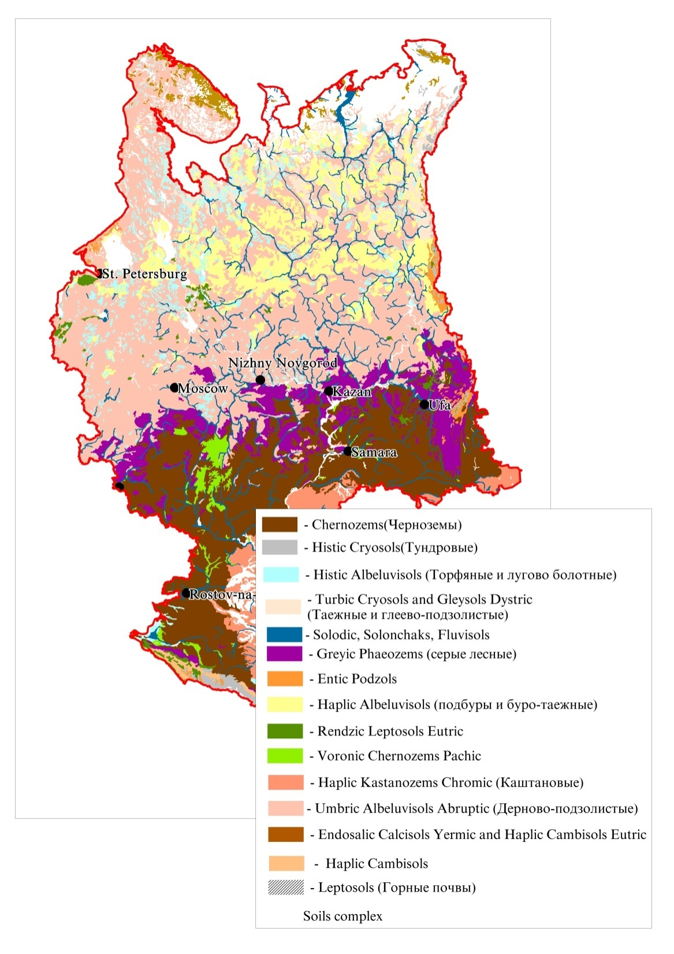
Input data: soil properties
The "Unified State Register of Soil Resources of Russia (USRPR) was used for the preparation of data on the properties of the soil, which is available on the website http://egrpr.esoil.ru/
№ | Description
1 | Soil name in WRB 2006
2 | Amount of humus (%)
3 | Water-permeability class of soil type
4 | The coefficient of reduction of erosion depending on the stony type of soils
5 | Percentage of soil particles 0.1 - 0.05 mm.
6 | Percentage of soil particles 1 - 0.25 mm.(%)
7 | Percentage of soil particles 0.25 - 0.05 mm.(%)
8 | Percentage of soil particles 0.05 - 0.01 mm.(%)
9 | Percentage of soil particles 0.01 - 0.005 mm.(%)
10 | Percentage of soil particles 0.005 - 0.001 mm.(%)
Properties were determined for about 300 soil contours.

Slide 8
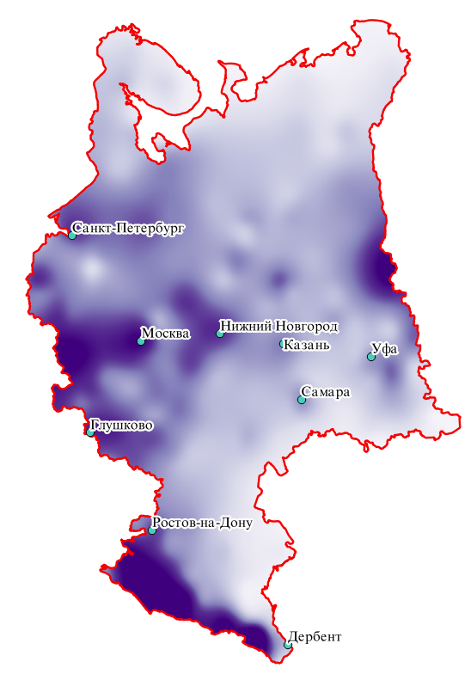
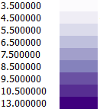
Input data: climate
1) Spatial model of the rainfall erosivity factor;
2) Spatial model of the annual layer of the runoff during the snow melting period ;
1)The construction of the spatial model of the rainfall erosivity factor was carried out in two stages with scripts in the "R" programme environment:
a) computation the rainfall erosivity factor at each meteorological stations,
R = 3,19e ^{0,006P} (Kanatyeva et al., 2010)
where P is the average annual precipitation of daily precipitation over 10 mm. in the warm season (warm is the time of year when the average daily temperature is above 0 C degrees).
b) The spatial model of the modern annual rainfall erosivity factor model was created.
2)The models of spatial models of annual layer runoff during the snow melting period and annual distribution of the rainfall erosivity factor were taken by us from study «Eroziya i deflyatsiya pochv» (Larionov, 1993)

Slide 9
Results:
Statistical indicators of soil loss in the fallow land and with using of the support practices factor coefficient (t/ha in year)
 | 99% - quantile | Average | Average – agro
European part of Russia | 3574.66 | 11.03 | 4.04
Landscape Zone | Average, t/ha per year
 | year | rain | Snow melt
Forest Zone | 4.91 | 4.77 | 0.49
Forest-Steppe Zone | 3.91 | 3.67 | 0.29
Steppe Zone | 3.37 | 3.26 | 0.16
Semi-Deserts Zone | 2.15 | 2.14 | 0.08
Deserts Zone | 0.61 | 0.60 | 0.003
The Caucasus Mountains | 11.23 | 11.07 | 0.41
The Ural Mountains | 3.85 | 3.46 | 0.43
 | Average, t/ha per year | Standard Deviation
Lowland Plain (<200 m) | 3.65 | 7.79
High Plain 200–500 m | 4.90 | 11.21
Mountains >500 m | 12.88 | 26.77

Slide 10
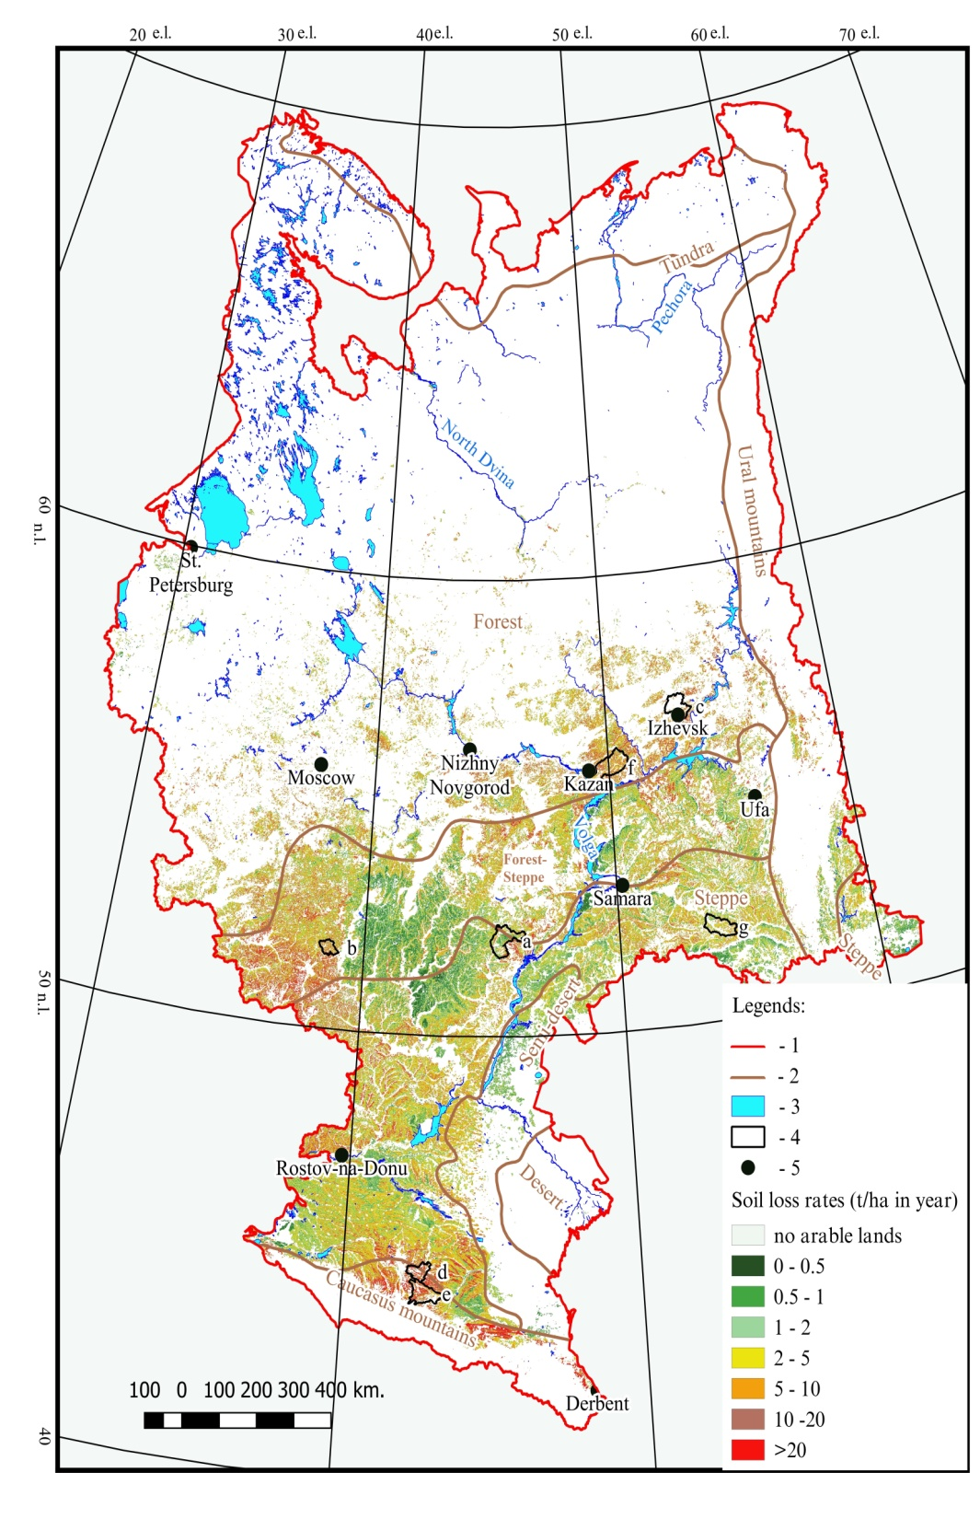
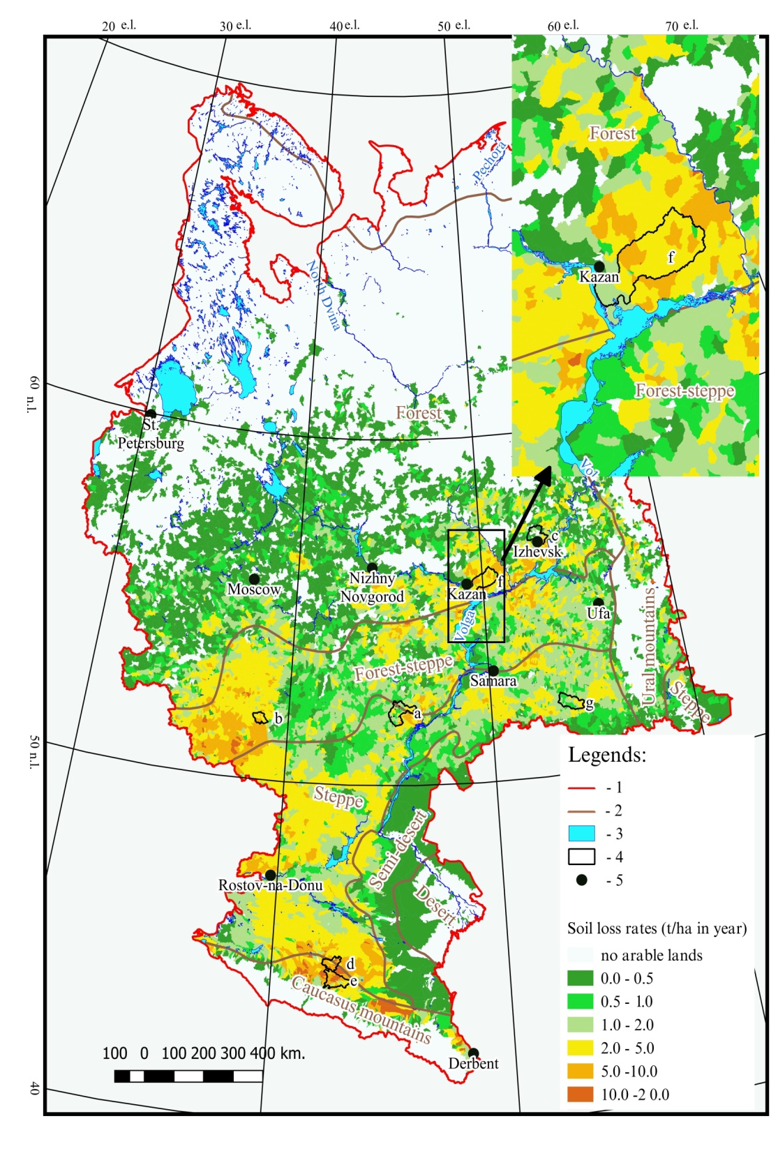
Results: Soil loss map on the European part of Russia.

Slide 11
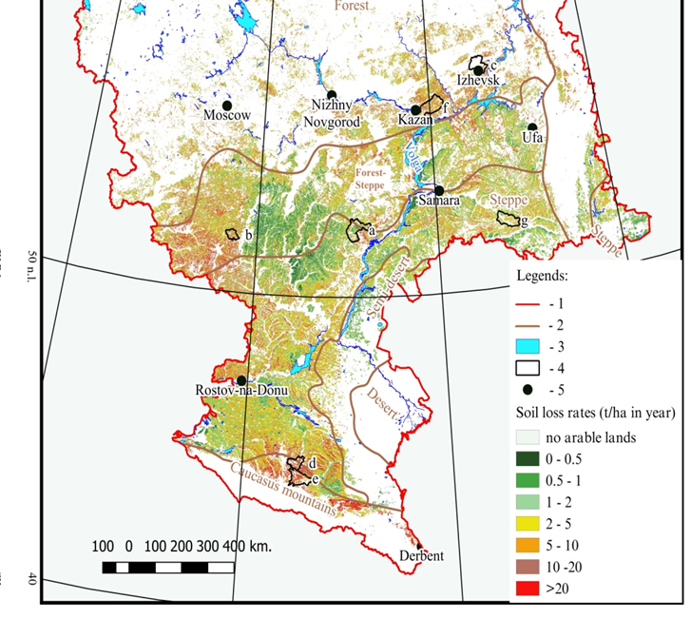
Verifying results:
Average soil loss from erosion for 1965–2015 within test river basins
River basin, regions Russian Federation | Soil loss, t/ha per year |  | Differences, %
 | Scale 1:50,000 | Scale 1:500,000
Medveditsa, Saratov region (a) | 2.10 | 2.12 | 0.9
Veduga, Voronezh region (b) | 5.55 | 6.57 | 18.4
Izh, Udmurt Republic (c) | 4.51 | 6.13 | 35.9
Kalaus, Stavropol region (d) | 14.34 | 13.83 | 3.6
Kuma, Stavropol region (e) | 15.55 | 12.57 | 19.2
Mesha, Republic of Tatarstan (f) | 7.30 | 7.91 | 8.4
Samara, Orenburg region (g) | 2.52 | 2.27 | 9.9
Annual soil loss on the European part of Russia: 4.04 t/ha in year
Annual soil loss on the EU: (Panagos P. et. al., 2015) - 2.46 (t/ha in year);(Bosco C., et. al., 2015) - 2.76 (t/ha in year)

Slide 12
Verifying results:
Results of geoinformation modeling (t/ha in year)
 | Average - agro Scale 1:50 000 (SRTM 1’) | Average – agro Scale 1: 500 000 (GMTED2010)
Medveditsa river (4) | 2.10 | 2.12
Veduga river (3) | 5.55 | 6.57
Izh river (1) | 4.51 | 6.13
Kalaus river (6) | 14.34 | 13.83
Kuma river (6) | 15.55 | 12.57
Mesha river (2) | 7.30 | 7.91
Ulema river (2) | 5.37 | 6.35
Samara river (5) | 2.52 | 2.27
Results of field observations (Golosov et. al., 2017)
 | from 1963 to 1986 year (t/ha in year) | from 1986 to 2015 year (t/ha in year)
Veduga river (3) | 2.62 | 1.21
Izh river (1) | 2.65 | 0.66
Mesha river (2) | 3.43 | 0.86

Slide 13
Conclusions:
The quantitative assessment and soil loss mapping of the European part of Russia on the territory of 3.8 million sq. km was carried out.
The intensity of soil losses in the European part of Russian decreased, on average, by nearly 15%, from 4.7 to 4.04 t/ha per year.
The rates of potential soil erosion for the arable lands of the EPR decrease in the forest and forest -steppe landscape zones. At the same time, at present it is impossible to clearly speak about the direction of changes in the erosion intensity within the steppe landscape zone.
The conducted analysis of the quality of the obtained quantitative evaluation showed comparability of the obtained results:
with the results of medium-scale and large-scale modeling;
with the results of modeling performed on a similar scale within the countries of the European Union.
At the same time, the results of modeling are seriously different from the results of field observations, the reasons for this may be:
Different periods of observation of meteorological parameters;
Mismatch of the boundaries of the territories under consideration;
The absence in the algorithm of the model of the accumulation of the soil is lower along the slope.

Slide 14
Perspectives:
Study territory can not only loss soil from water erosion, but also receive it with water streams coming from above located slopes. Therefore, one of the future tasks is the creation of a spatial model of soil loss, taking into account the accumulation of a part of the soil on the slopes of river basins.
One of the future tasks is to create modern spatial model of the rainfall erosivity factor of a maximum 30-minute intensity with an estimate of its reliability with INLA, the statistical system of Bayesian modelling.
Building a spatial distribution model of the managemental and agronomical factors (crop factors - P) for the EPR
We plan to place a map of modern soil losses on the geoportal bassepr.kpfu.ru and make it available for free download in the near future.

