Slide 1
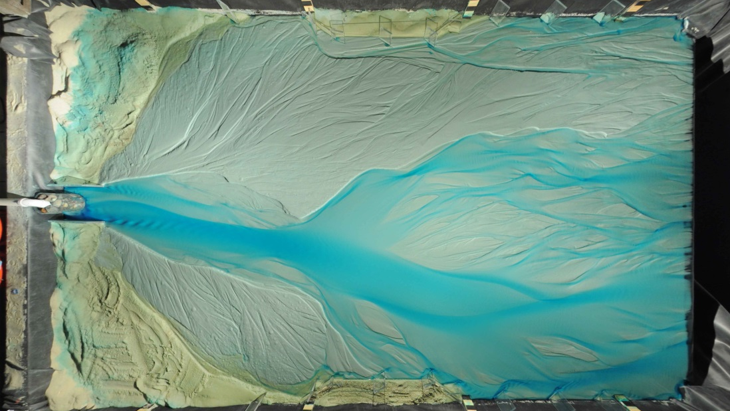
Controls on the lateral channel migration rate of braided alluvial channel systems.
Aaron Bufe, Jens M. Turowski, Douglas W. Burbank, Chris Paola, Andrew D. Wickert, Stefanie Tofelde

Slide 2
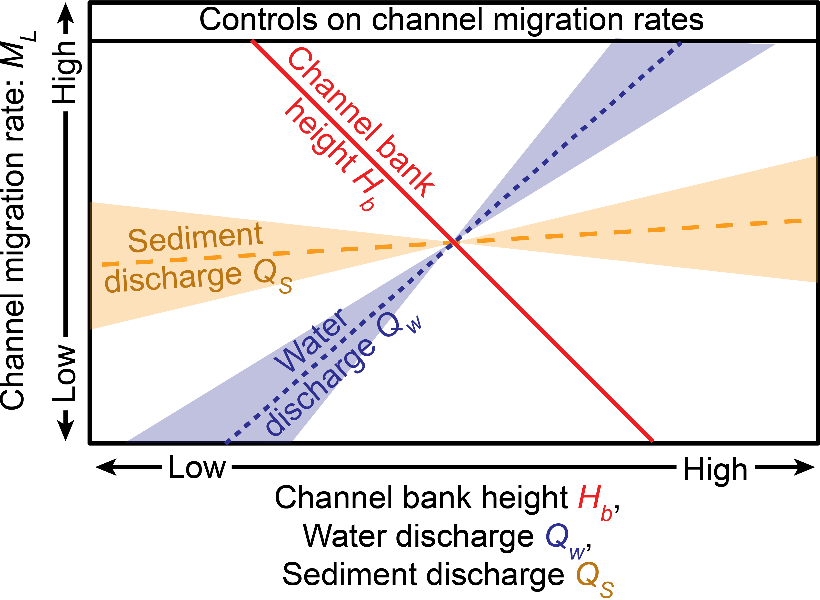
Key question
What controls the rate of lateral channel migration in alluvial channels?
Aim
Develop scaling between channel migration rates, the channel geometry and external boundary conditions
Test the scaling against existing field data
Main finding
Direct controls on migration rates, $M_{L}$
Strong influence of channel bank height $H_{b}$
Strong influence of water discharge, $Q_{w}$
Weak influence of sediment discharge, $Q_{s}$
$M_{L}=k\frac{Q_{w}^{0.9±0.2}{ Q}_{s}^{0.1±0.2}}{{D_{50}H}_{b}}$
Presentation based on:
Bufe et al., (2019), Controls on the lateral channel-migration rate of braided channel systems in coarse non-cohesive sediment. ESPL (Link)

Slide 3
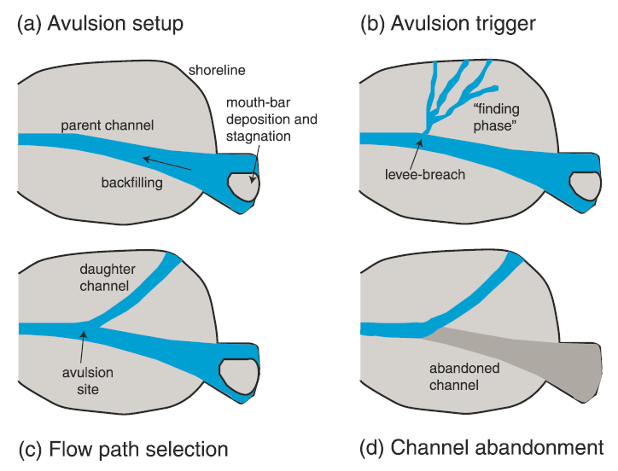
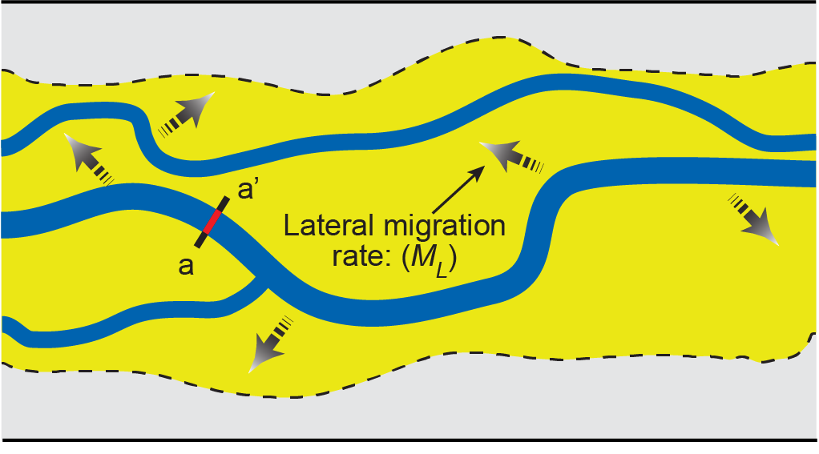
Two types of channel movement
Avulsions (abrupt)
Dominant in rapidly aggrading systems
Migration (gradual)
Dominant in bypass systems
Focus on
Sediment bypass systems
Systems dominated by migration
Ganti et al., (2016), JGR
Bufe et al., (2019), ESPL

Slide 4
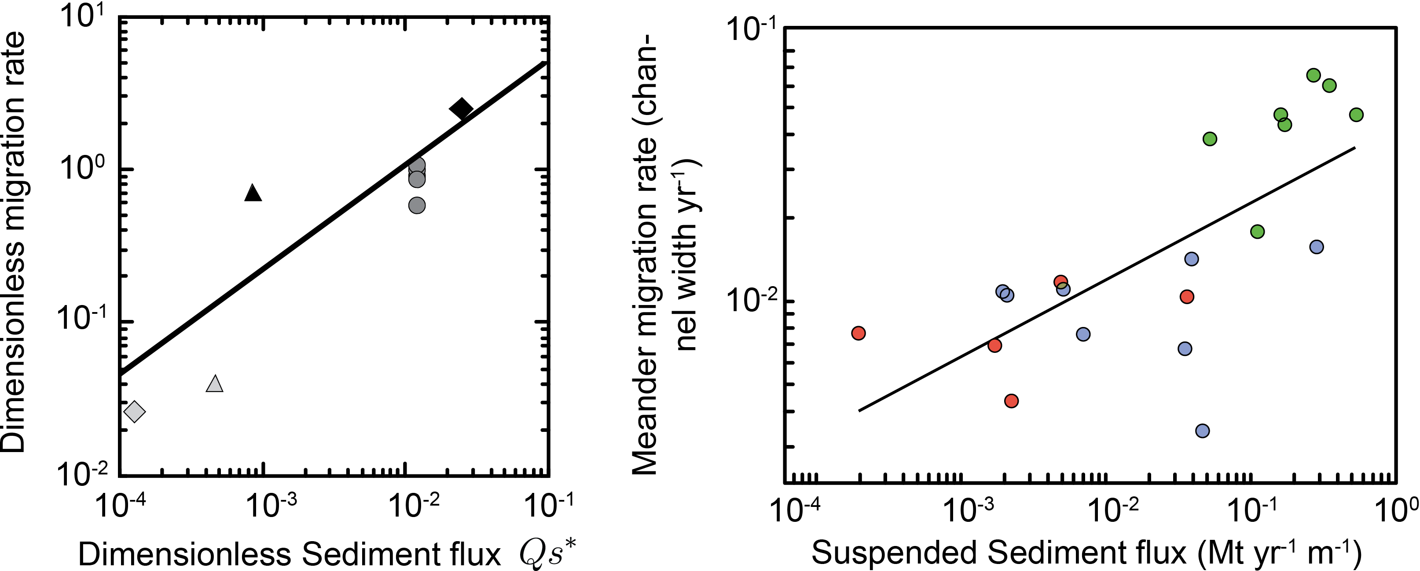
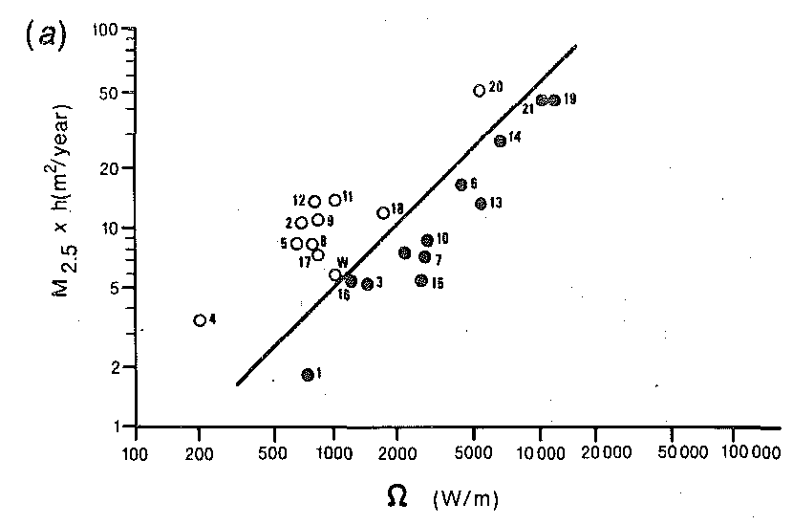
Controls on lateral channel migration rate
Hypothesized controls on channel migration rates
Water discharge (Q_{w})
Sediment discharge (Q_{s})
Bank height (H_{b})
(Bank cohesion (τ_{w}) – not addressed here)
Malatesta et al., (2017), JGR
Lateral migration rates (m²/y)
Hickin & Nanson (1984), JHE
Wickert et al., (2013), JGR
Constantine et al., (2014), Nat. Geosci.
Stream power (~ Q_{w})
Suspended Sediment flux per channel width (Mt yr⁻¹ m⁻¹)

Slide 5
Controls on lateral channel migration rate
Challenges
Co-variation of parameters
For example, water and sediment discharge affect channel geometry => difficult to unravel independent controls on migration rates
Absence of constraints on bank height
In many field and experimental datasets
Hypothesized controls on channel migration rates
Water discharge (Q_{w})
Sediment discharge (Q_{s})
Bank height (H_{b})
Bank cohesion (τ_{w}) – not addressed here
Malatesta et al., (2017), JGR
Experimental approach
Part 1: Migration rates under constant boundary conditions
Isolates control of channel geometry.
Part 2: Migration rates under varying boundary conditions
With knowledge of (1), can isolate control of external boundary conditions.
Effects of water and sediment discharges and gran size.
Wickert et al., (2013), JGR
Constantine et al., (2014), Nat. Geosci.

Slide 6
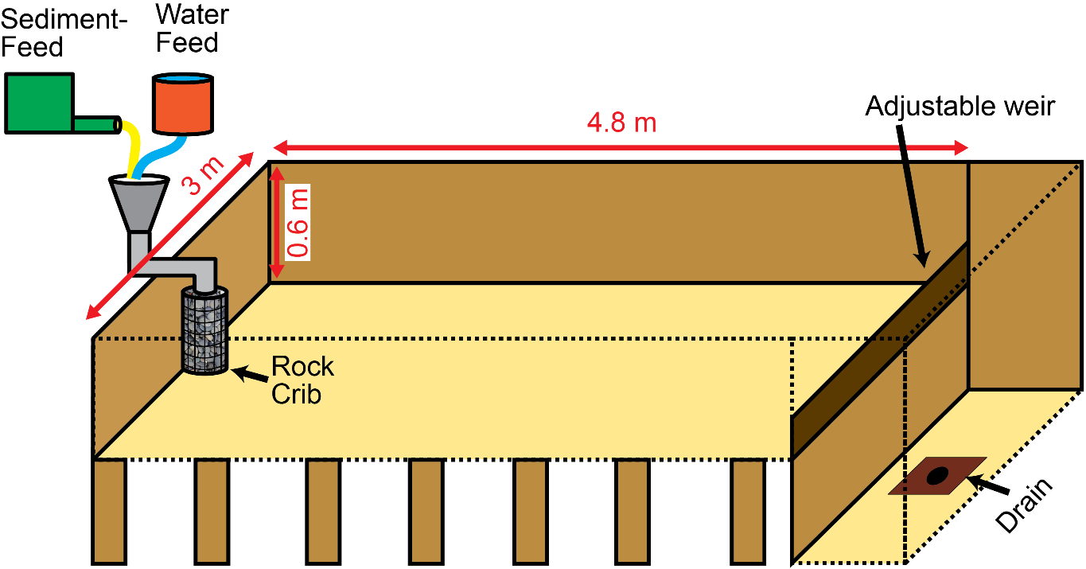
Experimental setup
Alluvial fan experiments
Loose sand (D₅₀ = 0.52 mm)
Steady water flux
Steady sediment flux
Steady base level
Bufe et al., (2019), ESPL

Slide 7
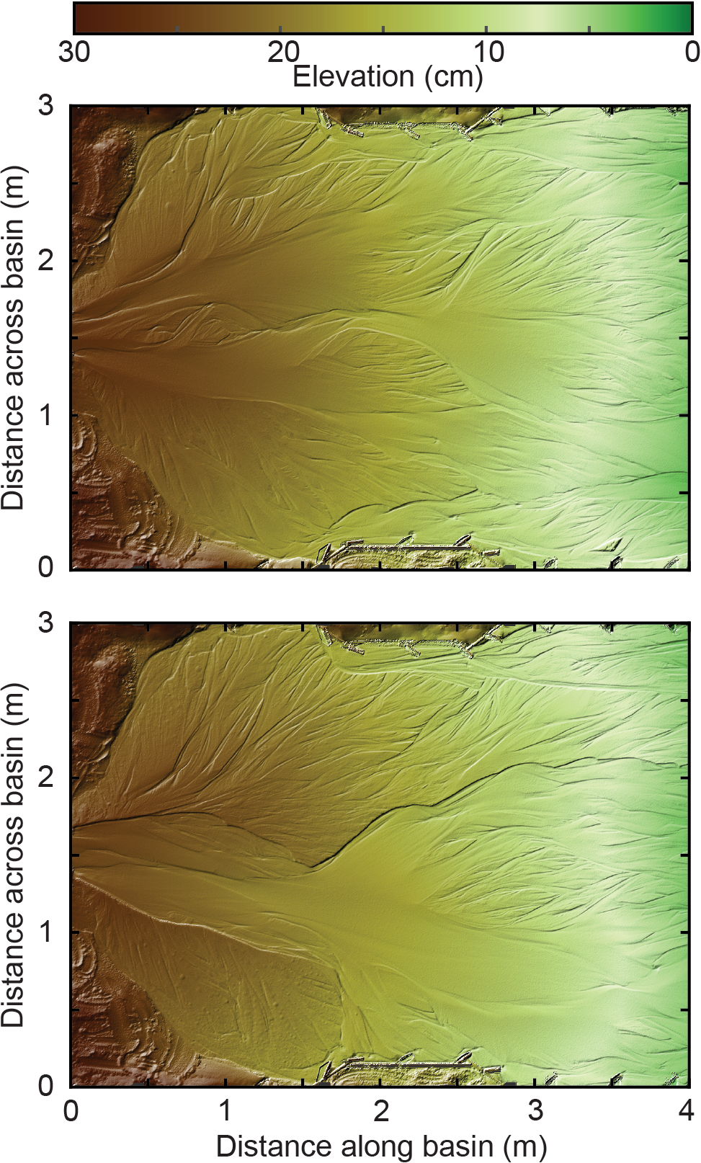
Data analysis
Overhead photographs
1-minute interval
Calculate average channel mobility
1 mm resolution topography without water
1-hour intervals
Calculate channel geometry
Bufe et al., (in review)
Bufe et al., (2019), ESPL

Slide 8
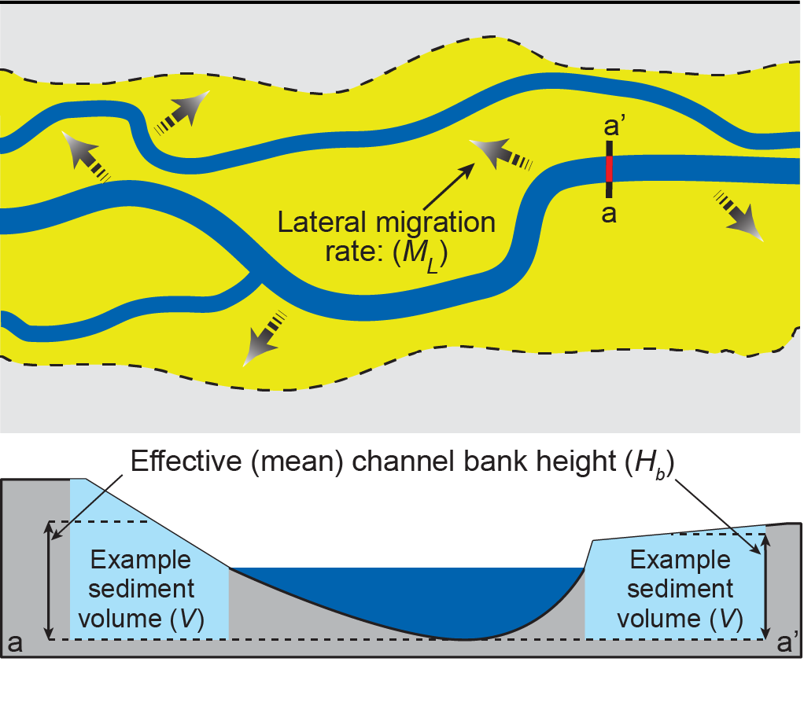
Part 1: Constant boundary conditions
Hypothesis
Volumetric reworking rate is constant for constant boundary conditions:
$$M_{V}={L_{c}H_{b}M}_{L}$$
Expectation
Inverse scaling of migration rate and bank height:
$$M_{L}=\frac{M_{V}}{L_{c}H_{b}}$$
M_{V} = volumetric reworking rate
L_{c} = Length of channel
H_{b} = Bank height
M_{L} = lateral migration rate
Bufe et al., (2019), ESPL

Slide 9
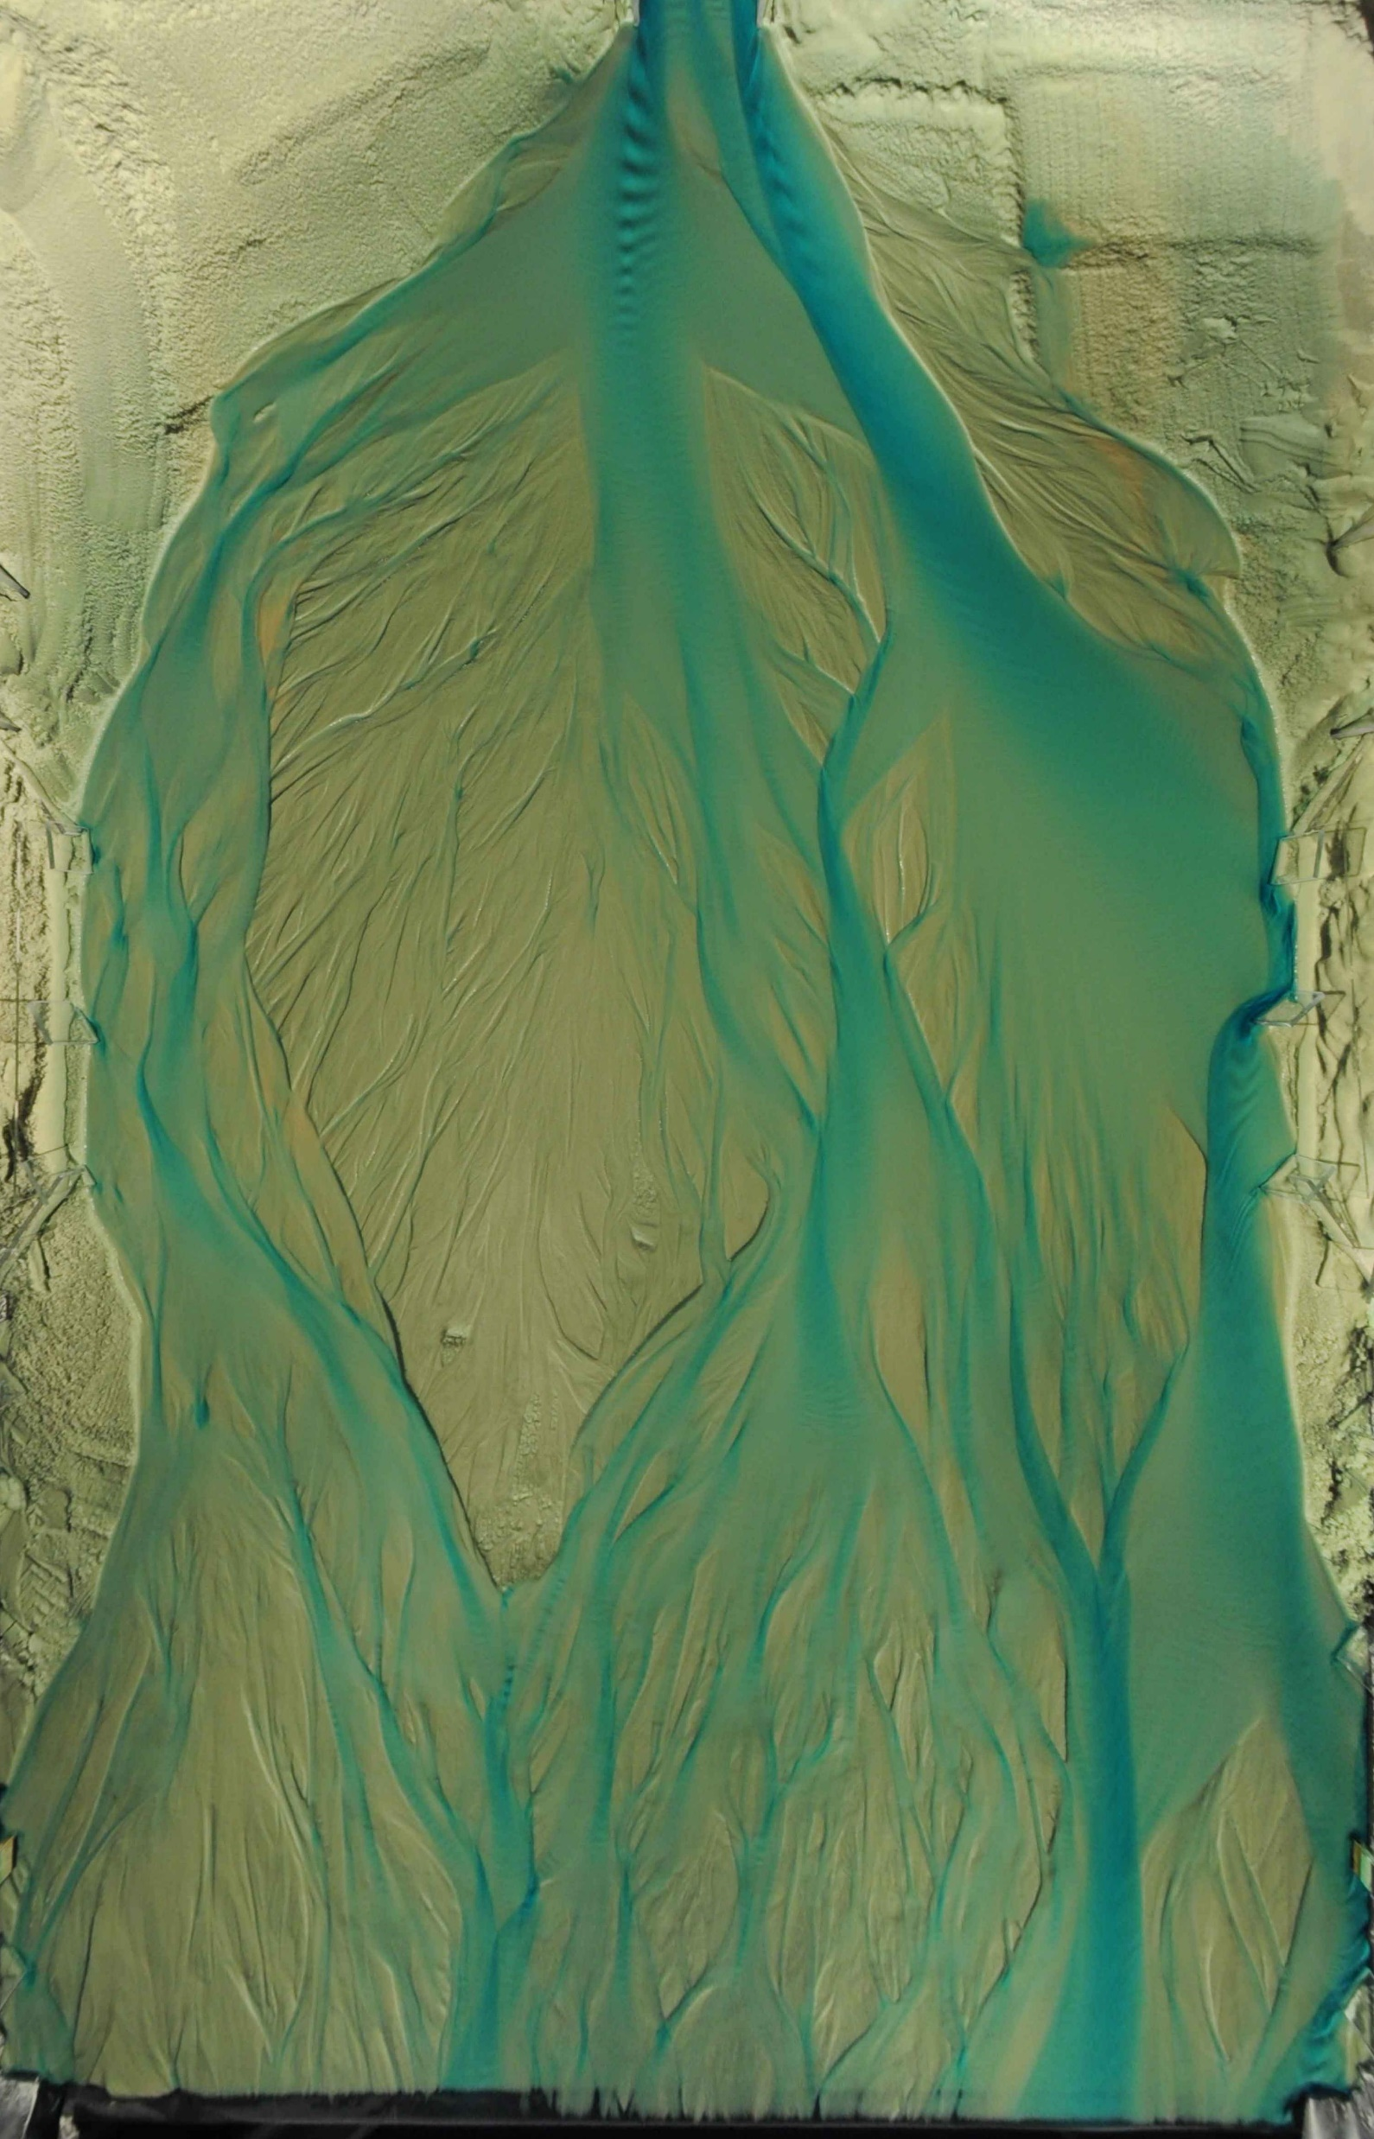
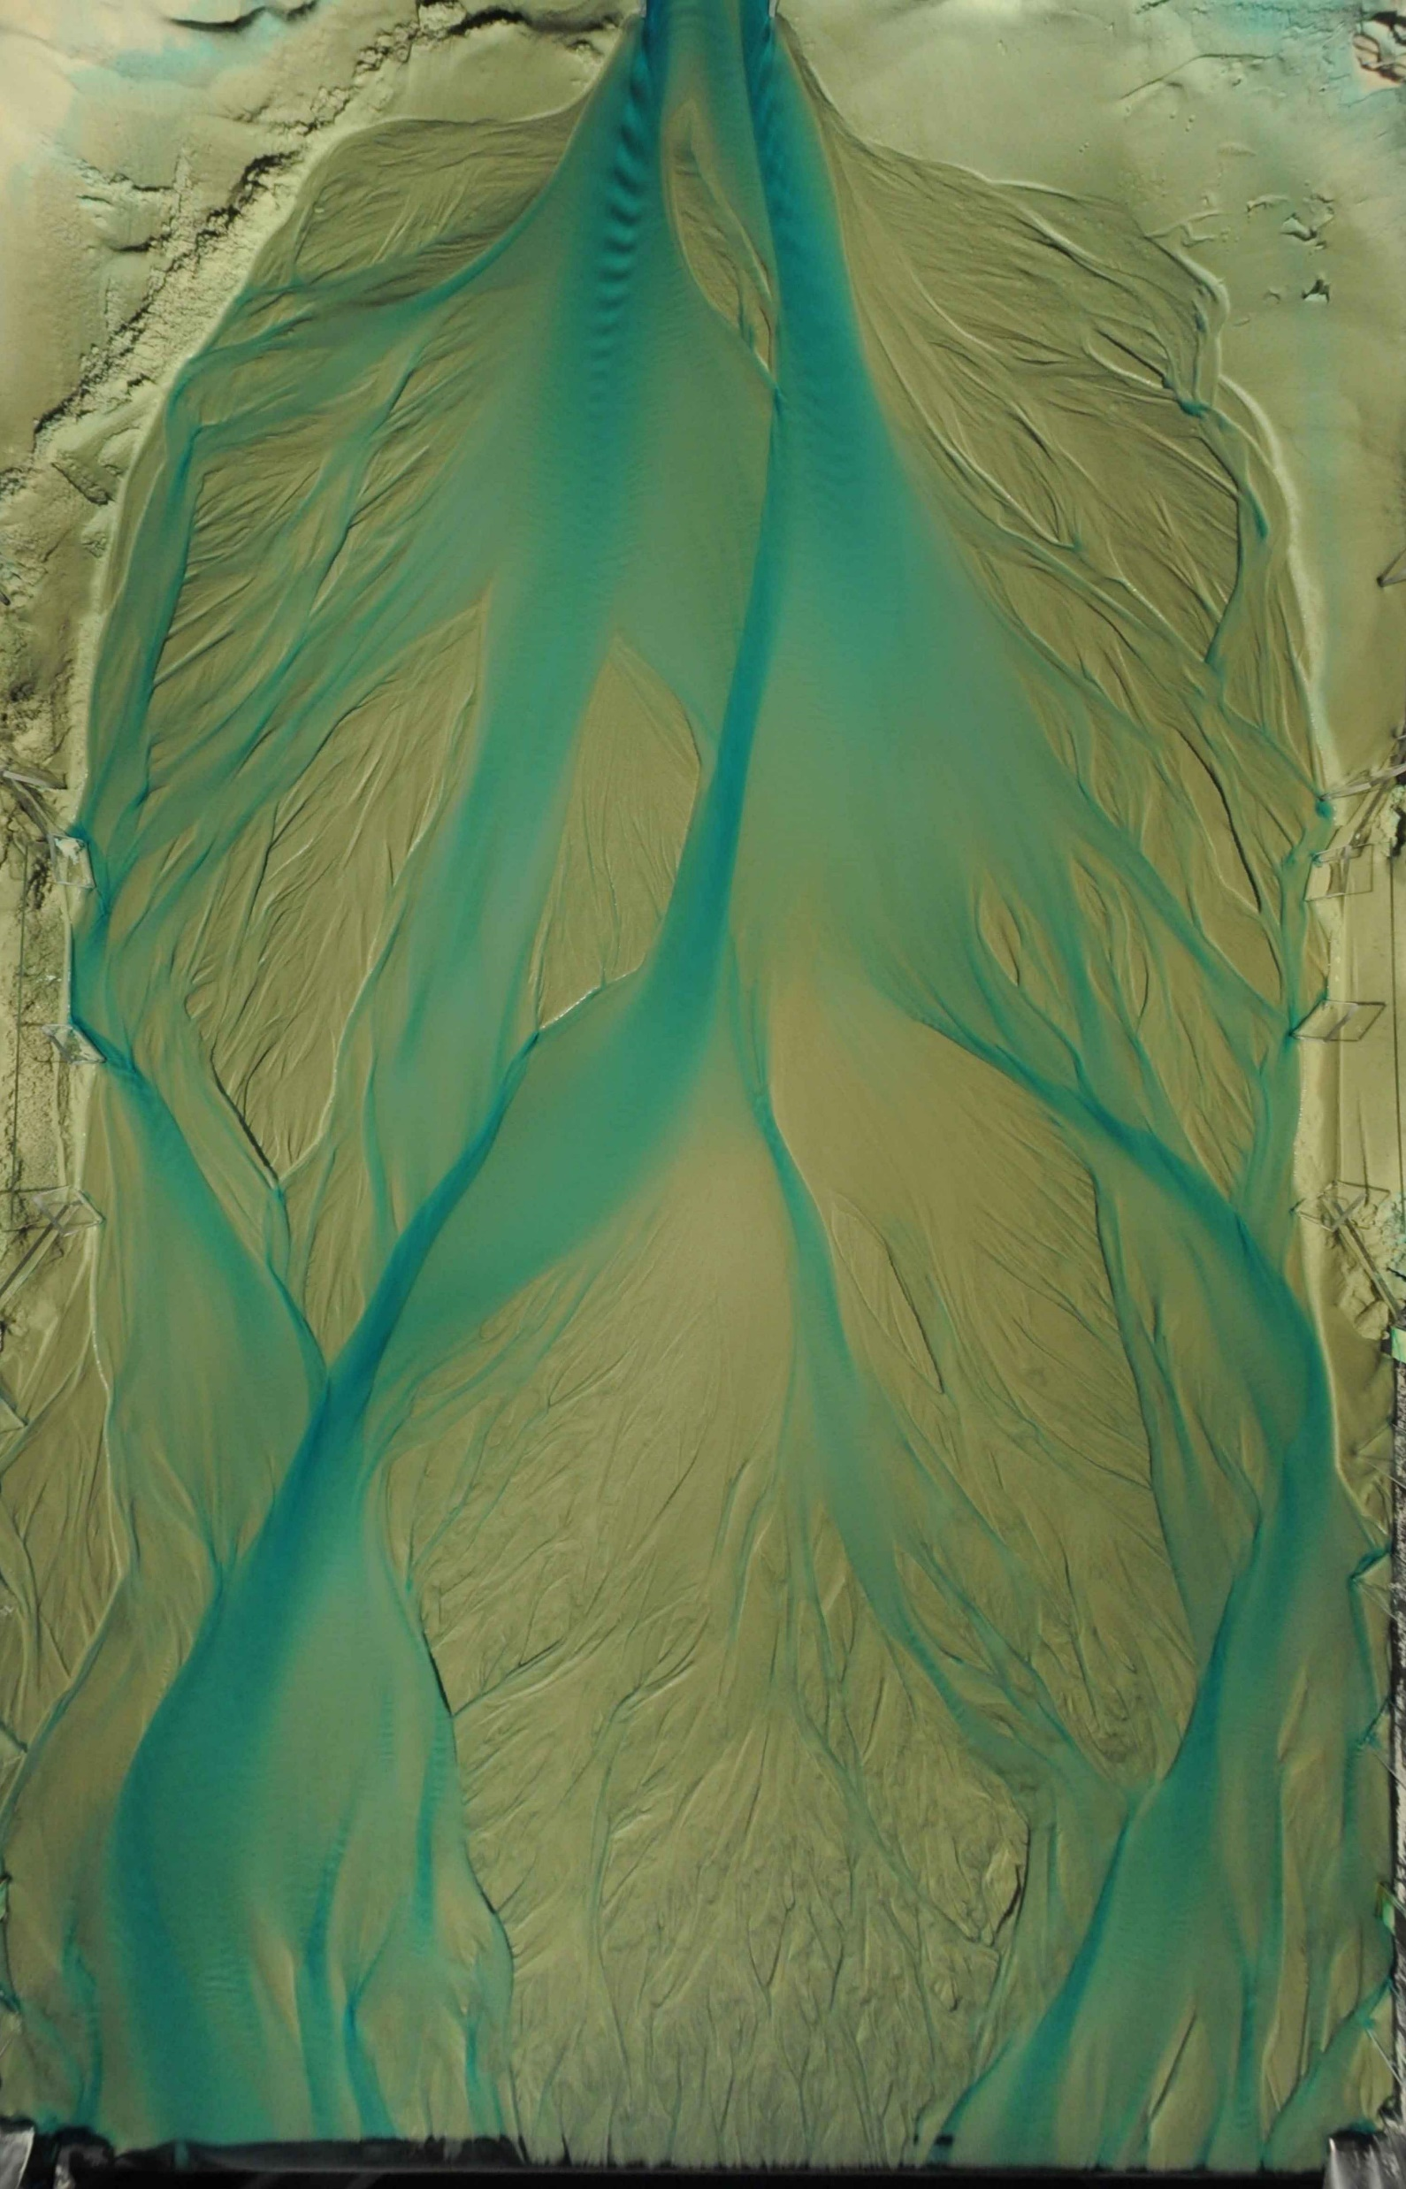
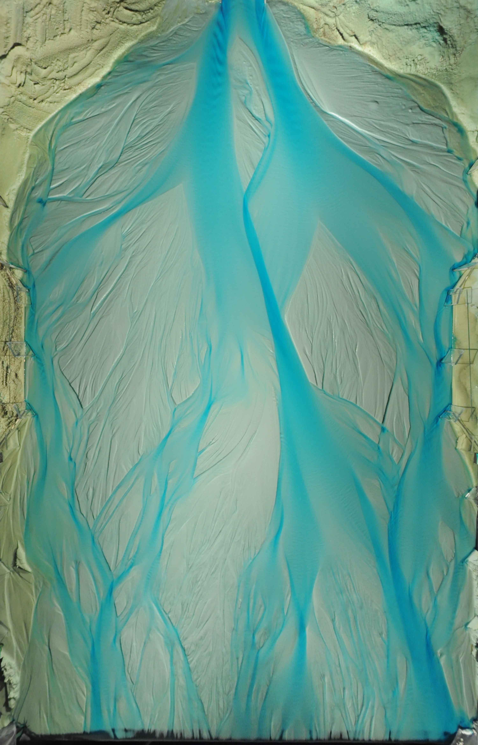
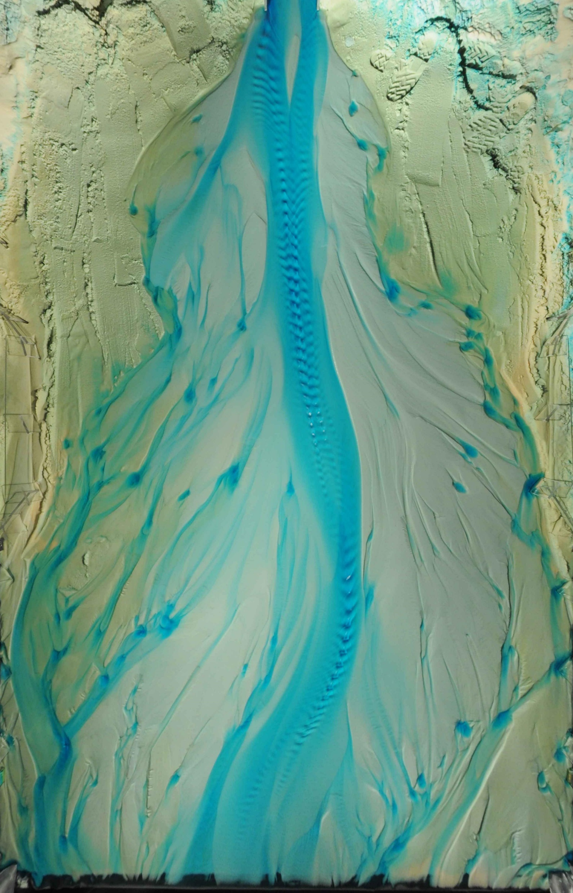
Four experiments
Run 1: Constant sediment and water discharge
Q_{s} = 790 mL/s
Q_{w} = 15.8 mL/s
D = 0.52 mm
Run 2: Constant sediment and water discharge
Q_{s} = 790 mL/s
Q_{w} = 15.8 mL/s
D = 0.52 mm
Run 7: Constant sediment and water discharge
Q_{s} = 790 mL/s
Q_{w} = 15.8 mL/s
D = 0.52 mm
Run 7: Constant sediment and water discharge
Q_{s} = 790 mL/s
Q_{w} = 2.4 mL/s
D = 0.52 mm
85% lower

Slide 10
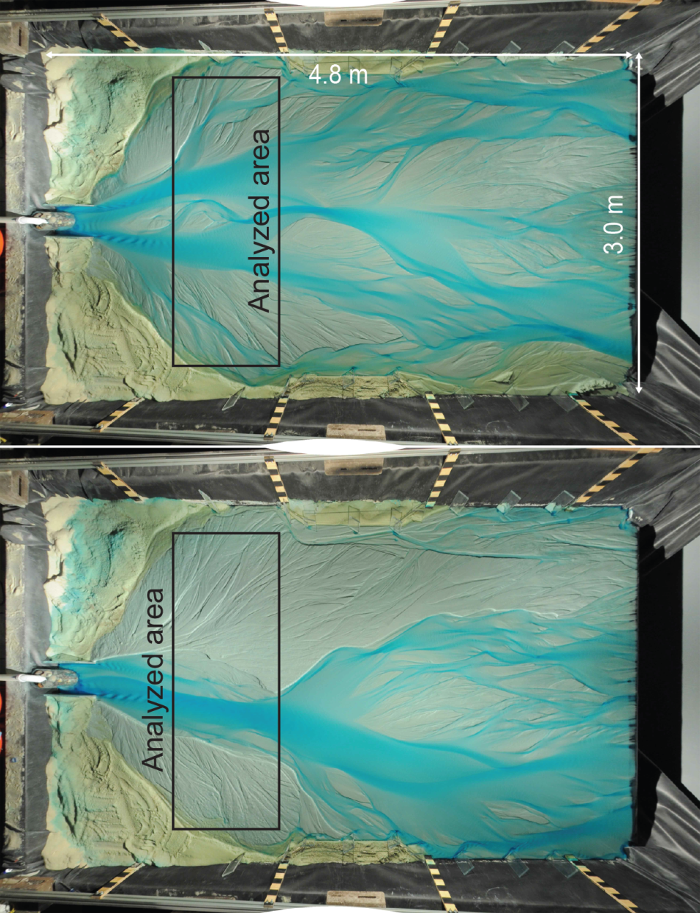
Autogenic variability of bank height
Unincised
Run time: 6h
Same experiment
8h difference
Run time: 6h
Autogenic incision
Incised
Run time: 18h
Run time: 18h
Bufe et al., (2019), ESPL

Slide 11
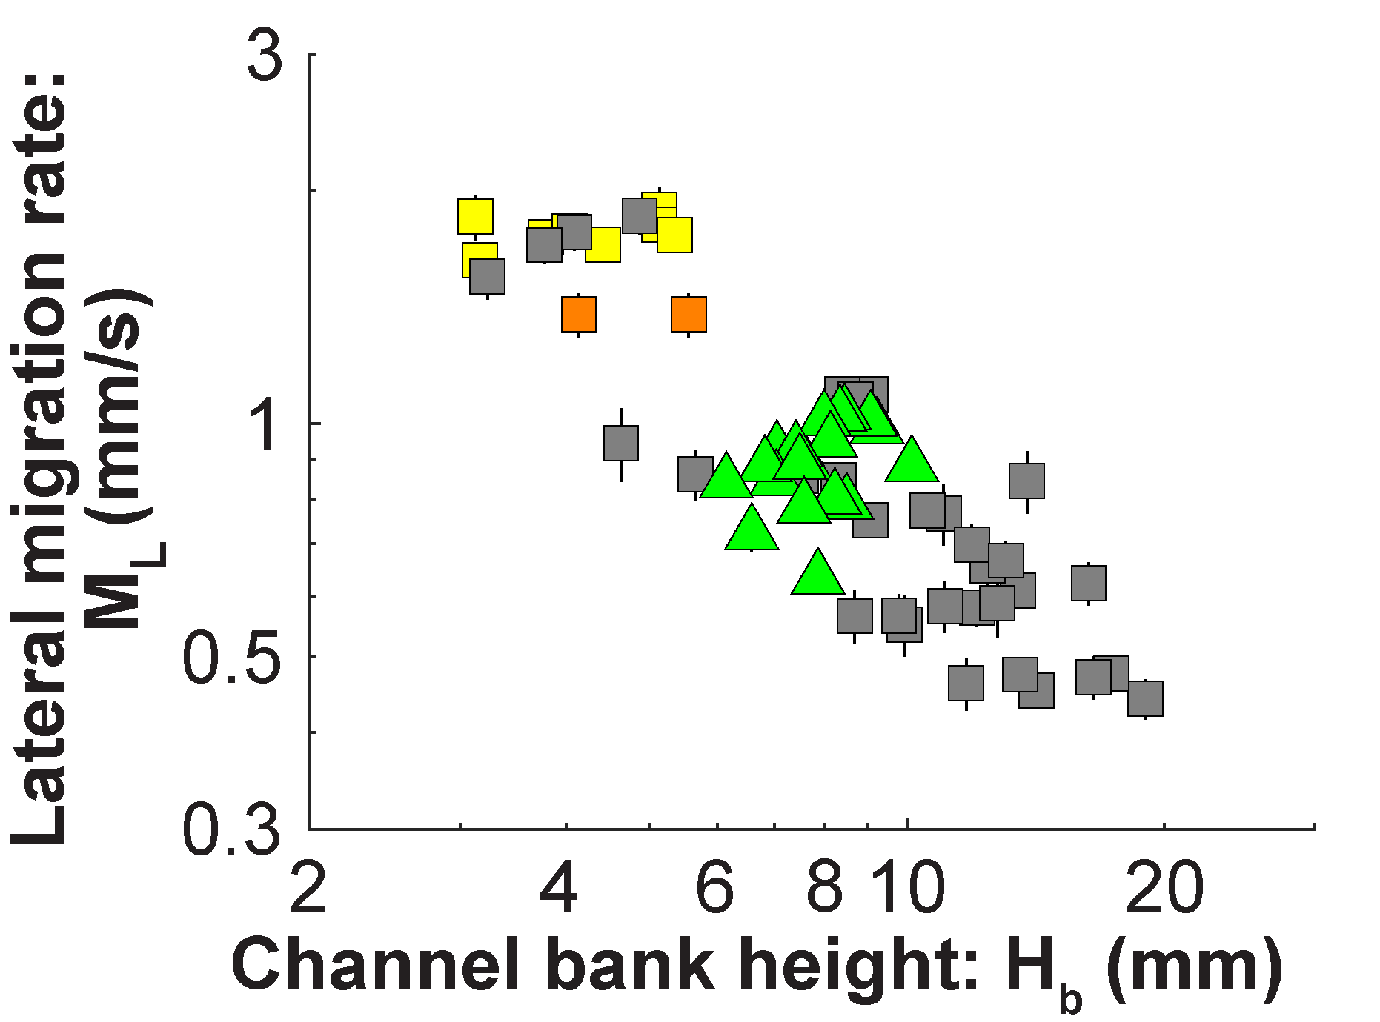
Part 1: Constant boundary conditions
Hypothesis
Volumetric reworking rate is constant for constant boundary conditions:
$$M_{V}={L_{c}H_{b}M}_{L}$$
Expectation
Inverse scaling of migration rate and bank height:
$$M_{L}=\frac{M_{V}}{L_{c}H_{b}}$$
Low-sediment flux experiments plot on same trend
Autogenic incision and reduction of bank height in Run 7
M_{V} = volumetric reworking rate
L_{c} = Length of channel
H_{b} = Bank height
M_{L} = lateral migration rate
Bufe et al., (2019), ESPL

Slide 12
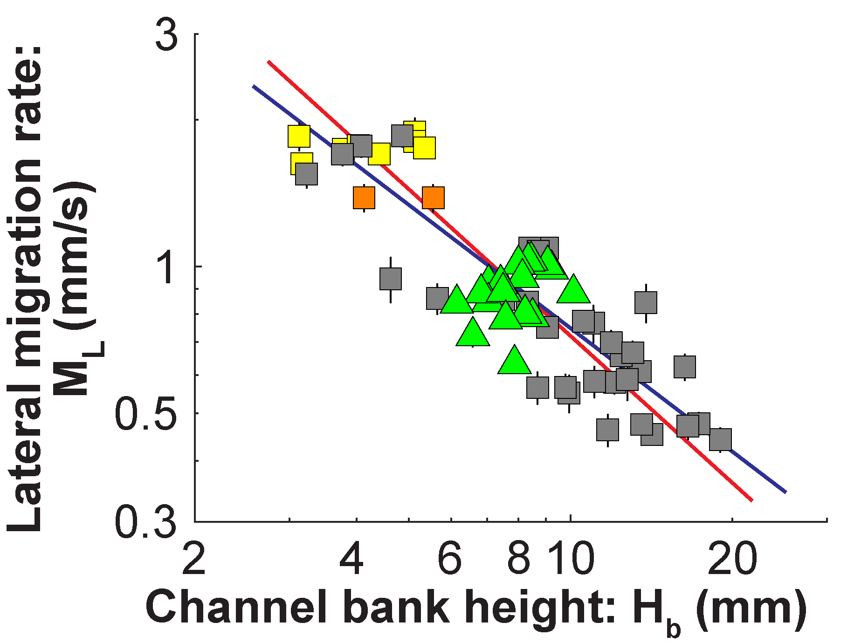
Part 1: Constant boundary conditions
Hypothesis
Volumetric reworking rate is constant for constant boundary conditions:
$$M_{V}={L_{c}H_{b}M}_{L}$$
Expectation
Inverse scaling of migration rate and bank height:
$$M_{L}=\frac{M_{V}}{L_{c}H_{b}}$$
Theoretical inverse fit $M_{L}=7.2H_{b}^{−1}$
$$r^{2}=0.78$$
Best fit
$$M_{L}=7.2H_{b}^{−0.84}$$
$$r^{2}=0.81$$
M_{V} = volumetric reworking rate
L_{c} = Length of channel
H_{b} = Bank height
M_{L} = lateral migration rate
Bufe et al., (2019), ESPL

Slide 13
Part 1: Constant boundary conditions
Results
bank height = first-order control on migration rate
Inverse scaling between migration rate and bank height fits well
Define a “bank-sediment yield”:$M_{L}H_{b}$
Hypothesis
Bank-sediment yield encompasses all autogenic variability
Bank-sediment yield is independent of other channel geometry parameters
Channel-system width
Channel slope
Water depth
Hypothesis
Volumetric reworking rate is constant for constant boundary conditions:
$$M_{V}={L_{c}H_{b}M}_{L}$$
Expectation
Inverse scaling of migration rate and bank height:
$$M_{L}=\frac{M_{V}}{L_{c}H_{b}}$$
Theoretical inverse fit $M_{L}=7.2H_{b}^{−1}$
$$r^{2}=0.78$$
Best fit
$$M_{L}=7.2H_{b}^{−0.84}$$
$$r^{2}=0.81$$
M_{V} = volumetric reworking rate
L_{c} = Length of channel
H_{b} = Bank height
M_{L} = lateral migration rate
Bufe et al., (2019), ESPL

Slide 14
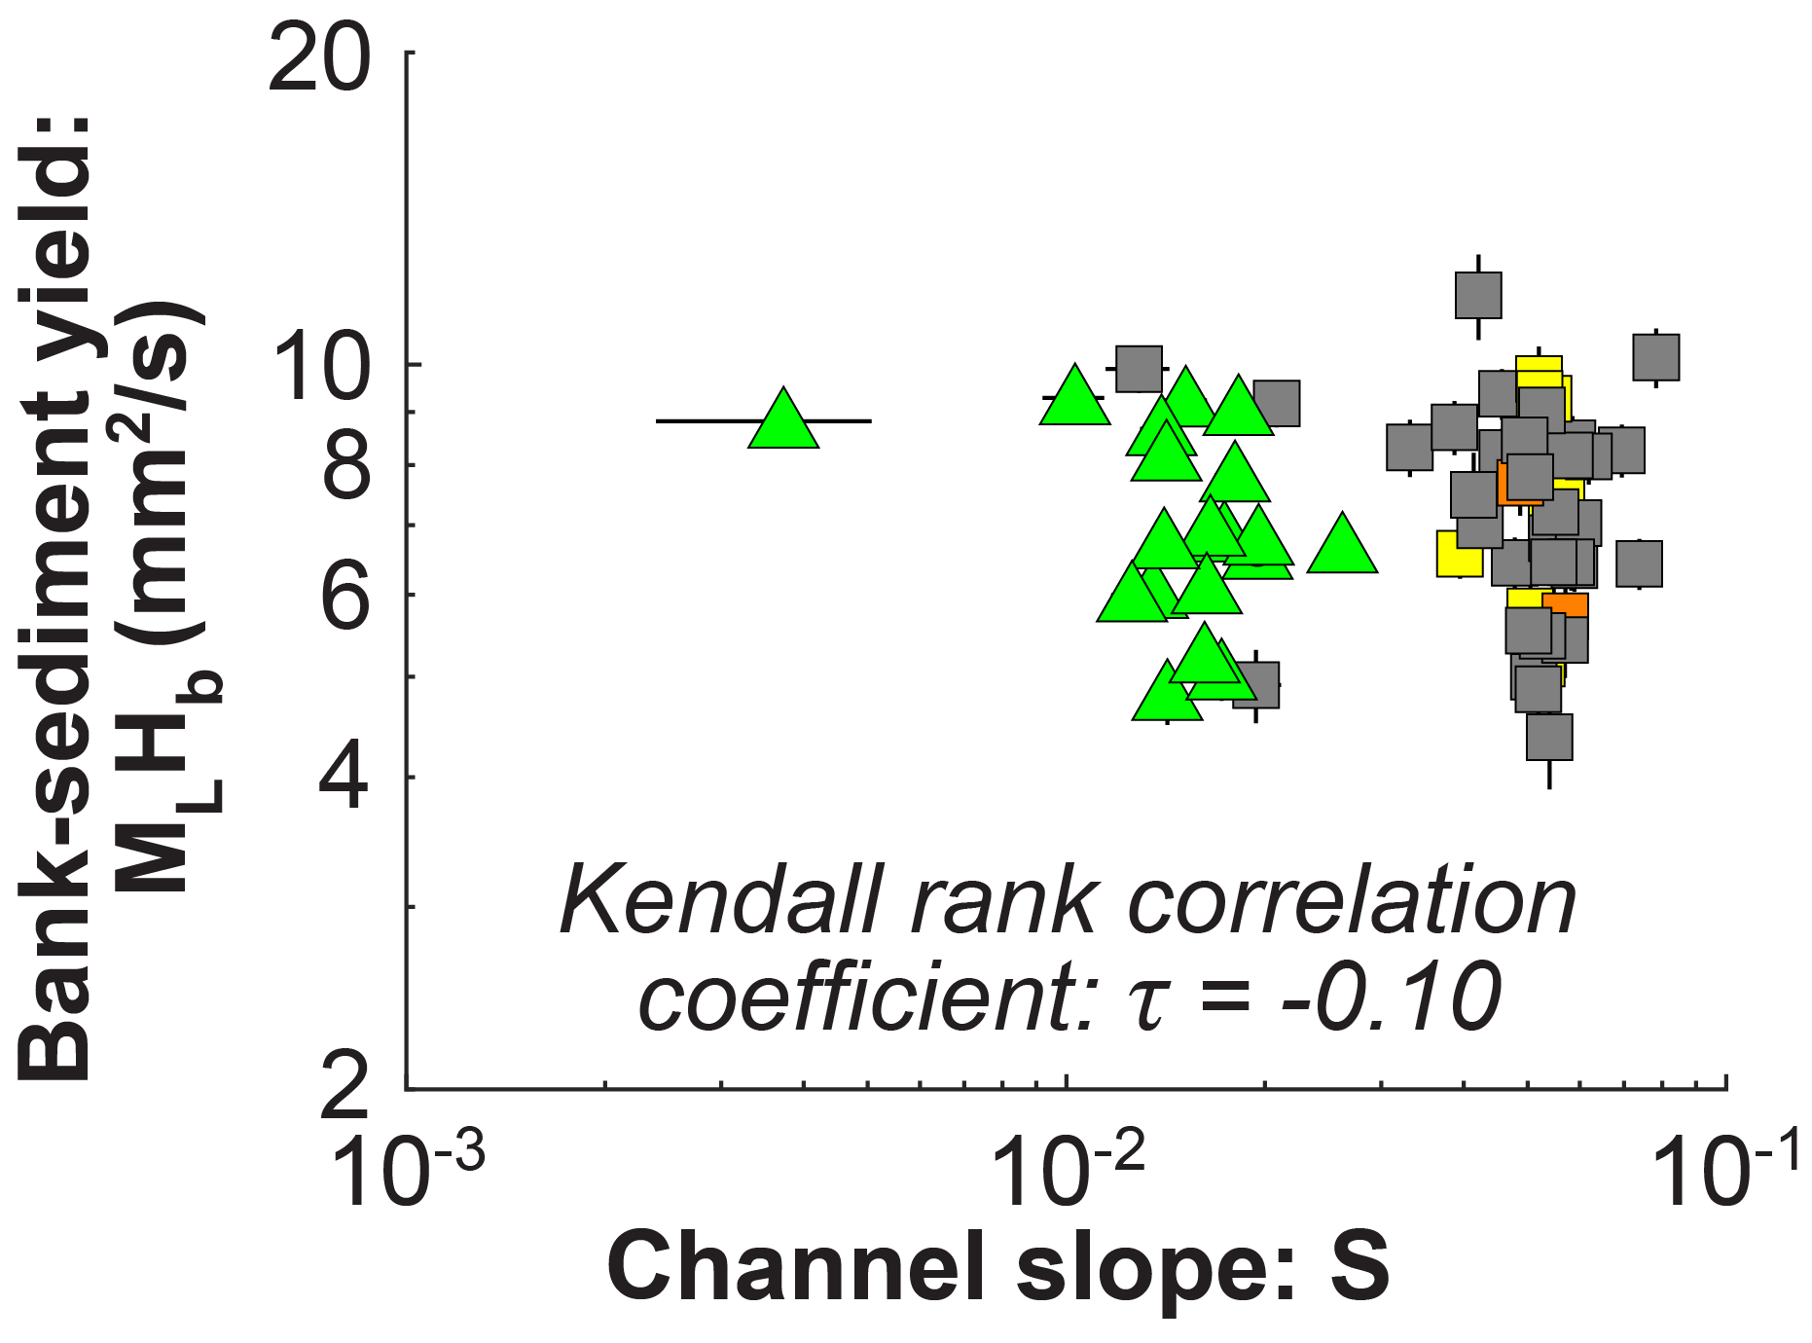
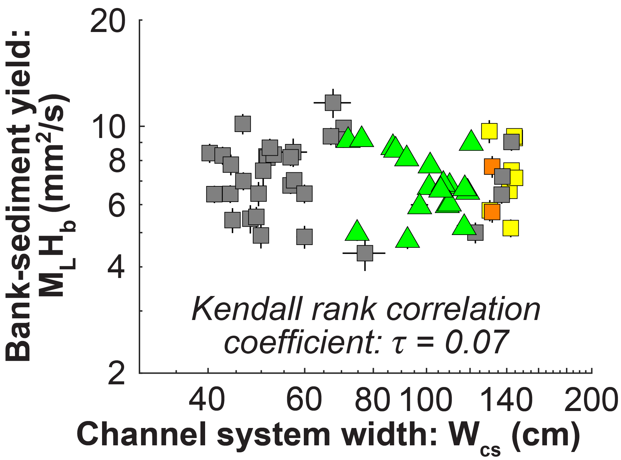
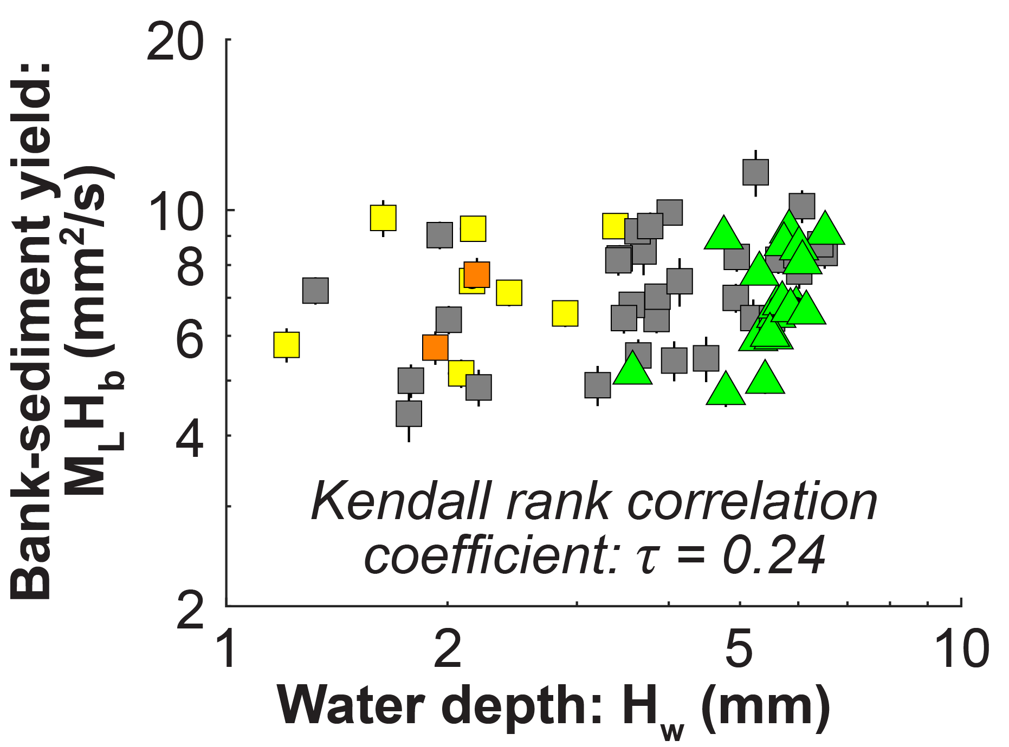
Part 1: Constant boundary conditions
Hypothesis
Bank-sediment yield encompasses all autogenic variability
Bank-sediment yield is independent of other channel geometry parameters
Channel-system width
Channel slope
Water depth
Independent of channel slope
Independent of channel width
Independent of water depth
Bufe et al., (2019), ESPL

Slide 15
Part 1: Constant boundary conditions
Hypothesis
Bank-sediment yield encompasses all autogenic variability
Bank-sediment yield is independent of other channel geometry parameters
Channel-system width
Channel slope
Water depth
Results for Part 1: constant boundary conditions
Variations in bank height can explain variations in migration rates
When bank heights are accounted for, none of the other main channel geometry parameters scale with migration rates. I.e. Bank sediment yield = constant
=> Volumetric rate of sediment reworking is constant under constant boundary condition.
Part 2: Varying boundary conditions
Dimensional analysis with varying boundary conditions
Test against compilation of experiments
Bufe et al., (2019), ESPL

Slide 16
Dimensional analysis
Governing variables
Bank-sediment yield: $H_{b}M_{L} [\frac{L^{2}}{T}]$
Water discharge: $Q_{w} [\frac{L^{3}}{T}]$
Sediment discharge: $Q_{s} [\frac{L^{3}}{T}]$
Grain size: $D_{50} [L]$
Buckingham π theorem
2 parameters ($π_{1}$, $π_{2}$)
$π_{2}=f(π_{1})$
Dimensionless parameters:
$π_{1}= \frac{{D_{50}H}_{b}M_{L}}{Q_{s}}$
$π_{2}=\frac{Q_{s}}{Q_{w}}$
From Part 1:
Bank-sediment yield encompasses direct control of channel geometry on migration rate
All other variations can be directly linked to external boundary conditions
Compilation of experiments
Parameters varied in compiled experiments
Theory
For n variables and k physical dimensions:
n-k independent dimensionless parameters describe the physics of the system
Each single parameter can be expressed as a function of the other parameters
Chosen parameters
The parameters can be chosen as desired as long as they are (1) independent and (2) among them, include all governing variables.

Slide 17
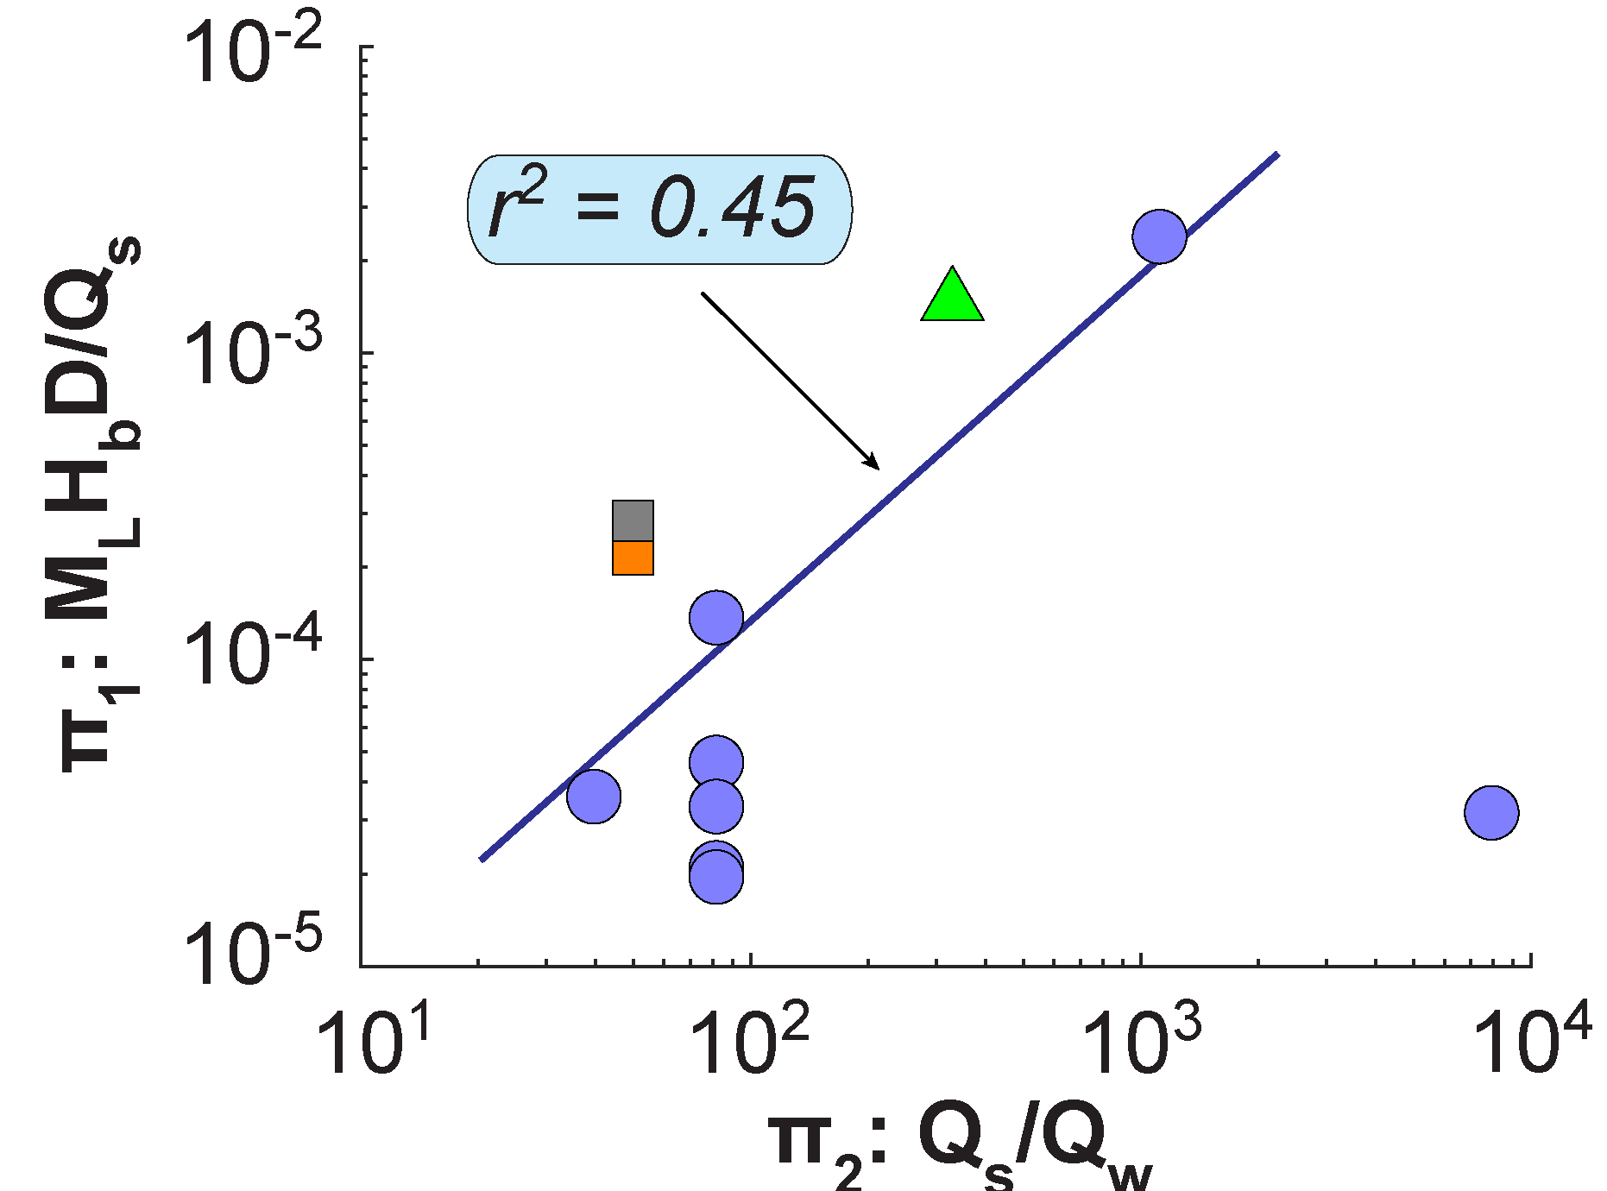
Regression against compilation of experiments
Governing variables
Bank-sediment yield: $H_{b}M_{L} [\frac{L^{2}}{T}]$
Water discharge: $Q_{w} [\frac{L^{3}}{T}]$
Sediment discharge: $Q_{s} [\frac{L^{3}}{T}]$
Grain size: $D_{50} [L]$
Buckingham π theorem
2 parameters ($π_{1}$, $π_{2}$)
$π_{2}=f(π_{1})$
Dimensionless parameters:
$π_{1}= \frac{{D_{50}H}_{b}M_{L}}{Q_{s}}$
$π_{2}=\frac{Q_{s}}{Q_{w}}$
Run 1: Behind other data
Compilation Wickert et al., 2013
$$M_{L}=k\frac{Q_{w}^{1.1±0.4}{ Q}_{s}^{−0.1±0.4}}{{D_{50}H}_{b}}$$
Bufe et al., (2019), ESPL

Slide 18
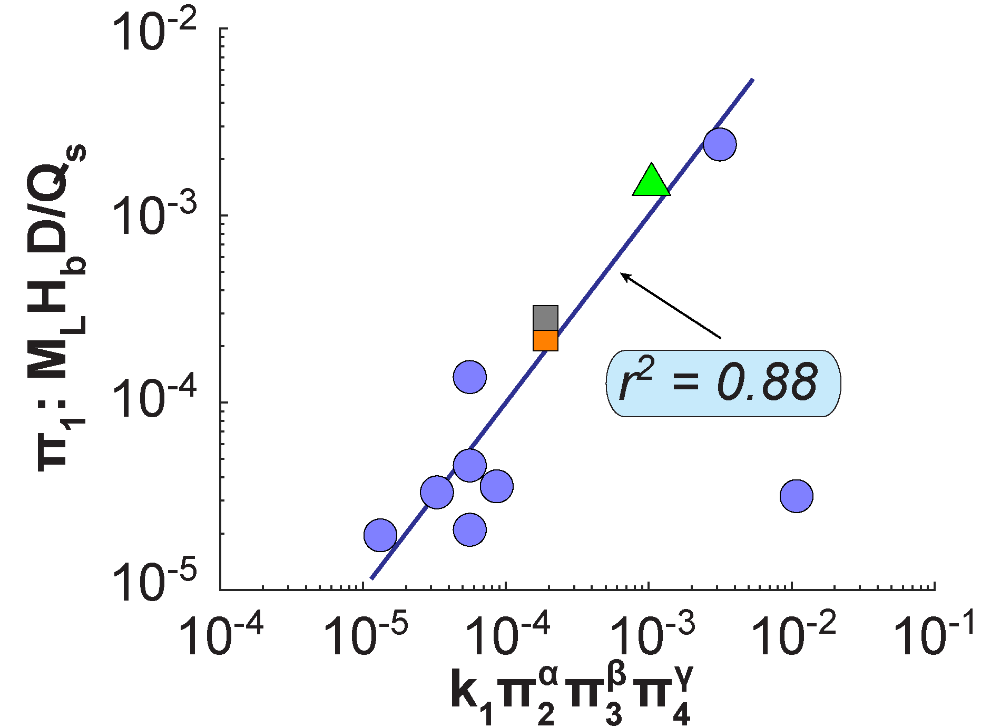
Including base-level changes
Governing variables
Bank-sediment yield: $H_{b}M_{L} [\frac{L^{2}}{T}]$
Water discharge: $Q_{w} [\frac{L^{3}}{T}]$
Sediment discharge: $Q_{s} [\frac{L^{3}}{T}]$
Grain size: $D_{50} [L]$
Buckingham π theorem
2 parameters ($π_{1}$, $π_{2}$)
$π_{2}=f(π_{1})$
Dimensionless parameters:
$π_{1}= \frac{{D_{50}H}_{b}M_{L}}{Q_{s}}$
$π_{2}=\frac{Q_{s}}{Q_{w}}$
Compilation Wickert et al., 2013
Run 1: Behind other data
$$M_{L}=k\frac{Q_{w}^{0.9±0.2}{ Q}_{s}^{0.1±0.2}}{{D_{50}H}_{b}}$$
Including base-level changes – see Bufe et al., (2019), ESPL
Bufe et al., (2019), ESPL

Slide 19
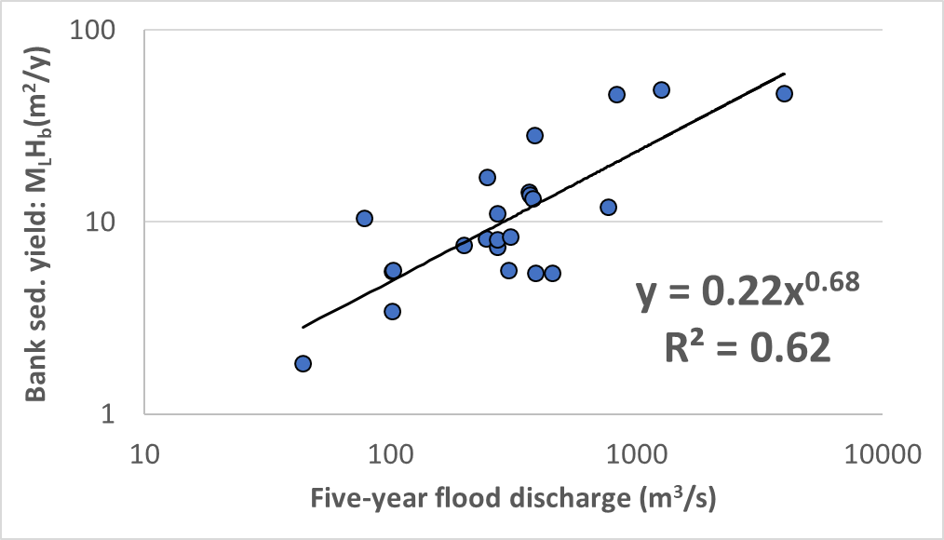
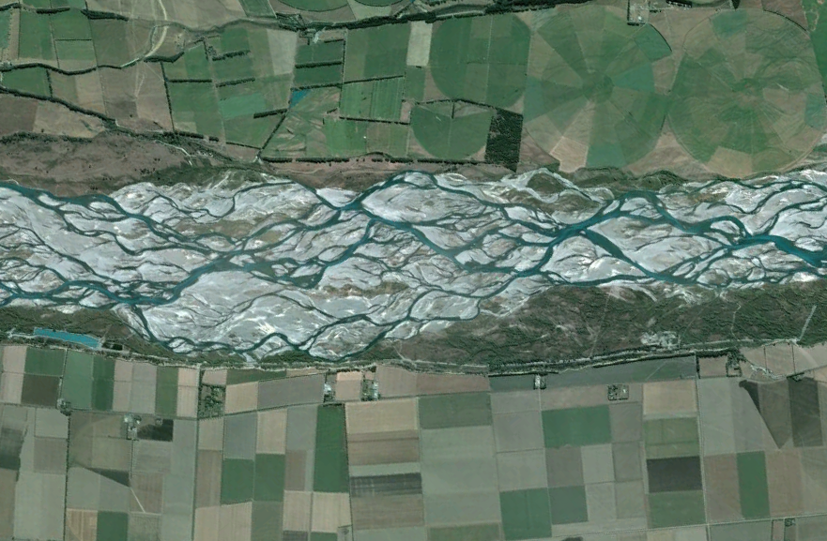
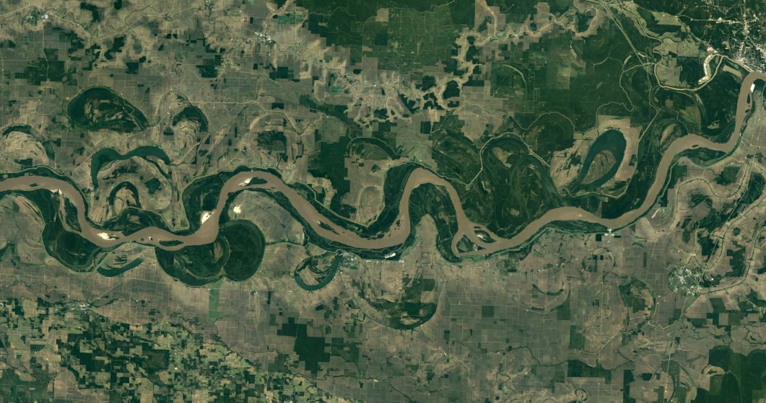
Application to the field?
Missing constraints on $Q_{s}$
Adapted from Hickin & Nanson (1984), JHE
$$M_{L}=k\frac{Q_{w}^{0.9±0.2}{ Q}_{s}^{0.1±0.2}}{{D_{50}H}_{b}}$$

Slide 20
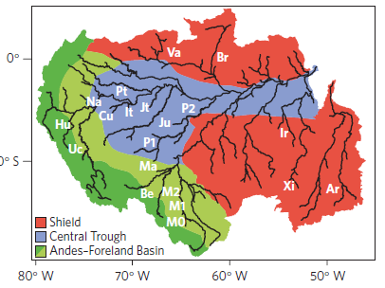
Application to the field?
Missing constraints on $H_{b}$
$$M_{L}\sim k{ Q}_{s}^{0.28}$$
Constantine et al., (2014), Nat. Geosci.
Suspended Sediment flux per channel width (Mt yr⁻¹ m⁻¹)
$$M_{L}=k\frac{Q_{w}^{0.9±0.2}{ Q}_{s}^{0.1±0.2}}{{D_{50}H}_{b}}$$
Notes:
Not aware of any datasets on braided channels or meandering channels that include wall height

Slide 21
Key question
What controls the rate of lateral channel migration in alluvial channels?
Aim
Develop scaling between channel migration rates, the channel geometry and external boundary conditions
Test the scaling against existing field data
Main finding
Direct controls on migration rates, $M_{L}$
Strong influence of channel-bank height $H_{b}$
Strong influence of water discharge, $Q_{w}$
Weak influence of sediment discharge, $Q_{s}$
$M_{L}=k\frac{Q_{w}^{0.9±0.2}{ Q}_{s}^{0.1±0.2}}{{D_{50}H}_{b}}$
References:
Bufe, A., J. M. Turowski, D. W. Burbank, C. Paola, A. D. Wickert, and S. Tofelde (2019), Controls on the lateral channel-migration rate of braided channel systems in coarse non-cohesive sediment, Earth Surf. Proc. Land., 44(14), 2823-2836, doi:10.1002/esp.4710.
Constantine, J. A., T. Dunne, J. Ahmed, C. Legleiter, and E. D. Lazarus (2014), Sediment supply as a driver of river meandering and floodplain evolution in the Amazon Basin, Nat. Geosci., 7(12), 899-903, doi:10.1038/ngeo2282.
Ganti, V., A. J. Chadwick, H. J. Hassenruck-Gudipati, and M. P. Lamb (2016), Avulsion cycles and their stratigraphic signature on an experimental backwater-controlled delta, J. Geophys. Res., 121(9), 1651-1675, doi:10.1002/2016JF003915.
Hickin, E. J., and G. C. Nanson (1984), Lateral Migration Rates of River Bends, J. Hydrol. Eng., 110(11), 1557-1567, doi:doi:10.1061/(ASCE)0733-9429(1984)110:11(1557).
Malatesta, L. C., J. P. Prancevic, and J.-P. Avouac (2017), Autogenic entrenchment patterns and terraces due to coupling with lateral erosion in incising alluvial channels, J. Geophys. Res., 122(1), 335–355, doi:10.1002/2015JF003797.

