Slide 1
A new scenario logic for the Paris Agreement long-term temperature goal
Rogelj, J., Huppmann, D., Krey, V., Riahi, K., Clarke, L., Gidden, M., Nicholls, Z. & Meinshausen, M.
Nature 2019, DOI: 10.1038/s41586-019-1541-4

Slide 2
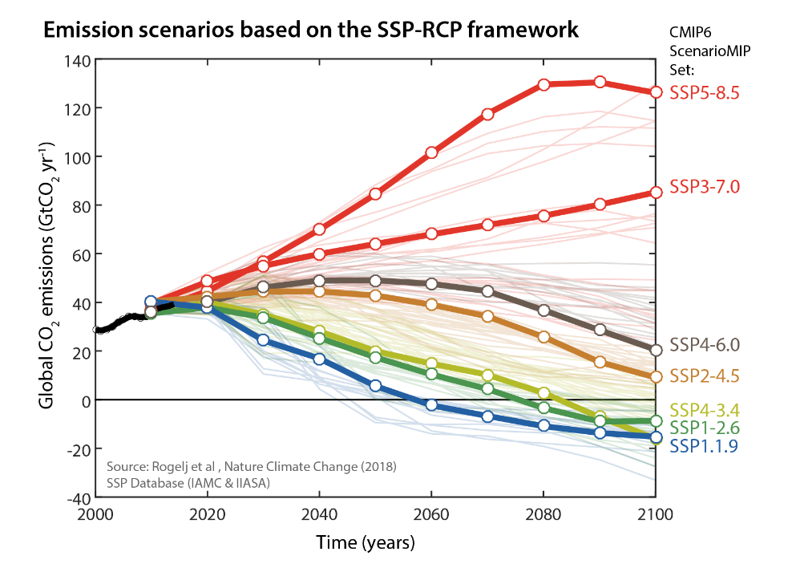
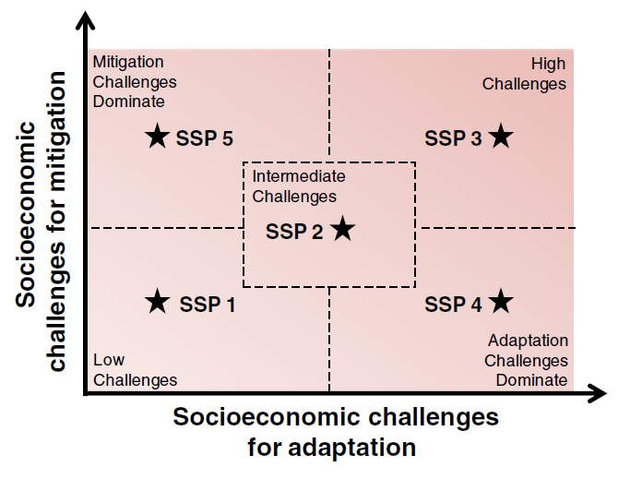
Dominant scenario framework results in ‘unfair and risky’ scenarios
Current situation:
Shared Socioeconomic Pathways (SSP) & Representative Concentration Pathways (RCPs): Focus on end-of-century (2100) forcing outcome
Consequences:
Climate policy inconsistency & cognitive dissonance (overshooting)
Intergenerational equity and carbon-dioxide removal (CDR)
Not directly compatible with Paris Agreement
Imprecise economic recommendations
SOLUTION: New scenario logic to resolve these issues
capping global warming at a specific maximum level
either temperature stabilization or reversal thereafter
Source: O’Neill et al, Climatic Change (2013)
Rogelj et al, Nature (2019) DOI: 10.1038/s41586-019-1541-4

Slide 3
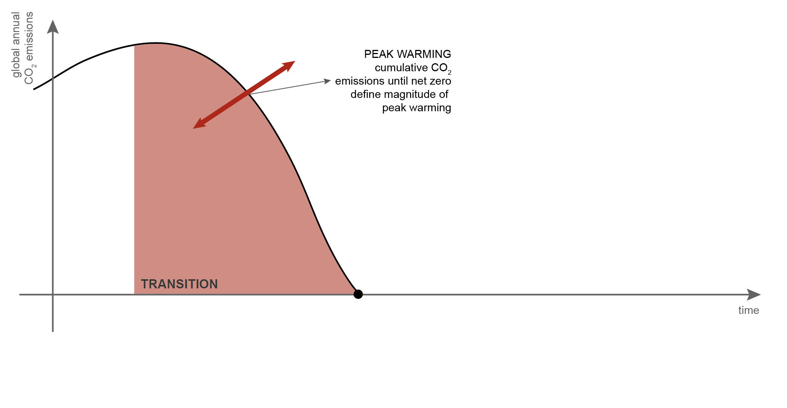
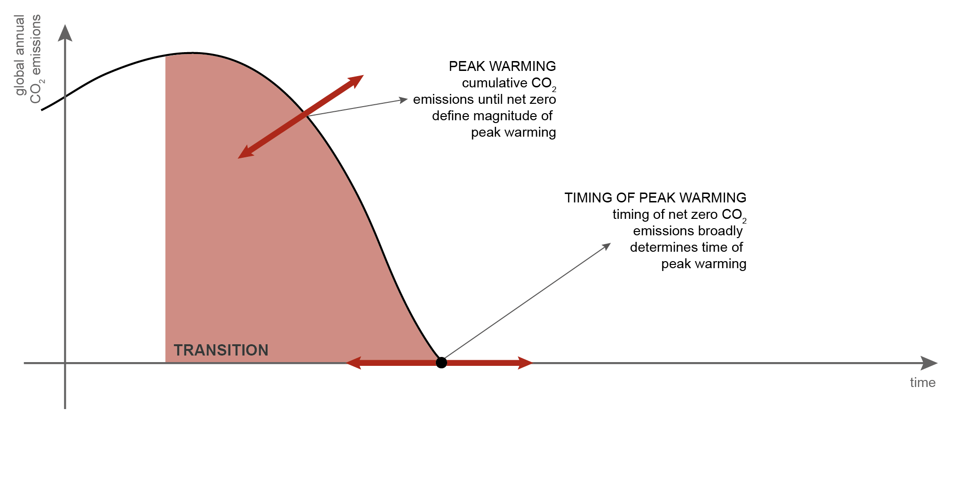
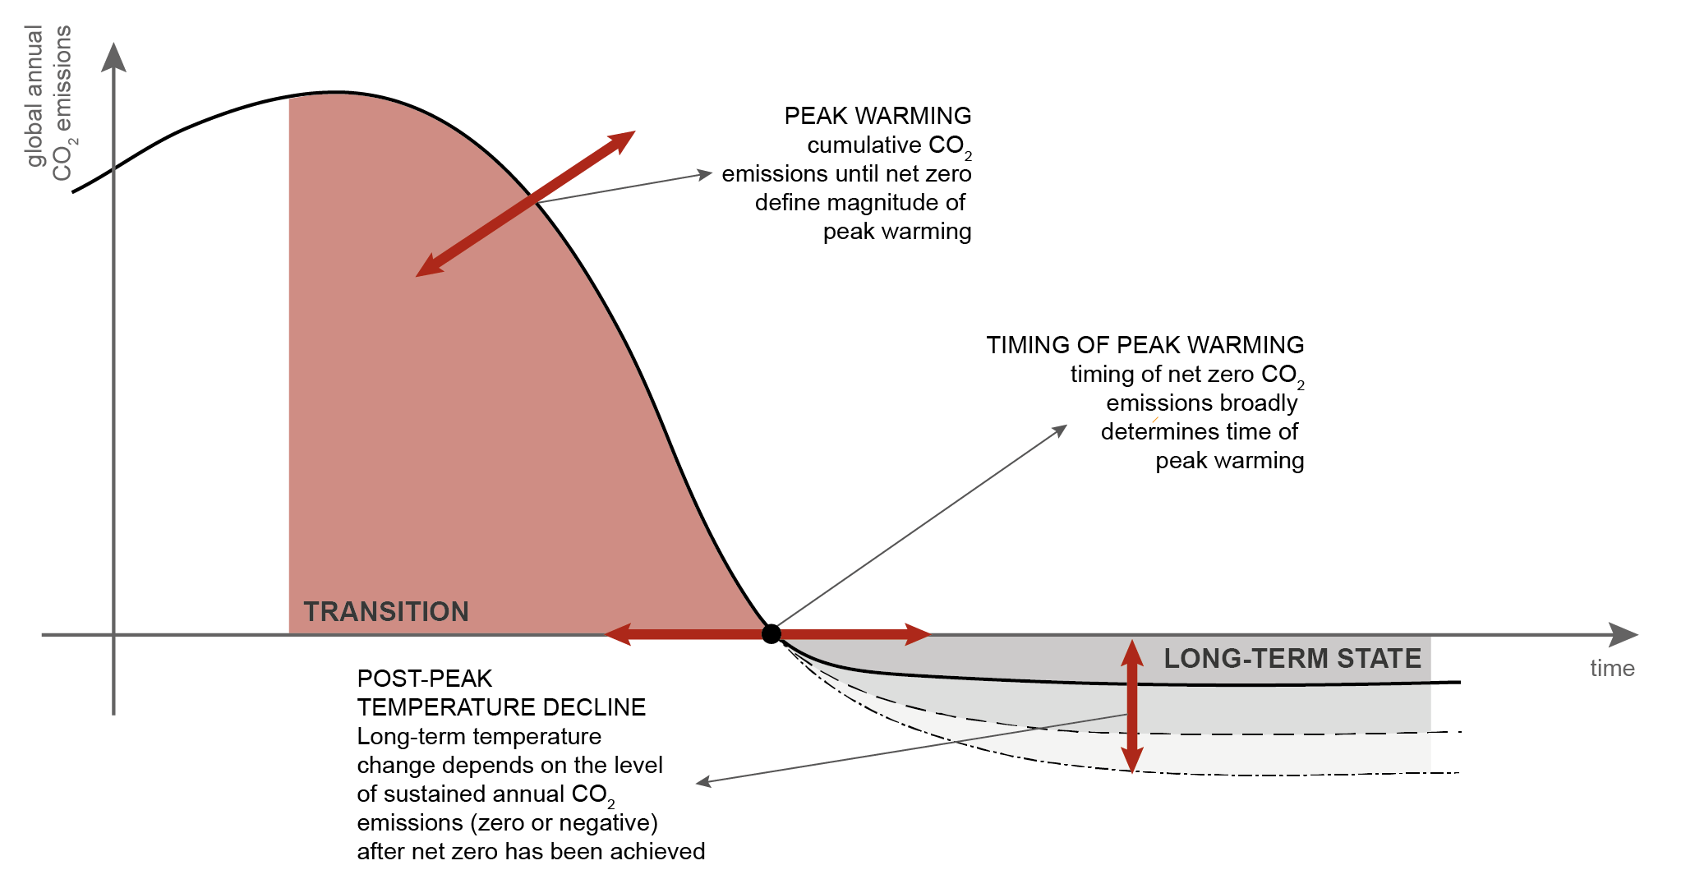
A new scenario logic for the Paris Agreement long-term temperature goal
Rogelj et al, Nature (2019) DOI: 10.1038/s41586-019-1541-4

Slide 4
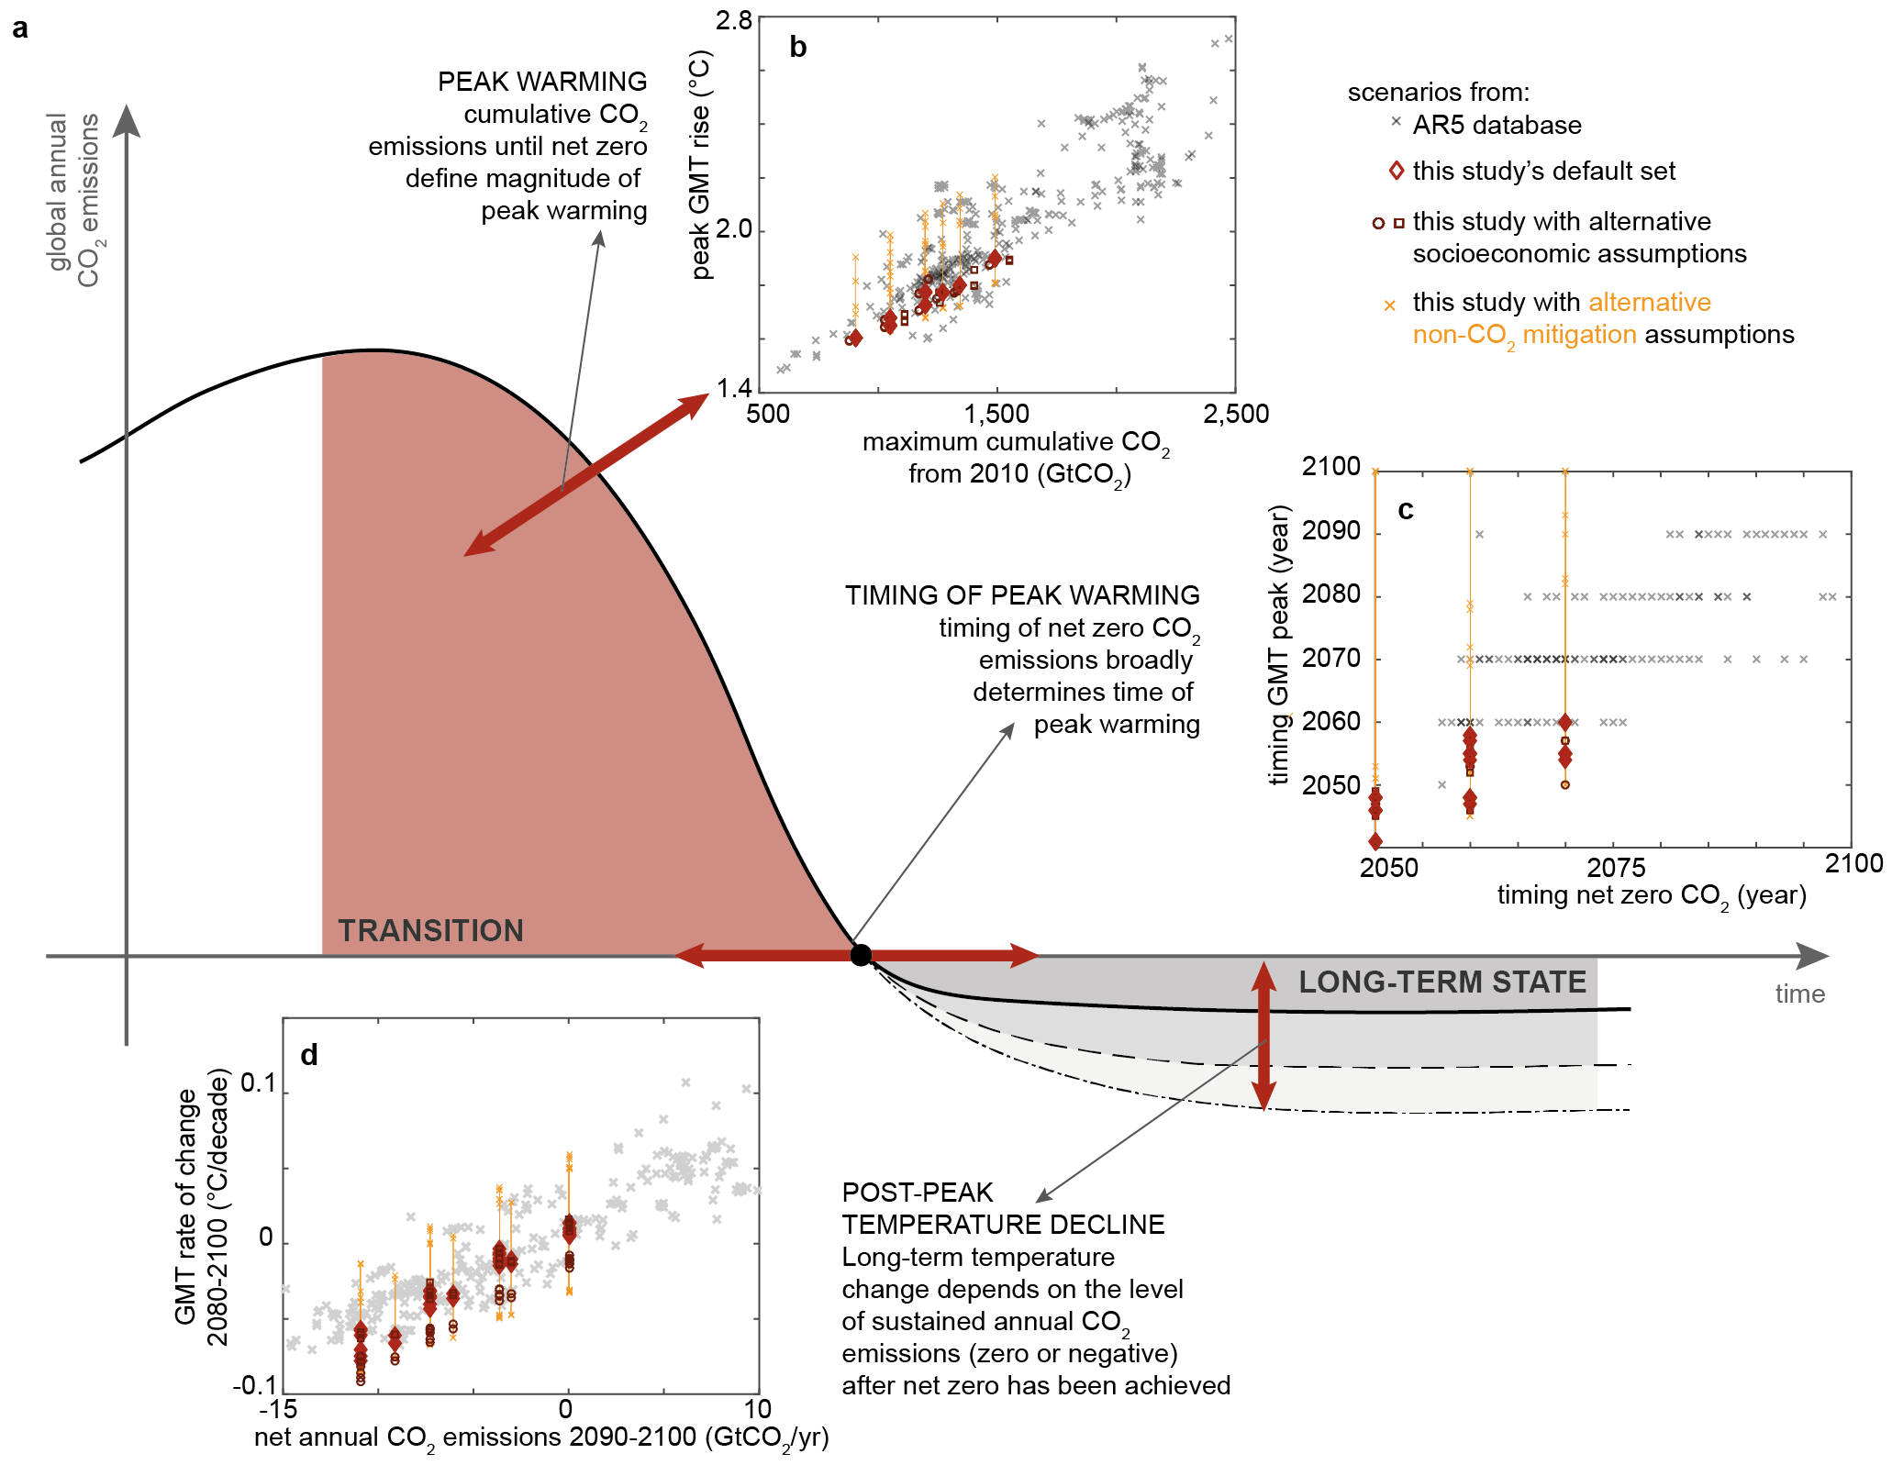
A new scenario logic for the Paris Agreement long-term temperature goal
Rogelj et al, Nature (2019) DOI: 10.1038/s41586-019-1541-4

Slide 5
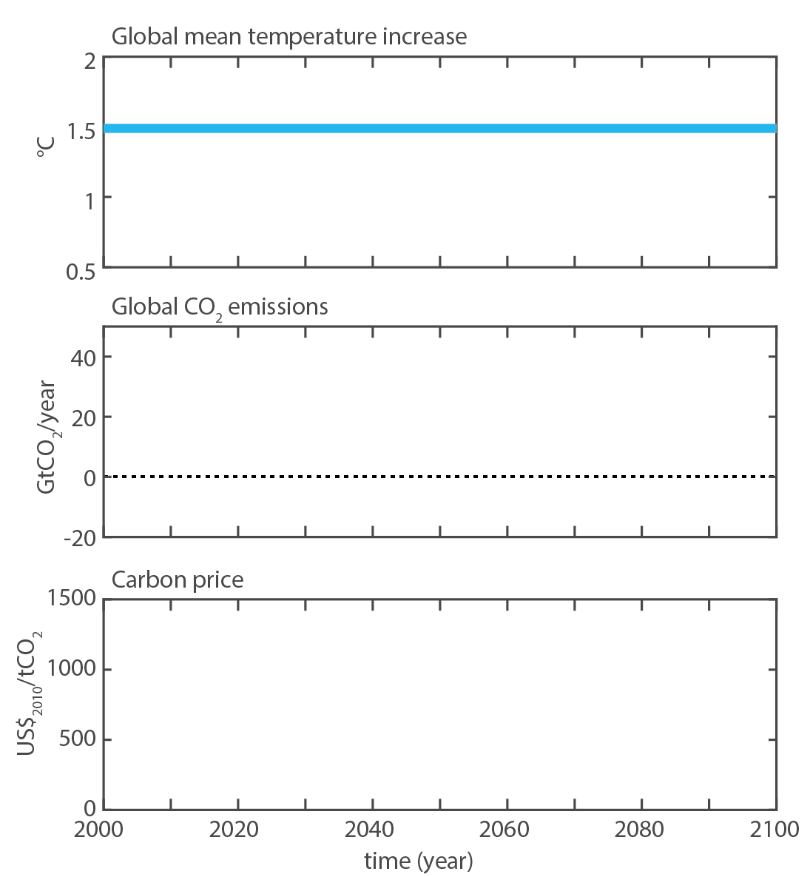
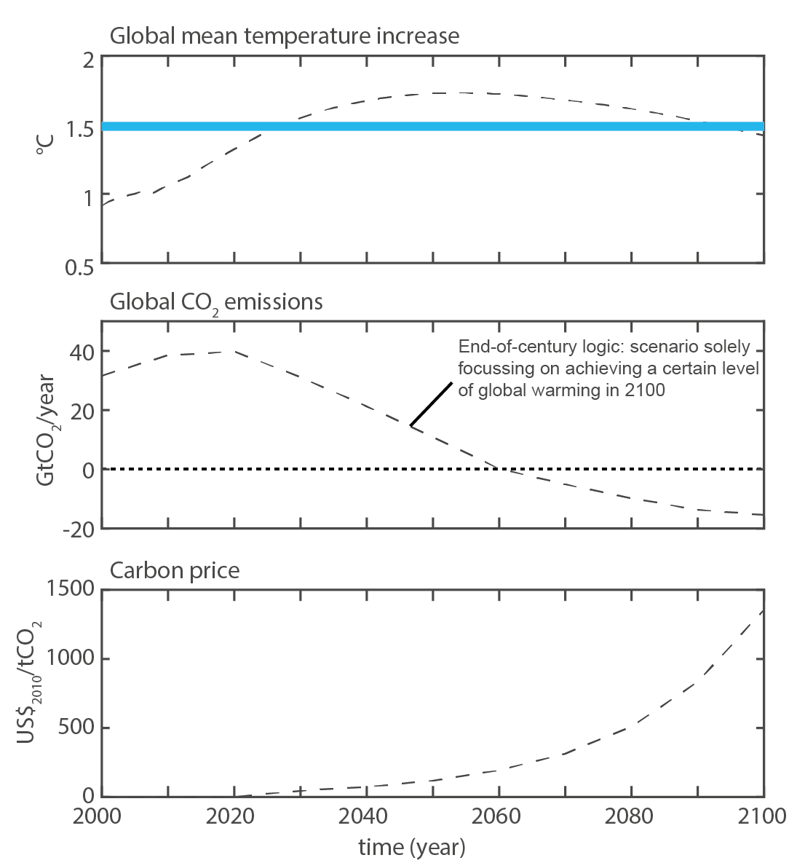
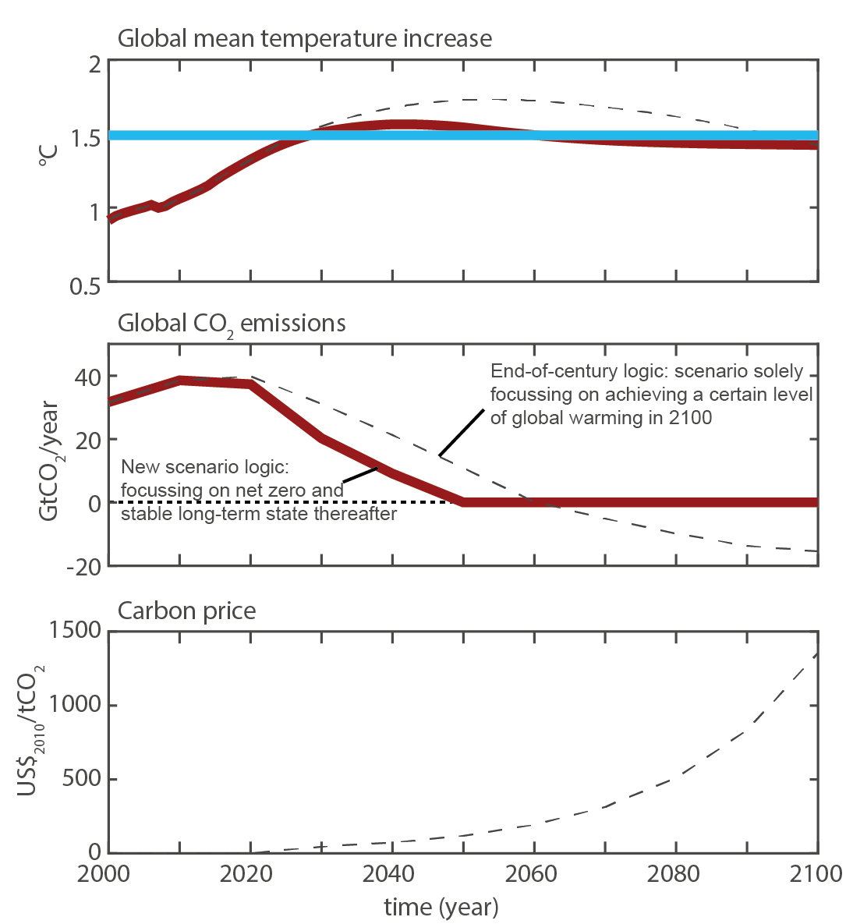
Implications and insights of our new scenario logic
Timing of cost-effective climate action for Paris Agreement becomes discount-rate independent
Rogelj et al, Nature (2019) DOI:10.1038/s41586-019-1541-4

Slide 6
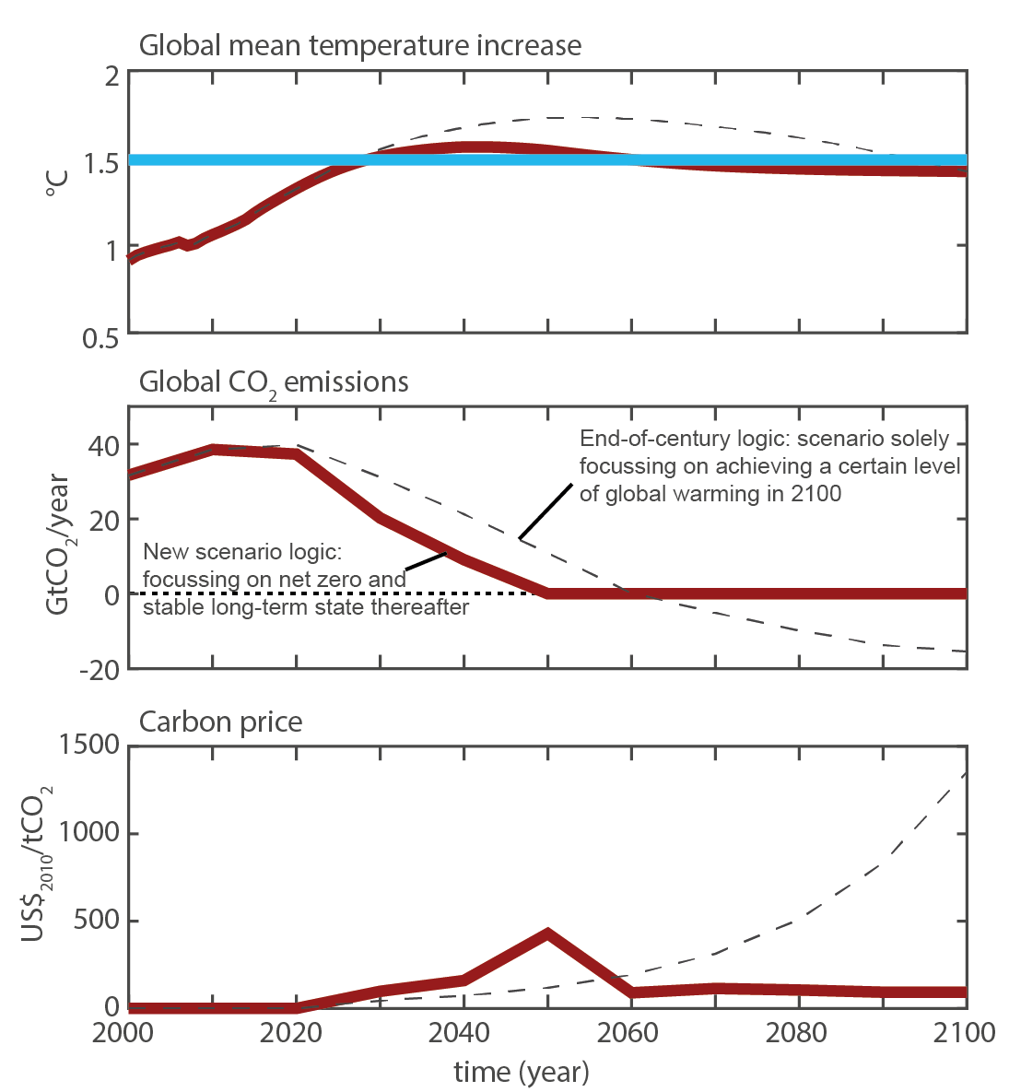
Implications and insights of our new scenario logic
Timing of cost-effective climate action for Paris Agreement becomes discount-rate independent
Fundamental shift in perception of cost of climate change mitigation over time
Rogelj et al, Nature (2019) DOI:10.1038/s41586-019-1541-4

Slide 7
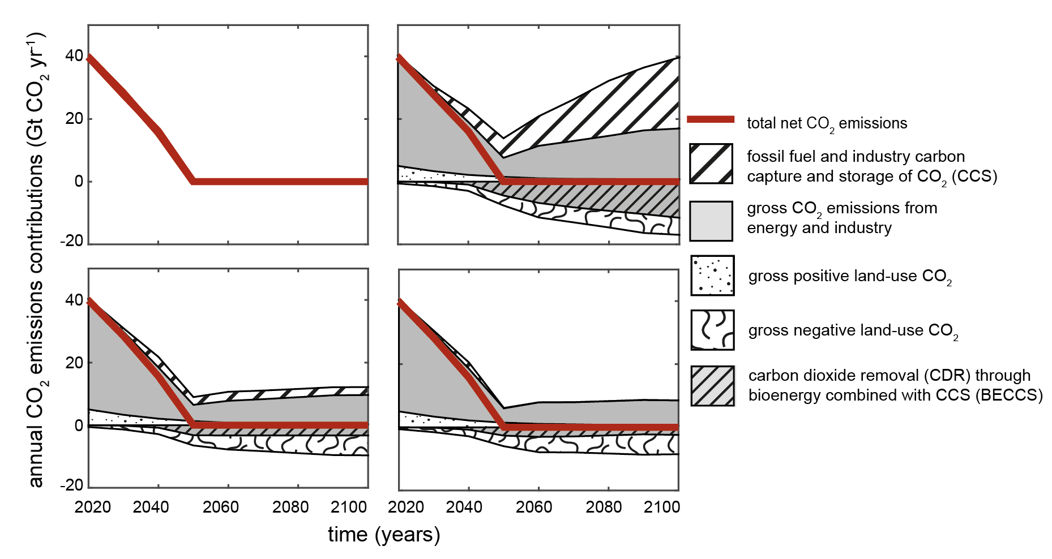
Implications and insights of our new scenario logic
Timing of cost-effective climate action for Paris Agreement becomes discount-rate independent
Fundamental shift in perception of cost of climate change mitigation over time
Exploration of sustainable development implications without shifting climate ambition goal posts
Rogelj et al, Nature (2019) DOI:10.1038/s41586-019-1541-4

Slide 8
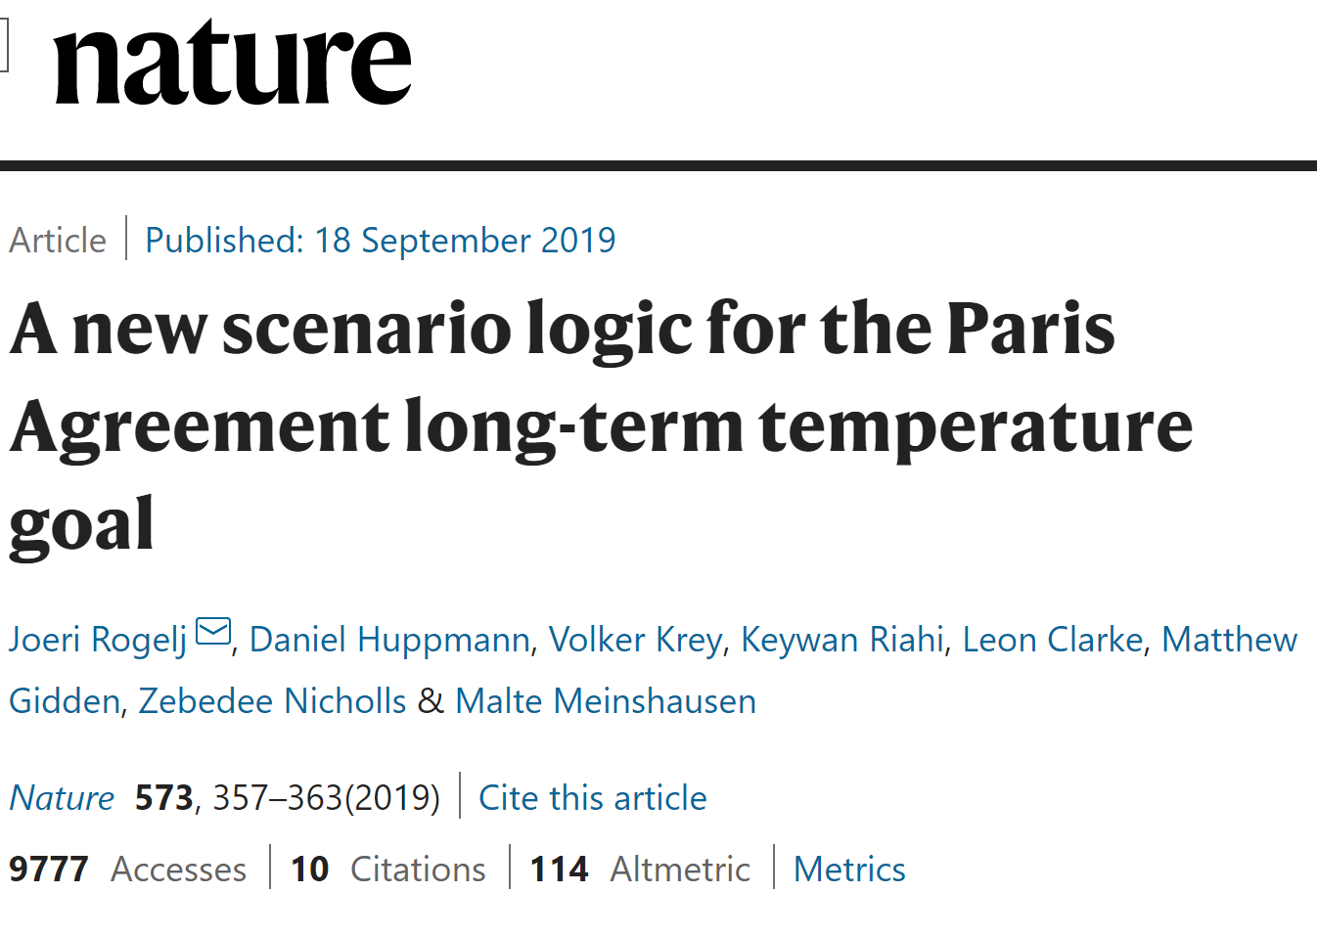
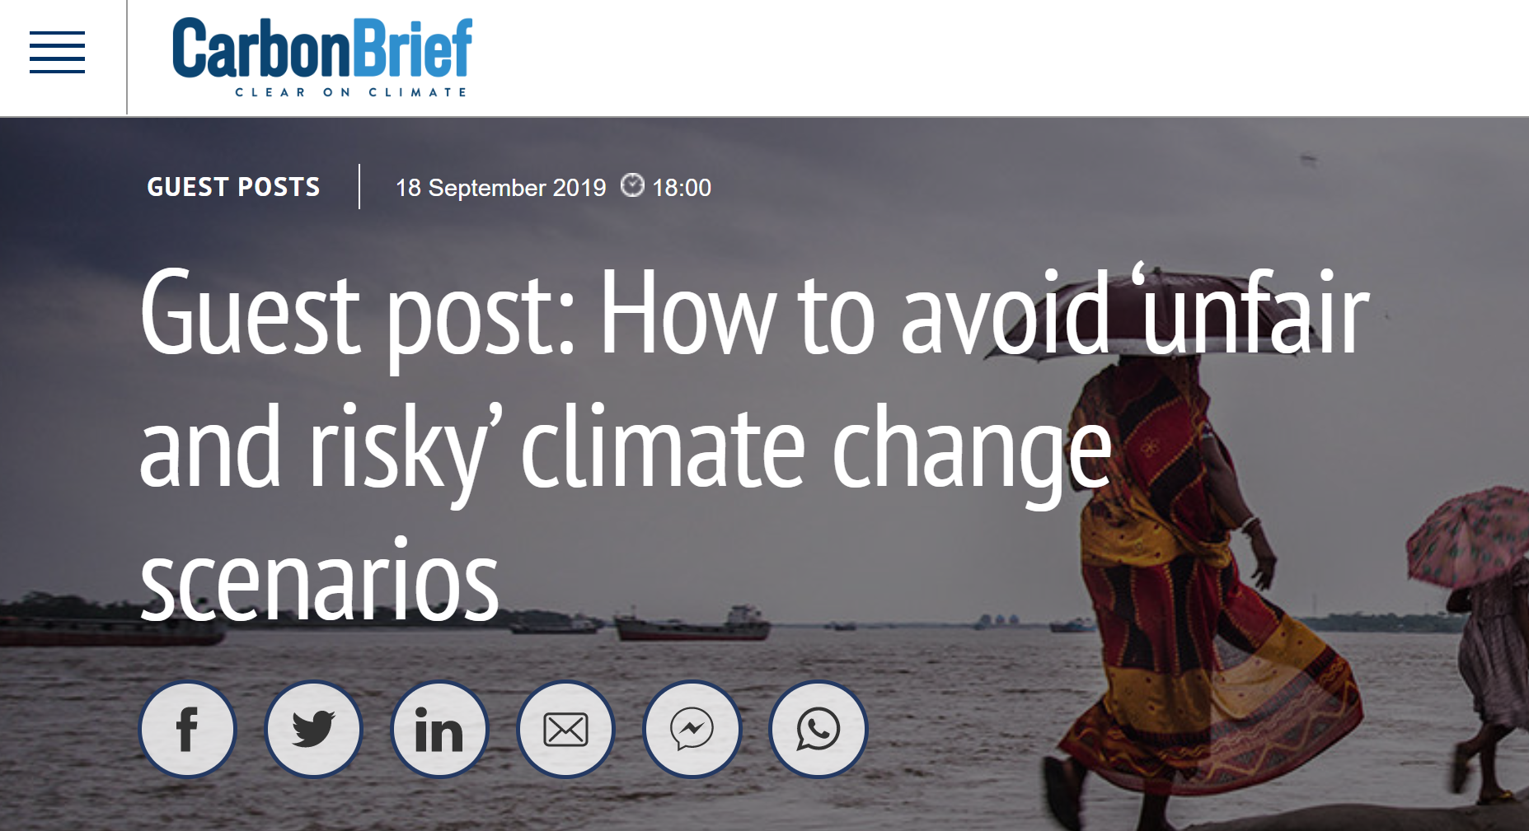
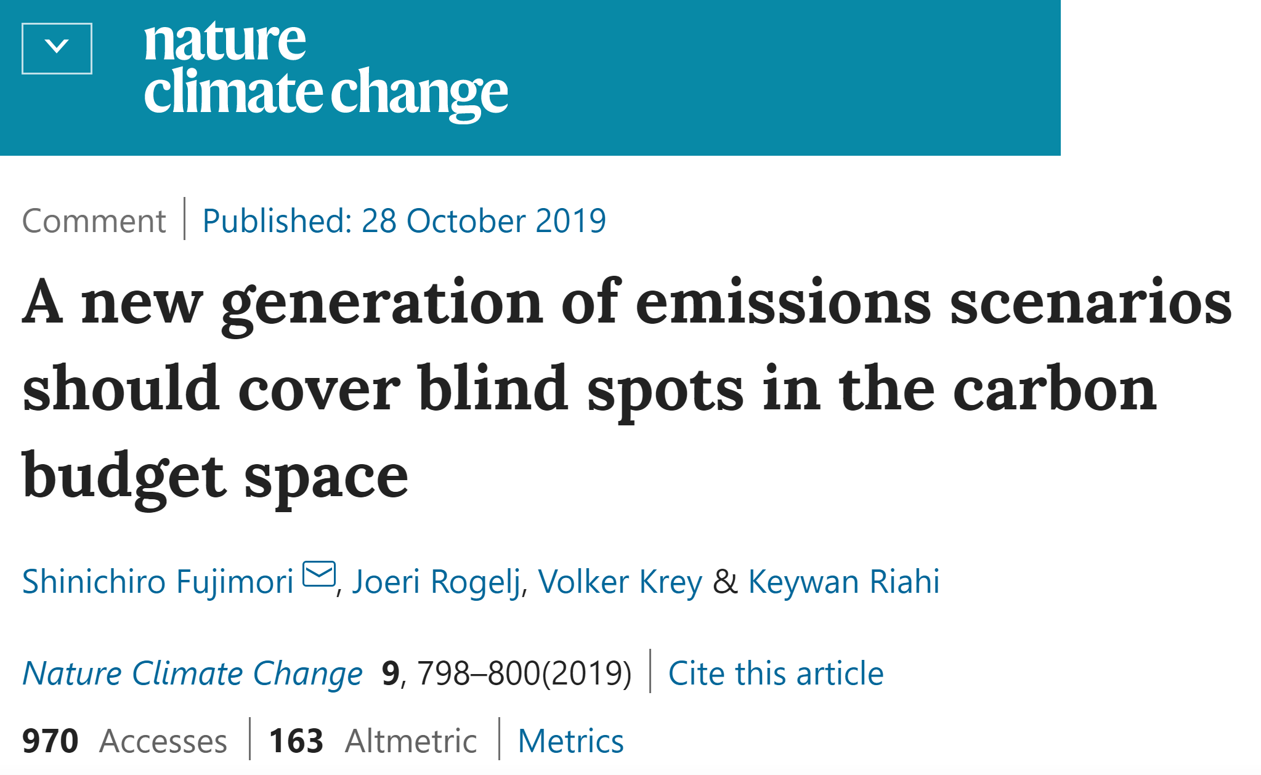
Thank you
Joeri Rogelj
Contact: j.rogelj@imperial.ac.uk rogelj@iiasa.ac.at Twitter: @JoeriRogelj
Rogelj et al, Nature (2019) DOI:10.1038/s41586-019-1541-4

Slide 9
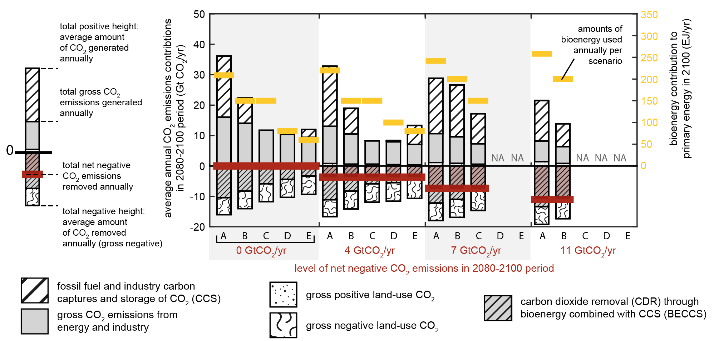
BACKGROUND: A new scenario logic for the Paris Agreement long-term temperature goal Different ways of achieving net zero and net negative global CO₂ emissions
Rogelj et al, Nature (2019) DOI:10.1038/s41586-019-1541-4

Slide 10
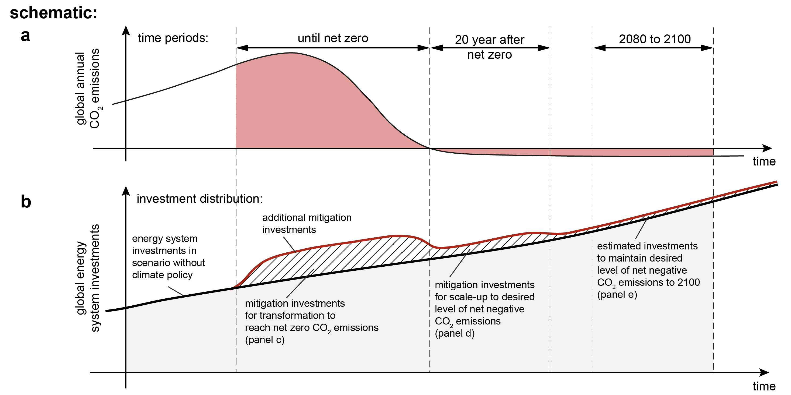
BACKGROUND: A new scenario logic for the Paris Agreement long-term temperature goal Climate change investment implications of new scenario logic
Rogelj et al, Nature (2019) DOI:10.1038/s41586-019-1541-4

Slide 11
BACKGROUND: A new scenario logic for the Paris Agreement long-term temperature goal Climate change investment implications of new scenario logic
Rogelj et al, Nature (2019) DOI:10.1038/s41586-019-1541-4

