Slide 1
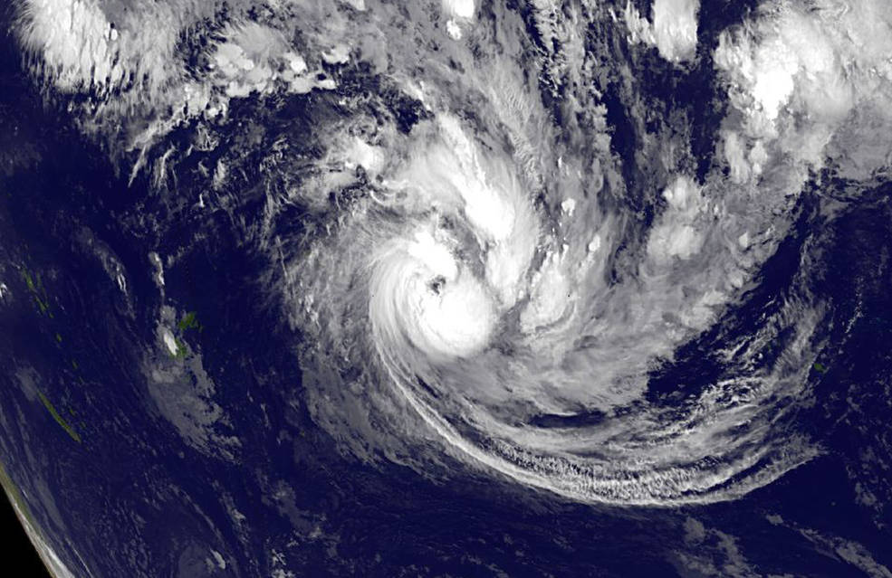
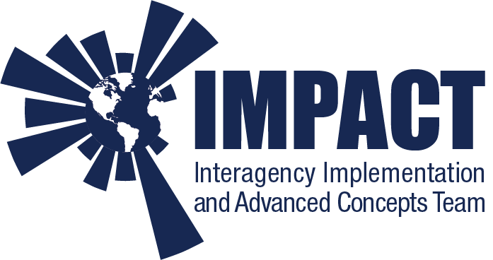
The Role of Data Systems to Enable Open Science
Rahul Ramachandran NASA/MSFC, Kaylin Bugbee UAH, Kevin Murphy NASA/HQ
EGU 2020
May 5, 2020
Notes:
IMPACT is an interdisciplinary team situated in NASA’s Earth Science Data System Program. IMPACT improves processes and develops best practices that maximize the effectiveness and efficiency of Earth science data management and stewardship. Our efforts broaden access to Earth science data, expanding its use by researchers both inside and outside of NASA. We rapidly prototype the latest technical and management concepts in order to optimize their application to Earth science data.

Slide 2
Open Science Definition(s)
Science is both a body of knowledge as well as a systematic method of knowing something
Open science definitions
Open science is the idea that scientific knowledge of all kinds be openly shared as early as it is practical in the discovery process (Narrow)
Open science can be defined as any activity that covers anything about the future of knowledge creation and dissemination (Broad)
Need to distinguish between Open science versus reproducible science
Transparency is a key driver for reproducible science and reproducible science as such is a key sub-component of this shift in culture to open science
Objective of this presentation
Provide an overview of different open science activities
Highlight how Earth science’s path to Open Science is deeply intertwined with data programs
This is still very much a work in progress

Slide 3
Drivers for expanding Open Science
While science has in some measure been open since the 1700s, technology advancements, big data and complex science questions have pushed science to become more open
Three factors pushing open science
Technology has opened new possibilities on both how the process of science is more efficient and sharing and communicating knowledge with each other
The volume and velocity of data being collected is disrupting existing data systems as well as the traditional means of analysis
As researchers tackle more complex problems, the approach has migrated from individual researchers to a collaborative team of researchers. In addition, the glut of data is also forcing collaboration and sharing of expertise

Slide 4
Open Science Focus Areas (1)
Make science accessible to the broader community including the general public
Making the scientific research process accessible by including the broader community in different stages of the scientific process
Enabling broader comprehension of research results by deconstructing complex research results into easily digestible bits of information
Make science knowledge products accessible and available to everyone
Open data sharing - prevents duplication in the collection of data and significantly increases the data use and reuse
Open code - open-source software culture is slowly taking root within the Earth sciences
Open access - Some journal publishers have modified their publication models to meet the need for accessibility to research publications
Some have moved to a gold model of publication
Added new policies that allow authors to self-archive (green publication)

Slide 5
Open Science Focus Areas (2)
Make the research process and collaboration efficient
Data-intensive science has necessitated new and better computation infrastructure and tools to support science at scale
New cyberinfrastructure liberates a researcher from locally available resources which could be limited
Science problems being tackled have become more complex and new collaborations are needed. This requires the adoption of a team science approach with members having different skill sets.
Social networks for scientists have also become popular. Networks like ResearchGate, Mendeley allow researchers to connect and share journal articles with each other
Develop Impact Measurements
Growing urgency to develop alternative metrics to better quantify scientific contributions
In addition to traditional measures, the new metrics need to take into account latent measures such as reading, bookmarking, resharing, discussing, likes, etc

Slide 6
Role of Data Programs (1)
Accessibility to Science
Support data collection activities that involve public participation as well as scientific challenges that are open to the public
Make a concerted effort to increase public awareness of the value of data being collected to the advancement of science and to humanity in general
Have policies to support open data and open-source software and encourage other organizations to adopt these policies
Ensure that open data and software policies are incorporated and clarified in new solicitations or as requirements for new research projects
Provide infrastructure support to allow authors to share green articles and incentivize authors to publish in open access journals
Improve in the discovery of knowledge by linking publications and data search pathways
Develop new stewardship practices to make software discoverable and accessible and treat software as a first-class research object
Ensure policies incentivize users to share and reuse data and code

Slide 7
Role of Data Programs (2)
New Data Infrastructures
Data archives have traditionally been designed as siloes separate from computing centers
Need to develop infrastructures that facilitate the construction of scalable data analysis pipelines
These infrastructures will enable researchers to cope with the volume of data and provide effective user/data interfaces and visualizations, as well as more powerful algorithms to extract knowledge
Support Data System Impact Measurement
Adopting existing measurements or developing new impact measurements for data, software, documentation, and users

Slide 8
Summary
Even with the adoption and implementation of these ideas, there will be:
Continuing challenges
Open access to data, code still do not solve all equity issues (ie. lack of network in developing countries)
Greater access to data and code also increases the risk of misuse
Acceptance of new impact measurements within the research community
New problems
Data authenticity issues as data move from one platform to another
Transitioning from data centers to knowledge centers will require rethinking stewardship roles, management approach as well as governance policies

Slide 9
Contact and Questions
Rahul Ramachandran
rahul.ramachandran@nasa.gov
Questions?

