Slide 1
Environmental controls on the magnetic properties of black shales on the Norwegian shelf
Jonas Kristensen Kimerud and Maarten Felix
NTNU Norwegian University of Science and Technology, Trondheim, Norway

Slide 2
Aim
“Determine if cyclicity can be detected in the magnetic measurement related to orbital forcing using time series analysis.”

Slide 3
Background - Overview of Cores
Farsun Sub-Basin (13/01-U-01)
Møre-Trøndelag (6307/07-U-03A)
Nordland VII (6814/04-U-02)
Nordkapp Basin (7230/05-U-02)
Project map
IKU Stratigraphic Drilling Projects 1982 - 1993

Slide 4
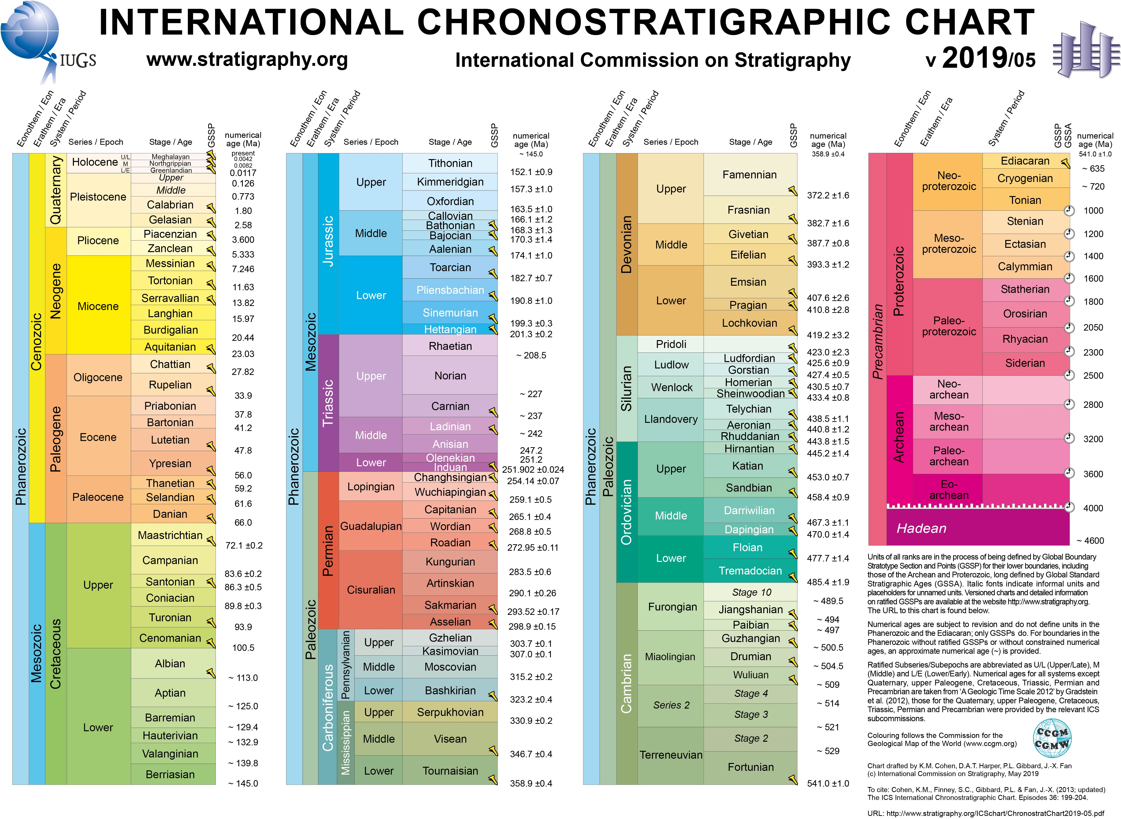
Background - Age and Formation
Upper Jurassic (163.5 Ma ±1.0 – 145.0 Ma)
Nordkapp Basin
Age: Oxfordian to Kimmeridgian
Formation: Hekkingen
Nordland VII
Age: Tithonian (Volgian)
Formation: Hekkingen
Møre-Trøndelag
Age: Oxfordian to Ryazanian
Formation: Spekk
Farsun Sub-Basin
Age: Kimmeridgian
Formation: Farsund
Can be correlated to the Kimmeridge Clay Formation in the North Sea
(Cohen, Harper, Gibbard, & Fan, 2019)

Slide 5
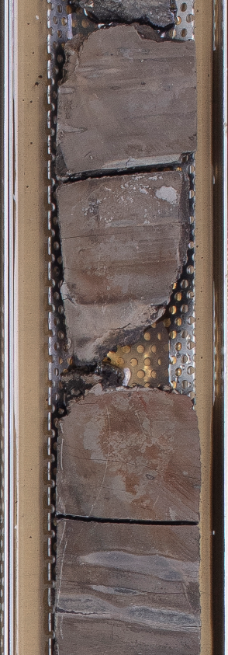
Background - Black Shale
Black Shale Siderite rich shale
Mud to silt grain size
High organic content
Homogenous to weakly laminated
Mostly deposited in anoxic water conditions
Iron carbonate minerals: Siderite and ankerite
(Iron rich calcite deposited in anoxic conditions)
Pyritised fossils
Bioturbation (in the more sandy parts)
From 13/01-U-01 93-104 m
Notes:
Pyrite: has a magnetic susceptibility which is virtually zero (+0.837 x 10""8 SI; Bleil k Petersen 1987). This means that pyrite has essentially no effect on measured susceptibility values in ancient organic carbon-rich mudrocks.
- Ferroan calcite and dolomite can have fairly high susceptibilities.

Slide 6
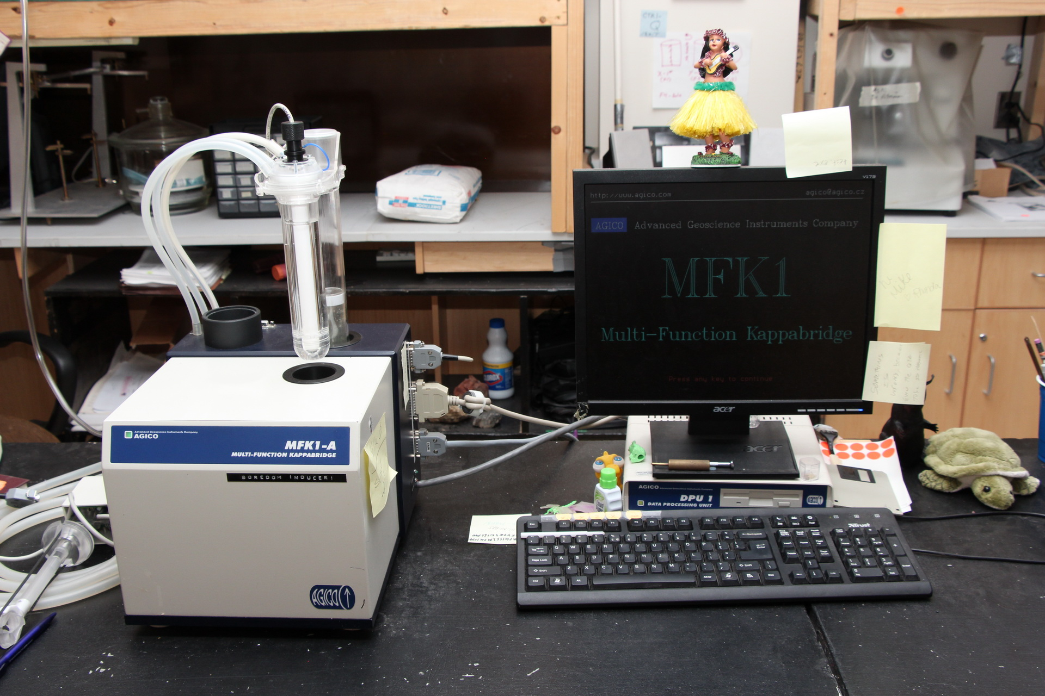
Method - Magnetic measurements
Magnetic Susceptibility (Kappabridge MFK1-A)
5-10 cm sampling spacing
Normalized by weight

Slide 7
Method - Spectral analysis
Analysed in Astrochron (Meyers, 2014) with Rstudio.
Data preparation steps: (1) Removal of outliers, (2) linear interpolation, (3) detrending and mean subtraction ,and (4) zero-padding.
Multi-taper method (MTM) from Thomson (1982)
Five Slepian sequences (DPSS)
Harmonic f-test and robust red noise (Meyers, 2012)

Slide 8
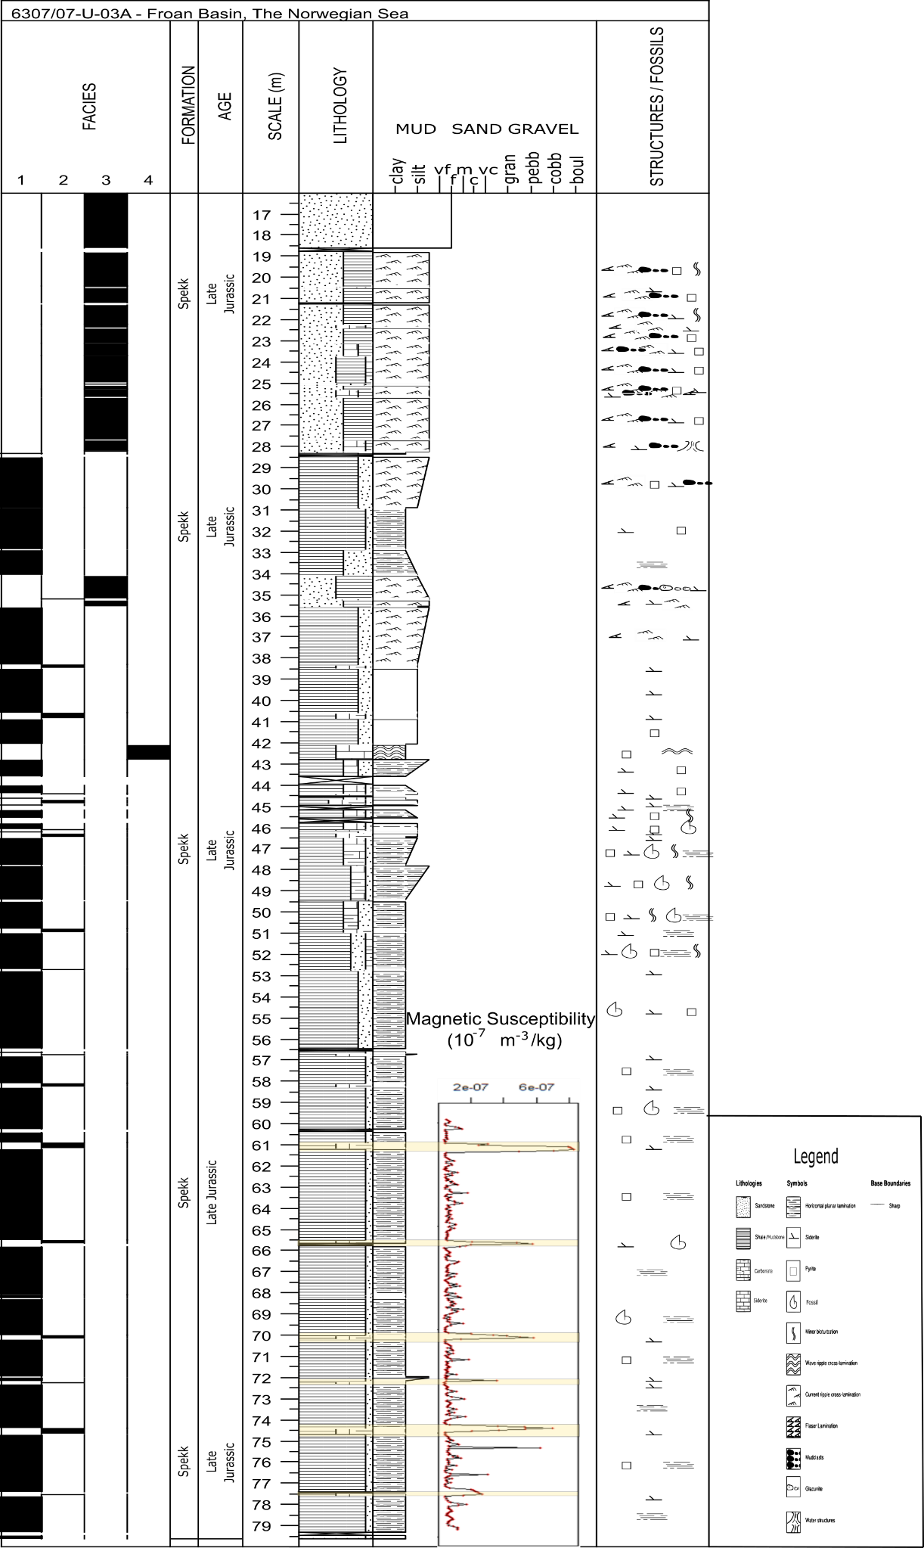
Results - Logging and magnetic susceptibility (MS) data
Facies number | Name
1 | Laminated black shale
2 | Siderite-rich black shale
3 | Laminated sandy shale
4 | Carbonate cemented shale
5 | Heavily bioturbated muddy sandstone
6 | Glauconite laminated grey conglomerate
Only result from one core is shown, but the other cores have comparable results.
Log from core drilled in the Lofoten area of the Norwegian Sea.
6 facies.
The relatively low range of MS values reflects paramagnetic behaviour from clayey and marly sediments.
The higher susceptibility readings correlated with siderite rich shales.

Slide 9
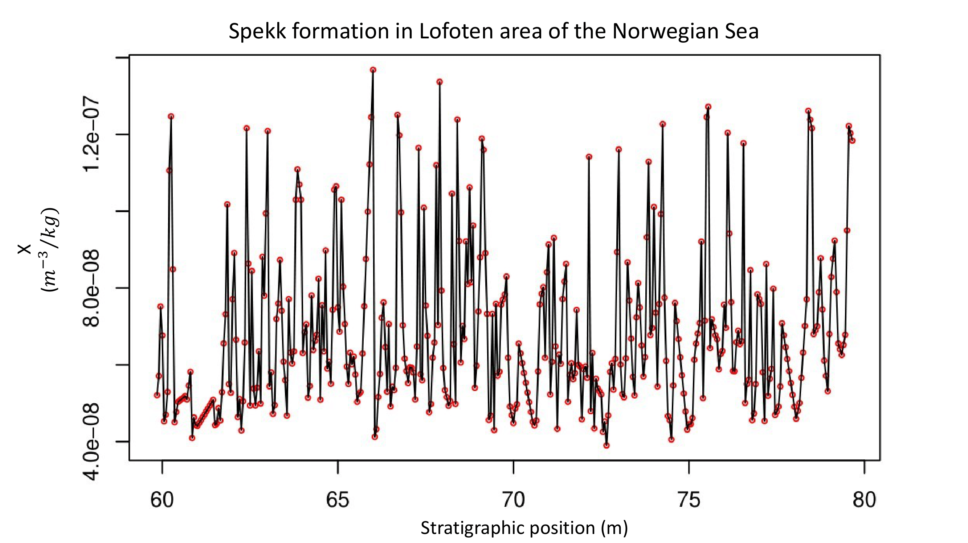
Result - Spectrogram
Peak number | Frequency (cycles per metre) | Period (m) | Harmonic confidence interval (%) | Robust Red Noise confidence interval (%)
1 | 0.1957091 | 5.109625 | 97.5842 | 67.59639
2 | 0.4287952 | 2.332116 | 97.29931 | 75.07356
3 | 2.027879 | 0.493126 | 98.12135 | 97.51229
4 | 3.830703 | 0.2610487 | 93.10573 | 94.84577

Slide 10
Discussion - Evolutionary spectrogram
Sedimentation rates do not vary significant throughout the section
The power of the frequencies varies, higher power from 60 to 70 meters

Slide 11
Discussion - Milankovitch cyclicity in peak nr. 1 and 2.
 | High sedimentation Rate (Mutterlose et al., 2003) | Medium sedimentation (Mutterlose et al., 2003) | Low sedimentation (Mutterlose et al., 2003) |  |  | Period (m) | Milankovitch cycles (kyr)
Sedimentation rates (m/myr) | 16.2 | 8.2 | 4.4 |  | Spectral Peak 1 | 5.1 | 41.0
Spectral peak 1 |  |  |  |  | Spectral peak 2 | 2.3 | 18.2
Period (m) | 5.1 | 5.1 | 5.1 |  | Ratio | 2.2 | 2.25
Time (kyr) | 31.5 | 62.3 | 116.1
Spectral peak 2
Period (m) | 2.3 | 2.3 | 2.3
Time (kyr) | 14.3 | 28.4 | 53.0
Spectral peak 1 with a length of 5.1 m can be related to obliquity (41 kyr) periodicity.
Spectral peak 2 with a length of 2.3 m can be related to precessional (18.2 kyr) periodicity.

Slide 12
Conclusion
Cyclicity in the Milankovitch range related to obliquity (41 kyr) and precession (18.2 kyr) is present in the black shales of the Upper Jurassic on the Norwegian shelf.
Longer intervals are needed to be able to detect eccentricity (100 and 405 kyr) cyclicity.

Slide 13
References
Cohen, K., Harper, D., Gibbard, P., & Fan, J.-X. (2019). ICS International Chronostratigraphic Chart 2019/05.
Meyers, S. R. (2012). Seeing red in cyclic stratigraphy: Spectral noise estimation for astrochronology. Paleoceanography, 27. Retrieved from <Go to ISI>://WOS:000308890000001. doi:10.1029/2012pa002307
Meyers, S. (2014). Astrochron: An R package for astrochronology.
Mutterlose, J., Brumsack, H., Flögel, S., Hay, W., Klein, C., Langrock, U., . . . Stein, R. (2003). The Greenland‐Norwegian Seaway: A key area for understanding Late Jurassic to Early Cretaceous paleoenvironments. Paleoceanography, 18(1).
Thomson, D. J. (1982). Spectrum estimation and harmonic analysis. Proceedings of the IEEE, 70(9), 1055-1096.

