Slide 1

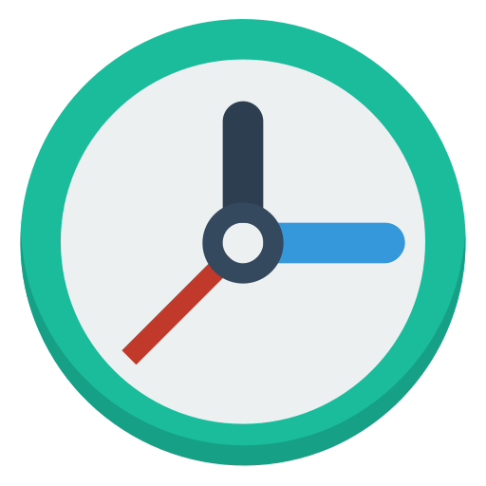
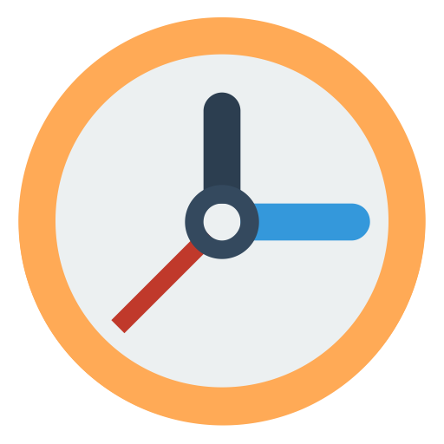


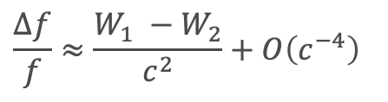
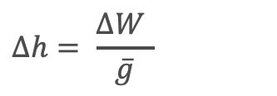

Optical clocks for gravity field observation and further geodetic applications
Hu Wu, Jürgen Müller, Annike Knabe
Institut für Erdmessung (IfE), Hannover
$$\frac{∆f}{f}≈\frac{W_{1} −W_{2}}{c^{2}}+O\left(c^{−4}\right)$$
$$W_{2}$$
EGU Generally Assembly
May 4-8, 2020
$$W_{1}$$
$$Δh= \frac{ΔW }{\overline{g}}$$

Slide 2
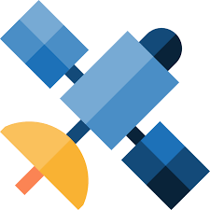
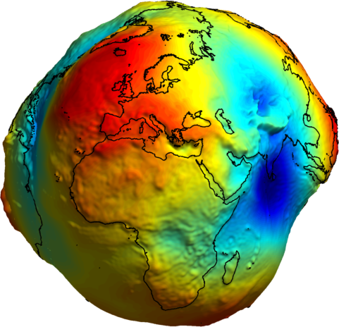

Clocks for space gravimetry / Scenario 1
Space-to-ground clock comparison
Potential value $V$
Reference clock
LEO satellite Clock
Notes:
Ground clocks: a number of ground clocks are requiced to transmit their potential values to the LEO clock via the link between geostationary clocks
LEO clock: to observave the potential value of the Earth gravity field through measuring the potential differences w.r.t. ground clocks
The goal is to obtain a gravity potential values with a global and homogeneous coverage for the global gravity field recovery.

Slide 3
Clocks for space gravimetry / Scenario 1
Degree-error RMS in geoid height
Clock error only
One-month GRACE satellite A orbit (January 2006)
@ ~475 km
sampling rate: 5 s

Slide 4

Clocks for space gravimetry / Scenario 2
Space-to-space clock comparison
Potential difference $ΔV$
LEO satellite clocks
Notes:
In addition to the one-single LEO satellite clock, we also consider a mission concept similar to GRACE, which apply a-pair LEO satellite to measure the potential differences. It is a kind of differential measuring concept.
Theoretically, this mission concept does not need ground clocks, and much easier to obtain observations with a global and homogenous spatial coverage.

Slide 5
Clocks for space gravimetry / Scenario 2
Degree-error RMS in geoid height
Clock error only
One-month GRACE satellite A & B orbit (January 2006)
@ ~475 km
sampling rate: 5 s
Notes:
Solid curves represent coefficient differences w.r.t. EIGEN-6c4;
Dashed curves represent formal errors;

Slide 6
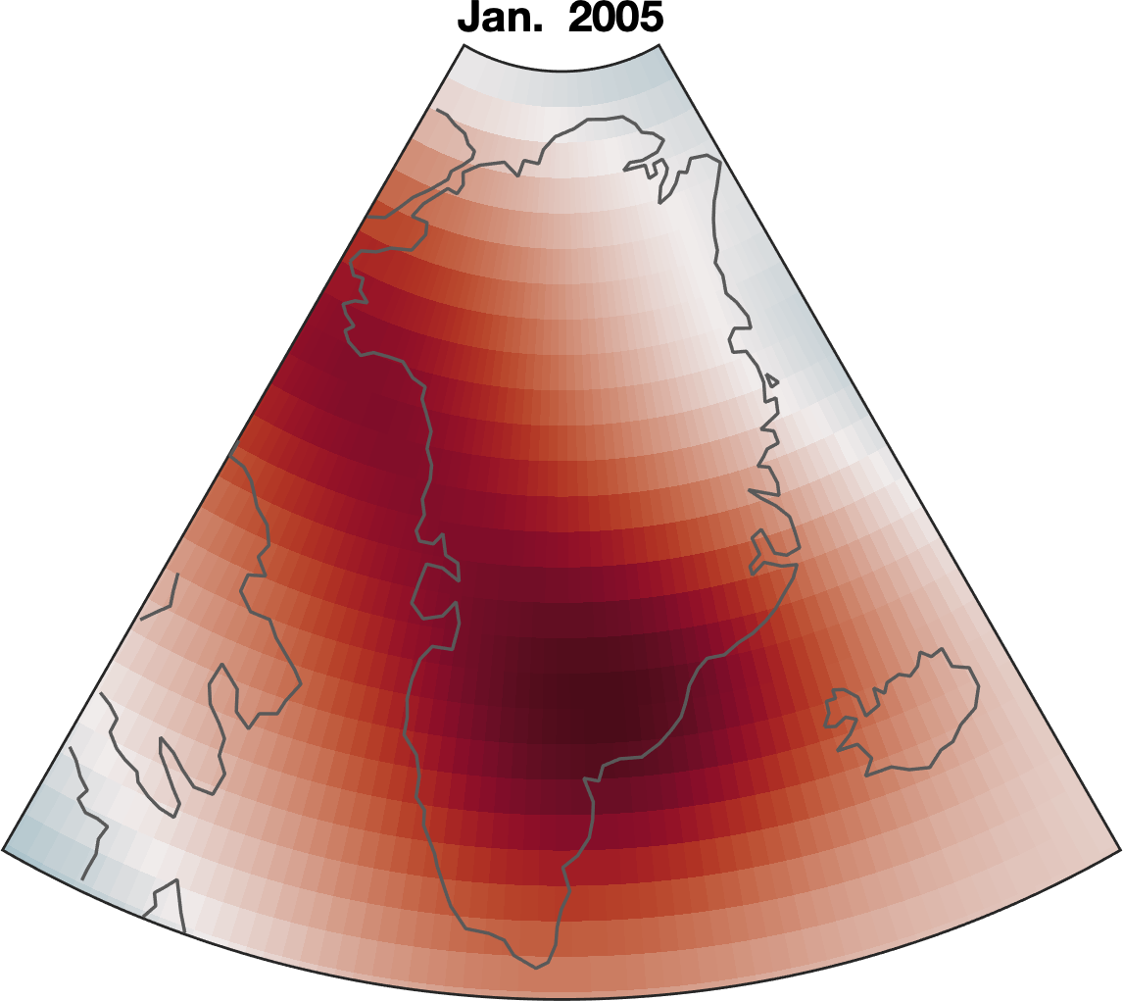
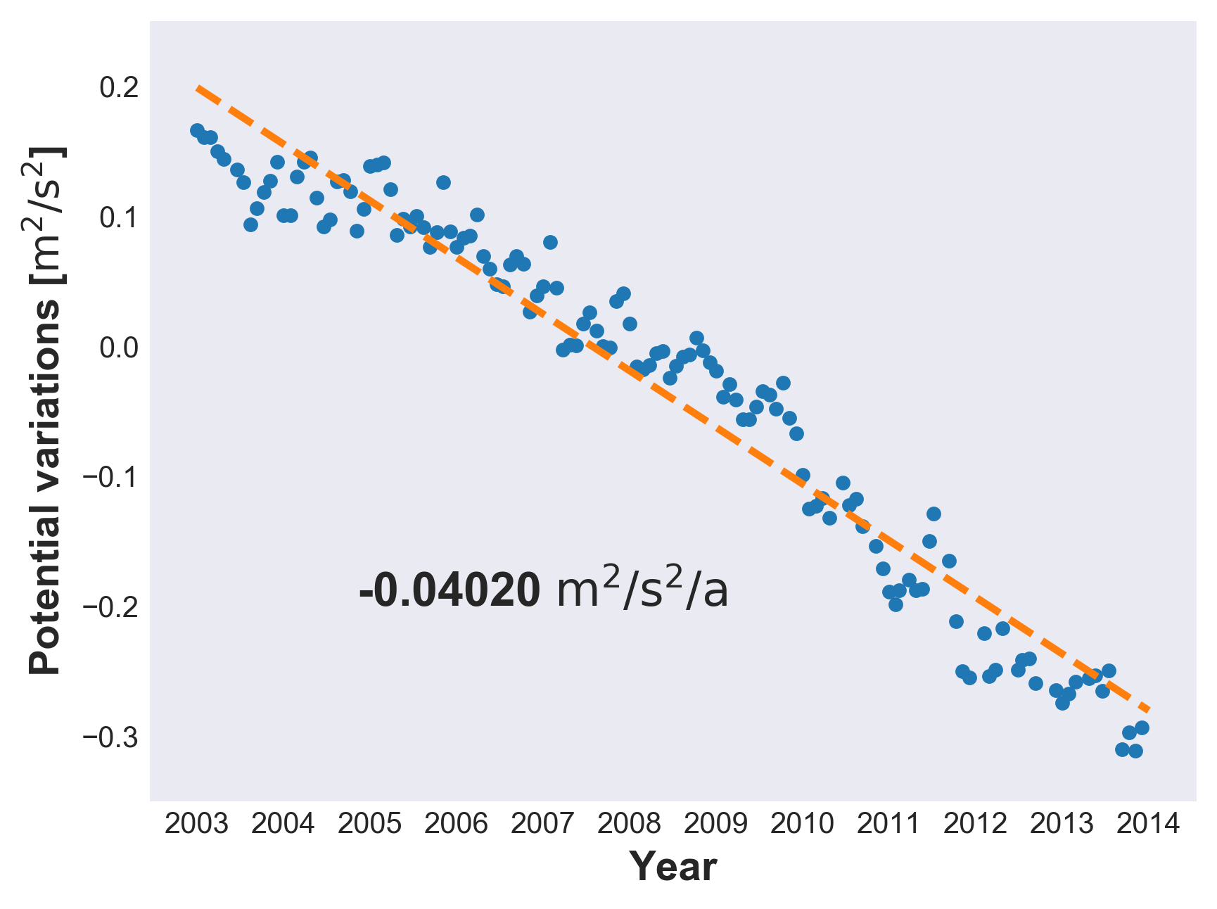
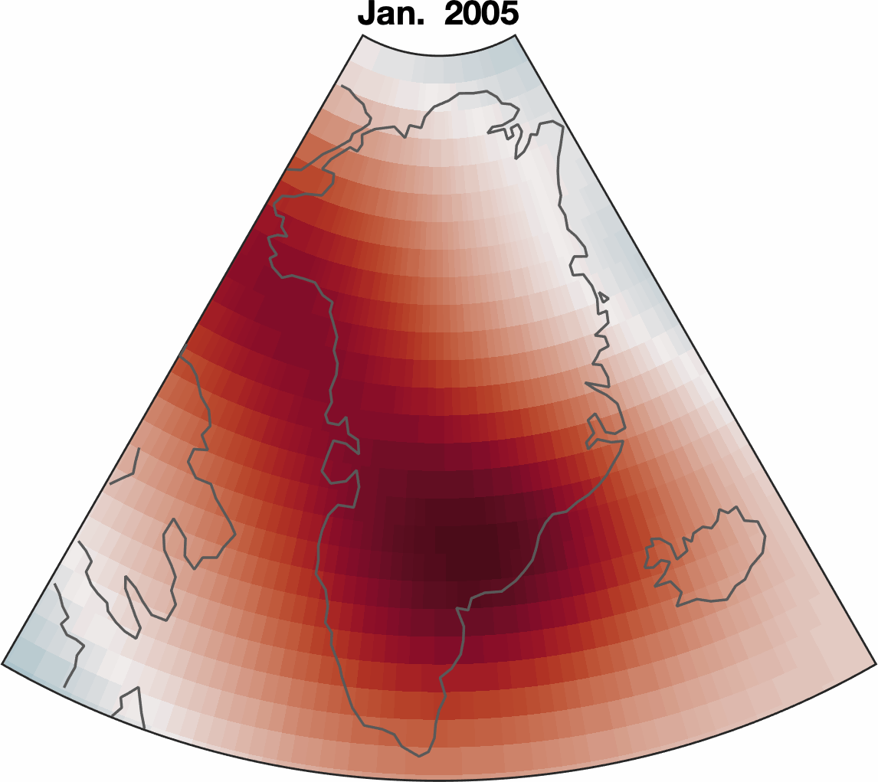
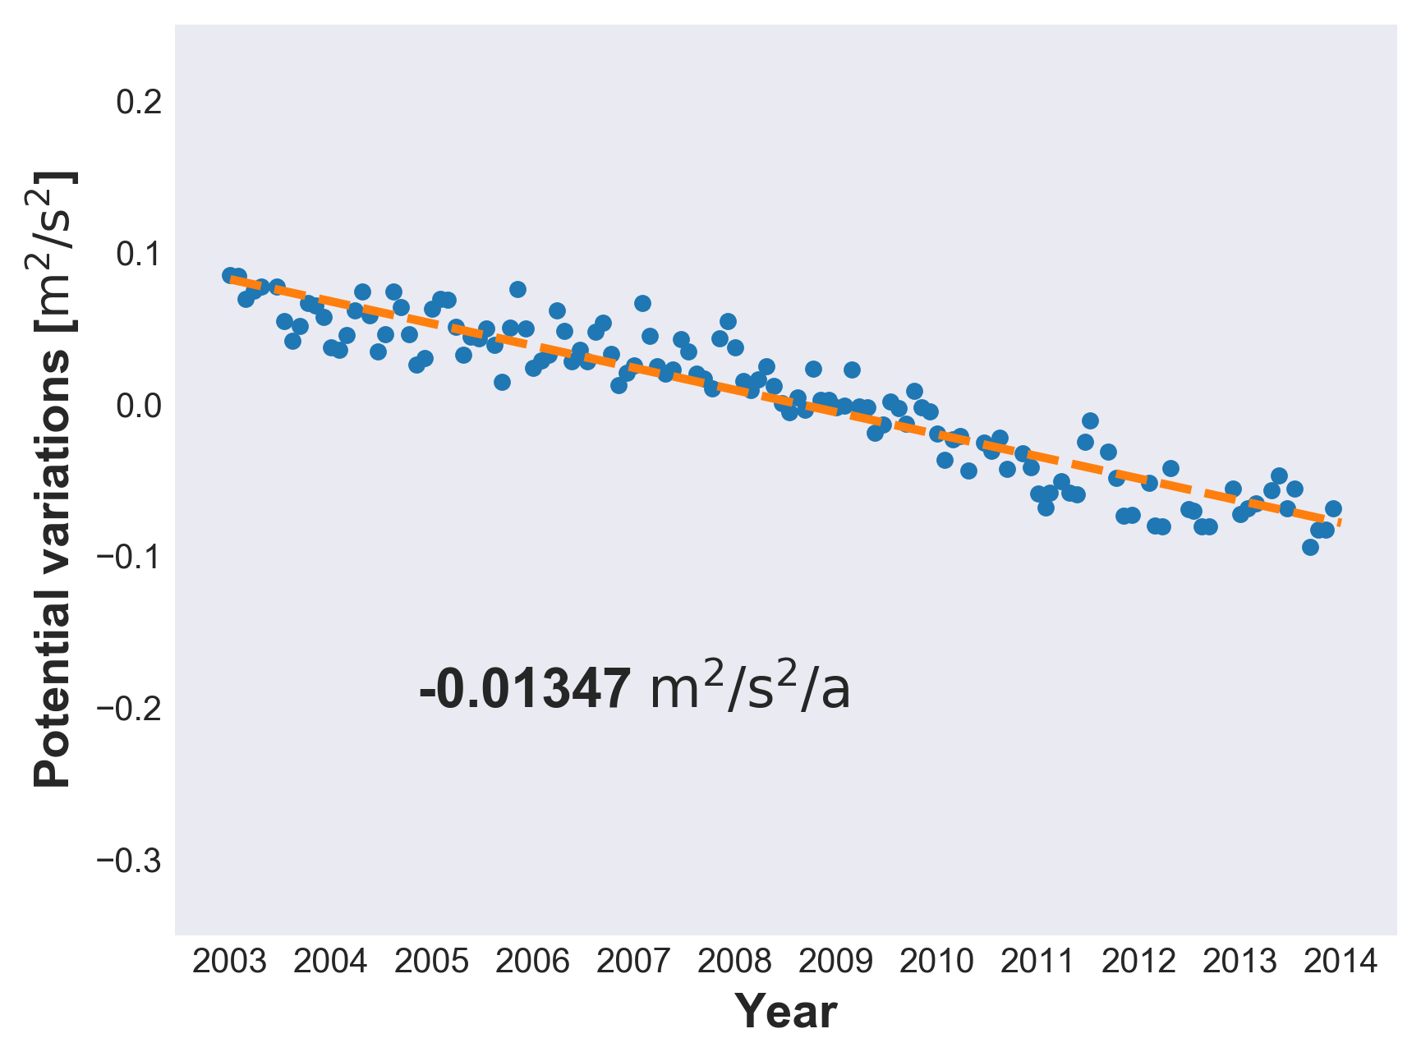
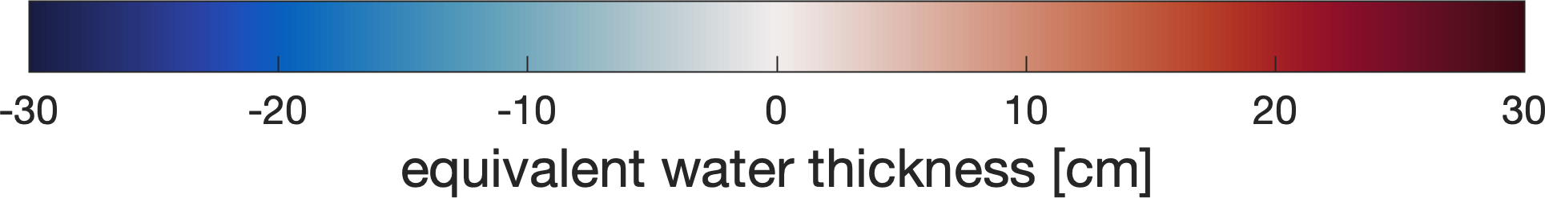
Mass loss in Greenland
B
A
A
A
Clock uncertainty: 10⁻¹⁸
B
Clocks can detect the mass loss in some areas. Being complementary to GRACE, clocks provide:
point-wise and
high-frequency sampling obs.

Slide 7
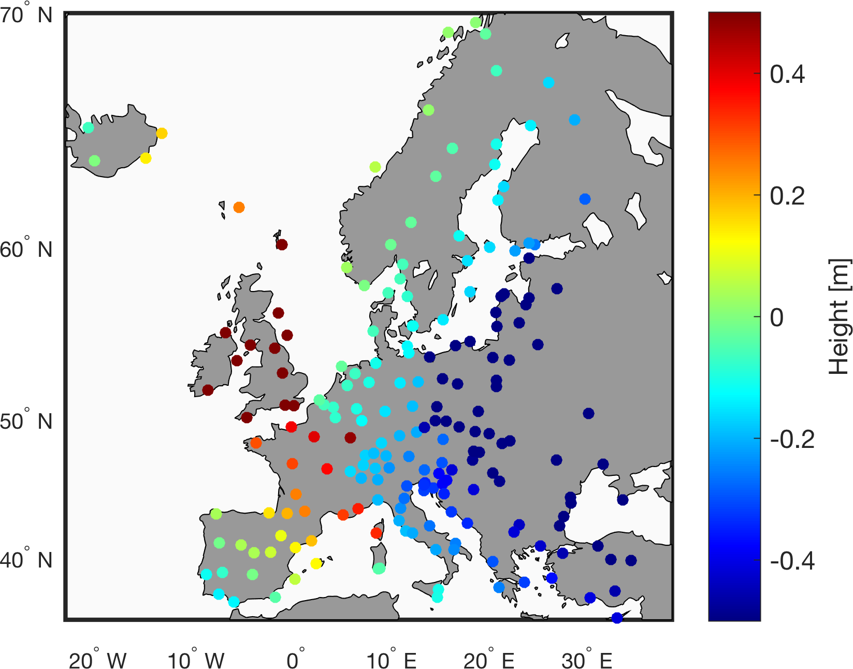
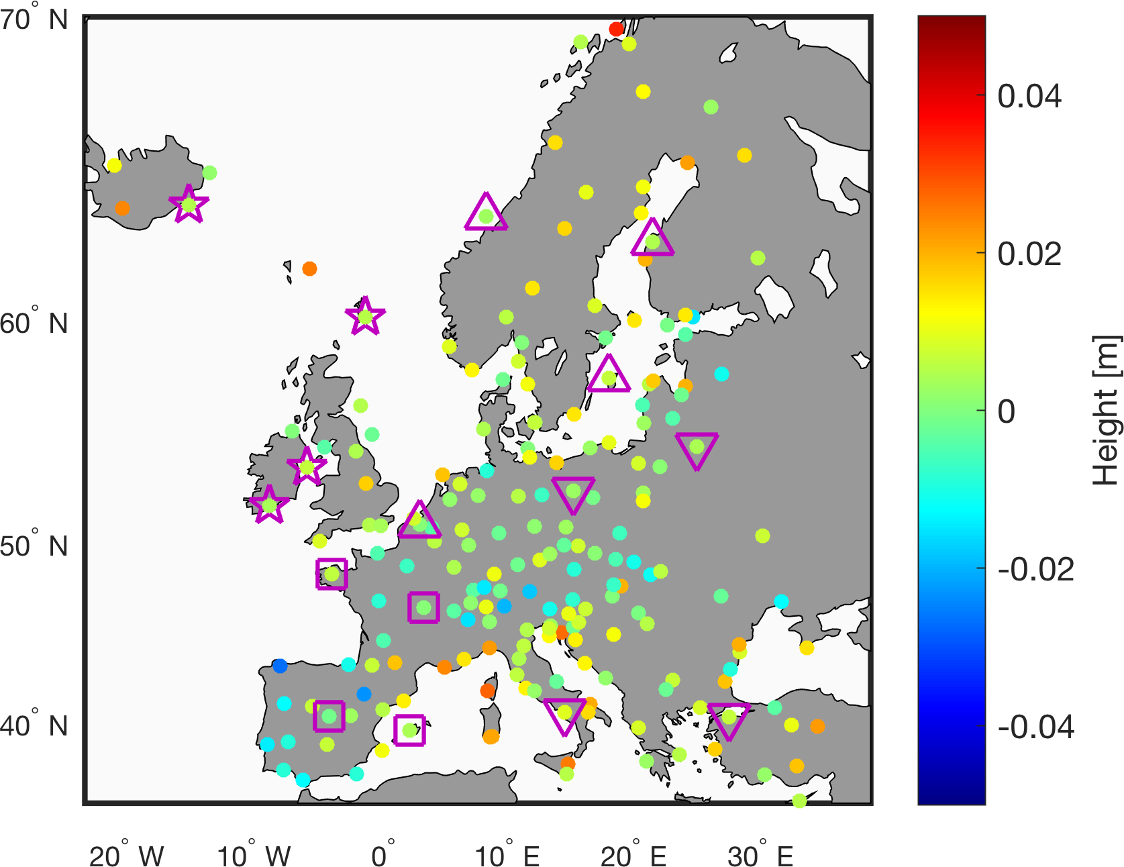
Height system unification
Clocks are powerful in obtaining height differences between distant points. This makes them appropriate for height system unification, by identifying:
discrepancies (offsets) between different height datums;
systematic distortions of national/regional levelling networks.
Notes:
In addition, clocks can be used to control at tide gauges and connect islands or remote areas where levelling is not possible.

Slide 8
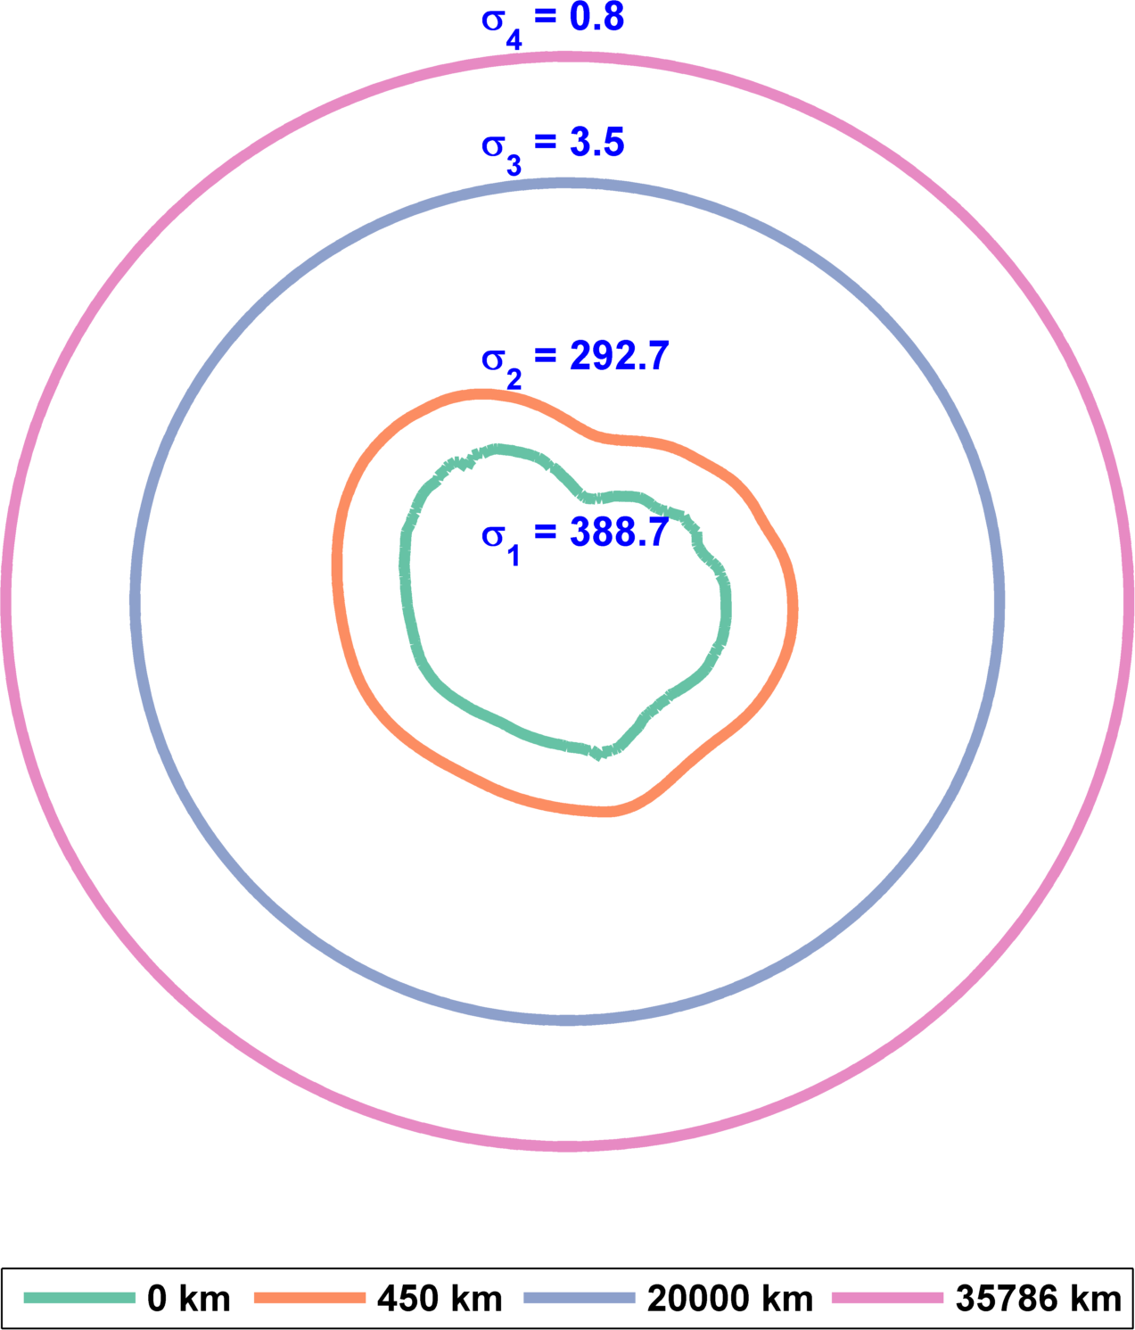
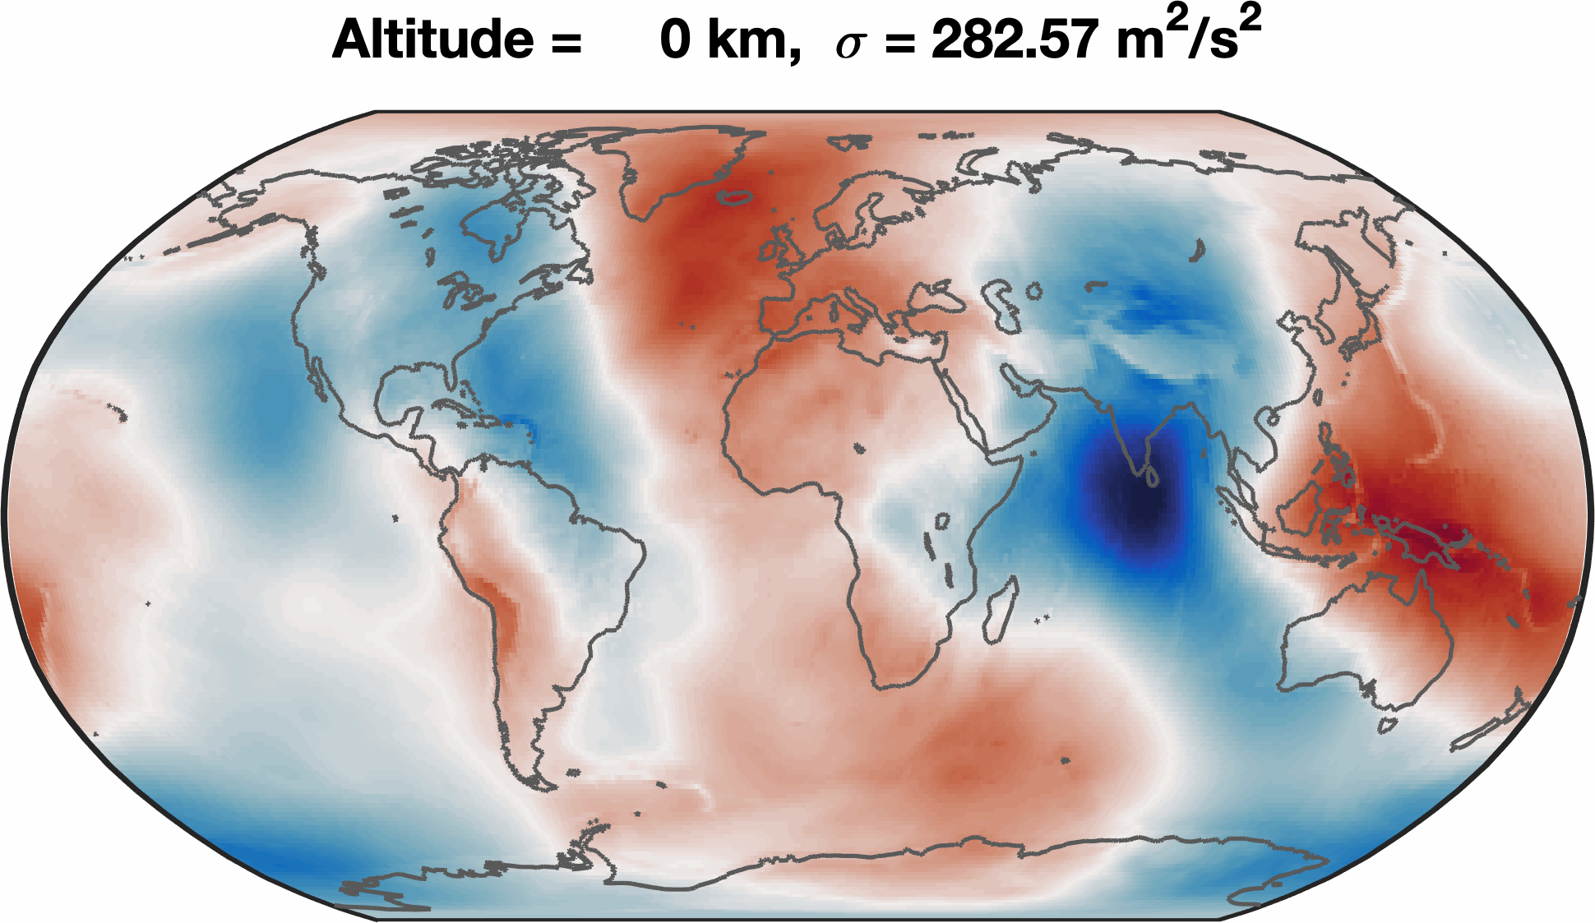
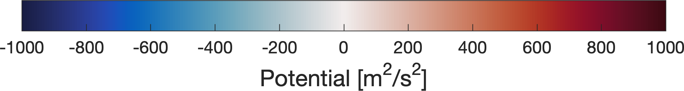
Space geodetic reference frame
Gravity field above the equator at different altitudes
Gravity potential at different altitudes
Potential: [m²/s²]
Notes:
The effect of temporal gravity field can be ignored;
The natural disaster can destroy the gound-based reference frame. But their influence on the space-based reference frame will be tiny. Therefore, the space-based reference frame is easily maintainable.
Satellites in a higher altitude can cover a large area. Several satellite in such orbits are able to cover the whole earth.
The gravity field is much regularer in higher altitudes, e.g., the navigation satellite or geostationary orbit.

Slide 9
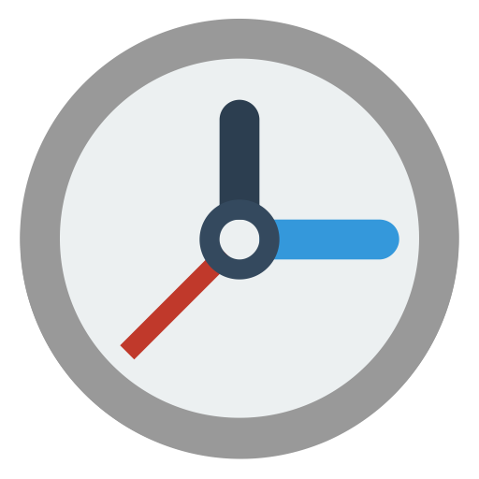
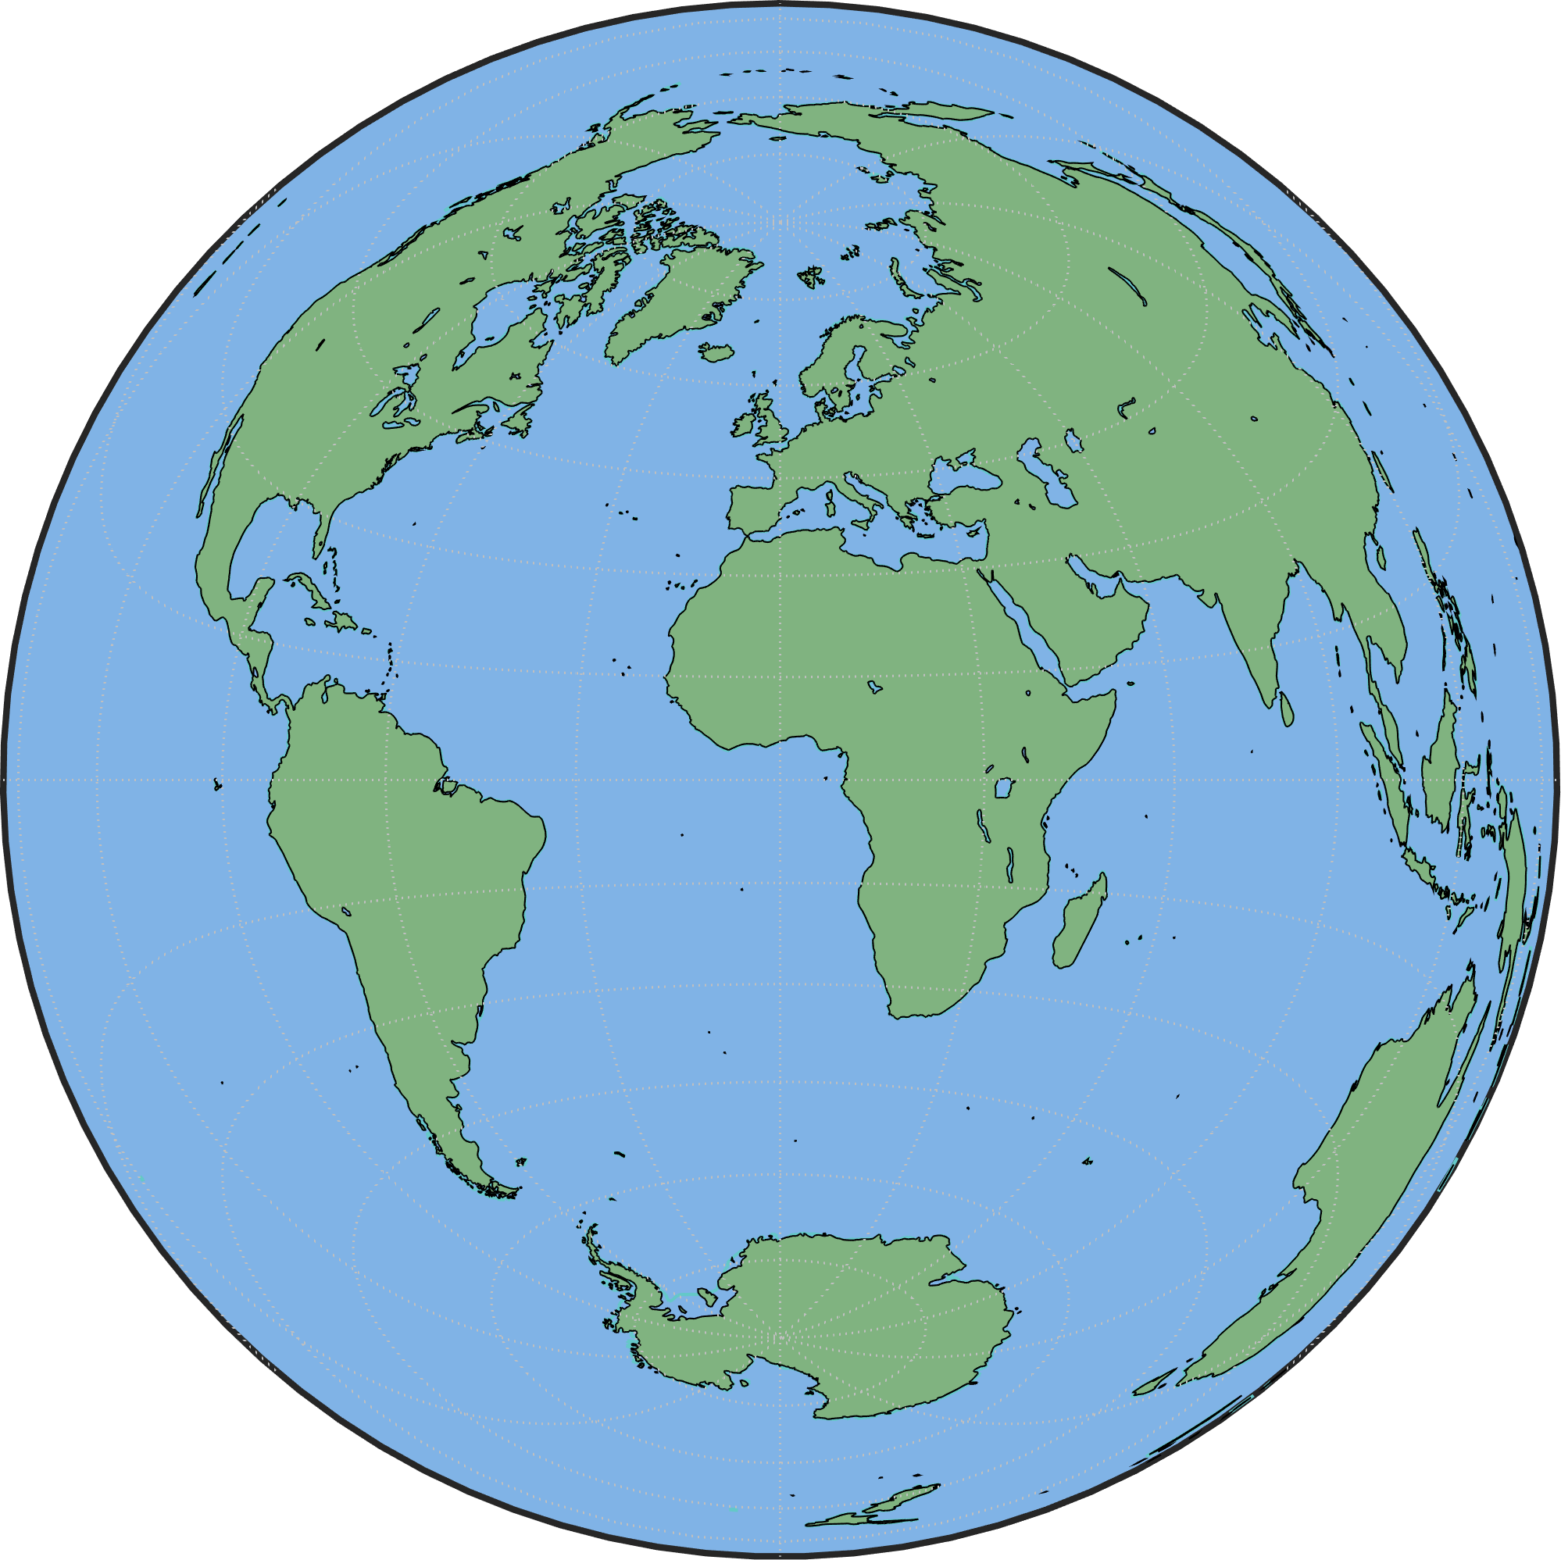
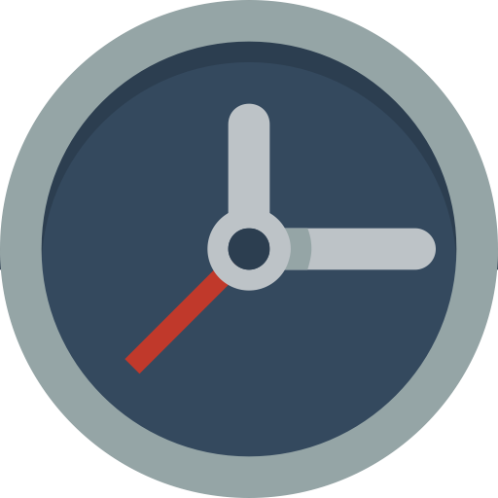
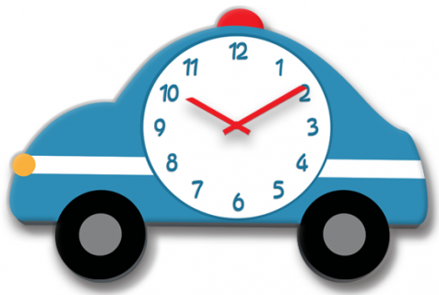
Space geodetic reference frame
Clocks in higher orbits support realizing a global gravity or height reference system, which is:
stable/robust over time;
easy to maintain.
Notes:
The effect of temporal gravity field can be ignored;
The natural disaster can destroy the gound-based reference frame. But their influence on the space-based reference frame will be tiny. Therefore, the space-based reference frame is easily maintainable.
Satellites in a higher altitude can cover a large area. Several satellite in such orbits are able to cover the whole earth.

Slide 10
Summary
For gravity field determination, clocks:
  deliver the gravity potential (difference), which is a scalar quantity and robust to attitude errors;
  are assumed for space gravimetric obsevations in two scenarios, and show the highest sensitivity to low-degree gravity field signals.
As further geodetic applications, clocks can:
unify local height systems;
monitor mass changes like in Greenland;
realize a global gravity/height reference system.

