Slide 1



EGU2020-10489
Large wood hydraulics - a fluvial process of growing interest
Dr. Ingo Schnauder
Forschungsbereich Wasserbau
TU Wien
Notes for the EGU onlince conference, April 2020

Slide 2
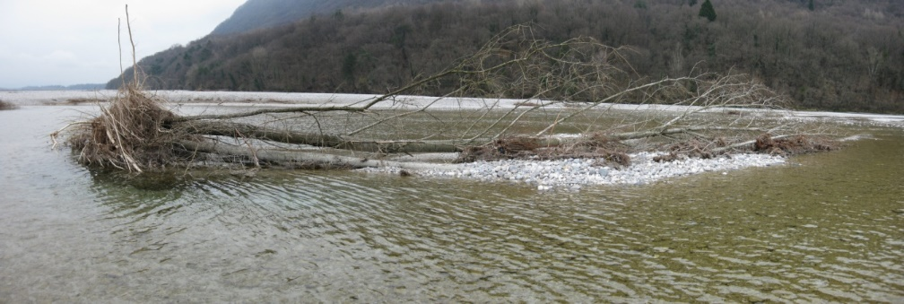
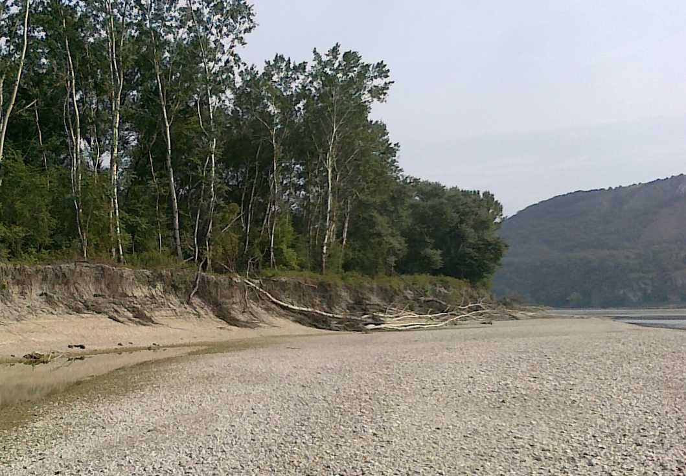
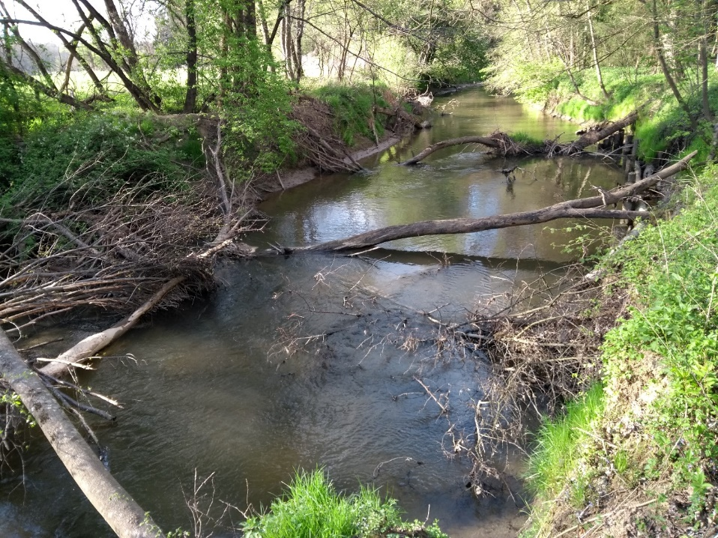
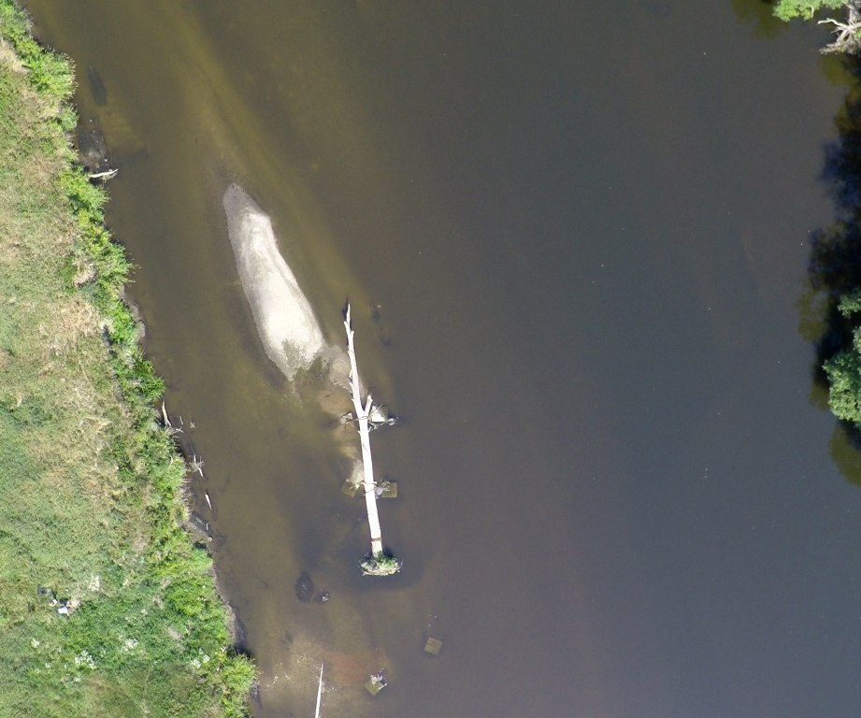
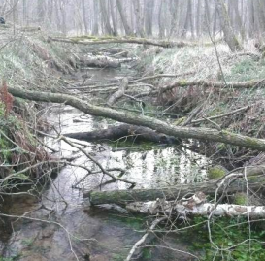
Large wood?
Foto: BAW
Rhein, GER
Tagliamento, ITA
Lafnitz, AT
Configuration (isolated/groups)
Foto: BMBF Wilde Mulde
Foto: M. Seidel
Mulde, GER
Scale river/
wood
Installation/
input
Kimura, 2017
Dierberger Graben, GER

Slide 3
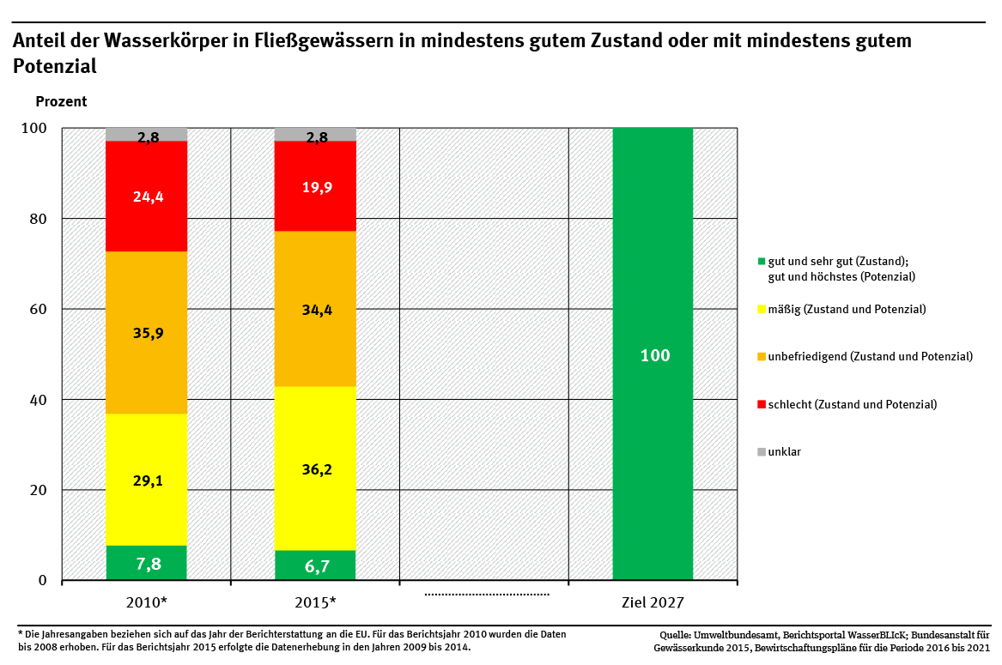
Why growing interest? – the benefits
EU-WFD (Water Framework Directive)
90% of rivers in Germany still not in good condition
Main reason: morphological degradation / lack of large wood in rivers
insufficient
the plan
UBA, 2016

Slide 4
Why growing interest? – the costs
EU-FD (WaFlood Directive) - safety issues
Mobilisation and transport dynamics of large wood
Log jamming at bridges, bridge scour
Kimura, 2017
Schalko, Weitbrecht et al., 2017

Slide 5
What can we contribute to more wood in rivers?
We (hydraulic engineers) have to provide methods to calculate the effects of large wood on:
Flow resistance and water levels
Instream retention, transient storage
Scouring and morphological changes
Incipient motion of wood
Transport, accumulation and deposition of wood
Natural sources and input mechanisms (e.g. landslides, debris flows)
Installation techniques / restoration measures
Ecologists / limnologist have to quantify the effects on biota and fluxes of matter:
Habitat provision (benthic invertebrates, fish, …)
Foodweb and fluxes of nutrients and matter (from biofilm to top predators)
Ultimate Goal:
Optimisation of ecological benefits and restoration – knowing what we do!
Quite some research is still needed: from fundamental to engineering, from hydraulics, morphology and biology

Slide 6
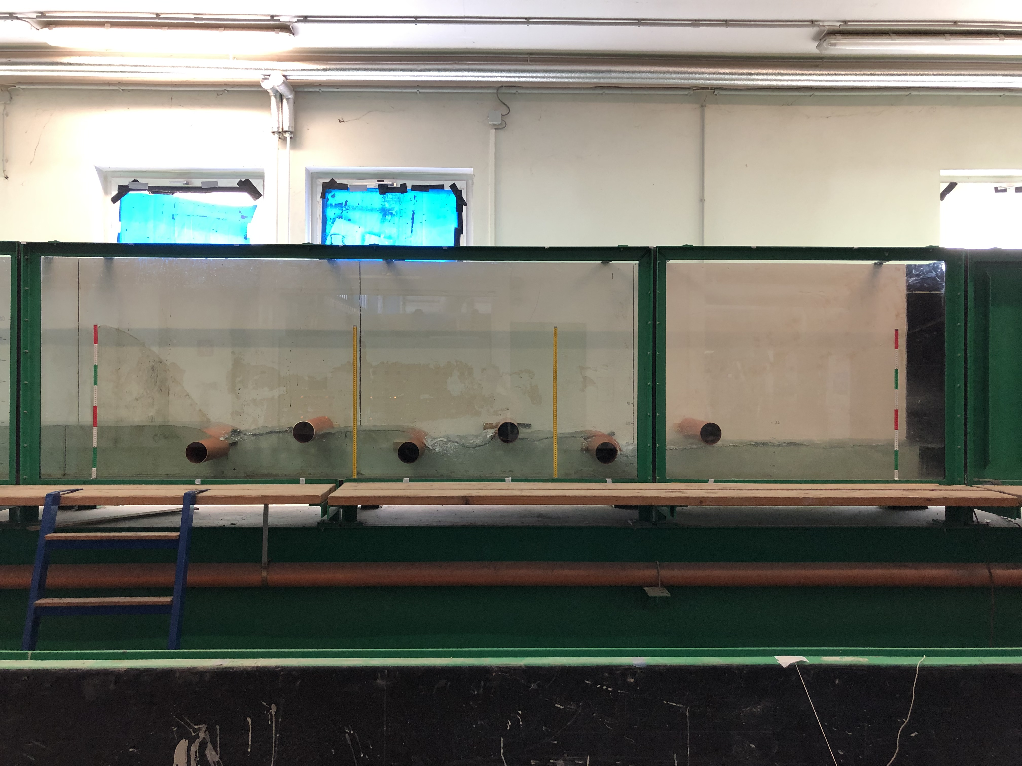
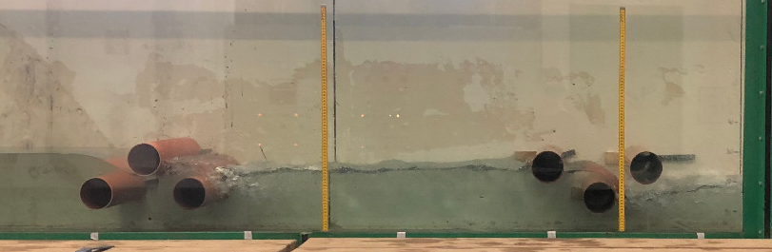
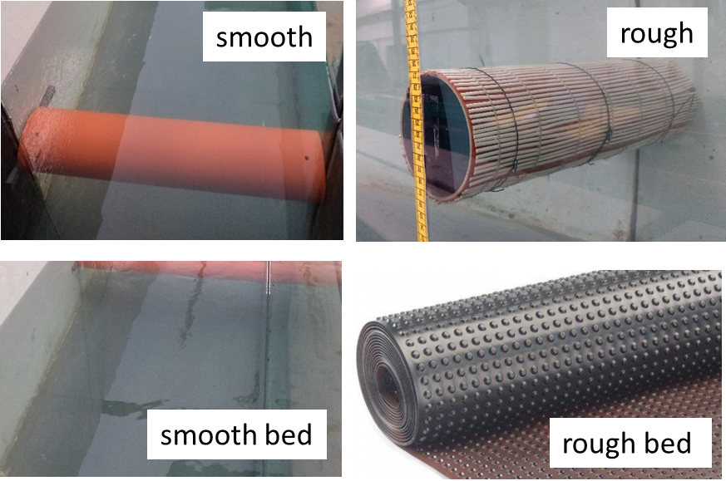
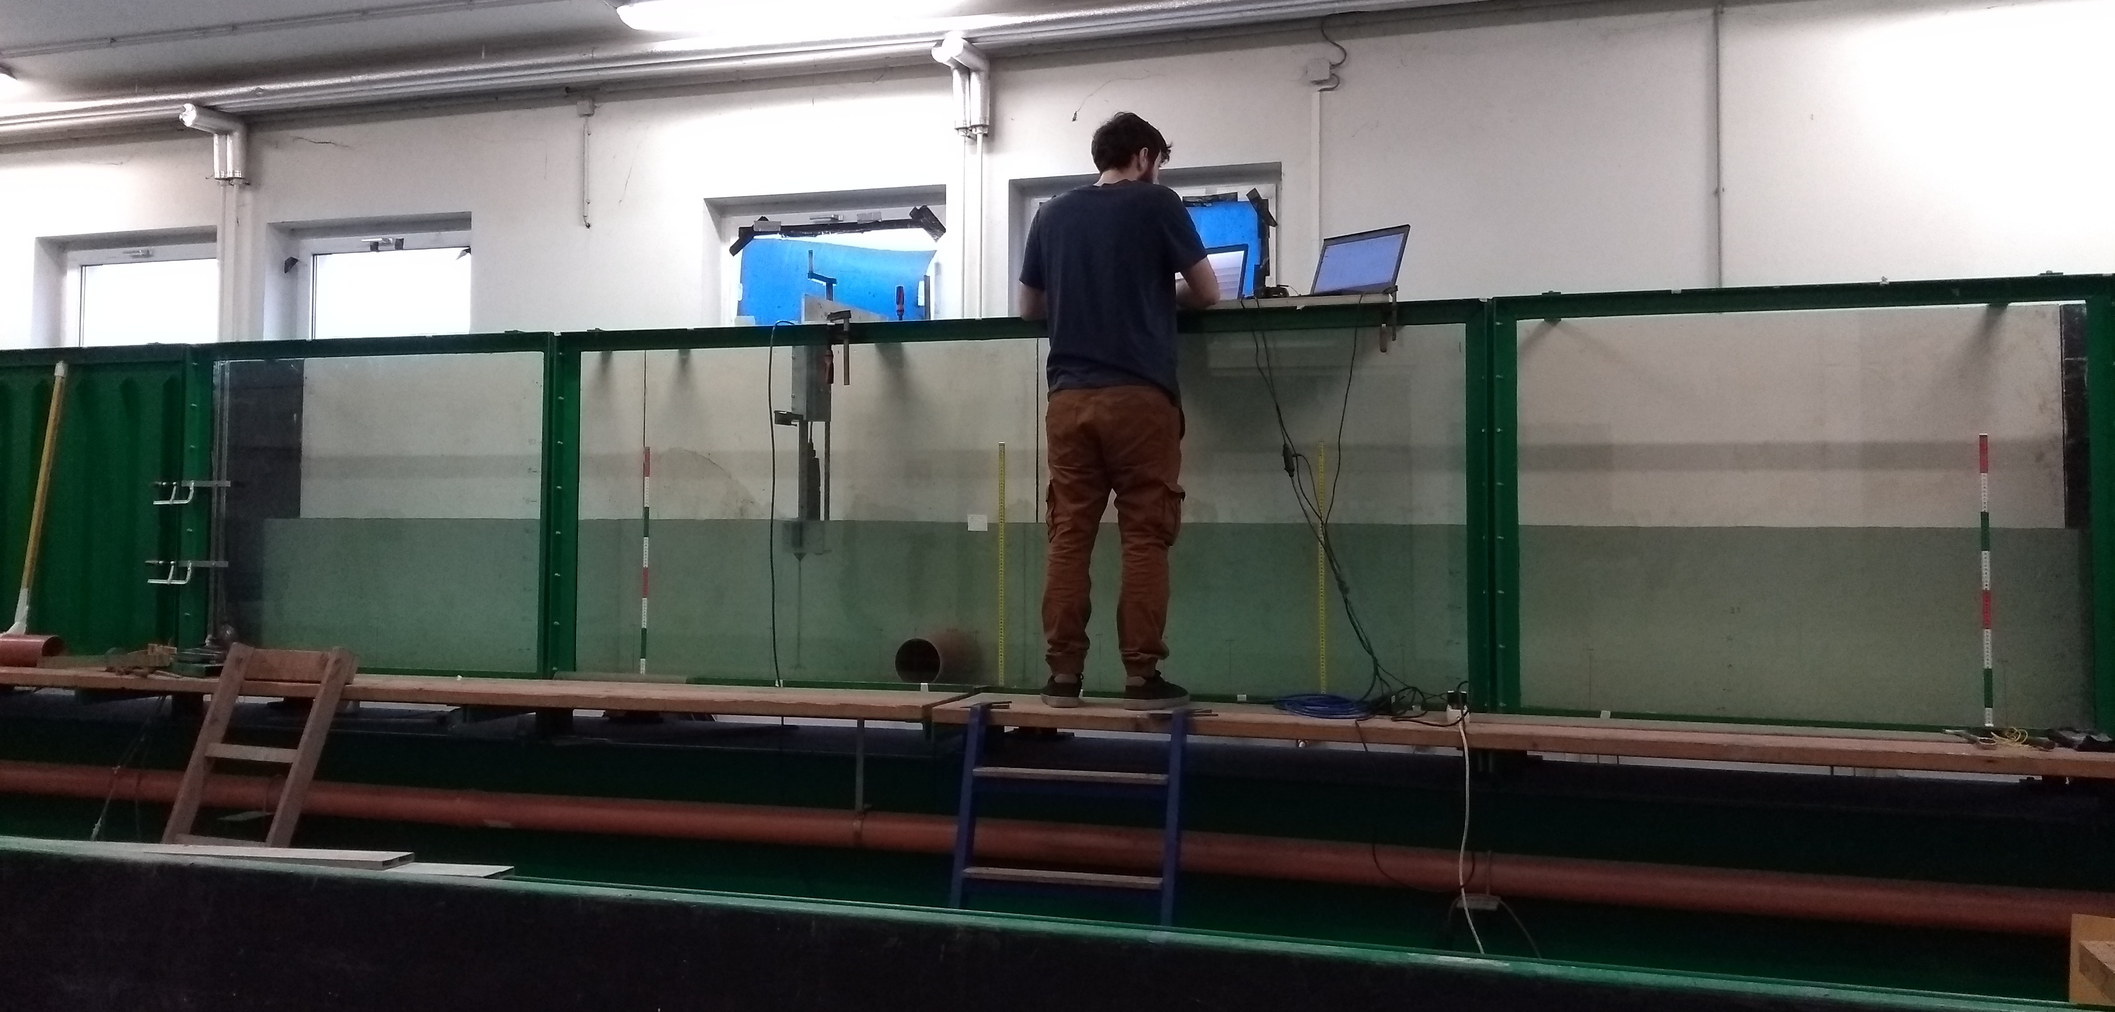
Our contribution at TU Vienna
Lab experiments in hydraulic flumes
Idealised large wood
Prototype: cylinders
Variation of surface roughness cylinders / bed
Solitary cylinders and groups, variation ofconfigurations, cylinder inclination etc.

Slide 7
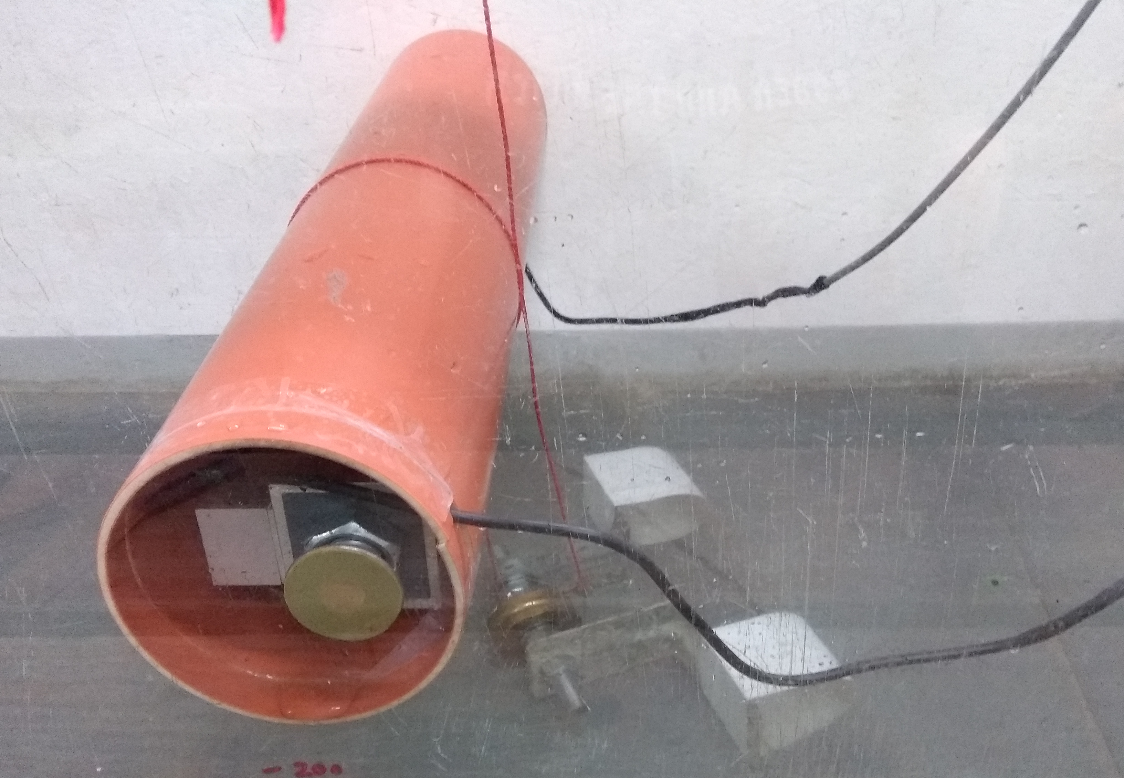
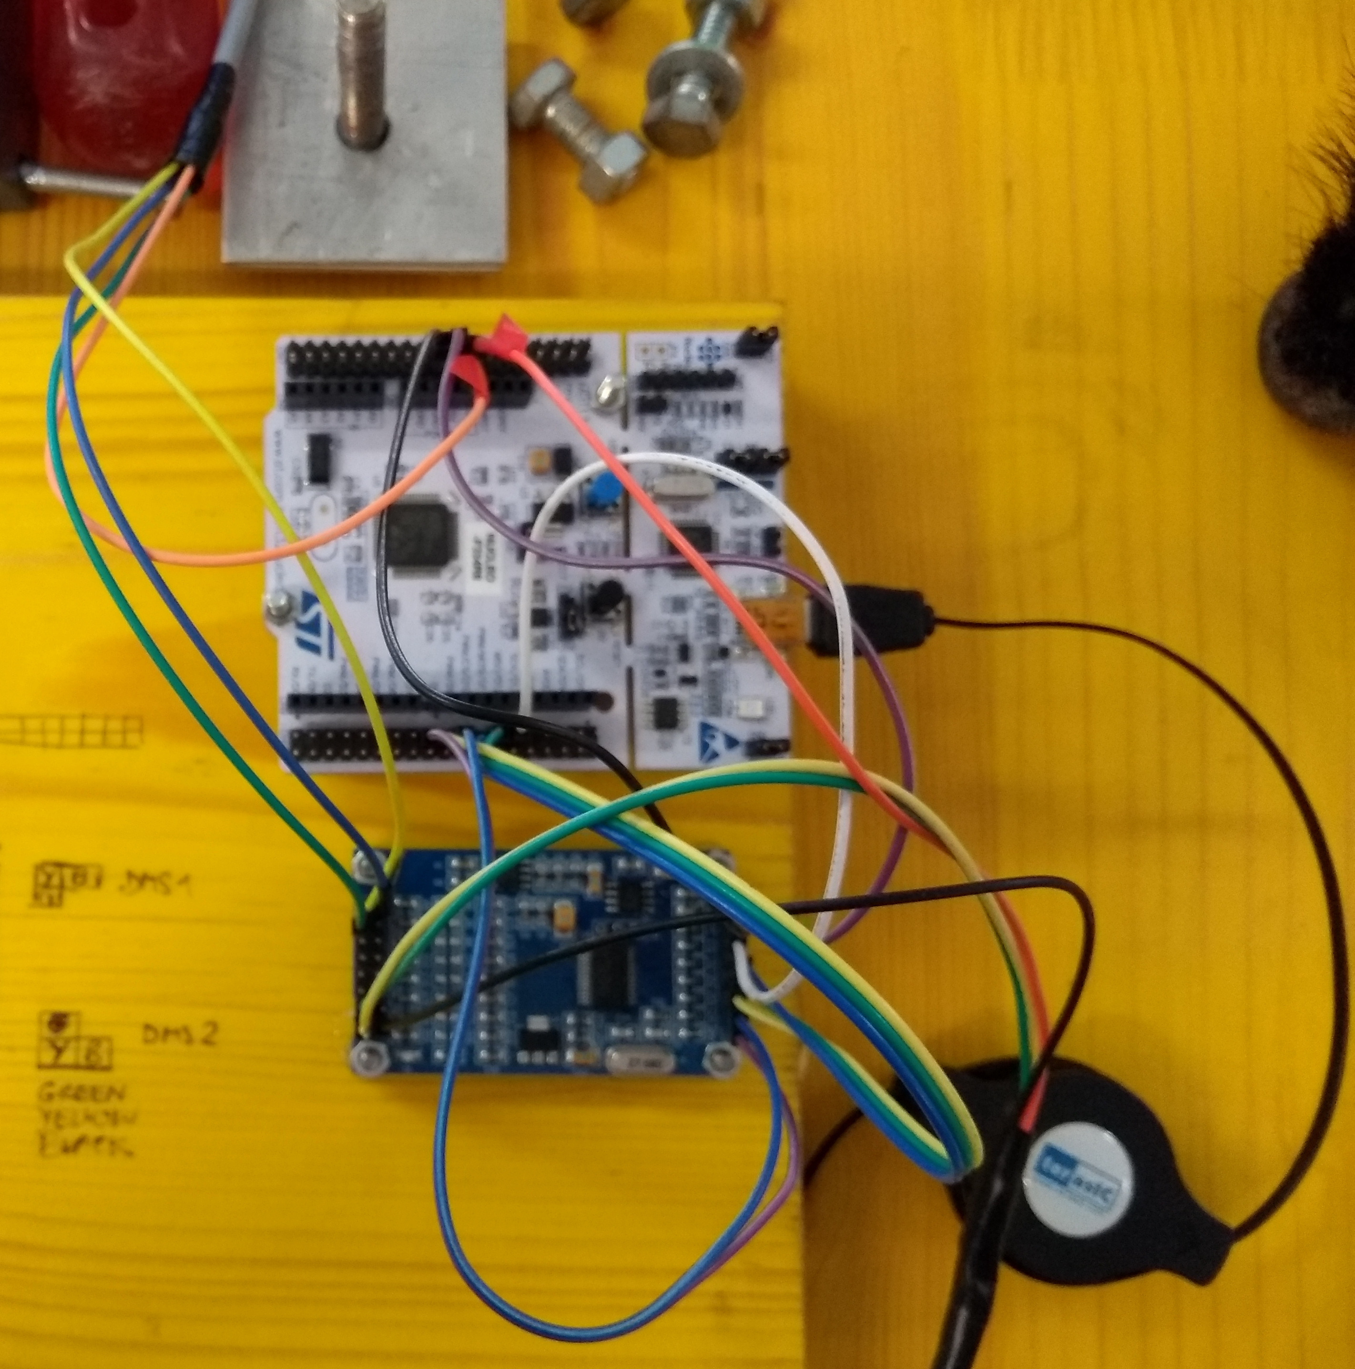
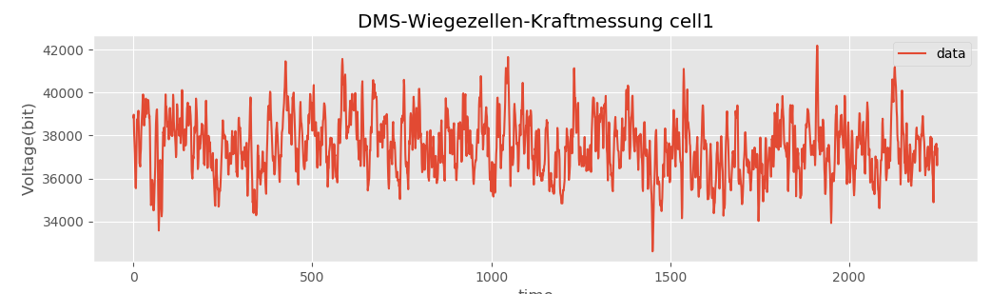
Our contribution at TU Vienna
Flow resistance and hydromechanics
Drag (force) measurements
Resistance estimates from drag
Time series analyses of drag data (e.g. peak values, vortex shedding…)
„smart“ cylinder equipped with load cells
Time series of recorded drag
(sampling frequency 15 Hz)

Slide 8
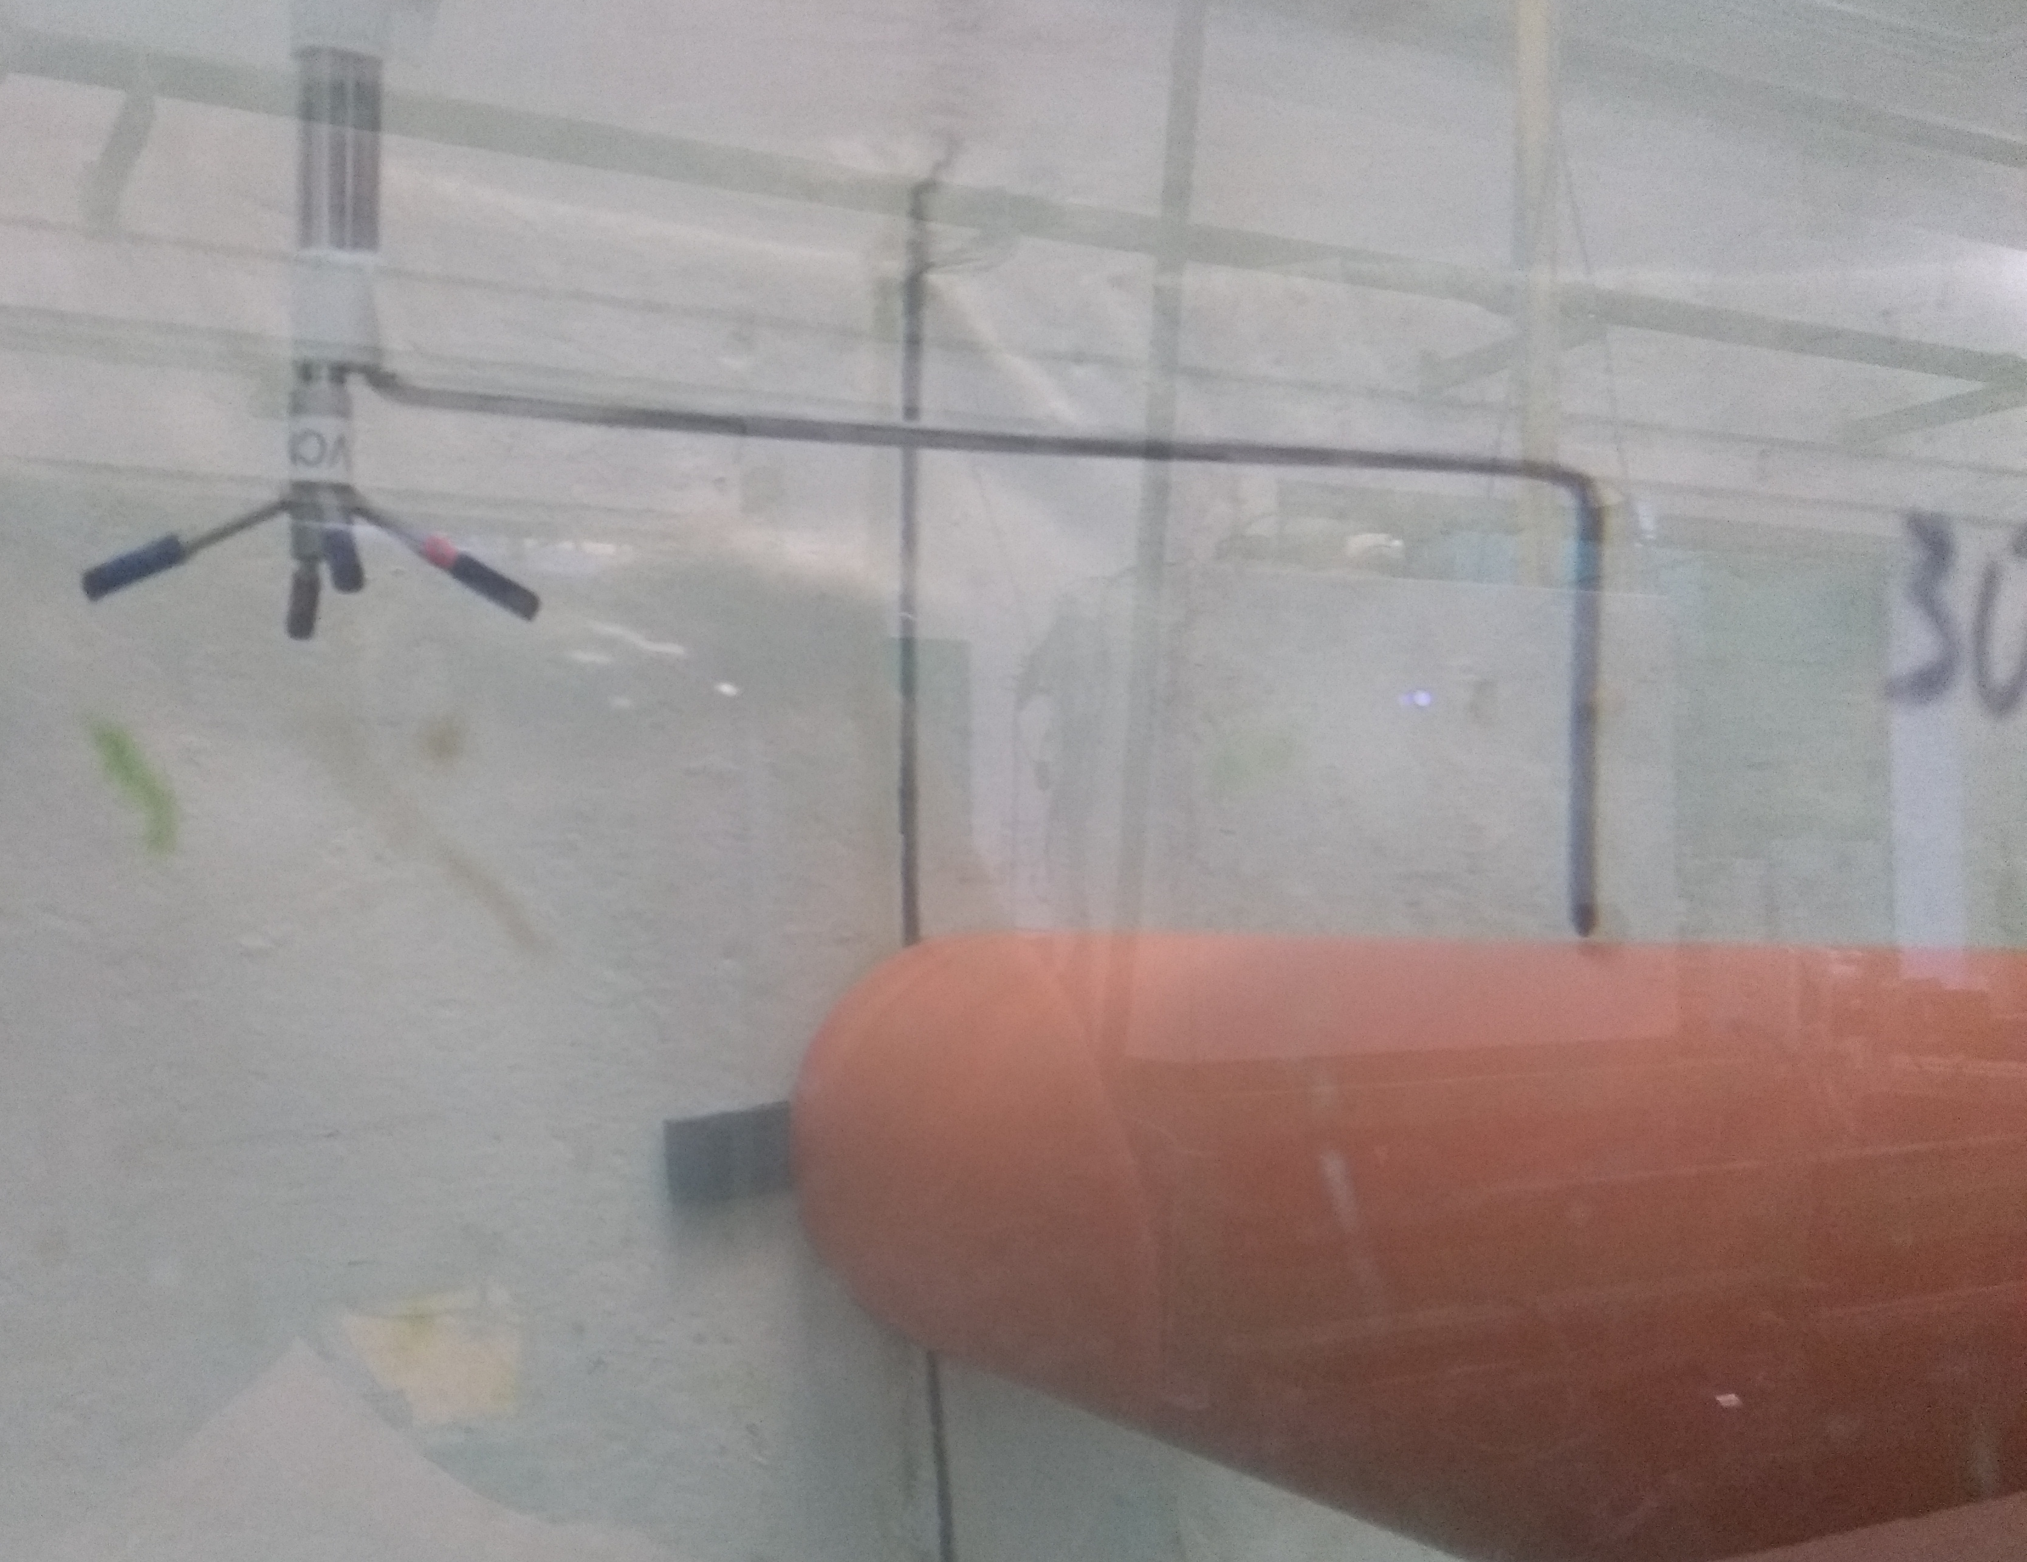
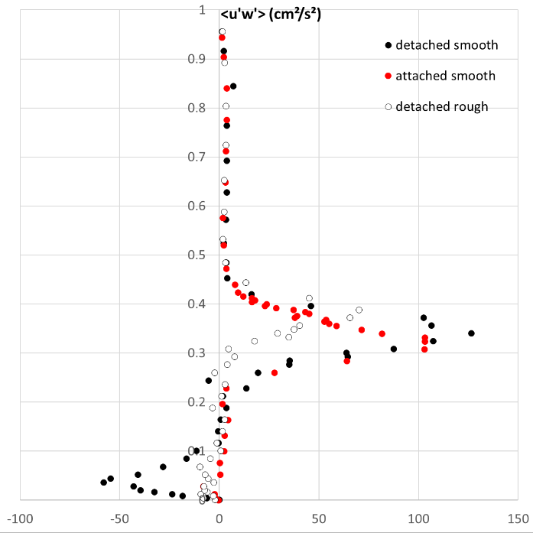
Our contribution at TU Vienna
Flow resistance and hydromechanics
ADV measurements of flow
Turbulence structure
Vortex shedding and wake interference
Vectrino+ measuring the approach flow
U‘w‘ stresses in the wake of a solitary cylinder attached to the bed
Autospectra of approach flow for 5 cylinders in an in-line configuration

Slide 9

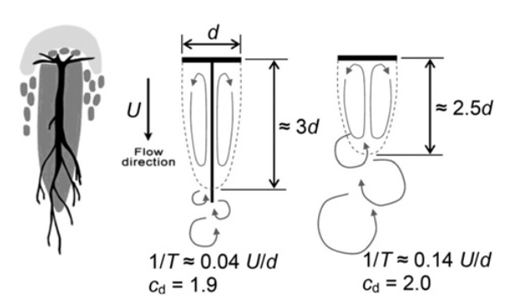
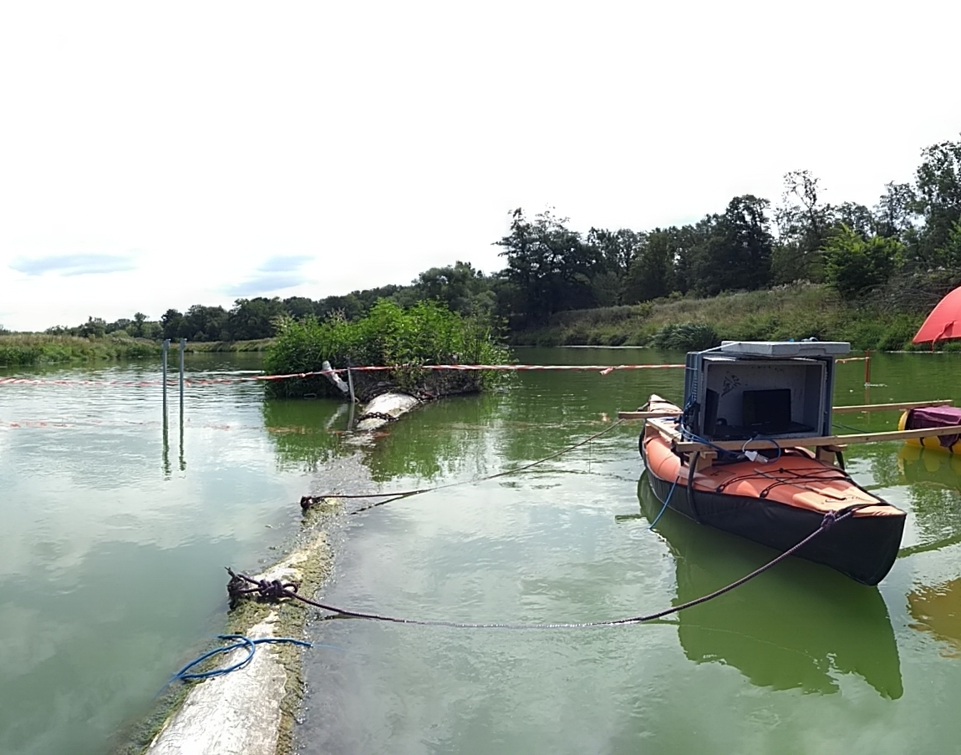
Our contribution at TU Vienna
Field work (Wilde Mulde project)
ADV measurements of flow
Turbulence structure
Wake structure
Schnauder & Moggridge (2009)
Depth-averaged velocities around installed large trees in Mulde River (ADV Vectrino+)

Slide 10
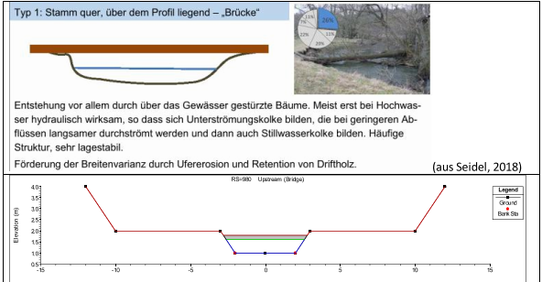
Our contribution at TU Vienna
Numerical Modelling
Applied: Implementation of data on drag coefficients in the 1D HECRAS models for water surface computations with large wood
Fundamental: research using 3D numerical modelling
HECRAS implementation

Slide 11

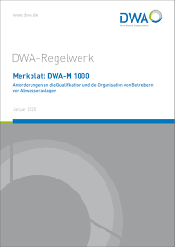
Our contribution at TU Vienna / DWA
Work for the DWA Germany
Knowledge transfer into praxis
Developing a guideline for large wood hydraulics
Including longitudinal dispersion
Start of the group in 2019
Core group members (alphabetic order):
J.P. Balmes, Uni Duesburg-Essen, GER
S. Heimann, Beuth FH Berlin, GER
H. Honsowitz, TU Wien, AT
D. Kurberg, Emscherverband Essen, GER
H.P. Rauch, BOKU Wien, AT
I. Schnauder, ZU Wien, AT
M. Seidel, FH Magdeburg-Stendal, GER
Handbook of large wood hydraulics:
Estimating and calculating resistance and dispersion

Slide 12
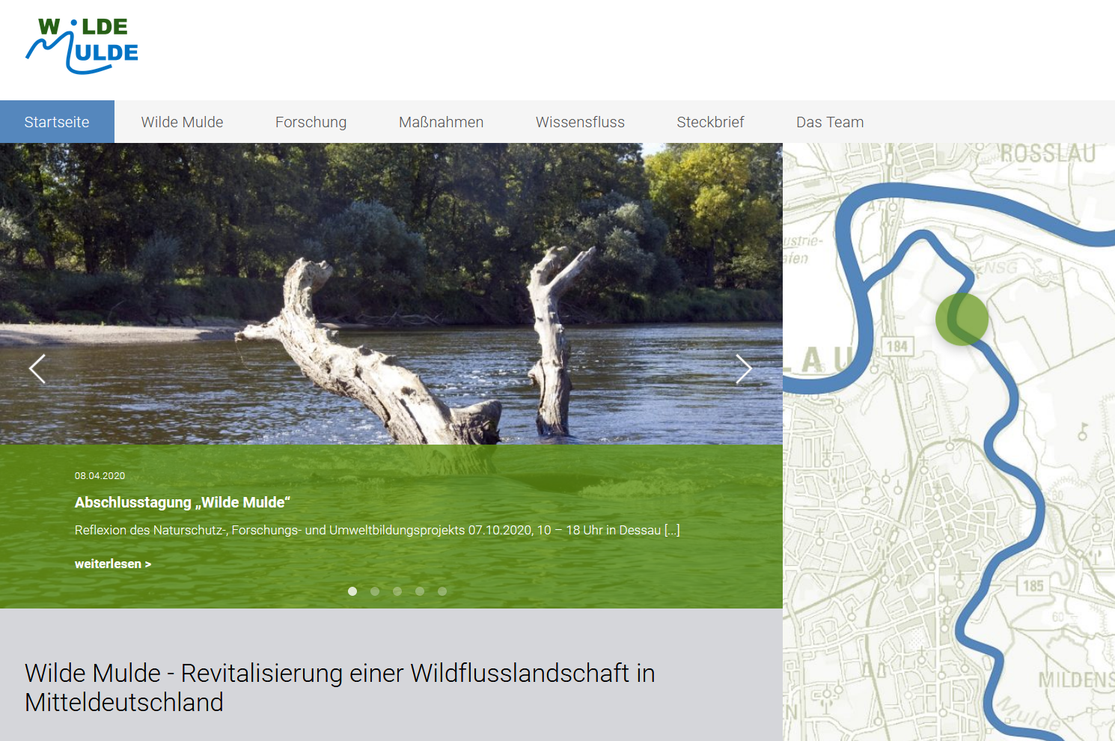
Until next EGU – live again!
Contact:
Dr. Ingo Schnauder,
ingo.schnauder@tuwien.ac.at
https://www.kw.tuwien.ac.at/home/
also visit the Wilde Mulde project website =
Putting large wood into a dynamic German river…
https://wilde-mulde.de/

