Slide 1
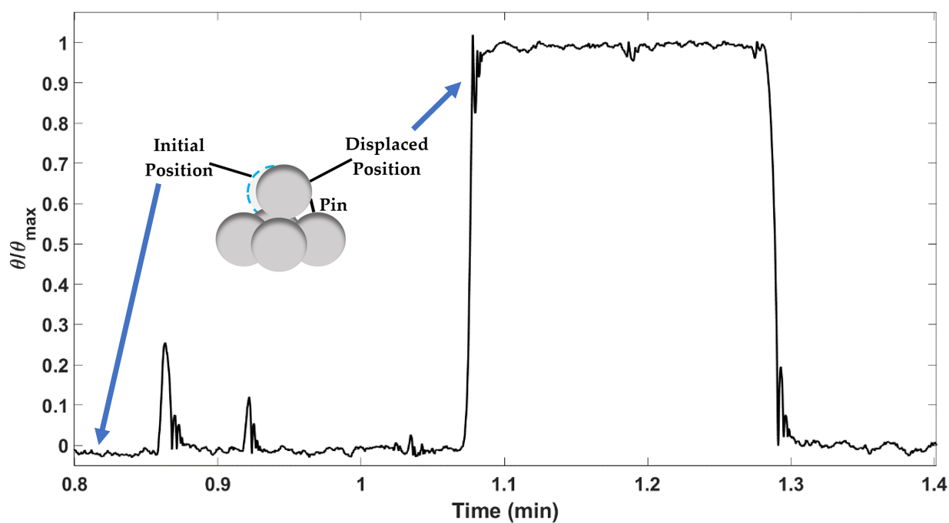
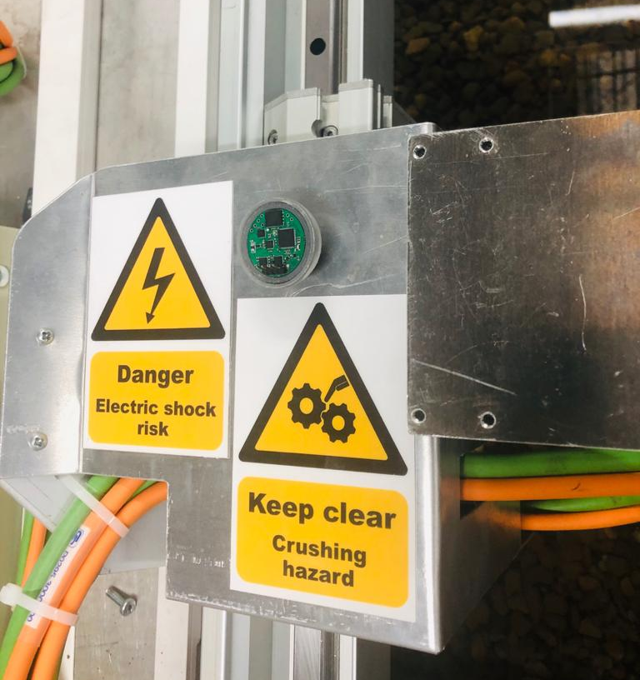
Khaldoon AlObaidiª and Dr. Manousos Valyrakis^{b}
ª PhD candidate, School of Engineering, University of Glasgow
^{b} Lecturer in Water Engineering, Manager of the Water Engineering Lab, University of Glasgow
Development, calibration and testing of a miniaturized instrumented particle for the study of sediment entrainment
Introduction
Infrastructure damage due to riverbed and bank destabilisation or localised scour may result in considerable financial costs and even loss of life. As the risk to infrastructure keeps increasing due to climate change, the need to directly monitor it becomes crucial. In this work, a miniaturized instrumented particle that can provide a direct, non-intrusive and accessible method for the assessment of coarse sediment particles entrainment is developed, calibrated and tested. The particle has a diameter of only 3cm and is fitted with inertial microelectromechanical sensors (MEMS) that enable recording its three-dimensional displacement [1,2].
The instrumented particle rests on micro-bed topography made of 4 hemispheres of the same diameter as the instrumented particle’s diameter. A pin is set at about 1.5mm downstream of the instrumented particle to record continuous entrainments without a need to disturb the experiment (see Figure 2). A video camera is used to record the experiment.
Testing Results
Sensor’s readings data is fused using an appropriate filter and the roll results (the particle is positioned so that the flow direction is sensor’s x-axis) is shown in Figure 3.
Discussion
The roll results are compared to the video camera recordings and the frequency of entrainment estimated using the sensor’s data and the frequency of entrainment recorded by the camera match.
The fusion of the sensor’s logged readings can be used to detect different types of motion as shown in Figure 3 without the need for visual observations making the sensor a tool with a potential to be used in field studies of sediment entrainment.
Conclusions
A minstrumented particle is calibrated using simple physical motions and uncertainties in the calibration experiments and sensor’s readings are quantified. The results of the calibration is used to determine the input for the inertial sensor fusion. The fused logged readings can be used to detect different types of motion.
The instrumented particle presented has a potential of use in a wide range of future applications around the fields of geosciences and environmental and infrastructures monitoring where sediment entrainment [2] and transport [4] is considered to be the governing process.
Objectives
Develop, calibrate and test a miniaturized instrumented particle that simulates a pebble of known properties. Therefore, it can provide direct, low-cost and non-intrusive mean to study the entrainment threshold and the three-dimensional movement of a particle for given bed geometry and roughness.
Figure 2. Schematic of the experimental set-up showing the relative location of the test section at the flume with the 3D micro-bed topography (side-view)
Development
The Invensense MPU9250 is selected [3].
It supports 3-axis acceleration, 3-axis rotational velocity, and a 3-axis magnetometer, as well as a well renowned internal Digital Motion Processor with data rate of the sensors ranges from 200Hz, up to 1000Hz.
The sensors supports up to 16g of measurable acceleration and up to 2000º/s of measurable rotational velocity.
The sensor is 2.5cm in diameter and is fitted inside a spherical enclosure of 3cm in diameter as shown in Figure 1.
Calibration
The calibration process of the sensor consisted of simple physical motions where the accelerometer and gyroscope each calibrated separately.
A simple harmonic motion of a pendulum for the accelerometer’s calibration.
Roll down an inclined plane of a known height for the gyroscope’s calibration.
Error in both experiments and sensors’ readings is below 5%.
The error in both sensors is deemed acceptable considering the experiments are performed by hand. The error values provide inertial sensor fusion filter’s input to achieve uncertainty reduction.
Figure 3. Types of motion detected from the results of the inertial sensor fusion (normalized roll results specifically).
Figure 1. Instrumented particle with the inertial sensor fitted inside it
Testing
The experiments took place at a tilting and water recirculating flume in the Water Engineering Laboratory at the University of Glasgow.
The flume is 8m length and 0.9m width with water capacity 0.2m3/s and carry flows up to 0.4m deep is used.
The bed is covered with three layers of uniformly sized fine sand with a d₅₀ of 0.6mm and a layer of uniform sized gravel (d₅₀ = 15mm) to achieve an adequate hydraulic roughness.
References
[1] M. Valyrakis, P. Diplas, C.L. Dancey, K. Greer, A.O. Celik, Role of instantaneous force magnitude and duration on particle entrainment, J. Geophys. Res. 115 (2010).
[2] M. Valyrakis, A. Alexakis, E. Pavlovskis, " Smart pebble" designs for sediment transport monitoring, 17 (2015).
[3] Cechowicz, R. Bias Drift Estimation for MEMS Gyroscope Used in Inertial Navigation. Acta Mechanica et Automatica. 2017, 11, 104-110.
[4] Xing, H.; Hou, b.; Lin, Z.; Guo, M. Modeling and Compensation of Random Drift of MEMS Gyroscopes Based on Least Squares Support Vector Machine Optimized by Chaotic Particle Swarm Optimization. Sensors 2017, 17, 2335.

