Slide 1
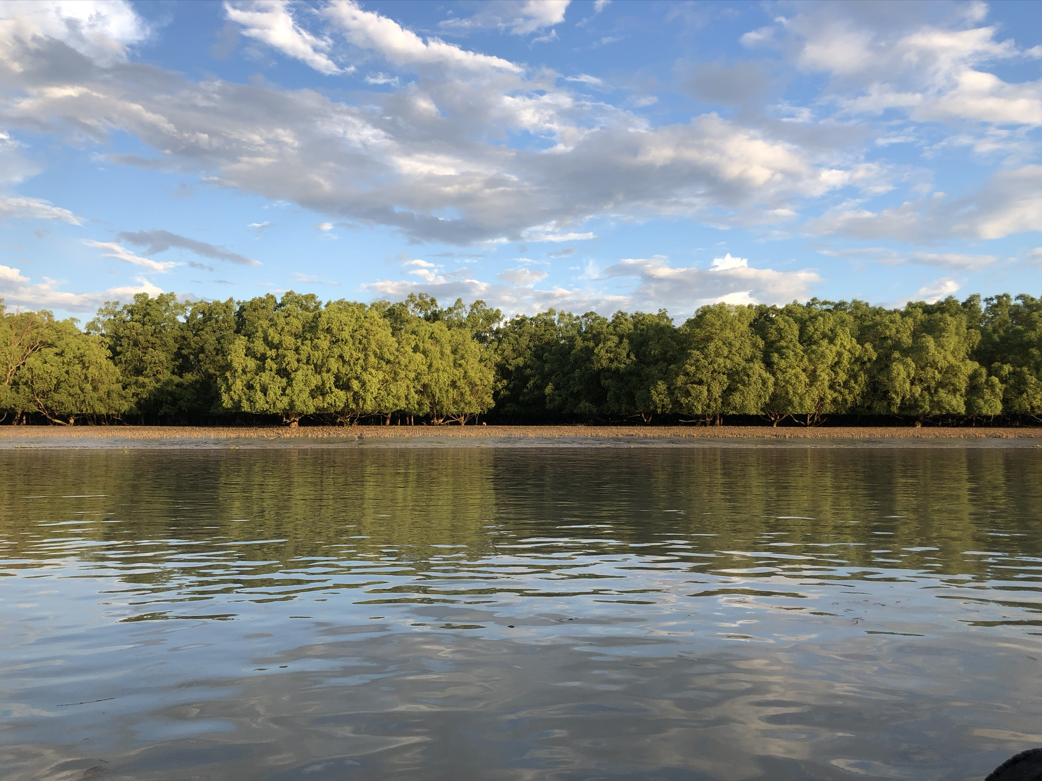
Dynamics of Sediment Delivery to Mangroves in Southern Coastal Bangladesh
R. Hale¹, A. Garnand¹, C. Wilson², E.J. Bomer²
¹Old Dominion University, Norfolk, VA
²Louisiana State University, Baton Rouge, LA

Slide 2
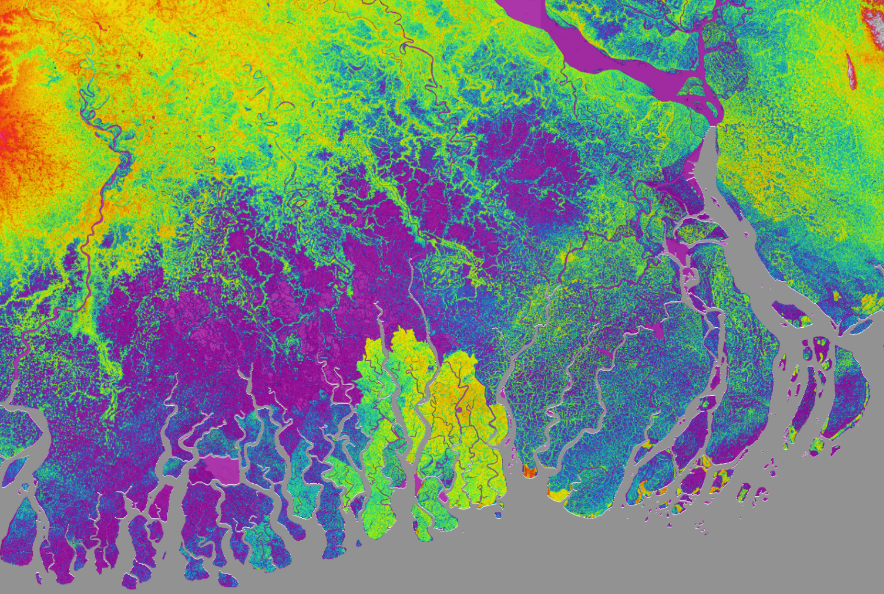
Digital elevation model (DEM) for Southern Bangladesh
< 4 m
~4-8 m
~8-12 m
> 12 m
Ganges-Brahmaputra-Meghna Rivers
Embanked agricultural region
Sundarbans National Reserve Forest
>700 million tons/y sediment

Slide 3
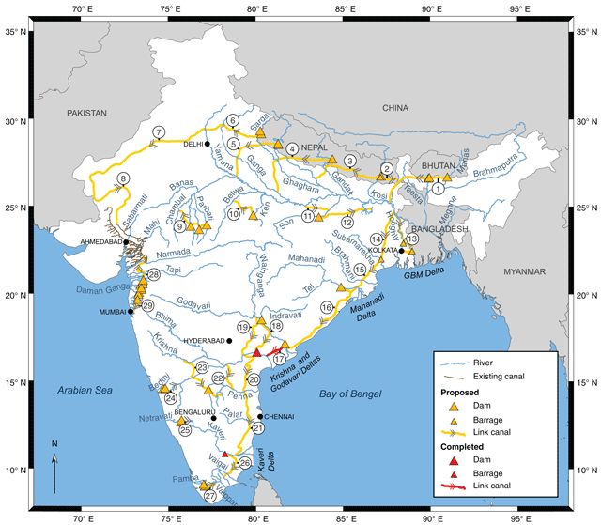
What happens if sediment and water supply are cut?
~3700 km of canal construction
Time period of fresh water delivery ~1 month shorter
Reduction of sediment load:
Ganges: 39-75%
Brahmaputra: 9-25%
Predicted delta-wide aggradation reduced from 3.6 to 2.5 mm/yr
How will this impact SNF viability?
Figure from Higgens et al., 2018

Slide 4
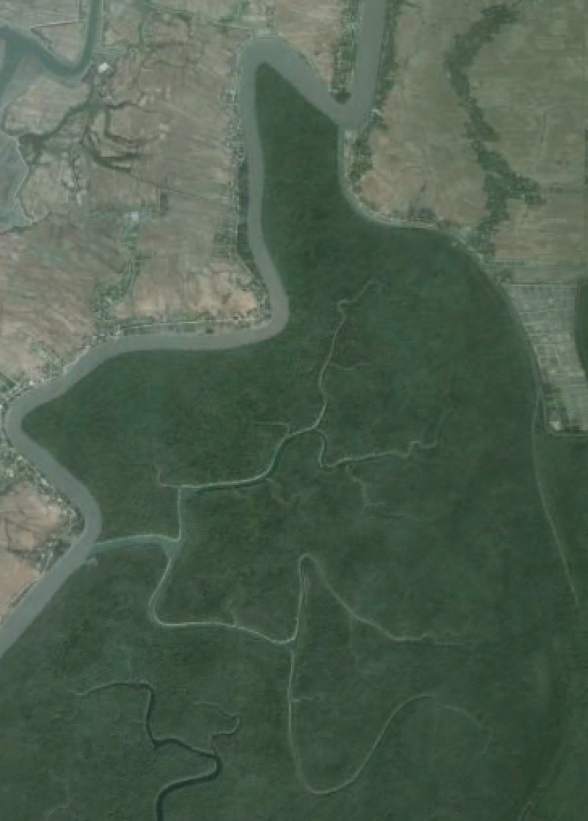
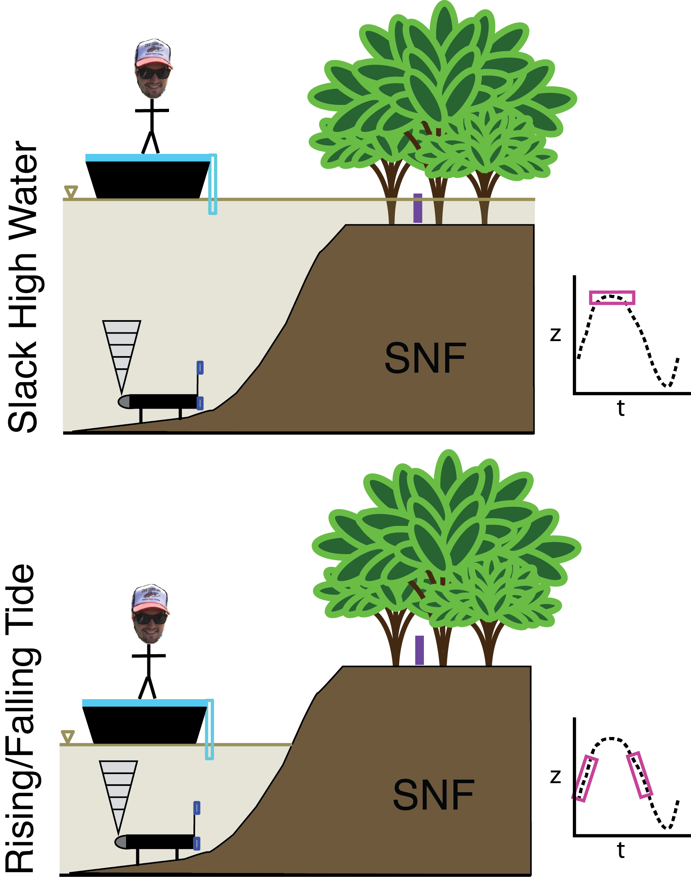
What is is most important for sediment delivery to the mangroves under present conditions?
Measurements collected:
Pressure, Temperature
Pressure, Temperature
SSC, Pressure (platform)
Pressure, Temperature, Velocity, SSC (channel bottom)
Salinity, Temperature, SSC (channel surface)
Site 1
Site 2
1 km
Notes:
go to board to draw out possibilities.

Slide 5
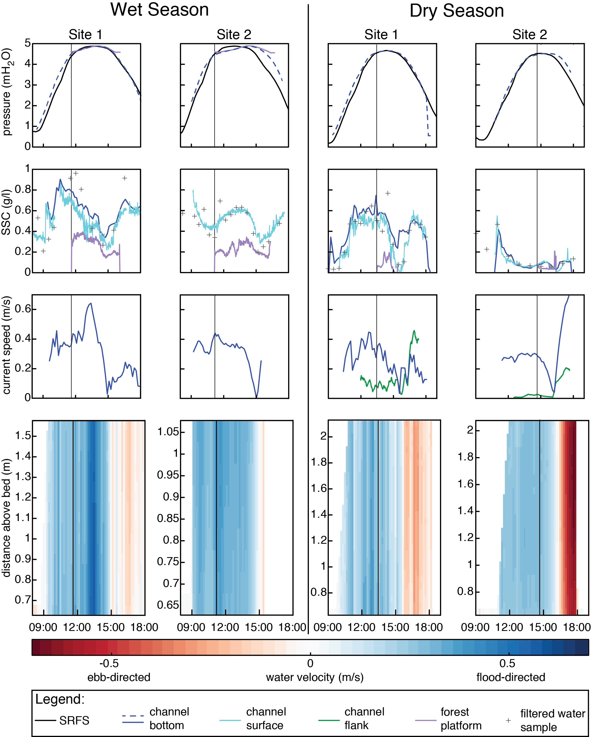
Inundation:
~40 cm, 4-5 h (wet)
~7 cm, 1-2 h (dry)
Fresh water in wet season; saline in dry season
Enhanced aggregation
Floccs redeposited in channel rather than platform
SSC reduction on platform causes deposition (1.8 cm/monsoon)

Slide 6
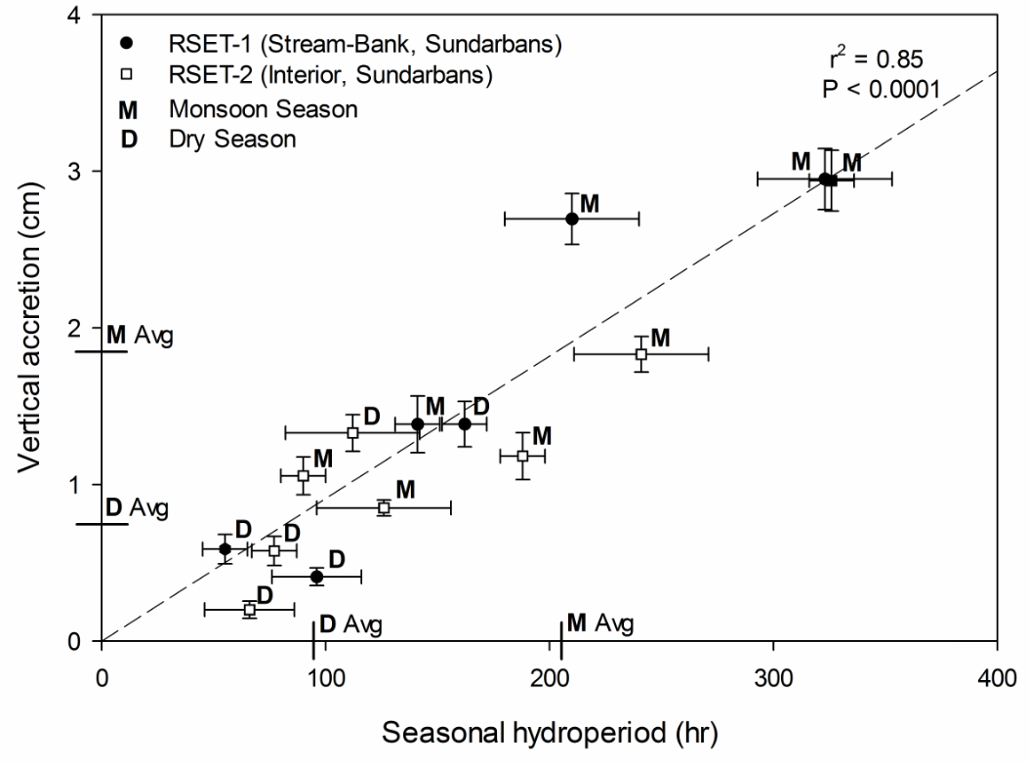
Good agreement between predicted and observed deposition
Predicted deposition
from observations
Predicted hydroperiod
from observations
Bomer et al., 2019

Slide 7
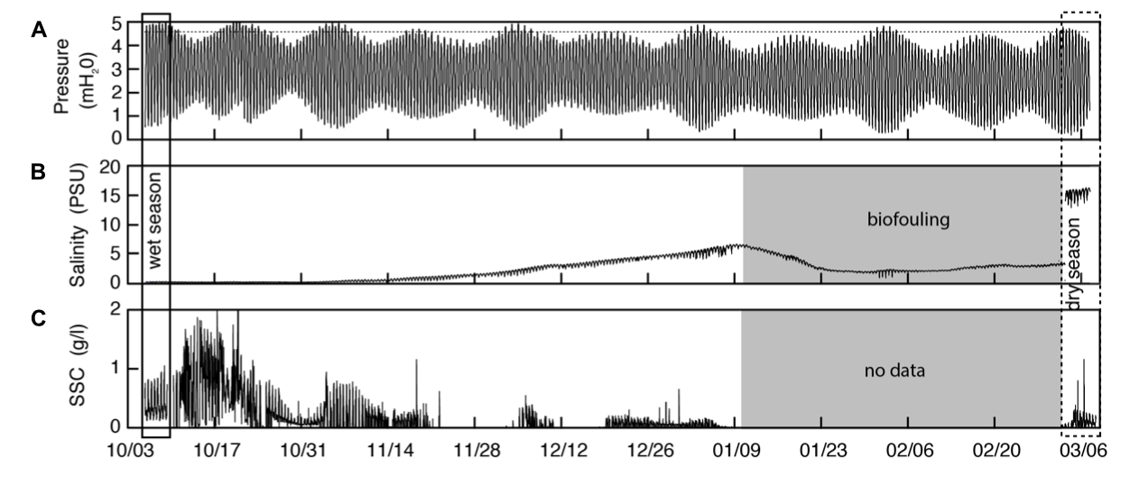
Northern SNF Summary
Hale et al., 2019b
Monsoon conditions much more conducive to sediment deposition
Inundation depth, duration, SSC, and salinity are all important factors

Slide 8
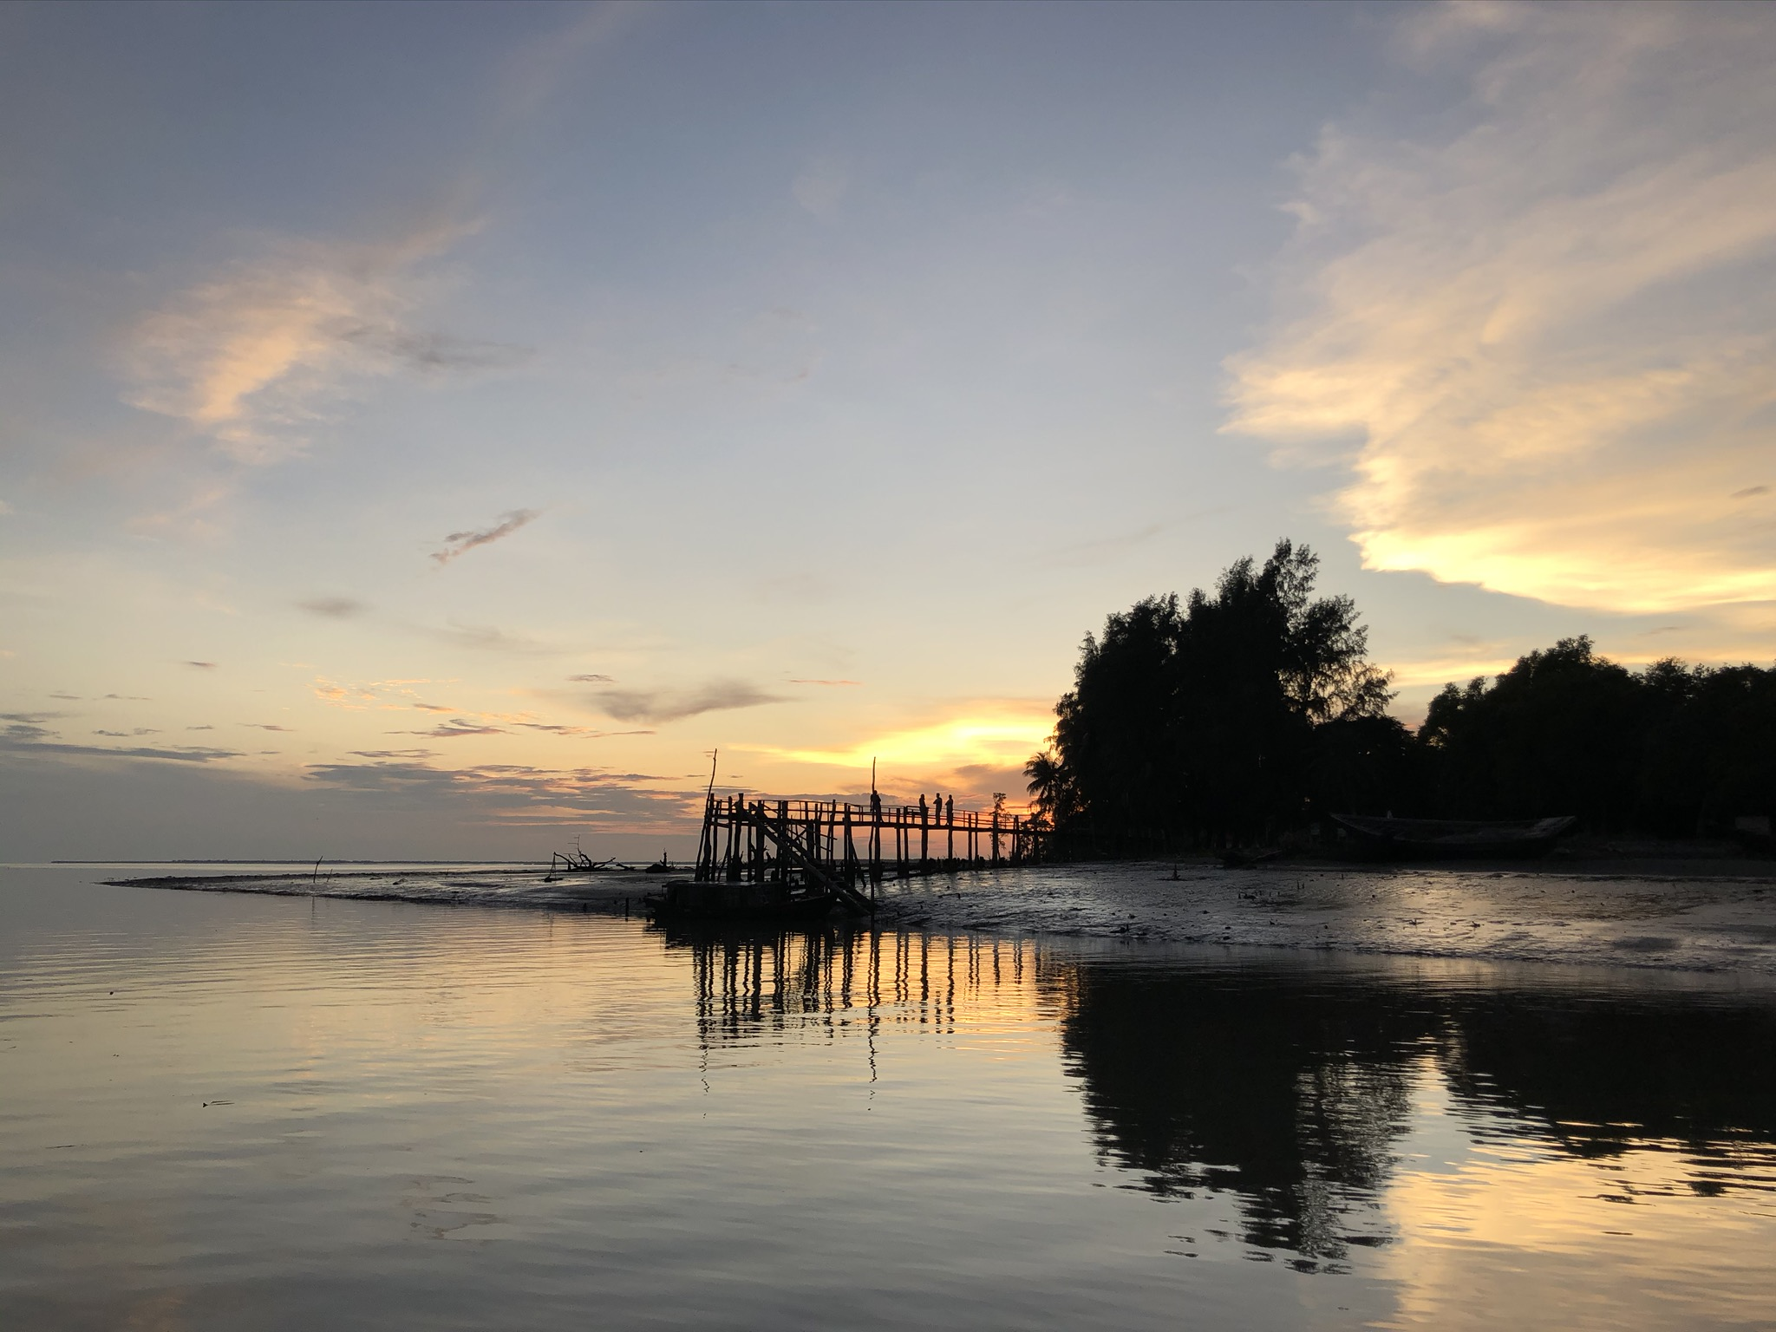
Apply predictions from Higgens et al., 2018, in response to proposed dams and diversions in India.
Under worst-case scenario, deposition rates are lower than effective sea-level rise, threatening delta viability.
Conditions | Monsoon deposition (cm) | Change from present (%)
Present day | 1.8 | -
9% SSC reduction | 1.6 | -10
12% SSC reduction | 1.4 | -20
12% SSC reduction AND 1 month less freshwater | 0.95 | -47

