Slide 1
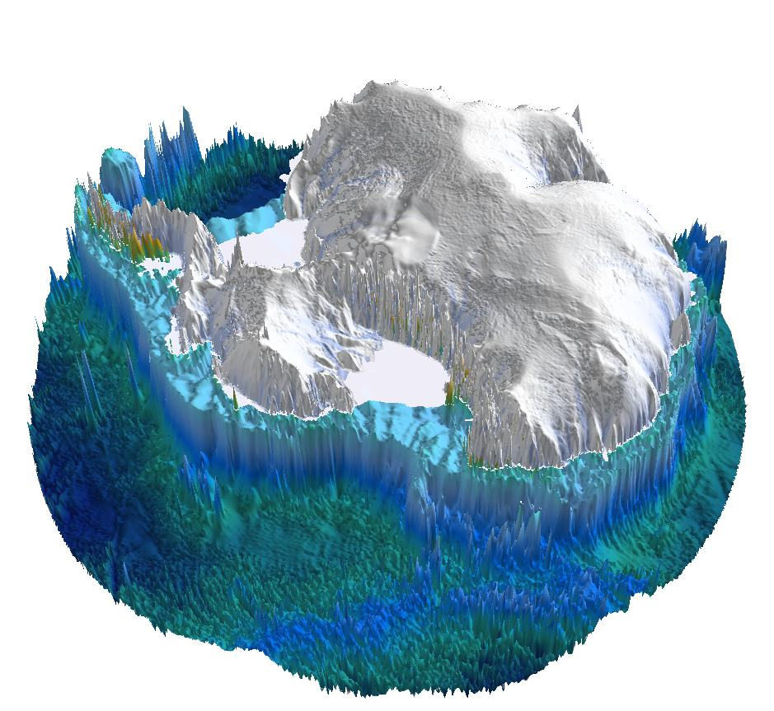
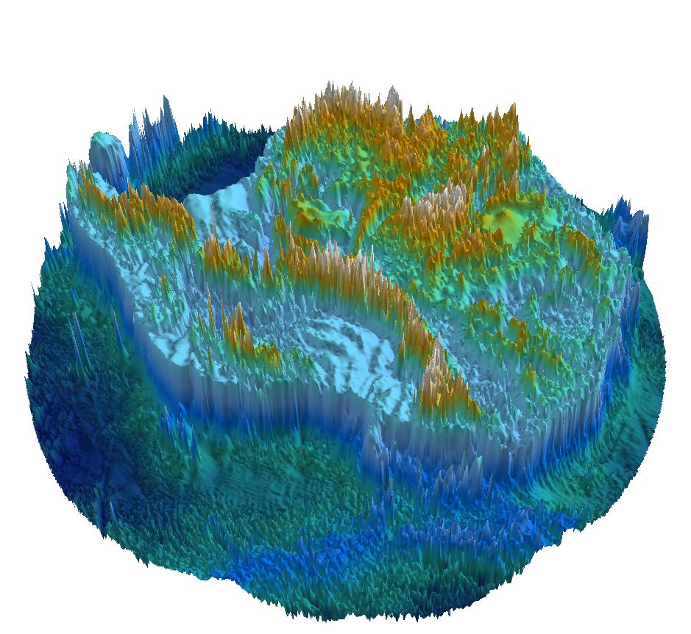

Magnetic and gravity views of crust and lithosphere heterogeneity in the
Wilkes Subglacial Basin of East Antarctica
Fausto Ferraccioli (1), Egidio Armadillo (2), Duncan Young (3), Donald Blankenship (3), and Martin Siegert (4)
(1) NERC British Antarctic Survey, Cambridge, United Kingdom
(2) Università di Genova, DISTAV, Genova, Italy
(3) The University of Texas at Austin, Jackson School of Geosciences, United States
(4) Imperial College London, The Grantham Institute for Climate Change, UK
Wilkes Subglacial Basin- one of the largest potentially unstable marine-based sectors of the East Antarctic Ice Sheet
New aerogeophysical and satellite images reveal heterogeneity in its subglacial geology, crust and lithosphere
New implications for our understanding of the Precambrian basement beneath the Wilkes Subglacial Basin
The newly unveiled heterogeneity has implications for future assessments of Geothermal Heat Flux
Wilkes Subglacial Basin

Slide 2
Wilkes Subglacial Basin- one of the largest marine-based sectors of the EAIS
b
a- Rate of future sea-level rise & timing of major retreat and thinning for the WAIS & EAIS. Note significant predicted longer-term contributions from the Wilkes Subglacial Basin region (DeConto & Pollard, 2016, Nature).
b- Predicted ice sheet configuration in year 2500 showing significant retreat in the northern Wilkes Subglacial Basin.
a
EAIS
WAIS
WSB
c
d
c- Past behaviour of the Antarctic Ice Sheet during the warm mid-Pliocene- as a potential analogue for future warming. (DeConto & Pollard, 2016, Nature).
b- Maximum predicted mid-Pliocene ice sheet retreat. Note partial collapse of the EAIS in the northern Wilkes Subglacial Basin region.
WSB
WSB

Slide 3
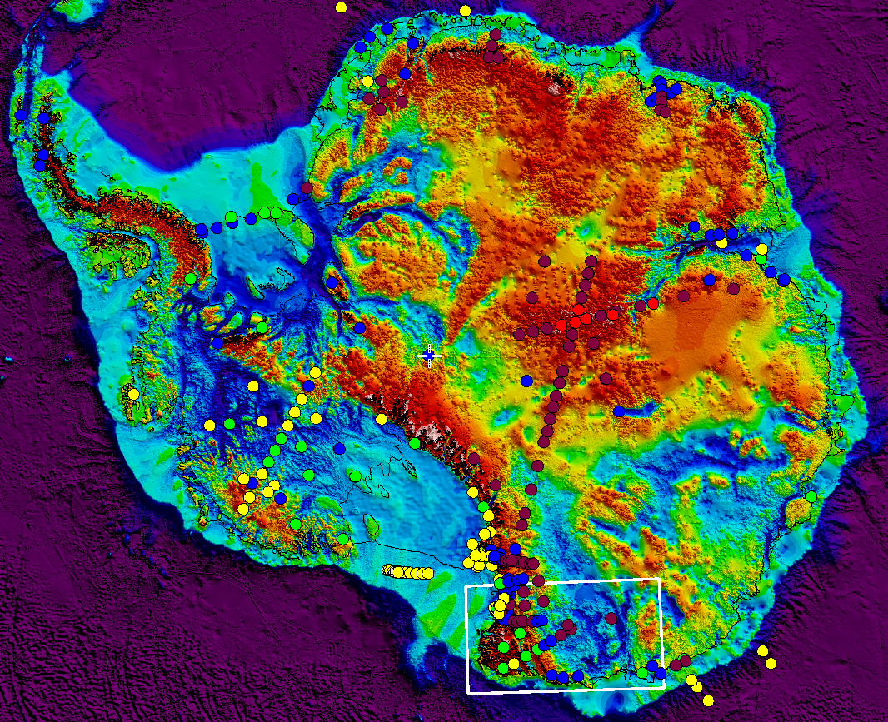
Wilkes Subglacial Basin- a major tectonic feature in East Antarctica
Location of our study area in the Wilkes Subglacial Basin (WSB) (white rectangle) superimposed on BedMachine bed topography (Morlighem et al., 2020, Nature Geoscience) & a compilation of crustal thickness ranges from seismology
(updated from An et al., 2015, JGR).
The Wilkes Subglacial Basin (WSB) is a major tectonic feature in East Antarctica. It stretches for ca 1400 km from the edge of the Southern Ocean, where it is up to 600 km wide towards South Pole, where it is less than 100 km wide.
While basins in the West Antarctic Rift System exhibit thin (ca 25-20 km thick) crust, the Wilkes Subglacial Basin is inferred from passive seismic studies to be underlain by ca 40 km thick crust (e.g Hansen et al., 2016, JGR).
The thicker crust imaged by passive seismics is consistent with flexure of the more rigid East Antarctic lithosphere in response to uplift of the adjacent Transantarctic Mountains (TAM) (e.g. ten Brink et al., 1997, JGR).
However, alternative models based on gravity studies and numerical modelling infer a crustal root beneath the TAM & relatively thinner crust beneath the WSB
(e.g. Bialas et al., 2007, Geology).
W A R S
W S B
T A M

Slide 4
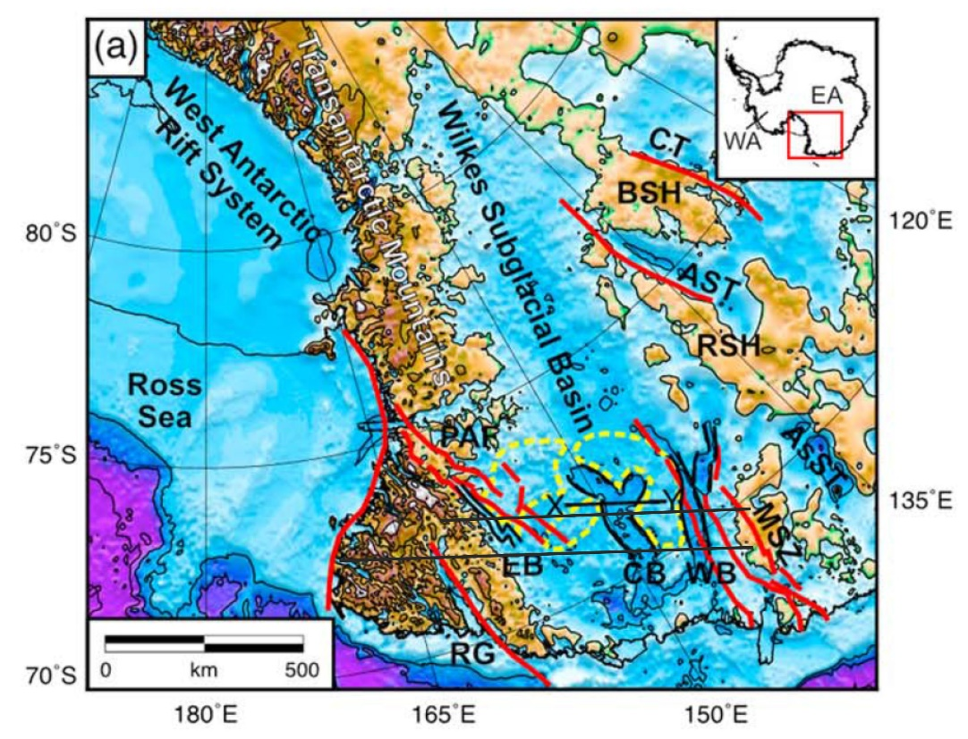
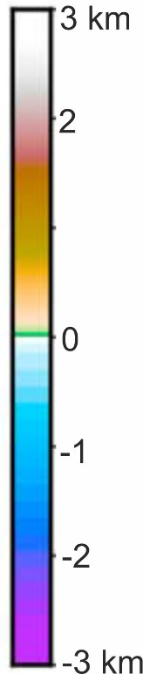
Wilkes Subglacial Basin- long-wavelength flexure and narrower glacially over-deepened grabens
(b)
A
A’
B
B’
A
A’
(c)
B
B’
(a) Location of new flexural modelling profiles across the Wilkes Subglacial Basin (Paxman et al., 2019, JGR). Red lines show major faults; yellow dashed line shows flat lying subglacial bedrock plateaus (Paxman et al., 2018, GRL).
(b) Flexural responses to Cenozoic TAM uplift and Rennick Graben faulting.
(c) Glacial erosion focussed along the narrower Eastern, Central and Western basins (Ferraccioli et al., 2009, Tectonophysics) within the Wilkes Subglacial Basin.
(d) Graben system in the Central Basin region where Beacon sediment and Jurassic magmatism have been modelled from aeromagnetic data (Ferraccioli et al, 2009).
(d)

Slide 5
Beacon Superbasin and Jurassic Ferrar Large Igneous Province in the Wilkes Subglacial Basin
a
b
V
V
V
V
V
V
V
V
V
V
V
V
V
V
V
V
V
V
V
Aerogeophysical interpretation revealing the extent of the Beacon Superbasin within the Wilkes Subglacial Basin region (Ferraccioli et al., 2009) superimposed on Gondwana reconstruction (modified from Elliot et al., 2017, Geosphere).
(b) Rocks of the Jurassic Ferrar Large Igneous province rocks have been inferred within the Wilkes Subglacial Basin from aerogeophysics (Ferraccioli et al., 2009) & by studies of subglacial geology from IODP drilling (modified from Cook et al., 2013, Nature Geoscience).
W S B

Slide 6
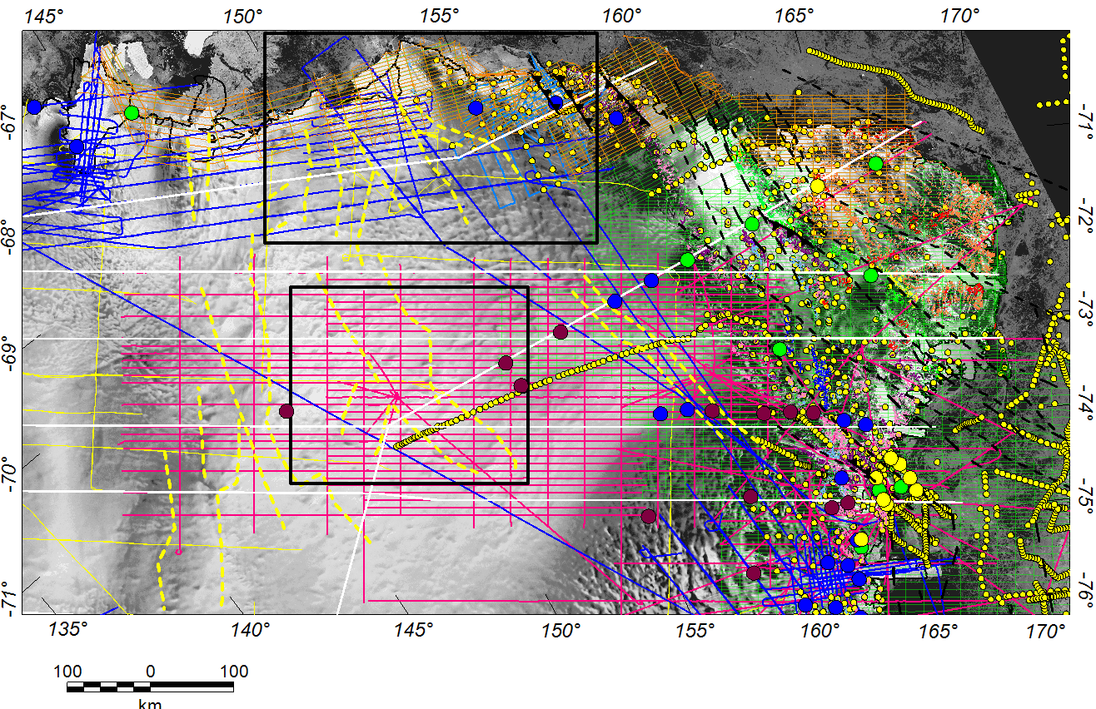
Location of Aerogeophysical datasets in the Wilkes Subglacial Basin and adjacent TAM
Aerogeophysical datasets in the
northern Wilkes Subglacial Basin (WSB).
Flight lines & surveys
(airborne radar, aerogravity, aeromagnetic)
ICECAP- blue
WISE-ISODYN- magenta
Flight lines (airborne radar)
GANOVEX VIII- pale blue
SPRI- yellow
Flight lines (aeromagnetic)
BACKTAM- orange
GITARA, GANOVEX, WIBEM, MAGANTER- green
Land & marine gravity (small yellow dots)
Passive seismic stations (large coloured dots)
Dashed yellow lines indicate sub-basins in the WSB. Solid white lines show selected profiles that we plan to model (but not shown here) to investigate heterogeneity in the WSB and TAM region; black rectangles show the areas of our detailed geophysical images of the Cook Basins & Central Basin.
P1
47
Cook Basins
P2
P3
Eastern Basin
P4
Western Basin
Central Basin
P5
P6
Ferraccioli et al., 2020, JGR, MS, in prep. Image Author Copyright.

Slide 7
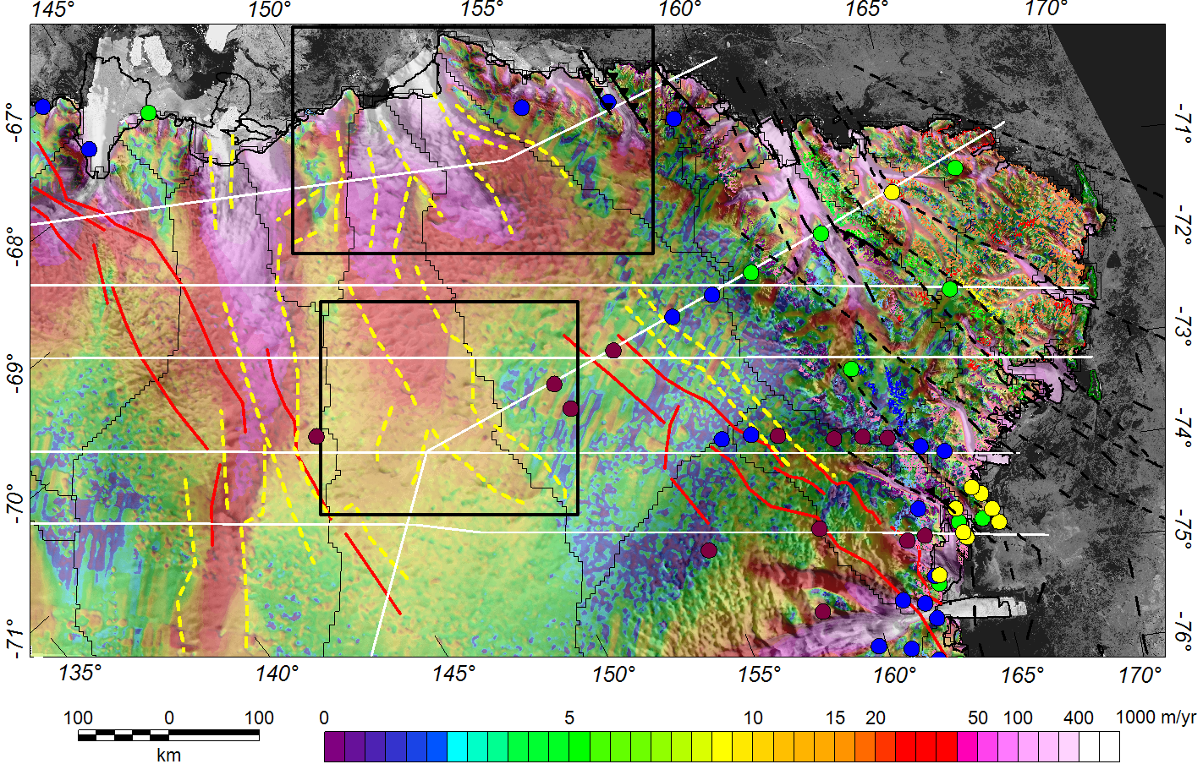
East Antarctic Ice Sheet flow in the Wilkes Subglacial Basin and adjacent TAM
47
Cook Basins
P2
P1
P3
Note the location of the major glaciers including the Mertz, Ninnis, Cook ice shelf, Matusevich, Rennick and Lillie Glaciers.
Geology in the northern Victoria Land
segment of the TAM from PNRA-GANOVEX.
Major basement fault systems flank the WSB. These are traced from aeromagnetic imaging (see following slides) and include a newly proposed Paleoproterozoic fault system related to the exposed Mertz Shear Zone (Di Vincenzo et al., 2007, Prec. Res.) and the Prince Albert Fault System (Ferraccioli & Bozzo, 2003, Geol. Soc. London).
Eastern Basin
P4
Western Basin
Central Basin
P5
P6
MSZ: Mertz Shear Zone
PAFS: Prince Albert Fault System
Ferraccioli et al., 2020, JGR, MS, in prep. Image Author Copyright.

Slide 8
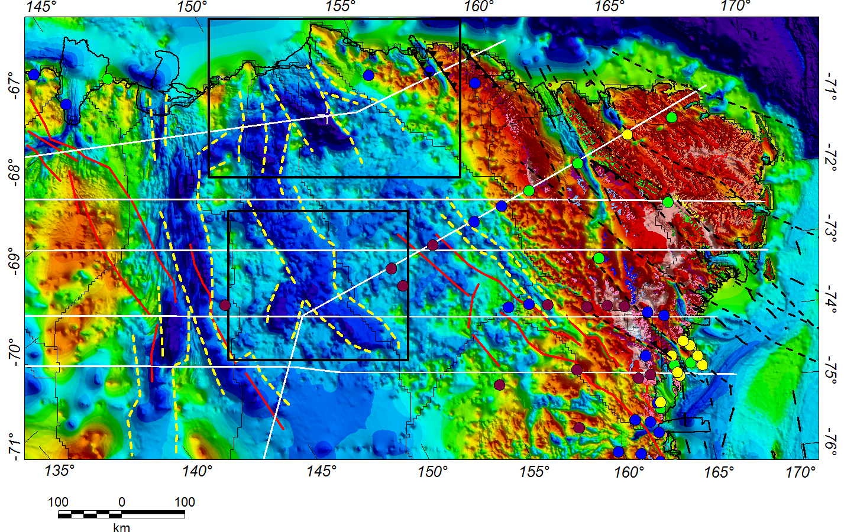
Bedrock topography in the Wilkes Subglacial Basin and adjacent TAM
P1
47
Shaded relief image of bedrock topography in the Wilkes Subglacial Basin and TAM from BedMachine (Morlighem et al., 2020, Nature Geoscience).
Note the deep Cook Basins, where the bedrock deepens inland of the grounding zone of the Cook ice shelf ice streams. There is a potential connection between these newly imaged coastal subglacial basins and the previously identified Central Basin in the interior of the EAIS.
We propose from new airborne gravity imaging (see following slide) that the central Cook Basin (CCB) is underlain by a graben or pull-apart basin resembling the northern Rennick Graben (RG).
CIS
Cook Basins
P2
CCB
RG
P3
Eastern Basin
P4
Western Basin
Central Basin
P5
P6
CIS: Cook Ice Shelf
MSZ: Mertz Shear Zone
PAFS: Prince Albert Fault System
Ferraccioli et al., 2020, JGR, MS, in prep. Image Author Copyright.

Slide 9
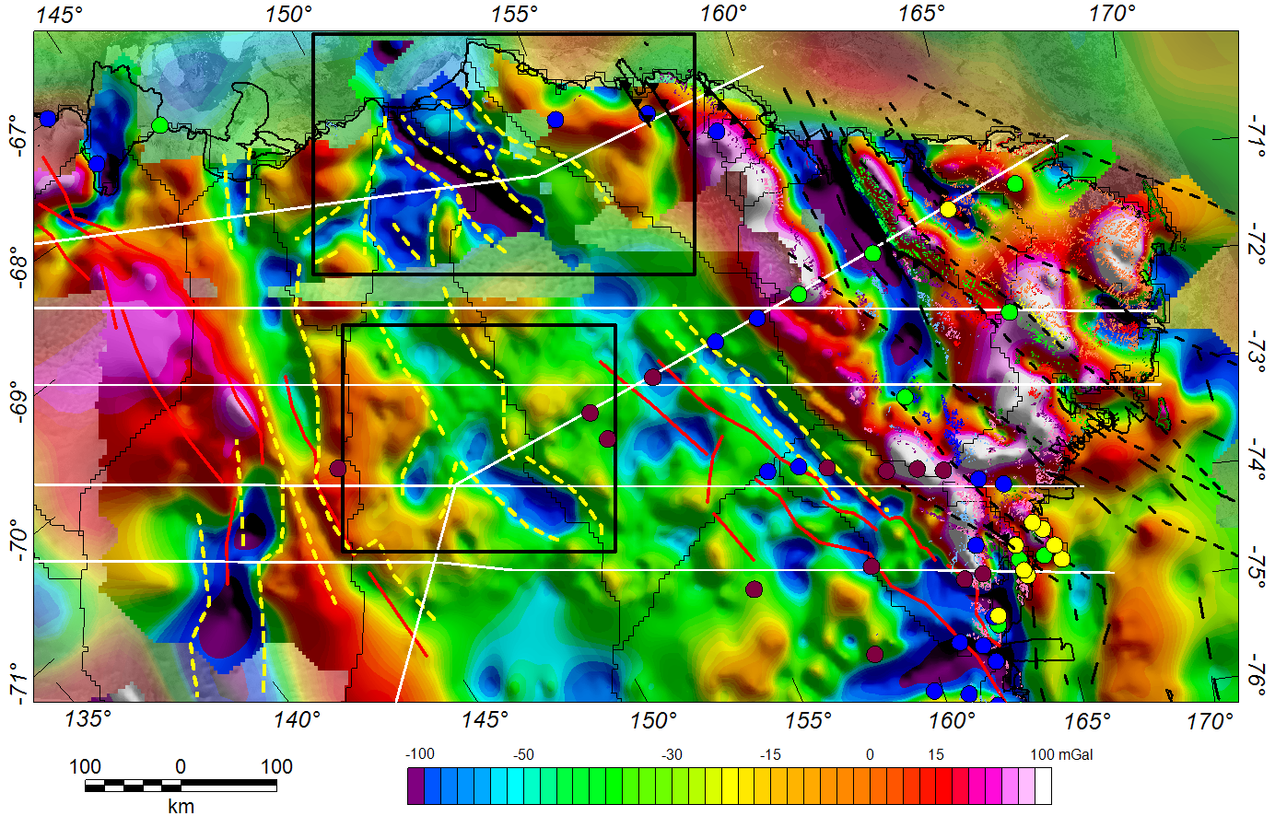
New Free-Air Gravity Anomaly Map in the Wilkes Subglacial Basin and adjacent TAM
CIS
P1
47
New shaded relief image of Free-Air gravity in the Wilkes Subglacial Basin and adjacent TAM.
Note the prominent Free-Air gravity low over the central Cook Basin that resembles the low over the northern Rennick Graben.
The central Cook Basin lies on strike with the previously imaged Eastern Basin and the Prince Albert Fault System.
Satellite-derived gravity anomalies (Zingerle et al, 2019; TIM R6e gravity field model) are shown as a transparent backdrop to help fill in data voids.
Cook Basins
P2
CCB
RG
P3
Eastern Basin
P4
Western Basin
Central Basin
P5
P6
CIS: Cook Ice Shelf
MSZ: Mertz Shear Zone
PAFS: Prince Albert Fault System
Ferraccioli et al., 2020, JGR, MS, in prep. Image Author Copyright.

Slide 10
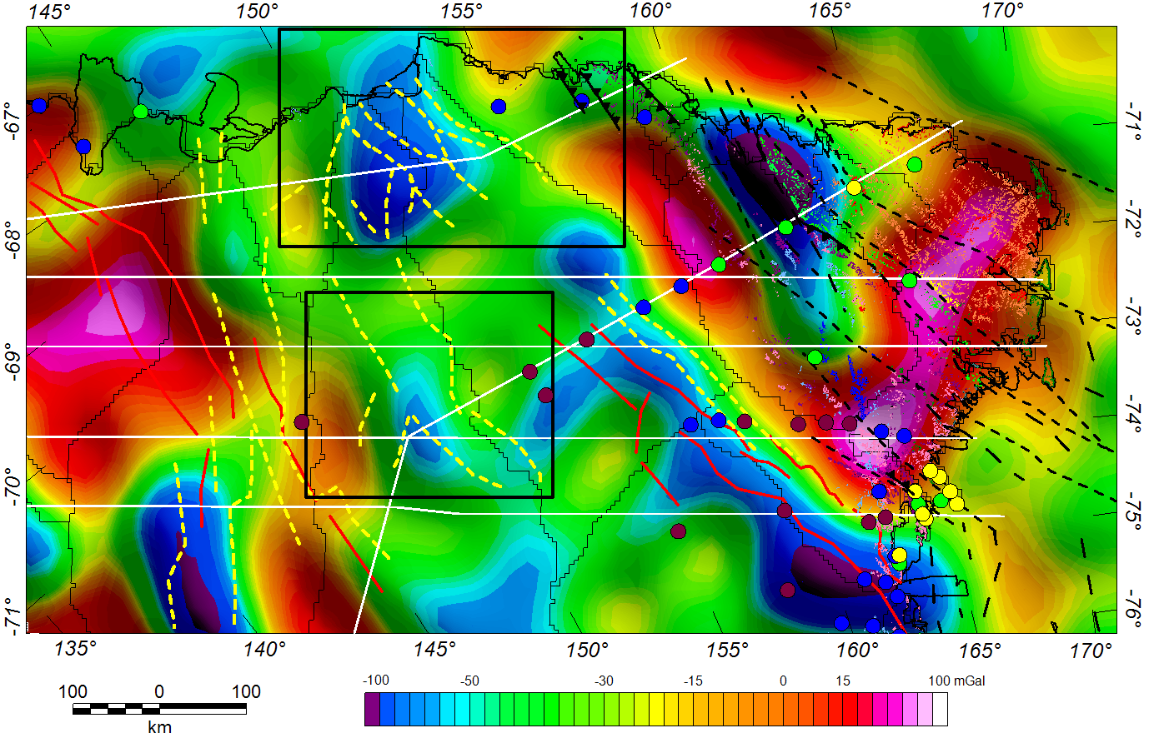
Satellite-derived Free-Air Gravity Anomaly Map in the Wilkes Subglacial Basin and adjacent TAM
CIS
P1
47
New shaded relief image of Free-Air gravity in the Wilkes Subglacial Basin and adjacent TAM derived from satellite gravity data (from Zingerle et al., 2019).
Note that although satellite gravity data much have lower spatial resolution compared to airborne gravity, prominent Free-Air gravity lows are still detected over the Cook Basins and northern Rennick Graben.
A prominent satellite gravity low is also observed over the south western basin (SWB), in an area where airborne gravity coverage remains sparse.
Cook Basins
P2
CCB
RG
P3
Eastern Basin
P4
Western Basin
Central Basin
P5
P6
SWB
CIS: Cook Ice Shelf
MSZ: Mertz Shear Zone
PAFS: Prince Albert Fault System
Ferraccioli et al., 2020, JGR, MS, in prep. Image Author Copyright.

Slide 11
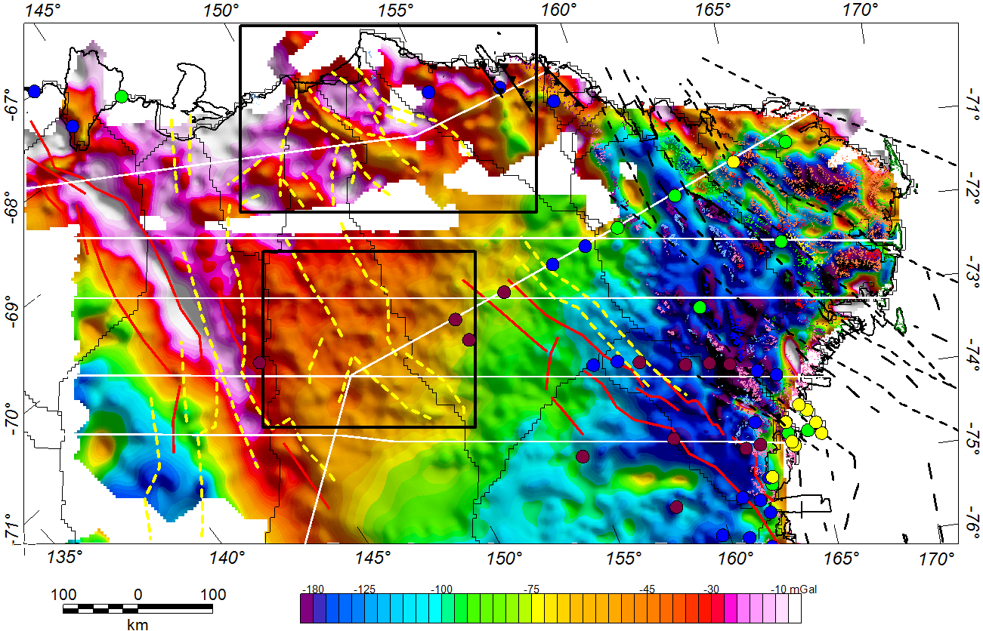
New Bouguer Gravity Anomaly Map in the Wilkes Subglacial Basin and adjacent TAM
CIS
P1
47
New shaded relief Bouguer gravity anomaly image for the Wilkes Subglacial Basin and adjacent TAM.
Note the contrast between the regional low over the thick crust of the TAM & Eastern Basin region and the highs over the Cook Basins area.
A more subdued high is imaged over the Central Basin region.
A remarkable linear gravity high flanks the proposed Paleoproterozoic fault system inferred from aeromagnetic data.
Cook Basins
P2
CCB
RG
P3
Eastern Basin
P4
Western Basin
Central Basin
P5
P6
SWB
CIS: Cook Ice Shelf
MSZ: Mertz Shear Zone
PAFS: Prince Albert Fault System
Ferraccioli et al., 2020, JGR, MS, in prep. Image Author Copyright.

Slide 12
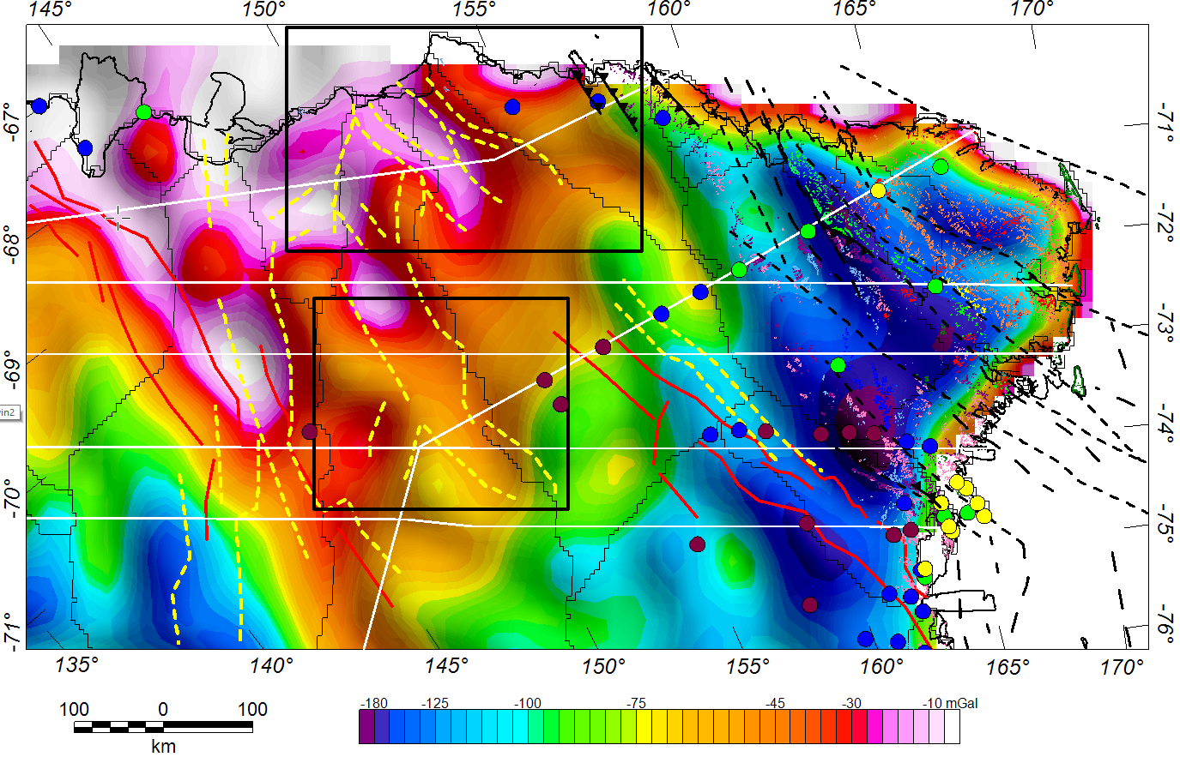
Satellite-derived Bouguer Gravity Anomaly Map in the Wilkes Subglacial Basin and adjacent TAM
CIS
P1
47
New satellite-derived Bouguer gravity anomaly image for the Wilkes Subglacial Basin and adjacent TAM.
The NW-SE boundary between the TAM and the eastern flank of the WSB is clearly imaged (PAFS), as is its western boundary along an inferred Paleoproterozoic fault system.
These faults are likely first-order crustal-scale features that exert major structural controls on the flanks of the WSB.
Cook Basins
P2
CCB
RG
P3
Eastern Basin
P4
Western Basin
Central Basin
P5
P6
SWB
CIS: Cook Ice Shelf
MSZ: Mertz Shear Zone
PAFS: Prince Albert Fault System
Ferraccioli et al., 2020, JGR, MS, in prep. Image Author Copyright.

Slide 13
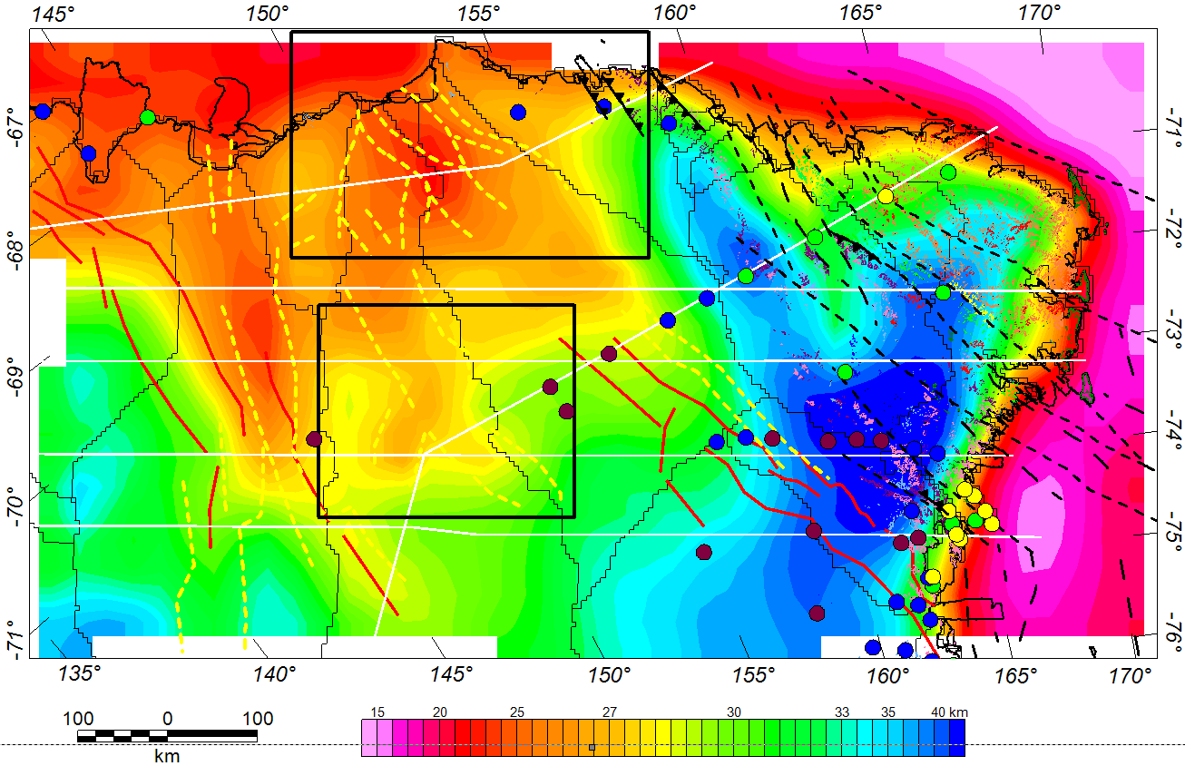
Satellite-gravity derived Crustal Thickness Map in the Wilkes Subglacial Basin and adjacent TAM
CIS
P1
47
New satellite-gravity derived crustal thickness map for the Wilkes Subglacial Basin and adjacent TAM.
(data from recent lithospheric modelling of
Pappa et al., 2019, JGR).
The model images linear regions of ca 25 km thick crust beneath the Cook Basins and Western Basin & ca 27 km thick crust beneath the Central Basin. This is thinner than the ca 31 km thick crust previously modelled from airborne gravity
(Jordan et al., 2013, Tectonophysics).
There are, however, currently no passive seismic stations to help constrain or validate these results or to test possible alternative models - e.g. anomalously dense crust (which is not considered in the continental-scale lithospheric model).
Cook Basins
P2
CCB
RG
P3
Eastern Basin
P4
Western Basin
Central Basin
P5
P6
SWB
CIS: Cook Ice Shelf
MSZ: Mertz Shear Zone
PAFS: Prince Albert Fault System
Ferraccioli et al., 2020, JGR, MS, in prep. Image Author Copyright.

Slide 14
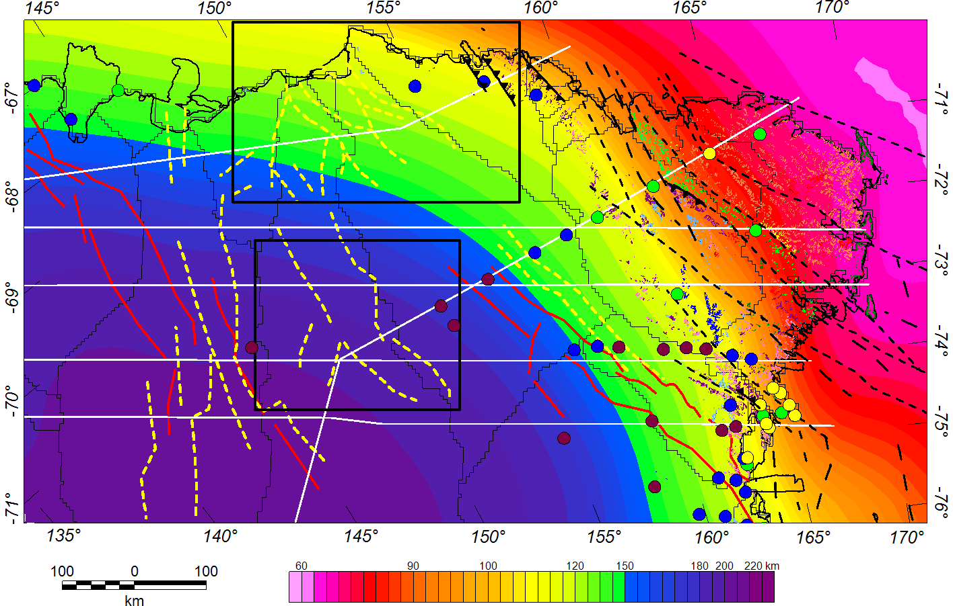
Satellite-gravity derived Lithosphere Thickness Map in the Wilkes Subglacial Basin and adjacent TAM
P1
47
New satellite-gravity derived lithosphere thickness map for the Wilkes Subglacial Basin and adjacent TAM.
(data from recent lithospheric modelling of
Pappa et al., 2019, JGR).
The image lends weight to the hypothesis that the WSB is underlain by thick cratonic lithosphere (150-220 km thick), while thinner lithosphere (ca 120 km thick) underlies the adjacent Ross Orogen.
The SWB is underlain by particularly thick lithosphere (ca 220 km), while the coastal Cook Basins appear to be underlain by ca 120 km thick lithosphere. The lithosphere may have been thinned here during Gondwana break-up between Australia and East Antarctica.
CIS
Cook Basins
P2
CCB
RG
R o s s O r o g e n
P3
Eastern Basin
P4
Western Basin
Central Basin
P5
P6
SWB
C r a t o n I c L i t h o s p h e r e
CIS: Cook Ice Shelf
MSZ: Mertz Shear Zone
PAFS: Prince Albert Fault System
Ferraccioli et al., 2020, JGR, MS, in prep. Image Author Copyright.

Slide 15
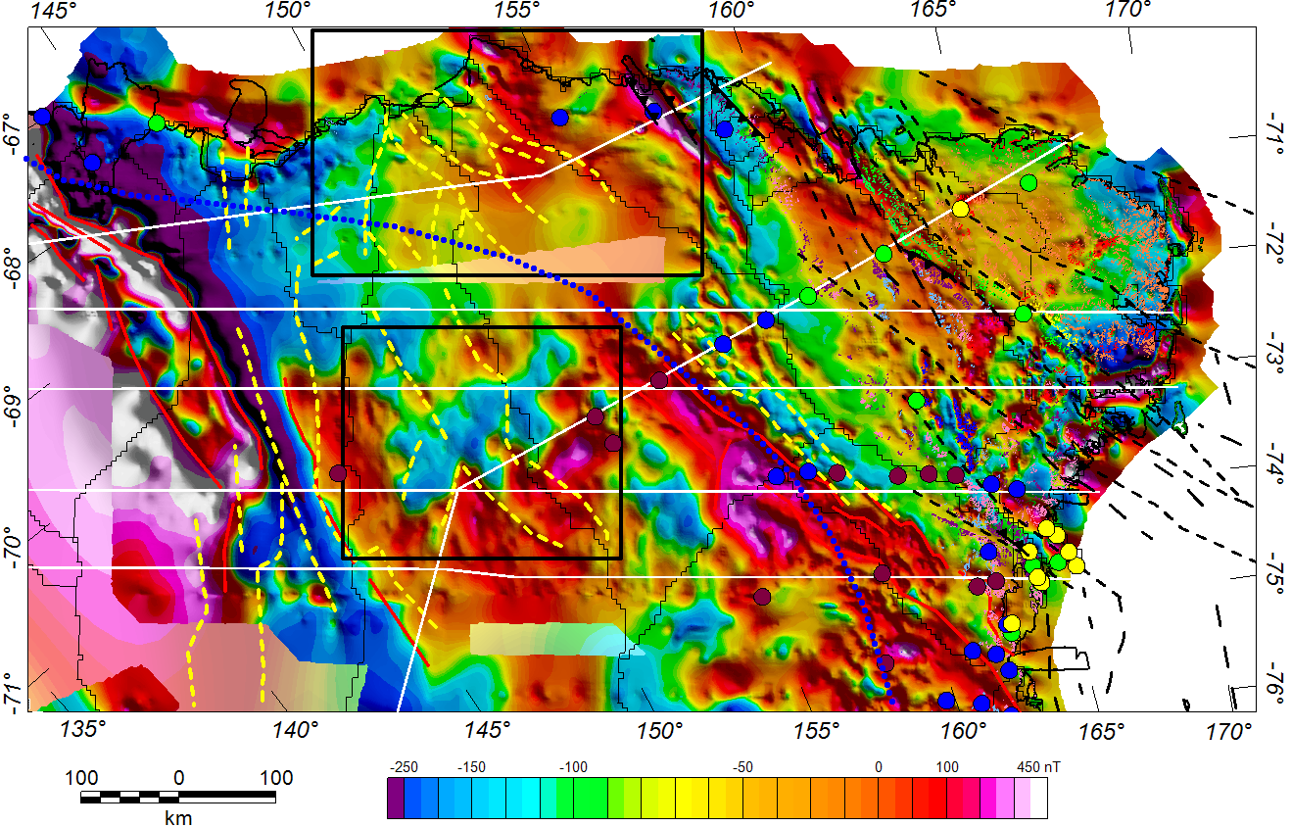
Aeromagnetic anomaly map of the Wilkes Subglacial Basin and adjacent TAM
P1
47
New aeromagnetic anomaly map of the Wilkes Subglacial Basin and adjacent TAM.
The aeromagnetic image helps unveil the cryptic and likely composite Precambrian basement of the Wilkes Subglacial Basin.
Magnetic lows delineate areas where basement is likely buried deeper beneath Beacon sediments and thicker late Neoproterozoic to early Cambrian metasediments.
Such heterogeneity in basement and cover rocks in the WSB is a key finding for future assessments of GHF variability beneath this sector of the EAIS.
Dotted blue line denotes the edge of the thick cratonic lithosphere as modelled from satellite gravity data (see previous slide).
CIS
Cook Basins
P2
CCB
RG
R o s s O r o g e n
P3
Eastern Basin
P4
Western Basin
Central Basin
P5
P6
SWB
CIS: Cook Ice Shelf
MSZ: Mertz Shear Zone
PAFS: Prince Albert Fault System
Ferraccioli et al., 2020, JGR, MS, in prep. Image Author Copyright.

Slide 16
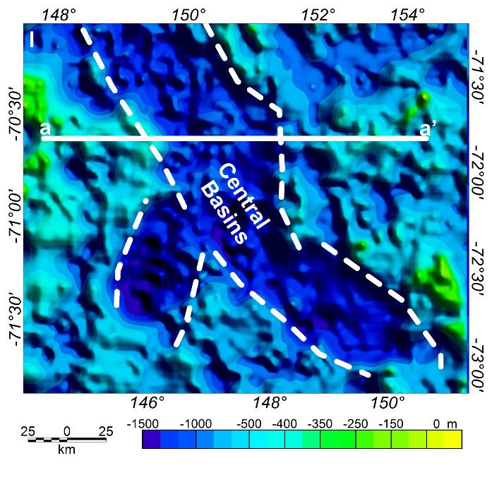
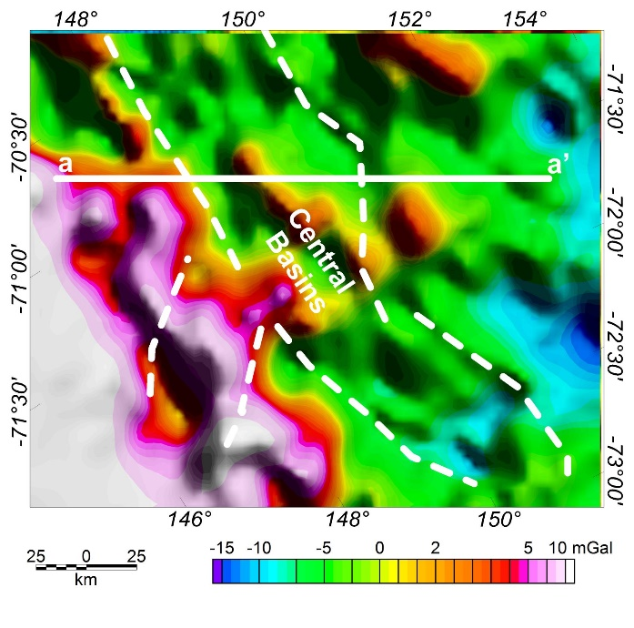
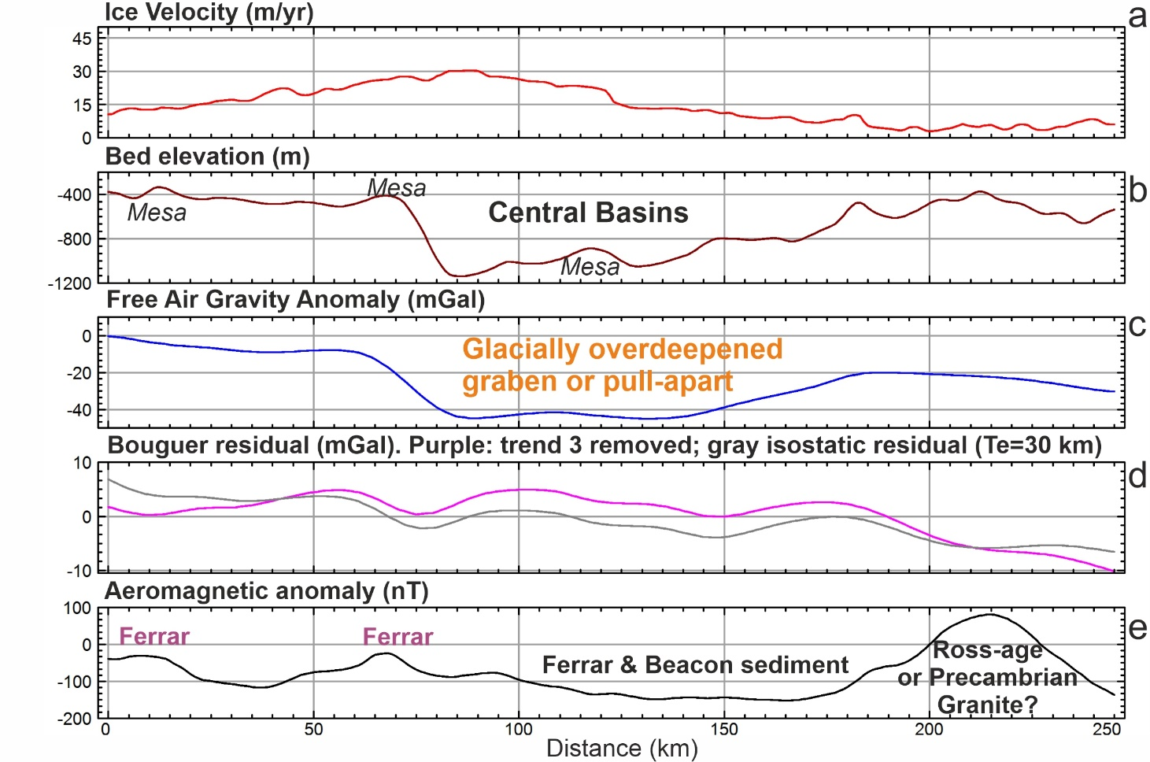
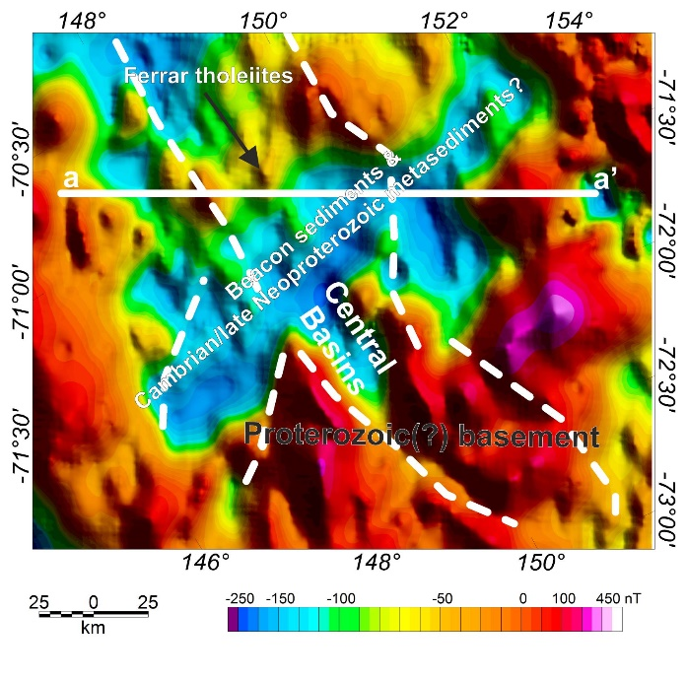
Example of profile views across the Wilkes Subglacial Basin and adjacent TAM
a
b
a
a’
New aeromagnetic anomaly map of the Wilkes Subglacial Basin and adjacent TAM.
The aeromagnetic image helps unveil the cryptic and likely composite Precambrian basement of the Wilkes Subglacial Basin.
Magnetic lows delineate areas where basement is likely buried deeper beneath Beacon sediments and thicker late Neoproterozoic to early Cambrian metasediments.
Such heterogeneity in basement and cover rocks in the WSB is a key finding for future assessments of GHF variability beneath this sector of the EAIS.
Dotted blue line denotes the edge of the thick cratonic lithosphere as modelled from satellite gravity data (see previous slide).
c
a- Bedrock topography map of the Central Basin(s) region
b- Isostatic Residual gravity anomaly map over the Central Basin(s) region
c- Interpreted aeromagnetic anomaly map of the Central Basin(s) region
Profile view showing slow but enhanced velocities at the onset of flow for the Cook ice streams in the area of the Central Basins, interpreted as glacially overdeepened graben or pull-apart structures.
Ferrar igneous rocks and Beacon sediment are interpreted as preserved in the Central Basins, while a basement granitoid is inferred as the source of the aeromagnetic anomaly on its eastern flank.
Ferraccioli et al., 2020, JGR, MS, in prep. Image Author Copyright.

Slide 17
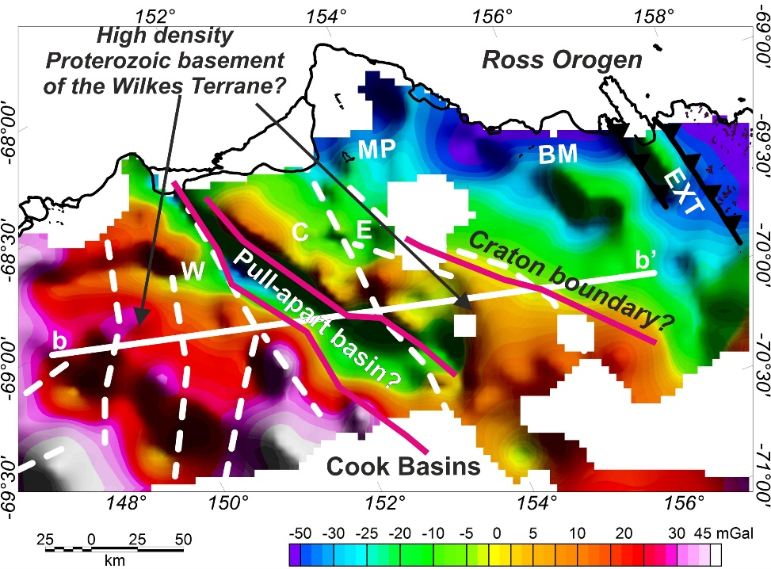
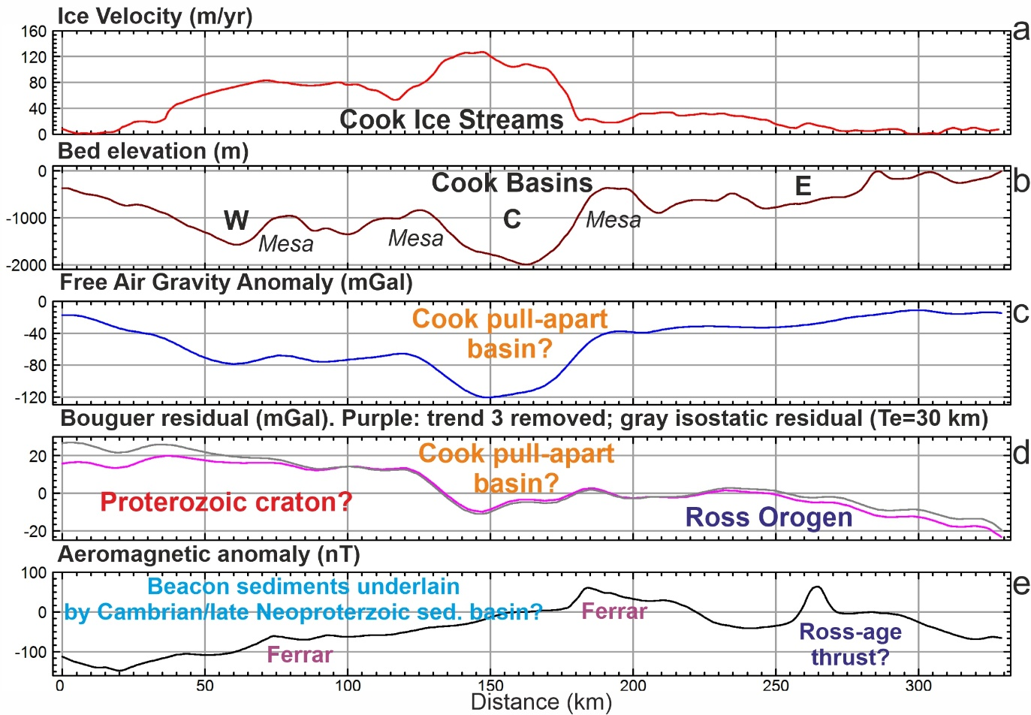
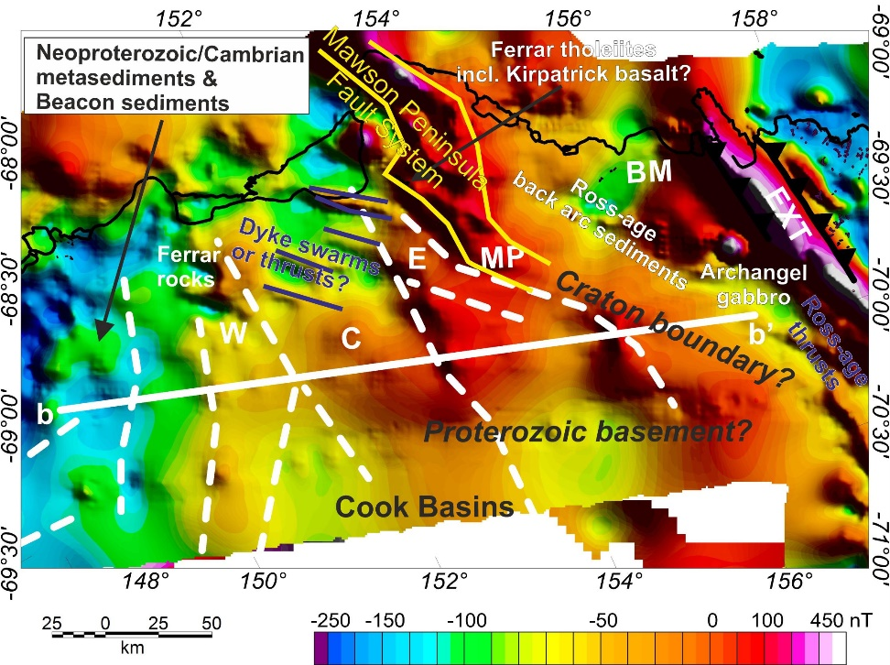
Example of profile views across the Wilkes Subglacial Basin and adjacent TAM
a
c
b
b’
New aeromagnetic anomaly map of the Wilkes Subglacial Basin and adjacent TAM.
The aeromagnetic image helps unveil the cryptic and likely composite Precambrian basement of the Wilkes Subglacial Basin.
Magnetic lows delineate areas where basement is likely buried deeper beneath Beacon sediments and thicker late Neoproterozoic to early Cambrian metasediments.
Such heterogeneity in basement and cover rocks in the WSB is a key finding for future assessments of GHF variability beneath this sector of the EAIS.
Dotted blue line denotes the edge of the thick cratonic lithosphere as modelled from satellite gravity data (see previous slide).
b
a- Interpreted isostatic residual gravity anomaly map over the Cook Basins region.
b- Interpreted aeromagnetic anomaly map of the Cook Basins region.
c- Profile view showing fast flow of the central Cook Ice Stream atop of an inferred pull-apart basin, which may have been imposed on a major pre-existing crustal boundary separating the Ross Orogen from a composite Proterozoic basement terrane (buried beneath inferred Beacon sediments and Cambrian/late Neoproterozoic sedimentary basins).
Ferraccioli et al., 2020, JGR, MS, in prep. Image Author Copyright.

Slide 18
Conclusions
New aeromagnetic anomaly map of the Wilkes Subglacial Basin and adjacent TAM.
The aeromagnetic image helps unveil the cryptic and likely composite Precambrian basement of the Wilkes Subglacial Basin.
Magnetic lows delineate areas where basement is likely buried deeper beneath Beacon sediments and thicker late Neoproterozoic to early Cambrian metasediments.
Such heterogeneity in basement and cover rocks in the WSB is a key finding for future assessments of GHF variability beneath this sector of the EAIS.
Dotted blue line denotes the edge of the thick cratonic lithosphere as modelled from satellite gravity data (see previous slide).
The Wilkes Subglacial Basin hosts a large and potentially unstable marine-based sector of the East Antarctic Ice Sheet.
Our new aerogeophysical and satellite images reveal heterogeneity in its subglacial geology, crust and lithosphere.
We propose that buried beneath Beacon and older (likely early Cambrian to Late Neoproterozoic) sediments in the Wilkes Subglacial Basin lies a cryptic and composite Precambrian basement terrane.
The heterogeneity in subglacial geology, crust and lithosphere beneath the Wilkes Subglacial Basin has
significant additional implications for future assessments of Geothermal Heat Flux in this key sector of the EAIS.

