Slide 1
Neural network for automated recognition of prehistoric carvings at Stonehenge
Gavin Leong, Matthew Brolly
University of Brighton, School of Environment and Technology, UK

Slide 2
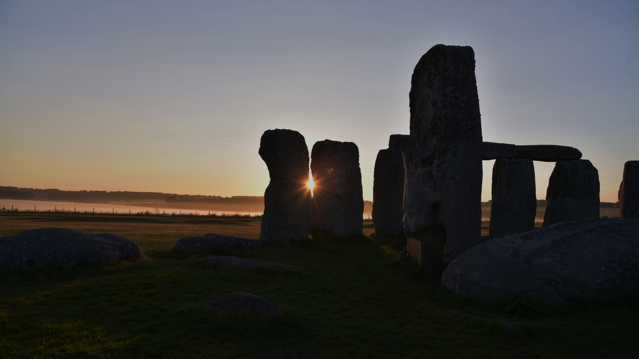
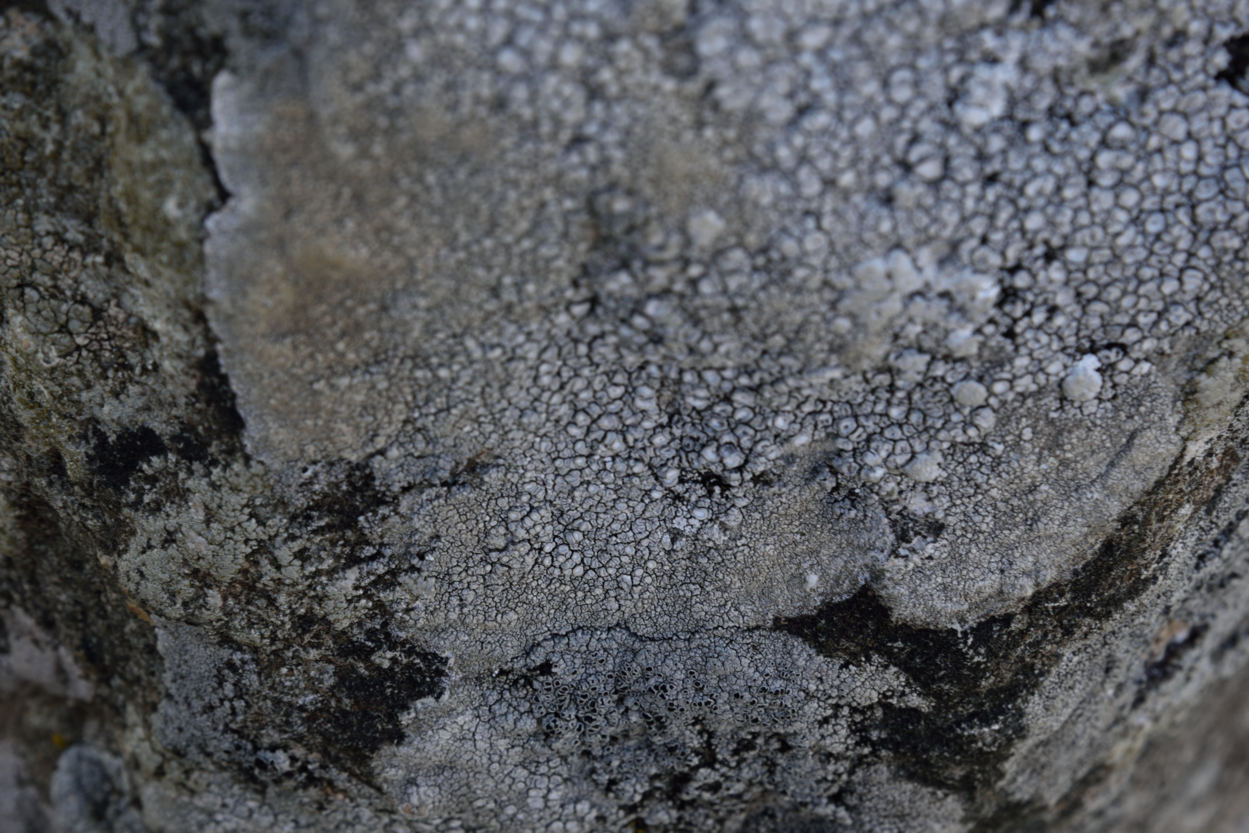
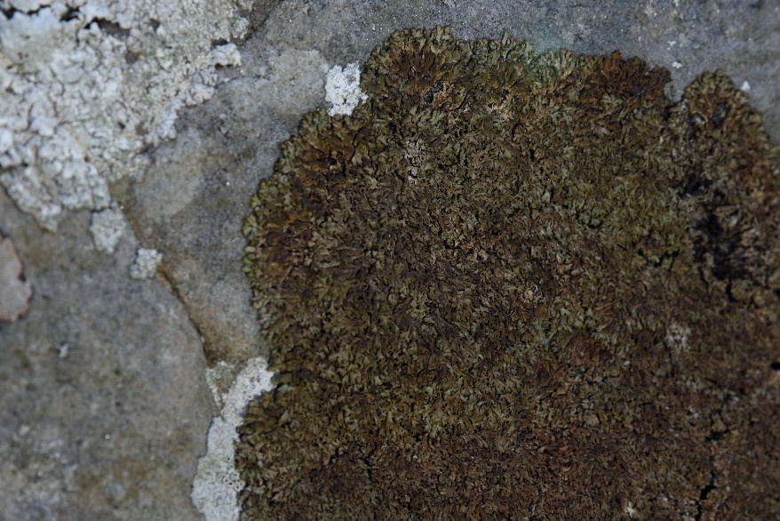
Problem: lichen at Stonehenge
Are there any more carvings to be found beneath the lichen on the stones of Stonehenge?
?
On unobscured surfaces, English Heritage discovered 71 new axe-head carvings
Dense coverage of shrubby fruticose lichen obscures 23% of the stone surface at Stonehenge

Slide 3
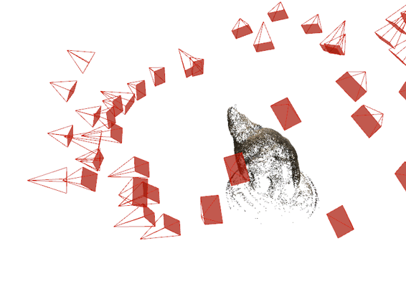
Towards a solution: photogrammetry
We take advantage of two key observations of lichen and the axe-head carvings at Stonehenge:
Thus, with carving depths greater than variation in lichen thickness, carvings may not be fully obscured by lichen.
A surface imaging technique such as structure-from-motion photogrammetry, which turns 2-D pictures into 3-D models, could be used to reveal subsurface (below the lichen) rock features.
lichen
<0.2mm
~0.5 mm
Numerous lichen species adhere to stone surfaces with minimum variation in thickness: <0.2 mm
In contrast, the minimum depth of the carvings is ~0.5 mm. This could be exploited to reveal new carvings
Structure-from-motion photogrammetry virtual reconstruction (gif)

Slide 4
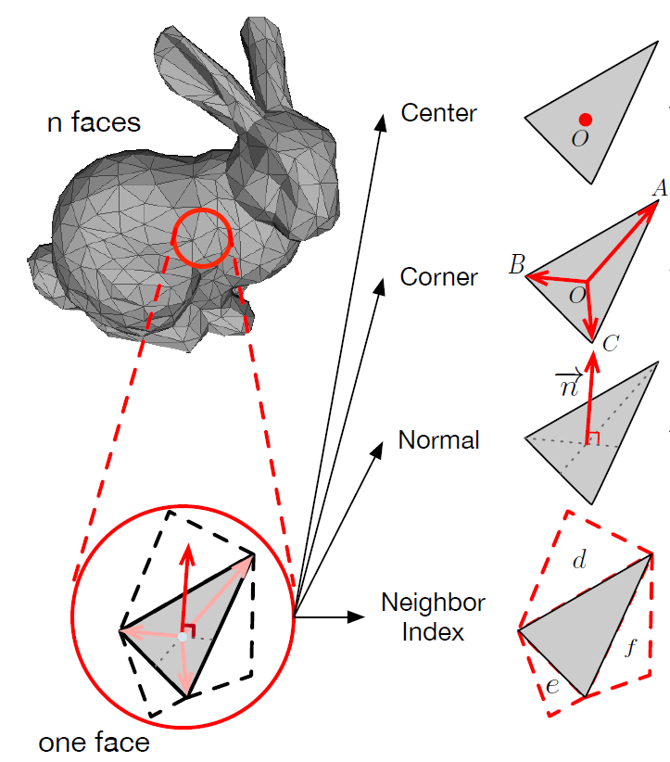
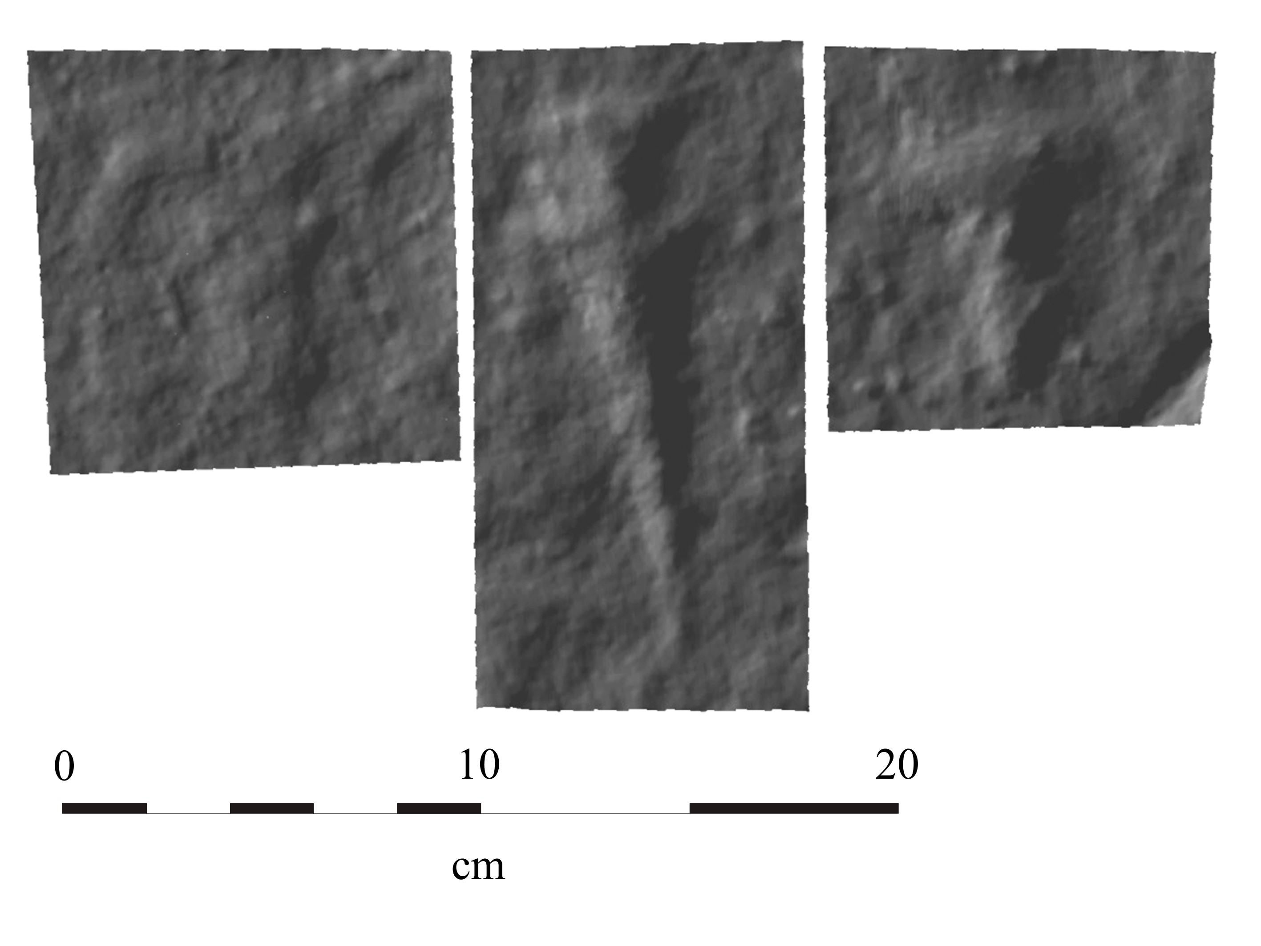
Towards a solution: machine learning
MeshNet
The resultant 3-D models from photogrammetry were used to train MeshNet, a neural network that learns 3-D shape representation.
MeshNet takes key features such as corners and normals and turns them into descriptors of the local surface of a model.
Training and testing
75 prehistoric carvings were extracted for training and 19 for testing from stones numbered 3, 4, 5 and 53. See bottom right for examples.
The same number of randomly extracted non-carving 3-D models of the stone surface were used as negative examples.
MeshNet was tasked with differentiating between 3-D models with carvings and 3-D models without carvings.

Slide 5
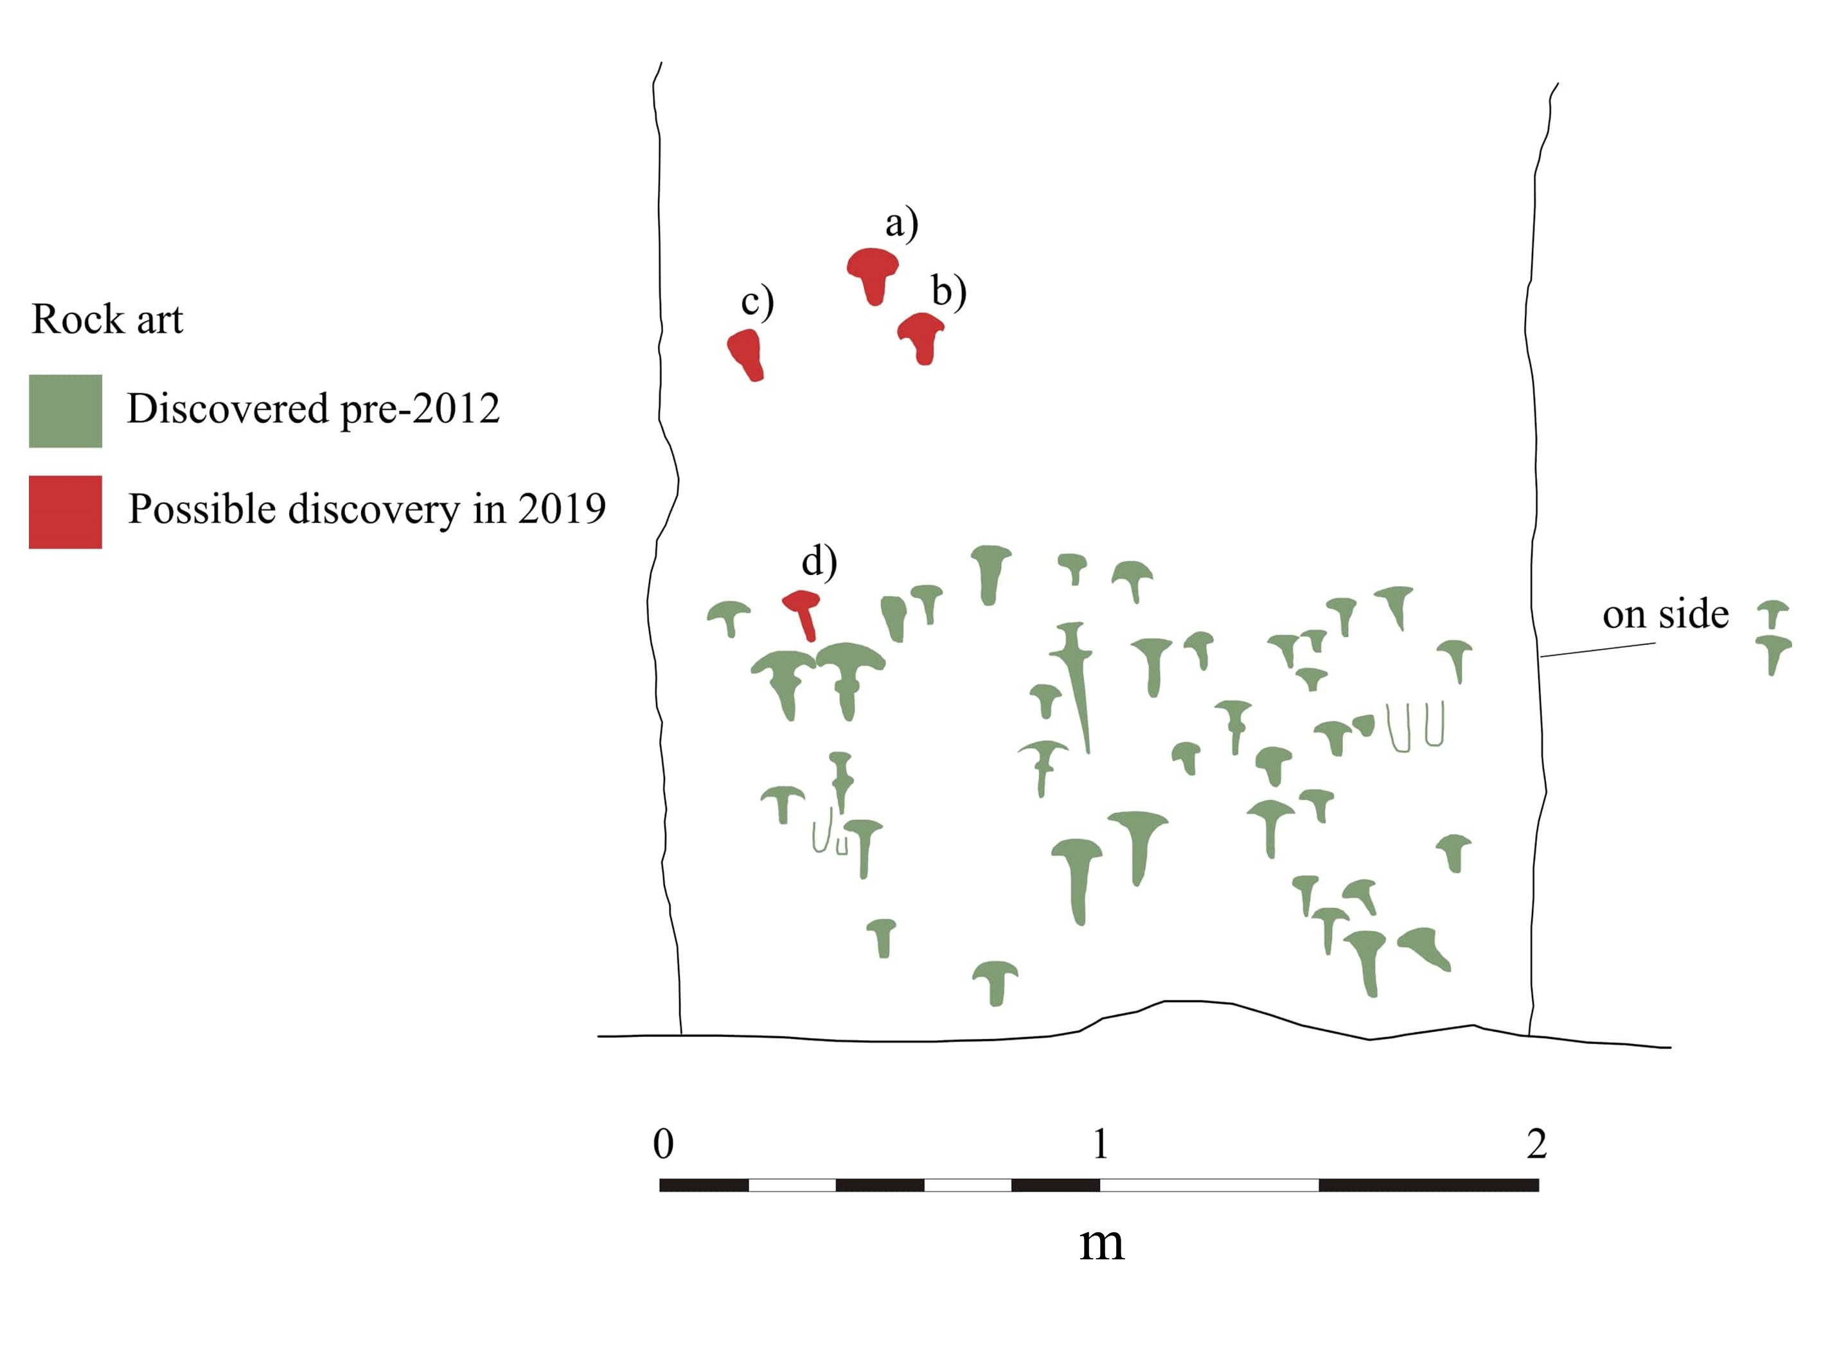
Results
The highest accuracy at identifying prehistoric carvings achieved using MeshNet was 84.2%.
Using MeshNet, four possible prehistoric carvings were newly identified on stone 53 (see bottom right)

Slide 6
Future work
The next step is to train MeshNet on examples of lichen on prehistoric carvings. This requires that we
Use synthetic lichen and carvings to inform our machine learning model for detecting the presence (location and shape) of carvings beneath lichen.
Improve the MeshNet algorithm to avoid the pitfall of overfitting the neural network on the dataset.
Create more examples of carvings by introducing slight variations in the 3-D model of the existing carvings.

