Slide 1
Presentation on
Development and Evaluation of a New “Snow Water Index (SWI)” for Accurate Snow Cover Delineation
Centre of Excellence in Disaster Mitigation and Management
By: Dr. Ajanta Goswami (Earth Sciences)
Abhilasha Dixit

Slide 2
Table of Content
1
Introduction
2
Research Gaps
3
Need of the Study
4
Study Area
5
Methodology
6
Results

Slide 3
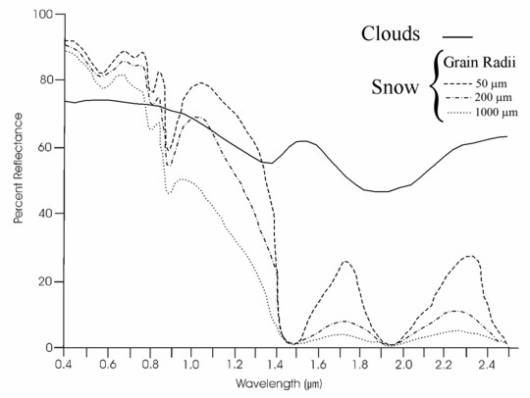
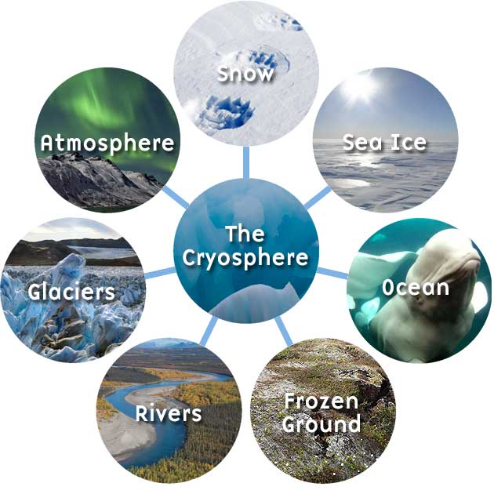
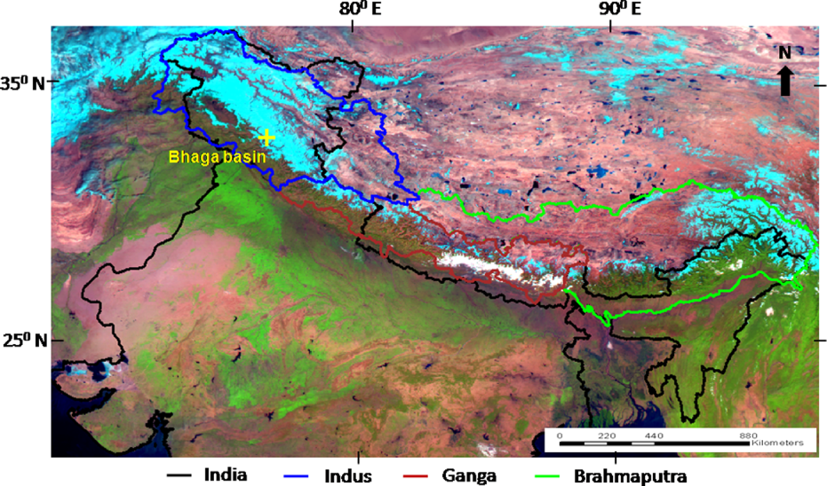
Introduction
The Cryosphere: Earth has many frozen feature like: sea, river, ocean ice, snow cover glaciers, and frozen ground collectively called as “ Cryosphere”
Snow: Snow is a collection of ice grains and air,
and when at 0⁰ C, it also has significant fraction
of liquid water (Stephen G. Warren 1982)
Fig: Spectral reflectance curve of snow
Fig: various components of cryosphere
Fig: Snow cover variability in Indian Himalaya

Slide 4
Research Gaps
Limitations of NDSI:
Water misunderstood as snow
Table : In shadow Condition (A V Kulkarni et., al. 2002 Manali sub-basin)
Target | Reflectance (%) |  | NDSI
 | Green | SWIR
Fresh and Clean Snow | 88.6 | 3.9 | 0.90
Snow with mild Clay Contamination | 65.4 | 1.4 | 0.96
Wet and Patchy Snow | 74.5 | 1.4 | 0.96
Flowing River Water | 3.6 | 0.3 | 0.84
Standing Water | 5.2 | 0.1 | 0.96
Study done by Joseph and Navalgund et. al.1991, George A. Riggs, Dorothy K. Hall 1994 and 1995, Kulkarni et. al. 2002 and 2004 , Ram C. Sharma et. al., 2016 shows that water bodies generally shows low reflectance but its NDSI value is higher, because of higher NDSI value it is always misunderstood as snow.
Table : Without Shadow Condition (A V Kulkarni et., al. 2002)
Target | Reflectance (%) |  | NDSI
 | Green | SWIR
Snow | 83.8 | 4.0 | 0.91
River Water | 4.2 | 0.8 | 0.67

Slide 5
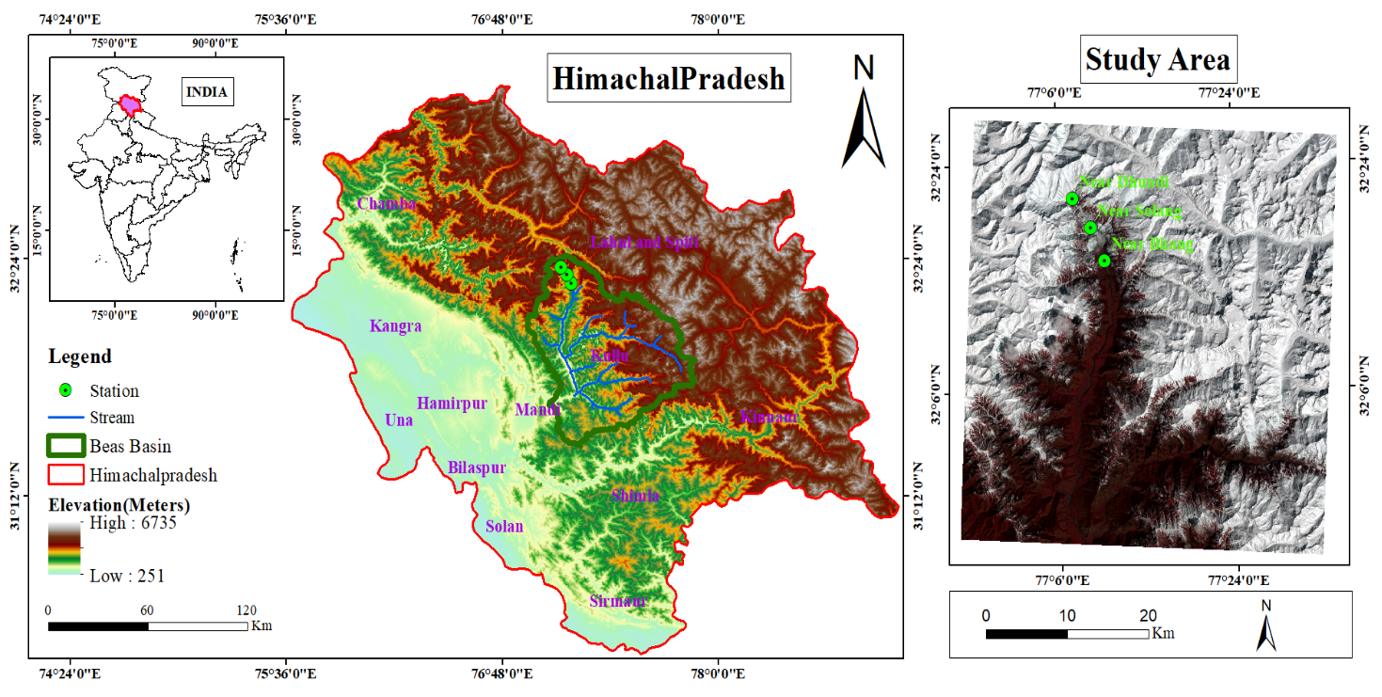
Study Area
The present study carried out at Bahang (77.18◦ E 32.27◦ N) area of high altitude Himalayan town of Manali in Beas river basin, India. The location map of study area presented in Figure. Beas river basin is one of the major river basin of Indus river basin.
Fig: Location Map of Study area
It lies in the Pir-Panjal range at the altitude range of 2000 to 4000m. On this altitude range the Beas basin is characterized by a moderate temperature and high precipitation. Data receive from snow observatory of SASE, India shows that Bahang receives a significant amount of seasonal snowfall of 53cm (average) with high temperature of Tmax: 21◦C and Tmin: –5.0◦C in between April and November (Mohile et al 2004).

Slide 6
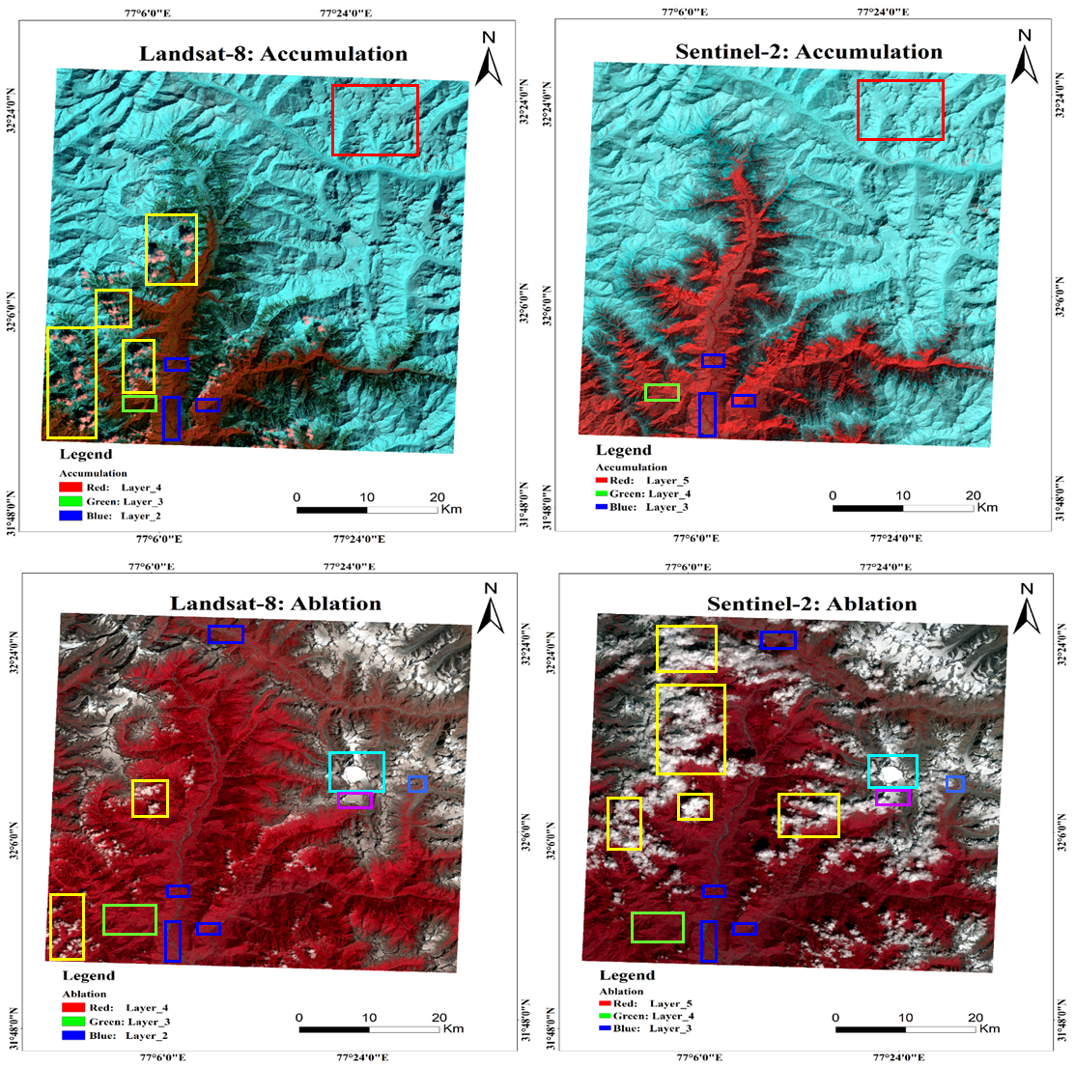
Data used in current study
Table: Data characteristics of LANDSAT-8 and SENTINEL-2 sensor
Sensor | Acquisition Date | Spectral Band with Wavelet (µm) | Cloud Cover
Landsat-8 | 12 March 2017 | Costal (0.43–0.45) Blue (0.45–0.51) Green (0.53–0.59) Red (0.63–0.67) NIR (0.85–0.88) SWIR-1 (1.57–1.65) SWIR-2 (2.11–2.29) Cirrus cloud (1.36–1.38) | 13.26 %
 | 20 Sept 2017 |  | 5%
 | 18 March 2019 |  | 2.28%
 | 10 Sept 2019 |  | 9%
Sentinel-2 | 21 March 2017 | Costal (0.443) Blue (0.490) Green (0.560) Red (0.665) Vegetation red edge (0.705) Vegetation red edge (0.740) Vegetation red edge (0.783) NIR (0.842) Vegetation red edge (0.865) SWIR-Cirrus (1.375) SWIR-1 (1.610) SWIR-2 (2.190) | 58%
 | 10 Sept 2017 |  | 67%
 | 26 March 2019 |  | 51.85%
 | 17 Sept 2019 |  | 42%

Slide 7
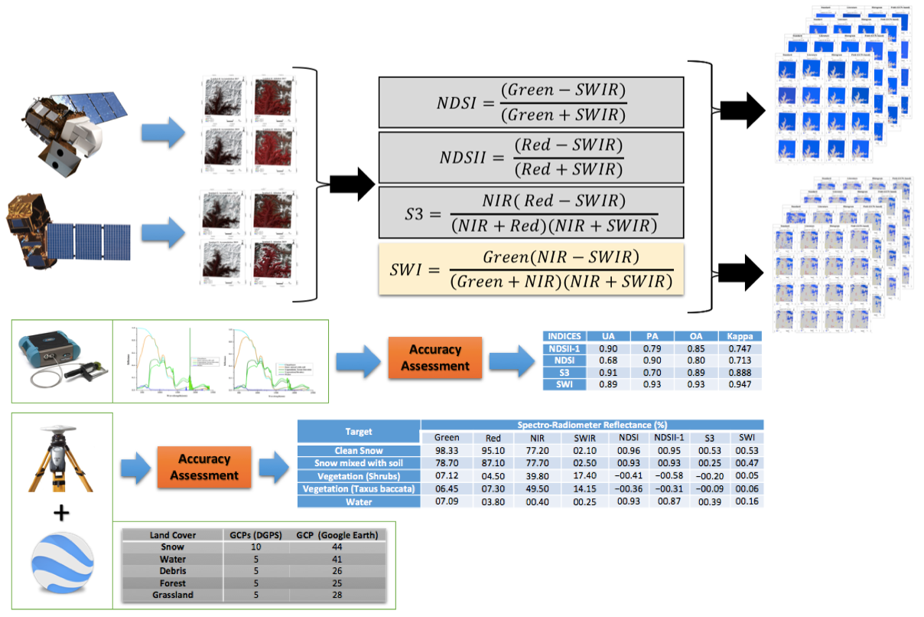
Methodology
Fig: Methodology Diagram

Slide 8
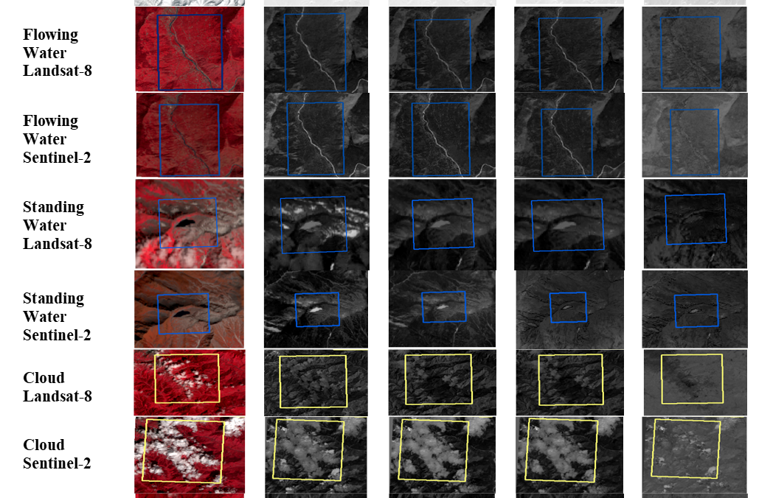
Results
SENSOR | ML | NDSI | NDSII-1 | S3 | SWI

Slide 9
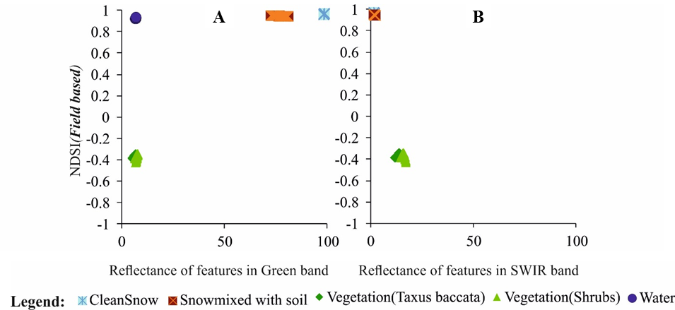
Results: Performance of various snow cover indices
Target | Spectroradiometer Reflectance (%)
 | Green | SWIR | NDSI
Clean Snow | 98.33 | 2.1 | 0.96
Snow mixed with soil | 78.7 | 2.5 | 0.938
Vegetation (Taxus baccata) | 7.12 | 17.4 | -0.419
Vegetation ( Shrubs) | 6.45 | 14.15 | -0.36
Water | 7.09 | 0.25 | 0.93

Slide 10
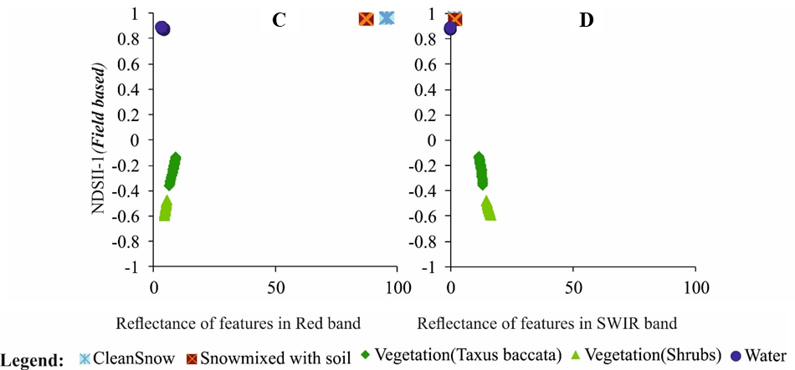
Results: Performance of various snow cover indices
Target | Spectroradiometer Reflectance (%)
 | Red | SWIR | NDSII-I
Clean Snow | 95.1 | 2.1 | 0.956
Snow mixed with soil | 77.7 | 2.5 | 0.937
Vegetation ( Shrubs) | 4.5 | 17.4 | -0.589
Vegetation (Taxus baccata) | 7.35 | 14.15 | -0.316
Water | 3.8 | 0.25 | 0.876

Slide 11
Results: Performance of various snow cover indices
E
F
G
Target | Spectraoradiometer Reflectance (%)
 | Red | NIR | SWIR | S3
Clean Snow | 95.1 | 77.2 | 2.1 | 0.53
Snow mixed with soil | 87.1 | 77.7 | 2.5 | 0.25
Vegetation ( Shrubs) | 4.5 | 39.8 | 17.4 | -0.20
Vegetation (Taxus baccata) | 7.35 | 49.5 | 14.15 | -0.09
Water | 3.8 | 0.4 | 0.25 | 0.39

Slide 12
Results: Performance of various snow cover indices
I
J
H
Target | Spectroradiometer Reflectance (%)
 | Green | NIR | SWIR | SWI
Clean Snow | 98.33 | 77.2 | 2.1 | 0.53
Snow mixed with soil | 78.7 | 77.7 | 2.5 | 0.47
Vegetation ( Shrubs) | 7.12 | 39.88 | 17.4 | 0.059
Vegetation (Taxus baccata) | 6.45 | 49.5 | 14.15 | 0.06
Water | 7.09 | 0.4 | 0.25 | 0.16

Slide 13
Thanks…..

