Slide 1
Department of Chemistry
University of Crete
European Geosciences Union
EGU2020
"Atmospheric Degradation and Climate and Air-Quality Impact of Furan-based Biomass Burning Emission Products:
A Kinetic and Mechanistic study"
Maria E. Angelaki and Vassileios C. Papadimitriou
Laboratory of photochemistry and kinetics, University of Crete, 71003, Heraklion, Crete, Greece
Manolis N. Romanias
IMT Lille Douai, Univ. Lille, SAGE, F-59000 Lille, France
May, 2020

Slide 2
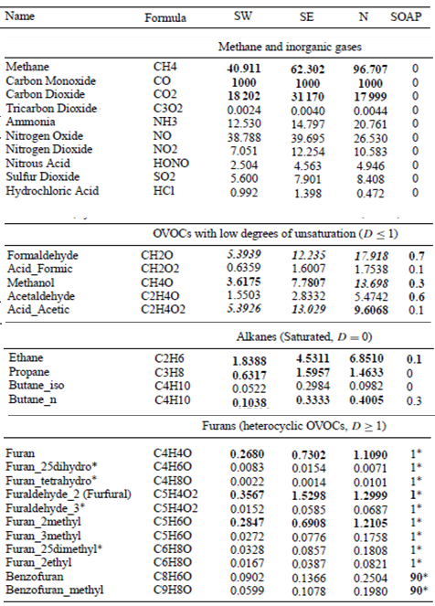
Biomass Burning Emission Products
Biomass Burning (BB) Sources
Anthropogenic: Indoor Fires, Agricultural Burning and Fuel Use
Biogenic: Wild – Land Fires
Emission from BB
Gases
Particles (Primary)
Greenhouse Gases
High, Semi and Low
Volatile Compounds
May Lead to Secondary
Organic Aerosol Formation
Direct Impact on Air-Quality, Climate and Human Health
Furan-Based Compounds
Recently Identified as Important BB Products
High Values of SOAP
(Secondary Organic Formation Potential)
J. B. Gilman., et. al., Atmos. Chem. Phys., 15, 13915–13938, 2015

Slide 3
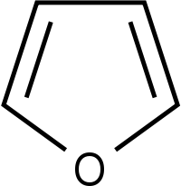
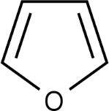
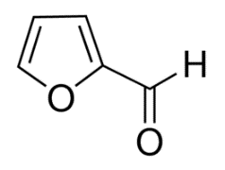
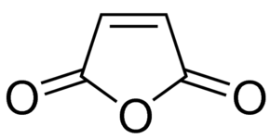
Impact of Furan-based Compounds
Heterocyclic Oxygenated Organic Compounds
(Aromatic or Non-Aromatic)
R
(–OH, –C_{n}H_{2n+1}, –C(O)R
R: C_{n}H_{2n+1} , n≥0)
High Volatile
Semi Volatile
Low Volatile
Furan
V.P. ~470 Torr (296 Κ)
Furfural
Maleic Anhydride
V.P. ~2 Torr (296 Κ)
V.P. ~0.16 Torr (296 Κ)
Adverse Effect of Furan-based Compounds
Humans Health: Causing Pulmonary Problems and Cancer
(Potent Condensation on Atmospheric Particles)
Air Quality: May Lead to Photochemical Production O₃ and
Secondary Organic Aerosol Formation (SOA)
Alter Atmospheric Irradiation and Chemistry Balance

Slide 4
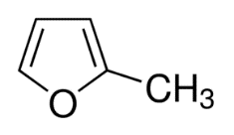
Aim of This Work
Evaluation the Hole Impact of Furans to Atmosphere, Air Quality and Health
Detail Kinetic and Mechanistic Study of Gas-Phase Oxidation of
Furan, 2-MethylFuran, 3-MethylFuran, Furfural, Maleic Anhydride, BenzoFuran, 5-Hydroxy-(2,5H) Furanone
with ΟΗ, Cl, NO₃, O₃: X
Kinetic Study
Determination of Rate Coefficients, k_{x}(T,P)
Over the Temperature and Pressure Range: 273 – 363 K, 0.002 – 760 Torr
Mechanistic Information about the Potent Degradation Pathways
Addition of X on Furan Ring or/and -H Abstraction Pathway – Evaluation of their Contribution
Determination of Lifetime
(Gas Phase Chemistry)
$\frac{1}{τ_{eff}}= \frac{1}{τ_{OH}}\text{+}\frac{1}{τ_{Cl}}$ + $\frac{1}{τ_{NO3}}\text{ +}\frac{1}{τ_{O3}}$ + $\frac{1}{τ_{Photolysis}}$
Mechanistic Study
Key Role
Products are Potent
Precursors for SOA Formation
End Oxidation Products Identification and Yields Quantification
Secondary Organic Aerosol Production and Quantification
This Presentation focuses on OH Kinetics of Furan and 2-Methylfuran
Furan (C₄H₄O)
2-Mathylfuran (C₅H₆O)

Slide 5
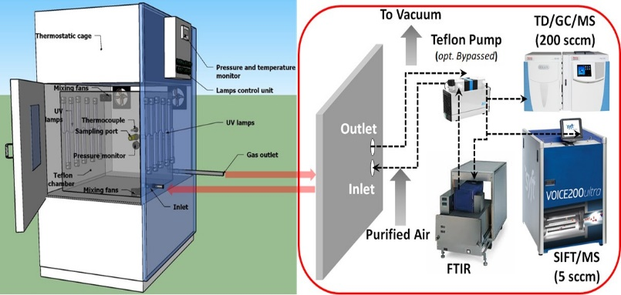
Experimental Techniques and Conditions
OH kinetics
a. 600 L Teflon Chamber
THermAL Regulated AtMOSpheric Simulation Chamber
THALAMOS
b. Thermostatic Cage enables
Control of Temperature
b
c. Introduction of Reactants
d. Homogeneity of Gas Mixture
e
e. UVA and UVC Lamps for
Production of Reactive Species
d
f. Detection Techniques
a
c
Chemical Ionization Mass Spectrometry
Infrared Spectroscopy
f
Noureddin Osseiran, Manolis N. Romanias, Vincent Gaudion, Maria E. Angelaki, Vassileios C. Papadimitriou, Alexandre Tomas, Patrice Coddeville, Frederic Thevenet, 2020
Precursors for OH Radicals
H₂O₂ Photalised with UV-C Irradiation
HONO Photalised with UV-A Irradiation
RELATIVE RATE COEFFICIENTS DETERMINATION
$$ln\left(\frac{[{Furan]}_{0}}{{\left[Furan\right]}_{t}}\right)− (k_{Loss_F}×t)=\frac{k_{F}}{k_{Ref}}×\left[ln\left(\frac{[{Ref]}_{0}}{{\left[Ref\right]}_{t}}\right)− (k_{Loss_Ref}×t) \right]$$
k_{F}
k_{Ref}
P₂
OH + Furan
P₁
OH + Ref

Slide 6
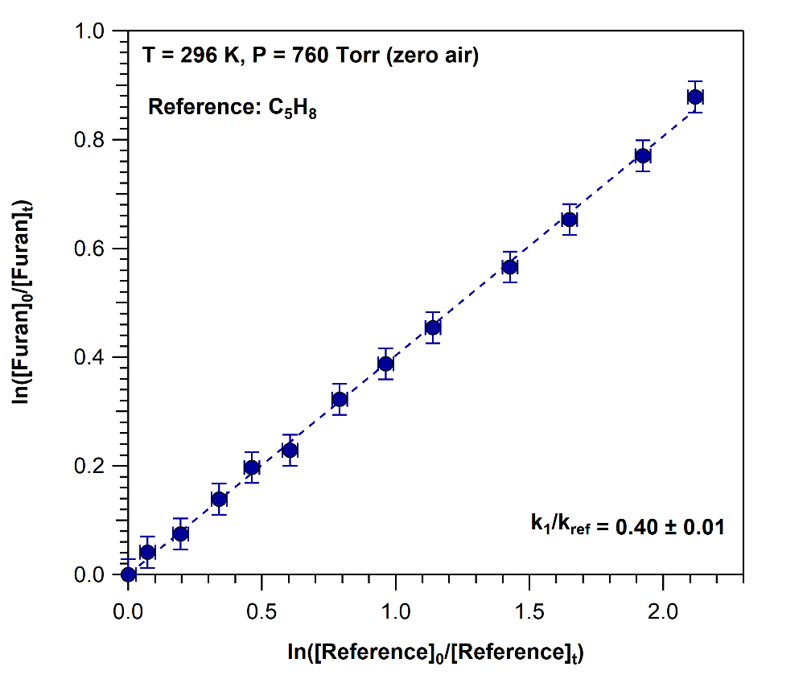
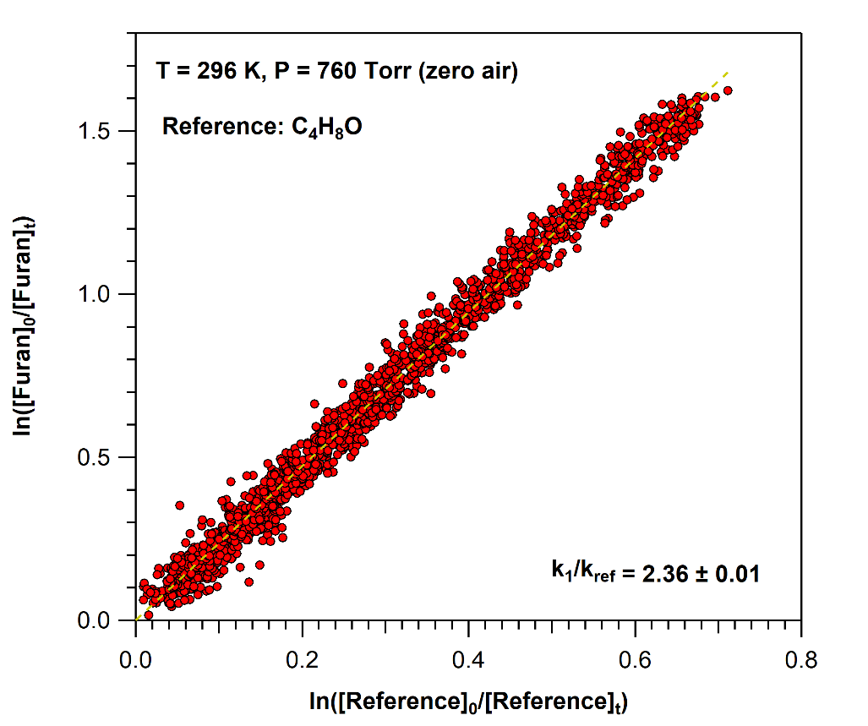
OH Kinetics with Furan at 296 K and 760 Torr
Relative Rate Measurements for OH + C₄H₄O, k(296 K, 760 Torr)
FT – IR
SIFT – MS
k_{(296 K, 760 Torr)} = (4.04 ± 0.20) × 10⁻¹¹ cm³ molecule⁻¹ s⁻¹
k_{(296 K, 760 Torr)} = (4.15 ± 0.24) × 10⁻¹¹ cm³ molecule⁻¹ s⁻¹
Agreement Between Reference Reactions and Detection Techniques
~ 3 %

Slide 7
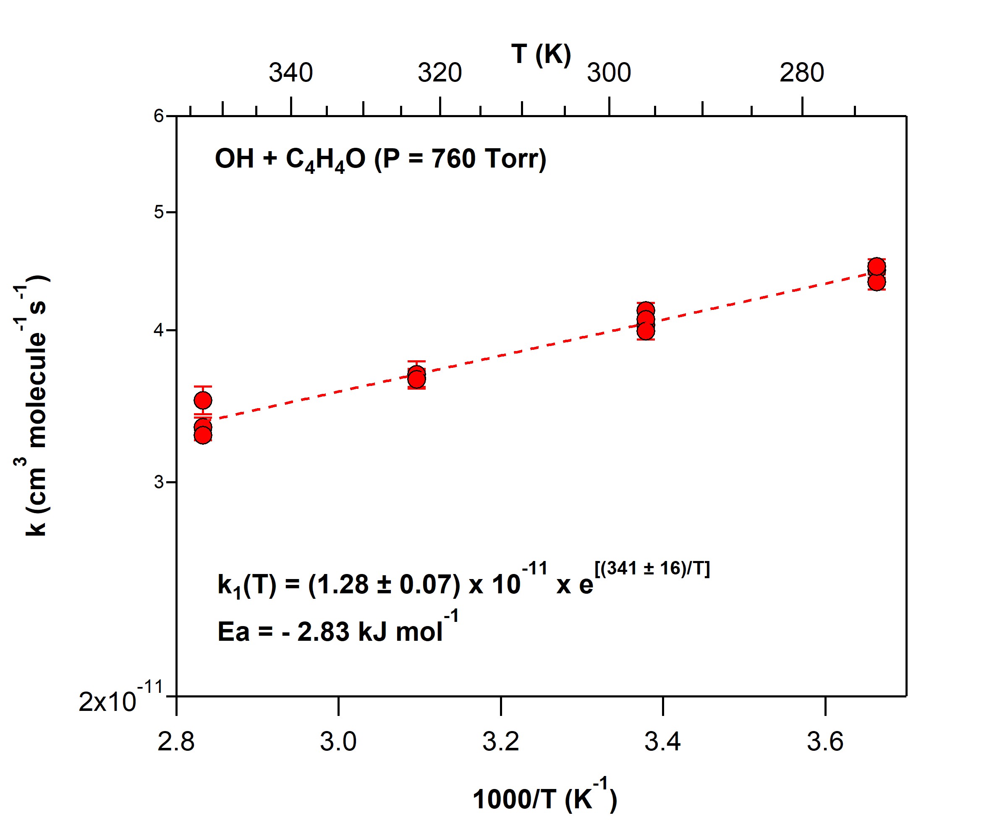
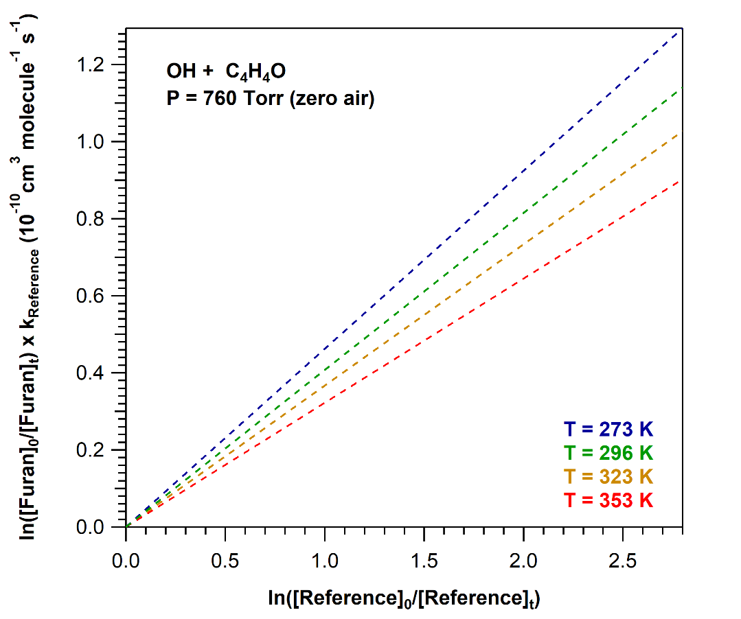
Temperature Dependent OH Kinetics with Furan – Comparison with 2-Methylfuran
Relative Rate Measurements
for OH + C₄H₄O, k(T, 760 Torr)
Arrhenius Plot for OH + C₄H₄O, k(T, 760 Torr)
Negative Activation Energy
Complex Reaction Mechanism
Decrease of k₁ as Temperature Increases
Formation of an intermediate adduct during OH addition to the double bond that its stabilization is favored at low temperatures where the thermal energy of the system is low

Slide 8
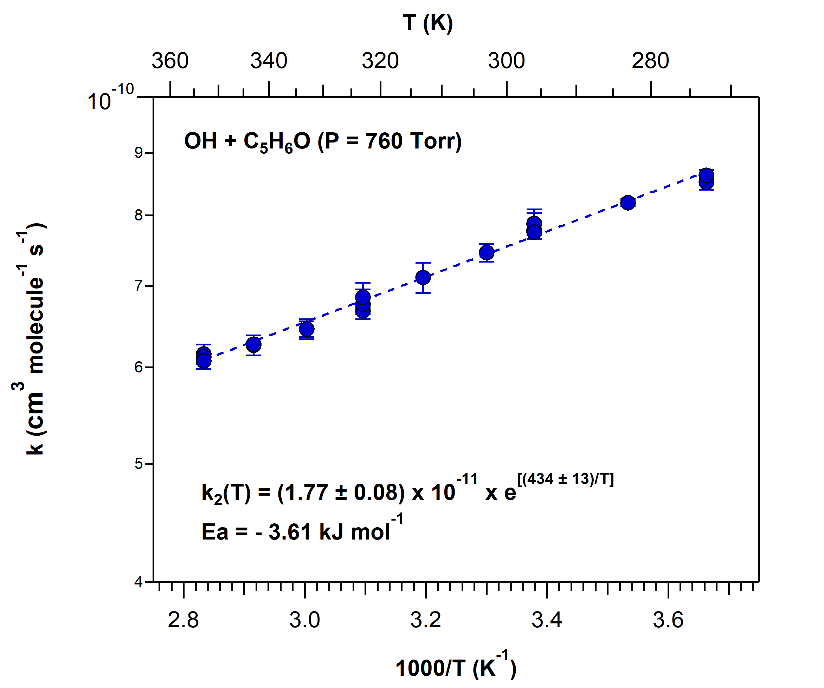
Comparison of Furan with 2-Methylfuran
Arrhenius Plot for OH + C₄H₄O, k(T, 760 Torr)
Arrhenius Plot for OH + C₅H₆O, k(T, 760 Torr)
Both
Negative Activation Energy
Complex Reaction Mechanism
k_{OH}(296 K)
k₁ | (4.04 ± 0.32) × 10⁻¹¹ cm³ molecule⁻¹ s⁻¹
k₂ | (7.77 ± 0.52) × 10⁻¹¹ cm³ molecule⁻¹ s⁻¹
k₁ < k₂
Substitutes Play Key Role in Reactivity
-CH₃ → Increase the Electronic Density of Furan Ring
-H Abstraction from CH₃ Group is Competing
Preserving the Aromaticity

Slide 9
Atmospheric Implications of Furan and 2-Methylfuran
Fast Reactions
Short Lifetimes
Fast Removal from the Atmosphere
Furan
[OH]_{avg}= 10⁶ molecule cm⁻³
2-Methylfuran
τ_{ΟΗ} = 6.9 hours
τ_{ΟΗ} = 3.6 hours
Furan and 2-Methylfuran are two High Volatile Compounds
Addition of OH to the Double Bond
-H Abstraction
Other Processes
Degradation with OH Radicals through
Complex Reaction Mechanism
Unsaturated and Big Molar Mass
End Oxidation Products
¹Maleic Anhydride: Product
from 2-Methylfuran + OH
Lower Volatility
Leading to SOA Formation
Production of Other Furans
¹A. Bierbach, et al., Atmospheric Environment, 29, 2651-2660, 1995

Slide 10
Maleic Anhydride – A Very Low Volatile Organic Compound
Atmospheric Degradation
Reaction with OH
Photalised at Actinic Wavelengths
C₂H₂(CO)₂O, Furan-2,5-dione
Maleic Anhydride
k_{(296 K, 760 Torr)} = (4.09 ± 0.04) × 10⁻¹³ cm³ molecule⁻¹ s⁻¹
(This Study)
Slow Process
Vapor Pressure (296 K) = 0.16 Torr
Even Lower at Low Temperatures
≌ Higher Altitudes
Primary Aerosol Formation due to
Potent Condensation on Atmospheric Aerosols
Products may have Lower Volatility
Secondary Organic Aerosol Formation

Slide 11
Conclusions
Furans are important biomass burning products mainly from fires and fuel use
They have an adverse effect on Air-Quality, Climate and Human Health
Removal Processes: Photolysis and Reaction with OH, Cl, NO₃ and O₃
Fast Removal from Troposphere, Short Atmospheric Lifetimes
However…
End-Oxidation Products may Play a Key-Role to Air-Quality
Potent Precursors for Secondary Organic Aerosol Formation
Alter Atmospheric Irradiation and Chemistry Balance – Related to Health Issues
Future work…
Kinetic Study with NO₃ and O₃
Identification and Quantification of All Gas Phase End-Oxidation Products and SOA
Evaluation the Hole Impact of Furans to Atmosphere, Air Quality and Health

Slide 12
Acknowledgments
University of Crete, Department of Chemistry
École Mines-Télécom
IMT – Université de Lille
Scientific Supervisor: Dr. Vassileios C. Papadimitriou
Scientific Advisor: Pr. Maria Kanakidou
Members of Committee
Prof. Maria Kanakidou
Prof. Demetrios Anglos
Ass. Prof. Constantinos Milios
Ass. Prof. Manolis ROMANIAS
Prof. Alexandre TOMAS
Prof. Frederic THEVENET Group
This research is co-financed by Greece and the European Union (European Social Fund- ESF) through the Operational Programme «Human Resources Development, Education and Lifelong Learning» in the context of the project “Strengthening Human Resources Research Potential via Doctorate Research” (MIS-5000432), implemented by the State Scholarships Foundation (ΙΚΥ)»

