Slide 1
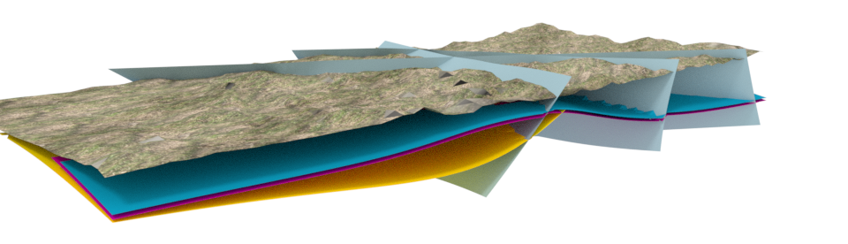
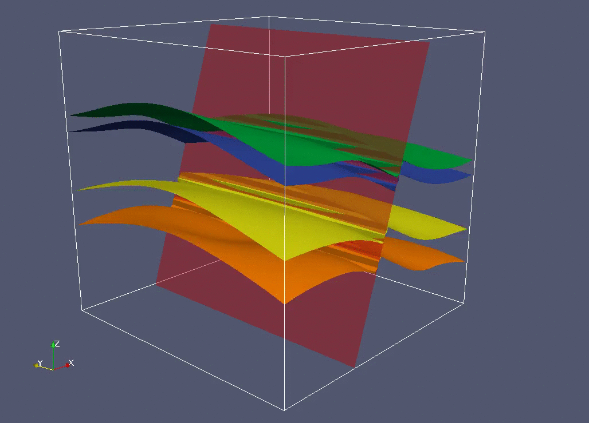
Probabilistic machine learning in geological modeling
M. de la Varga, F. Wellmann & GemPy Contributors
Notes:
Key words: Uncertain Geological models
Bayesian Network

Slide 2
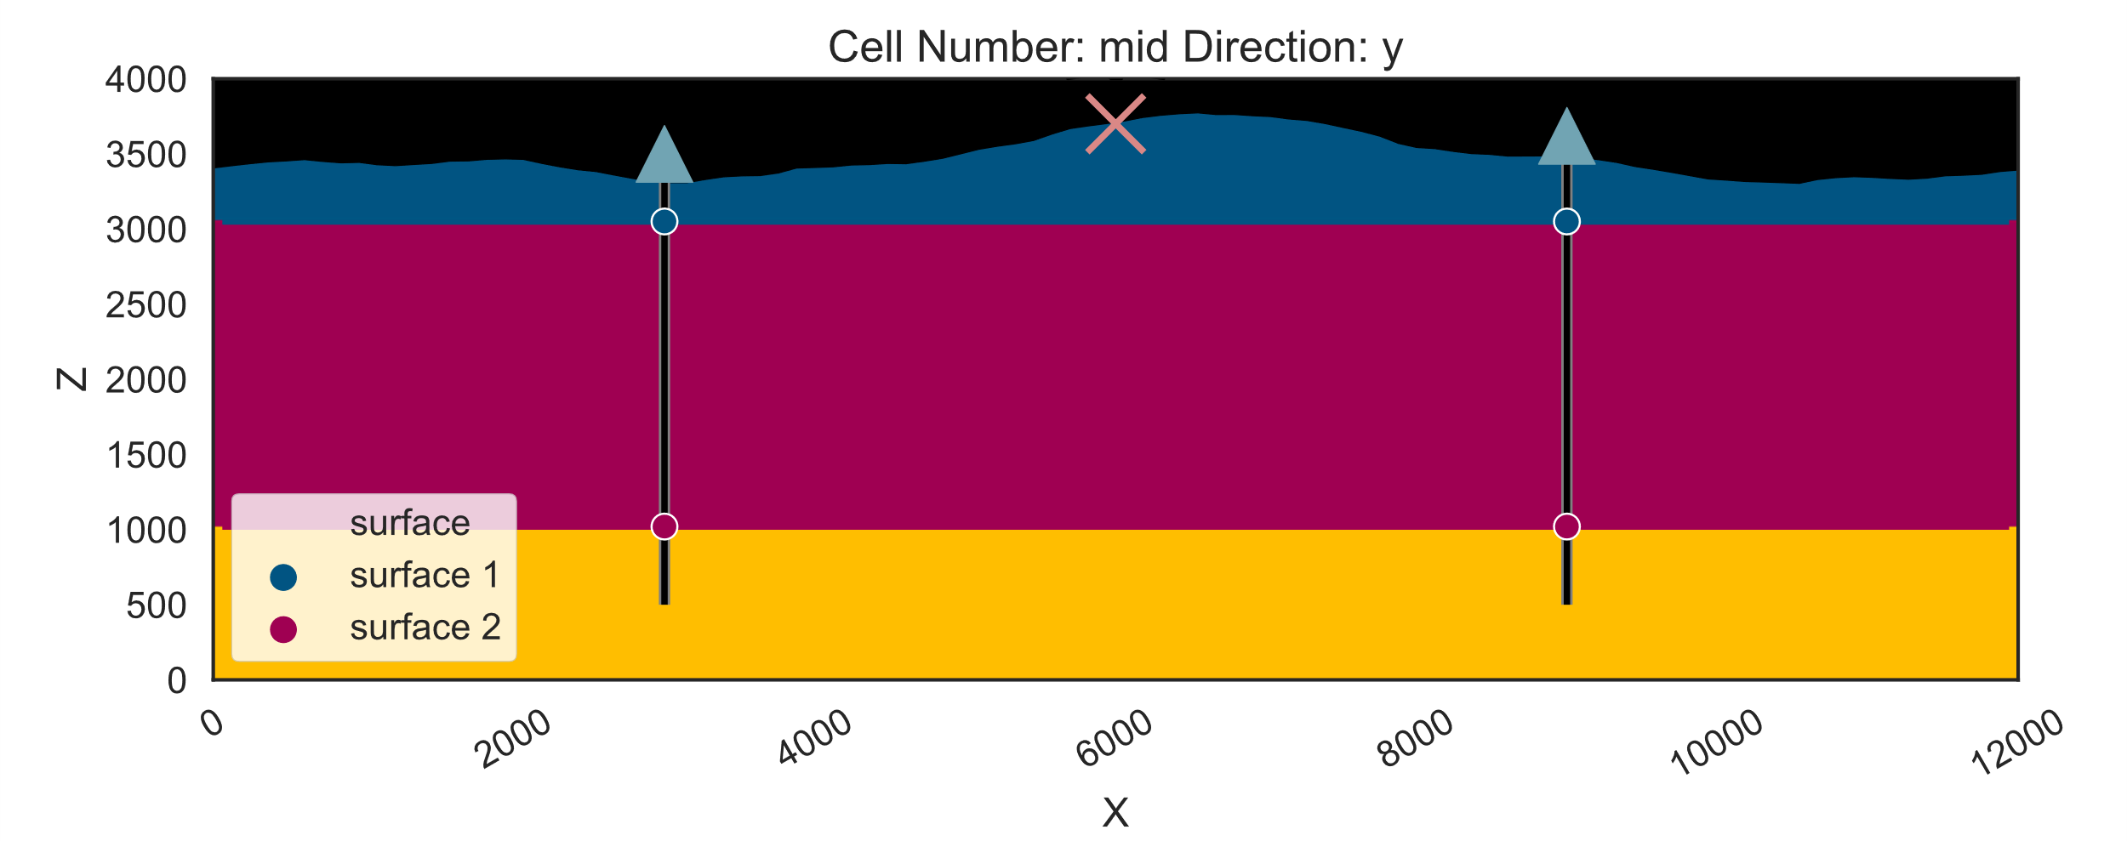
How certain are you of your uncertainty?

Slide 3
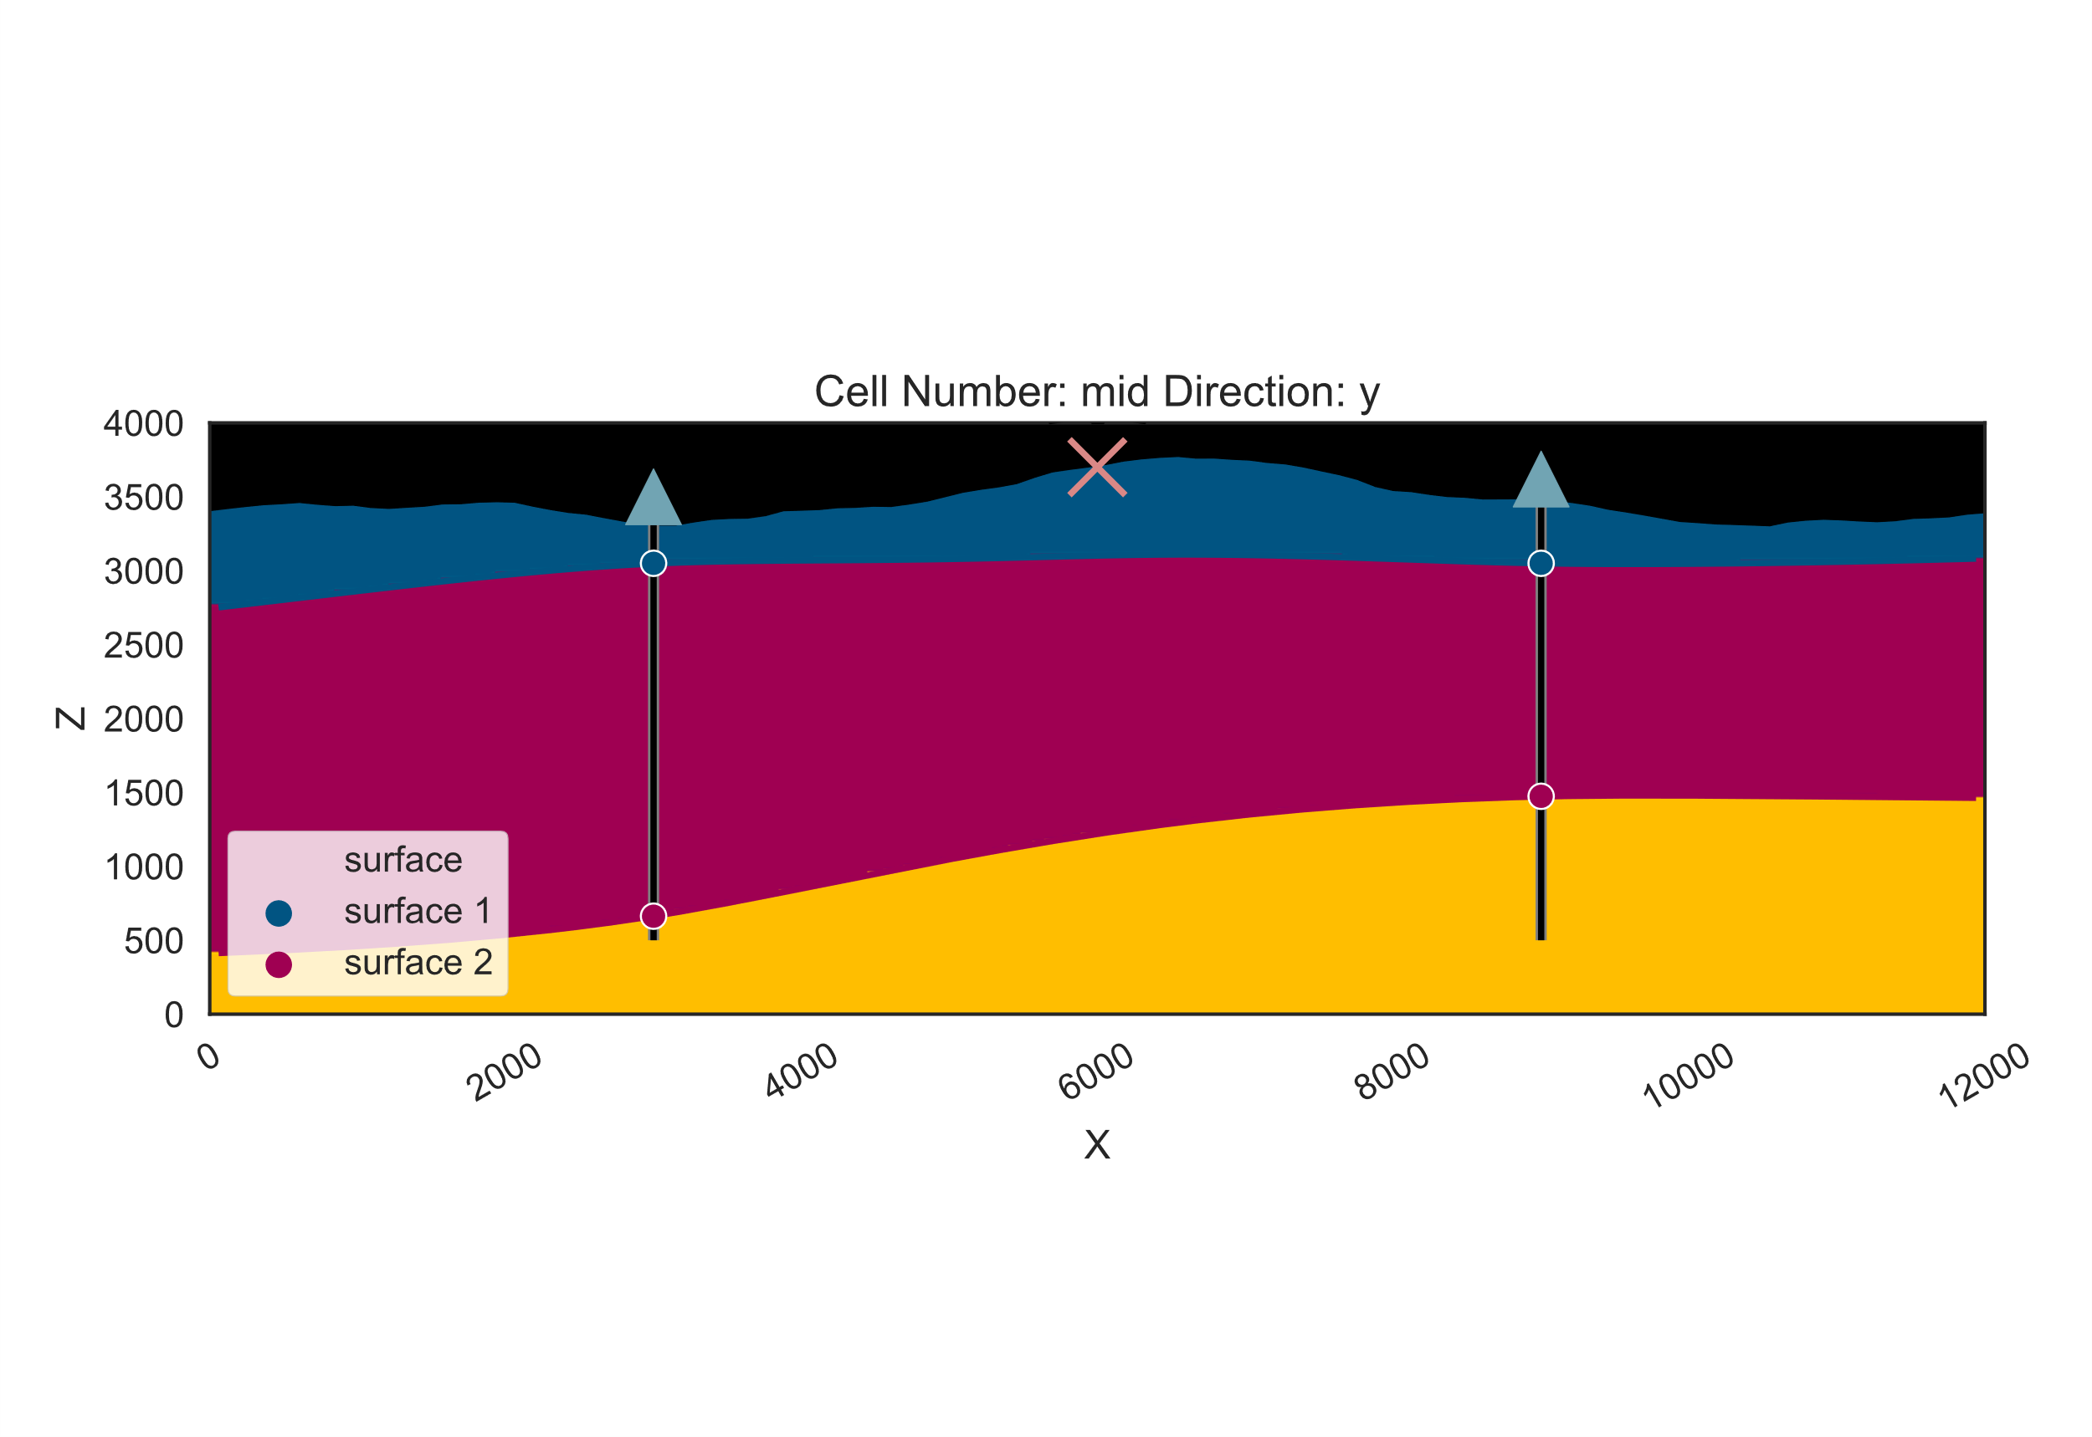
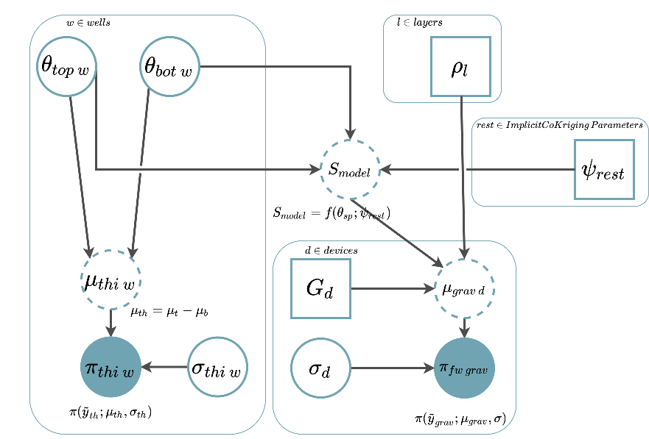
Take home message:
Designing probabilistic models (PM) is a continuous balance of complexity keeping the problem tractable. These are the main points to keep into consideration:
Quality of high dimensional integration: Number of evaluations necessary to approximate the true posterior.
Computational complexity of the forward model: Number of computations per evaluation.
Complexity of the PM: Number of random variables and likelihoods necessary to represent reality to a sufficient scale for a given question

Slide 4
Starting simple

Slide 5
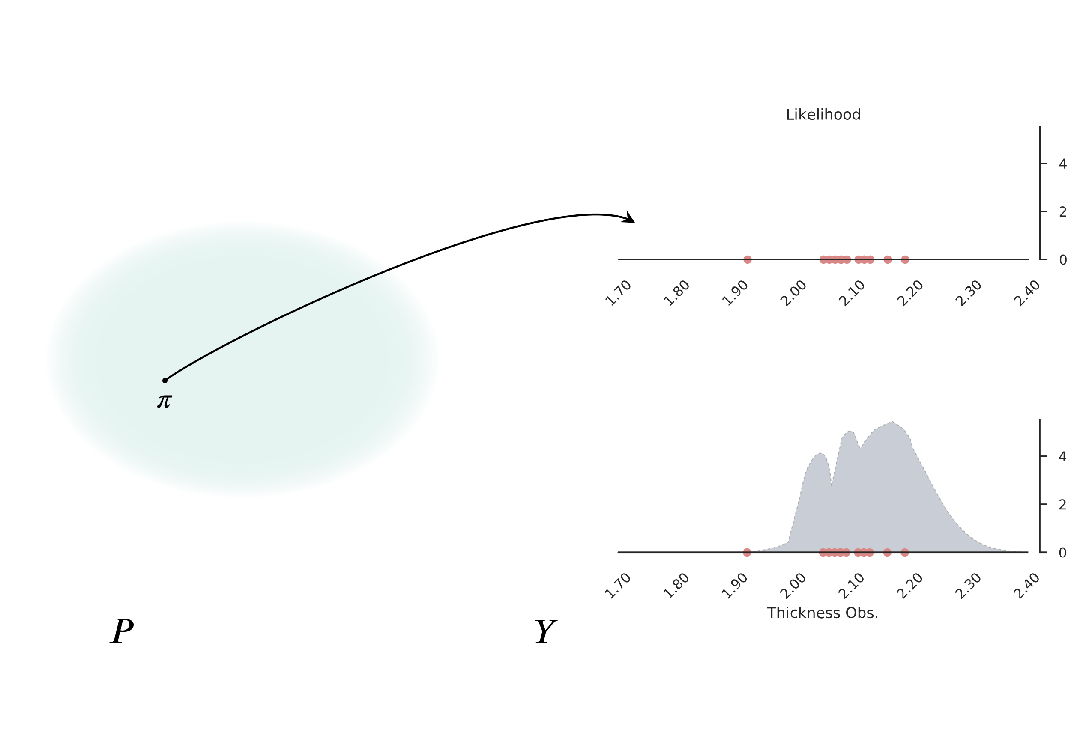
What is my thickness?
Focus first on 1D, how thick is the red Layer?
Space of all possible random variables. Not only the classical probability density functions.
Measured observations of the real world
Hidden random variable that generate observations. Intractable…
Example of random variable
… However we can infer some kind of approximation

Slide 6
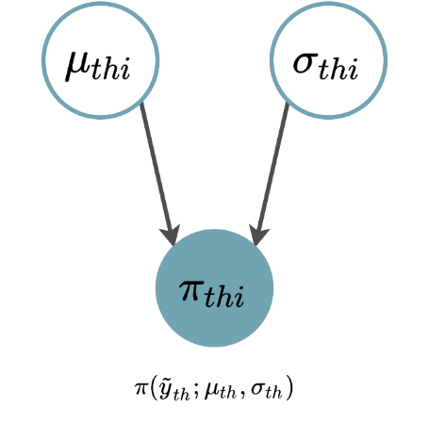
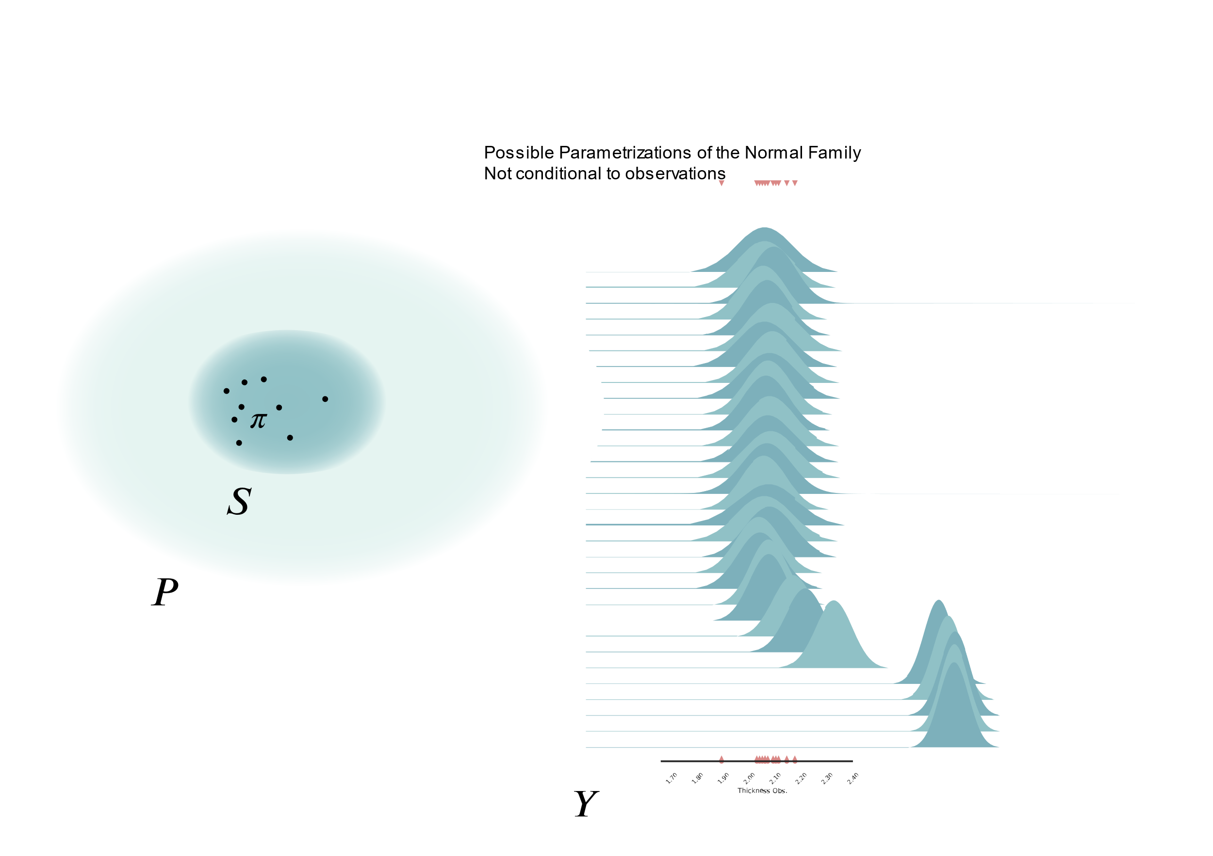
Let’s assume…
Graphical Models can help to represent large conditional probability networks
Let’s assume the random variable that generated the thickness observations belongs to the Normal Family.
Looking less daunting… but still there are many that could fit…
… But these ones here looks very unlikely

Slide 7
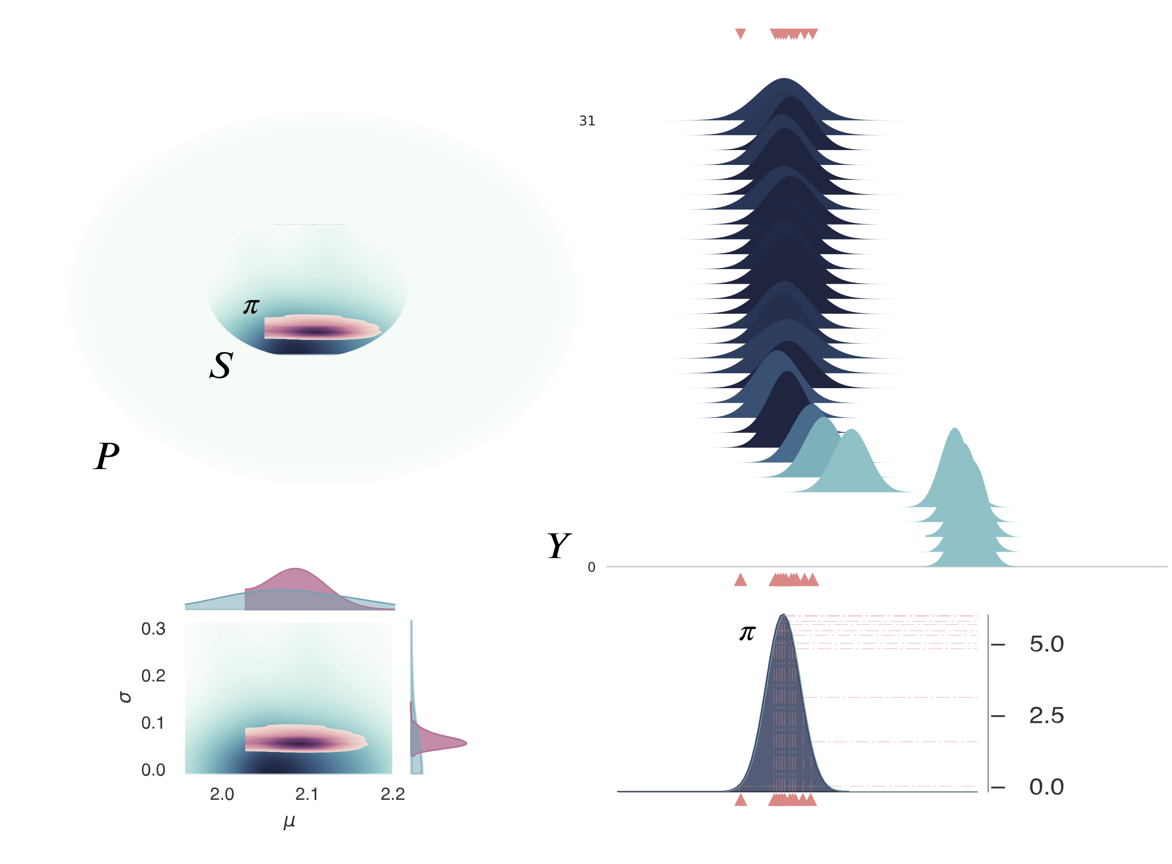
Probability of probability
We can use conditional probability to quantify how likely is that an observation was generated by one of the Normal distribution
Darker means more likely
In blue: Prior probability before conditioning to the data
Since we have many observations, we should add the likelihood of each individual observation
In red: posterior probability

Slide 8
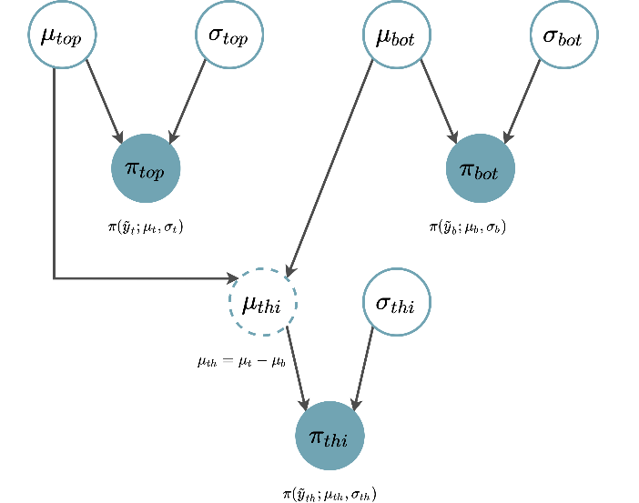
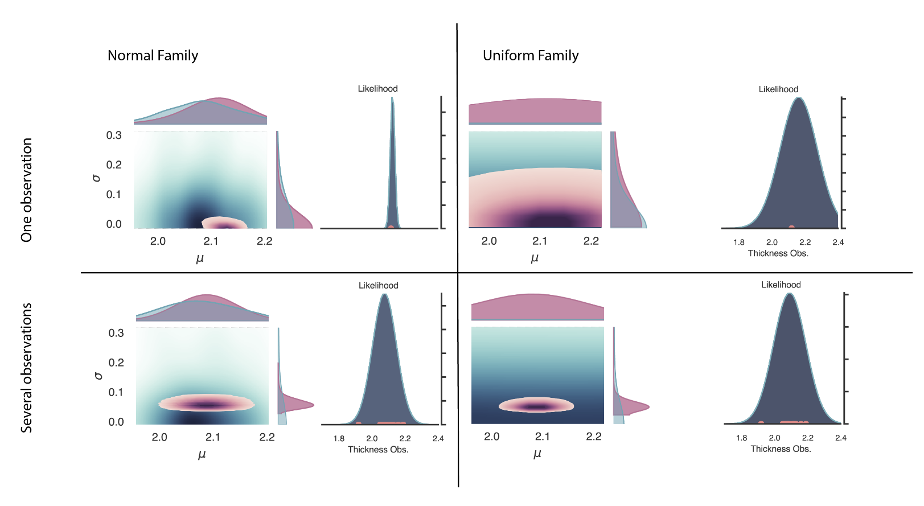
Adding complexity
Using conditional probability we can add observations that relates algebraically to other observations…
If we have only one observation, the prior will dominate the problem
…By doing so we increase the dimensionality of the problem
Unbounded uniform distributions are not unbiased since most (all) area accumulates around infinite

Slide 9
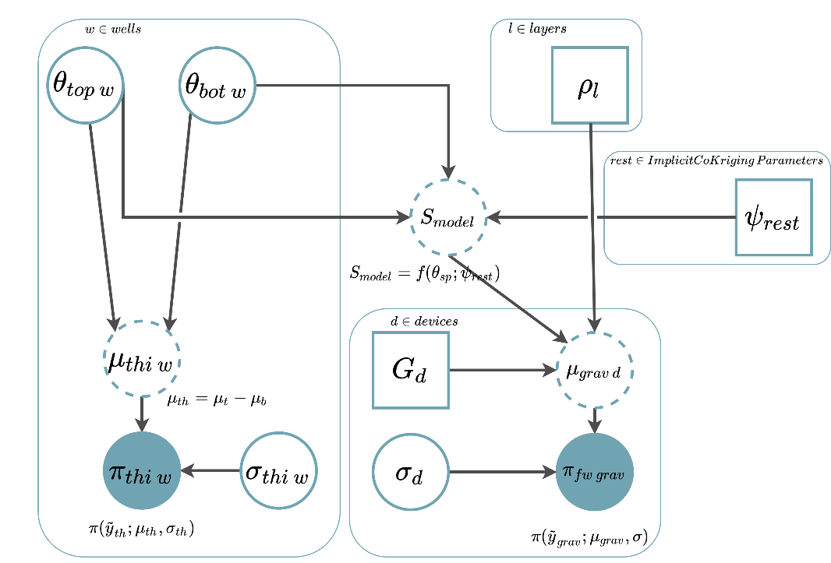
Joint Inversion
We can scale the PM to full 3D structural models…
…but integral get hard
Adding observations that share less information with each other, such as geophysics, will bring us closer to the “true” generative random functions

Slide 10
Joint Inversion
Using uncorrelated parameters is important to keep the posterior as well behave as possible
The more information the model has, the more incoherent it gets. This means that the distributions will get flat and low

Slide 11
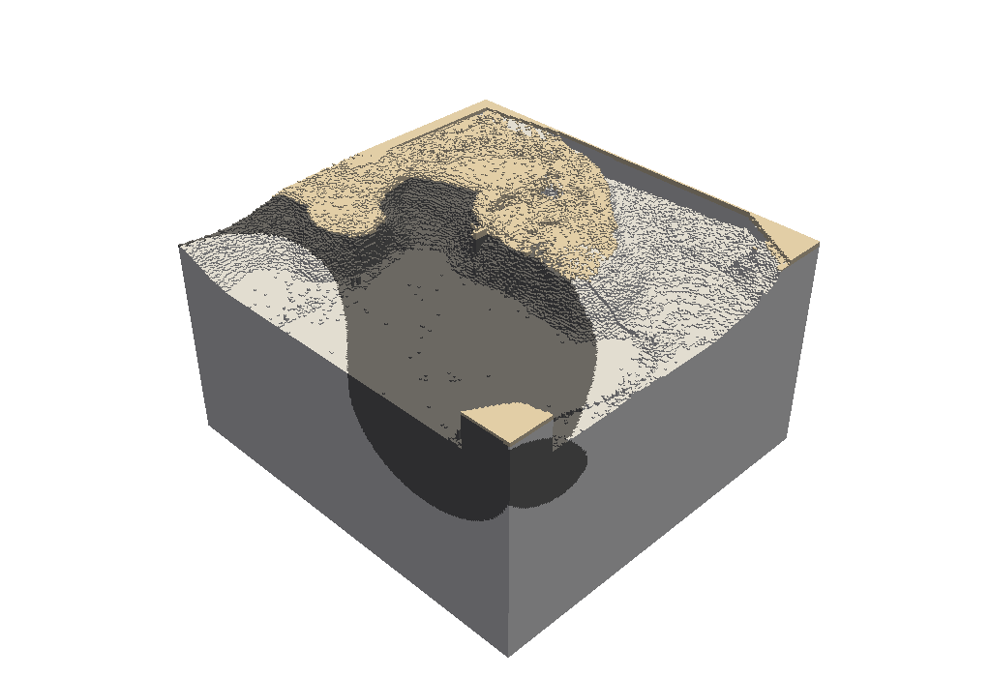
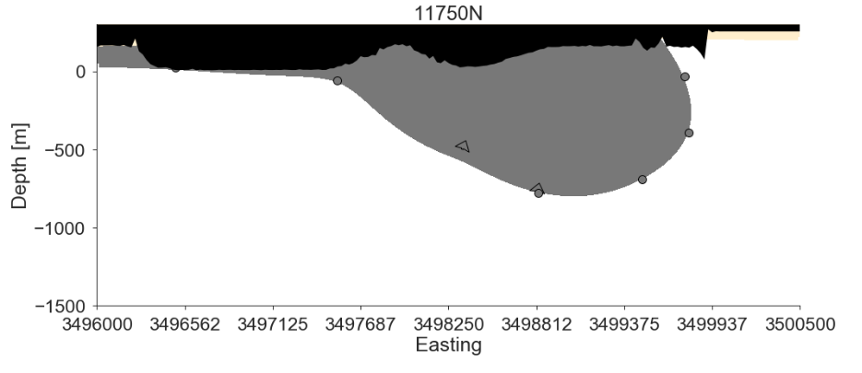
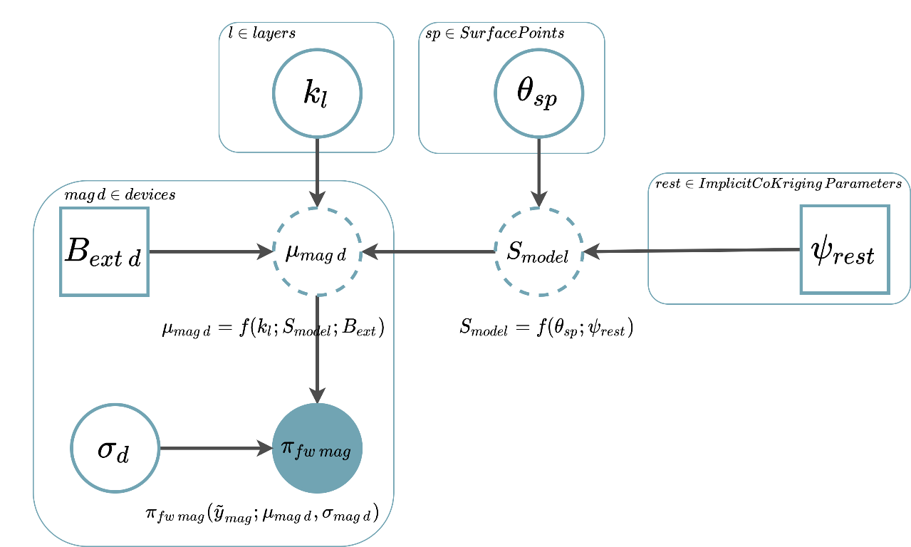
Kevitsa Deposit: Magnetics Likelihood
Every year we are able to increase the complexity of the models!
And we include more and more possible data.
Model-Based Probabilistic Inversion Using Magnetic Data: A Case Study on the Kevitsa Deposit. Master’s Thesis Nilgün Güdük

Slide 12
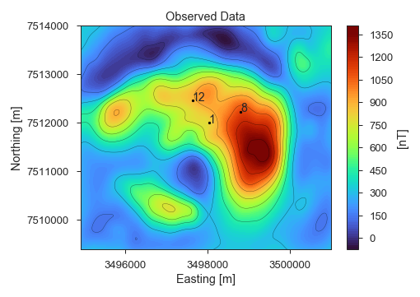
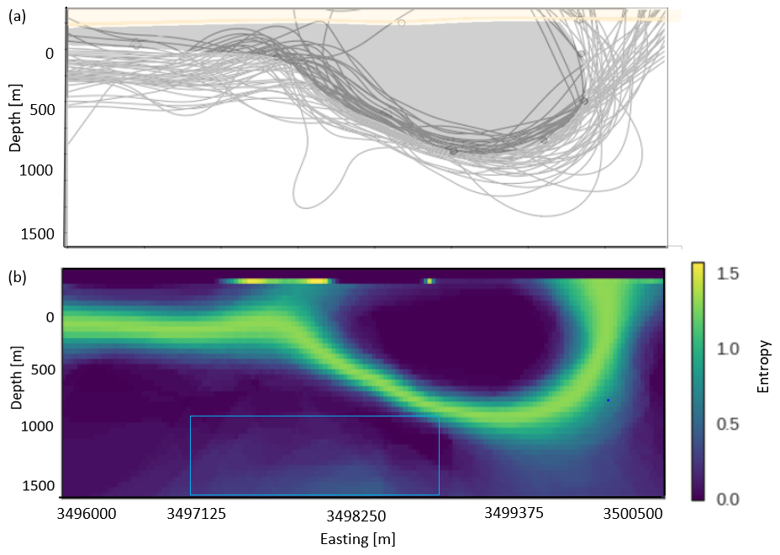
Kevitsa Deposit: Magnetics Likelihood
As complexity increase, more and more mathematical artefacts occurs
This is information entropy. Very useful to represent uncertainty in 3D
Model-Based Probabilistic Inversion Using Magnetic Data: A Case Study on the Kevitsa Deposit. Master’s Thesis Nilgün Güdük

Slide 13
Gullfaks Field: Topology Likelihood
This is just a teaser for what is coming! Stay tuned!
Constraining stochastic 3-D structural geological models with topology information using probabilistic machine learning Alexander Schaaf, Miguel de la Varga, Florian Wellmann, and Clare E. Bond, upcoming

Slide 14
Publication detailing this presentation will arrive soon
Thank you for making all the way till here
Questions?
All the content showed here has been created with GemPy…
https://github.com/cgre-aachen/gempy
Become contributor!
https://github.com/cgre-aachen/gempy/blob/master/CONTRIBUTING.md
… Although some of the functionality is not publicly released yet

