Slide 1
EGU2020-10856 | Displays | GI3.4/AS5.15/CR2.9
Inter-Calibration of nine UV sensing instruments over Antarctica and Greenland since 1980: impact on global UV cloud albedo trends
Clark Weaver, Gordon Labow, Dong Wu, Pawan K. Bhartia, and David Haffner
Tue, 05 May, 14:00–15:45 | D840
A suite of NASA/NOAA UV (340nm) sensing satellite instruments, starting with Nimbus-7 SBUV in 1980, provides a global long-term record of cloud trends and cloud response from ENSO events. We present new method to inter-calibrate the radiances of all the SBUV instruments and the Suomi NPP OMPS mapper over both the East Antarctic Plateau and Greenland ice sheets during summer. First, the strong solar zenith angle dependence from the intensities are removed using an empirical approach rather than a radiative transfer model. Then small multiplicative adjustments are made to these solar zenith angle normalized intensities in order to minimize differences when two or more instruments temporally overlap. While the calibrated intensities show a negligible long-term trend over Antarctica, and a statistically insignificant UV albedo trend of -0.05 % per decade over the interior of Greenland, there are small episodic reductions in intensities which are often seen by multiple instruments. Three of these darkening events are explained by boreal forest fires using trajectory modeling analysis. Other events are caused by surface melting or volcanoes. We estimate a 2-sigma uncertainty of 0.35% for the calibrated radiances. Finally, we connect the estimated radiance uncertainties, derived from our calibration approach, to the tropical and midlatitude UV cloud albedo trends.

Slide 2
Are there trends in global/regional cloudiness since 1980?
Method: Construct a cloud albedo record using the NASA/NOAA suite of UV satellite instruments.
PART I
Inter-calibration of nine UV sensing instruments
Weaver, C., Bhartia, P. K., Wu, D. L., Labow, G., and Haffner, D.: Inter-Calibration of nine UV sensing instruments over Antarctica and Greenland since 1980, Atmos. Meas. Tech. Discuss., https://doi.org/10.5194/amt-2020-7, in review, 2020.

Slide 3
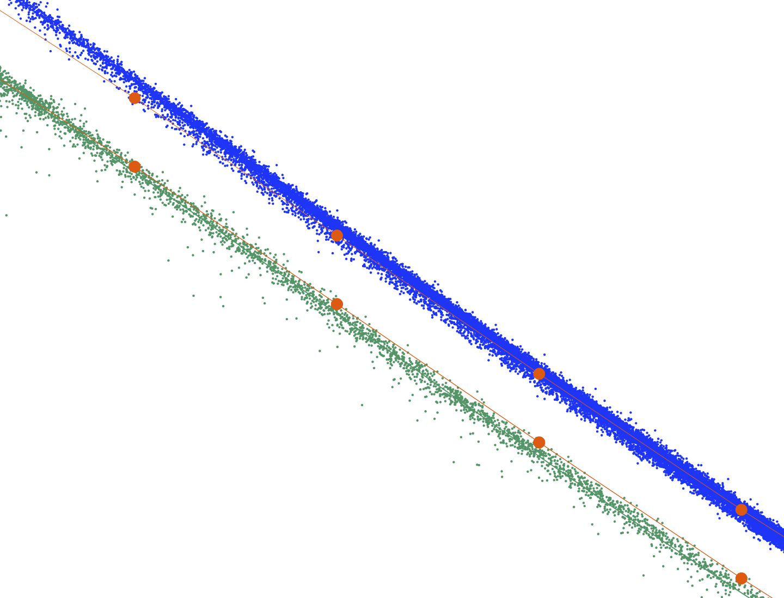


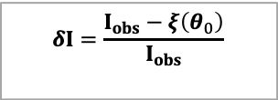




Figure 1. Observed Intensity (340nm) versus Solar Zenith Angle relationship over Ice Sheets for NOAA-16 (reference instrument).
δI quantifies how much an observation deviates from this empirical relationship.
VLIDORT Simulation
Intensity Antarctica
Four term Polynomial fit
$$I_{obs}$$
$$δI=\frac{I_{obs}−ξ\left(θ_{0}\right)}{I_{obs}}$$
$$ξ\left(θ_{0}\right)$$
Intensity over Greenland
$$ξ\left(θ_{0}\text{dark} \text{scene}\right)$$
$I_{obs}$ ^{dark scene}
$$\left(θ_{0}\right)$$
Solar Zenith Angle
$$\left(θ_{0}\right)$$

Slide 4
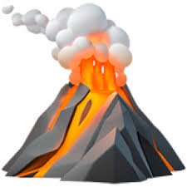
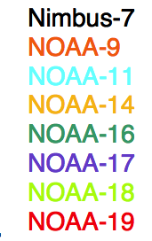
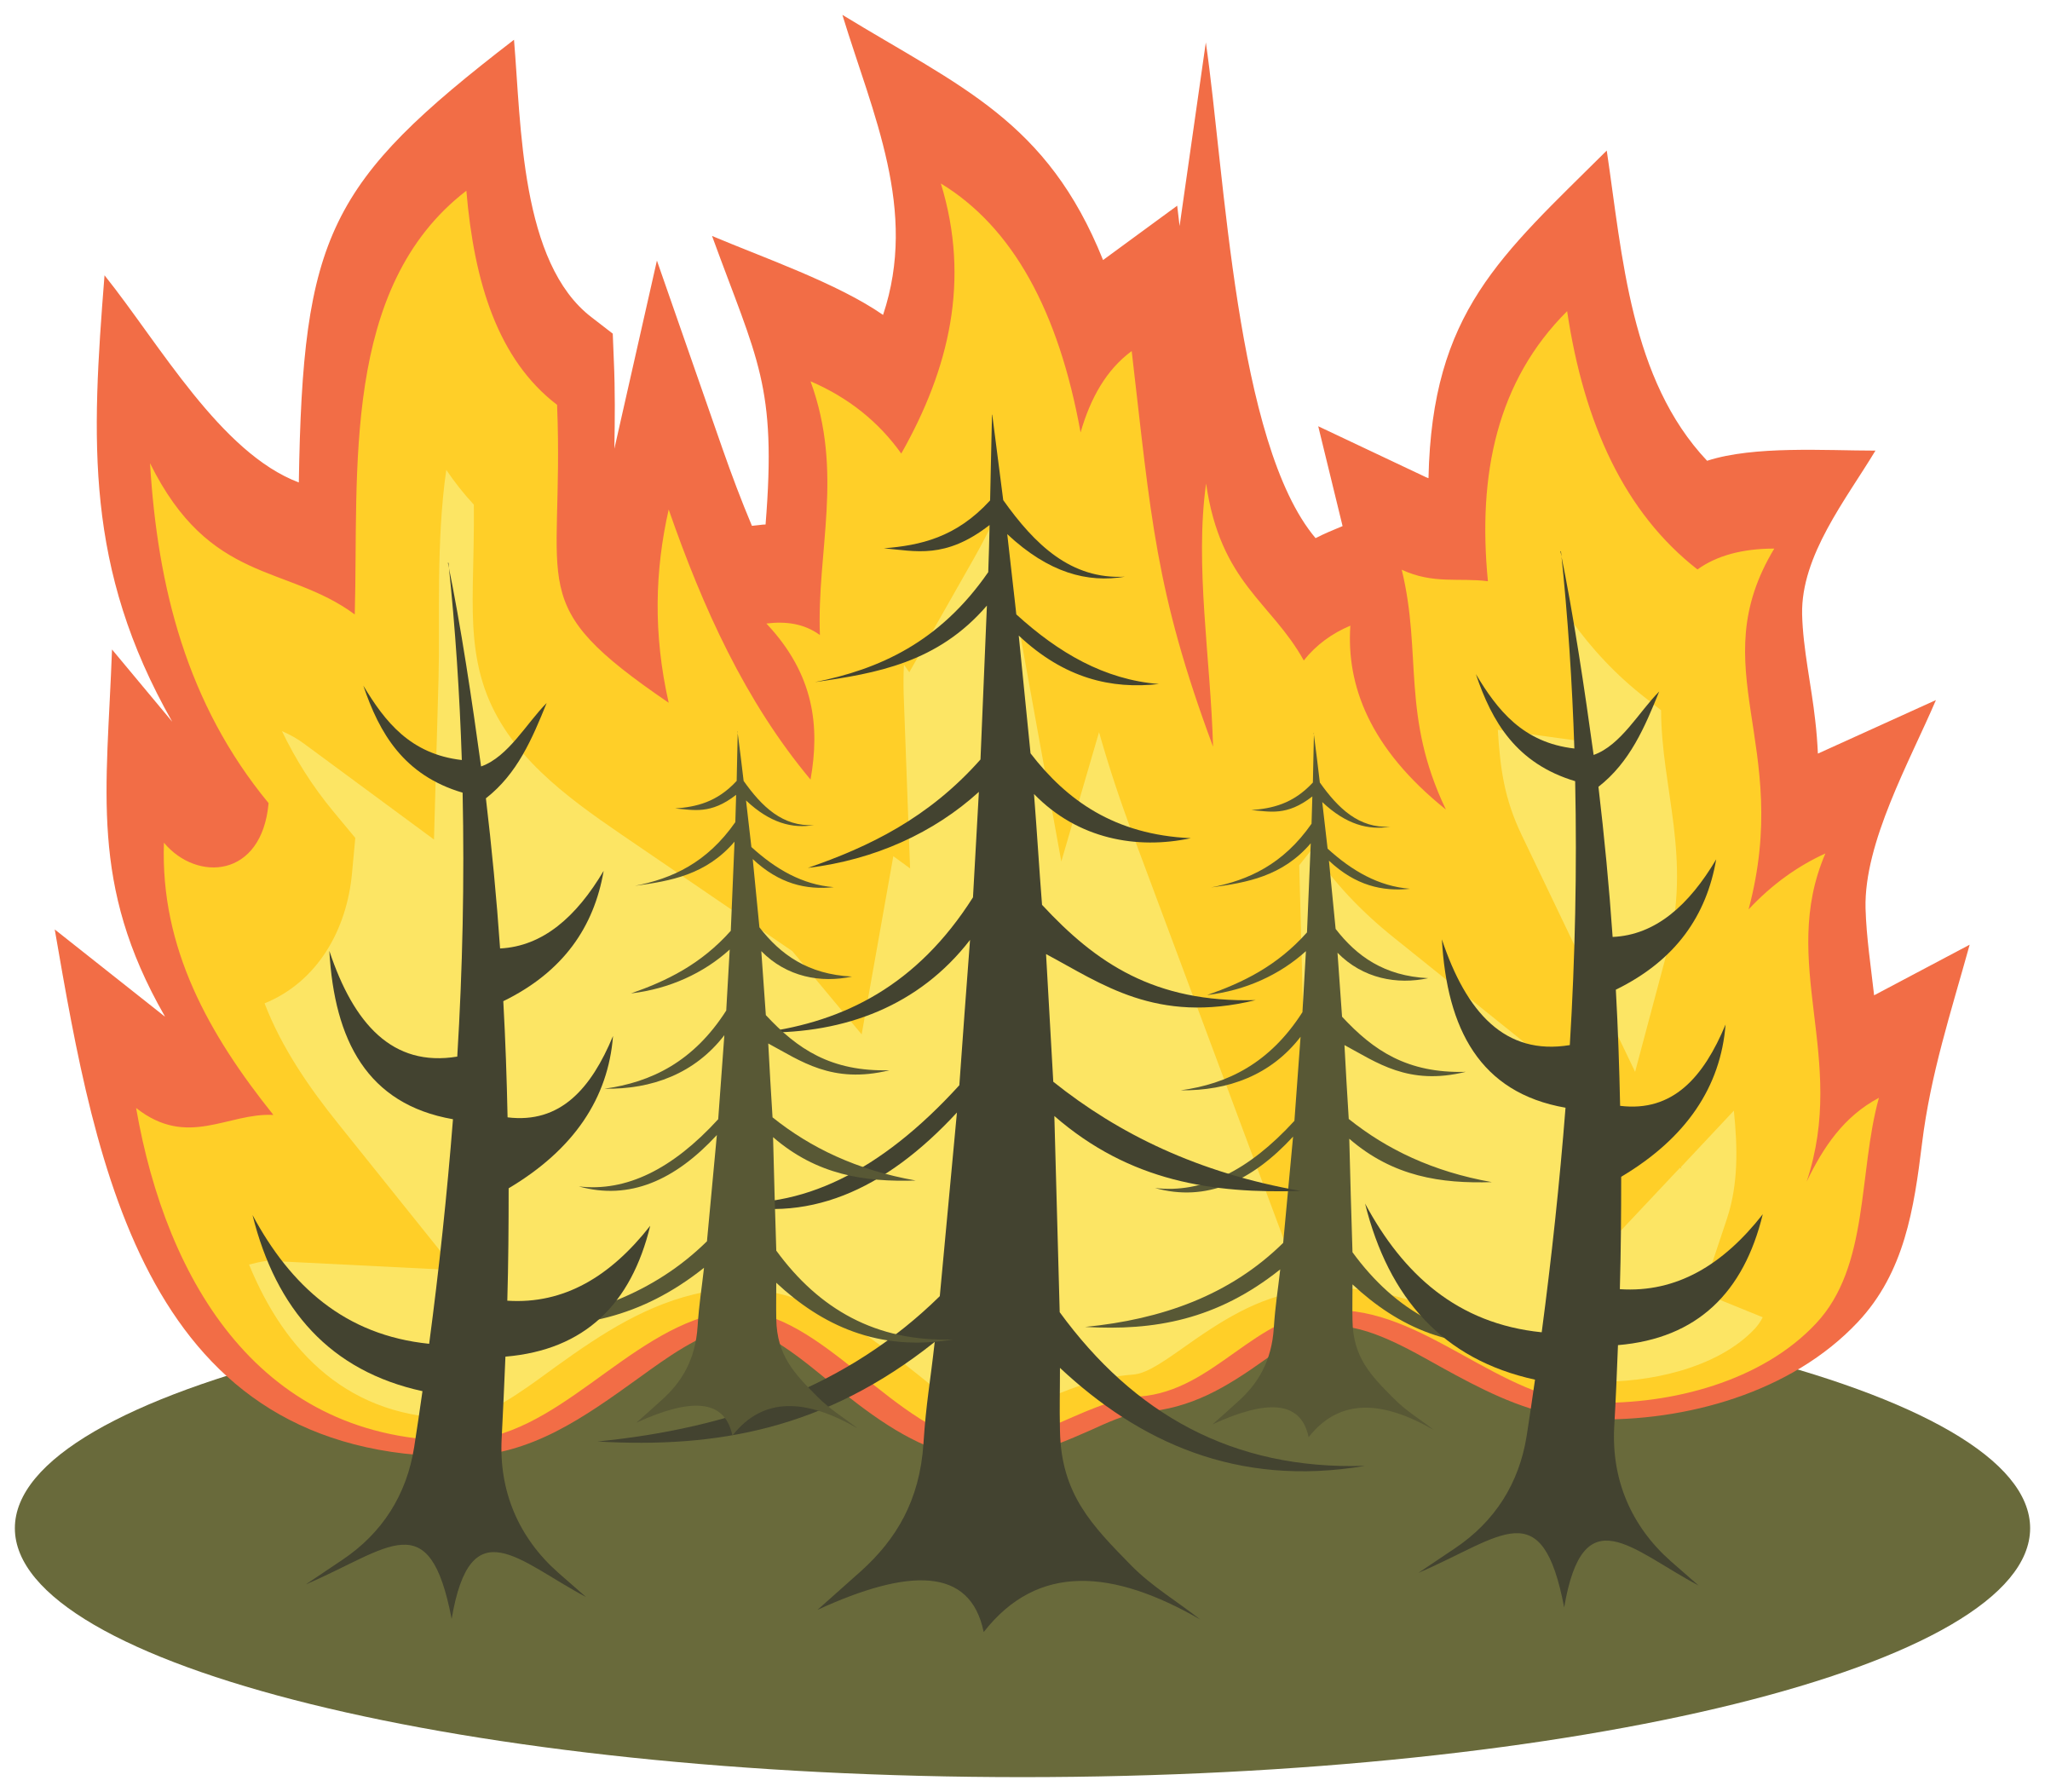


Figure 2. Inter-annual variability of δI for the SBUV instruments (colored) and the OMPS Mapper (grey) over Antarctica (a) and interior locations over Greenland (b) after calibration
Calibration Approach:
Minimize the inter-satellite differences when more than one instrument temporally overlap.
Evaluate the RMS of the all the inter-satellite differences across all SBUVs over both ice sheets. This is the ‘Cost’.
Assign an adjustable multiplicative gain constant to each SBUV instrument.
Adjust the gain constants to minimize the cost.
Note: We make no assumptions about a temporally constant reflectivity over Antarctica or Greenland.
East Antarctic Plateau Trend: +0.03 (0.06) albedo decade⁻¹
$δI$
OMPS mapper
LER albedo
Trend -0.05 (0.06) albedo decade⁻¹
$δI$
Reference instrument
MODIS C6
reflectance
Dry snow (>2000 m elevation)
Canadian wild fires
Wet snow (<2000 m)
Pinatubo

Slide 5
PART II
Derive the Black-sky Cloud Albedo from the UV intensities
From the calibrated radiances calculate the Black-sky Cloud Albedo (BCA) using VLIDORT Vector LInearized Discrete Ordinate Radiative Transfer package, (Spurr, 2006)
While the Nimbus-7 (1980-1991) was in a stable 11:45am orbit, all the following NOAA satellite platforms had a drifting orbit. Using the 14 million SBUV observations since 1980 we construct diurnal statistics over 6 local time bins for selected geographic locations
Apply diurnal adjustment to BCA, determine monthly averages, compare with CERES SW cloud albedo.
Weaver, C., Bhartia, P. K., Wu, D. L., Labow, G., and Haffner, D.: A long-term cloud albedo data record since 1980 from UV satellite sensors, manuscript in preparation.

Slide 6
Figure 3. Monthly anomalies of UV BCA (black trace) with shortwave cloud albedo from CERES (red trace) over Ocean and Land.
The CERES SW cloud albedos have been scaled to the UV BCA. A scaling factor for each 15º latitudinal band is used.
(0.07 2σ) dec⁻¹
(0.07 2σ) dec⁻¹
(0.07 2σ) dec⁻¹
(0.07 2σ) dec⁻¹
(0.07 2σ) dec⁻¹
(0.07 2σ) dec⁻¹
(0.07 2σ) dec⁻¹
No statistically significant change in cloudiness equatorward of 45º
Take home message

Slide 7
ENSO response: More clouds over warm water and reduced cloudiness over western Pacific
(0.13 2σ) dec⁻¹
(0.13 2σ) dec⁻¹
(0.13 2σ) dec⁻¹
Significant cloud decrease over North Atlantic
Trends over earth’s stratocumulus decks?
Increasing cloudiness off South America coast but decreasing off California coast.
(0.16 2σ) dec⁻¹
Take home message
In contrast, 1984–2009 trends in Lower cloud amount from both ISCCP and PATMOS-x show significant increases over all three stratocumulus decks.
(0.16 2σ) dec⁻¹
(0.16 2σ) dec⁻¹

Slide 8
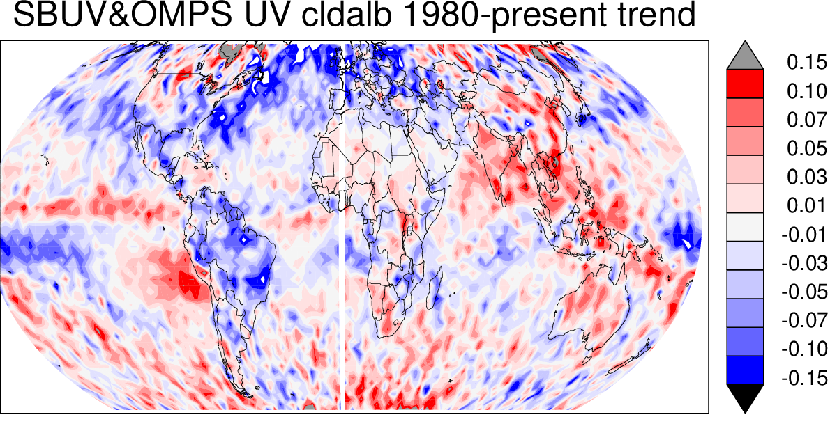
Figure 4. Map of UV BCA trends (1980-present) in % albedo year⁻¹.
Trends are determined for each 2º latitude by 3º longitude grid cell.
%Albedo year⁻¹

