Slide 1
Heuristic Algorithm to Compute Geodetic Height (h) from Ellipse Equation
session G1.1 Recent Developments in Geodetic Theory
Monday, 04 May 2020
EGU2020-10857
Mohamed ELEICHE
mohamed.eleiche@gmail.com
Faculty of Engineering
Egyptian Russian University
Ahmed Hamdi MANSI
Civil Engineering Department
College of Engineering, Shaqra University
Dawadmi, Saudi Arabia
ahmed.mansi@su.edu.sa
Istituto Nazionale di Geofisica e Vulcanologia, Sezione di Pisa, Pisa, Italy
ahmed.mansi@INGV.it

Slide 2
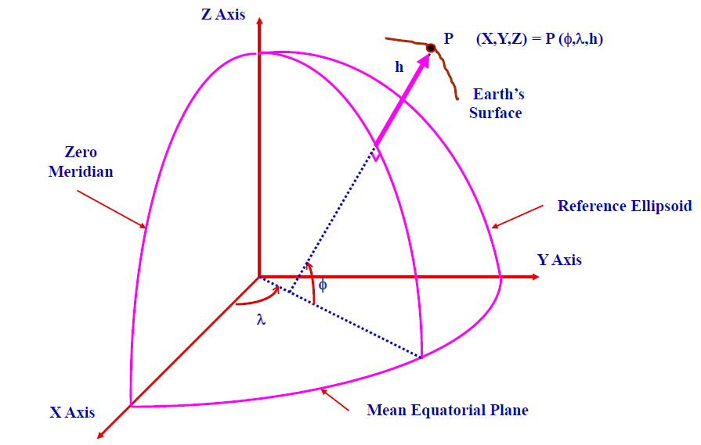
Geodetic Conversion Problem
Given (X,Y,Z) compute (φ,λ,h)
The ellipse equation (s) in the Meridian plan is defined as follows
$$s=\left(\frac{r_{p}^{2}}{a^{2}}+ \frac{z_{p}^{2}}{b^{2}}\right) ⟹\left\{\begin{aligned}s>1 if P is outside the ellipse \\ s=1 for P on the surface of the ellipse \\ \begin{aligned}s<1 if P is inside the ellipse\end{aligned} \\ s=0 at ellipse center\end{aligned}\right.$$
Can (s) be used to determine (h) ?
Eleiche & Mansi

Slide 3
Ellipse equation as function of (φ,h)
$s= {\left(\frac{(N+h) cosφ}{a}\right)}^{2}+ {\left(\frac{\left({\left(\frac{b}{a}\right)}^{2}N+h\right) sinφ}{b}\right)}^{2}$
$s=\frac{1}{1− e^{2}\sin^{2}φ} \left(1−e^{2}\sin^{2}φ\right)+\frac{2N }{a^{2}}h+\left(\frac{\cos^{2}φ}{a^{2}}+ \frac{\sin^{2}φ}{b^{2}}\right)h^{2}$
Eleiche & Mansi

Slide 4
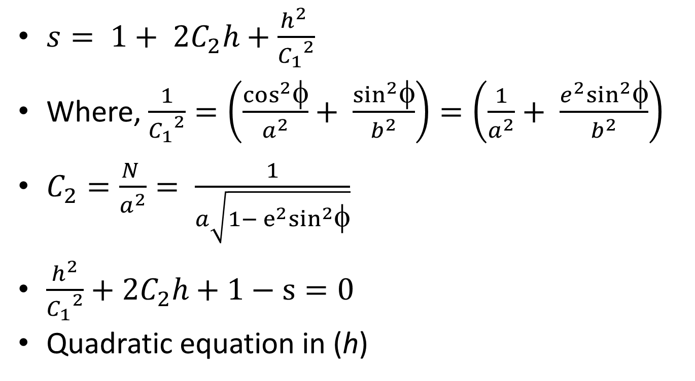
Ellipse equation simplified
$s= 1+ 2C_{2}h+\frac{h^{2} }{{C_{1}}^{2}}$
Where, $\frac{1}{{C_{1}}^{2}}=\left(\frac{\cos^{2}φ}{a^{2}}+ \frac{\sin^{2}φ}{b^{2}}\right)=\left(\frac{1}{a^{2}}+ \frac{{e^{2}sin}^{2}φ}{b^{2}}\right)$
$C_{2}=\frac{N }{a^{2}}= \frac{1}{a\sqrt{1− e^{2}\sin^{2}φ}}$
$\frac{h^{2}}{{C_{1}}^{2}}+2C_{2}h+1−s=0$
Quadratic equation in (h)
Eleiche & Mansi

Slide 5
(h) as function in (s)
$h= C_{1}\left(−{C_{1}C}_{2}±\sqrt{{{{C_{1}}^{2}C}_{2}}^{2}+s−1}\right)$
$for \left(φ =0\right), N= a, then$
$s= 1+ \frac{2h }{a}+\frac{h^{2}}{a^{2}}$
$h=a\left(\sqrt{s}− 1\right)$
$for \left(φ =90\right), N=\frac{a^{2}}{b}, then$
$s= 1+ \frac{2h }{b}+\frac{h^{2}}{b^{2}}$
$h=b\left(\sqrt{s}− 1\right)$
Eleiche & Mansi

Slide 6
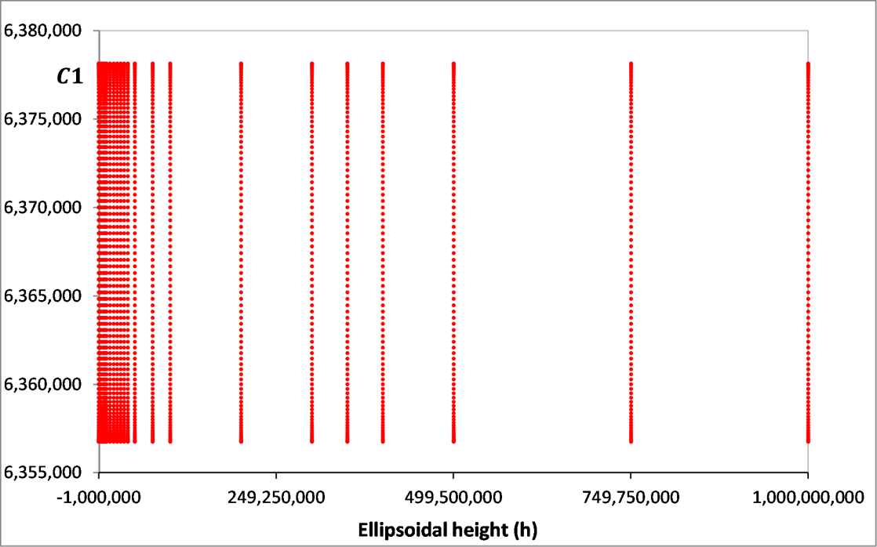
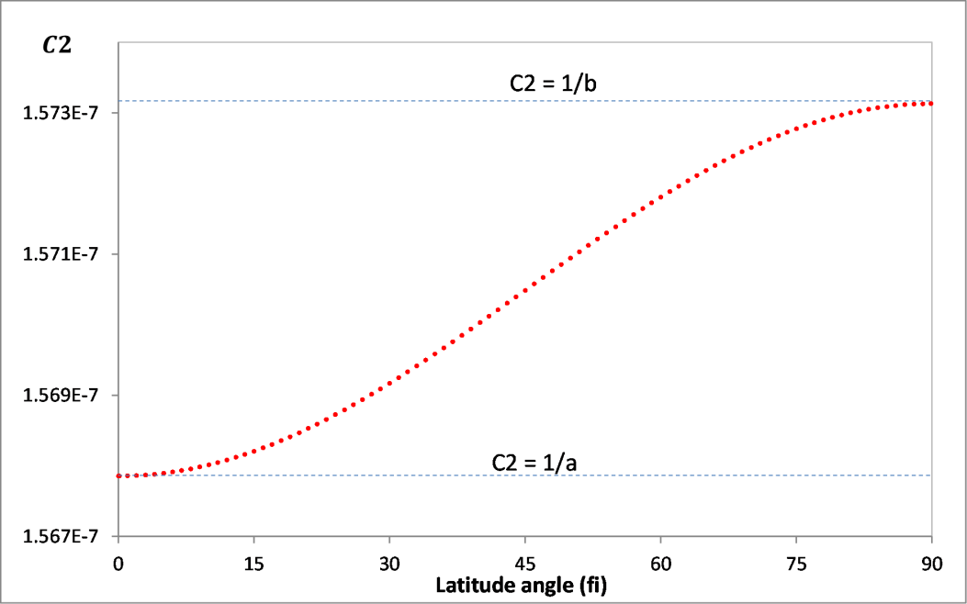
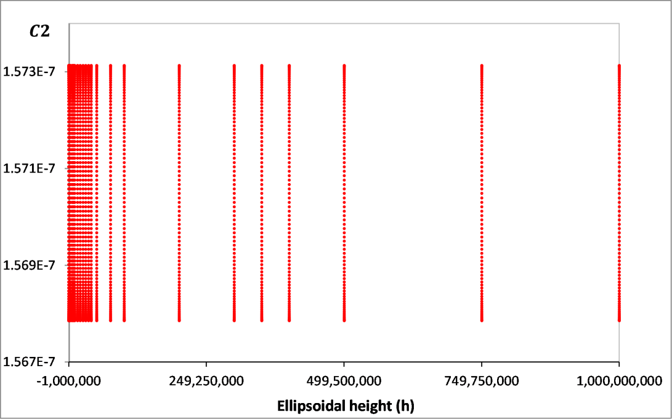
Eleiche & Mansi

Slide 7
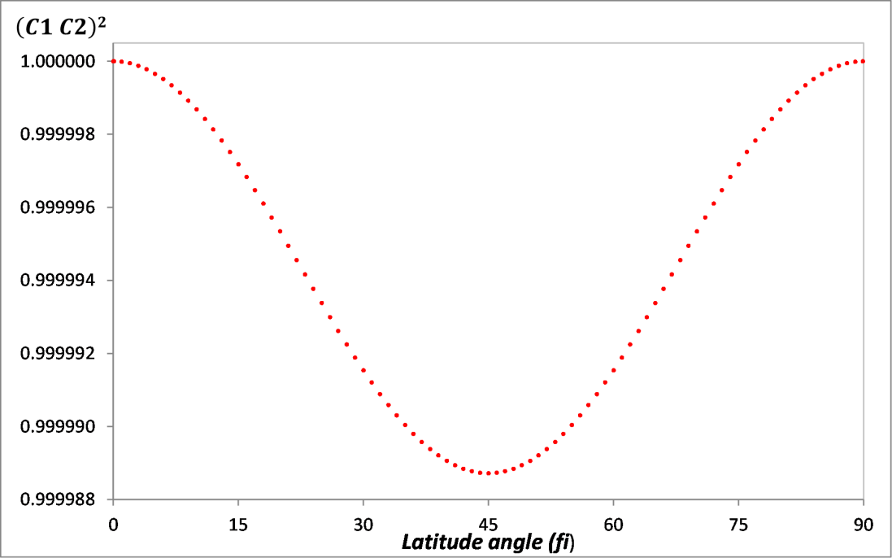
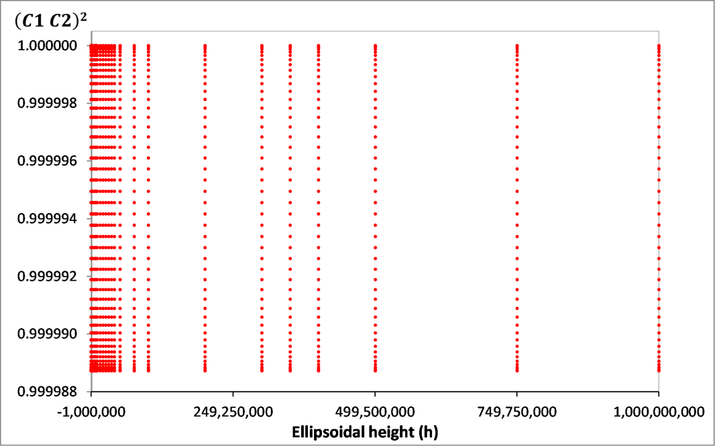
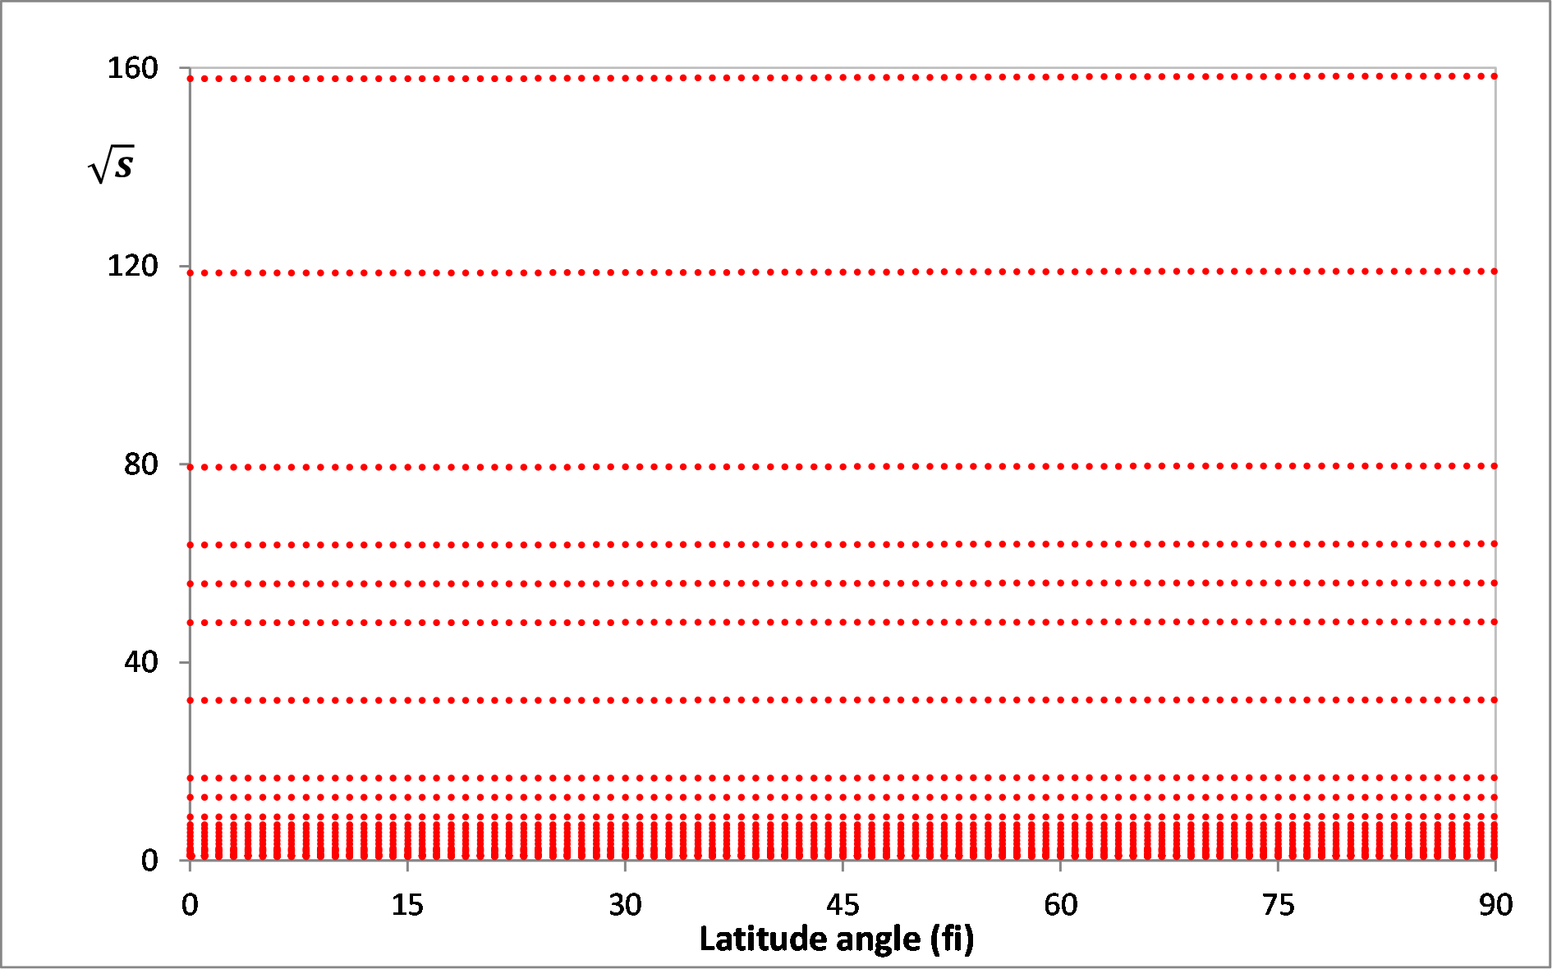
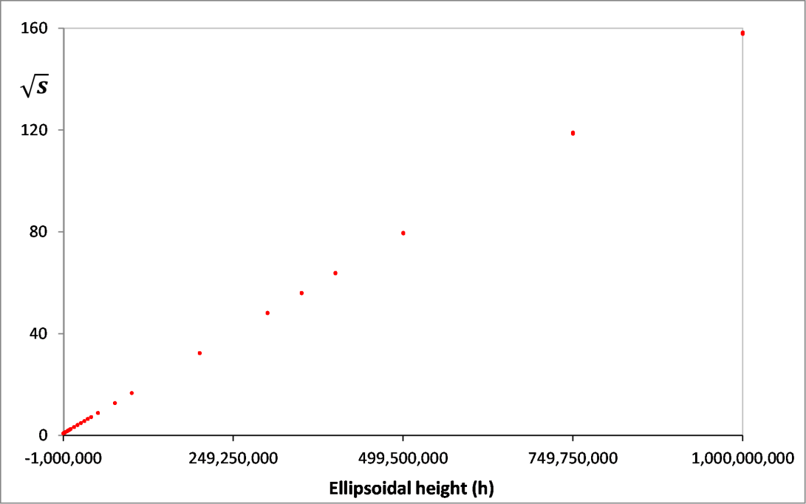
Eleiche & Mansi

Slide 8
Conclusion
(s) has a direct relationship with (h)
$\frac{∂s}{∂h}$ = $2C_{2}+\frac{2h}{{C_{1}}^{2}}$
$\frac{∂^{2}s}{∂h^{2}}=\frac{2}{{C_{1}}^{2}}\text{= }\text{constant}$
The change in (φ) has a small effect on (s)
There is a linear relation between ($\sqrt{s}$) and (h)
Eleiche & Mansi

Slide 9
Eleiche & Mansi

