Slide 1


Detection of Fog/Low Stratus with multispectral satellite imagery
Daria Tatsii¹ and Natalya Fedoseyeva¹
¹Russian State Hydrometeorological University, Saint Petersburg, Russia
The satellite image with advection fog and low stratus clouds over the Laptev sea on Sep 6th 2016, 06:00 UTC

Slide 2
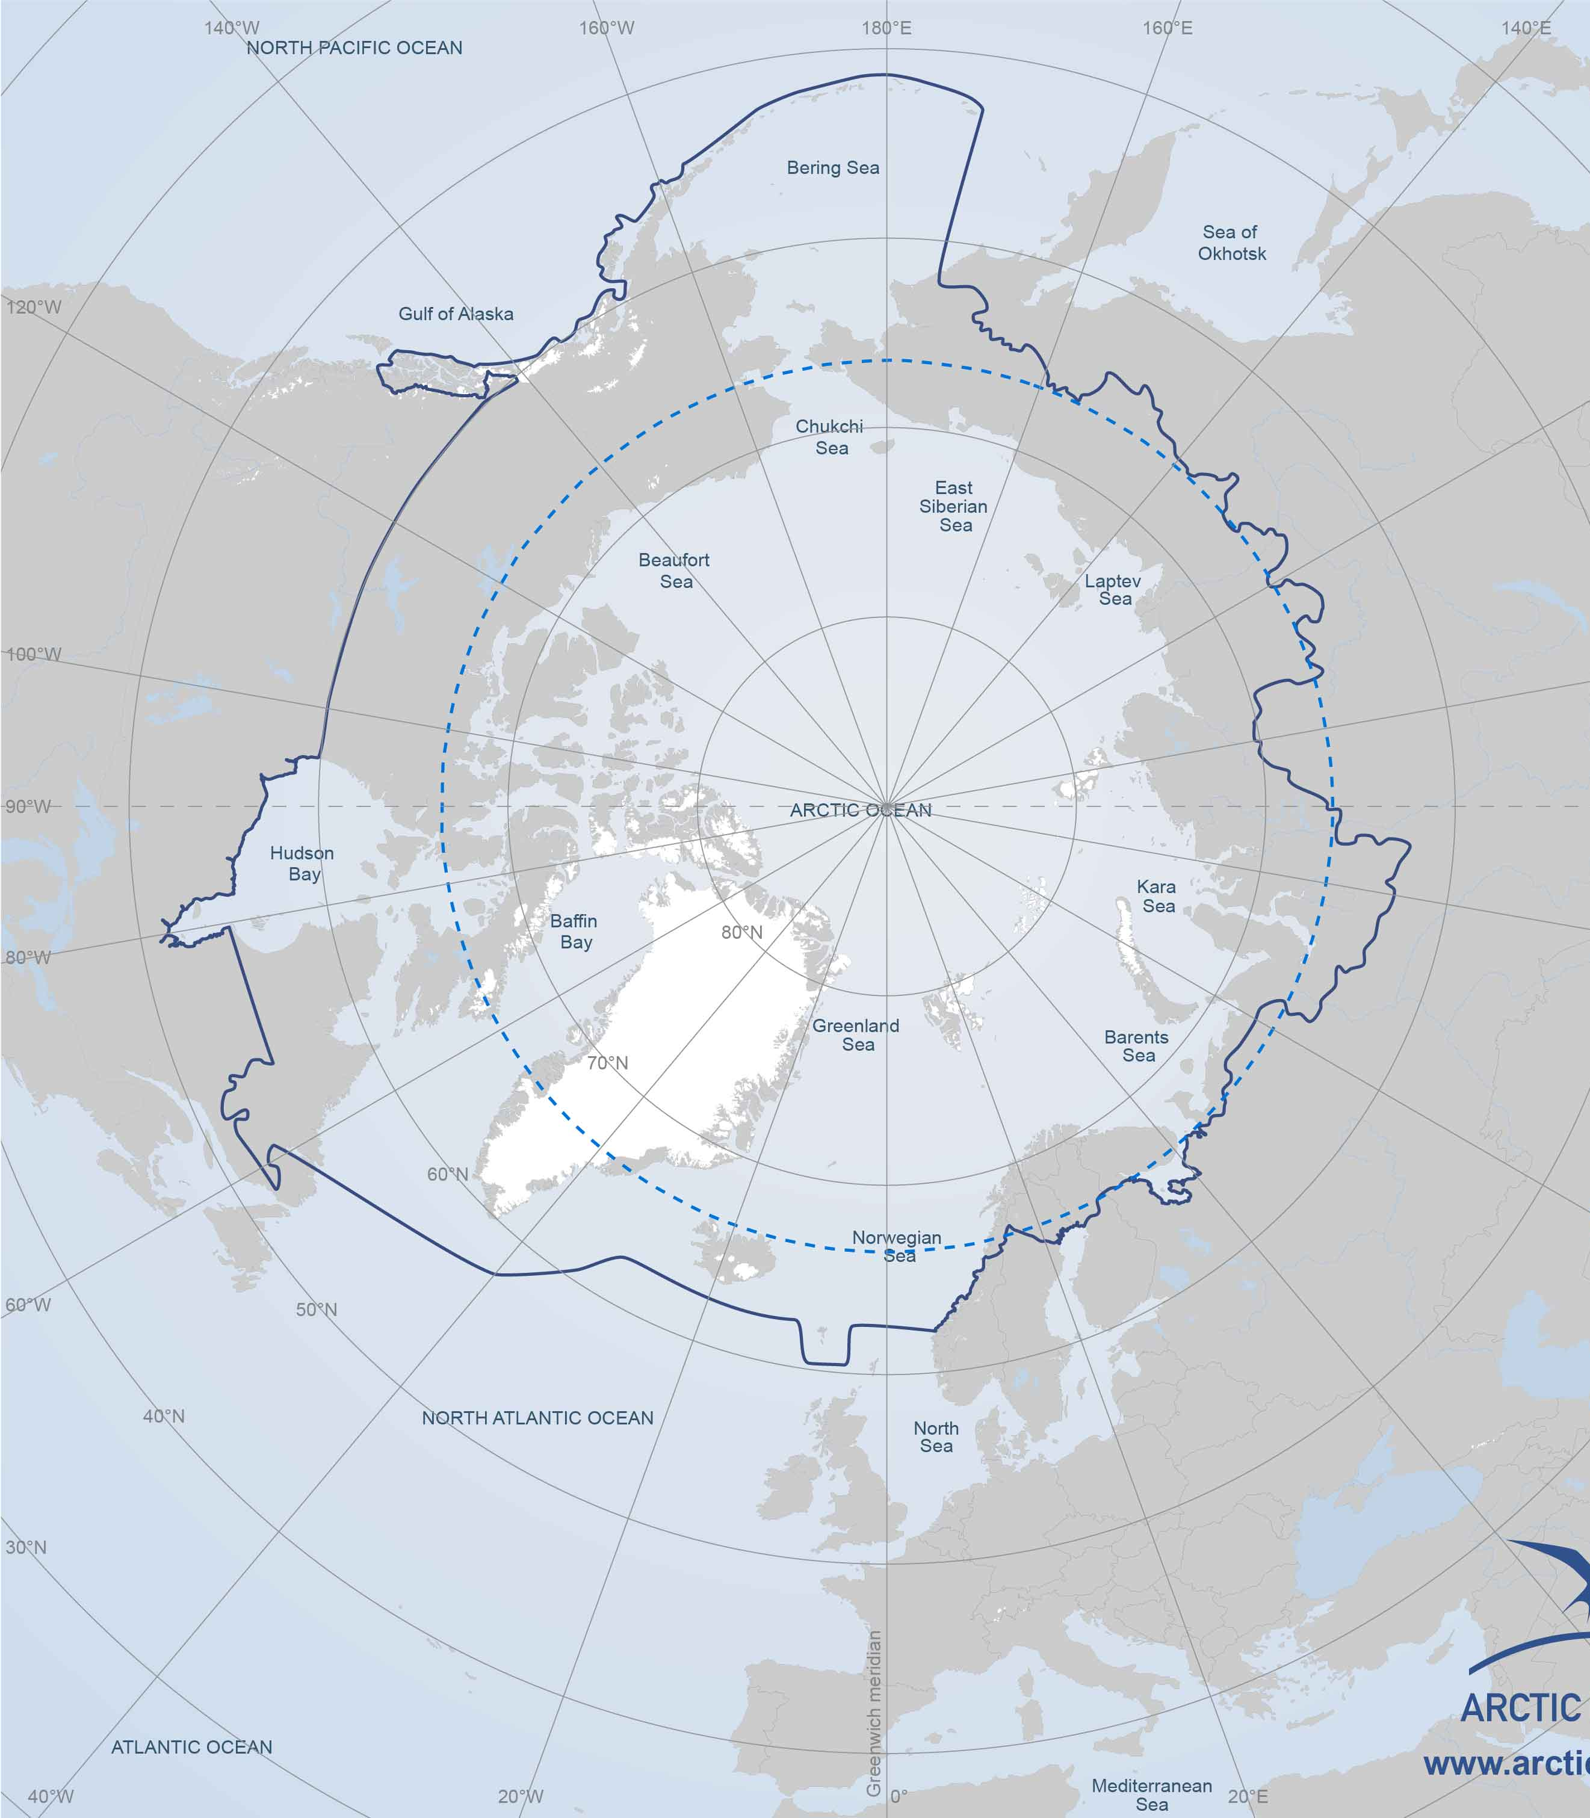
INTRODUCTION
Motivation
The safe operation of aviation and shipping, particularly in areas of
insufficient coverage of automatic meteorological stations in the Arctic,
requires accurate interpretation of satellite images.
Purpose of work
To develop thematic digital techniques of satellite multispectral
data with Beam VISAT 5.0 program for detection of fog/low stratus
clouds in images with snow and ice cover and cloudiness of the upper
and/or middle layer.

Slide 3
METHODOLOGY
Instrument for data collecting
Scanning radiometer MODIS, installed on Aqua and Terra satellites.
MODIS operates in 36 spectral bands, with wavelengths from 0.4 µm to 14.4 µm.
Table 1. Verified satellite images used for fog and low stratus detection.
№ | Name of product | Location | Date | UTC | Satellite
1 | MOD021KM.A2016185.0730.006.2016185193144 | Severnaya Zemlya archipelago | 20.08.2016 | 09:10 | Aqua
2 | MOD021KM.A2016250.0455.006.2016250134020 | The Laptev Sea | 06.09.2016 | 06:00 | Terra
3 | MOD021KM.A2014246.1015.006.2016246192721 | The Taymyr Peninsula | 01.07.2014 | 06:20 | Terra

Slide 4
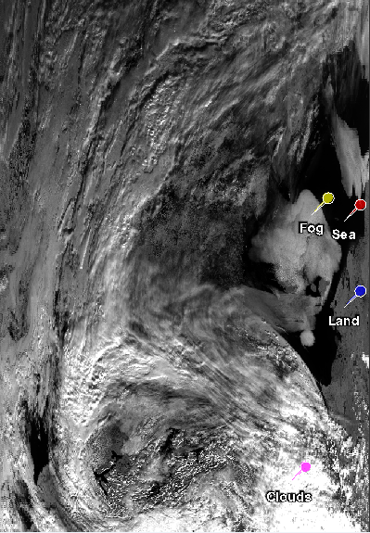
METHODOLOGY
Steps of the detection schemes development
To choose the bands with the substantial differences
in the values of the spectral irradiance of underlying surfaces.
For the development of the detection schemes
BEAM Visat 5.0 software was used.
Fig.1. The satellite image
with tags of underlying surfaces:
sea and land surfaces, fog and
clouds over the Laptev sea
on Sep 6th 2016, 06:00 UTC

Slide 5
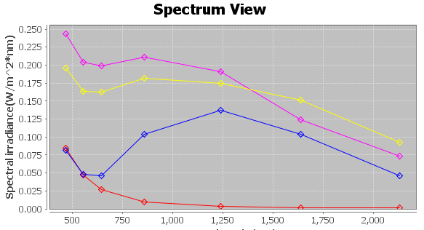
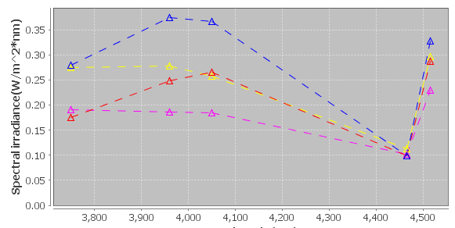
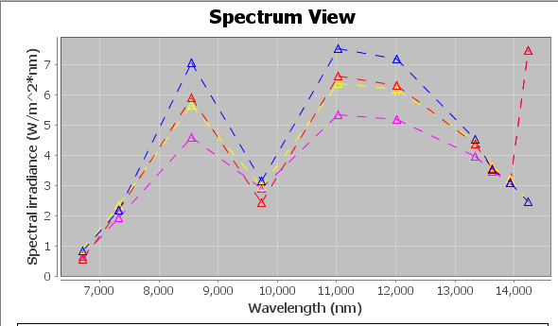
METHODOLOGY
Steps of the detection schemes development
To choose the bands with the substantial differences
in the values of the spectral irradiance of underlying surfaces.
For the development of the detection schemes
BEAM Visat 5.0 software was used.
Selected bands (μm)
0.6; 0.8; 1.6; 3.9; 8.9; 11.0; 12.1
Fig.2 . Spectrum view
of satellite images
in 0.4 – 14.4 μm ranges.
Red lines show bands,
where differences of spectral
irradiance are the most significant.

Slide 6
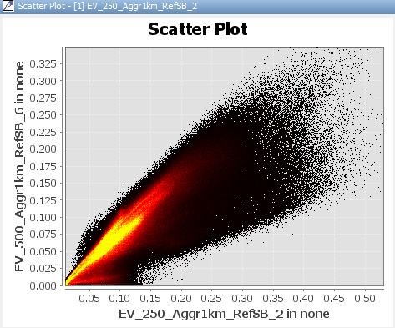
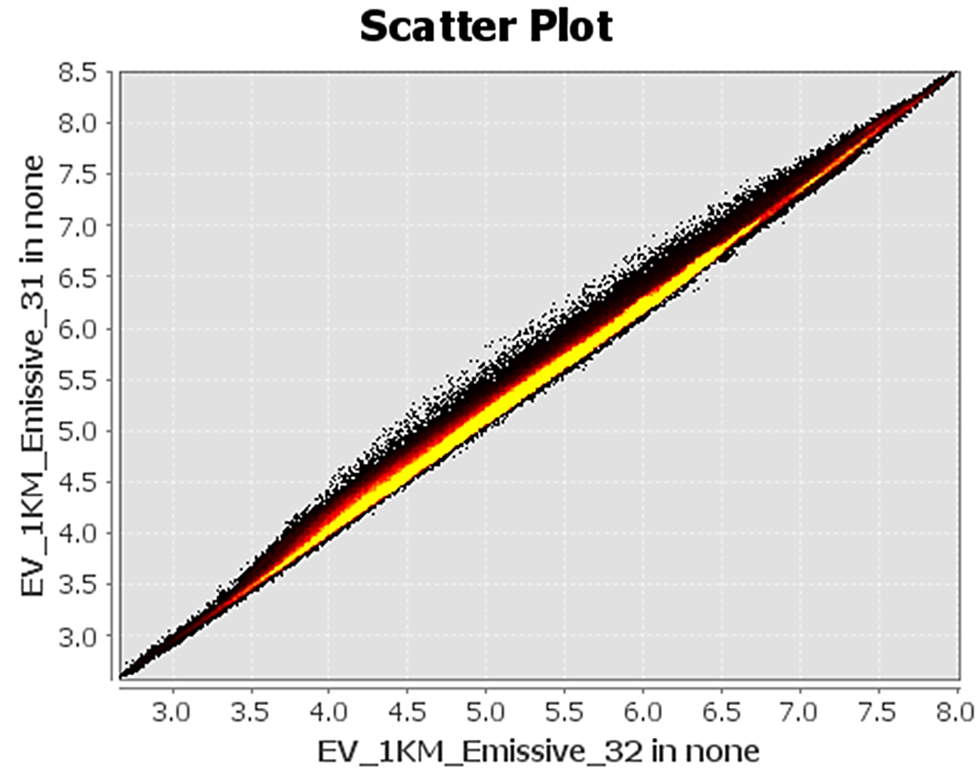
METHODOLOGY
Steps of the detection schemes development
2. To determine the necessity of digital data processing (i.e. mathematical difference of bands) use. If the images in different bands are visually different, then no digital processing needed, while the images are visually the same, digital data processing is required. The scatter plots of the integral brightness of the images in the selected bands help with it.
Fig.3. Scatter plot from the left (0.8 vs 1.6 μm) has the form of a wide sheet and a lot of black dots, suggesting substantial differences in the values of the integral brightness. Scatter plot from the right (11.0 vs 12.1 µm) has the form of a narrow sheet, that shows insignificant differences in the values of the integral brightness.

Slide 7
METHODOLOGY
Steps of the detection schemes development
To assign three spectral bands or bands with mathematical
differences to the RGB color components.
Figure 3 is an example of RGB 1.6, 0.8, 0.6 μm combination.
Developed RGB schemes
RGB 1.6, 0.8, 0.6
RGB (12.1-11.0), (3.9-11.0), (Inverse 11.0)
RGB 0.8, (3.9-8.7), 11.0
RGB 0.8, 1.6, (3.9-8.7)
Fig.4. Color image synthesis
(the Gulf of Ob (Obskaya guba)
03.09.2016, 06:05 UTC)
for RGB 1.6, 0.8, 0.6 μm
combination.

Slide 8

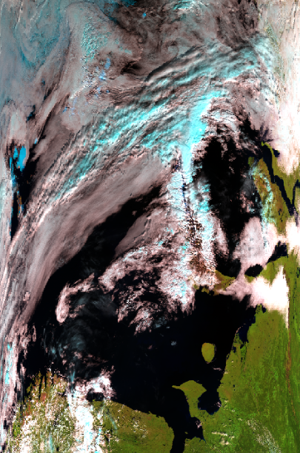
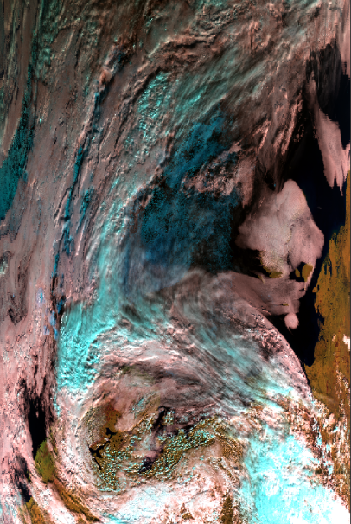
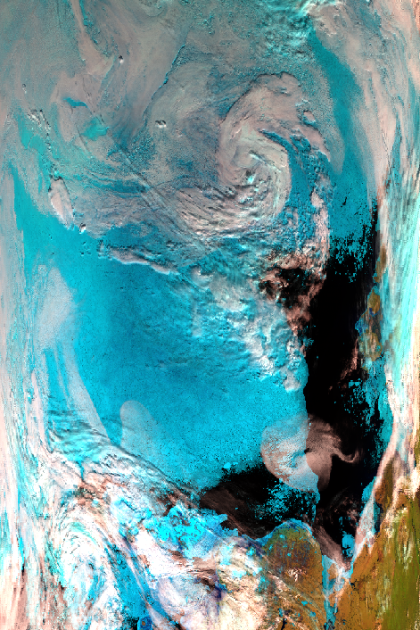




RESULTS
RGB 1.6, 0.8, 0.6
Object | Red IR 1.6 | Green IR 0.8 | Blue IR 0.6 | RGB | Color
Fog | 199 | 138 | 134 | #c78a86
Low-level clouds | 218 | 164 | 165 | #daa4a5
Middle-level clouds | 251 | 244 | 248 | #fbf4f8
Upper-level clouds | 107 | 247 | 249 | #6bf7f9
Ice | 12 | 85 | 106 | #0c556a
Fig.5. Satellite images after processing. From the left: Severnaya Zemlya archipelago (20th of August 2016 9:10 UTC); the Laptev sea (6th of September 2016, 06:00 UTC); The Taymyr Peninsula (1st of July 2014, 06:20 UTC).

Slide 9
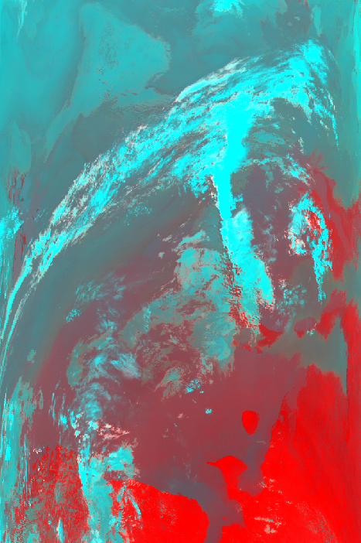
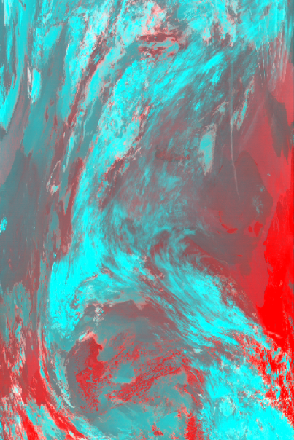
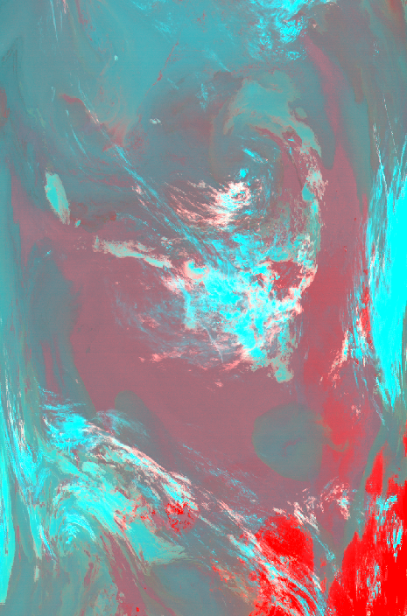





RESULTS
Object | Red IR -12.1-(-11.0) | Green IR -11.0-(-3.9) | Blue IR -11.0 | RGB | Color
Fog | 135 | 96 | 99 | #876063
Low-level clouds | 118 | 126 | 130 | #767e82
Middle-level clouds | 87 | 173 | 174 | #57adae
Upper-level clouds | 0 | 255 | 255 | #00ffff
Ice | 79 | 201 | 201 | #4fc9c9
RGB (12.1-11.0), (3.9-11.0), (Inverse 11.0)
Fig.6. Satellite images after processing. From the left: Severnaya Zemlya archipelago (20th of August 2016 9:10 UTC); the Laptev sea (6th of September 2016, 06:00 UTC); The Taymyr Peninsula (1st of July 2014, 06:20 UTC).

Slide 10
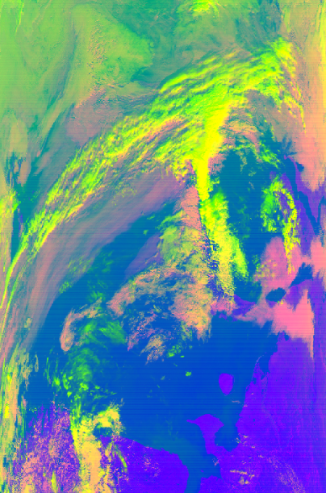
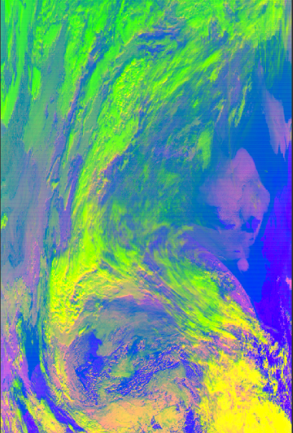
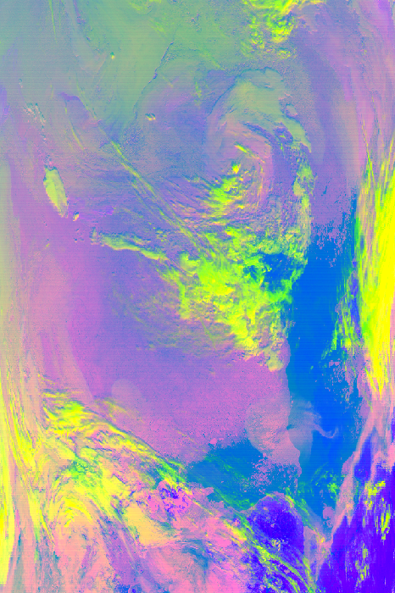





RESULTS
RGB 0.8, (3.9-8.7), 11.0
Object | Red IR 0.8 | Green IR 3.9-8.7 | Blue IR 11.0 | RGB | Color
Fog | 255 | 108 | 255 | #ff80ff
Low-level clouds | 242 | 156 | 140 | #f29c8c
Middle-level clouds | 255 | 255 | 0 | #ffff00
Upper-level clouds | 158 | 255 | 0 | #9eff00
Ice | 145 | 100 | 104 | #9164cc
Fig.7. Satellite images after processing. From the left: Severnaya Zemlya archipelago (20th of August 2016 9:10 UTC); the Laptev sea (6th of September 2016, 06:00 UTC); The Taymyr Peninsula (1st of July 2014, 06:20 UTC).

Slide 11
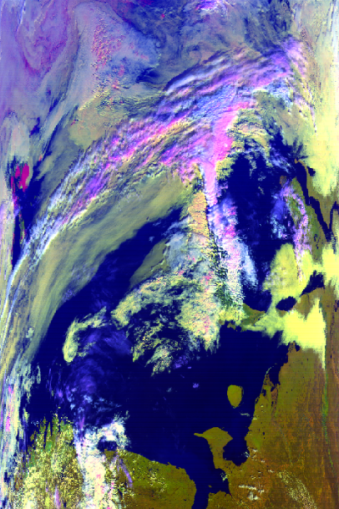
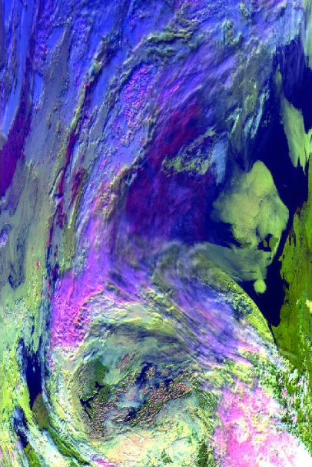
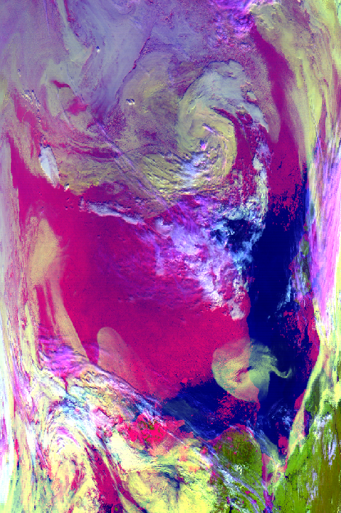




RESULTS
Object | Red IR 0.8 | Green IR 1.6 | Blue IR 3.9-8.7 | RGB | Color
Fog | 155 | 203 | 94 | #9bcb5e
Low-level clouds | 115 | 173 | 171 | #73adab
Middle-level clouds | 156 | 105 | 255 | #9c69ff
Upper-level clouds | 255 | 108 | 255 | #ff80ff
Ice | 111 | 3 | 112 | #6f0370
RGB 0.8, 1.6, (3.9-8.7)
Fig.8. Satellite images after processing. From the left: Severnaya Zemlya archipelago (20th of August 2016 9:10 UTC); the Laptev sea (6th of September 2016, 06:00 UTC); The Taymyr Peninsula (1st of July 2014, 06:20 UTC).

Slide 12
CONCLUSION
Obtained images show that the developed schemes of the color synthesis are complementary under different conditions of the satellite shooting.
Thus, the joint use of the these schemes allows reliable detection of fogs and low stratus clouds in case of the complex underlying surfaces of the scene of the satellite imagery.

Slide 13
REFERENCES AND NOTES
For satellites images credits to: www.ladsweb.modaps.eosdis.nasa.gov

