Slide 1
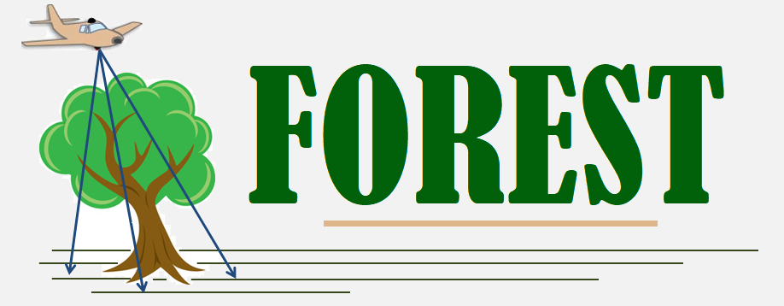
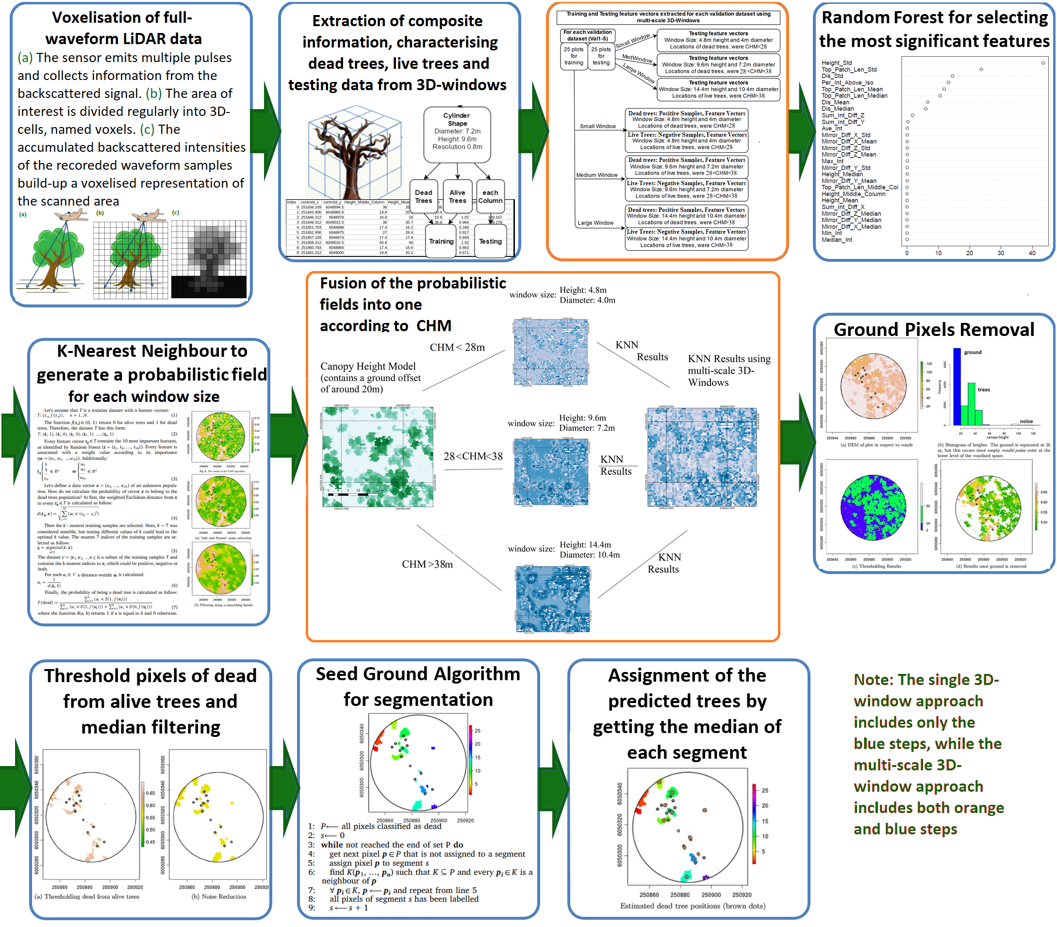
Structural features extracted from voxelised full-waveform (FW) LiDAR using the open source software DASOS for detecting dead standing trees
Milto Miltiadou (milto_miltiadou@hotmail.com) ^{1,2}, Maria Prodromou^{1,2}, Athos Agapiou^{1,2}, Diofantos G. Hadjimitsis^{1,2}
¹Department of Civil Engineering and Geomatics, Faculty of Engineering and Technology, Cyprus University of Technology, 3036 Lemesos, Cyprus
²Eratosthenes Centre of Excellence, 3036 Lemesos, Cyprus
Introduction
FW LiDAR data are able to record the entire backscattered signal of the emitted laser pulses. The signal is digitized and stored as a number of waveform samples. This poster presents:
1. DASOS, which is an open source software mainly developed by the first author to support the usage of full-waveform (FW) LiDAR data. Instead of point extraction, DASOS voxelises the waveform samples and extracts information from the voxelised space. It has three main functionalities as shown below.
2. Detection of dead standing trees using multi-scale 3D windows for tackling height variations: Structural features are extracted using DASOS for training a classifier. The study area Study area is a native River Red Gum (Eucalypt camaldulensis) forest of size 95,196 ha2 in south-eastern Australia. Full-waveform LiDAR acquired from 6th to 31st of March, 2015, with average footprint spacing 4:3 per m2, including flight overlapping. Field data, collected in July 2015, contain in-situ measurements from about 2386 trees of which 260 are dead.
2. Extracting structural features from Multi-scale 3D windows
For comparison and validation purposes, two approaches were implemented: one approach uses a single 3D-window for extracting structural features, while the more recent multi-scale methodology uses three 3D-windows of different sizes.
Using cross-validation it is showed the usage of multi-scale 3D-windows improves both precision (TP/(TP + FP)) and recall (TP/(TP + FN)) by 2.1% and 27.6% respectively.
Bibliography:
[1] Detecting Dead Standing Eucalypt Trees from Voxelised Full-Waveform Lidar Using Multi-Scale 3D-Windows for Tackling Height and Size Variations. Miltiadou, Milto, et al. Forests 11.2 (2020): 161.
[2] Open source software DASOS: efficient accumulation, analysis, and visualisation of full-waveform lidar. Miltiadou, Milto, et al. SPIE Library (RSCy2019). Vol. 11174., 2019.
[3] Detection of dead standing Eucalyptus camaldulensis without tree delineation for managing biodiversity in native Australian forest. Miltiadou, Milto, et al. International journal of applied earth observation and geoinformation 67 (2018): 135-147.
.
1.
Acknowledgment: The Project OPPORTUNITY/0916/0005 (“FOREST“) is co-financed by the European Regional Development Fund and the Republic of Cyprus through the Research Promotion Foundation.

