Slide 1
Earthquake stress drop: what can we resolve from observations, and what can we infer about earthquake triggering processes
EGU2020-10935
Session SM1.1
Xiaowei Chen¹, Rachel Abercrombie², Qimin Wu¹
University of Oklahoma
Boston University

Slide 2
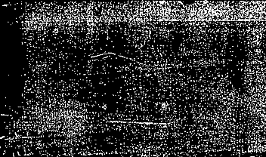

Outline
1. Theoretical background
2. Synthetic experiment #1: joint spectral inversion
3. Synthetic experiment #2: stacking approach
4. Application to the Guthrie sequence induced by wastewater injection
5. Triggering processes of the Guthrie sequence
6. Implications for future studies

Slide 3
1. Theoretical background
Recorded displacement spectra in log10 domain:
D(i,j) = S(j) + P(i,j) + E(i)
Red: Noise spectrum
Blue: Observed D(i,j)
Green: S(j) + P(I,j) + E(i)
Blue: E(i) averaged from 9 stations
Green: E(i) at this station
Hmm…. the propagation term dominate the shape of the far-field displacement spectrum with high attenuation..

Slide 4
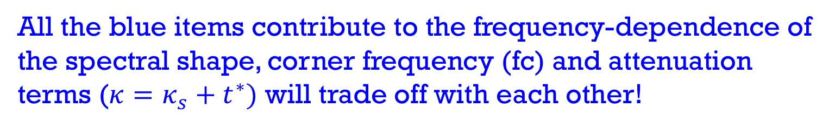
What influences D(f)
Site response
Attenuation
Source spectrum
Instrument response
Instrument response
Geometric spreading
Moment and radiation pattern
All the blue items contribute to the frequency-dependence of the spectral shape, corner frequency (fc) and attenuation terms ($κ=κ_{s}+t^{∗})$ will trade off with each other!

Slide 5
2. Synthetic experiment #1: joint spectral inversion for fc and kappa.
Objective: (1) What influence the tradeoff between fc and kappa, (2) what is the resolution limit of fc with different usable frequency bands?
2.1 Trade off between fc and kappa. Fitting band: 1-45 Hz.
1. No noise. Both fc and kappa are well resolved from joint inversion.
No trade-off when there is no noise!
2. High noise. When fc=5 Hz, both fc and kappa are well resolved.
When fc = 10 and 15 Hz, very large uncertainty zone for fc and kappa.
Strong trade-off with noise for higher fc!

Slide 6
2.2 Resolution limit of the corner frequency: simulate 2500 spectra with 50 stations (with kappa from 0.0001 to 0.04 s) and 50 events (with fc from 1 to 100 Hz).
When upper limit of frequency for spectral fitting (max freq)= 45 Hz.
fc<=10 Hz can be resolved at > 95% stations (individual-resolvable).
Fc>10 and < 30 Hz can be resolved from the average of 50 stations (median-resolvable).
Fc > 30 Hz, both fc and kappa are systematically underestimated.
Vary “max freq” from 10 to 50 Hz.
Individual-resolvable fc is ≤ 20% to 25% of “max freq” .
Median-resolvable fc is ≤ 40% to 80% of “max freq” .
Consider 80% of “max freq” as maximum acceptable “median-resolvable” fc.

Slide 7
3. Synthetic experiment #2: stacking
Average stress drop for each bin from values drawn from log-normal distribution for Neq = 3000, 1000, 300
Key idea: use stacked event source spectra from wide range of magnitude bins to mitigate the trade-off.
Synthetic experiment:
  Generate datasets with different different scaling relationships. (scale factor = 0.0 and scale factor = 0.2)
  Stress drops are drawn from log-normal distributions, with standard deviation of 0.5 in log-10 domain.
Scale factor = 0.0
Reference stress drop
Scale factor = 0.2
An example of randomly generated stress drop with reference stress drop of 2.2 Mpa, and standard deviation of 0.5 in log-10 domain.
Note the large scatter of average stress drop when Neq = 300 for large magnitude bins! Because large magnitude bins have fewer events, the average stress drop for large magnitude bins from randomly generated datasets can deviate from reference stress drop if standard deviation is large.

Slide 8
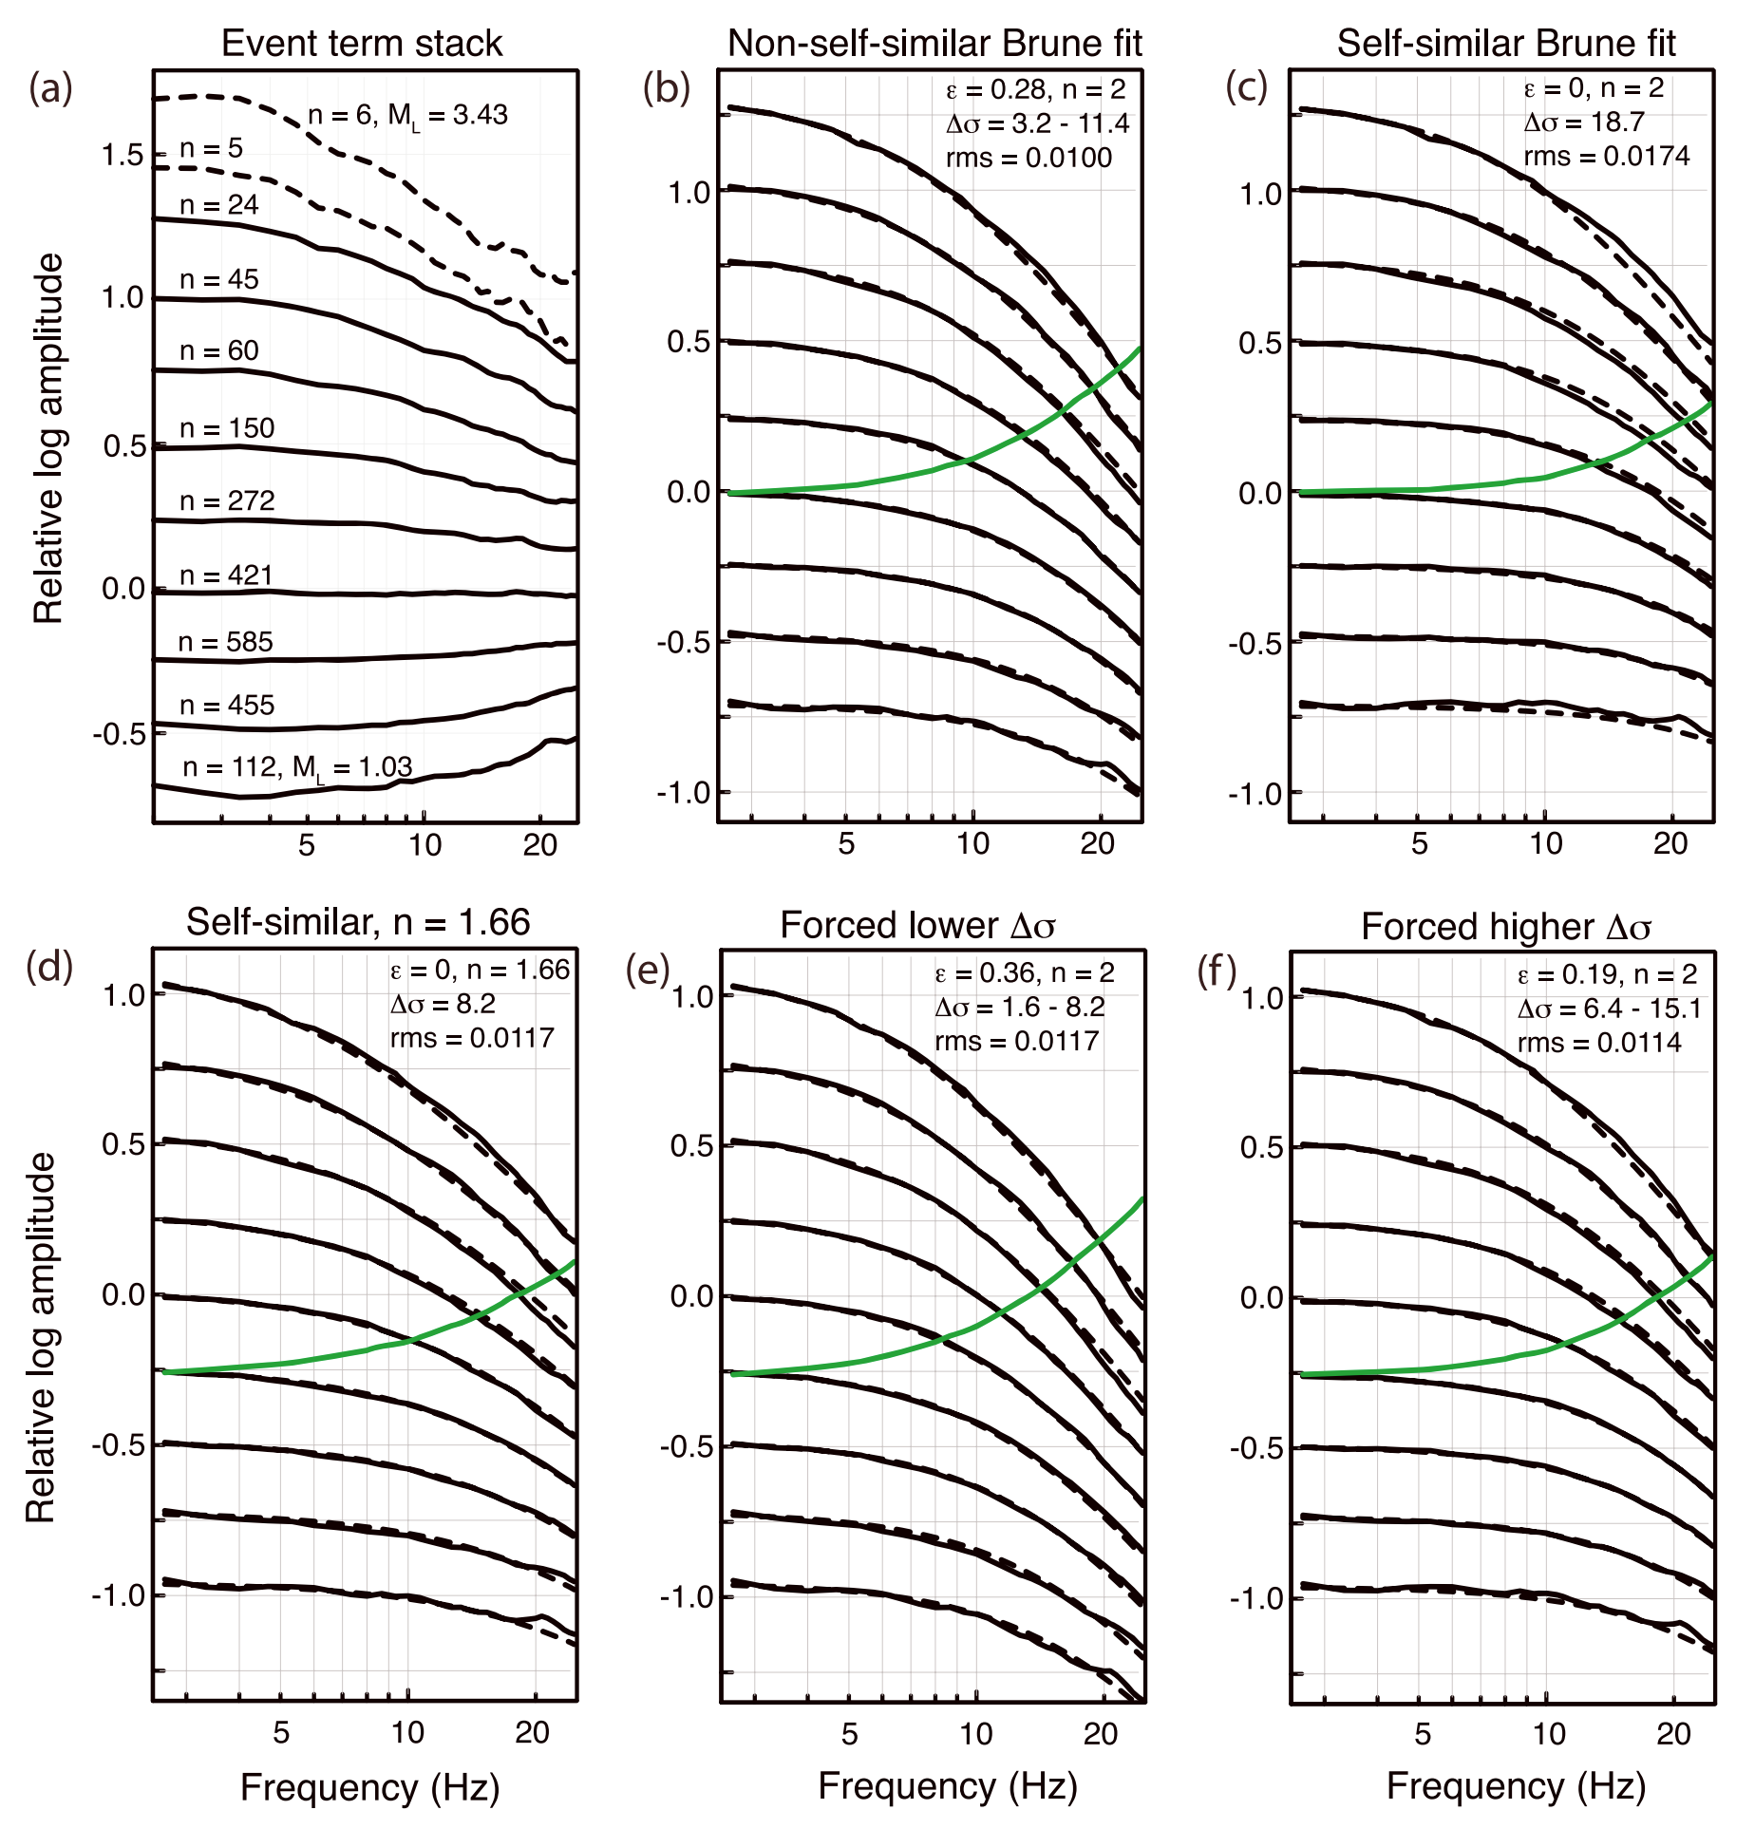
Known problem with stacking: Results can trade-off with scaling factor, high-frequency fall off rate, and attenuation correction of common path terms (Shearer et al., 2019)
Approaches for comparison:
  (1) “SSS” (Stacking-assuming-Self-Similarity) (Shearer et al., 2006): All magnitude bins have the same stress drop.
  (2) “SNSS” (Stacking-Not-assuming-Self-Similarity): Allows average stress drops to differ from different magnitude bins, no assumptions of scaling relationship.
Objective: (1) Can stacking approaches recover input stress drop; (2) What is the resolution limit of stacking approaches?

Slide 9
1. Can stacking recover input stress drop?
Answer: Yes, with SNSS for small dataset.
For each scale factor, generated 100 datasets, each has 300 events, compare distributions of (1) ECS standard deviation and (2) ratio between input and inverted stress drop.
SNSS has ECS standard deviation within 0.25, but SSS produces ECS with much higher standard deviation. The ECS refers an empirical correction function. In the synthetic test, the ECS should have standard deviation within 0.25.
On average, SNSS has inverted stress drop within 20% of input stress drop for all 100 datasets. SSS has wide range of stress drop ratio for different datasets.

Slide 10
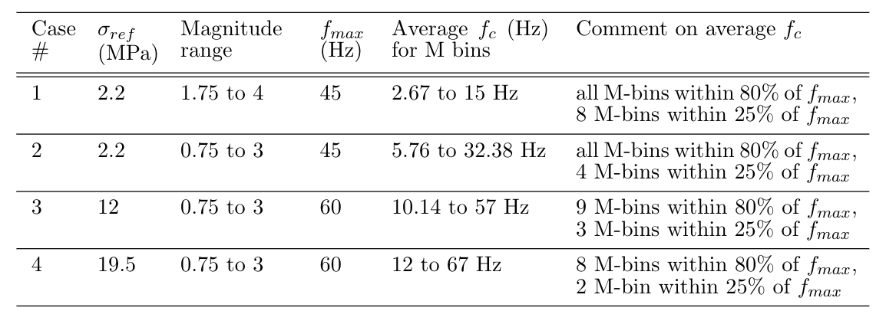
2. What is the resolution limit?
Generate additional four cases to check the resolution.
For each case, examine input stress drop with low and high standard deviation, and magnitude distribution of GR and uniform.
(uniform distribution represents unreal but ideal case where all magnitude bins are equally sampled)
Perfect!
Acceptable
Hmm..
Hmm..
Low std and uniform magnitude (figure b), both SSS and SNSS are perfect! All cases can be resolved! But, this is not going to happen in nature…
High std and uniform magnitude (figure d), both SSS and SNSS are perfect for cases 1 and 2. Cases 3 and 4 are underestimated.
Low std and GR distribution (figure a), SNSS perfect for cases 1-3, SSS less ideal for cases 3. Both are not good for case 4.
High std and GR distribution (figure b), for the acceptable cases 1 and 2, SNSS is great, SSS is not good. Both not good for cases 3 and 4.
Stacking resolution is limited by the resolution limit from joint spectral inversion. When lower magnitude bins exceed 80% of fmax, results can be unreliable.
SNSS solid lines; SSS dashed lines

Slide 11
4. Application to the Guthrie sequence, induced by wastewater injection
With average stress drop of 3.16 MPa, M≥1.8 are median resolvable from synthetic prediction.
Great azimuthal coverage!
Highly compact cluster with lots of events!
With average stress drop of 3.16 MPa, M≥2.6 are individually resolvable from synthetic prediction.
The Guthrie sequence is selected due to its azimuthal coverage, scientific interest and appropriate corner frequency ranges.
We expect similar results from joint inversion and SNSS.

Slide 12
Data selection: Real data is not as ideal as synthetic data. So it is important to compare different datasets.
1. Three wave types. Direct P (1.5s), Direct S (3s), and Extended S (10 s, including both direct S and early coda).
2. Four different SNR sets:
  SNR1 = SNR-highest: minimum SNR ≥ 5 from 1 to 20 Hz, and SNR ≥ 3 from 20 to 40 Hz;
  SNR2 = SNR-median: minimum SNR ≥ 3 from 1 to 40 Hz;
  SNR3 = SNR-bandlimited: minimum SNR ≥ 5 from 1 to 20 Hz;
  SNR4 = SNR-lowest: average SNR ≥ 5 within three frequency bands: 1 to 5 Hz, 5 to 10 Hz, and 10 to 20 Hz.
3. SNSS method produces 12 datasets. Joint inversion produces 8 datasets for Direct S and Extended S.
4. Compare the 12 SNSS datasets (assumes constant attenuation within the fault zone). Then use SNR2 to compare SNSS and joint inversion (does not make assumption about attenuation, and invert each spectra individually, then take the average).
Comparison between SNSS and joint inversion can help us understand whether the spatiotemporal variation could be due to attenuation changes.

Slide 13
For such an ideal dataset, we still get different results using different wave types and different SNR.
Nature is more complicated than synthetic dataset!
Extended S-wave (S-coda) has highest standard deviation, but most stable median value. P-wave is not as stable as S-wave.
S-wave has lowest standard deviation!
P-wave has highest scale factor! (not sure why yet).
Lowest SNR (SNR4) has largest difference among the three wave types, and also highest scale factor!
S-wave produces very low scale factor, indicating no resolvable scaling.
Larger events (M≥3.5) consistently have higher stress drop than smaller events.

Slide 14
5. Triggering processes of the Guthrie sequence
Stress drops are lower at shallow depth, higher at deeper depth.
Cross-section
Map view
Largest event occur within high stress drop area
Earliest events occur within low stress drop areas from all 12 datasets.

Slide 15
Comparison between SNSS and joint inversion. Both confirm low stress drop at beginning stage.
The sequence exhibited gradual diffusive spatial migration from the initial location with low stress drop.
Suggesting initial fault activation is likely due to high pore pressure, causing low stress drop events.

Slide 16
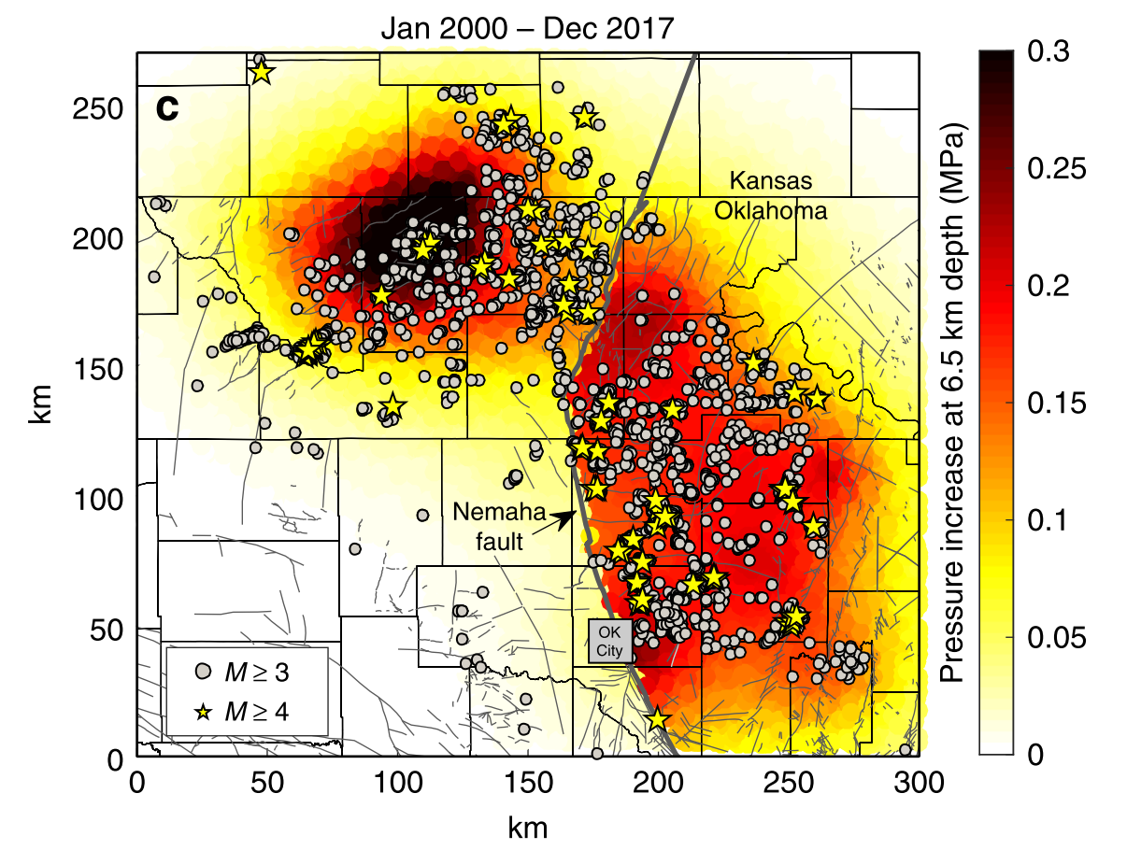
6. Implications for future studies
Resolution limit must be considered when interpreting stress drop results.
Multiple approaches are recommended for robust results.
Can we observe large-scale variations of stress drops that may be related to pore pressure propagations?
Langenbruch et al., 2018

Slide 17
Thank you!
Questions?
Contents in this presentation are currently under revision.

