Slide 1





MOPGA/Make Air Quality Great Again: Filling in the air quality data gap in Africa using low-cost sensors
R Subramanian
subu@lisa.u-pec.fr subu@cmu.edu
Matthias Beekmann

Slide 2
The Africa qualité de l’Air team (#AfriqAir)
MOPGA: R Subramanian, M Beekmann, M Giordano, C Malings, A Feron, P Formenti, B Marticorena, C Galy-Lacaux, C Liousse, Jean-Louis Rajot
Université Félix Houphouët-Boigny: Julien Bahino, Véronique Yoboué
University of Cape Coast: Kofi Amegah, Christian Sewor
University of Rwanda: Jimmy Gasore, Abdou Safari Kagabo, Valerien Baharane, Sandrine Guhirwa, Claver Sindayigaya, Langley Dewitt
University of Nairobi: Vincent Madadi, Enock Osoro
Université Abdou Moumouni de Niamey: Laouali Dungall
North West University: Stuart Piketh, Thomas Bigala, Joseph Adesina
CSIR: Rebecca M Garland
Carnegie Mellon University: Paulina Jaramillo, Albert Presto
Columbia University: Daniel M Westervelt, V Faye McNeill
University of Sydney: Emilia Tjernström

Slide 3
Acknowledgments
Funding
ANR Make Our Planet Great Again
CMU College of Engineering and Departments of EPP and MechE
Support
CMU Africa

Slide 4
“Air pollution was responsible for nearly 5 million deaths in 2017” – HEI State of Global Air (2019)
Air pollution causes lung cancer, ischemic heart disease, chronic obstructive pulmonary disease (COPD), respiratory infections
Identifying and quantifying sources necessary to improve air quality
  industrial activities, vehicular exhaust, biofuel use and biomass burning, secondary atmospheric reactions, dust
Traditional reference monitors: high accuracy (precision and bias), expensive (€10,000-100,000 for instruments alone), sparsely distributed, even missing in many African countries
Lower-cost stationary monitors or “mini-stations”: under €5,000; low power, low-cost sensors affected by T/RH and cross-sensitivity
Notes:
We can deploy a lot more lower-cost monitors especially in resource-challenged areas.

Slide 5
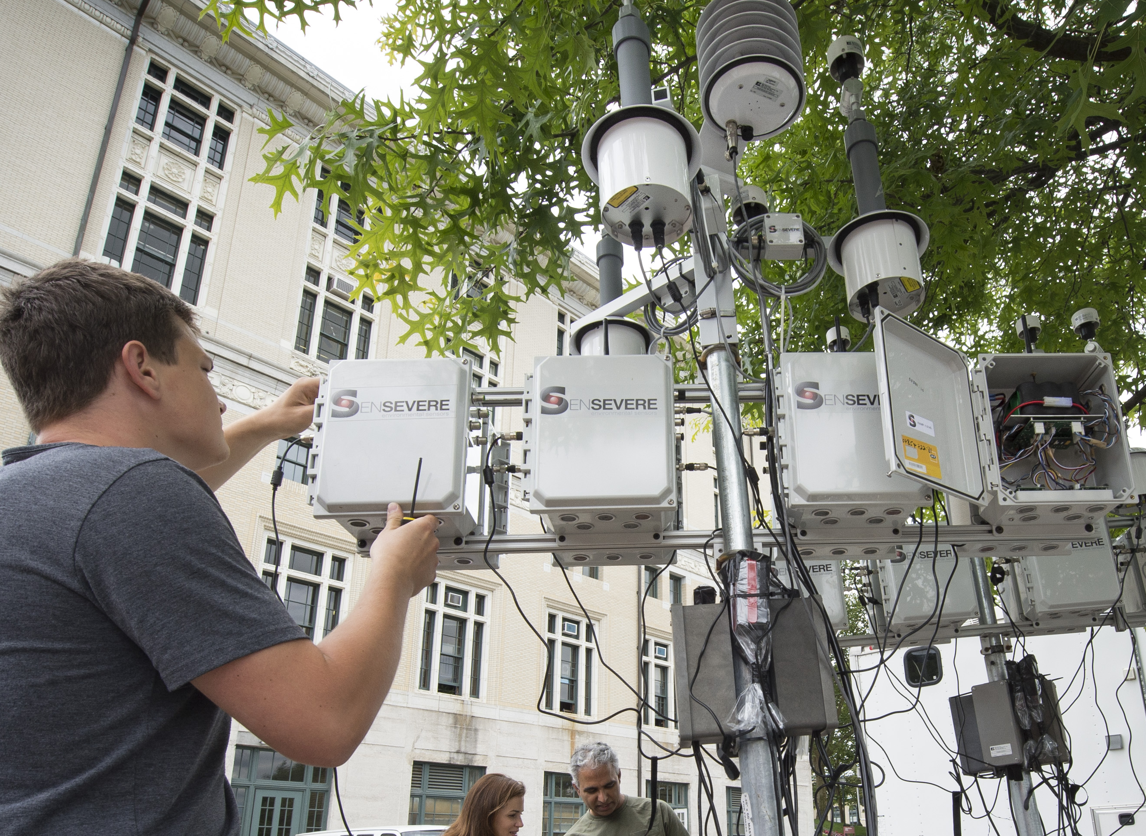
Real-time Affordable Multi-Pollutant (RAMP) monitor
Developed by Sensit/SenSevere+CMU CAPS
Alphasense electrochemical sensors for carbon monoxide (CO), ozone (O₃), nitrogen dioxide (NO₂), sulfur dioxide (SO₂)
  Optional: NO, VOCs
Met-One or PurpleAir (Plantower) optical sensor for particulate matter mass (PM_{2.5})
GSM communication, onboard SD card
More information:
Zimmerman et al. (2018) https://doi.org/10.5194/amt-11-291-2018
Malings et al. (2019) https://doi.org/10.5194/amt-12-903-2019

Slide 6
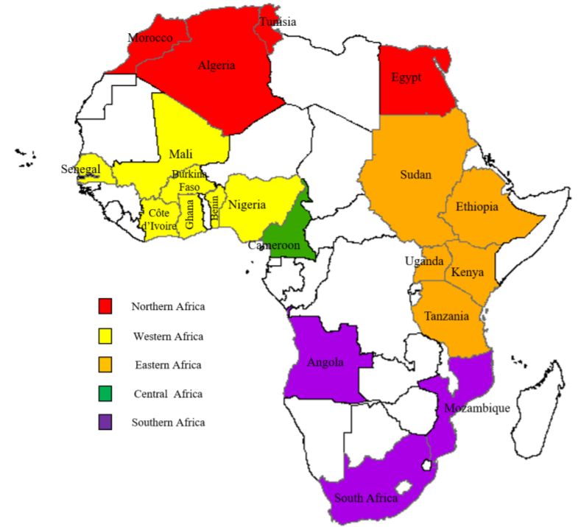
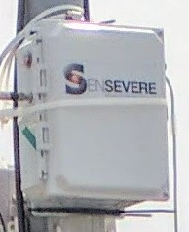
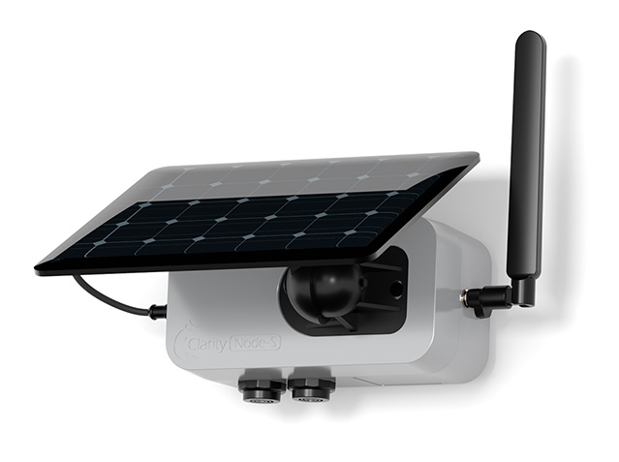
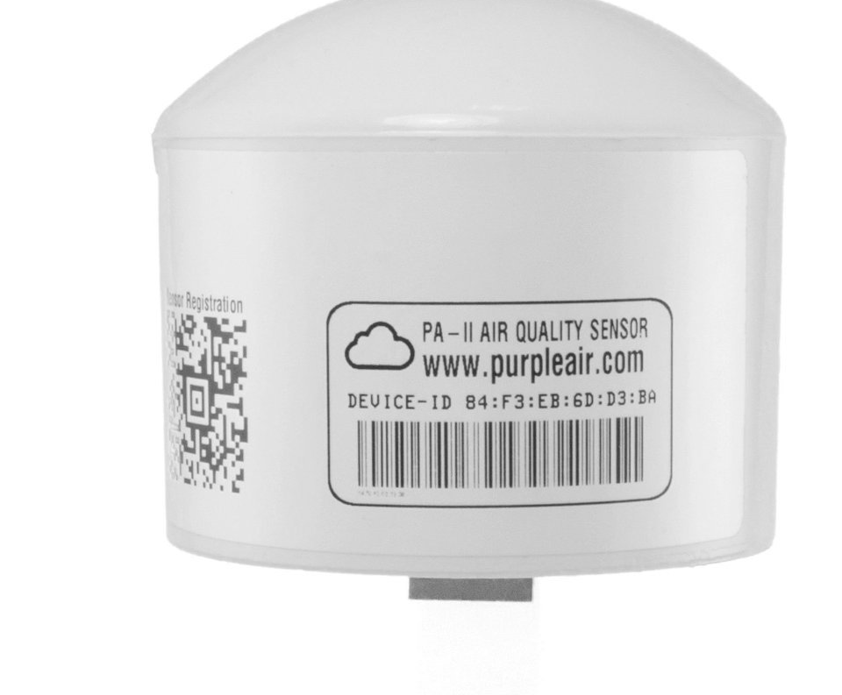
Filling in the air quality data gap: The Africa qualité de l'Air network
Africa map from Bahino et al. review of studies in Africa https://doi.org/10.5194/acp-18-5173-2018
  Colors show countries where some data are available
Sensor images show cities where AfriqAir nodes are deployed
  PurpleAir and Clarity pictures from manufacturer’s website.
Notes:
Can remove one of the graphs if it doesn’t flow.

Slide 7
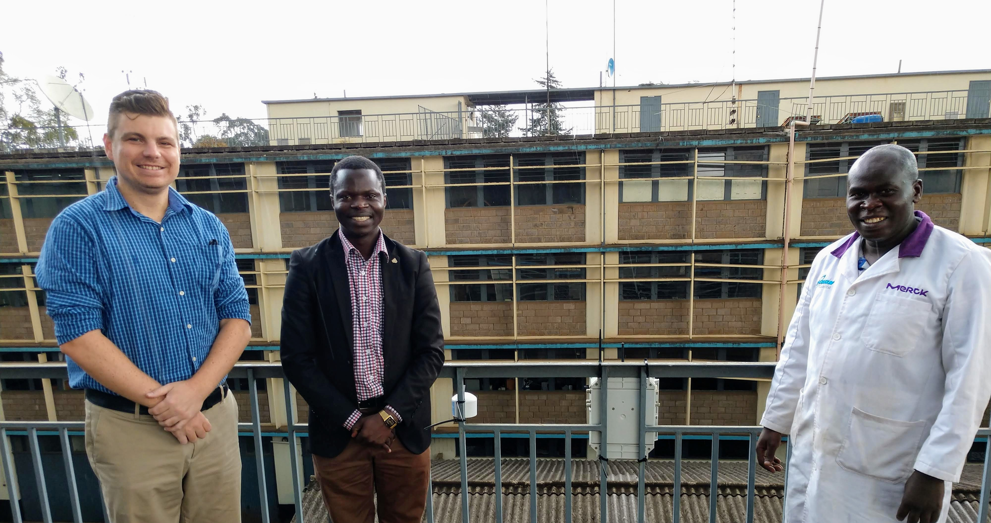
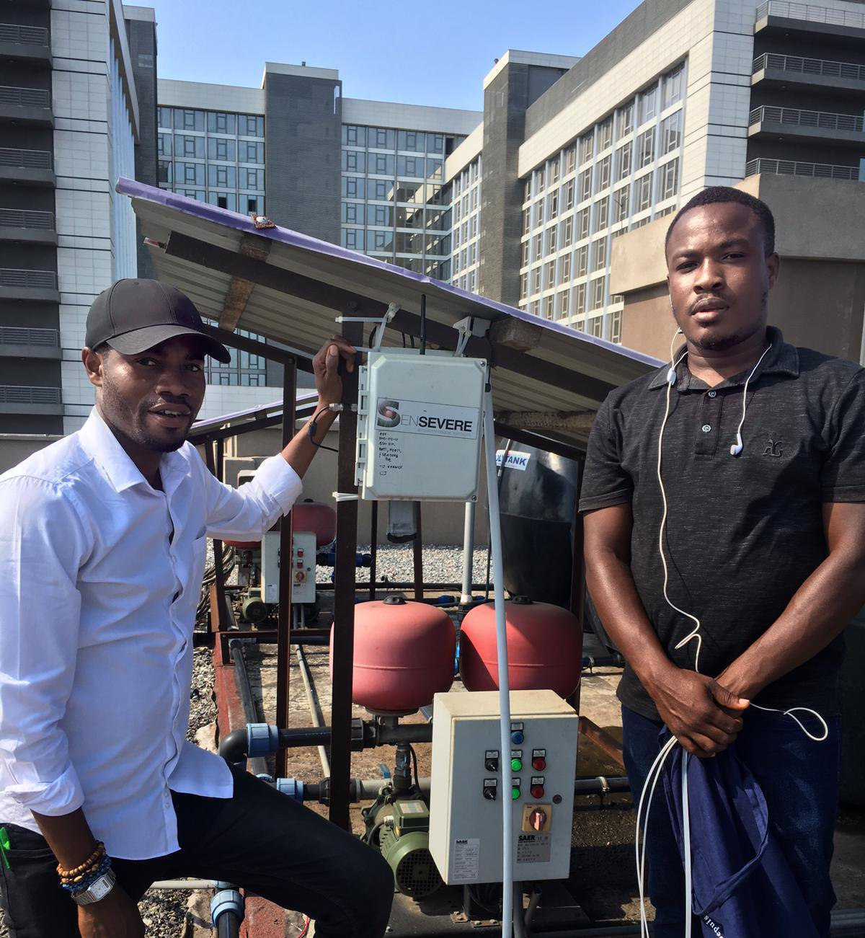
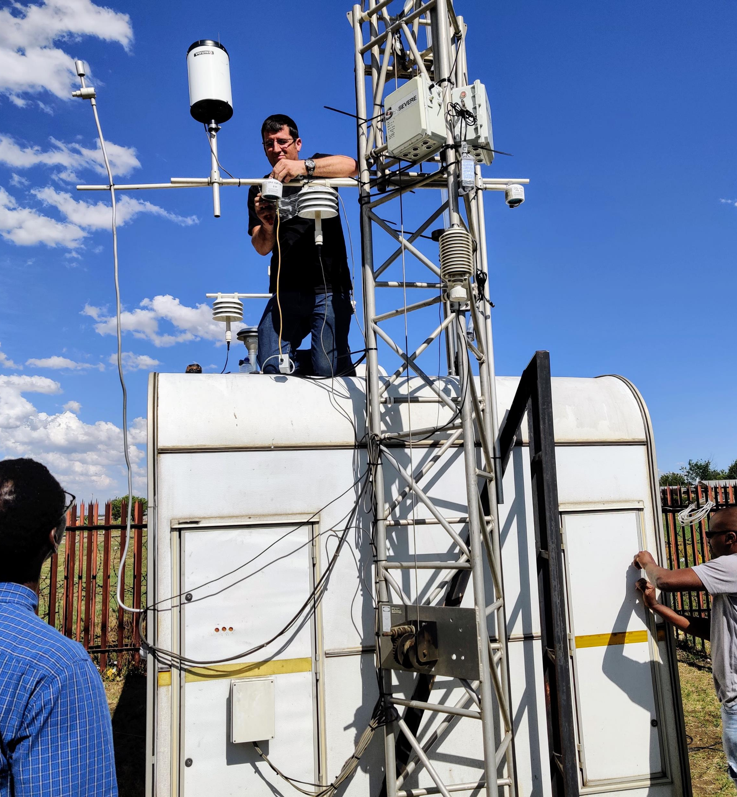
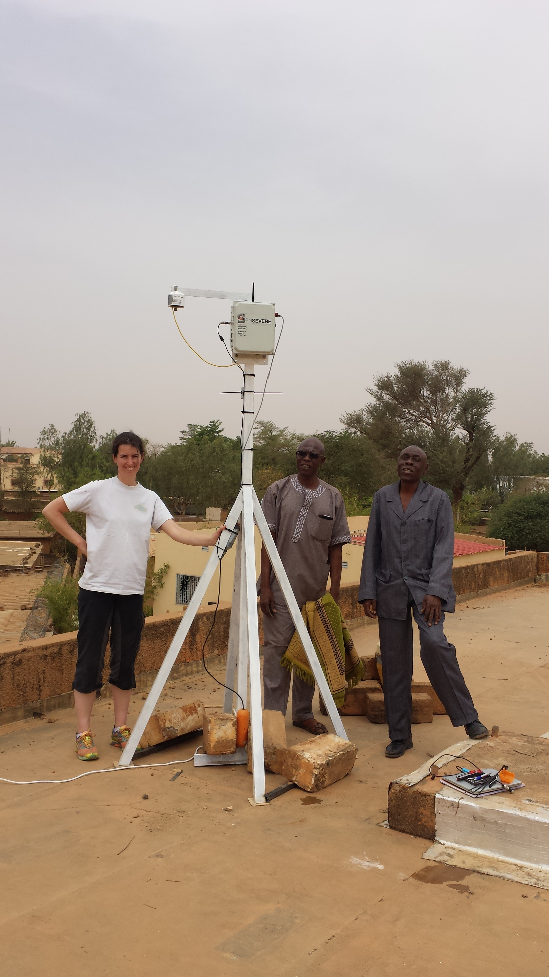

RAMP deployments in 2019/2020
(Not shown: Lamto/Abidjan, Côte d’Ivoire)
Nairobi, Kenya
Accra, Ghana
Zamdela, South Africa
Niamey, Niger

Slide 8
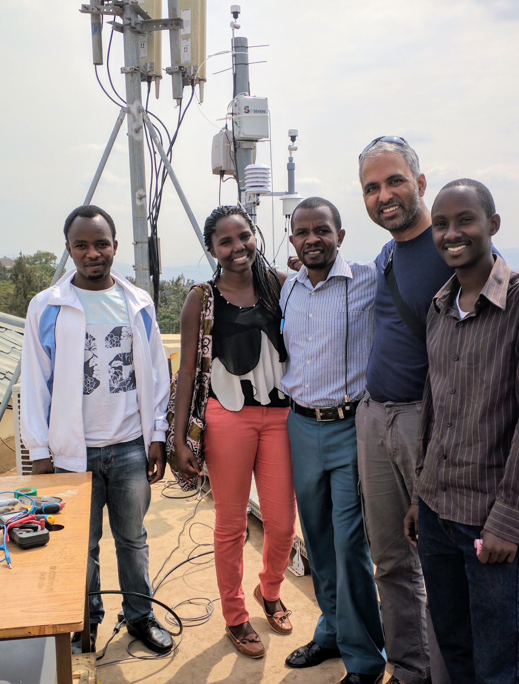
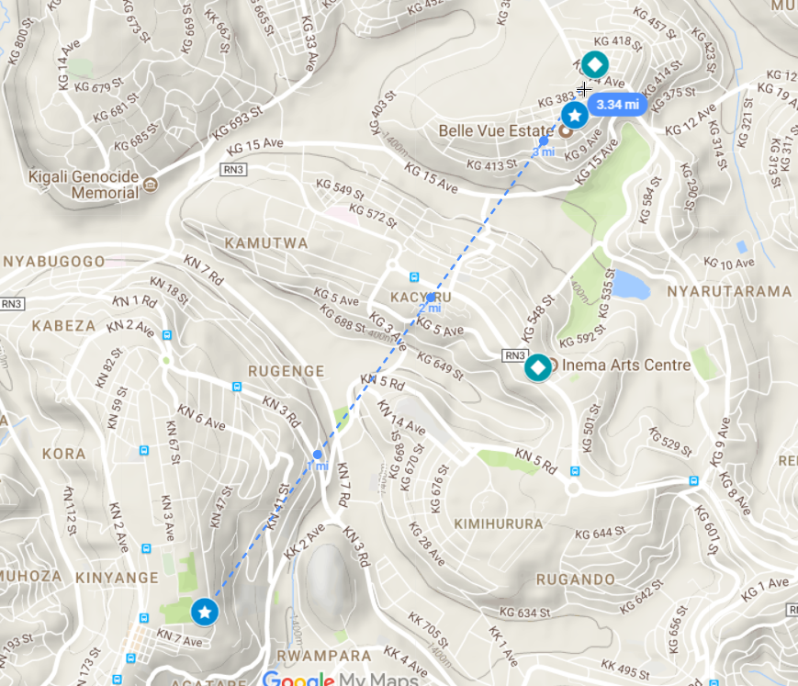
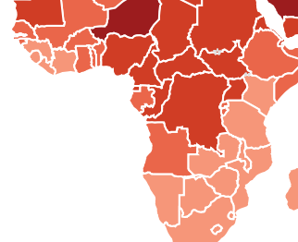
Air quality monitoring in Kigali, Rwanda
Gacuriro (residential area)
Sites 5 km apart
University of Rwanda CST
Rwanda
Notes:
First batch of students in the new UR Master’s program in atmospheric and climate science. The two sites are 5 km apart.

Slide 9
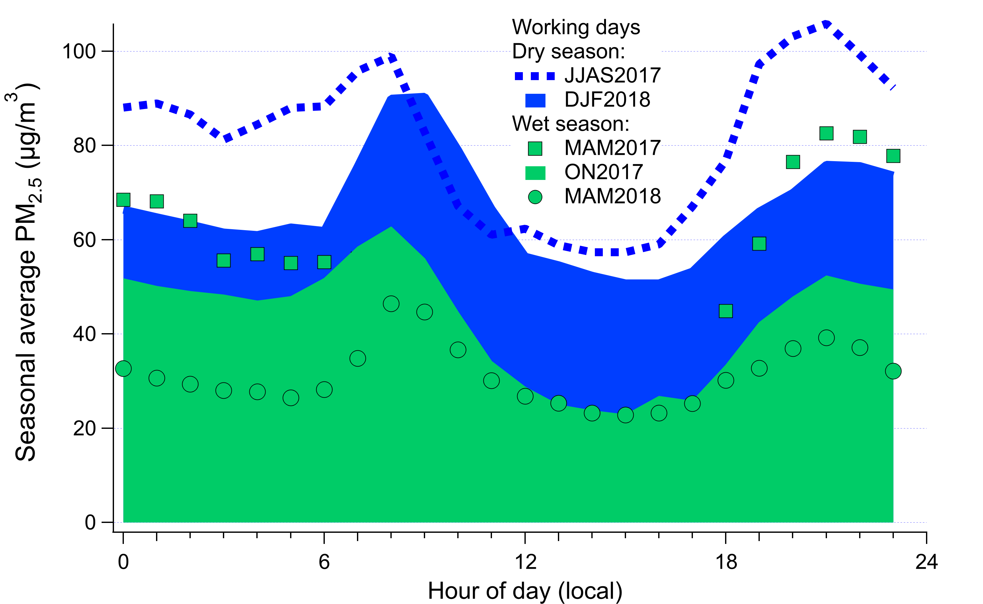
Temporal variability and sources of PM_{2.5} in Kigali: morning traffic, evening traffic+cooking?
RAMP PM_{2.5} mass corrected using coincidental 24-hour filter samples collected 5 km away by Egide Kalisa
Dry season sees significantly higher transported biomass burning emissions or dust
Similar diurnal profile seen for filter-based black carbon measurements
Based on wavelength dependence of particulate light absorption, morning PM peak is from vehicular traffic while the evening PM peak also includes domestic fuel burning
Seasonal average PM2.5 (µg/m³)
Dry
Wet season
Local hour of day
Notes:
We have data across five seasons, see similar patterns. Dry season PM2.5 is about 20 microg/m3 higher than wet season, likely regional forest fires and/or dust transported into the city. Night boundary layer is significantly lower than daytime BL, so concentrations are higher.

Slide 10
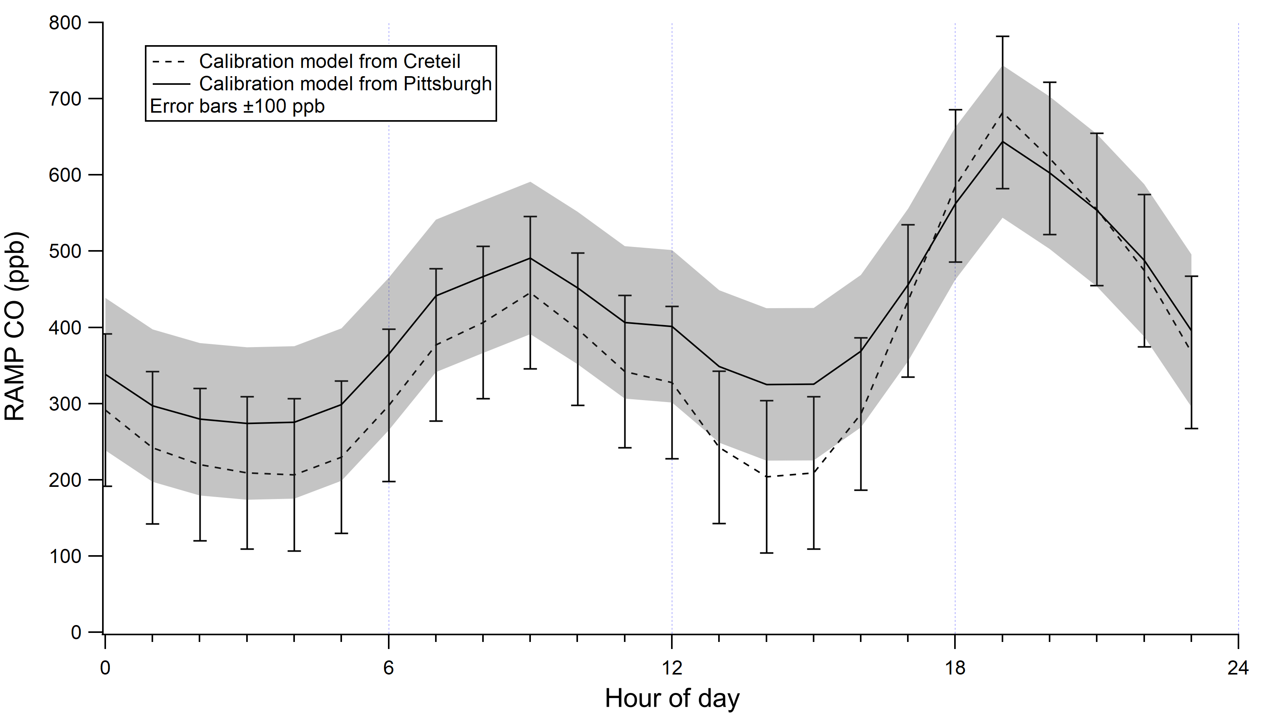
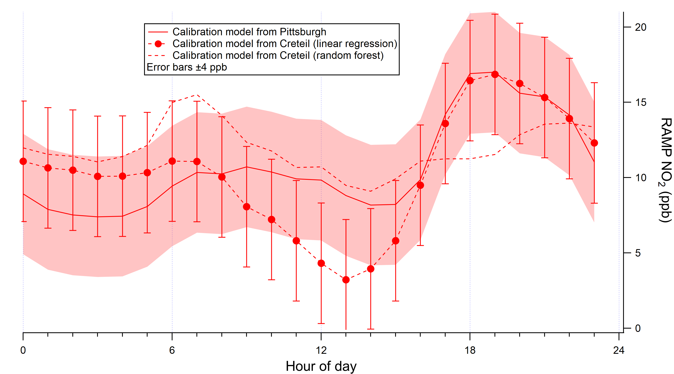
Nairobi: Early data show morning/evening traffic pollution peaks
Carbon monoxide
Nitrogen dioxide
Sept 2019 data without local calibration as no reference monitors are yet available locally. Calibration models for the data shown here were developed using collocations in Creteil, France and Pittsburgh, PA, USA

Slide 11
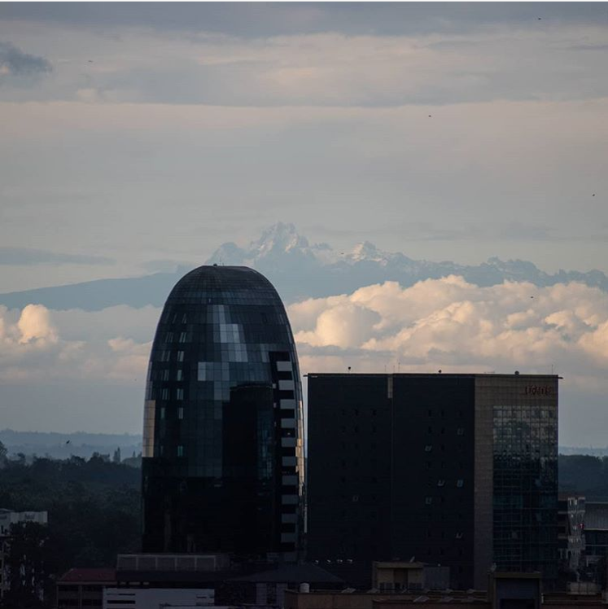
March-April 2020 in Nairobi: Covid-19 effects
March 27, 2020 - Overnight curfew starts
April 6, 2020 – Lockdown starts
  Road, rail, and air transport into/out of certain areas suspended
  Citizens asked to stay indoors unless travel is essential
Viral photograph by Osman Siddiqi suggests significantly improved visibility
  Reproduced here with permission; March 29 image on the last slide
  LCS PM_{2.5} at this hour 8.3 µg/m³
But also: “Big” rainy season starts in April – 1.5 - 2.5x rainfall in April as compared to March, historically (per Kenya Meteorological Dept., World Bank)
Image from Instagram
Taken at 17:33 local time on April 16, 2020

Slide 12
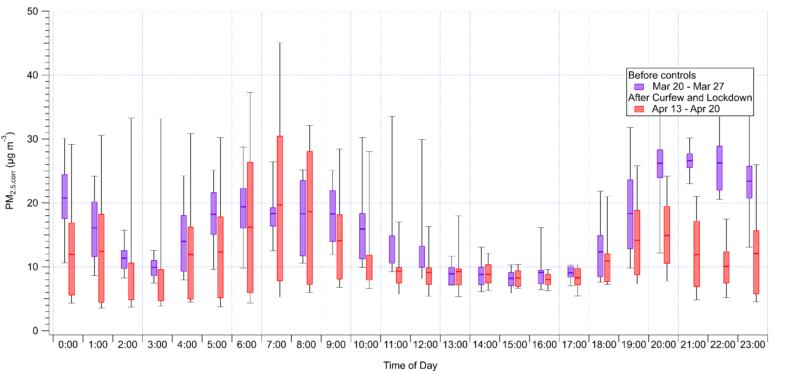

What do our low-cost sensors say about the air quality impacts of Covid-19 traffic restrictions in Nairobi?
23 Clarity nodes deployed at one location in Groganville Estate area, Nairobi
No local calibrations yet – PurpleAir correction from Malings et al. (2019) for Pittsburgh, PA, USA https://doi.org/10.1080/02786826.2019.1623863
Reductions in PM_{2.5} mass in the evening (19:00-23:00) –overnight curfew or weather? We don’t know yet.
Variable effects in the morning hours (04:00-09:00)
Collaboration with Emilia Tjernström, Daniel Westervelt, V Faye McNeill, Albert Presto, Paulina Jaramillo, and Innovations for Poverty Action

Slide 13
“Pittsburgh” calibration model overestimates ozone in Abidjan; local calibration is needed
Reference ozone analyzer operational at the Université Félix Houphouët-Boigny, Côte d’Ivoire (data in black)
RAMPs collocated at UFHB before deployment across Abidjan
RAMP data in red are based on RAMP calibrations from Pittsburgh, PA using the hybrid random forest/linear regression model in Malings et al. (2019a) https://doi.org/10.5194/amt-12-903-2019
RAMP data in blue based on the local collocation using the same algorithm – still some uncertainties, but closer to the reference values

Slide 14
Future use: Satellites and low-cost sensors are complementary
Temporal Coverage (local measurements) Spatial Coverage (satellite measurements)
RAMP measurements
PM_{2.5} diurnal pattern [µg/m³]
latitude
PM_{2.5} monthly average [µg/m³]
Kigali
satellite passes occurred within this window
Rwanda
hour of the day
Satellite passes during low-concentration periods may bias long-term averaging; ground monitors can provide temporal variability for correction
longitude
Notes:
We’d now like to look at integrating these low-cost sensor data with satellite information. Each of these data sources has certain benefits and drawbacks, which we need to be aware of, but also which can complement each other.
On the left is a diurnal PM2.5 profile obtained from one of the RAMPs in Kigali, Rwanda. Comparing this profile to the interval where MODIS satellite passes occur, you can see that, by only relying on satellite information, even if this information was accurate, it would still be biased low because passes occur during lower-concentration periods. So local information from low-cost sensors is important to obtaining temporal data coverage.
On the right is a spatial map of monthly averaged PM2.5, obtained from the satellite data using the methods I will present. It would be a major undertaking to obtain this same level of spatial coverage, even using low-cost sensors, so we would like to combine the spatial coverage of the satellite data with our ground-based low-cost sensor data to obtain better maps of surface PM2.5. In this presentation I will discuss one approach to doing that, and look at some of the preliminary results we can get from this approach.

Slide 15
Even one lower-cost monitor combined with satellite AOD improves our knowledge of spatial patterns in Kigali, Rwanda
1
14
8
13
7
0.9
6
12
0.8
satellite
better
11
5
10
4
0.7
3
9
2
0.6
8
1
Correlation (r²)
MAE [µg/m³]
Bias [µg/m³]
better
0.5
better
7
better
0
6
-1
0.4
-2
similar
lower spread for sat.
5
satellite
better
0.3
4
-3
3
-4
0.2
-5
2
-6
0.1
1
-7
0
0
-8
sat
int
sat
int
sat
int
sat: calibration of satellite AOD to ground site; int: “interpolation” assumes one site represents the city
MODIS AOD correction factor developed using one RAMP location; validation results shown above for the second RAMP location 5 km away (Malings et al. 2020: https://doi.org/10.5194/amt-2020-67)
Notes:
In Rwanda, however, where we had just three sites operating at any given time, such an interpolation is not really a viable method here, as indicate by rather poor results. Conversely, in Rwanda, PM2.5 concentrations and variability are much higher than in Pittsburgh, so our satellite-derived PM2.5 can be more accurate because the signal-to-noise ratio is much higher here. Thus, in this sparsely monitored area, having even a small ground-based low-cost sensor network can be a major benefit, when that data is used together with satellite information.

Slide 16
Ongoing work and next steps: #AfriqAir
Localized calibrations for NO₂, O₃, PM_{2.5}
  Need more reference monitors across Africa!
  In progress: Kigali, Johannesburg, Abidjan; plans for Nairobi, Accra
  PurpleAir devices collocated with some US embassy BAMs (Daniel Westervelt)
Nairobi: High-density mapping with ~30 Clarity/RAMP/PurpleAir devices
  With Emilia Tjernström, Daniel Westervelt, Albert Presto, Paulina Jaramillo, V Faye McNeill, Innovations for Poverty Action, University of Nairobi, JKUAT, Kenyatta Univ
Kigali: Study of urban, rural, and transboundary sources of pollution
  With Jimmy Gasore and Albert Presto
Abidjan vs Accra: “Improving Air Quality in West Africa” (IAQWA)
  MOPGA postdoctoral fellowship for Dr Julien Bahino
Assimilation with satellite/other data sources and new air quality models for air quality forecasting in Africa

Slide 17

March-April 2020 in Nairobi: Covid-19 effects
Viral photograph by Osman Siddiqi suggests significantly improved visibility
  Reproduced here with permission
Ambient PM_{2.5} at this hour 11 µg/m³
  Mean of Clarity node responses using the Malings et al. (2019) correction for PurpleAir monitors, which use the same Plantower sensor
Image from Twitter
Taken at 09:43 local time on March 29, 2020

