Slide 1
Global Landslide Hazard Assessment for Situational Awareness (LHASA) Version 2: New Activities and Future Plans
EGU General Assembly
NH3.11 Towards reliable Landslide Early Warning Systems
Dalia Kirschbaum¹
Thomas Stanley^{2,1}, Pukar Amatya^{2,1}, Robert Emberson^{3,1}, Sana Khan^{4,1} Hakan Tanyas^{3,1}
https://landslides.nasa.gov
¹ NASA Goddard Space Flight Center, Hydrological Sciences Laboratory, Greenbelt, MD
² Universities Space Research Association, Columbia, MD
³ NASA Postdoctoral Program, USRA
⁴ Earth System Science Interdisciplinary Center, U of Maryland

Slide 2
Background: Global and Regional Landslide Hazard Modeling
Global Landslide Hazard Assessment Situational Awareness (LHASA v 1.1) Model
Global Susceptibility (slope, geology, forest loss, distance to faults, distance to roads)
Near global, near-real time rainfall from GPM IMERG
Implementations
Globally running within NASA’s Precipitation Processing System
Colombia: IDEAM currently testing and implementing LHASA for country
In progress: Tajikistan/Pakistan, CEMADEN - Brazil
Current activities
Developing new framework for LHASA V2.0 to leverage machine learning information and inventories
Rio de Janeiro: LHASA-Rio operational since Fall 2018
Developing additional regional implementations focused in the Mekong region and High Mountain Asia region

Slide 3
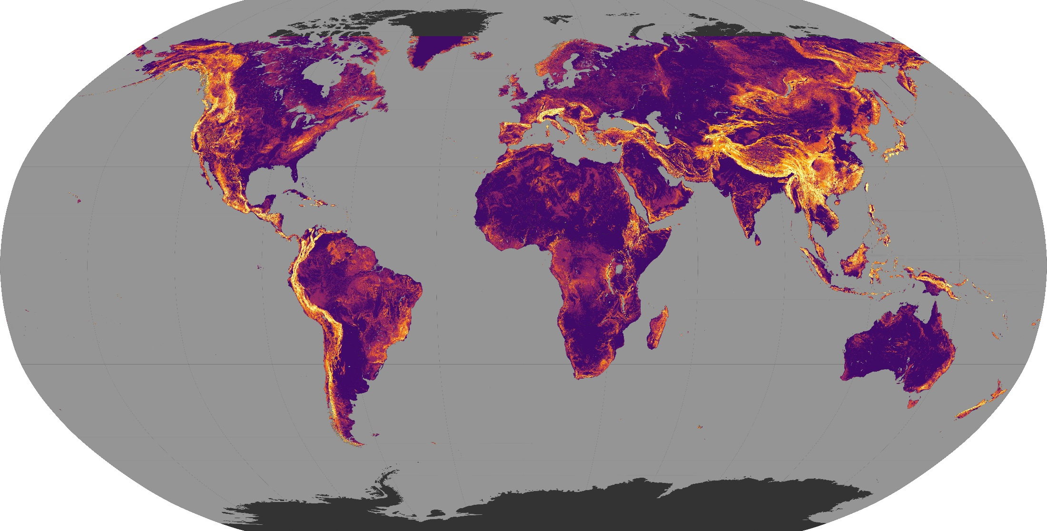
Global Landslide Susceptibility
Available for download at: https://pmm.nasa.gov/applications/global-landslide-model
Stanley and Kirschbaum 2017
Stanley et al., 2017

Slide 4
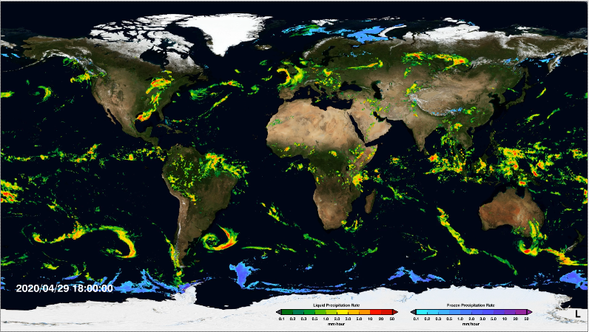
Global Precipitation Measurement Multi-Satellite Precipitation Data
https://gpm.nasa.gov/data-access/downloads/gpm
Notes:
Real-time data available for last 7 days as movie at: http://svs.gsfc.nasa.gov/cgi-bin/details.cgi?aid=4285

Slide 5
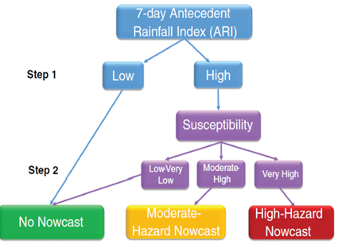
LHASA Output for Hurricane Willa, 2018
NASA GPM/LHASA product for Hurricane Willa
https://maps.disasters.nasa.gov

Slide 6
Rainfall-triggered Landslide Climatology
https://svs.gsfc.nasa.gov/12897#25012

Slide 7
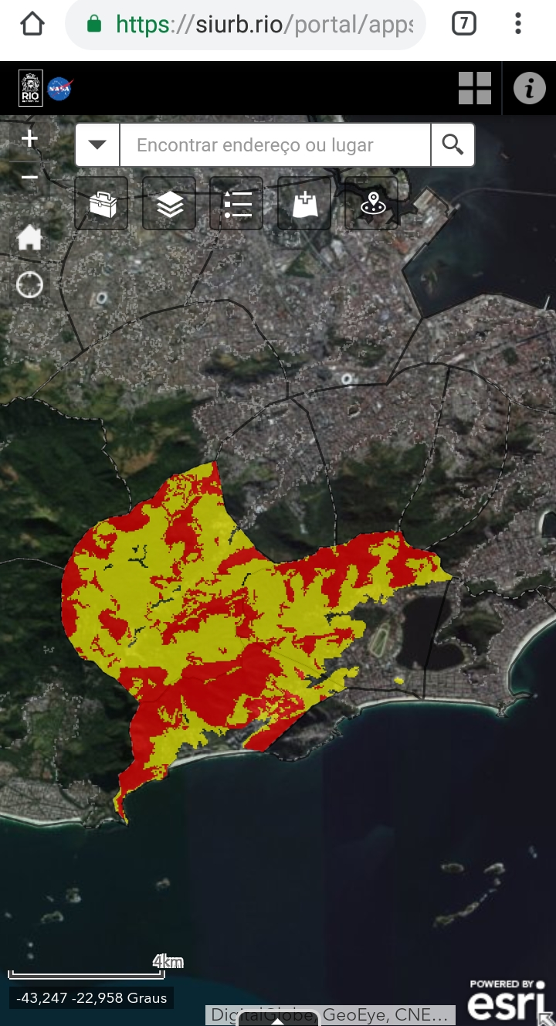
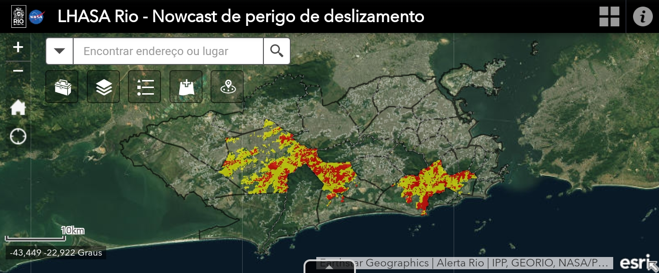
Application of LHASA-Rio in SIURB Portal
A

Slide 8
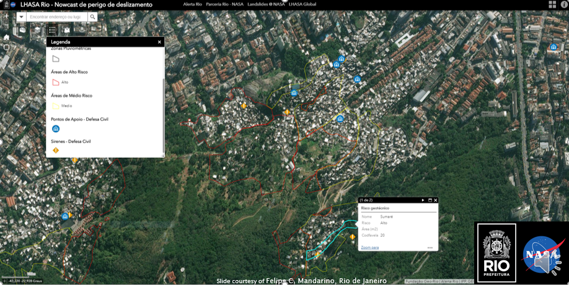
Zoom in of moderate and high risk areas
A

Slide 9
Conceptual LHASA 2.0 Structure
Static Factors
DEM
Geology
Rock strength
Triggers
Satellite NRT rainfall
Rainfall Forecast
Soil Moisture
Earthquake
PGA
(% shaking), recent events
Post-fire Debris Flow Module
Landslide Nowcast & Forecasts:
Probability of
Rainfall-triggered landslides
Post-fire debris flows
Methodology:
XGBoost machine-learning model trained with different types of landslide data
Exposure Model
Population
Roads
Infrastructure

Slide 10
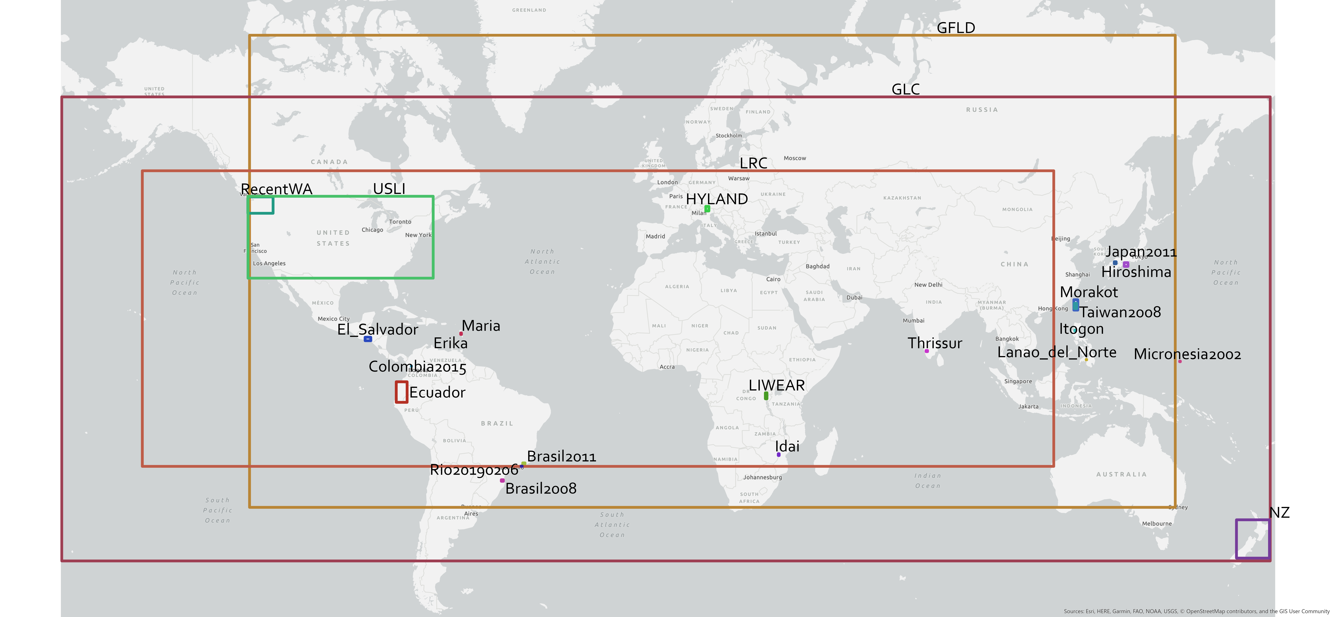
Selection of landslide inventories collated for training/testing
Lefkada
Puerto Rico
Notes:
13500 points from multiple catalogs: 80% training, 20% validation (2015-2019)
16 inventories ranging from 1 – 6400 landslides
61 total inventories but most are not usable in current form
18 event based inventories
22 multi-temporal inventories
2 from other sources

Slide 11
LHASA 2.0 Nowcast dynamic variables
SMAP L4 has a 3-day latency, so need to fill gap with IMERG.
Antecedent conditions represent year-to-date
Soil Wetness = Full-profile Soil Moisture / Porosity
SMAP L4
Antedent Rainfall =
$$\sum_{t=−1}^{−2}{rain}$$
IMERG Late NRT
Current Daily Rainfall Total
IMERG Early NRT
Fore-casted Precip 24 h+
GMAO FP
Soil Temperature
SMAP L4
Snow Depth
SMAP L4
All prior | t=-7 | t=-6 | t=-5 | t=-4 | t=-3 | t=-2 | Yesterday | Today (t0) | Tomorrow

Slide 12
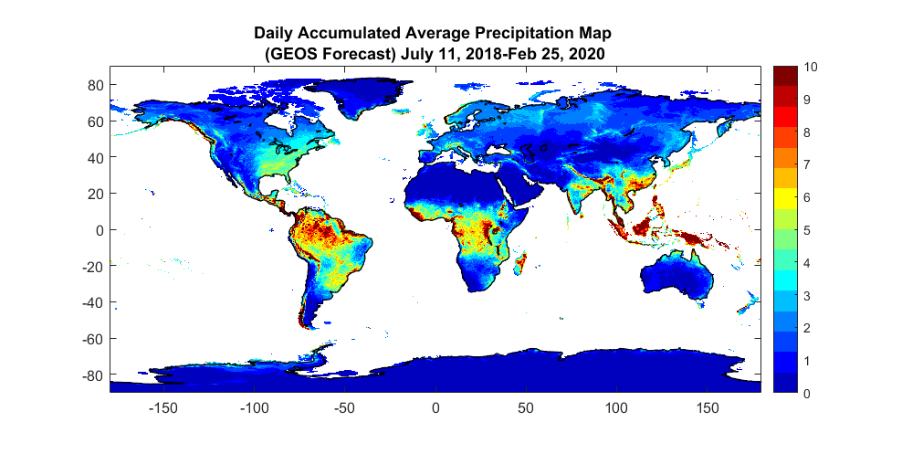
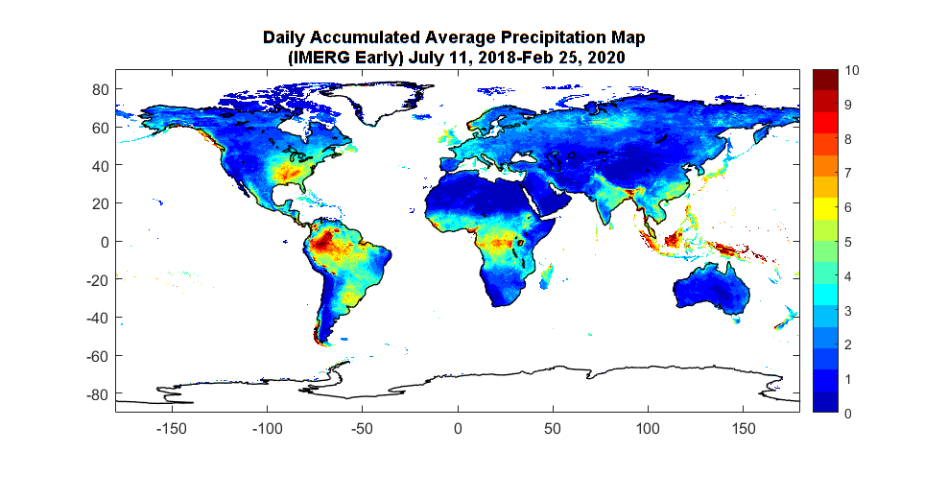
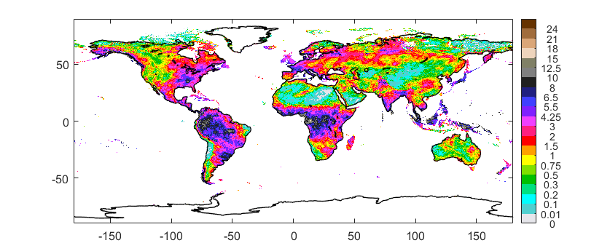
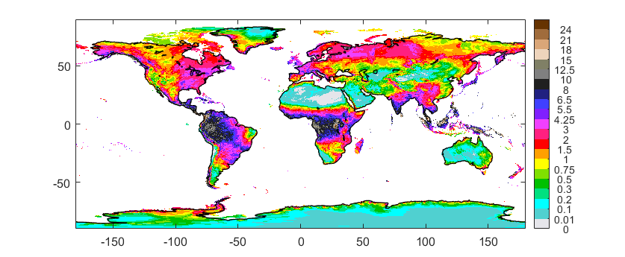
Towards Landslide Forecasting: Goddard Earth Observing System (GEOS) Model 2D Surface Precipitation Estimates
Daily Accumulated Average Precipitation map
(00z into 10 days)
Diagnostics
24 files/day
Temporal res.: 1hr
Spatial: 25km × 31km
GEOS
Forecast
IMERG early
Initialization
H00
IMERG 48 files/day Temporal res.: 30min Spatial: 10km×10km Units: mm/hr
Early (~4 hr latency)
Late (~12 hr latency)
Final (~2 mo latency): gauge adjusted
H06
H12
H18

Slide 13
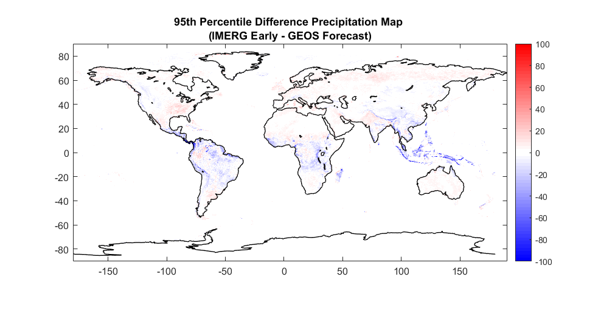
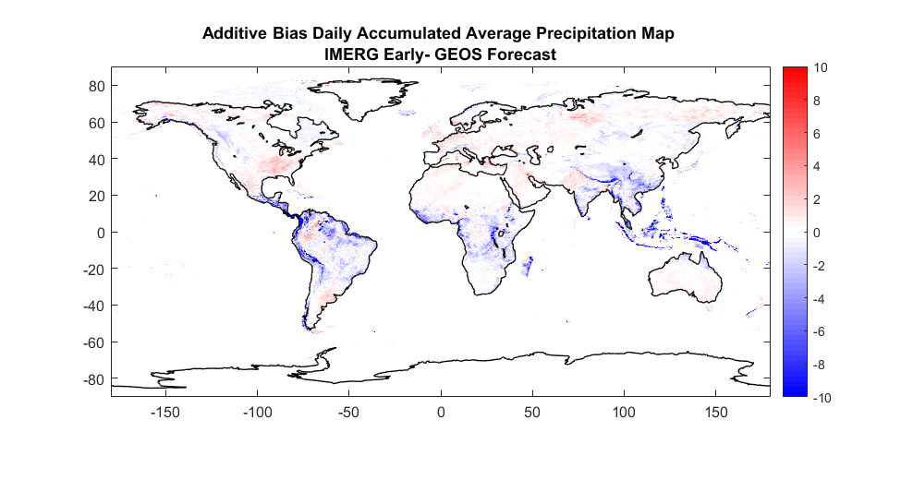
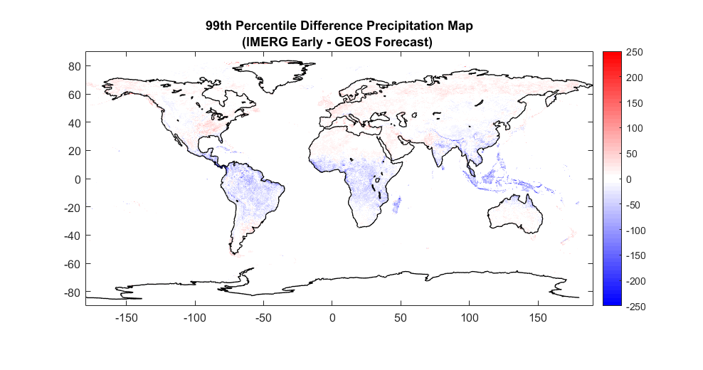

Slide 14
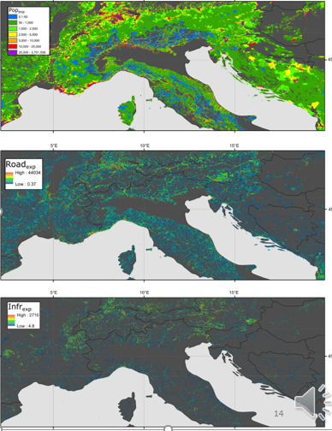
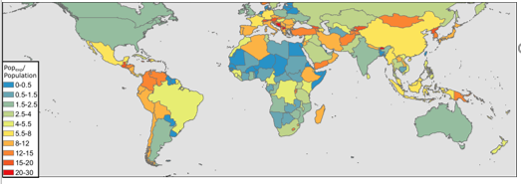
Exposure Estimates
Relative exposure of population, critical infrastructure, and roads in the European Alps and Italy.
Population exposure normalized by total population
Emberson et al. in review at NHESS
https://www.nat-hazards-earth-syst-sci-discuss.net/nhess-2019-434/

Slide 15
Please reach out to discuss!
LHASA 2.0 is still in development and requires landslide inventories for improved landslide modeling and characterization. If you have any inventories you are interested in sharing, please contact us.
Please find our list of publications and landslide inventories at: https://landslides.nasa.gov
Please consider adding landslides to our citizen science portal: Landslide Reporter (https://landslides.nasa.gov/reporter)
Dalia Kirschbaum, dalia.kirschbaum@nasa.gov
Thomas Stanley, Thomas.a.Stanley@nasa.gov
Pukar Amatya, pukar.m.amatya@nasa.gov
Robert Emberson, robert.a.emberson@nasa.gov
Hakan Tanyas, hakan.tanyas@nasa.gov

