Slide 1

A possible mechanism of space stem precursors formation at the negative lightning leader corona streamer burst periphery
A.A. Syssoev^{1,2}, D.I. Iudin^{1,2}
¹Institute of Applied Physics of Russian Academy of Sciences, Nizhny Novgorod, Russia
²Privolzhsky Research Medical University, Nizhny Novgorod, Russia
Online | 4–8 May 2020

Slide 2
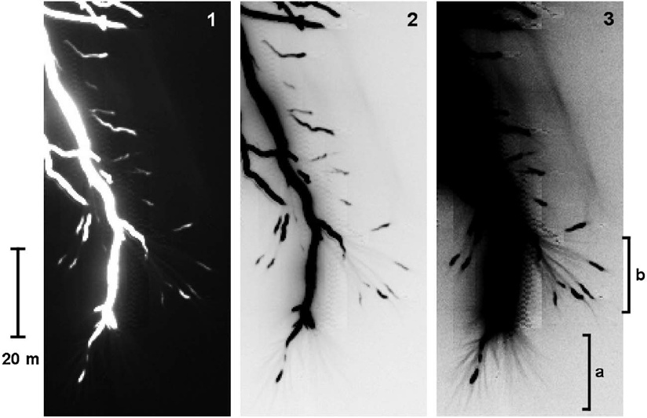
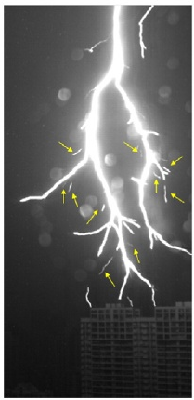
Motivation
Petersen and Beasley [2013]
Qi et al. [2016]
Notes:
It has long been known that both laboratory and lightning negative leaders in the air always propagate in a stepwise manner. A new step forms when a positive part of a space leader attaches to the primary negative leader channel. Space leaders arise from the so-called space stems, which are brightly glowing plasma formations with a volume of the order of 1 cm³ (under laboratory conditions) emanating positive and negative streamers. The space stem formation mechanism is steel poorly understood. The authors of the monograph “Lightning Physics and Lightning Protection” characterize the picture of the emergence of positive and negative streamers growing from a space stem by the words “nearly mystic”. The recent work of Malagyn-Romero and Luque [2019] explains the space stems formation by the attachment instability development. Their conclusions follow from 2D axially symmetric model, which doesn’t take collective effects of interaction between simultaneously developing streamers into account.
Malagуn-Romero, A., & Luque, A. (2019). Spontaneous emergence of space stems ahead of negative leaders in lightning and long sparks. Geophysical Research Letters, 46, 4029–4038. https://doi.org/10.1029/2019GL082063.
Petersen, D. A., and W. H. Beasley (2013), High-speed video observations of a natural negative stepped leader and subsequent dart-stepped leader, J. Geophys. Res. Atmos., 118, 12,110–12,119, doi:10.1002/2013JD019910.
Qi Qi, Weitao Lu, Ying Ma, Luwen Chen, Yijun Zhang, Vladimir A. Rakov, High-speed video observations of the fine structure of a natural negative stepped leader at close distance, Atmospheric Research, Volumes 178–179, 2016, Pages 260-267, ISSN 0169-8095, https://doi.org/10.1016/j.atmosres.2016.03.027.

Slide 3
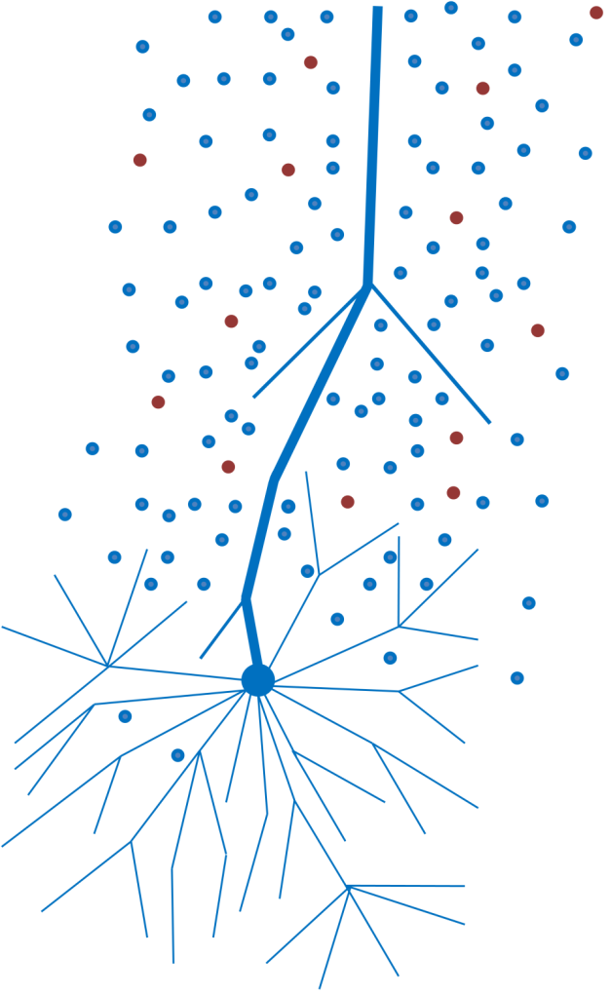
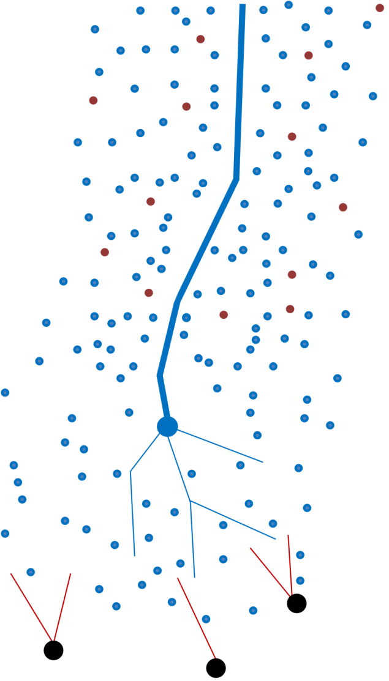
Motivation
Channel corona sheath
Primary leader channel core
Negative leader tip
Negative corona streamer burst
Space stems
Notes:
In this paper, we assume that space stems arise at the negative corona streamer burst periphery. It is clear that they should be formed there, because in this region the external electric field is amplified by the field of the negative corona space charge. Moreover, due to the inhomogeneous distribution of the negative charge inside the streamer corona volume, there are regions with electric field exceeding the threshold of ionization center creation. So, this study is devoted to the description and analysis of the ionization centers formation mechanism (implying that some of these ionization centers eventually turn into space stems). Since there are experimental examples of recording the negative leader steps at altitudes of the order of 10 km [Edens et al., 2014], in this study we consider the range of altitudes varying from 0 to 12 km above sea level.
Edens, H. E., K. B. Eack, W. Rison, and S. J. Hunyady (2014), Photographic observations of streamers and steps in a cloud-to-air negative leader, Geophys. Res. Lett., 41, 1336–1342, doi:10.1002/2013GL059180.
The figure is taken from [Syssoev, A. A., Iudin, D. I., Bulatov, A. A., & Rakov, V. A. (2020). Numerical simulation of stepping and branching processes in negative lightning leaders. Journal of Geophysical Research: Atmospheres, 125, e2019JD031360. https://doi.org/10.1029/2019JD031360].

Slide 4
Problem Formulation: Simple Estimates
R
Notes:
Let’s move from general to specific. We will start with a description of the negative leader streamer zone structure and parameters, and will later move on to a smaller scale. The figure on the left shows the negative leader channel, which is surrounded by the sheath of space charge. The leader channel ends with the tip, which is a source of the streamer zone (for the negative leader the last exists in the form of the corona streamer burst). For simplicity, we assume that the shape of the streamer corona can be approximated by a spherical segment and has a vertical direction of growth. Its length is determined by the leader sheath line charge density, the charge transferred to the newly-formed negative leader tip, and, to a lesser extent, by the external electric field magnitude. We assume that the entire step charge transferred to the newly-formed negative leader tip is distributed in the space in front of it and that electric field, which is finally established inside the streamer corona volume, has only a radial component equal to the negative streamers propagation threshold. Then, taking into account more or less known negative leader parameters, one can estimate the length of the streamer corona, its volume, and the physical quantity, which we would like to call the spatiotemporal noise intensity. The last is a very important parameter, which is discussed below.
Physical quantities:
E_{a} – ambient electric field;
R – streamer corona radius;
ρ_{sh} – leader sheath line charge density;
q_{t} – charge transferred to the newly-formed negative leader tip during the step-formation process;
ψ - streamer corona sweep angle;
ρ_{b}(r) – negative corona volumetric charge density (depends only on the radial coordinate r);
h – altitude above sea level;
$E_{pth}^{−}$ - negative propagation threshold field;
k – an electric constant;
E_{r} – radial electric field inside the negative corona;
A – some constant;
Ω – negative corona solid angle;
q_{b} – total charge inside the negative corona streamer burst (assumed to be equal to q_{t}).

Slide 5
Problem Formulation: Streamer Zone Volume
Notes:
To find the spatiotemporal noise intensity one must know a streamer corona volume. It is necessary to take into account the fractal nature of the streamer corona to correctly find its volume. Popov [2002] estimated the fractal dimension of the positive streamer zone being 2.16±0.05. Since electric fields on the heads of positive and negative streamers do not differ much, for negative streamer corona one must expect to get a close value. The volume of a fractal object depends on the choice of an elementary volume (minimal structural element). Conditionally choosing 1 cm³ as the minimum volume, we find that the actual volume of the streamer corona is many times smaller than the three-dimensional one and ranges from hundredths to dozens of cubic meters. Choosing such a minimum volume, we believe that the streamer heads with a size of the order of fractions of a millimeter, ionize a surrounding volume of approximately 1 cm³.
Popov, Nikolay. (2002). Spatial Structure of the Branching Streamer Channels in a Corona Discharge. Plasma Physics Reports. 28. 10.1134/1.1494061.
$d_{f}^{+}$ - positive streamer corona fractal dimension;
$d_{f}^{−}$ - negative streamer corona fractal dimension;
a – minimal scale inside the streamer corona volume;
V₀ – 3D streamer corona volume;
V_{b} – real (fractal) streamer corona volume.

Slide 6
Problem Formulation: Ambient Noise Intensity
Notes:
Now, knowing the approximate streamer corona volume, we are able to estimate the spatiotemporal noise intensity, which is defined as the ratio of the total charge injected into the streamer corona to the product of the streamer corona volume and the time of its formation (i.e., the time of filling it with space charge). The spatiotemporal noise intensity decreases with increasing altitude due to the rapid growth of the volume occupied by the streamer corona.
η - the spatiotemporal noise intensity for the entire streamer corona volume;
Δt_{b} – negative corona formation time.

Slide 7
Problem Formulation: Local Noise Intensity
Notes:
Since we are especially interested in a thin outer layer at the streamer corona boundary, we need to estimate the noise intensity for this location separately. The result greatly depends on the time of filling this layer with negative charge. The minimum time is poorly known and, in principle, can be arbitrarily small. The maximum time of filling the layer coincides with the streamer corona formation time, but most likely it is much less, since the outer layer is filled first and prevents the subsequent charge supply. On the one hand, there is reason to believe that for the boundary layer the noise intensity is likely to be higher than that for the entire streamer corona volume due to the much shorter filling time of the layer. On the other hand, when moving away from the leader tip, the ratio of the charge of each subsequent layer to its volume will decrease (see the form of the dependence of the charge density on the radius shown on the slide 4).
$η_{l}$ - the spatiotemporal noise intensity for a thin outer layer at the streamer corona boundary;
ΔR – the length of the outer layer;
$V_{str}$ - minimal streamer propagation speed (before stopping);
${Δt}_{l}$ - the time of filling the outer layer with streamer heads charge.

Slide 8
Problem Formulation: Simulation Domain
10 мм
R
4 мм
Notes:
We now discuss the model formulation. The two-dimensional simulation domain, which is a rectangular parallelepiped of unit thickness (the spatial grid spacing at sea level set to 50 μm), is located at the streamer corona periphery, where the highest values ​​of electric field are expected, because here the external field is amplified by the field of the negative corona charge. The background electric field inside the model volume is equal to the negative streamers propagation threshold, that is, approximately one third of the breakdown value. A smaller part of the simulation domain (upper 2.5 mm) is available for streamer heads stopping, while the rest (lower 7.5 mm) is filled due to electron drift. According to the similarity law, the scale of the model layer (L) grows with increasing height above sea level.

Slide 9
Problem Formulation: Basic Elements of Noise (ground level)
a)
b)
c)
d)
Notes:
In our model, we ignore moving streamers whose electric field is strongly localized in the region of their heads and consider only the heads of stopped negative streamers as the basic elements of spatiotemporal noise. This slide shows the spatial distribution of a negative streamer remnants immediately after it stops (at zero altitude). The negative charge (a) associated with electrons is predominantly concentrated in the region of its head and decreases exponentially with increasing distance from it. This charge creates electric field enhancement (hump) (b) in front of it. The streamer trail consists of atomic oxygen (c) and has a slightly higher temperature (d) compared to ambient air. This is important because atomic oxygen concentration and the gas temperature are included in the calculations of plasma-chemical quantities. The trace of positive and negative ions created by a negative streamer is not taken into account, because it has nearly zero total charge. In addition, due to the low mobility, the ion current practically does not produce any thermal effect. The linear dimensions of streamer remains exponentially increase with height while maintaining the spatial distribution shape.

Slide 10
Problem Formulation: Basic Equations
Notes:
This slide shows the basic system of seven equations describing the evolution of electrons and the three types of positive and negative ions. Looking ahead, the key terms contributing to the proposed space stems formation mechanism are ionization, which leads to an increase in the electrons and positive ions concentration and electron drift. Negative factors are the attachment of electrons to neutral molecules with the formation of low-mobility negative ions and the recombination of positive ions with electrons and negative ions. We now proceed directly to the mechanism itself. Most plasma-chemical reactions, which form the basis of the system can be found in [Iudin et al., 2019].
Iudin D.I., Rakov V.A., Syssoev A.A., Bulatov A.A., Hayakawa M. Formation of decimeter-scale, long-lived elevated ionic conductivity regions in thunderclouds // npj Climate and Atmospheric Science. 2019. Vol. 2, № 46. P. 1–10. doi:10.1038/s41612-019-0102-8.

Slide 11
Mechanism Description: 1D Scheme
Notes:
As it was already mentioned, the basic elements of the proposed mechanism are the heads of negative streamers stopping at the streamer corona periphery. Our ultimate goal is to grow a positively charged cluster, the charge of which will be enough to become an ionization center against the background of a negatively charged streamer corona. The only way to produce positive ions is an impact ionization, the effectiveness of which depends on the electric field magnitude and the seed concentration of electrons. One can control the growth of a positively charged cluster by throwing new negative streamer heads onto the remains of the old ones. In this case, one must try to do this in such a way that the electrons formed together with positive ions leave the ionization point via the drift as soon as possible, denuding positive ions. Otherwise, the electrons will work to reduce the positive ions concentration as a result of recombination. The rate of electron escape from the ionization center should be as high as possible so that they do not have time to attach to neutrals with the formation of low-mobility negative ions, the charge of which negatively affects the proposed mechanism efficiency.
Here and at the next 8 slides we will present the case of an altitude of 12 km above sea level, which is the most demonstrative. The blue, green and red solid lines stand for electrons and positive ions concentrations and for the electric field magnitude, respectively. Horizontal dashed black line shows the level of the critical electric field (see [Iudin et al., 2019]) at 12 km altitude (shortly speaking, this is the field, at which charged particles generation becomes possible). Speaking about 1D scheme, we mean that negative streamer heads can stop only at the fixed line (say, at x=0), which is parallel to y-axis.
Iudin D.I., Rakov V.A., Syssoev A.A., Bulatov A.A., Hayakawa M. Formation of decimeter-scale, long-lived elevated ionic conductivity regions in thunderclouds // npj Climate and Atmospheric Science. 2019. Vol. 2, № 46. P. 1–10. doi:10.1038/s41612-019-0102-8.
N_{h} – total number of stopped streamer heads;
t – the time elapsed from the start of the simulation;
ν_{i1} and ν_{i2} – ionization frequencies;
$J_{e}$ - electrons flux;
$µ_{e}$ - electrons mobility;
$D_{e}$ - electrons diffusion coefficient.

Slide 12
Mechanism Description: 1D Scheme
Notes:
Numerous tests evidence that the most favorable situation is when the next streamer head stops slightly before the electric field maximum. Here is the situation for a moment before the second streamer head stopping.

Slide 13
Mechanism Description: 1D Scheme
Notes:
Here is the situation immediately after it stops. Please, pay attention to the fact that after the “profitable” stop of the second streamer head the electric field peak value almost doubles, which significantly increases the effectiveness of electrons and positive ions production in this region.

Slide 14
Mechanism Description: 1D Scheme
Notes:
This is the picture before adding the third streamer head.

Slide 15
Mechanism Description: 1D Scheme
Notes:
And here is the effect of its stopping. Now it is necessary to wait until a sufficiently large number of positive ions has been generated and until most of electrons leave this zone.

Slide 16
Mechanism Description: 1D Scheme
Notes:
As a final result, one obtain a dipole-like charge distribution, the field at the positive pole of which is large enough to exceed the threshold for the charged particles generation.

Slide 17
Mechanism Description: 1D Scheme
Notes:
This is how the result of the presented 1D simulation looks in a two-dimensional representation. We get a positive charge spot with the total charge of approximately 16 pC. Being surrounded by a negative charge and placed in a relatively strong external field, this positively charged spot will create a field enhancement that will be enough to increase the threshold of charged particles concentration growth and to initiate positive streamers. Note that there is an abundance of seed electrons around the positively charged cluster, which ensures positive streamers survival.
This example with three negative streamer heads was shown for an altitude of 12 km above sea level. Calculations show that in the entire considered 0-12 km altitude range, three to four stopped negative streamer heads will be enough to create an ionization center under the use of the correct method of throwing them at fortunate places. If the heads fall into random places, this can both contribute to and prevent the ionization center formation. Therefore, in the general case, the number of stopped streamer heads should be greater. Let’s now consider more real 2D case, when negative streamer heads can stop at random points of 2D region of space.
E – electric field magnitude;
Q – electric charge.

Slide 18
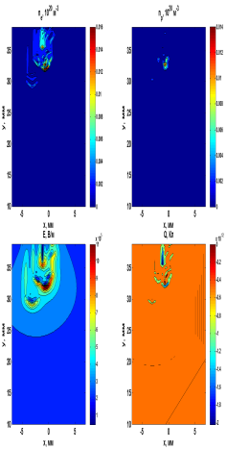


Results: 2D Uniform Spreading (21 ns)
Notes:
In the 2D calculations, the time of ionization centers formation was determined for the case of an arbitrary charge throwing. Here is the initial stage of our modeling, at which the heads of negative streamers stopping at random places. Their negative charge generate damped hemispherical waves propagating forward (away from the negative leader tip). At the places, where the negative streamer heads stop, spots of positive ions are formed due to electron drift.
E – electric field magnitude;
$n_{e}$ and $n_{p}$ - electrons and positive ions concentrations.

Slide 19
Results: 2D Uniform Spreading (191 ns)
Notes:
This is the final stage of modeling, at which the ionization center (enclosed in a red circle) is formed. The region of positive charge arising due to polarization becomes an analog of a floating anode, which can give rise to positive streamers. Since our model does not take photoionization into account and has a relatively poor spatial-temporal resolution, we restrict ourselves to considering only this stage, not reproducing the occurrence of positive and negative streamers growing from the space stem. The space stem precursor is considered to be formed (the simulation stops) when the increment of the increase of charge carriers concentration provided by the positive charge cluster begins to exceed the conditional value of 10⁹ s⁻¹.
ν_{i} – ionization frequency;
ν_{a} – attachment frequency;
$λ^{+}$ - an increment of charged particles concentration growth.

Slide 20
Results: Formation Time
Notes:
This slide shows the result of parameterization of the dependence of the space stem precursor formation time on the spatiotemporal noise intensity (blue line). Green dots indicate the results of numerical experiments. Due to the sharp (power) nature of this dependence and the fact that the background value of this intensity sharply decreases with increasing altitude above sea level (see slide 7), we can claim that the space stem formation time increases with increasing height, which is confirmed by experimental data [Rakov and Uman, 2003]. The values ​​of spatiotemporal noise intensities presented on this slide significantly exceed the previously performed estimates (see slides 6 and 7). Therefore, it is necessary to justify the workability of the proposed mechanism.
$t_{s−f}$ - space stem precursor formation time;
$η_{l}$ - the spatiotemporal noise intensity for a thin outer layer at the streamer corona boundary.
Rakov V.A., Uman M.A. Lightning: Physics and effects. New York: Cambridge University Press, 2003.

Slide 21
Mechanism Feasibility Estimation
Notes:
Let's try to estimate the probability of the proposed scheme realization. To do this, we consider a demo task from the course of combinatorics. Suppose that one has m identical cells over which one needs to distribute n streamer heads. We need to answer the question of what are the probabilities of finding a certain number of heads in a randomly taken cell? The problem is solved by expanding the number of heads into all possible sums of integers, followed by calculating the statistical weight of each resulting combination.
Speaking about this thought experiment, we neglect the Coulomb repulsion between negatively charged streamer heads. This is permissible, because the small charge of the streamer head (of the order of 10⁻¹¹ C) cannot overcome a relatively strong external electric field (of the order of 10⁶ V/m) at a distance bigger than a few tenths of a millimeter.
n – the number of streamer heads;
m – the number of available cells;
$C_{m}^{n}$ - the number of combinations of m by n;
P(i) – the probability of finding i heads in a randomly taken cell.

Slide 22
Assessment of the mechanism feasibility
n | 70 | 80 | 90 | 100 | 110 | 120 | 130 | 140 | 150
m=n
P(n=5) | 1.55e-2 | 1.55e-2 | 1.55e-2 | 1.55e-2 | 1.55e-2 | 1.56e-2 | 1.56e-2 | 1.56e-2 | 1.56e-2
P(n=10) | 3.98e-4 | 4.09e-4 | 4.18e-4 | 4.25e-4 | 4.31e-4 | 4.36e-4 | 4.40e-4 | 4.43e-4 | 4.46e-4
P(n=15) | 8.22e-6 | 8.97e-6 | 9.57e-6 | 1.01e-5 | 1.05e-5 | 1.09e-5 | 1.12e-5 | 1.14e-5 | 1.17e-5
m=10n
P(n=5) | 5.02e-6 | 5.09e-6 | 5.15e-6 | 5.20e-6 | 5.24e-6 | 5.27e-6 | 5.30e-6 | 5.33e-6 | 5.35e-6
P(n=10) | 1.96e-11 | 2.11e-11 | 2.24e-11 | 2.35e-11 | 2.44e-11 | 2.51e-11 | 2.58e-11 | 2.64e-11 | 2.69e-11
P(n=15) | 5.21e-17 | 6.31e-17 | 7.31e-17 | 8.21e-17 | 9.01e-17 | 9.73e-17 | 1.04e-16 | 1.10e-16 | 1.15e-16
m=100n
P(n=5) | 8.17e-11 | 8.32e-11 | 8.43e-11 | 8.53e-11 | 8.61e-11 | 8.68e-11 | 8.78e-11 | 8.73e-11 | 8.82e-11
P(n=10) | 4.61e-21 | 5.03e-21 | 5.33e-21 | 5.67e-21 | 5.92e-21 | 6.14e-21 | 6.36e-21 | 6.48e-21 | 6.60e-21
P(n=15) | 1.73e-31 | 2.14e-31 | 2.52e-31 | 2.85e-31 | 3.18e-31 | 3.47e-31 | 3.75e-31 | 3.96e-31 | 4.17e-31
Notes:
If we now define a unit cell as the minimal volume necessary for the implementation of the three-head scheme shown earlier (see slides 11-17), and determine the number of streamer heads based on the assumption that the streamer heads reaching the negative corona periphery have a minimum charge (do not forget about the intensive streamer branching), we get the situation with approximately equal numbers of cells and heads. This number is very large and cannot be divided into all the possible sums of integers for a reasonable time. Fortunately, we can take advantage of the fact that within a fixed ratio of the number of cells to the number of heads and within a sufficiently large number of heads, the probability of finding a fixed number of heads in a randomly taken cell is practically independent from the total number of heads. This table demonstrates the probabilities of finding n=5, n=10, and n=15 heads inside a randomly taken cell under the total number of cell m=n, m=10n, and m=100n. The green column shows approximate values of discussed probabilities in the limit of the number of heads n tending to infinity.
$V_{el}$ - an elementary cell volume;
$V_{b}$ - the negative corona streamer burst volume;
$q_{h}$ - the minimal charge of a negative streamer head;
$q_{b}$ - the total charge inside the negative corona streamer burst volume.

Slide 23
Assessment of the mechanism feasibility
Notes:
Then, knowing the total number of cells, we can determine the largest number of heads inside one cell. If the number of heads is equal to the number of cells, we find that up to 24 heads can be found in one cell. This should be enough in excess to form an ionization center. Since there will be much more cells with a slightly smaller number of heads, the number of such ionization centers can be quite large (note that, as shown on slide 2, there are usually several simultaneously existing space leaders in front of the negative leader tip). The mechanism remains operational even in worse conditions, when the number of cells become much larger than the number of heads.

Slide 24
Assessment of the mechanism feasibility
Notes:
With the number of cells ten times bigger than the number of heads, it turns out that we are unlikely to find at least one cell with more than seven heads.

Slide 25
Assessment of the mechanism feasibility
Notes:
With the number of cells a hundred times larger than the number of heads, it turns out that a maximum number of heads in one cell is only four. That is, theoretically, there is a chance for an ionization center formation, but it is vanishingly small.

Slide 26
Comparison with the lightning initiation problem
Space stem | Lightning (by [Iudin et al., 2019])
Similarities
a search for an ionization center (initiation of positive streamers)
the presence of collective dynamics of spatiotemporal noise
the mechanism of charged particles concentration growth is based on the cumulative effect (exponential growth starts from an elevated level)
Differences
relatively strong ambient electric field E_{a}=E_{b}/3≈1 MV/(m∙atm), which is bigger that the positive streamer propagation threshold | relatively weak ambient electric field E_{a}≤E_{b}/10≈0.3 MV/(m∙atm), which is smaller that the positive streamer propagation threshold
the presence of an intense source of spatiotemporal noise (elements are charged) | there are only hydrometeors at the initial stage (not necessarily charged)
D. I. Iudin, V. A. Rakov, A. A. Syssoev, A. A. Bulatov and M. Hayakawa, Formation of decimeter-scale, long-lived elevated ionic conductivity regions in thunderclouds // npj Climate and Atmospheric Science (2019) 2:46 ; https://doi.org/10.1038/s41612-019-0102-8.
Notes:
It would be interesting to compare the proposed space stem precursors formation mechanism with the lightning initiation scenario recently proposed by D. I. Iudin et al. [2019].

Slide 27
Summary
Space stems are formed at the negative leader streamer corona periphery, where the external electric field is amplified by the field of the streamer corona space charge.
The key processes leading to the formation of ionization centers are impact ionization and electron drift: one needs to generate positive ions and separate them from electrons.
The proposed mechanism needs a high, but achievable value of the local spatiotemporal noise intensity.
A relatively strong electric field and an excess of negative charge contribute to the survival of positive streamers originating from the space stem.
The proposed mechanism has much in common with the process of lightning initiating in the thundercloud, but has much greater spatiotemporal noise intensity.

Slide 28
Thank you for attention!

