Slide 1
Understanding the controlling factors of Ultra-Low Frequency waves and their penetration during geomagnetic storms
MULLARD SPACE SCIENCE LABORATORY
I. Jonathan Rae
Kyle R. Murphy, Clare E. J. Watt, Jasmine K. Sandhu, Alex W. Degeling, Samuel Wharton, Sarah N. Bentley, Colin Forsyth, Frances A. Staples, Quanqi Shi, Charlotte Willis
jonathan.rae@ucl.ac.uk

Slide 2
Key Points
Statistical models used to describe ULF wave powers for radiation belt physics do not reflect storm-time extremes
During enhanced ring currents, the Alfvén continuum plummets, allowing lower frequency waves to penetrate far deeper into the magnetosphere than during quiet.
ULF wave power is able to accumulate far closer to the Earth than characterised by statistical models
We demonstrate storms, substorms and the ring current are key to the penetration of ULF waves into the inner magnetosphere

Slide 3
The Alfven Continuum
The Alfvén continuum dictates how ULF wave energy of a given frequency can access the magnetosphere
Changes in magnetospheric mass density and magnetic field control the local Alfvén speed
Model density and Alfvén continuum (Menk et al., JSWSC, 2014)

Slide 4
Storm-time Differences
During storm-times, mass densities are highly dynamic, as are field topologies. Waves of a given frequencies penetrate further into the magnetosphere
Modelled ULF wave penetration during (top) quiet and (bottom) storm-time conditions (Degeling et al., JGR, 2018)

Slide 5
2013 St Patrick’s Day Storm
The 2013 St. Patrick’s Day storm is a radiation belt challenge event from the GEM QARBM focus group and of many papers in the literature
Solar wind, geomagnetic, and radiation belt conditions for 15-22 March 2013 (Rae et al., 2019)

Slide 6
Cross-Phase Analysis
Using ground-based magnetometers, we estimate the local Alfvén eigenfrequencies at the mid-point between station pairs and how these frequencies change with time in the pre- and post-noon sectors
The storm-time Alfvén continuum from ground-based magnetometers for 15-21 March 2013 (Rae et al., 2019)

Slide 7
Wave Penetration and the Continuum
Periods when the ULF wave power penetrate to lower L are at the same time as decreases in the Alfvén continuum.
Reasons for penetration two-fold:
1. Solar wind driver (usually considered)
2. Internal magnetospheric structuring (not usually considered)
(top) ULF wave power as a function of L-shell and time; (bottom) Alfvén continuum as a function of L-shell and time, contours show same frequency depth (Rae et al., 2019)

Slide 8
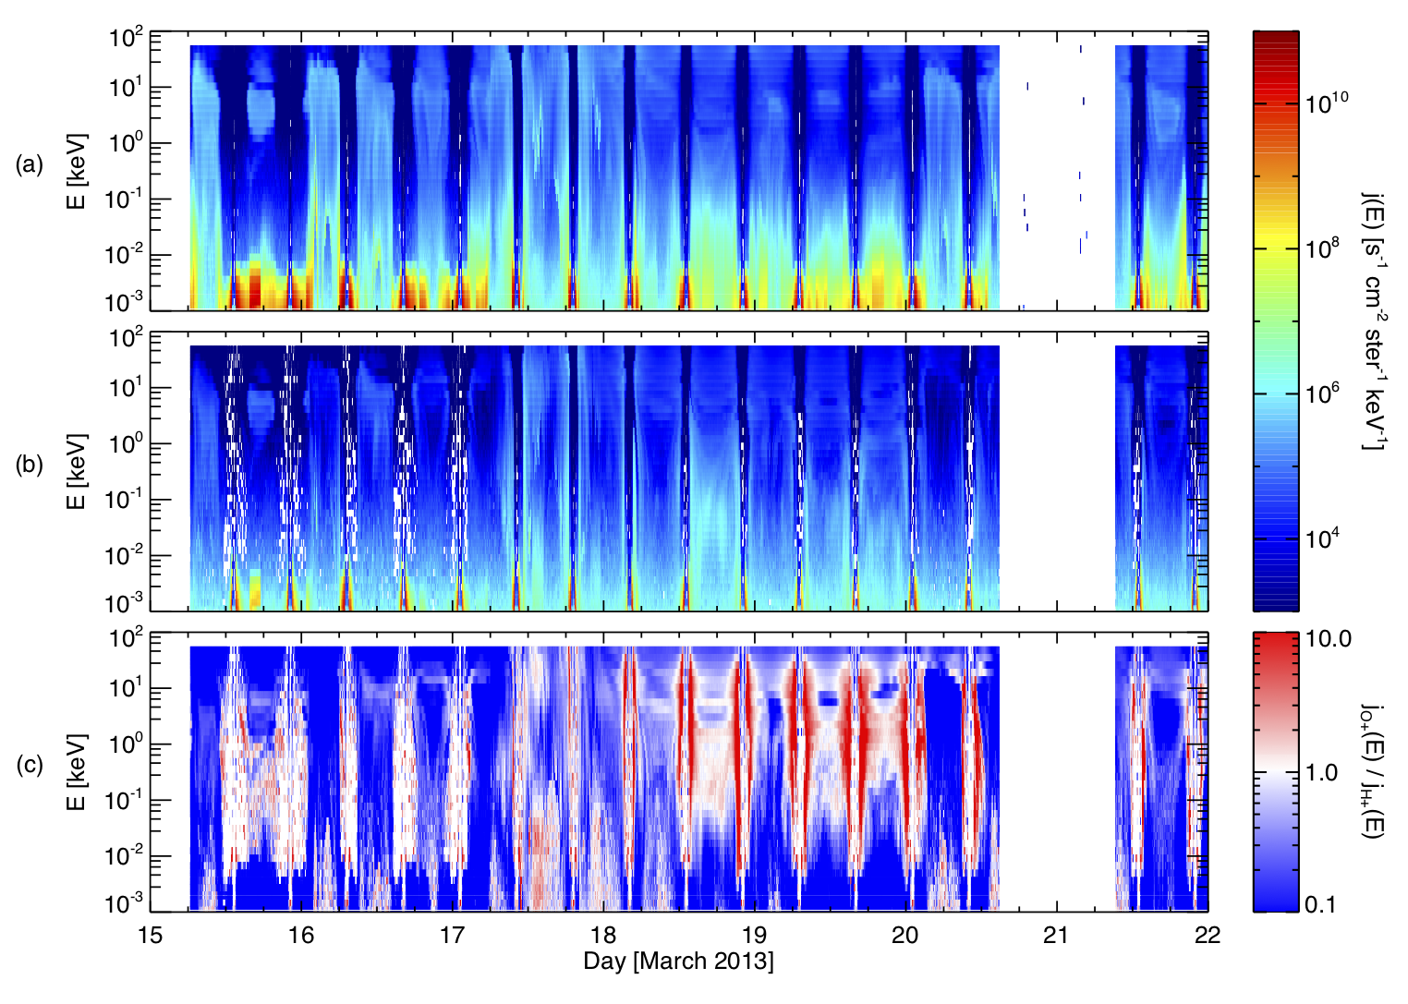
So why are storm-time ULF waves different?
Localised reductions in the Alfven continuum are clearly linked to the presence and strengthening of the ring current
Either the magnetic field must reduce, or the total mass density must increase. In fact, both occur due to the presence of the Oxygen rich ring current
Van Allen Probe measurements of (first) magnetic field reduction due to the ring current; (second) ion fluxes and heavy ion ratios (O+/H+) (Rae et al., 2019)

Slide 9
So why are storm-time ULF waves different?
Localised reductions in the Alfven continuum are clearly linked to the presence and strengthening of the ring current
Either the magnetic field must reduce, or the total mass density must increase. In fact, both occur due to the presence of the Oxygen rich ring current
Van Allen Probe measurements of (first) magnetic field reduction due to the ring current; (second) ion fluxes and heavy ion ratios (O+/H+) (Rae et al., 2019)

Slide 10
Is the storm-time suppression regular?
The answer is yes. It is ubiquitous.
Using storm-phase specific superposed epoch analysis (Walach and Grocott, 2019), we analyse 132 storms from L=3-7.
The double-whammy of ring current density increase and reduced field strength statistically suppress the continuum
Normalised variations of (left) measured eigenfrequencies, (centre) modelled equatorial B and (right) calculated plasma mass densities through storm phase labelled (a) to (e) (bottom panel) for 132 storms.

Slide 11
Conclusions
Storm-time ULF waves are a factor of both driving and internal conditions
Internal structuring of the magnetosphere is time-varying, complex, cannot be straightforwardly parameterised
Substorms and the development of the ring current are key components of this interplay
For realistic radiation belt dynamics, ULF wave models of storm-time dynamics must factor in both external and internal conditions
This work is supported by the Natural Environment Research Council (NERC) Rad-Sat project and Science and Technology Facilities Council (STFC), and the Royal Society Newton Fellowship

