Slide 1
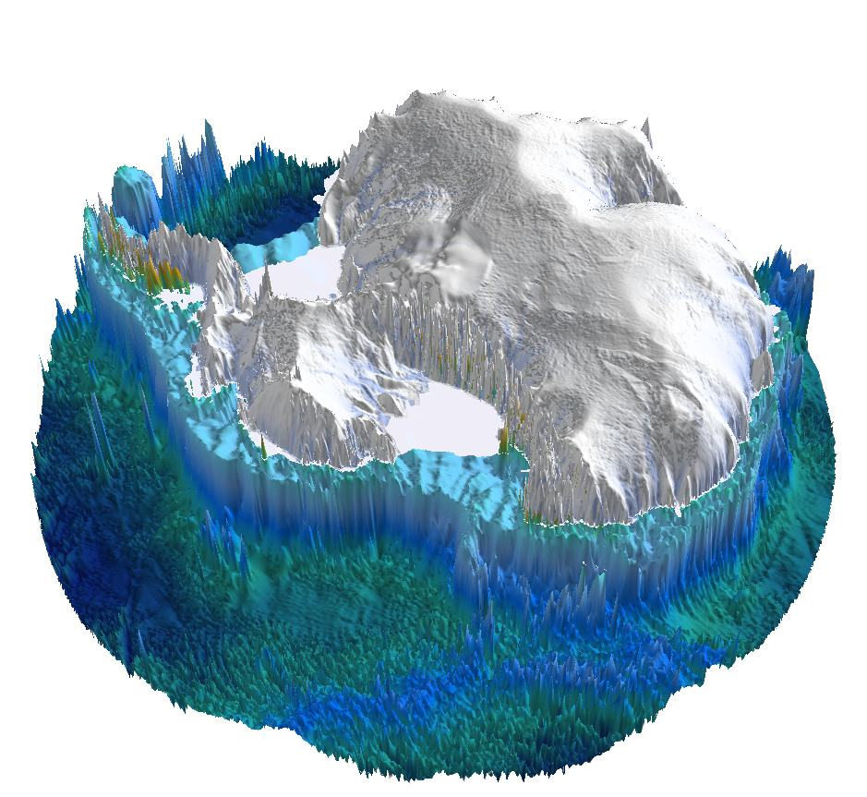
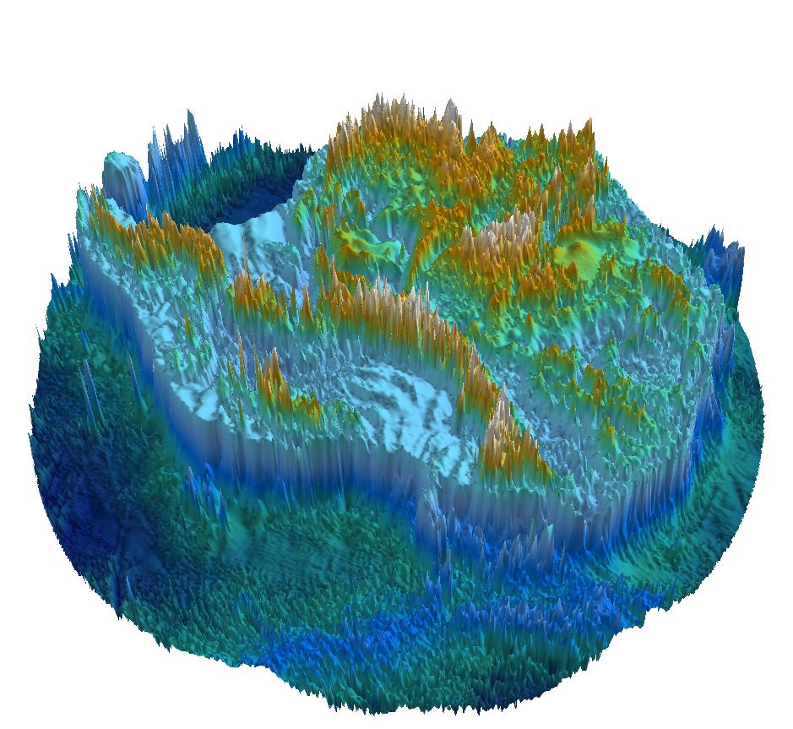

Tantalising new magnetic views of Precambrian and Pan-African age
crustal architecture in interior East Antarctica
Fausto Ferraccioli (1), Graeme Eagles (2), Alexander Golynsky (3), Jörg Ebbing (4), Wu Guochao (5),
Chris Green (6), Bruce Eglington (7), and Egidio Armadillo (8)
NERC British Antarctic Survey, Cambridge, United Kingdom
Alfred Wegener Institute, Bremerhaven, Germany
VNIIO, Saint Petersburg Russia
Christian-Albrechts-Universität zu Kiel, Germany
Second Institute of Oceanography State Oceanic Administration
University of Leeds, UK
Saskatchewan Isotope Laboratory, University of Saskatchewan, Canada DISTAV,
University of Genoa, Italy
Wilkes Subglacial Basin- one of the largest potentially unstable marine-based sectors of the East Antarctic Ice Sheet
New aerogeophysical and satellite images reveal heterogeneity in its subglacial geology, crust and lithosphere
New implications for our understanding of the Precambrian basement beneath the Wilkes Subglacial Basin
The newly unveiled heterogeneity has implications for future assessments of Geothermal Heat Flux

Slide 2
ADMAP 2.0+ Study areas in East Antarctica & “stay at home!” messages
South Pole & Recovery
frontiers
Target for future exploration-
Princess Elizabeth Land frontier
ADMAP 2.0+ Ongoing ESA project that aims to study subglacial geology, crustal architecture & supercontinent linkages
New aeromagnetic data & compilations for the South Pole, Recovery & Gamburtsev Province regions
New implications for our understanding of Precambrian basement & Pan-African (& Ross) age features
…..& plans to explore one of the largest remaining data gaps- the Princess Elizabeth Land frontier…..
Gamburtsev Province
East
Antarctica

Slide 3
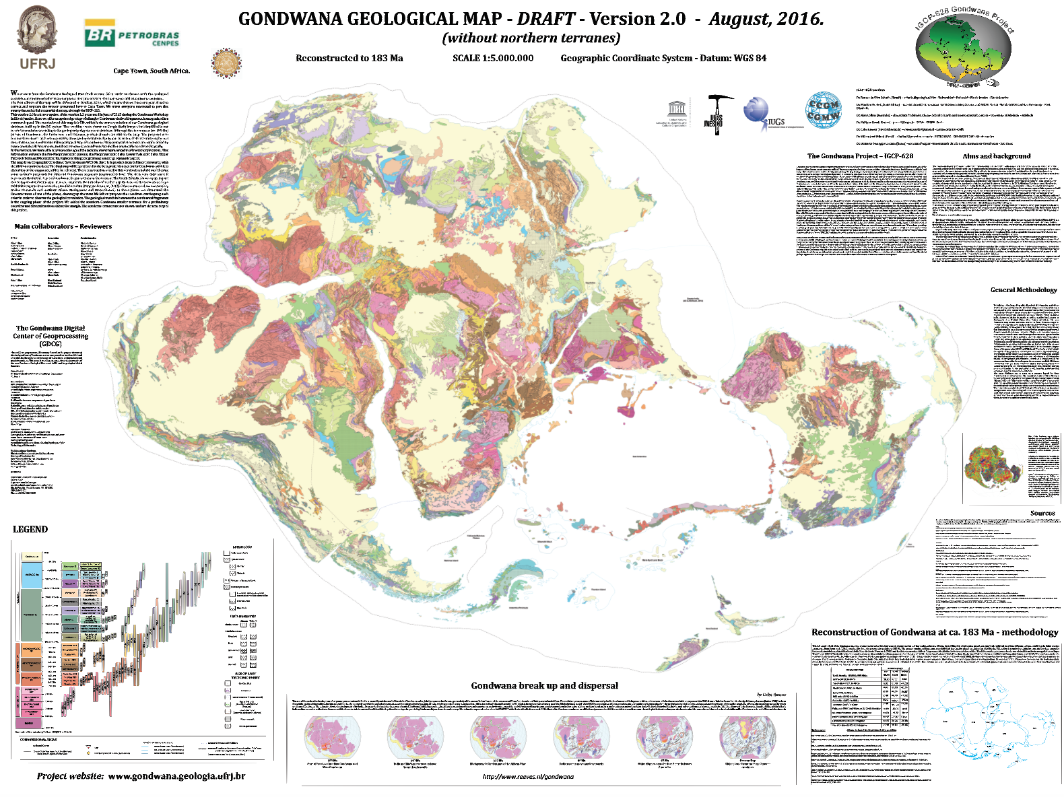
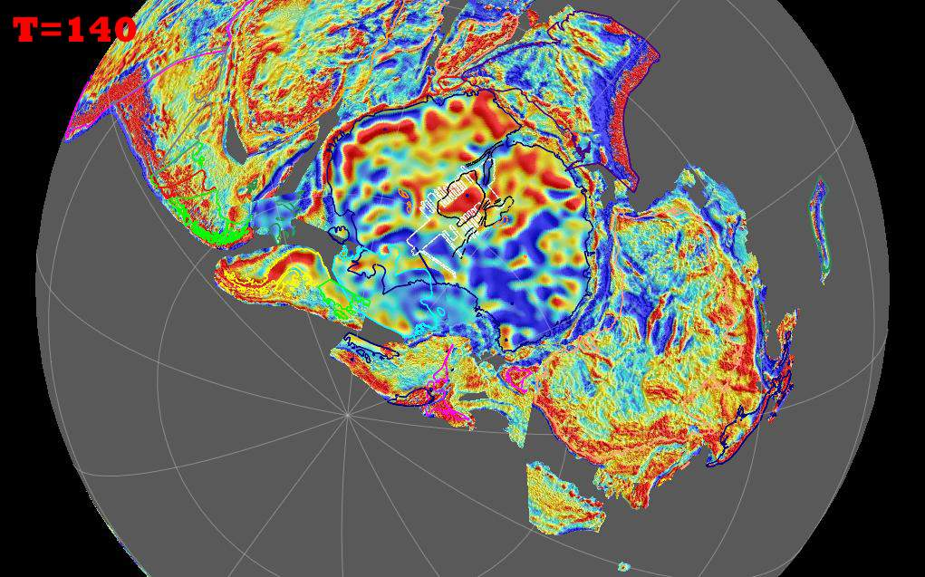
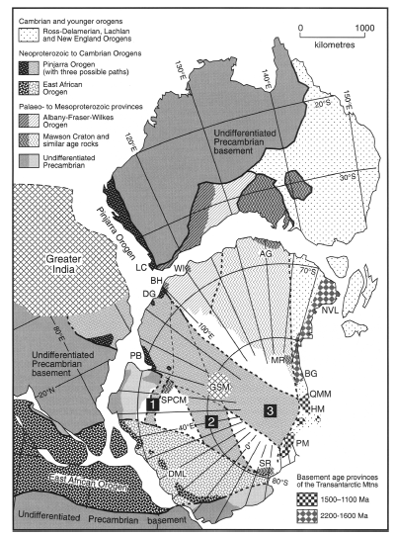
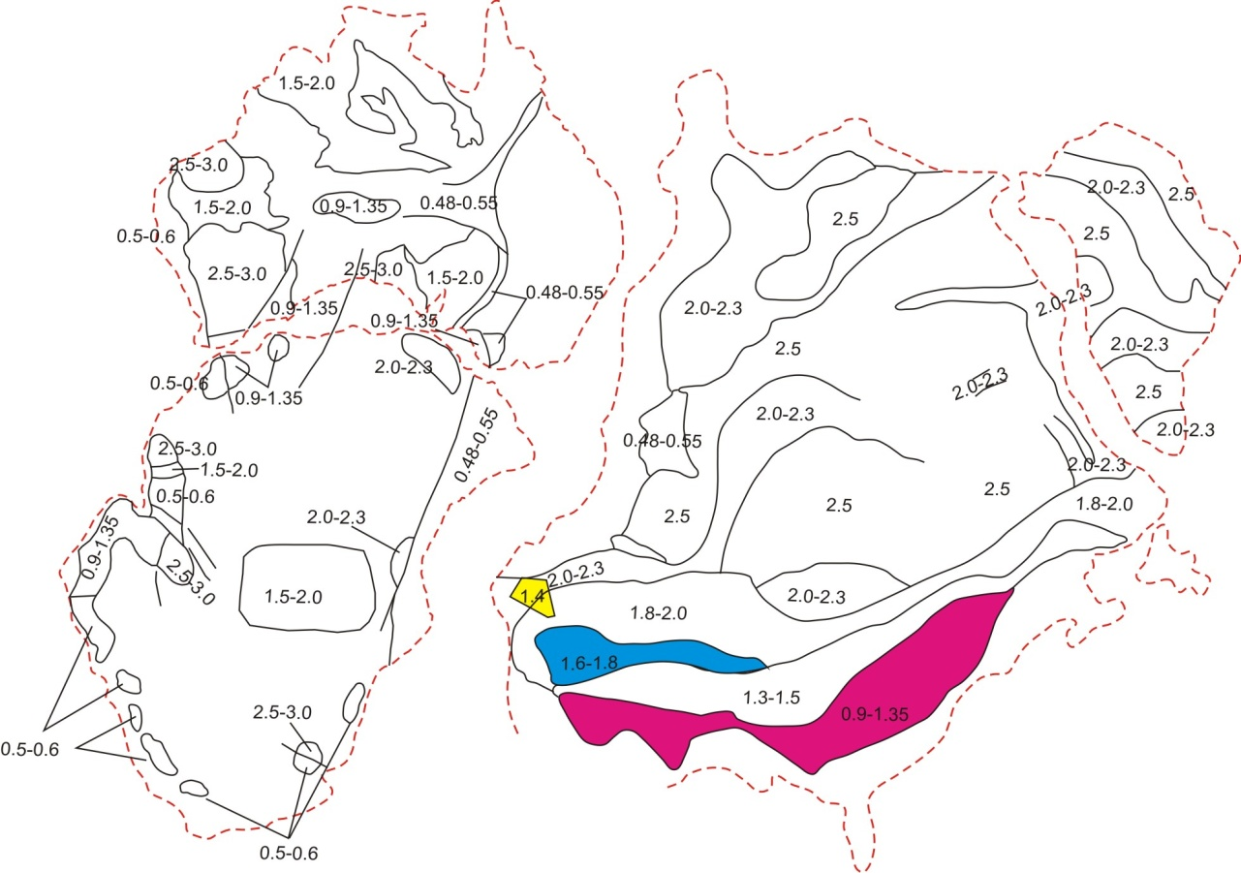
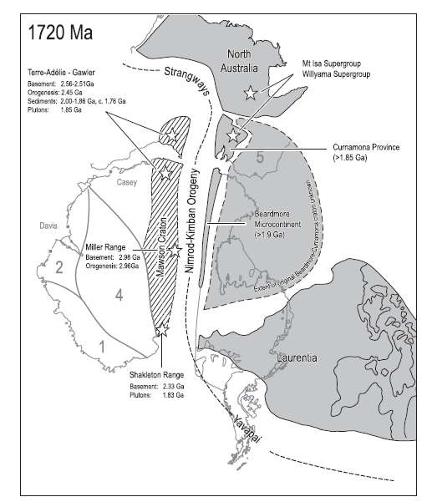
T=500-600
Fitzimonds, 2003
Antarctica
within Gondwana
Antarctica within Gondwana
T>750
Goodge et al., 2008 Science
???
Boger, 2011
Antarctica within Rodinia & Columbia

Slide 4
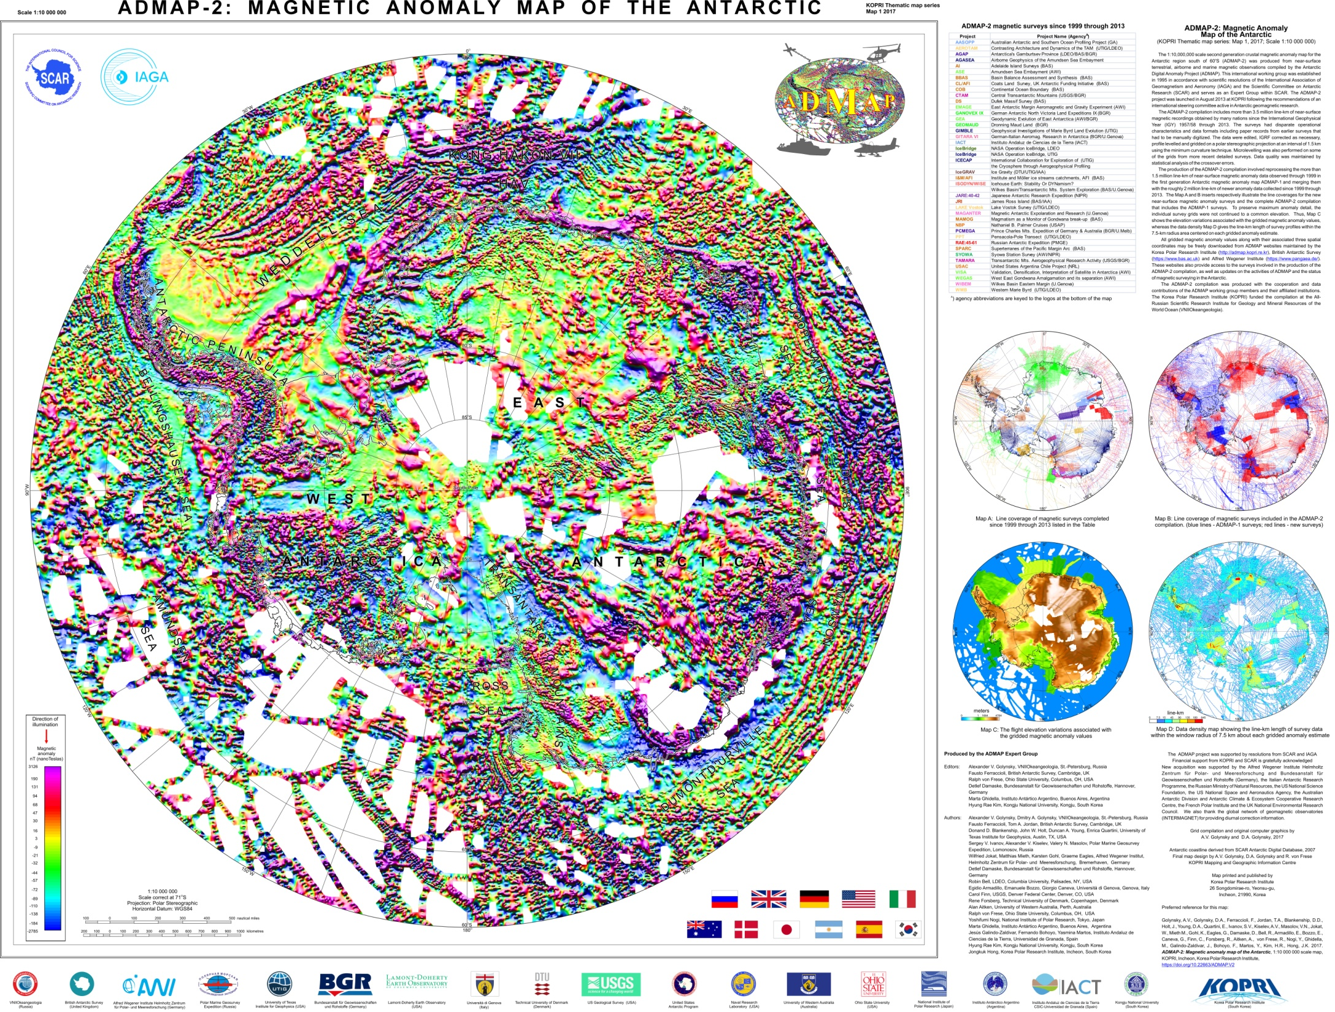
3.5 ML line km of magnetic data freely available for the community!
Antarctica
within Gondwana

Slide 5
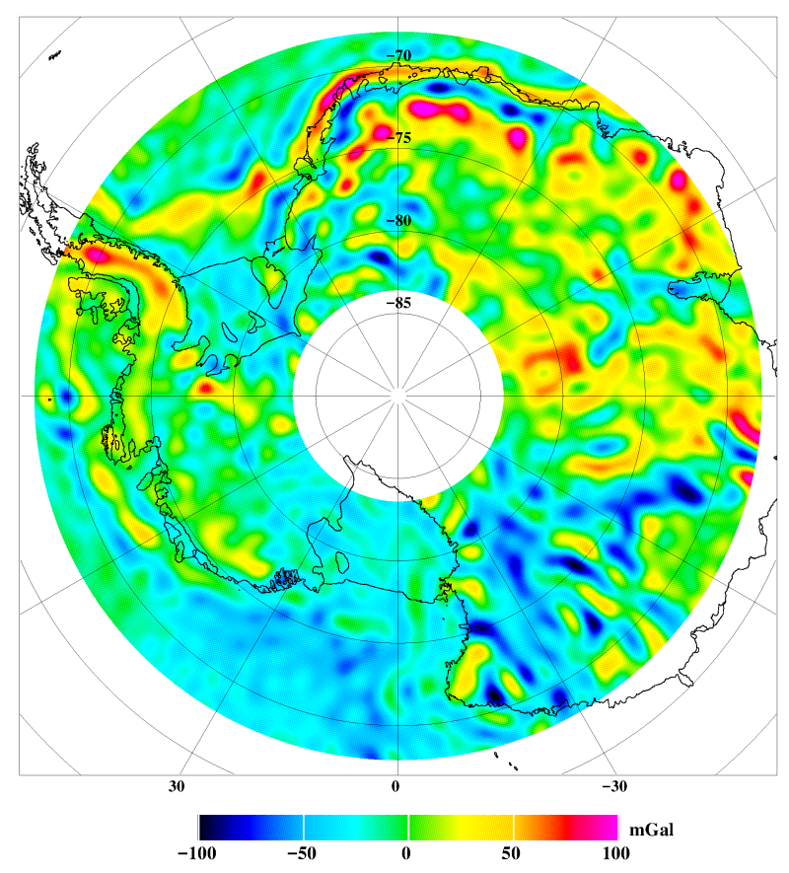
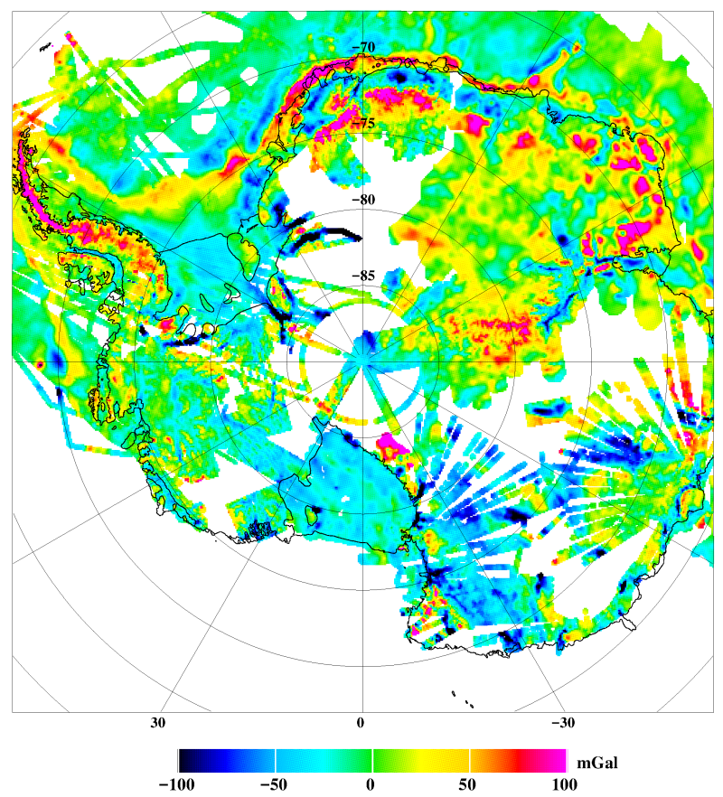
PolarGAP project- Main Aim was to Fill in the GOCE gravity data void at South Pole
GOCE Satellite gravity anomalies AntGP compilation (Scheinert, Ferraccioli et al., 2016, GRL)

Slide 6
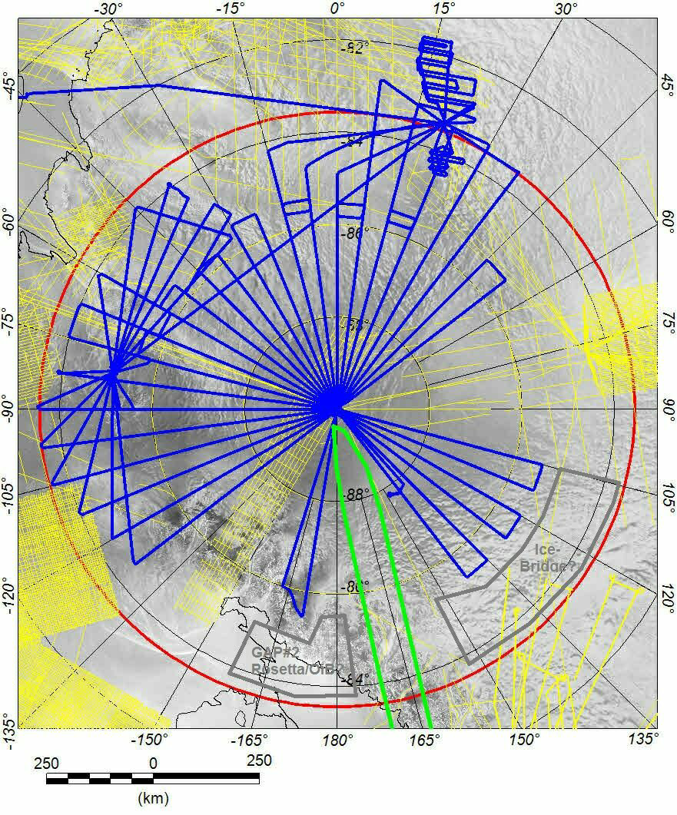
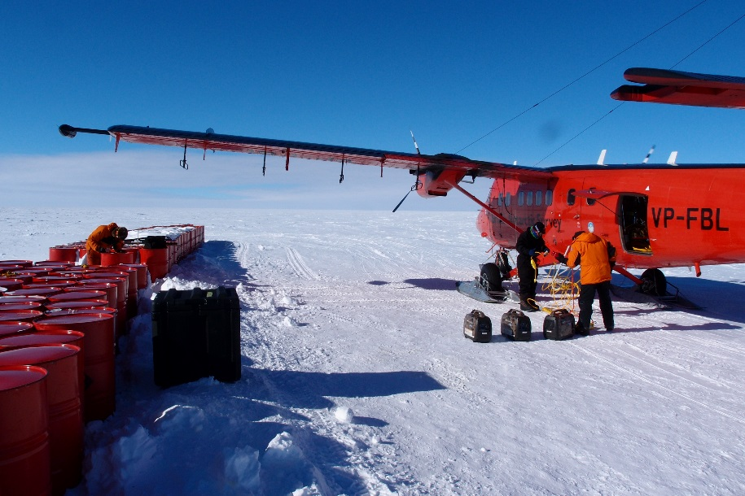
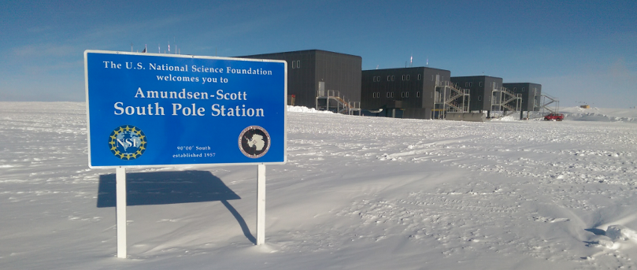
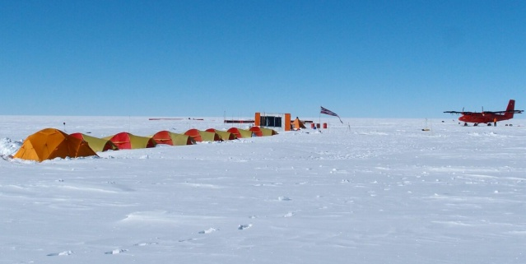
30,000 line km of new radar, laser,
airborne gravity & aeromagnetic data

Slide 7
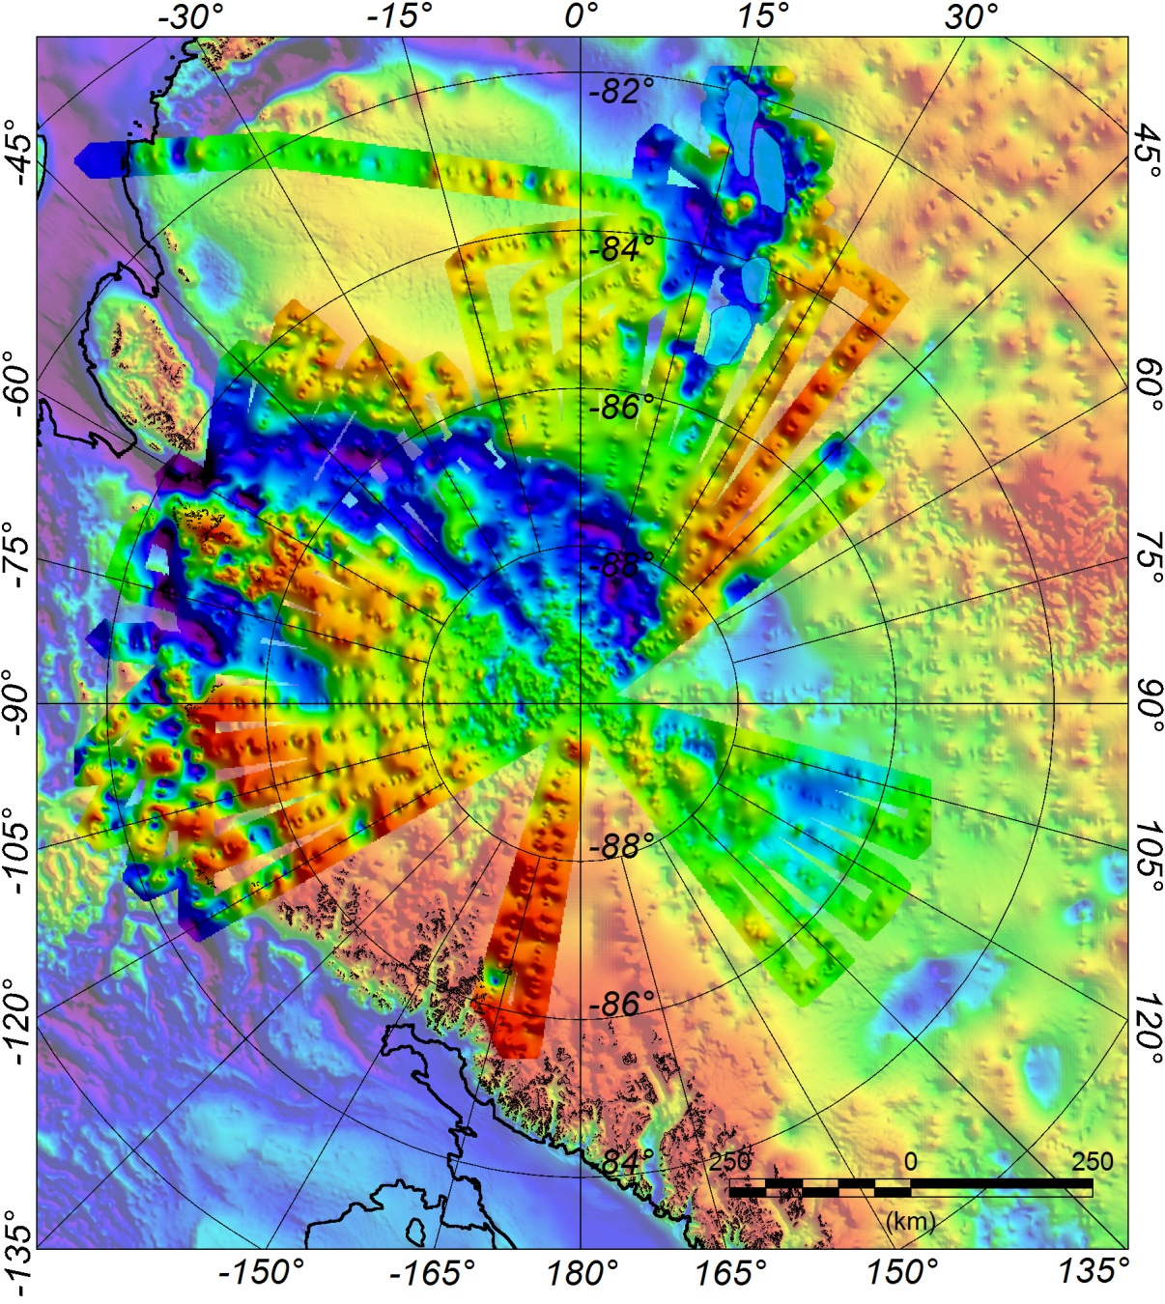
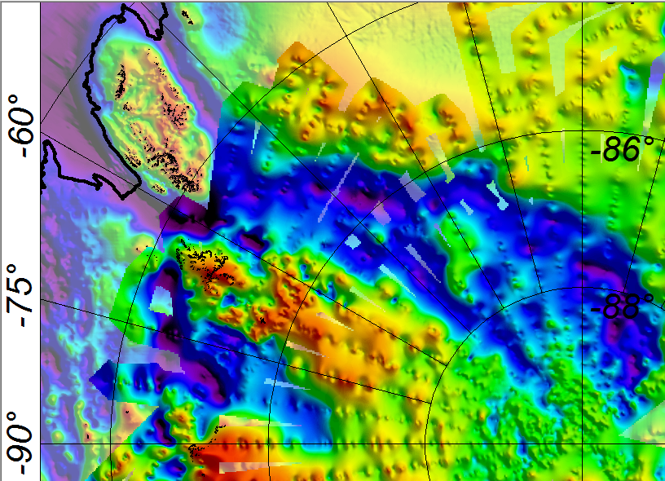
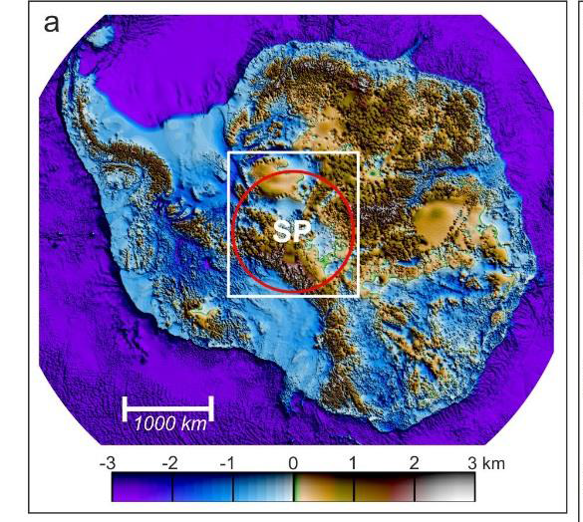
New Bedrock Topography
Recovery
Block
Recovery
Block
RSB
Pensacola
Mts
RSH
PPB
GSM
Eastern
Pensacola-Pole Basin
Transitional
Basins
Patuxent
Mts
Western
Pensacola-Pole Basin
PPB- Pensacola-Pole Basin
TAM- Transantarctic Mountains
TAM
Patuxent
Basin
RSB- Recovery Subglacial Basin
RSH- Recovery Subglacial Highlands
Thiel
Mts
GSM- Gamburtsev Subglacial Mountains
Ferraccioli et al. 2020, Science in prep

Slide 8
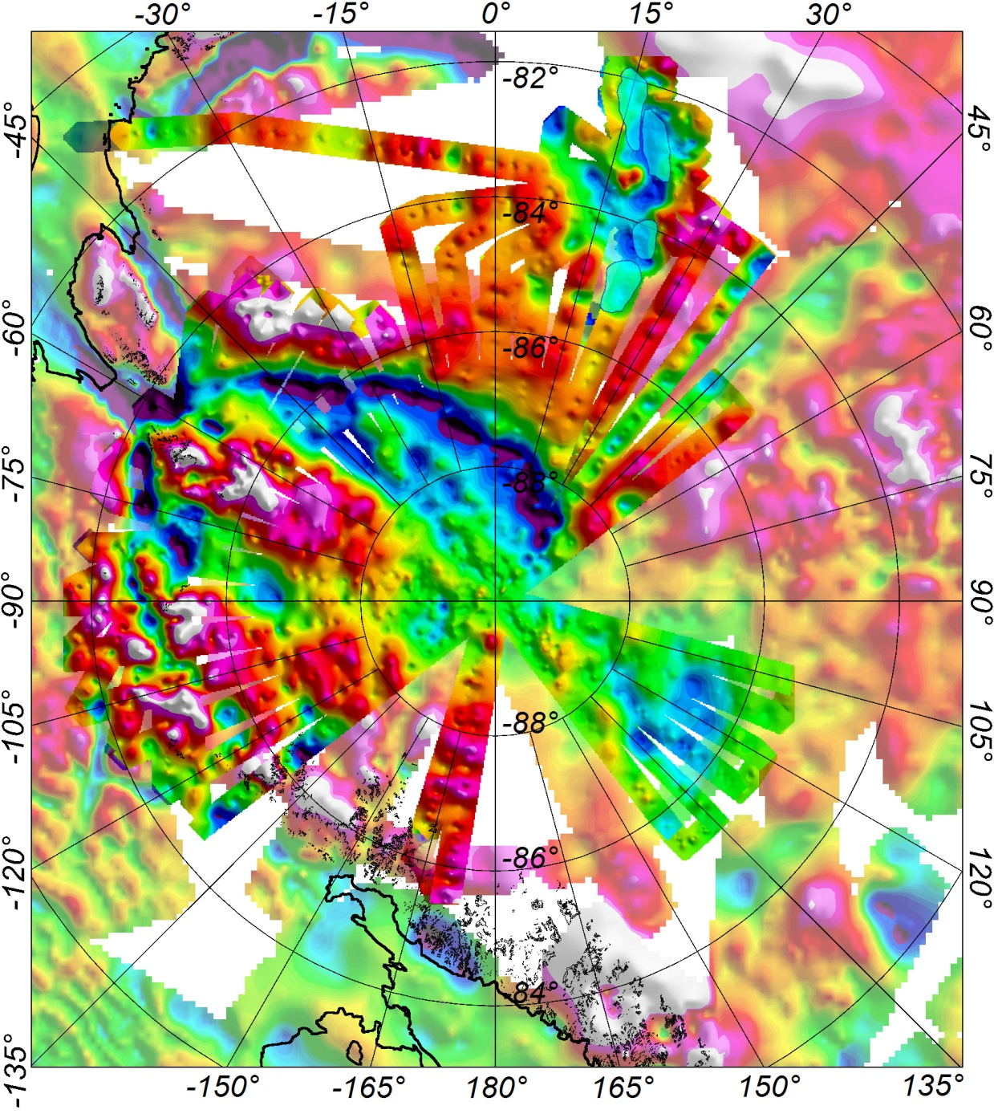
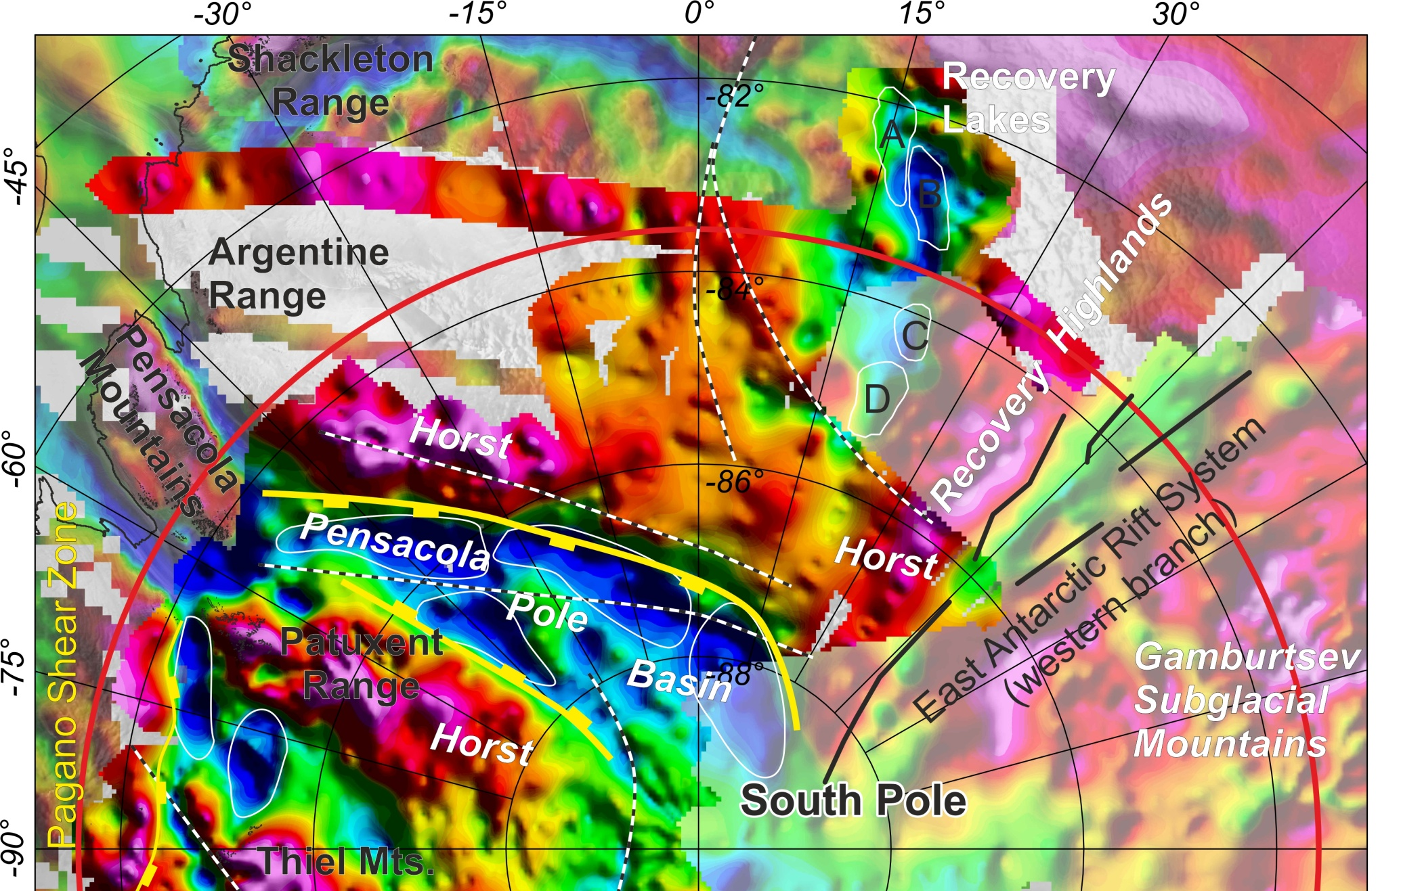
New Gravity Anomaly Map
Ferraccioli et al. 2020, Science, in prep

Slide 9
Subglacial geology and geomorpholgy of the Pensacola-Pole basin, East Antarctica
(Paxman, Jamieson, Ferraccioli et al, 2019 G3)

Slide 10
Key sector of the Ross Orogen and underexplored sector of the Mawson Continent (courtesy of John Goodge, ISAES, 2019)

Slide 11
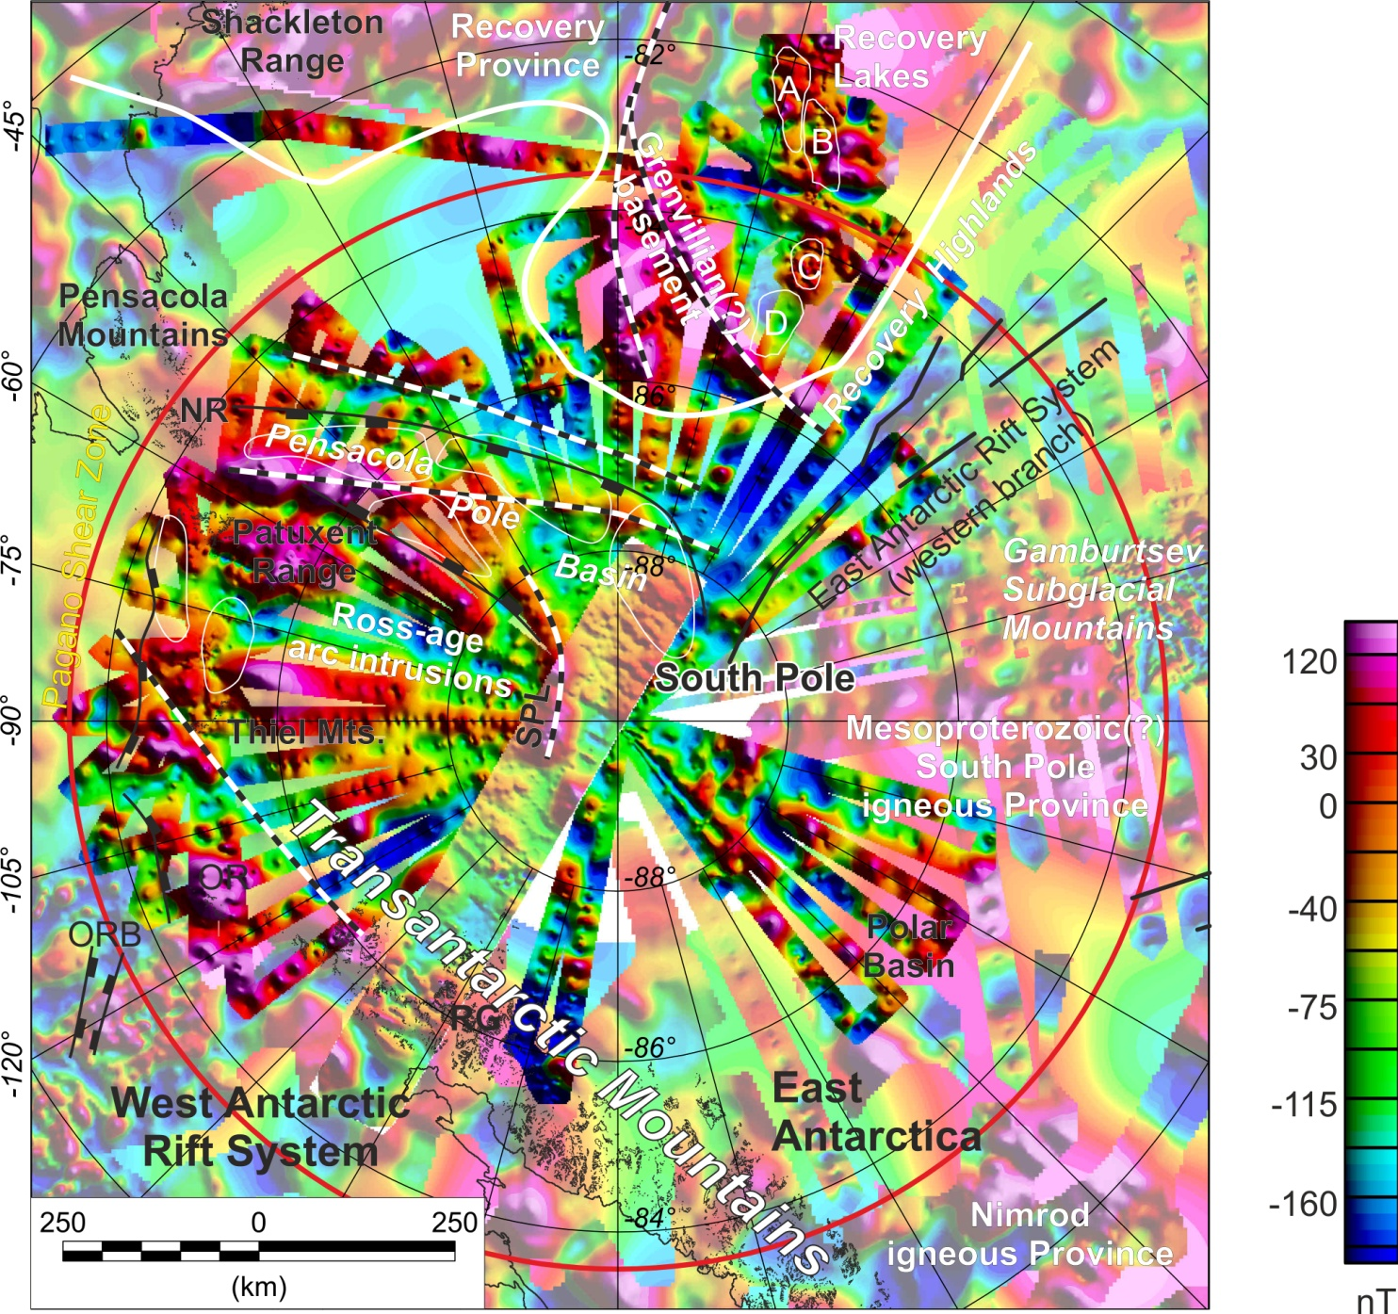
New Aeromagnetic Anomaly Map
Ferraccioli et al. 2020, Science, in prep

Slide 12
Magnetic Signatures reveal Ross-age & Precambrian basement
TAM- Ross-age ca 500 Ma arc related granitoids
Pensacola Pole Basin- Linear anomalies reflecting extension-related
early Ross back-arc basin intrusions
Ferraccioli et al. 2020, Science, in prep
Hinterland of the Transantarctic Mountains and Polar Basin
Inferred Mesoproterozoic igneous provinces (see Goodge et al., 2017 Prec. Res)

Slide 13
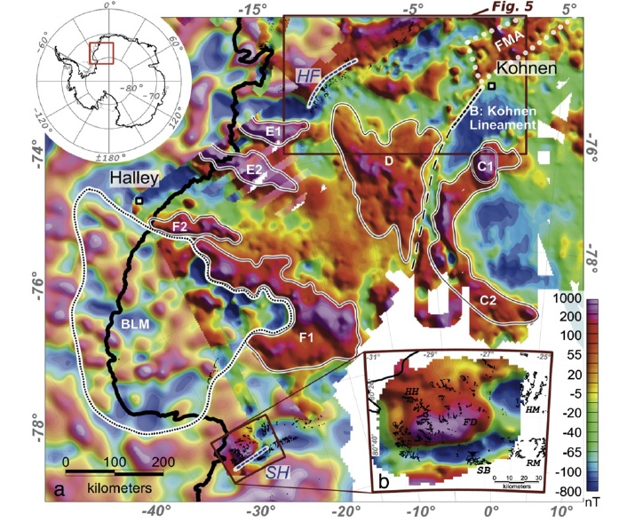
Magnetic Signatures reveal Ross-age & Precambrian basement
Aeromagnetic anomalies over Dronning Maud Land
Mieth & Jokat (2014)- Gondwana Research
Northeast of Pensacola-Pole Basin
Linear anomalies reflecting Grenvillian age arc-related belts?
Distinct anomalies wrt to inferred Paleo to Mesoproterozoic igneous crust of the Shackleton Range
Recovery Lakes
Circular anomalies reflecting Grenvillian or Jurassic intrusions?
Ferraccioli et al. 2020, Science, in prep

Slide 14
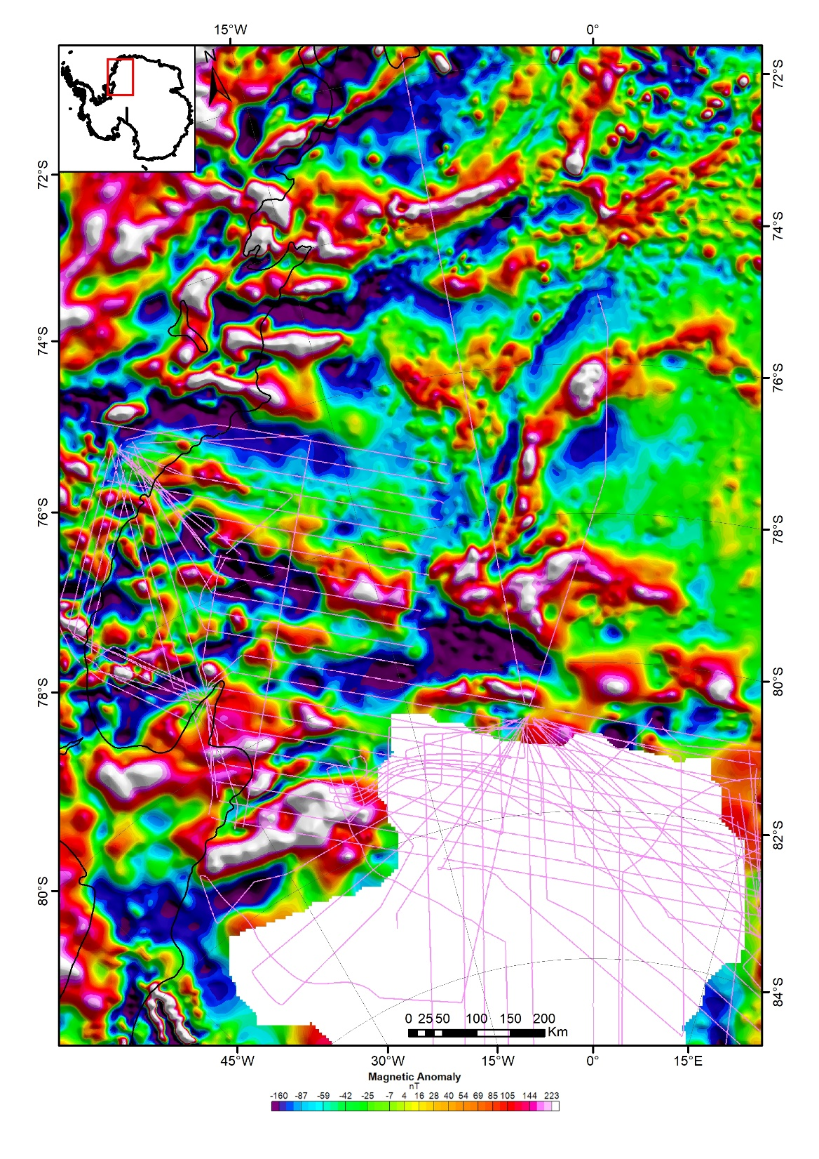
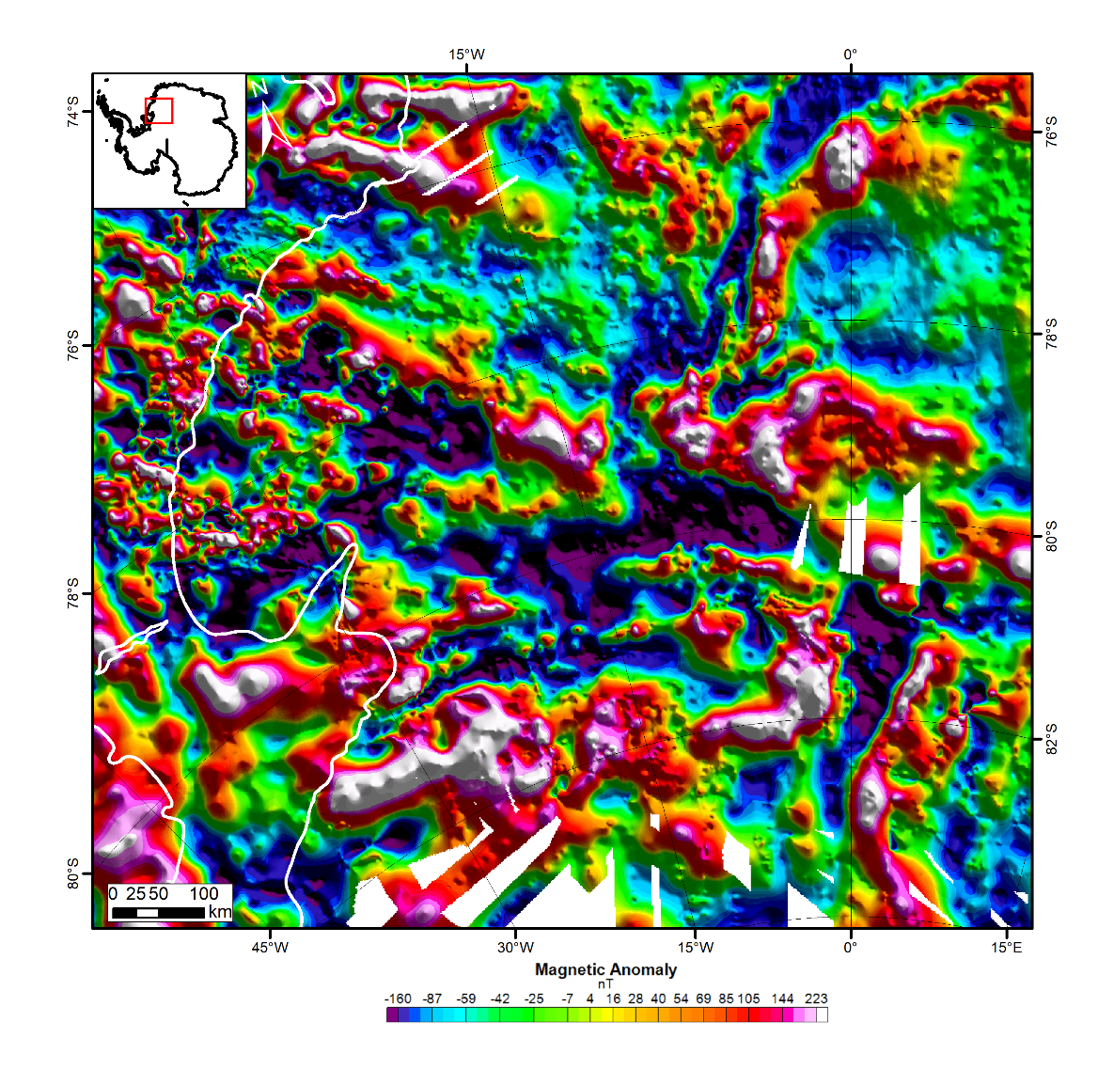
New magnetic anomaly compilation of the Recovery Frontier
ADMAP 2.0+
a
b
ADMAP 2.0
Ferraccioli et al. 2020, EPSL, in prep.

Slide 15
New magnetic anomaly compilation of the Recovery Frontier
a
Grunehogna Craton
(Archean)
Natal-like arc crust
1.2-1 Ga
Maud Belt 1.2-1 Ga
& 0.6-0.5 Ga reworking
Valkyrie Craton
(Archean?)
Note Tonian Oceanic Arc Superterrane (TOAST) east of the study area
Coats Land Block
(Paleoproterozoic?)
Slessor Block
(Paleoproterozoic?)
Shackleton
suture zone
Jacobs et al., 2020 Precambrian Research
Recovery Block (Paleoproterozoic?)
Ribbon
terranes?
The new magnetic anomaly compilation helps reveal the extent and architecture of major tectonic blocks, cratons, accreted arc terranes and orogenic belts north and South of the Shackleton Suture zone
ADMAP 2.0+
Ferraccioli et al. 2020, EPSL, in prep.

Slide 16
Pseudo- gravity imaging of the Recovery frontier
Natal-like arc crust
1.2-1 Ga
Natal-like arc crust
1.2-1 Ga
Valkyrie Craton
(Archean?)
Valkyrie Craton
(Archean?)
Coats Land Block
(Paleoproterozoic?)
Coats Land Block
(Paleoproterozoic?)
Slessor Block
(Paleoproterozoic?)
Slessor Block
(Paleoproterozoic?)
Shackleton
suture zone
Shackleton
suture zone
Recovery Block (Paleoproterozoic?)
Recovery Block (Paleoproterozoic?)
Ferraccioli et al. 2020, EPSL, in prep.

Slide 17
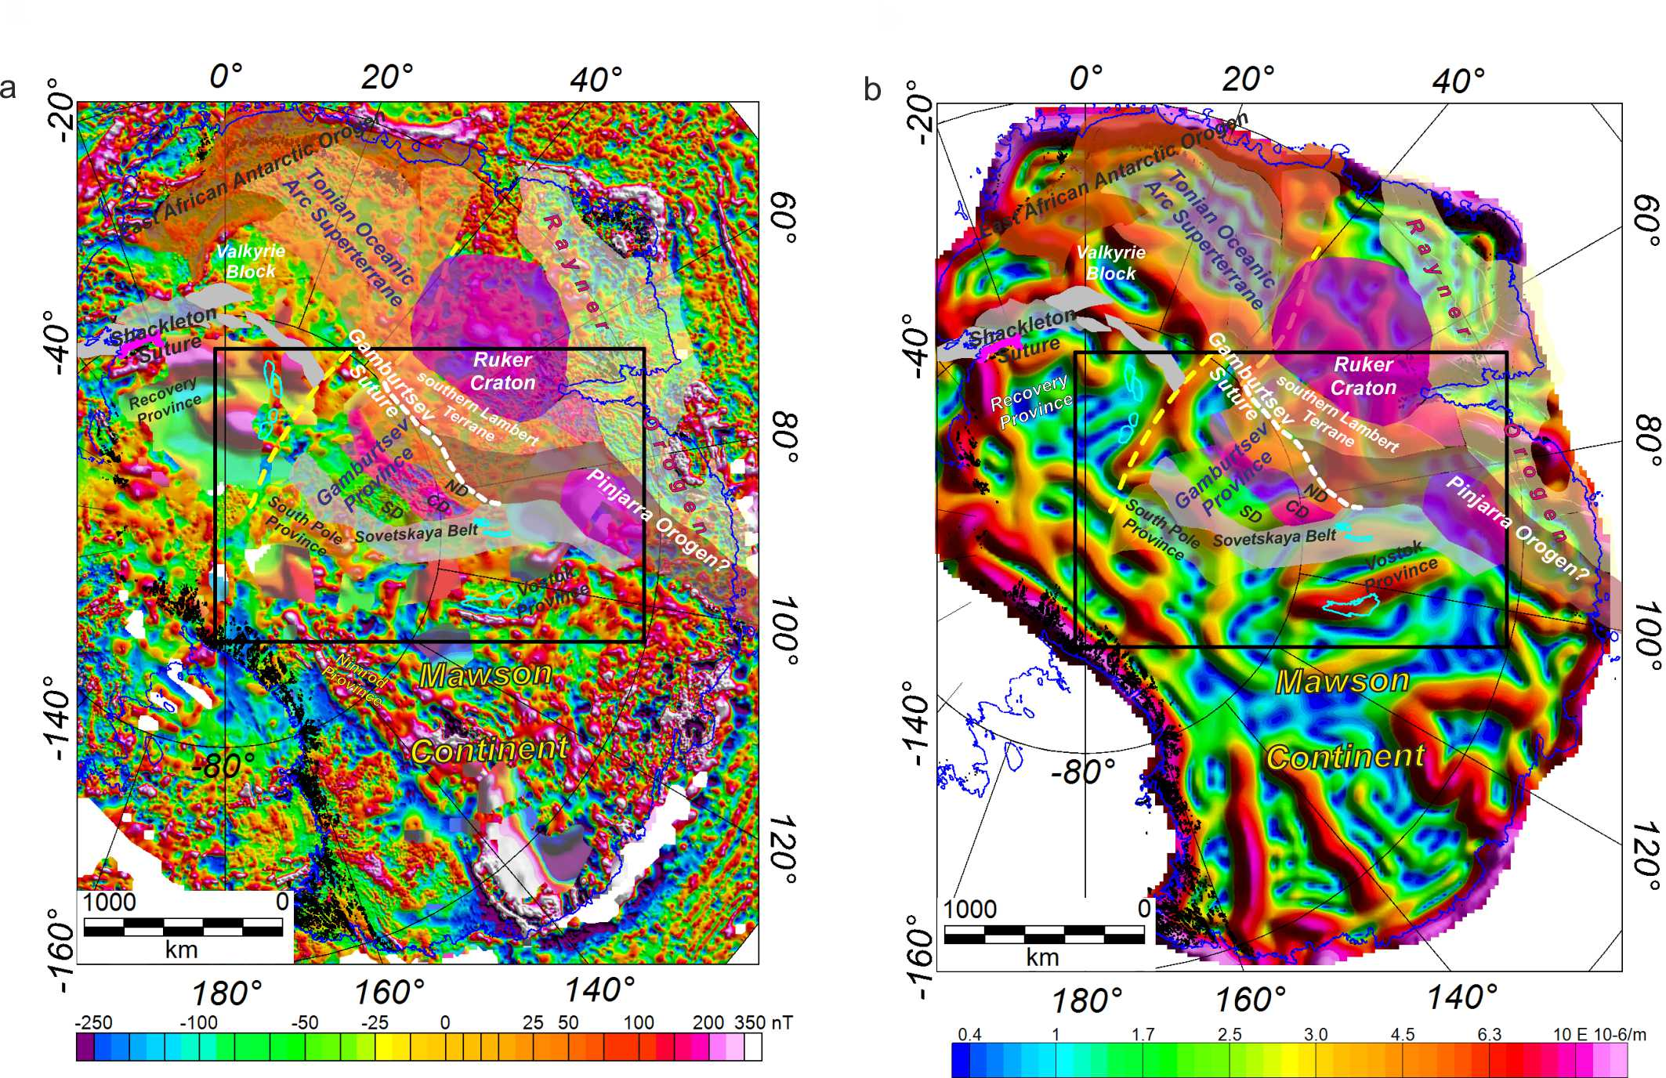
Crustal architecture of the Gamburtsev Province in interior East Antarctica
a Interpretation of ADMAP 2.0 predicting that the Gamburtsev Province is a major orogenic belt at the margin of the composite Mawson Continent (that included East Antarctica & Australia).
b. Interpretation of new satellite gravity gradient map. Dashed yellow line denotes the proposed Trans East Antarctic Shear Zone.
TEASZ
TEASZ
TEASZ
TEASZ
Antarctica
within Gondwana
Ferraccioli et al. 2020, JGR, in prep.

Slide 18
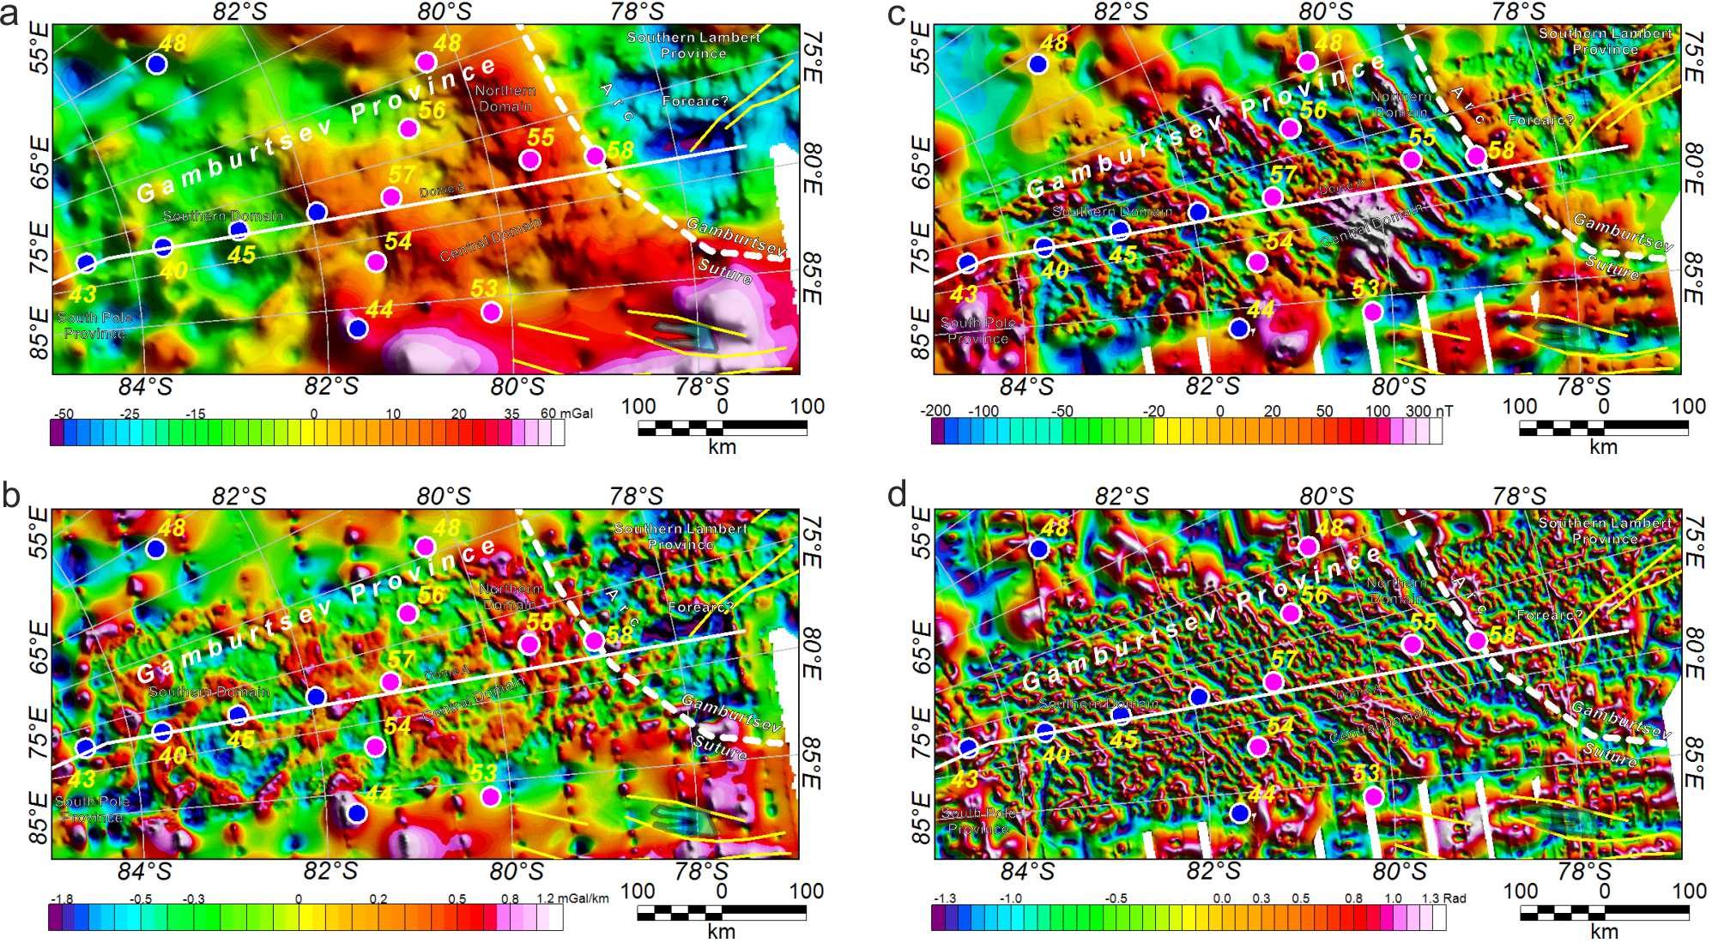
Crustal architecture of the Gamburtsev Province in interior East Antarctica
Isostatic Gravity Residual
Aeromagnetic anomalies
Antarctica
within Gondwana
First vertical derivative of gravity residual
Tilt derivative of aeromag anomalies
Ferraccioli et al. 2020, JGR, in prep.

Slide 19
Crustal architecture of the Gamburtsev Province in interior East Antarctica
a
b
c
Antarctica
within Gondwana
a Forward magnetic and gravity model revealing the architecture of three proposed Precambrian crustal domains in the Gamburtsev Province. The Northern and Central domain are underlain by thick crust; a high density lower crustal body is also required to fit both seismological and gravity constraints.
b & c Potential analogues including a section across the Grenville Orogen of Laurentia and a younger Pan-African orogen fringing the Sahara metacraton.
Ferraccioli et al. 2020, JGR, in prep.

Slide 20
Future international aerogeophysical exploration target in East Antarctica- the Princess Elizabeth Land Frontier
Princess Elizabeth
Land Frontier
Gap filled
with our new
data
Mulder et al., 2019 Geology
Detailed aerogeophysical exploration in the Princess Elizabeth Land Frontier is required to link the Gamburtsev Suture (Ferraccioli et al., 2011, Nature) with the Mirny Fault (Mulder et al., 2019) & further test the hypothesis that this region was the site of accretion & collision of Indo-Antarctica with Australo-Antarctica.

