Slide 1
Microbial mediation of ecosystem services
Rachel Hasler
European Geosciences Union 2020

Slide 2
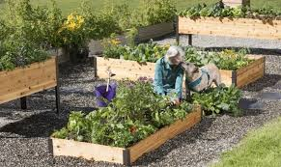
Introduction:
Horticultural management influences microbial community structure and function
Adapted from Ho, Di Lonardo and Bodelier, 2017

Slide 3
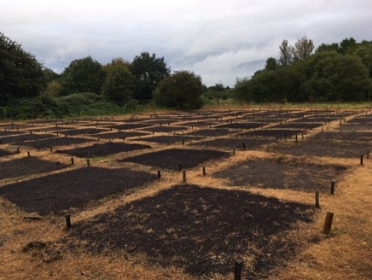
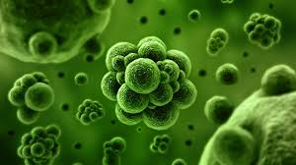
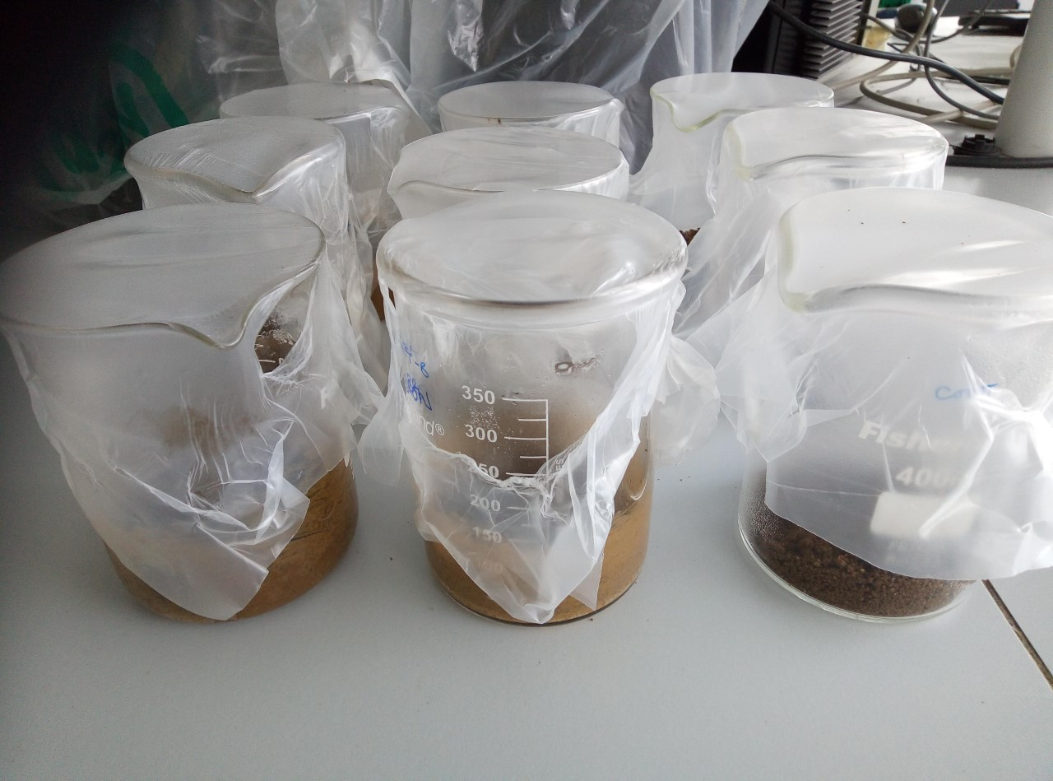
Methodological approach:
Overview
Do soil organic matter applications facilitate delivery of microbially mediated ecosystem functions?
Field trial:
Long-term field trial
8 compost treatments
Sandy soil
Hypothesis:
Respiration and decomposition rates will depend on the soils functional profile and not on the carbon composition of the soil organic matter additions
Methods:
Multiple substrate induced respiration
PLFA/ NLFA
Microbial biomass

Slide 4
Multiple substrate induced respiration
Functional (respiration) profiles for all treatments

Slide 5
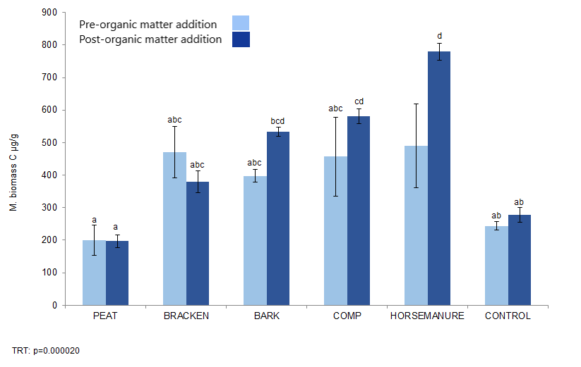
What are those microbes up to…?
Building a picture of the soil microbial community:

Slide 6
Carbon fractions in soil and compost
Total carbon:

Slide 7
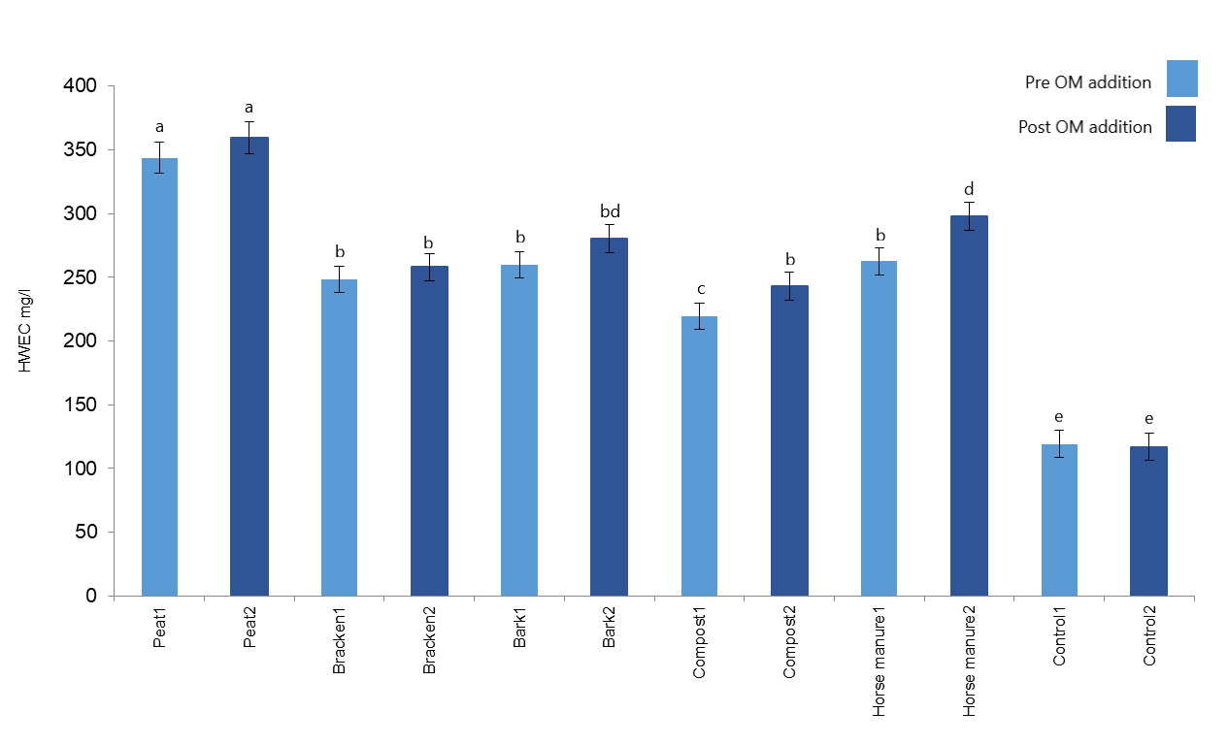
Carbon fractions in soil and compost
Hot water extractable carbon (HWEC):
p=0.03271

Slide 8
Phospholipid fatty acid (PLFA)
Organic matter addition effects on
microbial community structure:
p=0.002229

Slide 9
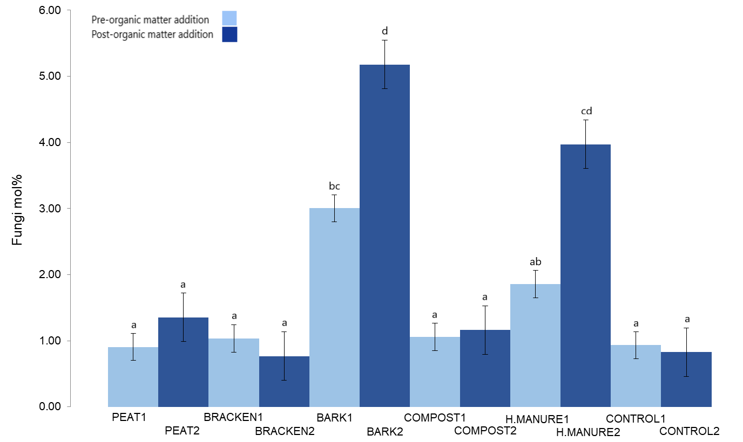
Fungal biomarker (PLFA) 18:2w6,9
TRT p=0.0000
TIME p=0.0001
TIME*TRT=0.0002

Slide 10
Horticultural compost applications:
Significant effects on soil microbial community…..
Land management:
Horticulture
Ecosystems
(+services)
Soil microbial community
Climate change

Slide 11
Thanks for listening – Feedback very welcome!

