Slide 1


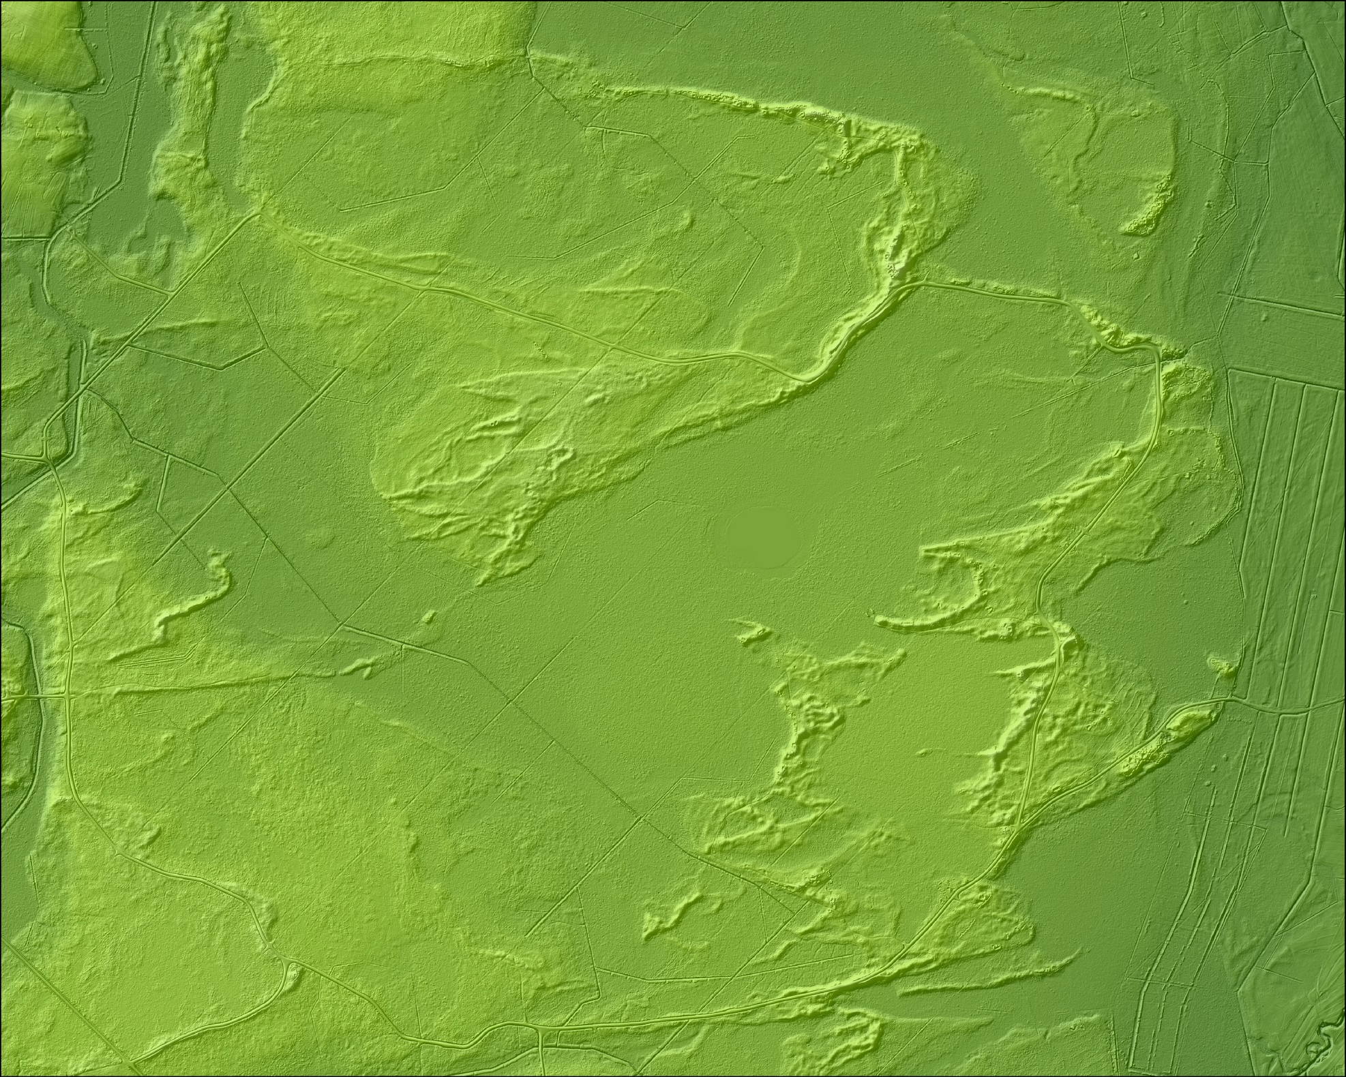

Inland dune field and deposits at Dviete: evidences of the late Pleistocene aeolian morphogenesis and landscape evolution during transition from glacial to post-glacial conditions in South-eastern Latvia
Online | 4–8 May 2020
SESSION: CR4.1 Evolution of glacial-periglacial-paraglacial landscapes and debris-covered glaciers
Daugavpils University
Department of Environmental Science and Chemistry
Juris SOMS e-pasts: juris.soms@du.lv
Zane EGLE e-pasts: zanebelinska@gmail.com

Slide 2
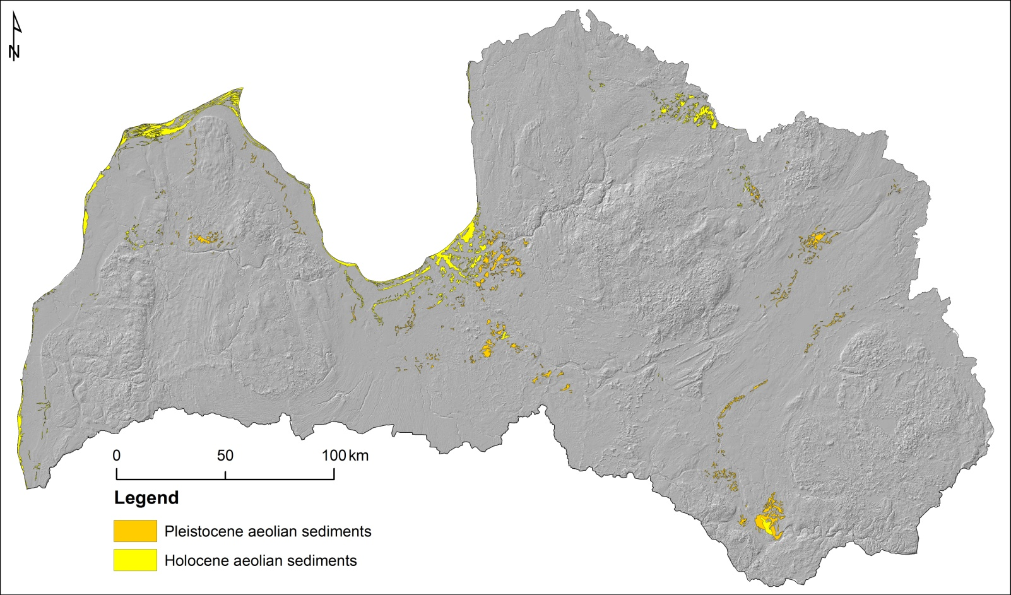
Study area
The area of the late Pleistocene aeolian sediments, documented in maps of Quaternary geology, is located in the Dviete forest, northward from Dviete village (south-eastern Latvia).
Map of distribution of tha late Pleistocene and Holocene aeolian sediments in Latvia.

Slide 3
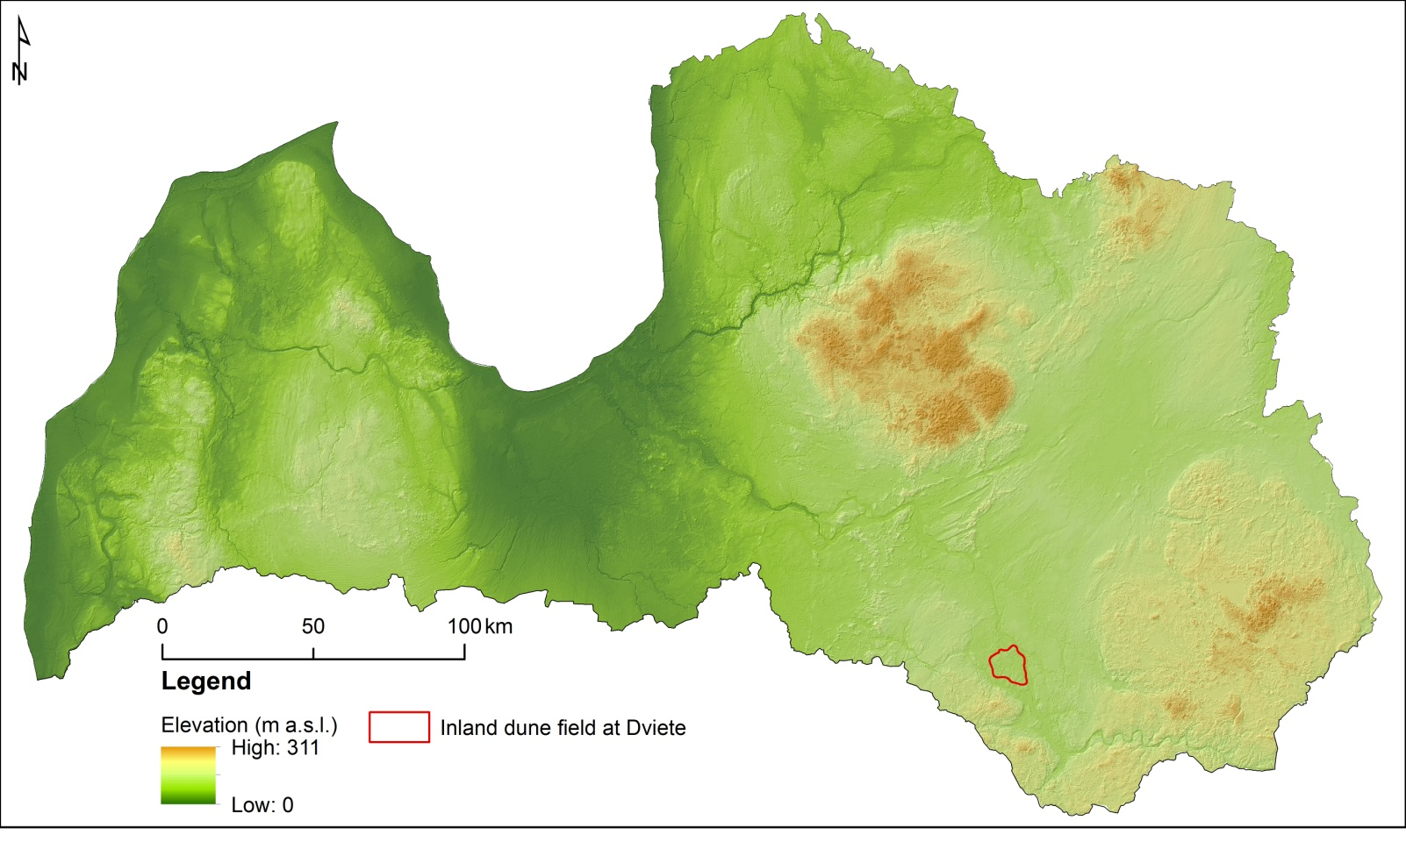
Study area
This area of aeolian sediments in the south-western part of the glaciolacustrine Jersika Plain, spreads over a surface >112 km², and form the inland dune field.
Map of location of study area in Latvia.

Slide 4
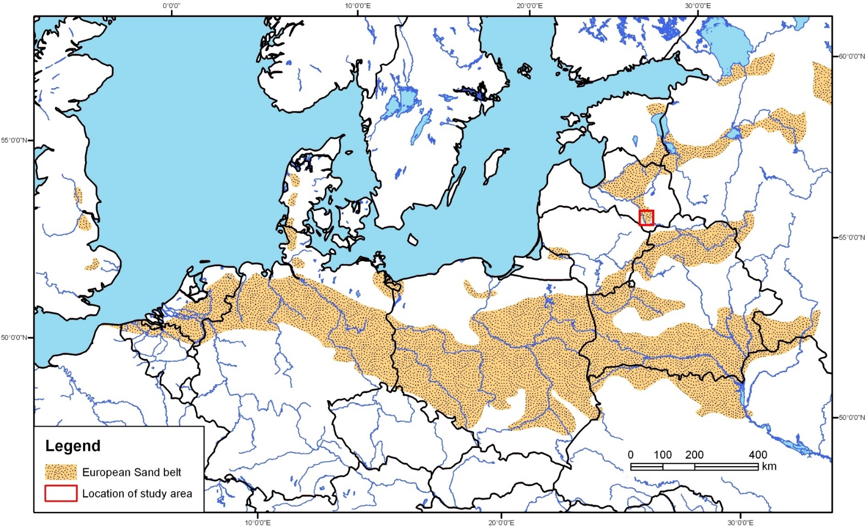
Study area
Inland dune field, belonging to the NE part of 'European Sand Belt' (Zeeberg, 1998), remains insufficiently studied in comparison with the similar territories in Western and Central Europe.
Source: Zeeberg, J., 1998. The European sand belt in eastern Europe – and comparison of Late Glacial dune orientation with GCM simulation results. Boreas, 27, 127-139.

Slide 5
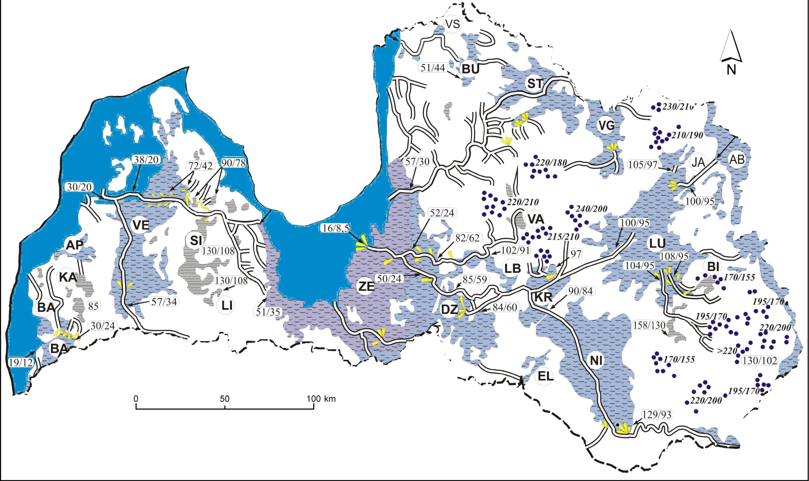
Study area
The dunes have developed on the surface of glaciolacustrine plain, where subaqueous sedimentation in the Nīcgale ice-dammed lake took place during the retreat of glacier, the Pomeranian phase of the last glaciation.
Source: Zelčs V. and Markots A., 2004. Deglaciation history of Latvia. In Ehlers, J., Gibbard, P. L. (eds.), Extent and Chronology of Glaciations, v.1 (Europe). Elsevier, 225–244 pp..

Slide 6
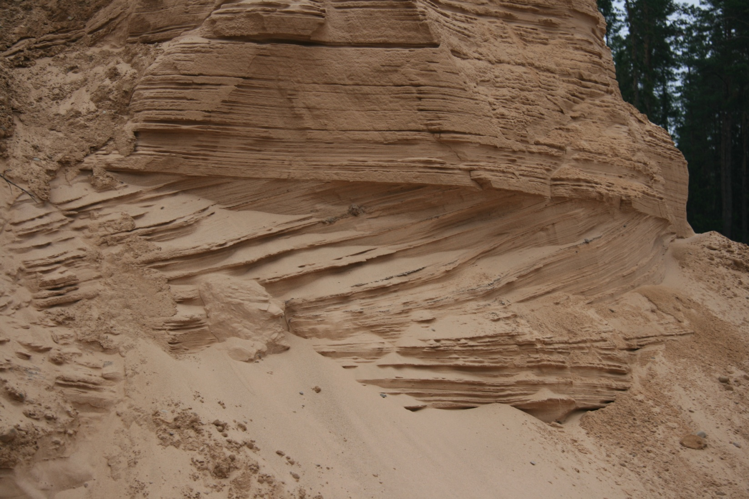
Study area
Evidences of glaciofluvial and glaciolacustrine sedimentation in the western part of Nīcgale ice-dammed lake.
Sequences of glaciofluvial (lower part) and glaciolacustrine (upper part) fine sediments in Osinovka sand quarry.

Slide 7
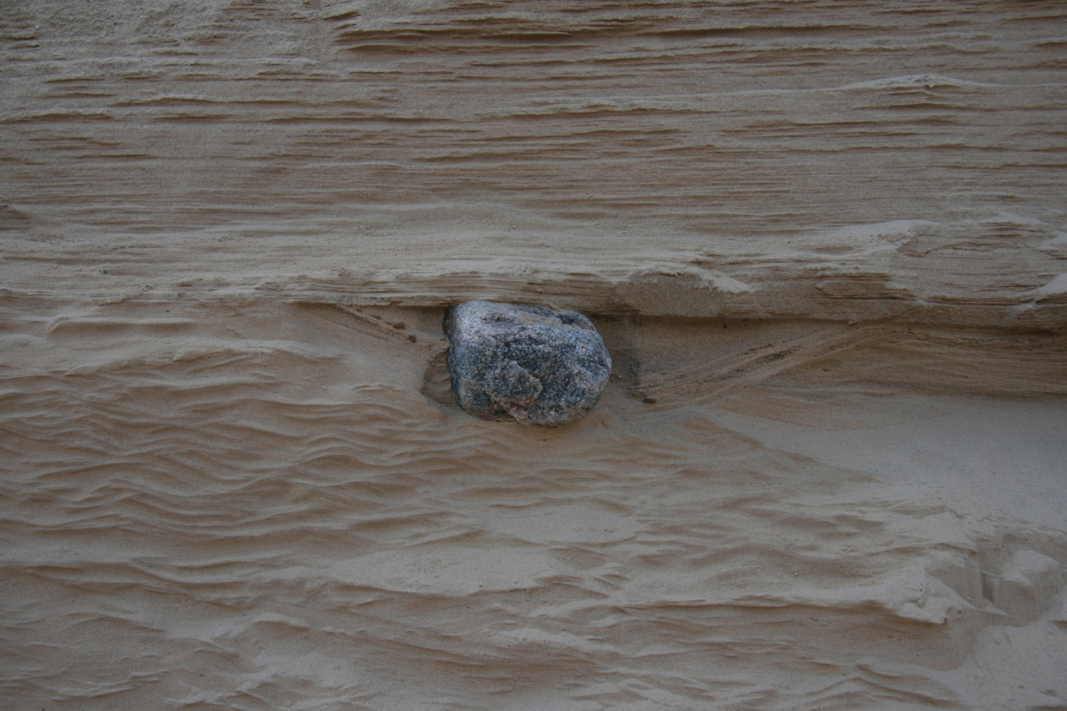
Study area
Evidences of glaciofluvial and glaciolacustrine sedimentation in the western part of Nīcgale ice-dammed lake.
Dropstone in in outcrop of fine sediments Osinovka sand quarry.

Slide 8
Study area
The expanding of glacial lake along glacial uplands and its subsequent drainage exposed unconsolidated sediments to subaerial conditions, in addition, lack of vegetation cover and cold and dry climate favoured the transportation of fine sediment particles by wind and the formation of aeolian landforms.
Hence this field of inactive dunes represents the evidence of past aeolian activity as driving force of landscape evolution during transition from glacial to periglacial and later to post-glacial conditions in this region.

Slide 9
Objectives of study
Here, we focus on reconstructing paleoenvironmental conditions in this region, as inferred from landforms morphology, grain-size distribution and geochemistry of aeolian sand deposits, and efficient wind directions derived from DEM.
It will contribute to better understanding the processes of landscape evolution conditioned by last deglaciation in south-eastern Latvia.

Slide 10
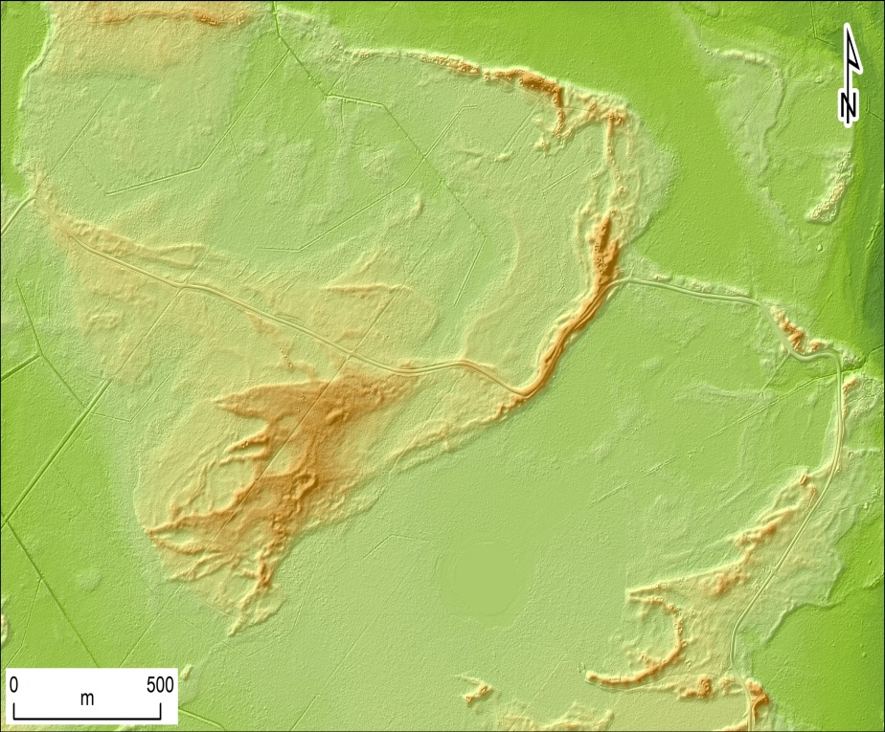
Material and Methods
Geomorphological characteristics of aeolian landforms including morphology of single dunes and dune groups, their planform shape and orientation, and geographic distribution of dunes were investigated using the airborne LiDAR-based DEM (pixel resolution 0.4 m) and field geomorphological reconnaissance.
To identify net sediment transport direction, the bisector was determined between the arms of the dunes. Hence the prevailing wind direction during the development of dune field was inferred from dune morphology.

Slide 11
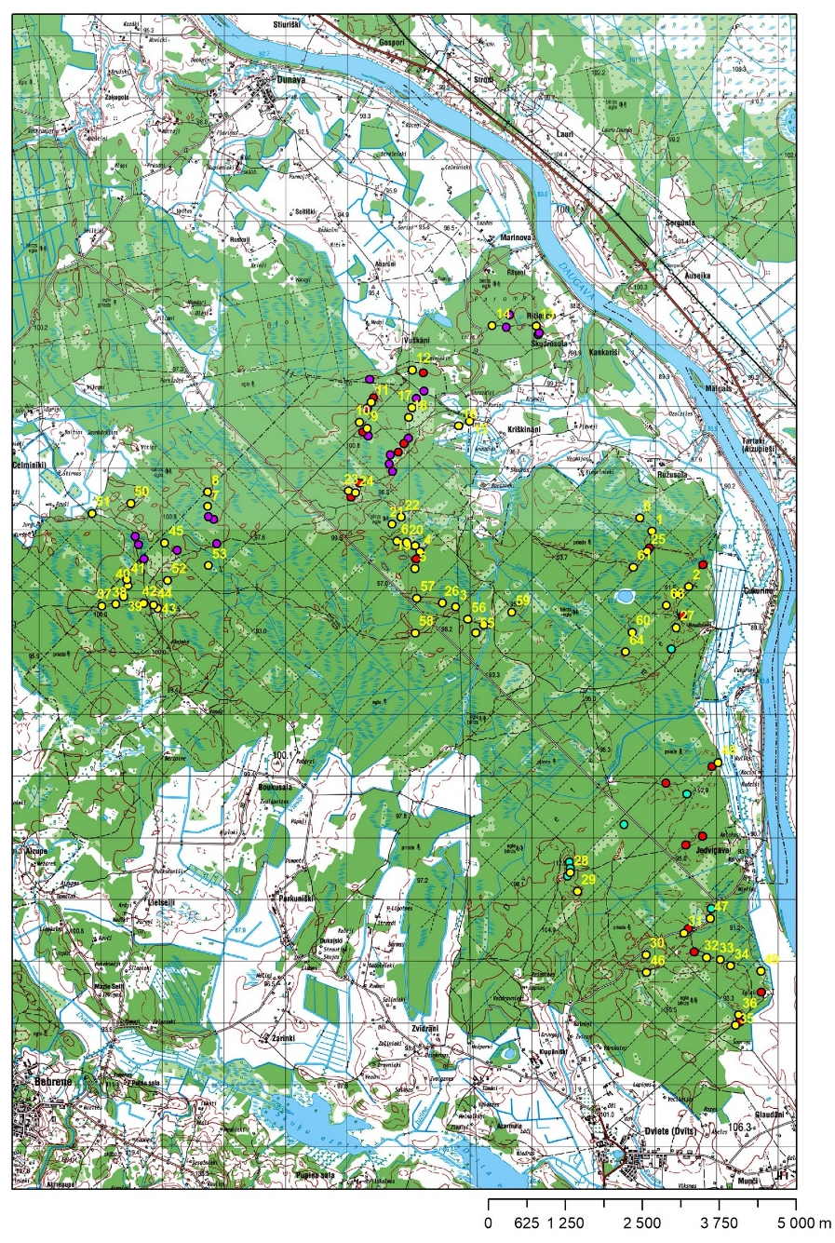
Material and Methods
During field works a total of 80 representative bulk samples for granulometric composition and geochemical analysis were collected from the inland dunes in the Dviete forest.
The location of dunes for sampling was identified from high resolution DEM (0.4 m) which was generated from the LiDAR cloud point data provided by the Latvian Geospatial Information Agency.
The location of each sampling point was fixed in the field by high accuracy GPS.

Slide 12
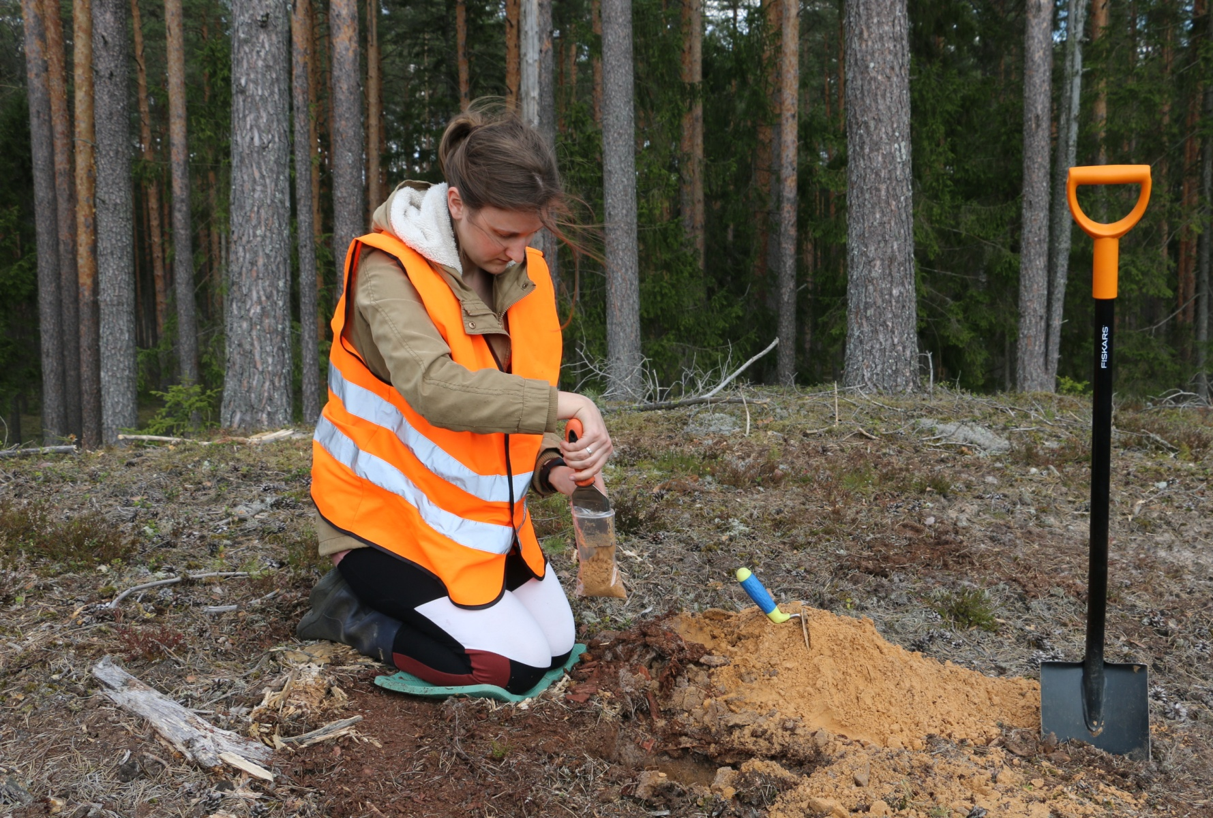
Materials and Methods
During seven field expeditions in total 80 samples of aeolian sediments have been taken from the C-horizon of the surface podzol in the crest parts of inland dunes.

Slide 13

Materials and Methods
Following standard procedures, sediment samples were dried, pre-treated and then processed using a laser particle size analyser Malvern Mastersizer 2000 equipped with Hydro 200MU dispersion unit in order to obtain data on grain size distribution.

Slide 14
Material and Methods
Data processing on granulometric composition was carried out by GRADISTAT module, and Folk and Ward (1957) granulometric indicators, i.e., mean grain size (M_{z}), sorting (σ), skewness (S_{k}), and kurtosis (K_{G}) were determined for each sample.
Spatial variability of these indicators across the dune field was analyzed by software package ArcGIS 10.6.
Data on aeolian sand geochemistry have been obtained by Olympus portable XRF instrument Vanta (M-Series). Previously collected samples after drying were analyzed in the Laboratory of Quaternary Research, Daugavpils University, following the procedure described by Chagué-Goff et al. (2012). For each sample analyses were repeated five times, each measurement was performed 90 s applying 2-beam soil mode, using the standard GeoChem REE2 protocol which is included in the manufacturer's software.

Slide 15
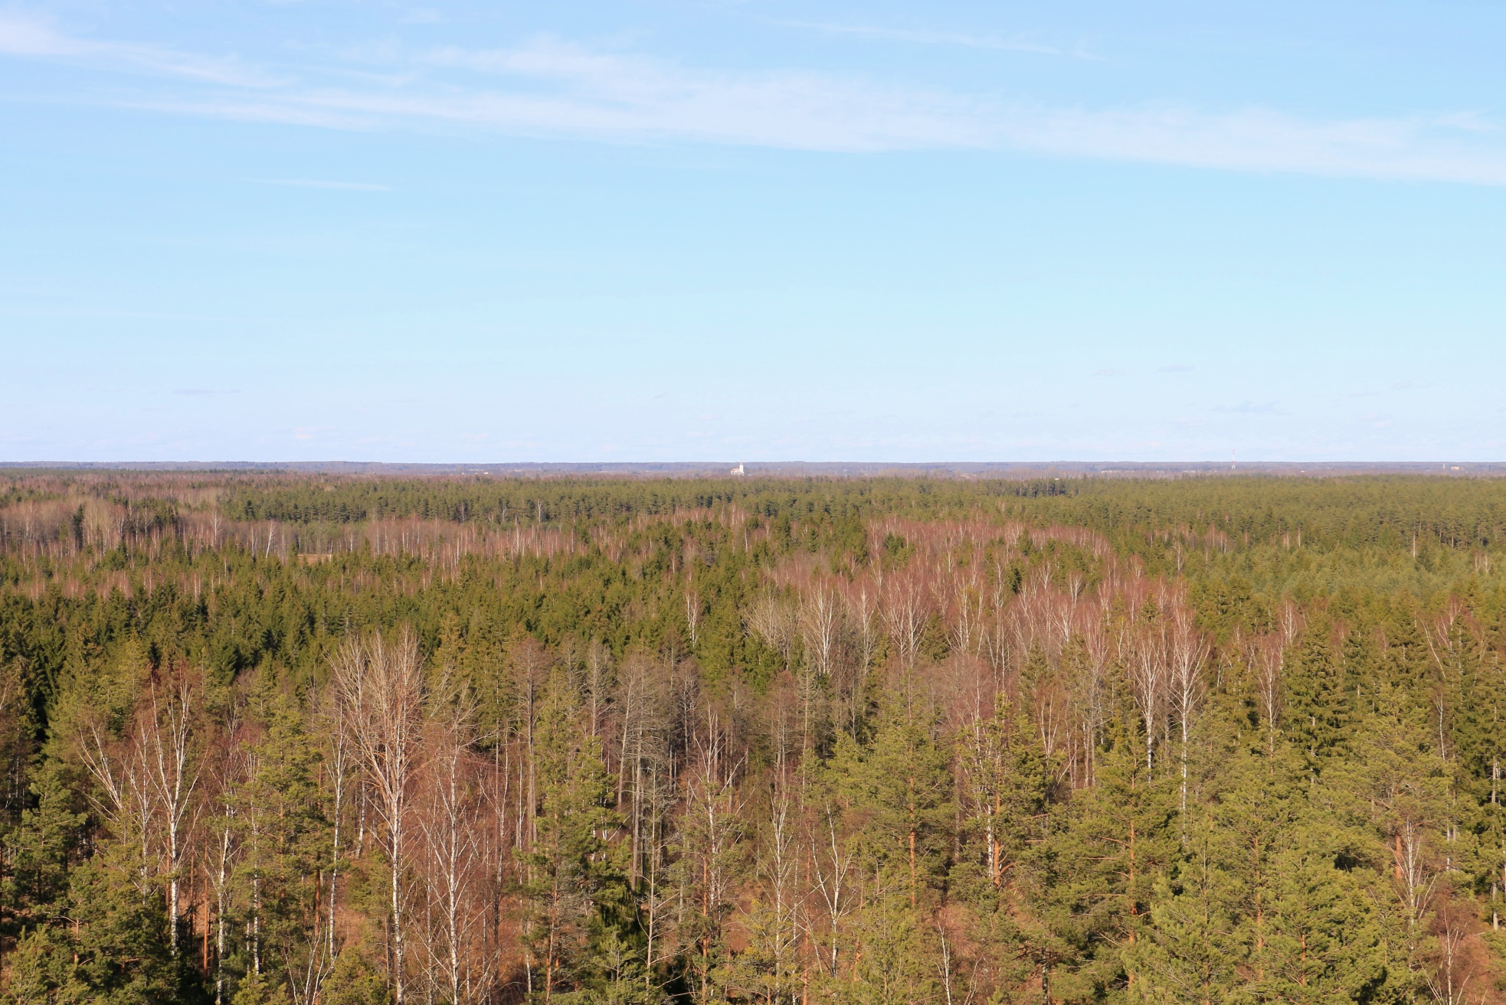
Results
The dune field under the influence of a humid temperate climate recently is completely stabilized by canopy vegetation, mainly represented by coniferous and mixed forests.
View over the central part of dune field from SE to NW

Slide 16
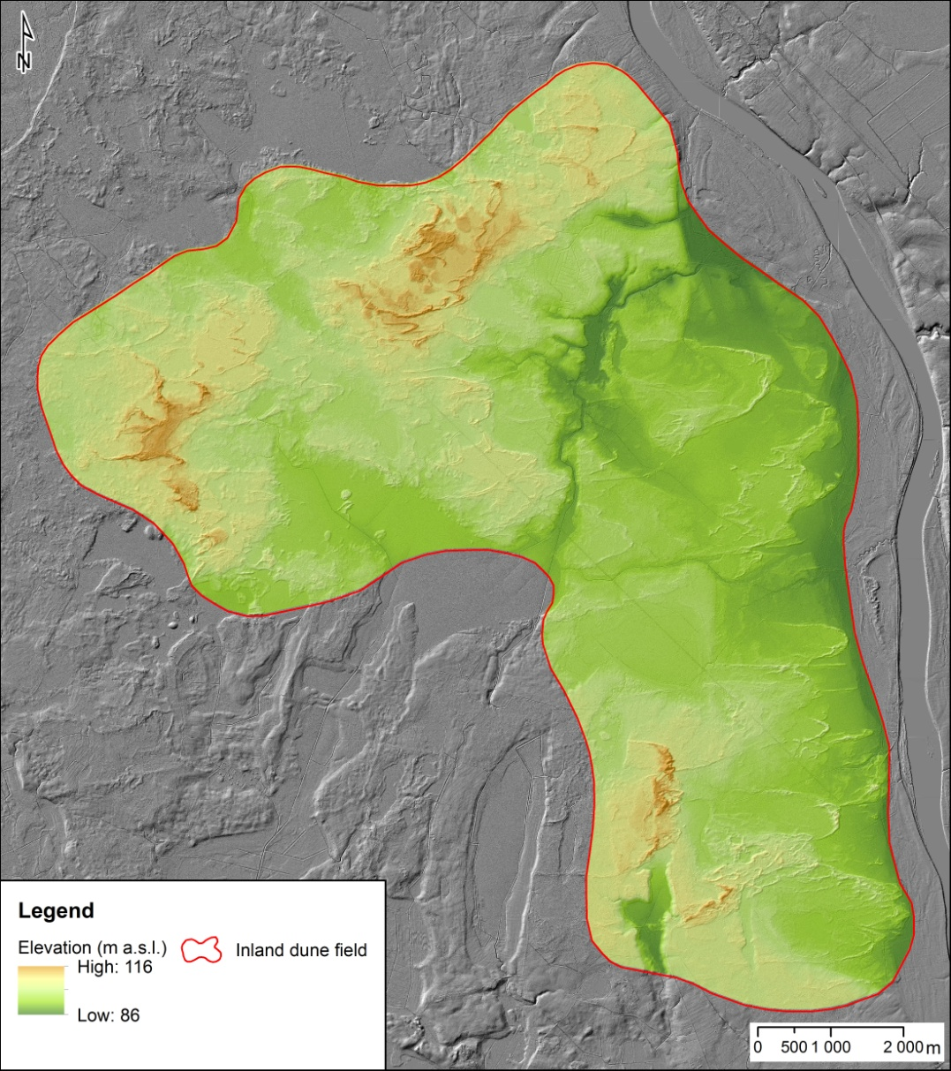
Results
Results of GIS analysis indicate that single parabolic dunes typically have U-shaped configuration in planar view.
Aeolian landforms also link and override each other, presenting clustered groups.
GIS analysis reveals that the dominating wind directions during the development of dunes would have been westerly to easterly.
Digital elevation model of dune field at Dviete

Slide 17
Results
Previously published dates on OSL chronology for this dune field indicate the initial phase of aeolian activity at around 15.5 Ka and 14.5 Ka (Kalińska-Nartiša et al., 2016)
Hence, when the studied landforms formed in presumably paraglacial landscape, the Scandinavian Ice Sheet (SIS) was still present, and most likely atmospheric circulation in this region was affected by anticyclone over the SIS.
Digital elevation model of dune field at Dviete

Slide 18
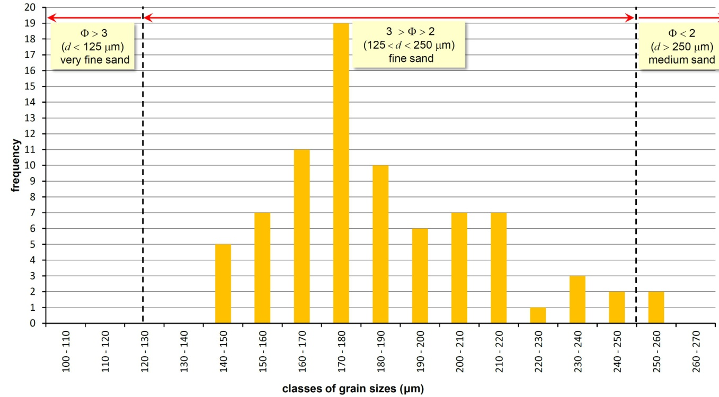
Results
The obtained results demonstrate that the mean grain size M_{z} of the aeolian deposits across the inland dune field in the Dviete forest ranges between extremes of 143 μm and 256 μm, or between 2.80 and 1.96 phi units, respectively.

Slide 19
Results
Hence aeolian landforms in the study area are composed of fairly homogenous, fine-grained sands according to the Udden-Wentworth grain-size scale. Most frequent classes of mean size of particles in micrometres are the sizes between 170-180 μm, 160-170 μm and 180-190 μm.

Slide 20
Results
The aeolian sediments demonstrate well and moderate sorting, i.e. σ values ranges between 0.473 and 0.707 phi with some outliers, when σ >0.8.
Grain-size analysis elucidate symmetrical bell-shaped distribution of particles of different fraction with small both negative and positive skewness Sk values ranging from -0.048 to 0.112 phi – with slight shift to fine fraction.

Slide 21
Results
For the values of graphic kurtosis K_{G}, results showed that sand from the Dviete forest is mesokurtic, with phi-transformed kurtosis values averaging 0.98, ranging from 0.94 to 1.18.
This means that sorting in fine-grained, medium-grained and coarse-grained fraction interval is similar.
Typically extremely high or low K_{G} coefficient values indicate that high energy wind affected sand during the transportation and sedimentation, and as a result the accumulation was not steady.
In this case, results obtained by authors do not indicate that.

Slide 22
Results
A sand fraction is composed mainly of fine sand particles – more than 40 % for each sample. Each sample also consists of medium sand (20-30%) and very fine sand (mostly less than 20 %). The results show that small parts of samples were identified as coarse sand and silt fractions (not more than 4 % of each sample).
The granulometric composition of all analysed samples and percentage of different fractions of sand, silt and clay in aeolian sediments.
The sequence of samples in the graph from left to right corresponds to their geographic distribution across the dune field from South to North.

Slide 23
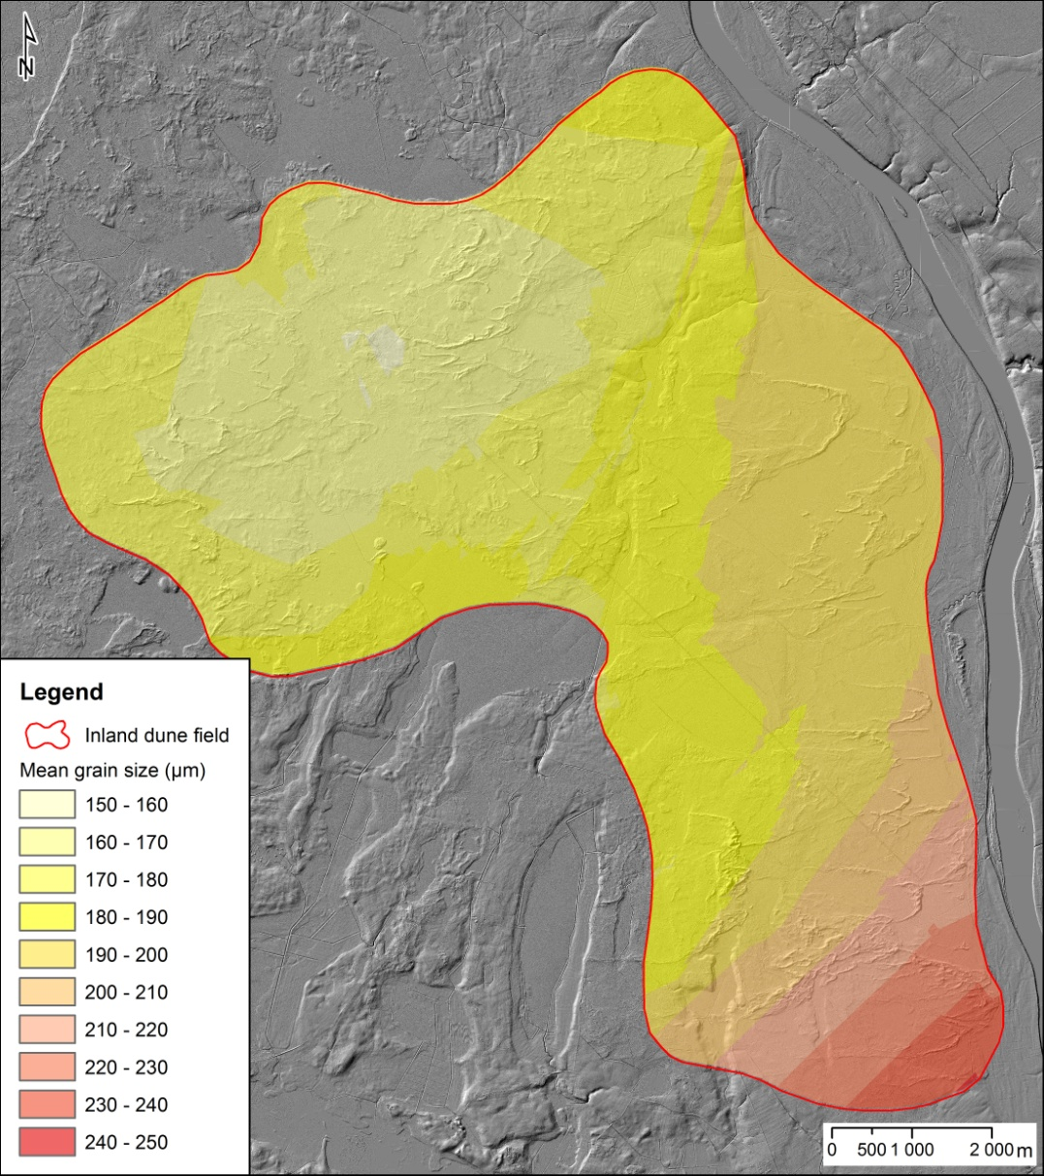
Results
Mean size of particles vs location in respect of glaciofluvial delta – geographic distribution.
Fining from S-SE to N-NW
Map of spatial distribution of M_{z} aeolian deposits across the inland dune field

Slide 24
Results
Mean size of particles vs location in respect of glaciofluvial delta –→ statistically significant negative linear correlation, where r = - 0,74; p<0,01 at n = 80
Map of spatial distribution of M_{z} aeolian deposits across the inland dune field

Slide 25
Results
Fining of dune-forming sediments across the dune field from S – SE to N-NW field suggest the provenance of sediments from one main source, possibly associated with glaciofluvial sediment transportation by extra-glacial water streams draining from the already ice-free parts of adjoining Augšzeme Upland through the Ilūkste valley to the Nīcgale ice-dammed lake.
Direction of paleostreams
Direction of paleostreams
Direction of paleostreams
Map of spatial distribution of M_{z} aeolian deposits across the inland dune field

Slide 26
Results
In turn it is revealed, that aeolian sediments within the study area had been derived from pre-existing glacioaquatic sediments, and during the past aeolian activity phases, these sediments had not been transported by wind far from nearby sources.
Direction of paleostreams
Direction of paleostreams
Direction of paleostreams
Map of spatial distribution of M_{z} aeolian deposits across the inland dune field

Slide 27
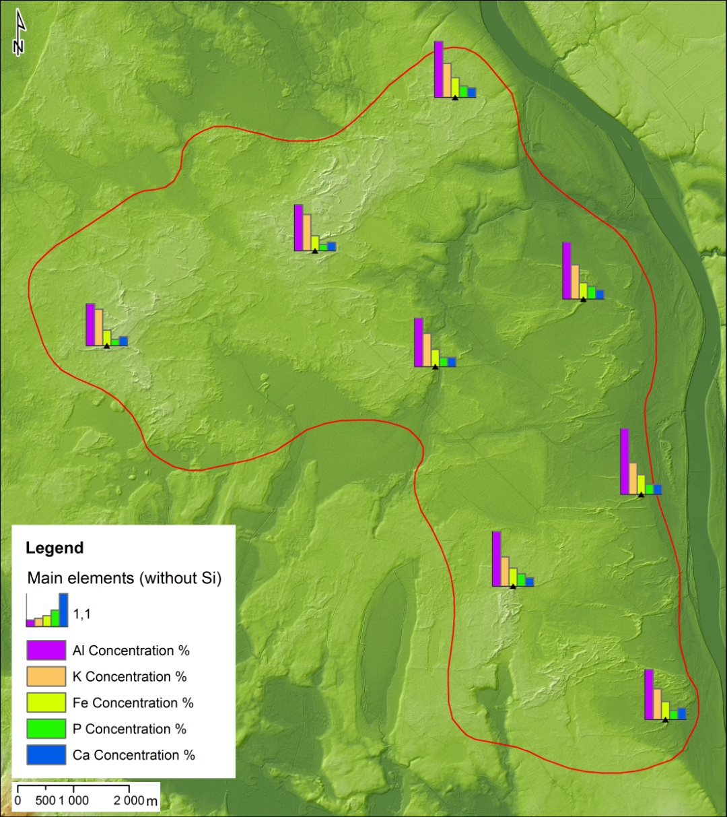
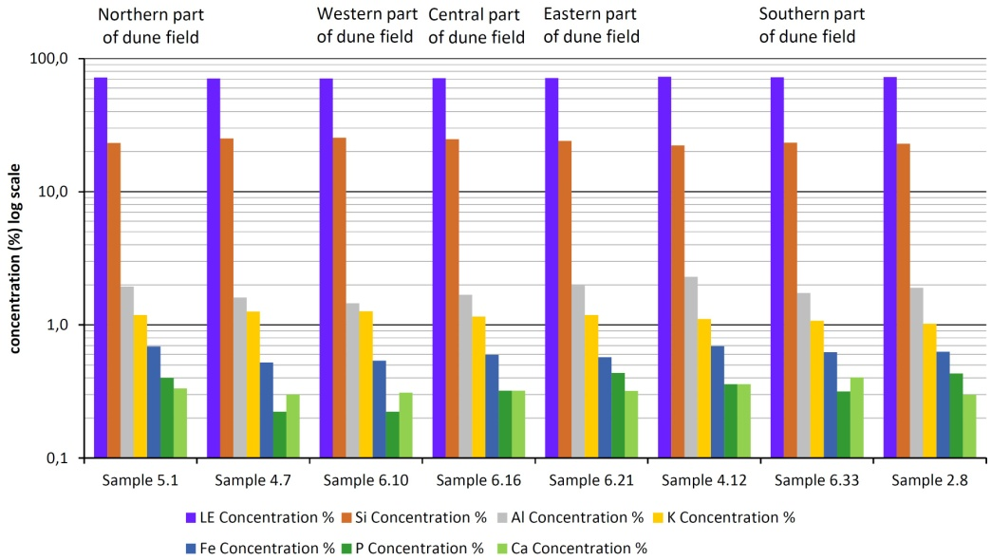
Results
Geochemical analysis points out that elemental composition is rather typical for aeolian sediments, determined by dominance of quartz and K-silicates.
Map of spatial distribution of main elements concentrations across the inland dune field

Slide 28
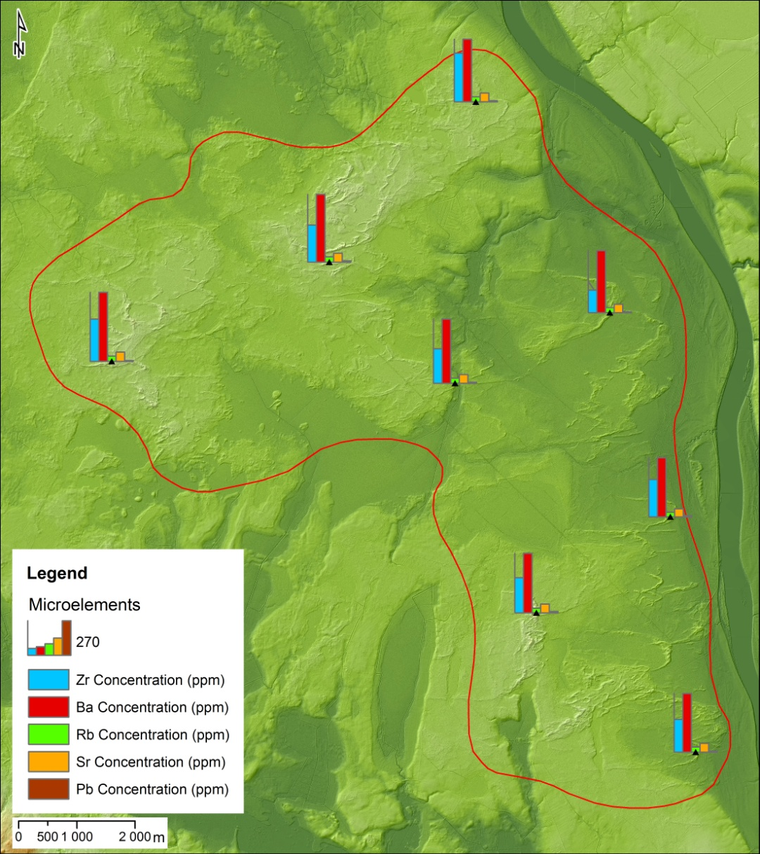
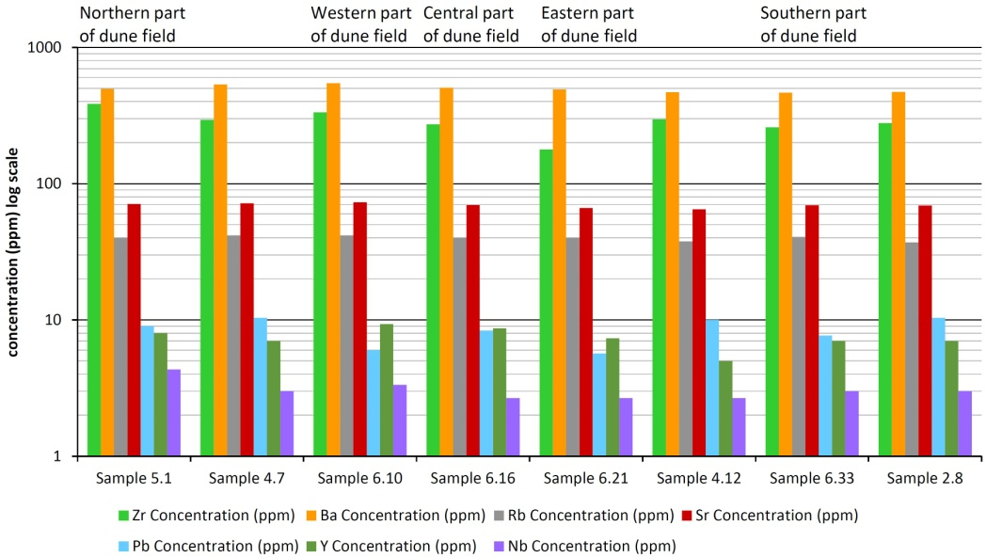
Results
Among microelements in the highest concentrations Ba and Zr are detected, 464 – 546 ppm or mg·kg⁻¹ and 178 – 385 ppm or mg·kg⁻¹ respectively.
Map of spatial distribution of microelements concentrations across the inland dune field

Slide 29
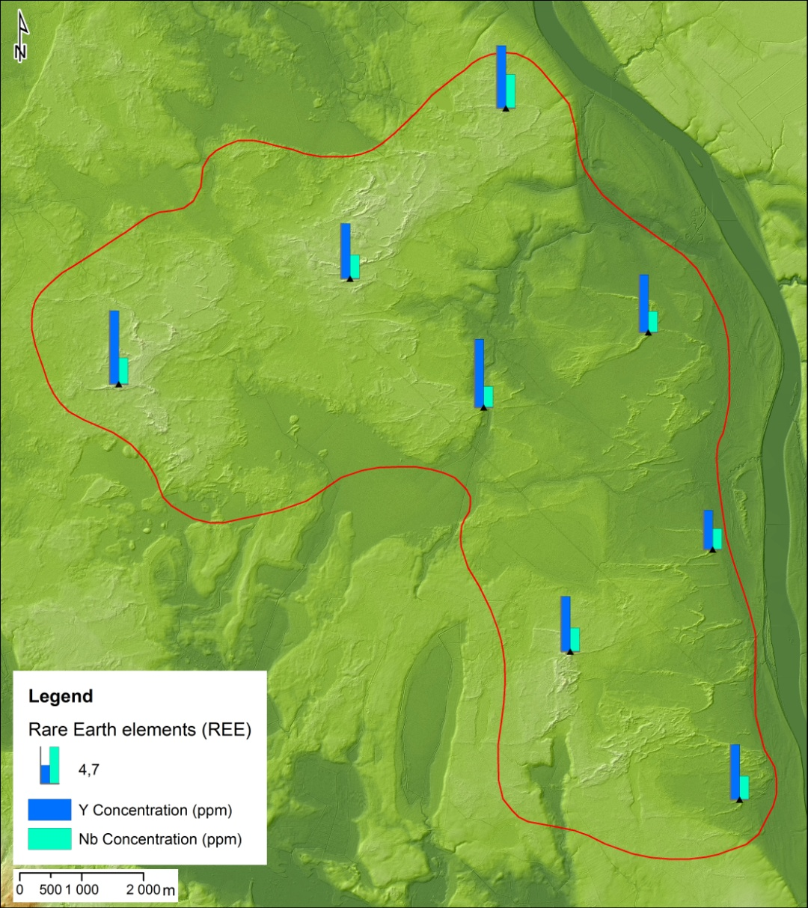
Results
Among Rare Earth elements, only Y un Nb were identified in detectable concentrations.
Map of spatial distribution of REE concentrations across the inland dune field

Slide 30
Conclusions
The pattern of grain size distribution and similar geochemical signatures across the dune field suggest the provenance of sediments from one main source. Possibly they have been transported to glacial lake mainly by extra-glacial waters draining from the already ice-free parts of adjoining uplands.
As apparent, aeolian deposition seems to nearly instantly follow the drainage of the Nīcgale ice-dammed lake.
The values of sorting, skewness and kurtosis indicate unimodally distributed particles in deposited sediments with well-expressed dominance of single fraction, hence allowing to conclude that wind power during the sorting, transporting and deposition process was more or less even. This leads to assumption that subaerial environmental and climate conditions during the aeolian activity were steady.

Slide 31
Conclusions
It is most likely that cold and dry climate in conjunction with low groundwater tables during the late Pleistocene – beginning of Holocene were among the main controlling factors which prevented development of vegetation cover in this region and delayed stabilisation of the dunes.
In turn, it facilitates the action of wind over glaciolacustrine plain as the main driving process of aeolian morphogenesis during the initial evolution of metastable post-glacial landscape.

Slide 32
Thanks for attention!

