Slide 1



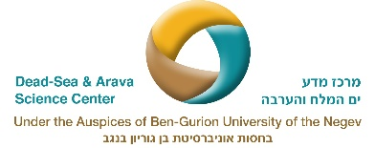
The contribution of Web of Interactions framework to the whole system approach
Shayli Dor-Haim, Daniel Orenstein and Moshe Shachak

Slide 2
Web of Interactions
We present the Negev Highland Desert ecosystem as a case study to demonstrate the concept of web of interaction (WoI), our interpretation to diversity within the whole system approach
We show how geodiversity and biodiversity interactions in the Negev Highlands creates through WoI ecosystem diversity.
Based on the WoI model we predict essential ecosystem variables.
For more information:
Dor‐Haim, S., Orenstein, D. E., & Shachak, M. (2019). Web of interactions among diversity approaches to identify ecosystem essential variables: Negev Highlands case study. Ecosphere, 10(11), e02906.‏

Slide 3
Web of Interactions (WoI) –Negev Highland
The fig shows:.
Web of interactions between biodiversity and geodiversity components
All the components and their interactions vary in time and space and determine ecosystem diversity and state.
Notes:
Web of interactions (WoI) among and between the diversity of components that links biotic and abiotic
diversities in the Negev Highlands ecosystem. All the components and their interactions vary in time and space
and together determine ecosystem diversity. The WoI model includes 10 types of diversities

Slide 4
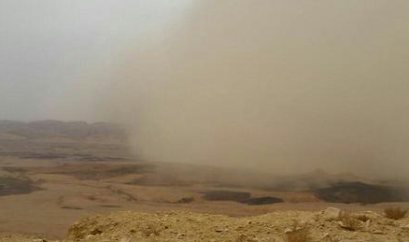
Rainfall diversity
GEO-diversity components
Dust deposition diversity
Driven by precipitation pattern including:
*amount
*spatial distribution
*duration, and frequency.
*variable in time and space.
*main source of soil in the desert
*Its diversity depends on the frequency and magnitude of dust deposition through time

Slide 5
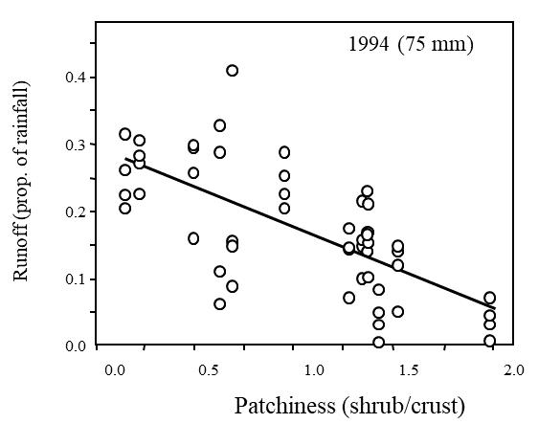
Surface property diversity
GEO-diversity components
Functional connectivity diversity
The landscape mosaic is a fundamental component of geodiversity, and its diversity depends on rock-to-soil ratio and the spatial distribution of rock and soil in space and time
*Determines the length of the runoff pathway diversity regulated by the interaction between soil property diversity, rainfall diversity, and biotic diversity
* Functional diversity affects two other diversities: soil moisture diversity and vegetation pattern

Slide 6
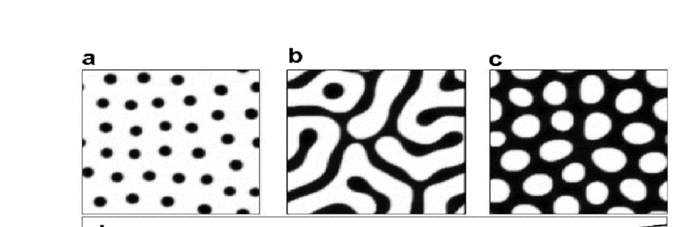
Soil moisture diversity
GEO & BIO diversity components interactions
Vegetation pattern
Main link between biodiversity and geodiversity.
Soil moisture characteristics are very diverse spatially and temporally in the Negev Highlands.
Depends on the interactions between surface properties, functional connectivity, and soil moisture.
This pattern diversity occur in spot, band, and hole patterns

Slide 7
Niche diversity, Plant, animal and microbe functional diversity
BIO-diversity components & interactions
Niche diversity
Driven by: surface properties, vegetation pattern, soil moisture and functional connectivity diversities.
Plant and animal functional and microbe functional diversity that regulate ecosystem functions.

Slide 8
Whole system interactions in the Negev Highlands
The Link: interactions-diversity-essential variables
Essential ecosystem diversity variables
Notes:
Hydro-geo-ecological components, drivers, and feedbacks that control geodiversity and biodiversity interactions in the Negev Highlands. The hydrological feedback (1) is controlled by rainfall pattern and affects the pedological feedback by runoff generation that accumulates dust and regulates rock-to-soil ratio (2). These two feedbacks control soil moisture, which links geodiversity with biodiversity components. The energy and material feedback (3) is characterized by the producer–consumer and decomposer relationship and supports ecosystem engineers. The flow among the ecosystem components describes the producer–consumer–decomposer feedback (4) to soil moisture. The three ecosystem components determine the cross-level interactions among populations, communities, and landscape. Ecosystem engineers are the agents of the feedback between biodiversity and geodiversity (5). The functional interactions among the biodiversity and geodiversity components create ecosystem diversity.

