Slide 1
Tsunami-derived sediments identified in the destruction sequence of an eighth century warehouse in Caesarea Maritima, Israel
1
Charles Everhardt
Supervisor: Beverly Goodman-Tchernov
In collaboration with Uzi Ad, Jacob Sharvit, Ofi Barkai, Roi Jaijel, Joel Roskin, and Lotem Robins

Slide 2
Study Site Location
Turkey
Herodian Harbor
Cyprus
Syria
Lebanon
Caesarea Maritima
Israel
Jordan
Egypt
Saudi Arabia
Eastern Mediterranean map (Google Earth Web, 2020).
Illustration of Caesarea Maritima. Dotted line represents the Byzantine extent of the city, and the shaded area shows the Early-Islamic inhabited area (Avni, 2011).

Slide 3
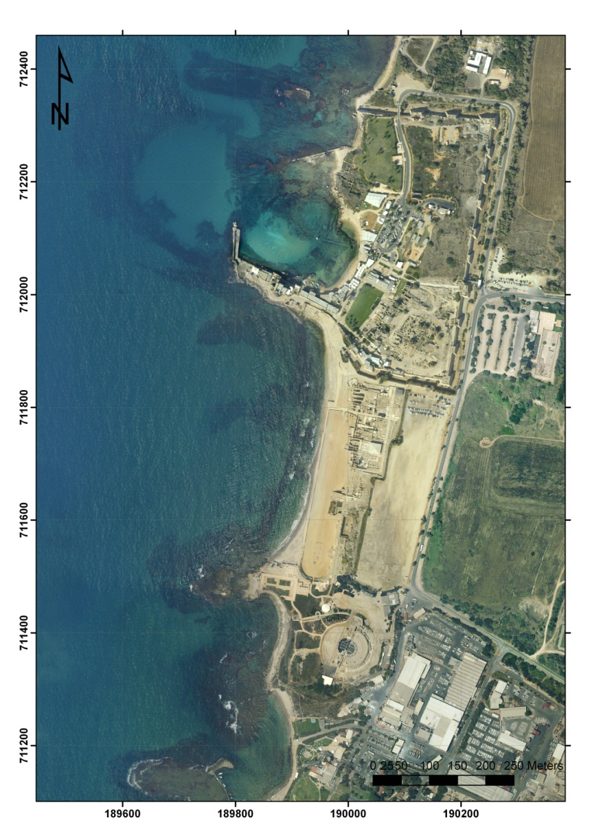
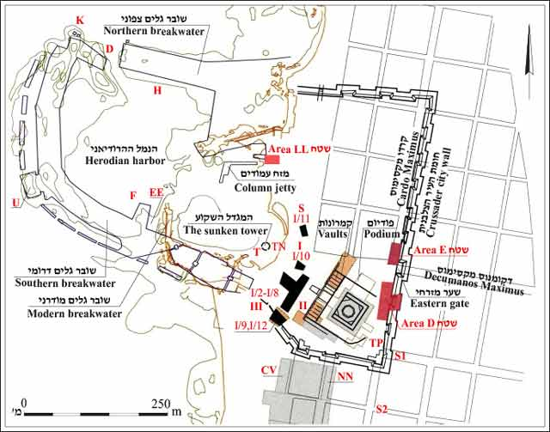
Caesarea Maritima
Aerial view of Caesarea Maritima (photo: Survey of Israel).
Archaeological map of Caesarea Maritima’s harbor and surroundings (‘Ad et al., 2018).

Slide 4
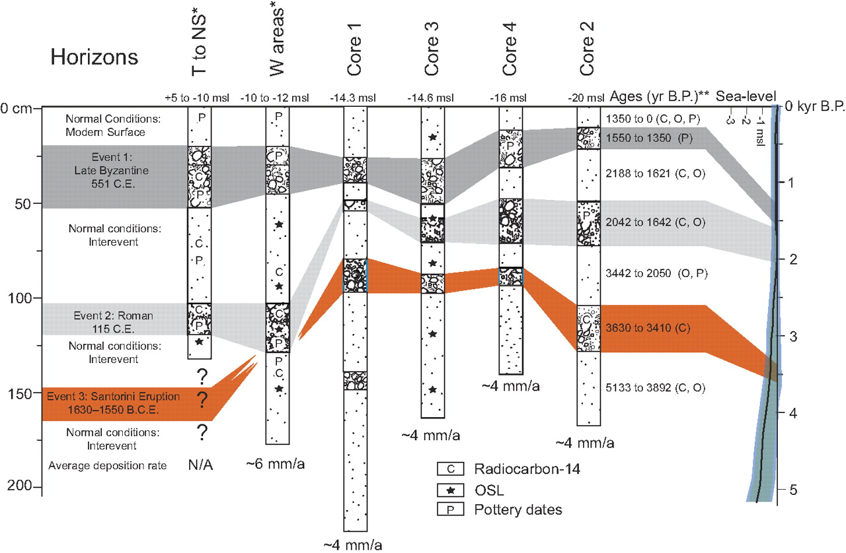
Evidence of Past Tsunamis
Evidence for at least 5 tsunami events have been identified offshore Caesarea Maritima (Goodman-Tchernov et al, 2009; Dey et al., 2014;Tyuleneva et al., 2018).
However, evidence on land has only been speculated post-excavation through reinterpretation of excavation reports (Dey and Goodman, 2010; Dey et al., 2014).
Past Excavations reported anomalous sand deposits throughout Caesarea Maritima, including Area LL, that dated to the eighth century (Stabler and Holum, 2008; Dey et al., 2014).
However, the excavators did not interpret them as tsunami deposits, and there was no sedimentological studies on these deposits.
Three tsunami events have been identified in sediment cores from the Herodian harbor (Goodman-Tchernov et al., 2009).

Slide 5
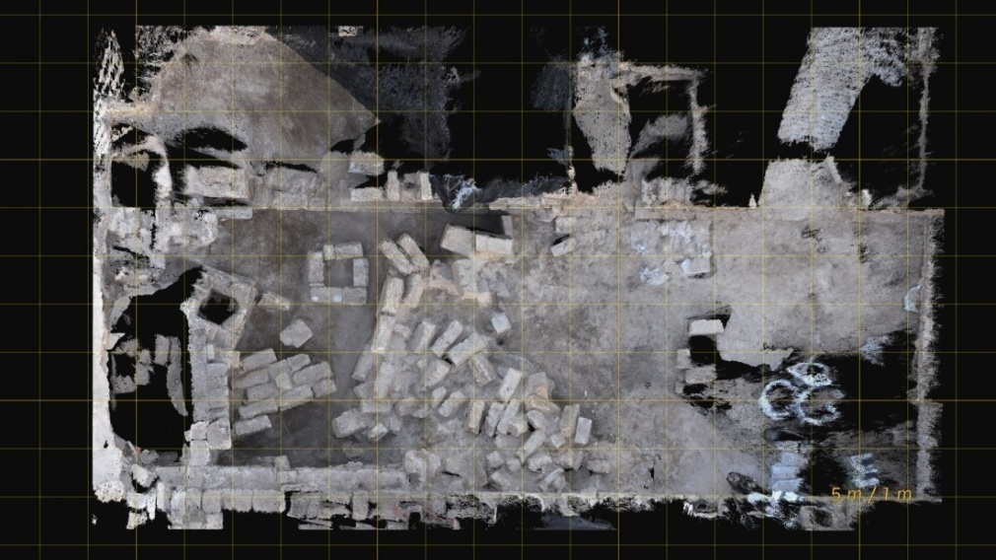
Area LL Excavation
In 2016, Area LL was reopened for excavation, providing the opportunity to revisit these anomalous deposits.
The western and eastern warehouses were the focus of the excavation.
These warehouses were built during the Byzantine period and were repurposed in the late seventh century before their abandonment in the early eighth century. However, the area was resettled in the late eighth century.
Room 2 of Eastern Warehouse.
Excavation map of Area LL (‘Ad et al., 2018).

Slide 6
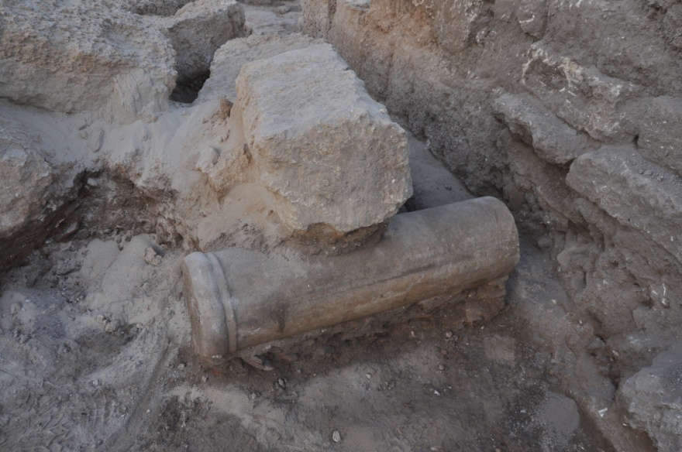
Anomalous Sand Layer
During this abandonment, evidence for 2 destruction sequences were found in the warehouse complex:
The first involved the collapse of the ceiling and fire damage and the second saw the arrival of a sandy layer (‘Ad et al, 2018).
This anomalous layer comprised clean sand with matrix-supported building stones and a few roof tiles. The layer was mainly massive with the exception of lamination.
Photos of the excavation of the anomalous deposit.

Slide 7
Study Goals
Main question: What is the origin of the mid-8th century anomalous sand layer?
To answer this, we must answer these secondary questions:
Did the formation of the anomalous layer occur gradually or rapidly?
Using a sedimentological approach, how does the anomalous sediment compare to samples of known origin, such as storm; dune; construction fill; and shallow marine sediment?
Many modern and ancient tsunami deposits from around the world have been identified and studied. Does the anomalous sediment fulfill tsunamigenic criteria?

Slide 8
Sediment Characteristics | Dune | Shallow Marine | Hamra (sandy loam) | Construction Fill | Storm | Tsunami
Depositional Time Scale | gradual | gradual | gradual | Rapid, but with stratification | Rapid deposition or erosion | Rapid
Grain Size | Fine sand; small grain size distribution (well sorted) | Coarser sand; large grain size distribution (poorly sorted) | Clay to sand-sized grains; large grain size distribution (poorly sorted) | Variable, depending on sediment source; large grain size distribution (poorly sorted) | Variable, depending on sediment available for transportation; large grain size distribution (poorly sorted) | Variable, depending on sediment available for transportation; small to large grain size distribution (well to poorly sorted)
Foraminiferal Characteristics | Few; weathered tests; very low diversity | Many; high percentage of pristine tests; high diversity | None to very few; weathered tests; very low diversity | Few; weathered tests; very low diversity (if sediment was taken from the coast and not dredged) | Many; high percentage of pristine tests; high diversity (shallow marine to brackish) | Many; high percentage of pristine tests; high diversity(deep marine to brackish)
Other Signature Features | Well-sorted grains; very few and only weathered fossils | Ripples; dunes; shallow marine fauna | High organic content; red/orange color | often includes refuse; layering from dumping of material | Shallow marine (above wave base) to beach/dune sediment; ripples; planar stratification | Terrestrial to deep marine mixing; signs of fluid flow or lamination; rip-up clasts; fining upward

Slide 9
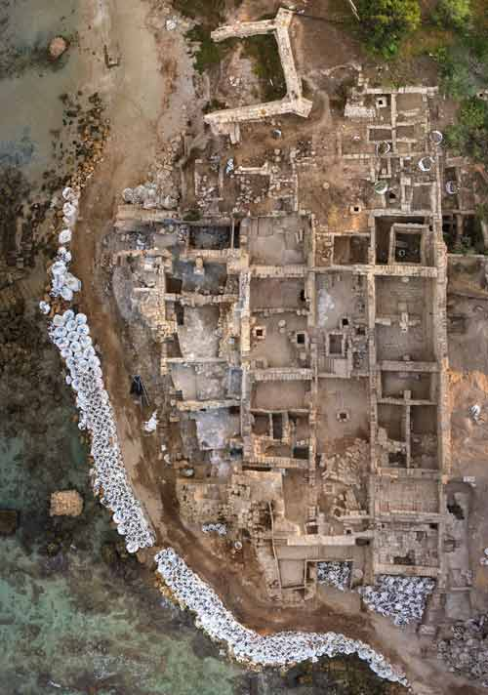
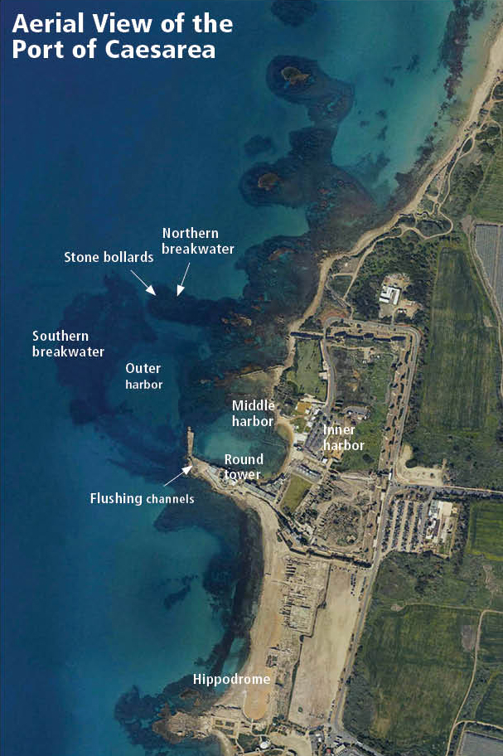
Field Methods
Shallow marine (3)
Hamra (3)
Storm (2)
Fill (19)
Aerial view of Area LL with excavated room in yellow. 2 cores were extracted from this room (‘Ad et al., 2018).
Locations of field sampling (after Ben Yehuda). The red arrow points to Area LL (outlined in red). In addition, 2 dune samples were taken from Aqueduct Beach, north of the harbor, and 3 from Michmoret Dunes, in the south of the Caesarea-Hadera dunefield (not shown on photo above).

Slide 10
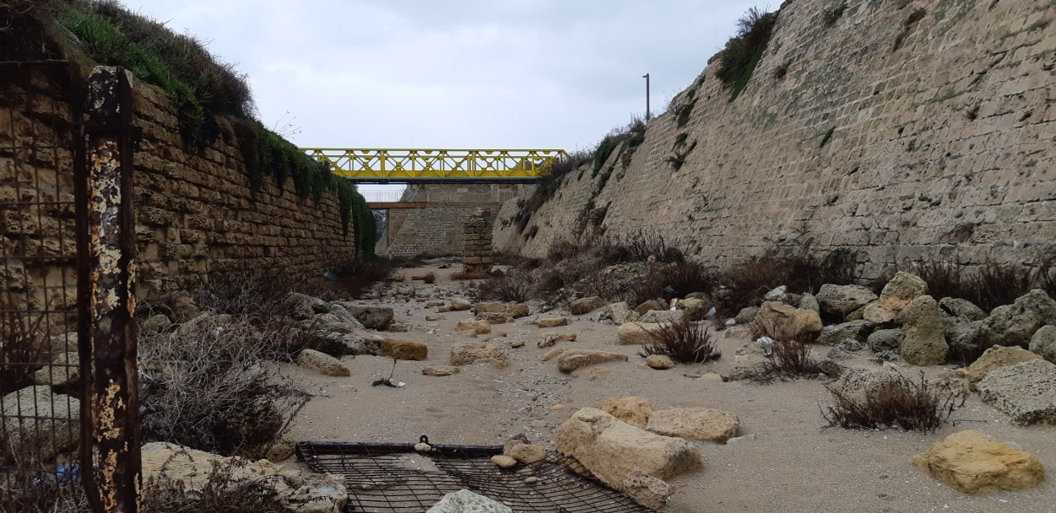
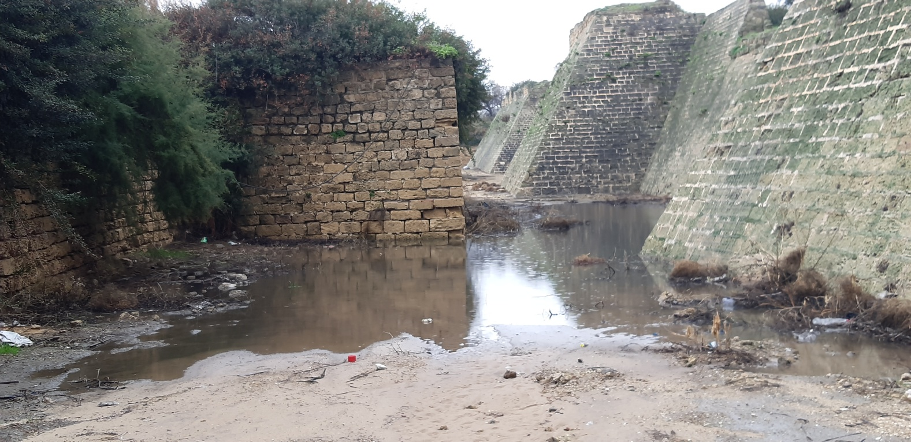
Storm Samples
Pictured left is the Crusader moat surrounding Caesarea Maritima’s harbor area. Strong winter storms can transport shallow marine to beach sediment into the moat.
Pictured right is the storm sampling location (one sample was taken from the exposed sandy area and one from the water-covered area).

Slide 11
Laboratory Methods
Portable optically-stimulated luminescence dating (P-OSL)
Grain size distribution
Foraminiferal assemblage (abundance, condition, diversity)
Scanning electron microscope (SEM) images
Notes:
Going to explain how each method helps solve question

Slide 12
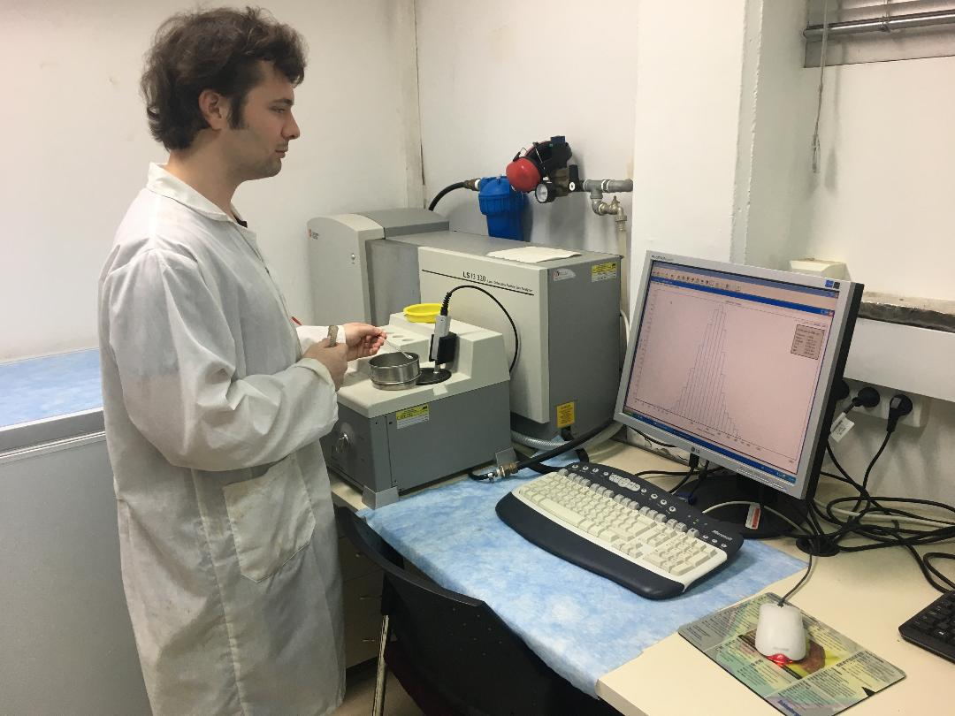
Grain Size Distribution
Cores were sampled at 1-centimeter resolution.
Samples were digested in H2O2 to remove organic matter.
Beckman Coulter LS 13 320 Laser Diffraction Particle Size Analyzer (shown on the right) was used to measure grain size distribution of grains from 0.04 to 2000 microns.
Ocean Data View (ODV) was used to present data in order to show grain size distribution patterns as well as the degree of sorting.
Grain size data was also plotted in Paleontological Statistics (PAST) software to compare the grain size distribution among samples, using multivariate statistics.
This method plots data points with multiple variables according to how similar they are to each other. This is helpful in identifying what sediment type, if any, resembles the anomalous samples in grain size distribution.

Slide 13
Foraminiferal Assemblage
Foraminifera are single-celled organisms that inhabit marine to brackish water, composed of secreted or agglutinated tests.
When foraminifera die, their tests are transported by currents, where they are subjected to weathering.
Due to their high preservation potential, small size, and preference for certain environments, they can be helpful in sedimentological studies (Pilarczyk et al., 2014).
Together, foraminiferal abundance, condition, and species diversity can help in identifying the origin of sediment samples.
Cores were sampled at 5cm resolution and sieved, along with reference samples. The 125-500 micron fraction was split further and used to pick over 300 forams from each sample, from which foraminiferal abundance per cubic centimeter could be calculated.
Scanning electron microscope images of representative foraminifera from each sediment type were useful in identifying species and surficial features.
Pilarczyk et al., 2014.

Slide 14
Portable Optically Stimulated Luminescence
OSL is a method for dating quartz grains by measuring energy released from the grains to determine when they were last exposed to sunlight.
P-OSL is useful where sediment is homogenous because it can identify relative age relationships.
If sediment was deposited rapidly, the majority of grains downcore were last bleached or partially bleached at the same time, and P-OSL signal downcore will exhibit no slope.
If sediment was deposited gradually, grains towards the bottom were last bleached before grains located above, ad P-OSL signal would, therefore, exhibit a slope downcore.
Samples were taken from one core at 5cm resolution for P-OSL measurements.
OSL method diagram (Mallinson, 2008).

Slide 15
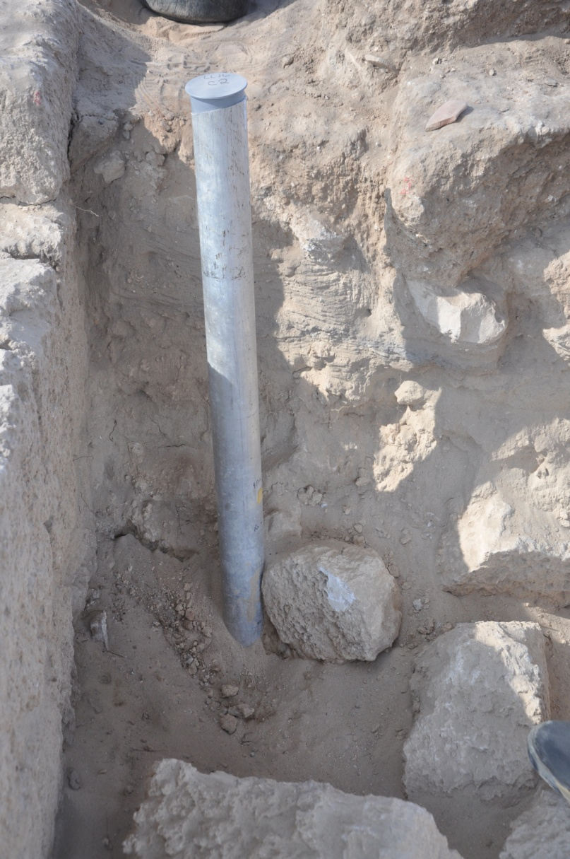
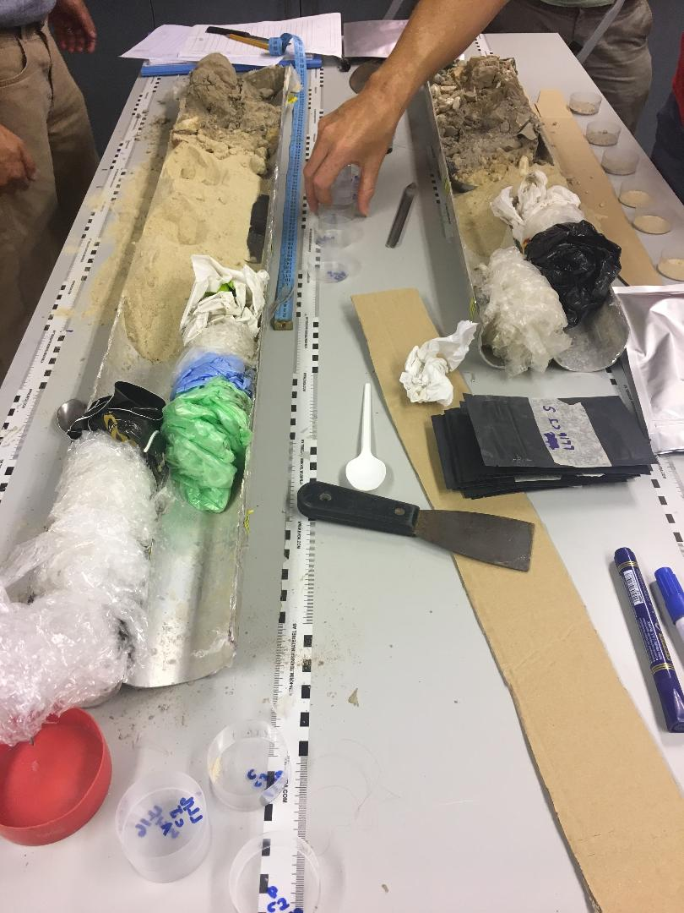
Extraction/Opening of Cores
Pipe used to core anomalous layer in LL.
Cores were opened in a dark room and then described and prepped for sampling.

Slide 16
Core Descriptions
LL16 CJ
LL16 MB
0
0
Clean, massive, well-sorted sand with no artifacts.
Clean, massive, well-sorted sand with no artifacts.
9
Darker, organic-rich sediment containing potsherds, glass, shells, pebbles, and bone fragments.
Depth (cm.)
34
Contains chunks of burned sand and marine-encrusted potsherds.
40
Darker, organic-rich sediment containing potsherds, glass, shells, pebbles, and bone fragments.
54
Compact floor.
65

Slide 17
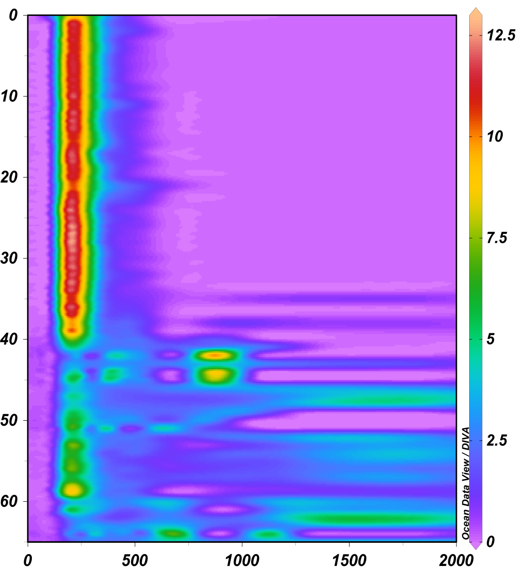
Results: Grain Size Distribution (CJ core)
%
Grain Size (micron)
ODV plot showing the well-sorted anomalous/contact layers above a poorly-sorted garbage layer and floor with larger grain size distribution.

Slide 18
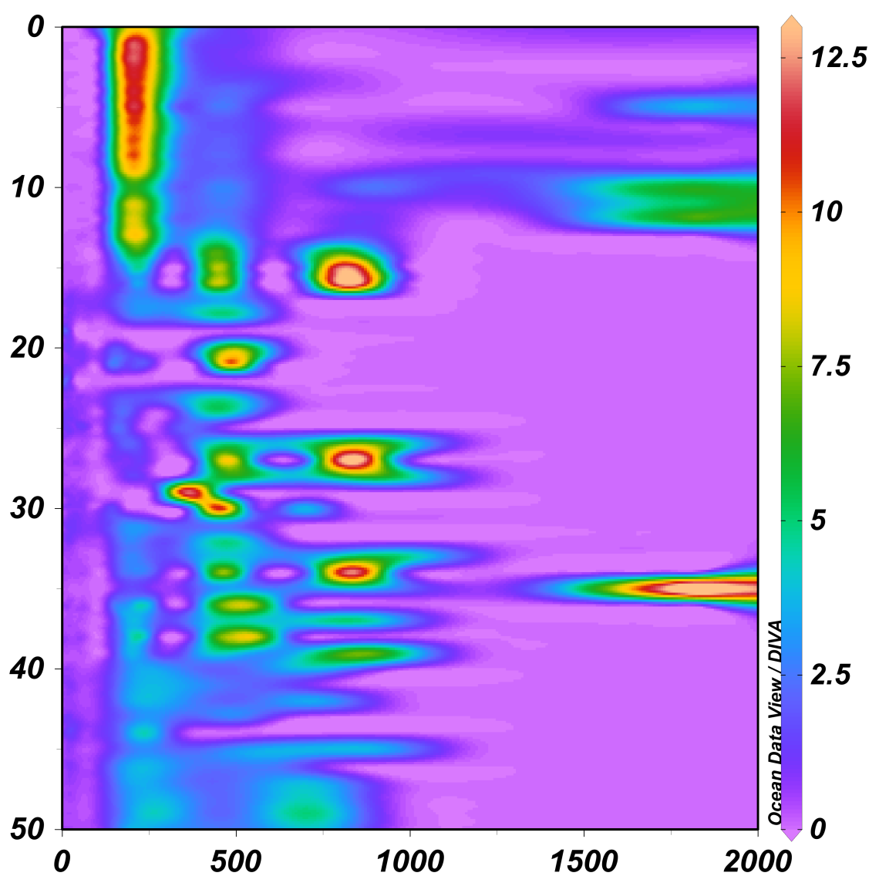
Results: Grain Size Distribution (MB core)
LL16 MB
0
9
%
Depth (cm.)
54
Grain Size (micron)
ODV plot showing the well-sorted anomalous layer above a poorly-sorted garbage layer with larger grain size distribution.

Slide 19
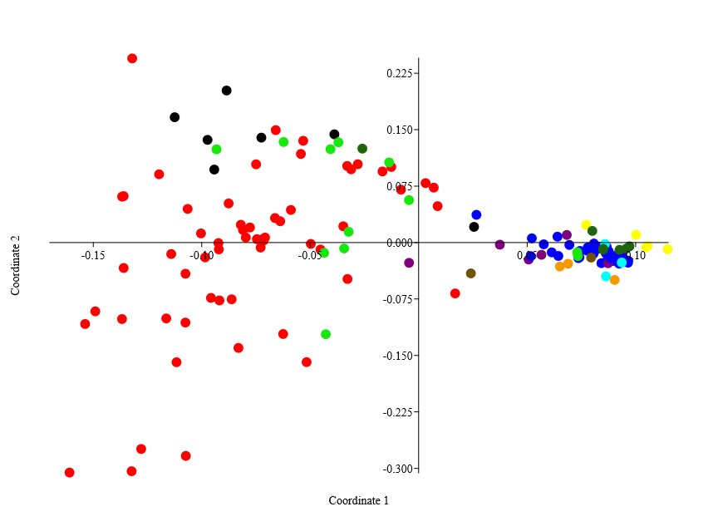
Results: GS PAST
Legend
Anomalous
Lower Fill
Contact Zone
Shallow Marine
Garbage Dump
Hamra
Dune
Storm
Upper Fill
Floor
Notes:
Replace tsunami with anomolous sand

Slide 20
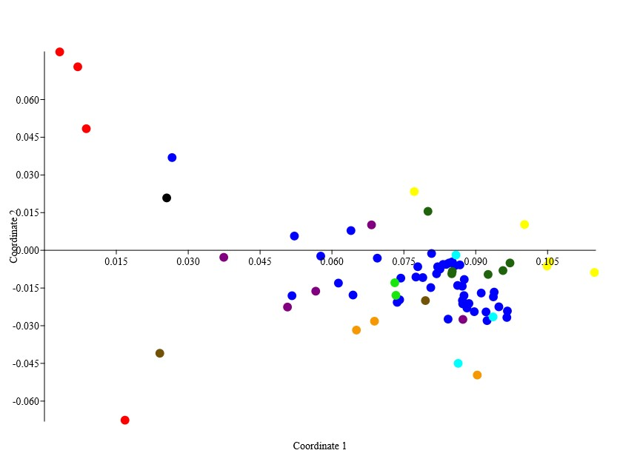
Anomalous cluster
Notes:
Same as before

Slide 21
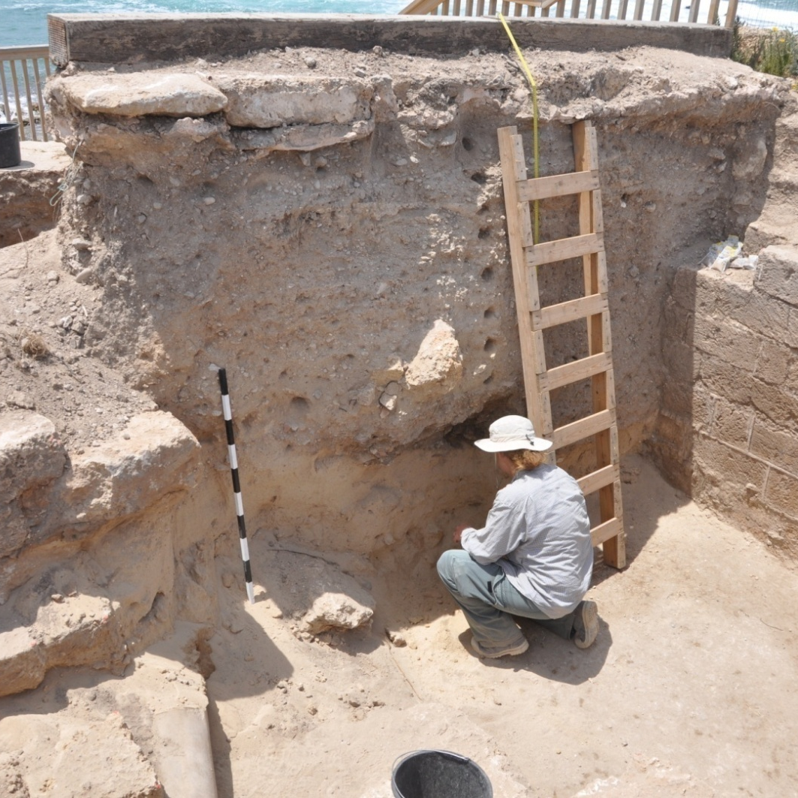
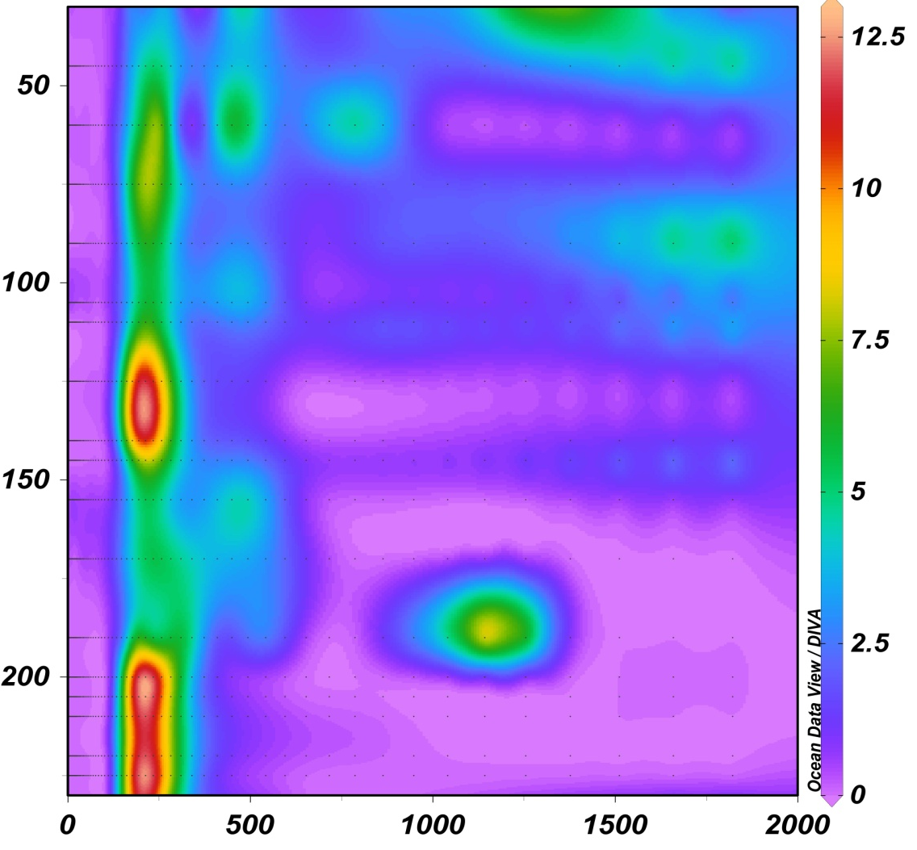
Lower Construction Fill
%
Depth (cm)
Grain Size (micron)
While sampling a construction fill abutting a Crusader wall, the same anomalous deposit was found at the bottom of the fill (corresponding to the bottom 7 samples from about 185 to 230cm depth in the ODV figure). The anomalous deposit is outlined in red in the left photo. Although the deposit was found abutting the later Crusader wall, it can be surmised that during the construction of the wall, builders dug through an earlier fill and the anomalous deposit for the foundation.

Slide 22
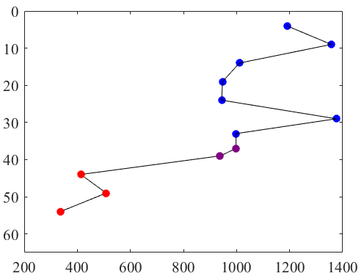
Results: Foraminiferal Abundance (CJ core)
Foraminifera per cubic centimeter

Slide 23
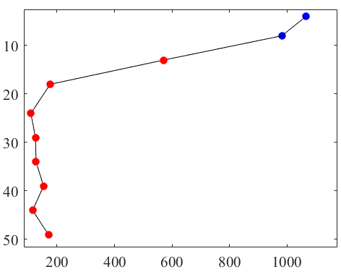
Results: Foraminiferal Abundance (MB core)
LL16 MB
Foraminifera per cubic centimeter

Slide 24
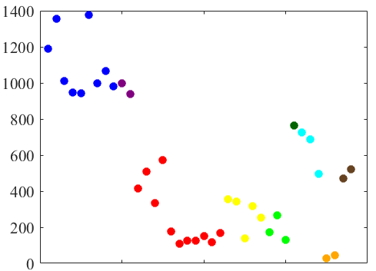
Results: Foraminiferal Abundances of Core and Reference Samples
Anomalous
Contact Zone
Lower Fill
Foraminifera per cubic centimeter
Shallow Marine
Dune
Storm
Garbage Dump
Upper Fill
Hamra

Slide 25
1
2
3
4
5
6
7
8
9
10
11
12
From the SEM photos of the most common foraminifera found in each sediment type (same color code as before), the anomalous; storm; and shallow marine forams are much more well-preserved than the fill and dune forams, which have weathered tests with rounded edges and less-pronounced structures.
13

Slide 26
Results: P-OSL
The topmost three anomalous samples (at 0, 4, and 7cm depth) show a negative slope as depth increases. This probably indicates post-depositional disturbance/mixing.
The five anomalous samples below have similar values that overlap each other and exhibit no slope. Lack of slope in the net BOSL values indicates same age and time of zeroing (when sand grains are cut off from sunlight). Therefore, the anomalous deposit was deposited altogether at the same time.
The contact zone sample below has a lower value and lies between the anomalous values and the floor values below.
The three floor values at the bottom do not overlap with each other and their counts are significantly lower than the anomalous and contact samples above.
Net BOSL values
Robins, 2019

Slide 27
Preliminary Conclusions
Anomalous Sediment Characteristics | Dune? | Construction Fill? | Storm Deposition? | Tsunami Deposition?
Massive, clean, with some laminations
Well-sorted grains
Very High Foraminiferal Abundance
Rapid Deposition

Slide 28
Proposed Sequence of Events
After the Arab Conquest of 640 A.D., Area LL was resettled during the Late 7th / Early 8th century, and floors were raised and warehouse rooms were subdivided (‘Ad et al., 2018).
During a period of abandonment during the early/mid-8th century, warehouse rooms were used as a garbage dump.
The earthquake of 749 A.D. along DSFT severely damaged cities in the region, including Caesarea Maritima. Fire, associated with many earthquakes, broke out in Area LL.
A tsunami, caused by offshore sediment slumping after the earthquake, entered the harbor and hit the warehouse from the southwest direction.
The tsunami toppled walls of the warehouse, depositing sediment and building stones together and putting out the fire during deposition.
Area LL was resettled by the Abbasids soon afterwards, and floors were installed over the deposit, sealing it and protecting it from erosion.

Slide 29
Key References
‘Ad , U., Arbel, Y., Gendelman, P., 2018. Caesarea, Area LL. Preliminary Report. 130.
Avni, G., 2011. “From Polis to Madina” Revisited – Urban Change in Byzantine and early Islamic Palestine. J. R. Asiat. Soc. https://doi.org/10.1017/s1356186311000022
Dawson, A.G., Stewart, I., 2007. Tsunami deposits in the geological record. Sediment. Geol. 200, 166–183. https://doi.org/10.1016/j.sedgeo.2007.01.002
Dey, H., Goodman-Tchernov, B., 2010. Tsunamis and the port of Caesarea Maritima over the longue durée: a geoarchaeological perspective. J. Rom. Archaeol. 23, 265–284. https://doi.org/10.1017/s1047759400002397
Dey, H., Goodman-Tchernov, B., Sharvit, J., 2014. Archaeological evidence for the tsunami of January 18, A.D. 749: a chapter in the history of Early Islamic Qâysariyah (Caesarea Maritima). J. Rom. Archaeol. 27, 357–373. https://doi.org/10.1017/s1047759414001287
Goodman-Tchernov, B.N., Dey, H.W., Reinhardt, E.G., McCoy, F., Mart, Y., 2009. Tsunami waves generated by the Santorini eruption reached Eastern Mediterranean shores. Geology 37, 943–946. https://doi.org/10.1130/G25704A.1
Mallinson, D., Burdette, K., Mahan, S., Brook, G., 2008. Optically stimulated luminenscence age controls on late Pleistocene and Holocene coastal lithosomes, North Carolina, USA. Quaternary Research 69, 97-109.
Pilarczyk, J.E., Dura, T., Horton, B.P., Engelhart, S.E., Kemp, A.C., Sawai, Y., 2014. Microfossils from coastal environments as indicators of paleo-earthquakes, tsunamis and storms. Palaeogeogr. Palaeoclimatol. Palaeoecol. 413, 144–157. https://doi.org/10.1016/j.palaeo.2014.06.033
Reinhardt, E.G., Patterson, R.T., Schroeder-Adams, C.J., 1994. Geoarchaeology of the ancient harbor site of Caesarea Maritima, Israel; evidence from sedimentology and paleoecology of benthic foraminifera. J. Foraminifer. Res. 24, 37–48. https://doi.org/10.2113/gsjfr.24.1.37
Reinhardt, E., Raban, A., 2008. Site formation and stratigraphic development of Caesarea's ancient harbor. BAR International Series, 1784.
Stabler, J., Holum, K., 2008. The warehouse quarter (area LL) and the Temple Platform (area TP), 1996-200 and 2002 seasons. In K.G. Holum, J.A. Stabler, and E.G. Reinhardt eds. Caesarea Reports and Studies: Excavations 1995-2007 within the Old City and the Ancient Harbor. BAR International Series, 1784. Oxford, 1-39.
Tyuleneva,, N., Braun, Y., Katz, T., Suchkov, I., Goodman-Tcherov, B., 2018. A new chalcolithic-era tsunami event identified in the offshore sedimentary record of Jisr al-Zarka (Israel). Marine Geology. 396,67-78.

