Slide 1
Impact of land surface processes on mesoscale convective initiation over Africa in ensemble model simulations: 2 Case studies using UKMO Unified Model
Valiyaveetil Shamsudheen Semeena¹, Christopher Taylor¹ and Andrew Hartley²
1 Centre for Ecology and Hydrology, Wallingford, UK
^{2 UK MetOffice, Exeter, UK}

Slide 2
INTRODUCTION:
Influence of soil moisture on convective initiation
There is strong natural variability in soil moisture on a daily time scale driven by
convective rain events. This soil moisture variability induces strong variation in
surface fluxes in the days after rain.
How well is it represented in the MO forecast models
SM feebdbacks explained above occur on length scales which are not represented
in current climate models, although their effects have large scale consequences.
Improving weather forecasts and provide warnings on extreme events on a local scale
Using Land Surface Temperature Anomaly (LSTA) as a proxy to predict weather events

Slide 3
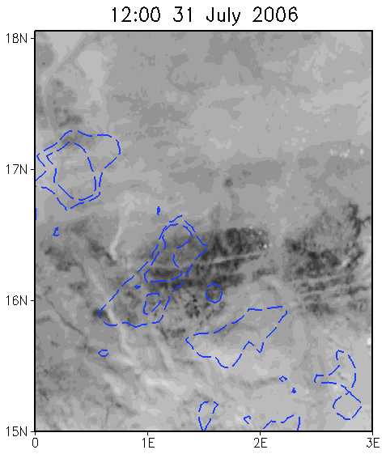
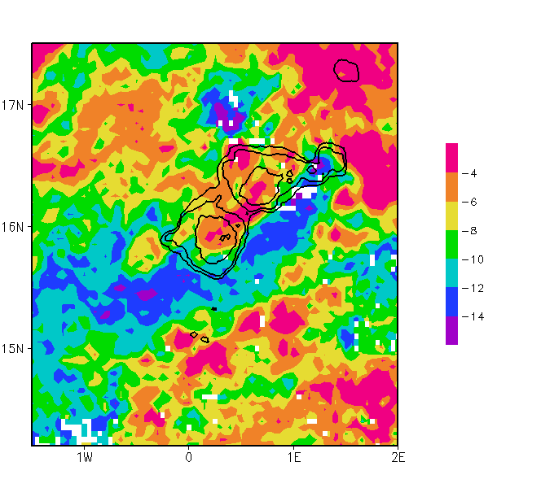
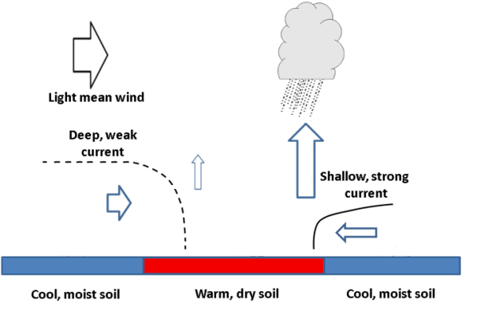
Case study from AMMA
(Taylor et al, QJRMS 2010, Birch et al QJRMS 2012)
Blue contours: LSTA
FEEDBACK:
Cold (wet) features
Land Surface Temperature Anomalies (LSTA) as a proxy for soil moisture (cooler=wetter)
Statistics from 1000s Sahelian storms show convective initiation favoured by wet/dry soil gradients
(Taylor et al Nat Geo 2011)
Visible Imagery from Meteosat

Slide 4
Data and methodology:
SEVIRI LST: Near real time Land Surface Temperature at 15 mins interval, ~3km resolution.
METEOSAT Second Generation (MSG) Spacecraft. Instrument > Spinning Enhanced Visible and InfraRed Imager (SEVIRI)
GPM Precipitation (NASA): Near real time images at 30 minutes interval
Global Precipitation Measurement is an international network of satellites
IMERG, the Integrated Multi-satellitE Retrievals for GPM
The near real time LST anomaly images in 15 minutes intervals and GPM precipitation in 30 minutes interval
are created operationally and are copied to JASMIN
Ensemble simulations:
Global model 0.2813 X 0.1875 (longitude X latitude) resolution
Regional models in 8.8km and 4.4 km horizontal resolution
17 member ensemble simulations
Analysis of 2 case studies on 25th April over SW Mali and on 5th May over South Sudan region.

Slide 5
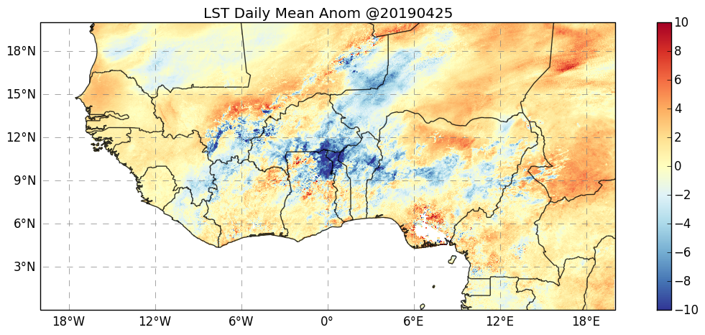
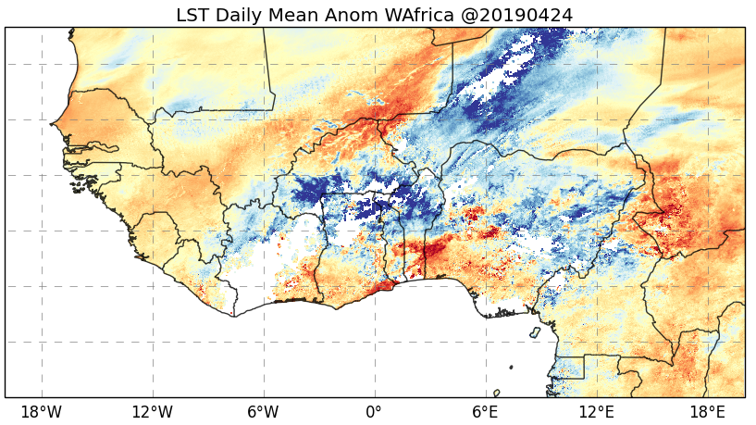
Strong LST gradient
over SE Mali

Slide 6
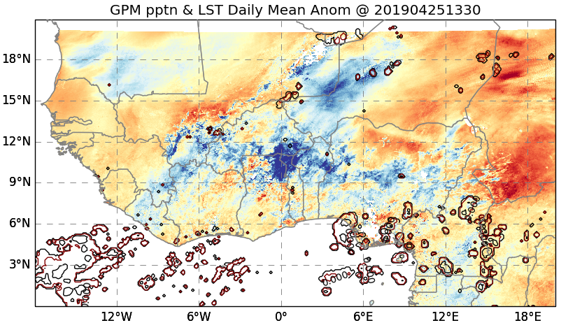
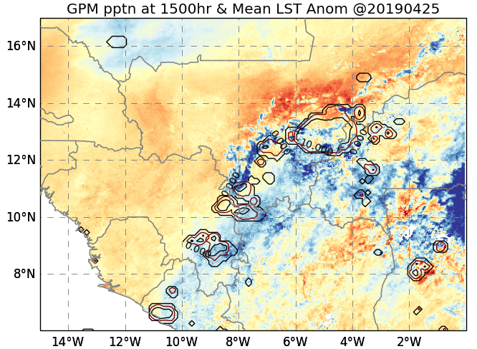
Initiates West and North of Black Volta (Mouhoun) along the NS temperature
gradient line

Slide 7
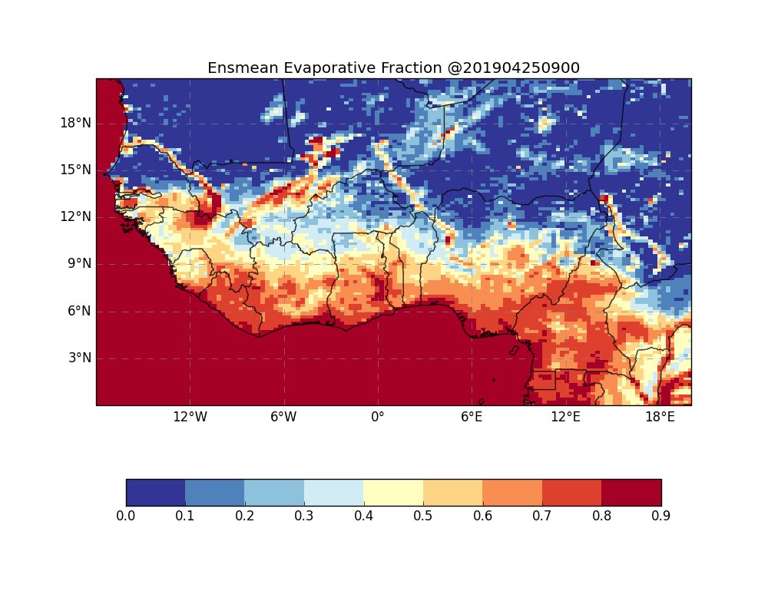
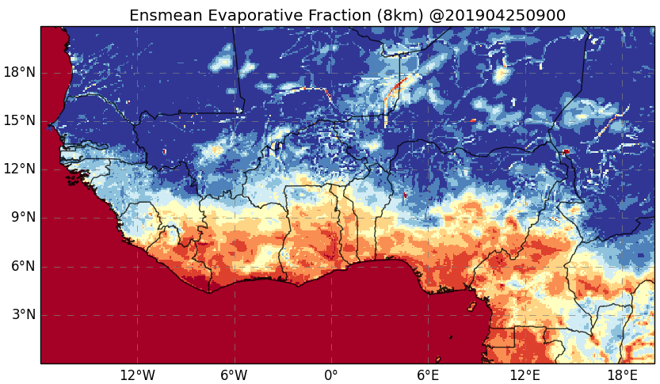
EF = LE/(LE+H)
Both models capture the
main features
How are the rivers and
wetlands represented in
the global model

Slide 8
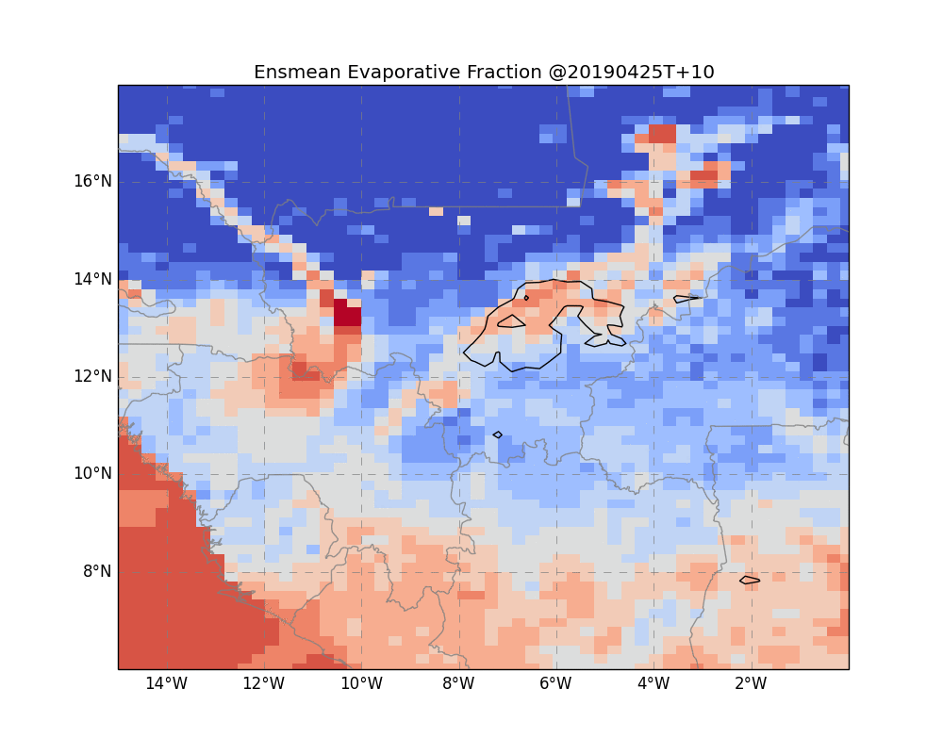
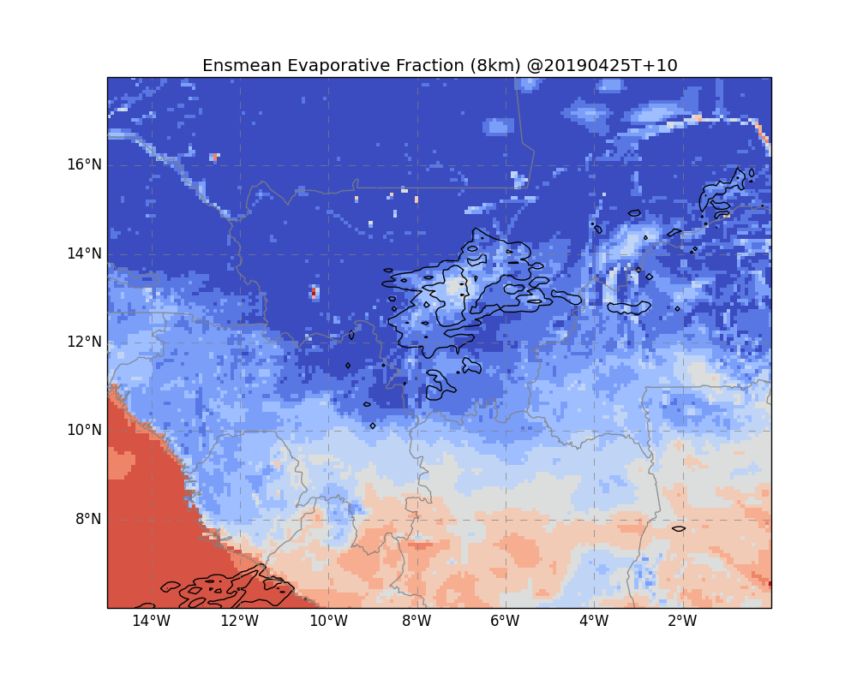
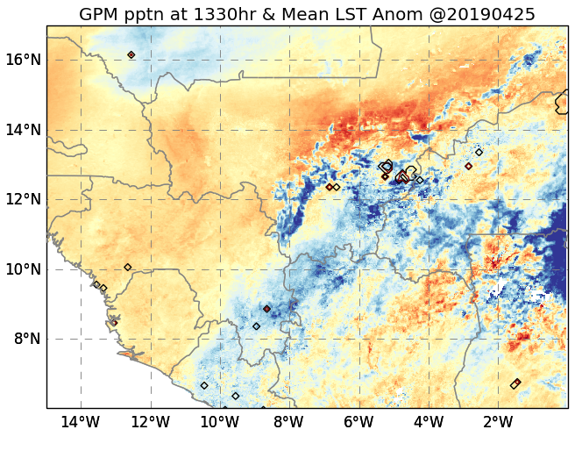
Started raining at 1330 in the GPM data
Develops into a MCS by 1500hr along LST gradient over Southern Mali
Much earlier rain initiation in both
models

Slide 9
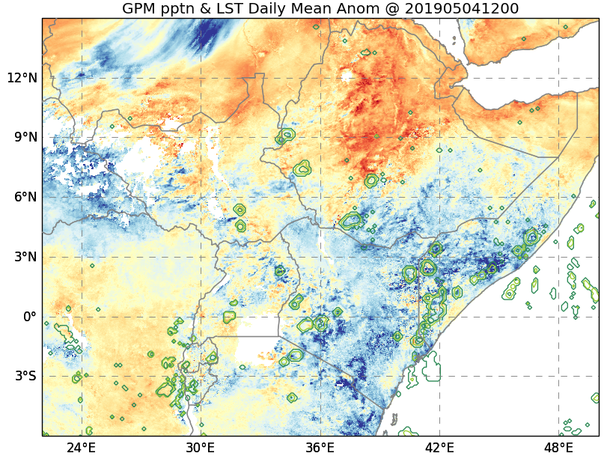
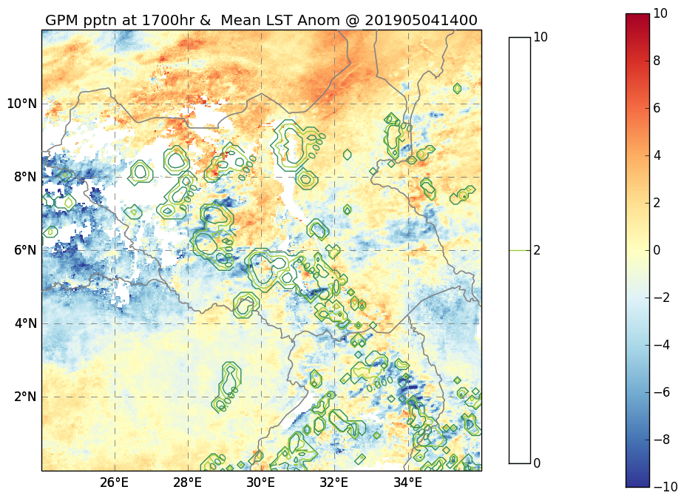
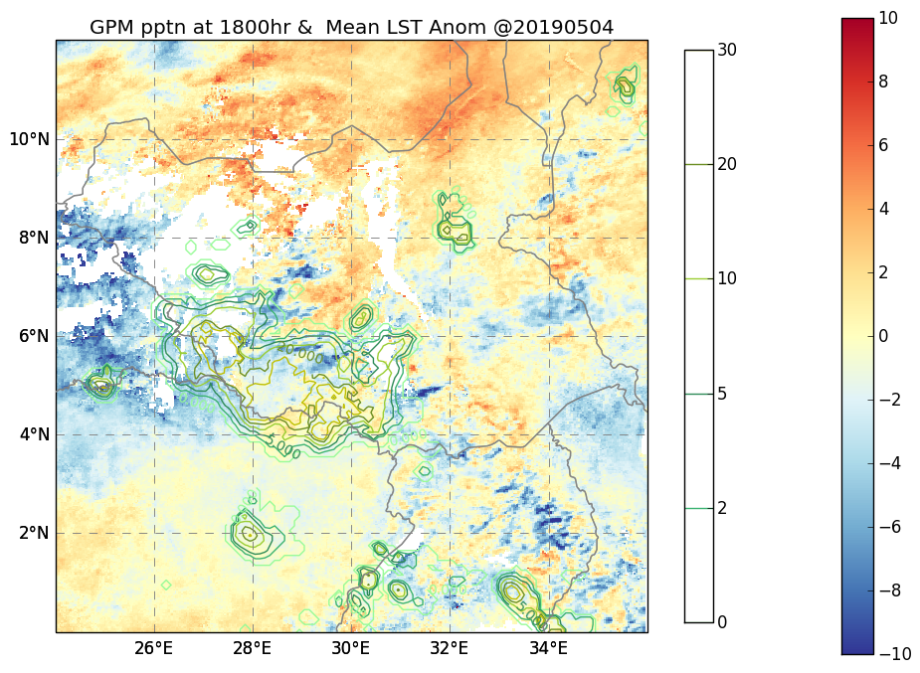
Convective initiation at 1200 hr
Nile and highlands
Gambella National Park Omo River system
Developed into MCS
by 1400 hr
Some of the systems dies by
1800hr while others develop
into MCS and spread across
the Sudan – Congo border
Lake Abaya, Lake Chew Bahir
and Lake Chamo and river systems

Slide 10
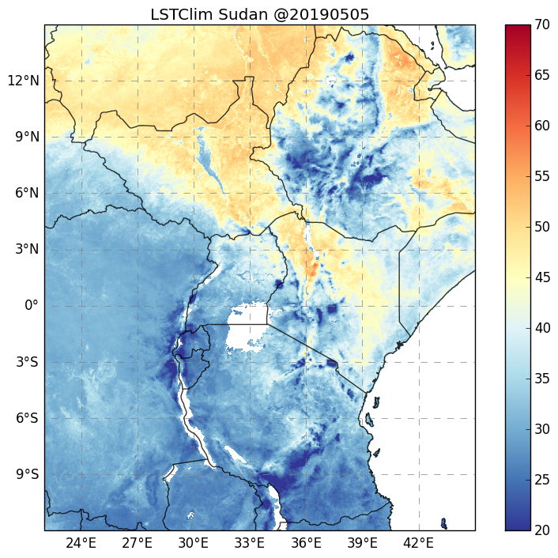
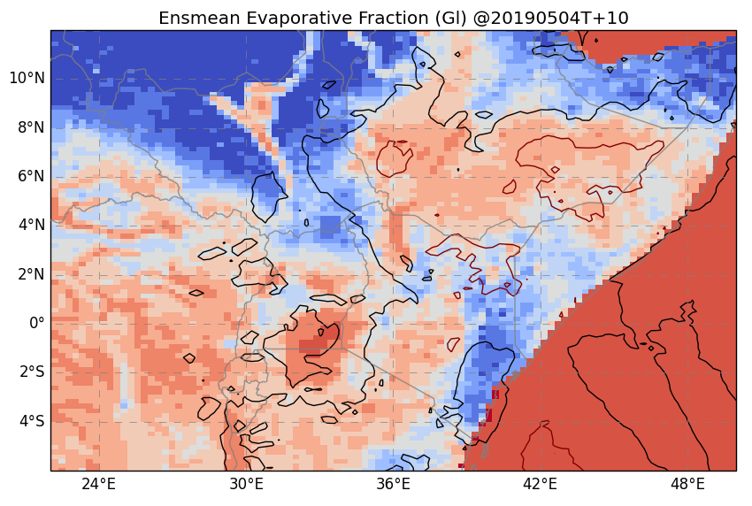
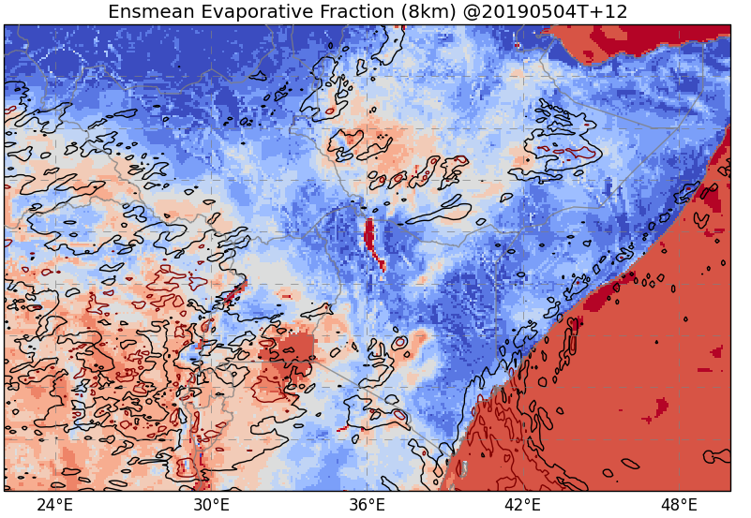
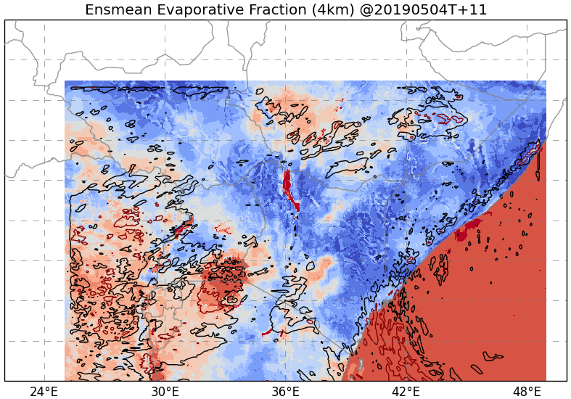
Wet lands resolved
too much in the
Global model

Slide 11
DISCUSSION:
Suggestion of SM influence in Mali and Kenyan storm initiation
How SM is represented in the models…
Rivers/wetlands in global model problem. This might affect ability of model to simulate rain in observed location
Some of transient SM features captured in initial state (ASCAT? Good forecast rain on previous day?)
Fine resolution models are showing similar behaviour in both cases
studied.
More systematic evaluation of the model is needed
This work was supported by UK Research and Innovation as part of the Global Challenges Research Fund, grant number NE/P021077/1.
https://africanswift.org/

