Slide 1
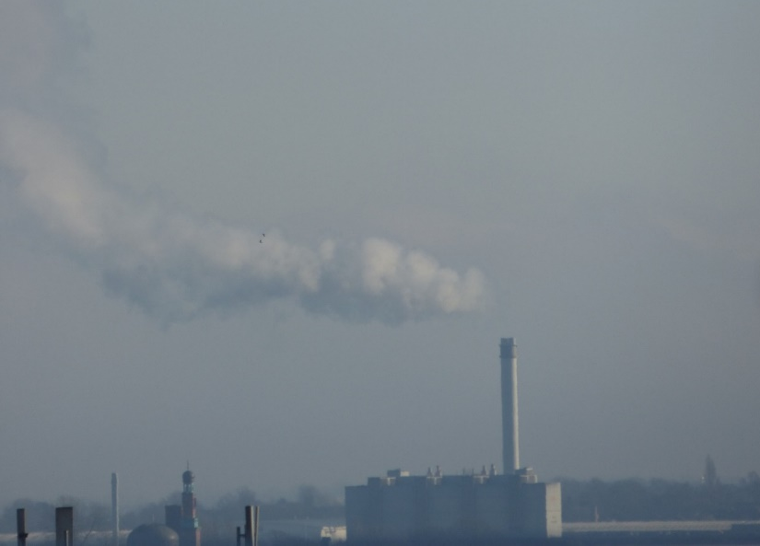
A space-based perspective of trends in air quality in major cities in the UK and India
Karn Vohra^{1*}, Eloise A. Marais², Shannen Suckra^{1,a}, Louisa Kramer^{1,b}, William J. Bloss¹, Ravi Sahu³, Abhishek Gaur³, Sachchida N. Tripathi³, Martin Van Damme⁴, Lieven Clarisse⁴, Pierre F. Coheur⁴
¹University of Birmingham, Birmingham, UK
²University of Leicester, Leicester, UK
³Indian Institute of Technology Kanpur, Kanpur, India
⁴Université libre de Bruxelles, Brussels, Belgium
ªNow at: National Environment & Planning Agency, Kingston, Jamaica
^{b}Now at: Ricardo Energy & Environment, Harwell, UK
* kxv745@bham.ac.uk
Check out the website for more information
http://maraisresearchgroup.co.uk

Slide 2
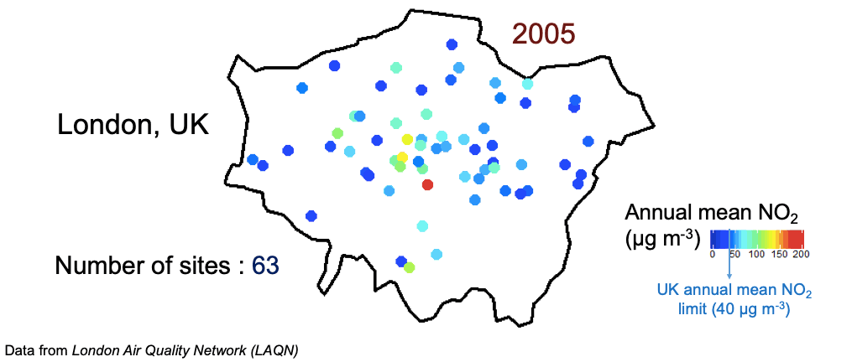
Surface monitoring networks have their limitations
Expensive to set up and maintain
Limited spatial and temporal coverage
Limited pollutants monitored
Issues with data quality
Inconsistent (sites come and go over time like in animation below)

Slide 3
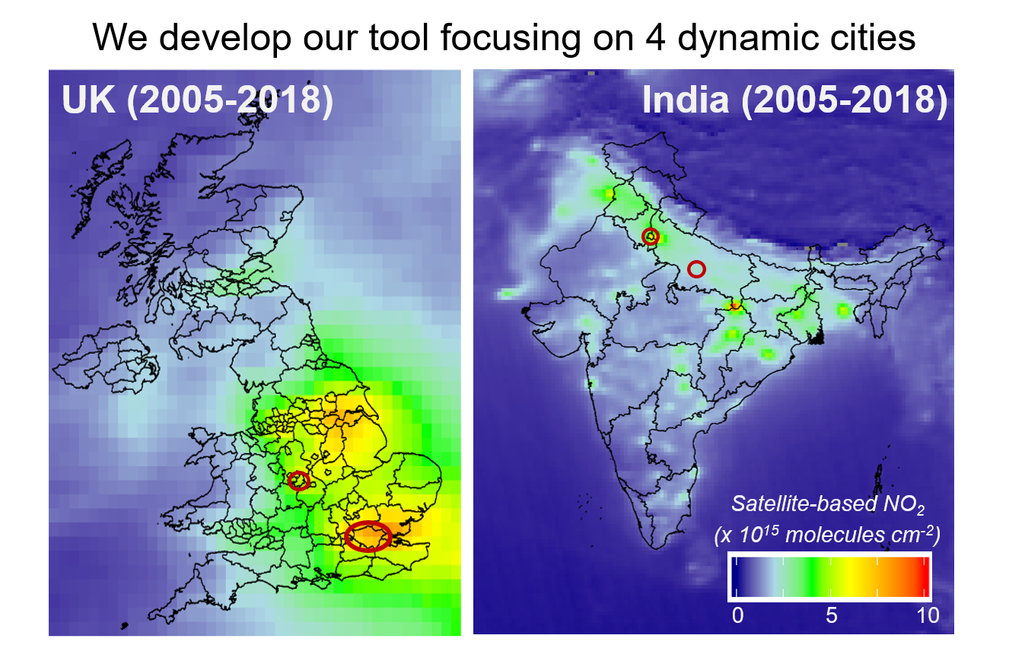
Space-based instruments provide extensive data coverage
Delhi
Kanpur
Birmingham
London
* Maps on different scales

Slide 4
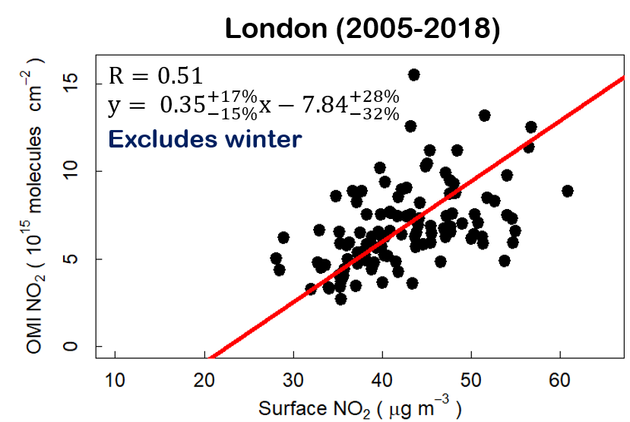
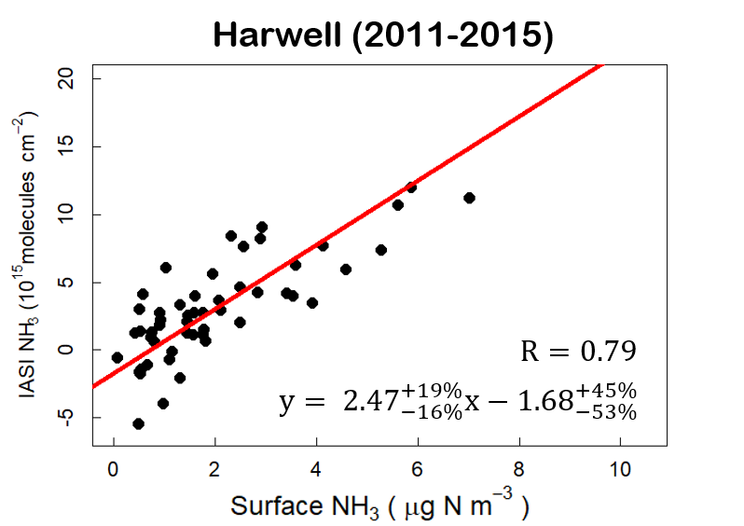
We conduct careful assessment with surface monitors (where available)
Satellite versus surface NO₂ in London
Satellite versus surface NH₃ in Harwell
Points are monthly averages.
Pearson’s correlation coefficient (R-value) indicates consistency
[ Vohra et al., submitted, ACP ]

Slide 5
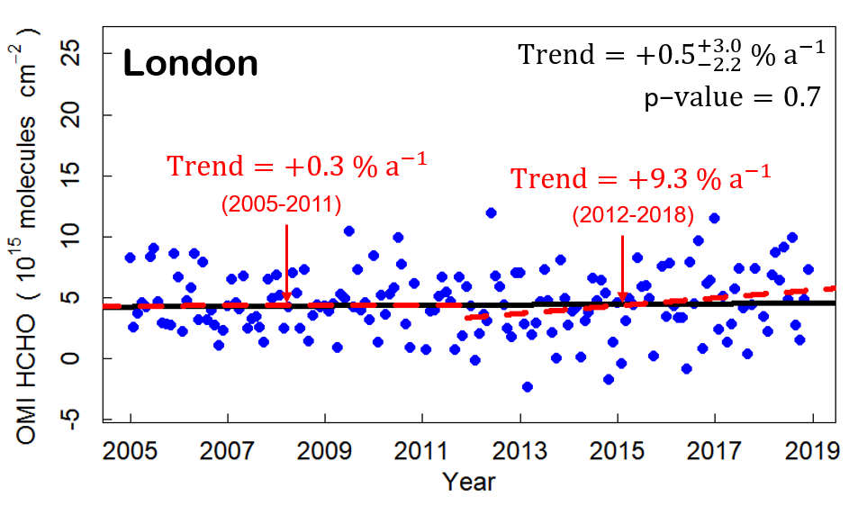
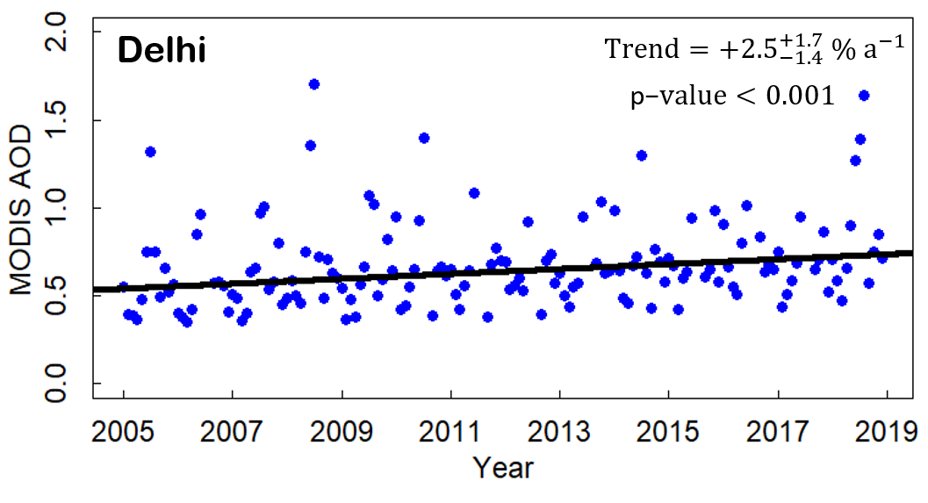
And apply trend analysis to long-term record of satellite observations
Trend in London NMVOCs
Trend in Delhi PM_{2.5}
Reactive NMVOCs have increased by over 65 % in London since 2012
while PM_{2.5} has increased by 35 % in Delhi from 2005 to 2018
[ Vohra et al., submitted, ACP ]

Slide 6
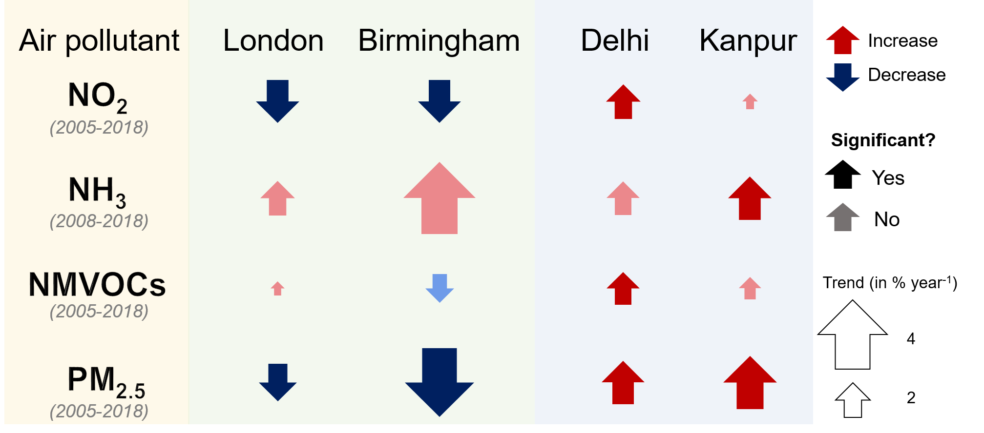
Long-term trends in pollutants
Unregulated NH₃ increases in all four target cities
Concentrations of all other pollutants increase in Delhi & Kanpur
NO₂ and PM_{2.5} decline in London & Birmingham due to successful emission controls
[ Vohra et al., submitted, ACP ]
Any Questions? Contact Karn (kxv745@bham.ac.uk)

