Slide 1
Ecological effects of sudden drainage of large karst lakes in the Lacandon Maya region, southern Mexico
Liseth Pérez and the Selva Lacandona Science Team

Slide 2
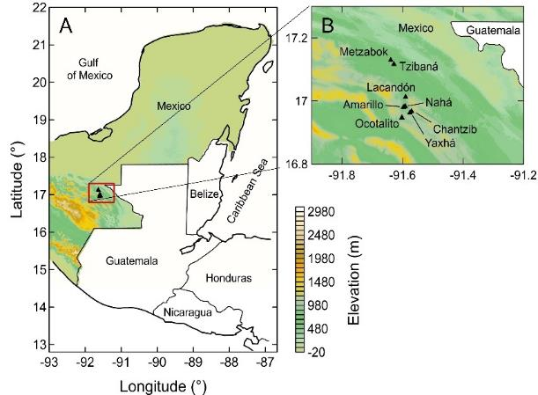
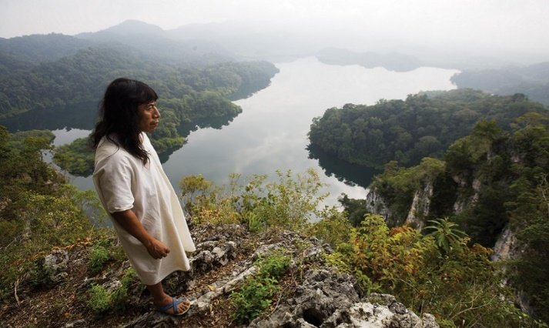
The Lacandon Forest
Located in the karst mountains of southern Mexico
Abundant large and deep lakes
Altitude: 516 m a.s.l.
Rainy and dry season
Remote area
Economy: ecotourism
Lacandones: Maya inhabitants
https://www.travelreport.mx/wp-content/uploads/2019/09/la-selva-Lacandona-el-ed%C3%A9n-chiapaneco.jpg
Notes:
Figure 1. Location map of the study area in the Maya Lacandon Forrest in Chiapas, Mexico. A. Elevation map of south-western Mexico showing the Lacandon Forest (red square). B. Close-up of the mid-elevation lakes studied previously by the project group. Lakes Metzabok and Tzibaná are further north and at lower elevations than the rest of studied lakes.

Slide 3
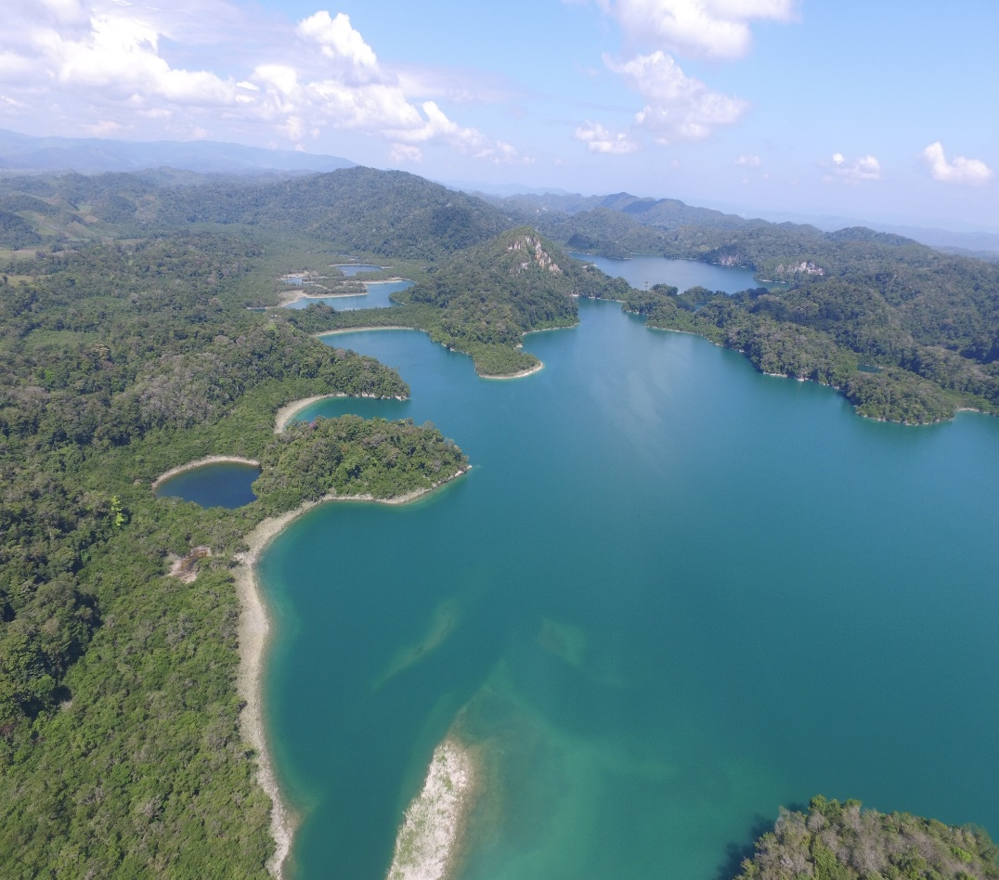
Importance of karst lakes
Good water quality and low trophic status → Remote area
Exceptional natural resources that provide potable water and protein sources for local Maya communities and are of socio-economic importance.
High biological diversity, thus, the Nahá and Metzabok areas were declared Area of Protection for Flora and Fauna (APFF) in September 1988 by the Commission on National Protected Areas (CONANP).
In 2010, the Man and the Biosphere (MAB) Program of UNESCO added it to the World Network of Biosphere Reserves (WNBR).
In 2003, both lakes were placed on the list of Ramsar sites (Wetlands of International Importance).
Drone image: Geotem, 2018

Slide 4
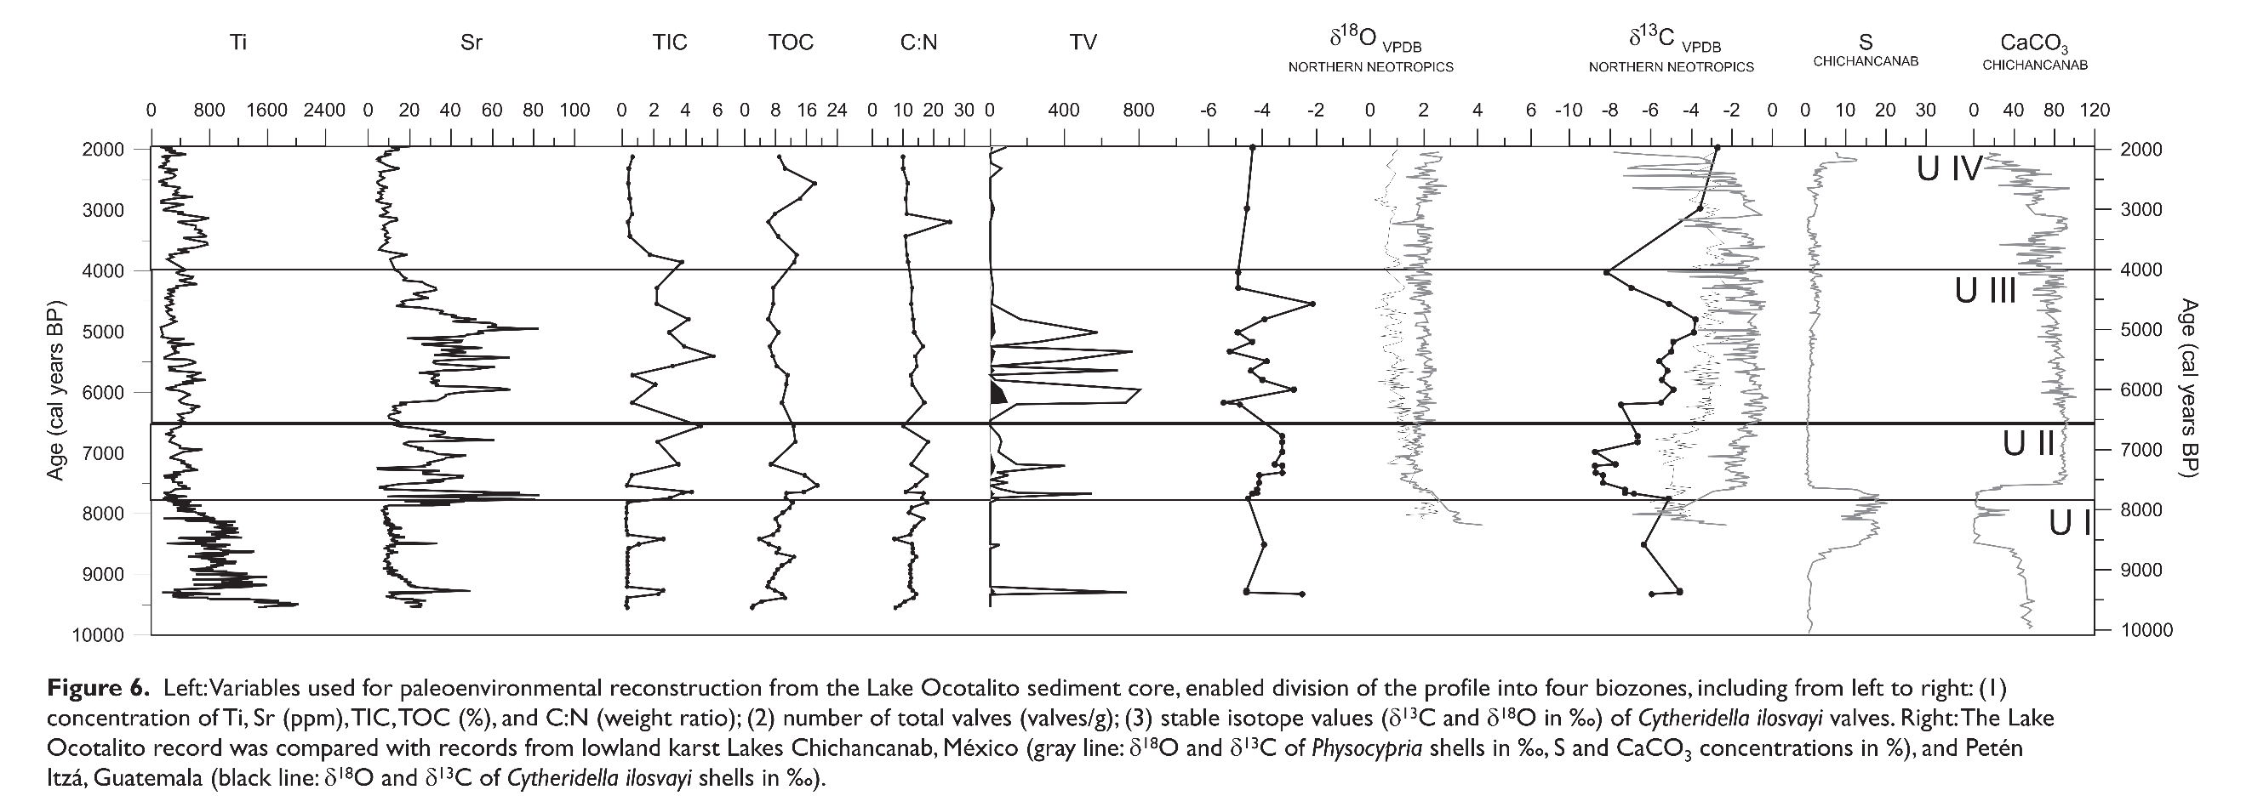
Lake sediments of the Lacandon Forest: great environmental and climate records
→ Studies have analyzed ostracodes, cladocerans, pollen, and geochemical proxies
(Díaz et al. 2017)
Díaz, K.A., Pérez, L., Correa-Metrio, A., Franco-Gaviria, J.F., Echeverría, P., Curtis, J., Brenner, M., 2017. Holocene environmental history of tropical, mid-altitude Lake Ocotalito, México, inferred from ostracodes and non-biological indicators. The Holocene 27, 1308-1317.https://journals.sagepub.com/doi/abs/10.1177/0959683616687384

Slide 5
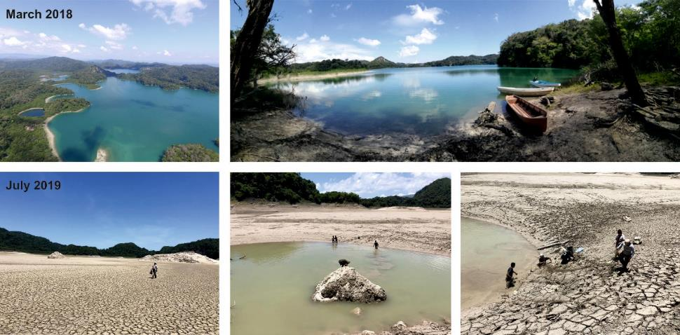
Sudden lake drainage during July 2019
Native Lacandon Maya observed that water levels in the two largest lakes decreased dramatically during a two-week period.
Lake Metzabok (0.83 km²; depth=25 m) dried completely.
Lake Tzibaná (1.24 km²; depth=70 m) water levels dropped by ~30 m.
Aerial images taken with a drone in March 2018 (top panels, drone images: Geotem, Bücker 2018) and sudden desiccation in July 2019 (bottom panels) of Lakes Tzibaná and Metzabok (images: CONANP 2019).

Slide 6
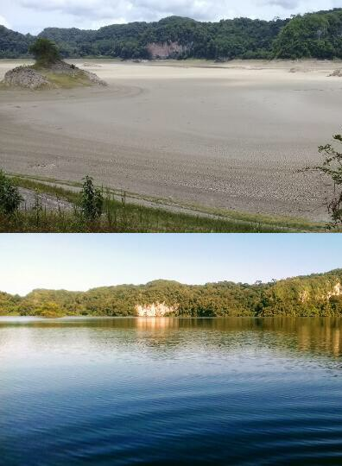
Lake level variability since 2016
Lake Metzabok
Images from CONANP, 2019
Lake Tzibaná
Click to play! → Note that generally lake levels slightly decrease during May-September. A rapid drainage occurred in July 2019.

Slide 7
Scope of the Selva Lacandona Project
The abrupt lake drainage that happened in July 2019 in lakes Metzabok and Tzibaná provides a unique opportunity to evaluate the hydrological and ecological effects of such a sudden event.
The overall goal is to understand the dynamics of this karst system, the causes and effects of seasonal lake level changes as well as the recurrence rates of such dramatic drainage events during the Holocene.

Slide 8
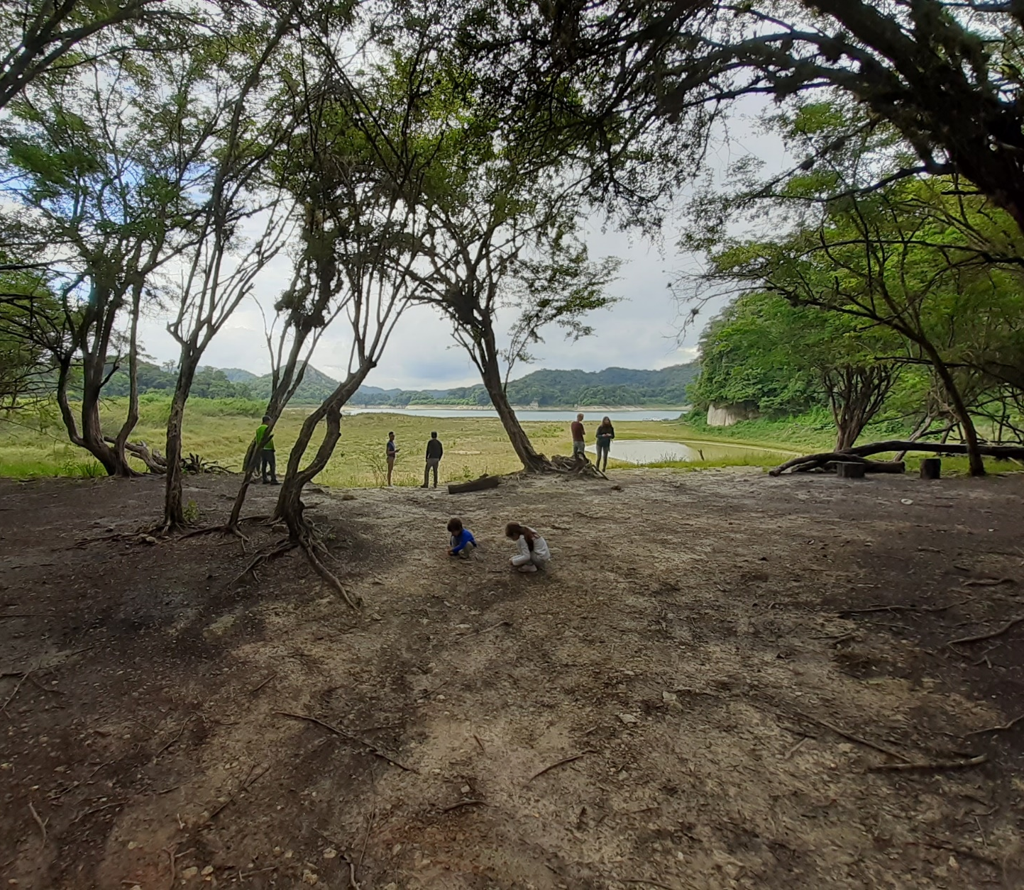
Objective and scientific questions
Assess the effects of the sudden lake drainage on the aquatic communities as well as on the surrounding terrestrial communities.
Which aquatic organisms and vegetation taxa are most tolerant/ sensitive to lake drainage?
How strong was the ecological change during the present drainage event?
Image: L. Pérez, 2019

Slide 9
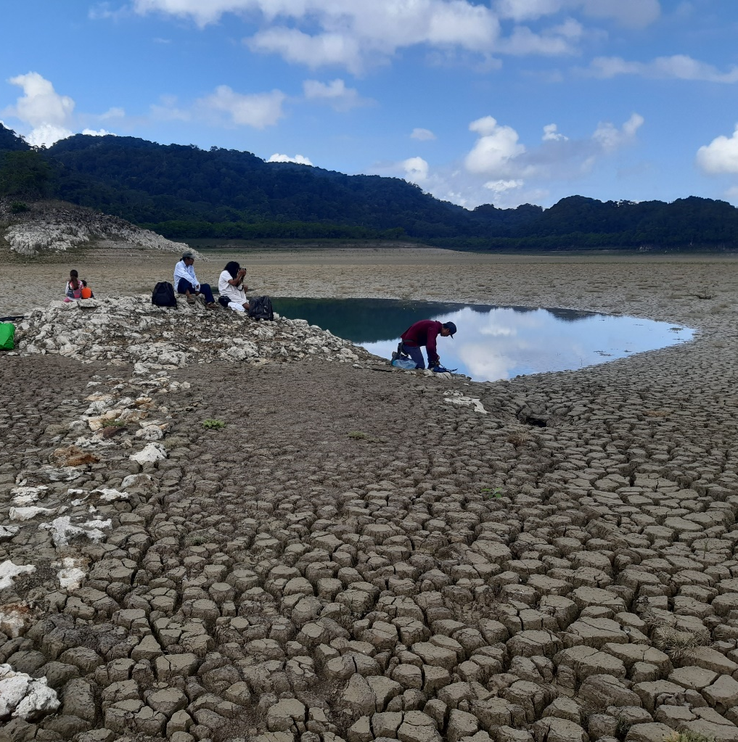
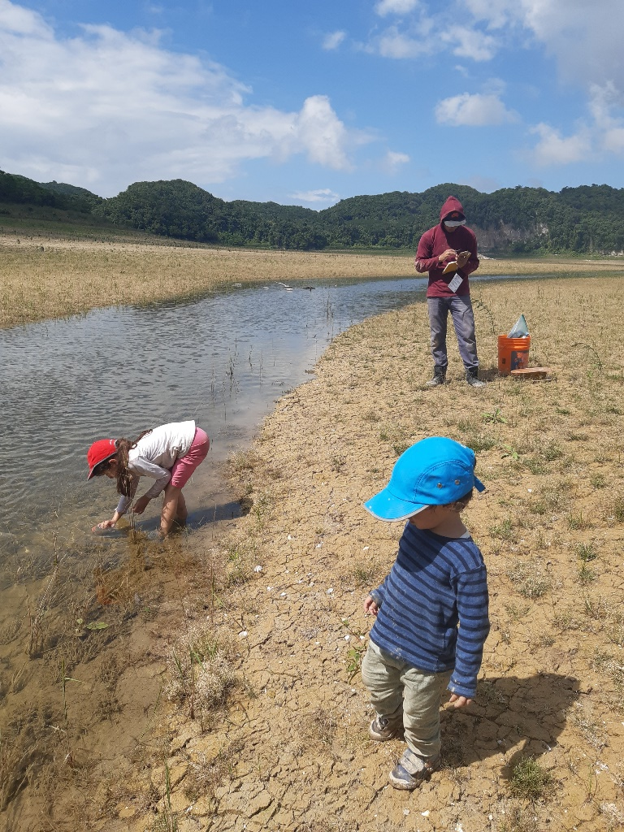
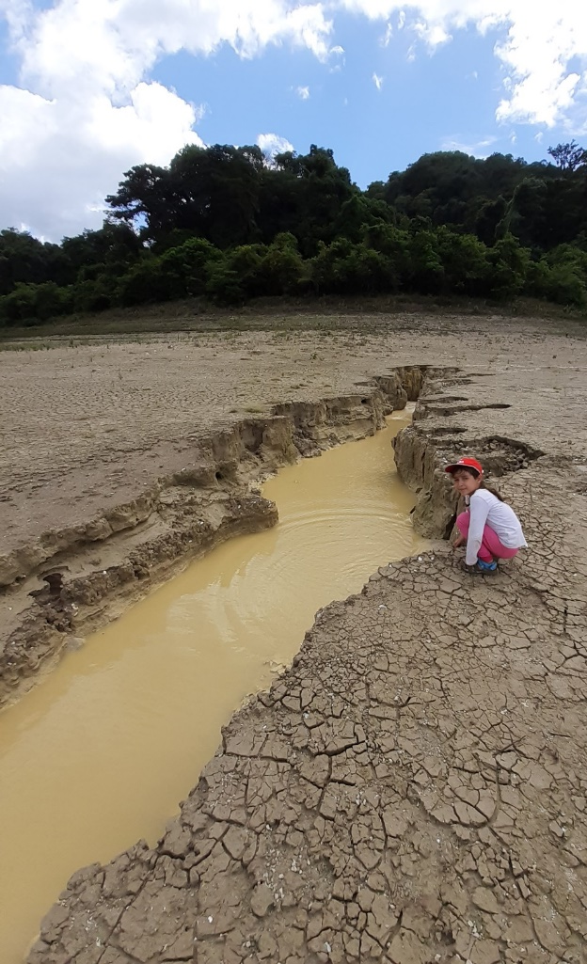
Methods
In situ water column measurements (temperature, pH, conductivity, etc.) │ Water chemistry (anions, cations, stable isotopes) │ Collection of phyto- and zooplankton samples in remnant waters
Images: L. Pérez, 2019

Slide 10
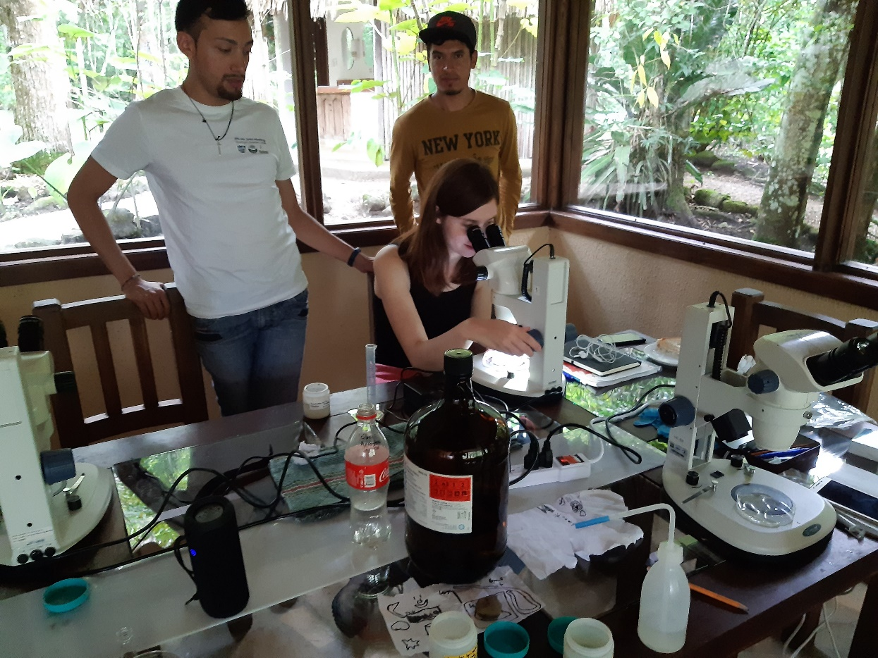
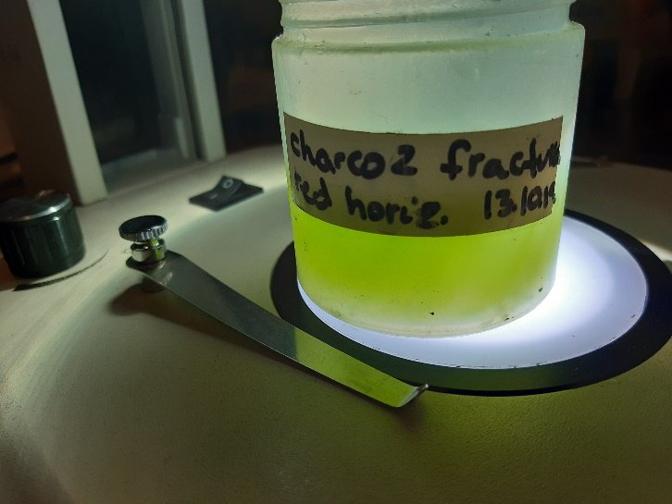
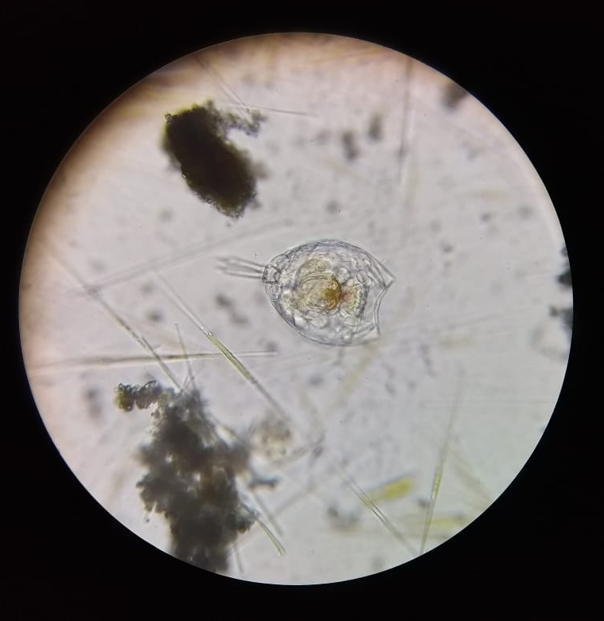
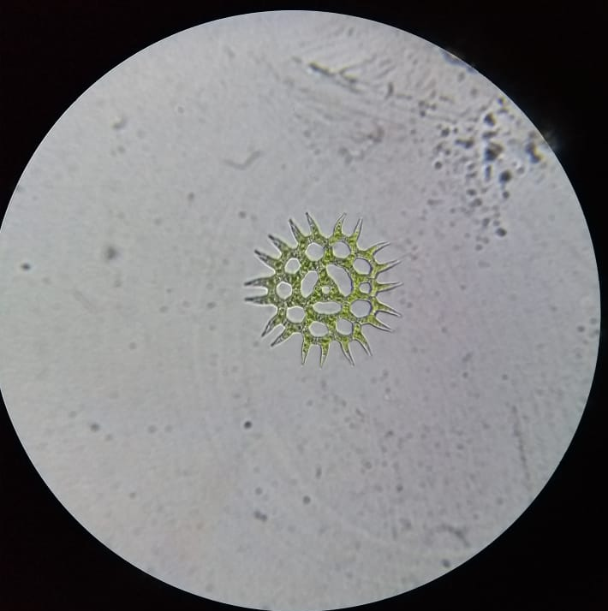
Methods
Analysis of living organisms (identification and counts)
Images: M. Bonilla, 2019

Slide 11
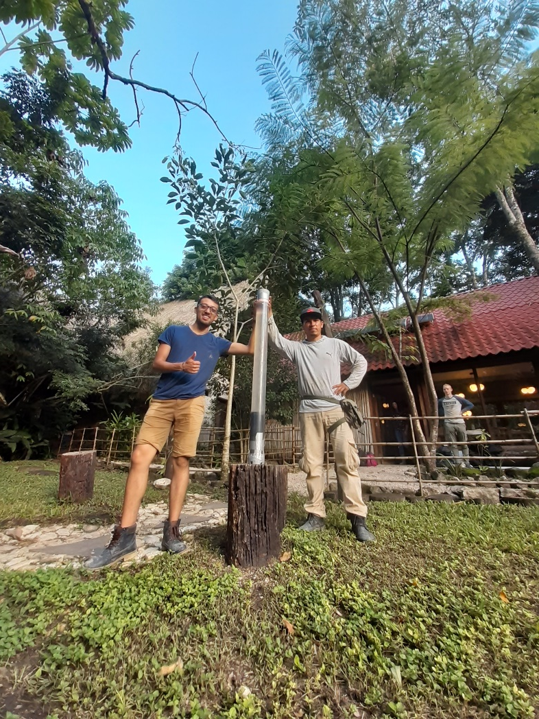
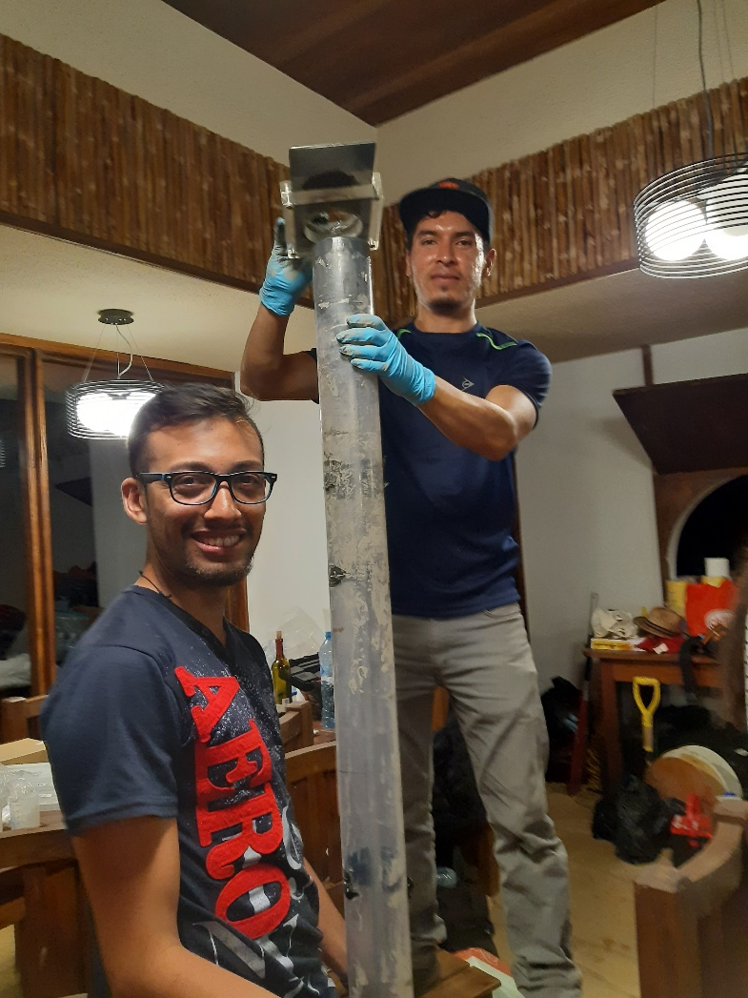
Methods
Sampling of exposed lake sediment profiles │ Collection of surface and short sediment cores from remnant water bodies to assess whether evidence of such drainage events is preserved in lake sediments
Images: L. Pérez, 2019

Slide 12
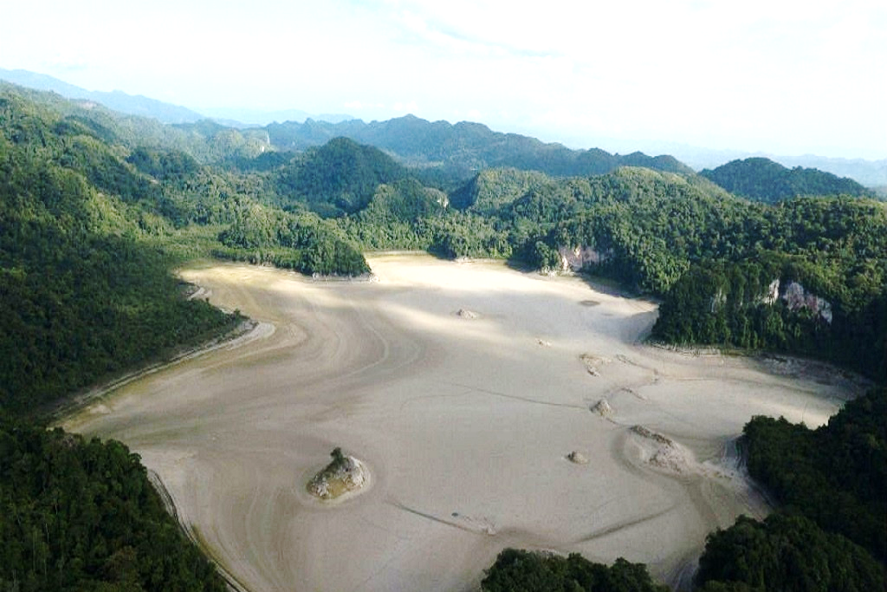
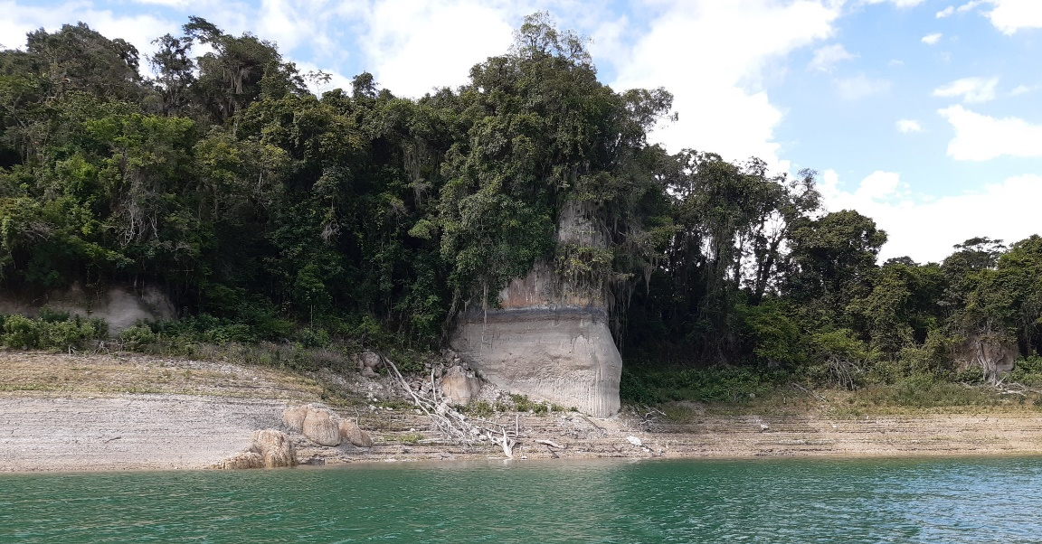
Results: Hydrology
Reduction in surface area: ~0.39 km²
Water volume loss of ~11.7 million m³
Image: L. Pérez, 2019
Image: http://xeva.com.mx/nota.cfm?id=96623&t=laguna-de-metzabok-en-la-selva-lacandona-recupera-su-cauce-tras-sequia

Slide 13
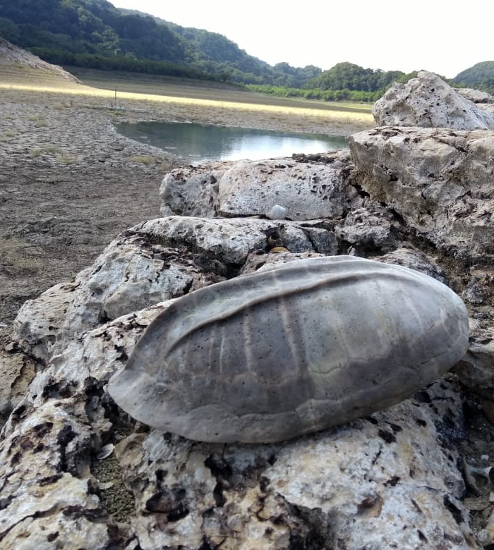
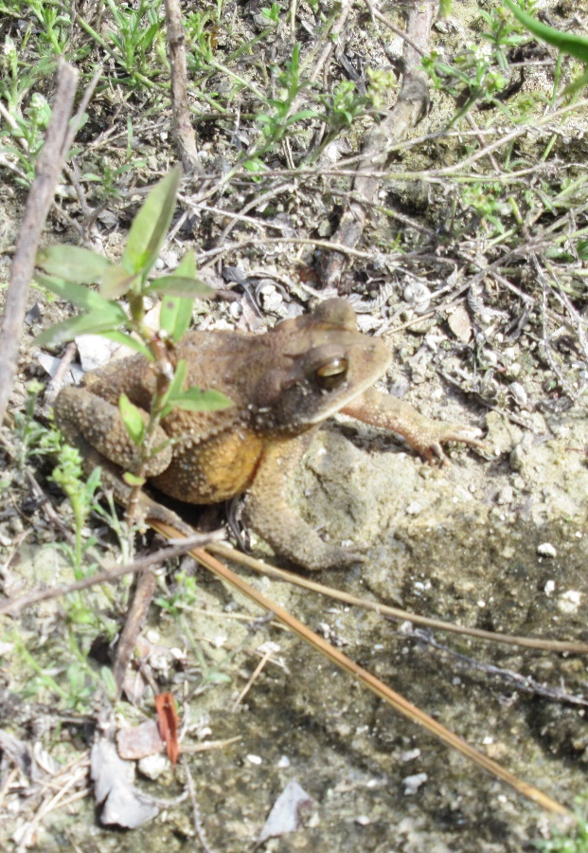
Results: Ecology
Sudden drainage had profound ecological and environmental effects→ Biodiversity loss
Reptiles and amphibians suffered from dramatic lake drainage
Image: CONANP, 2019
Image: M. Bonilla, 2019
Crocodylus moreletii
Incilius valliceps
Image: T. Lauke, 2019
Several crocodiles, turtles were rescued by the CONANP and Lacandones

Slide 14
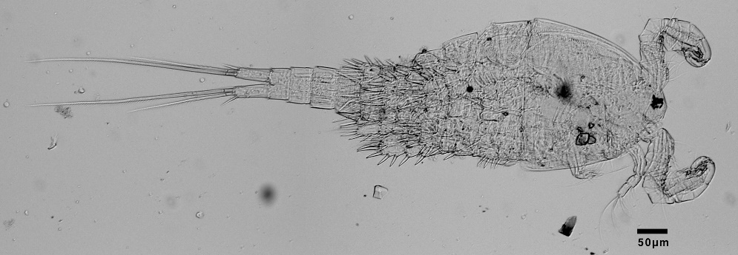
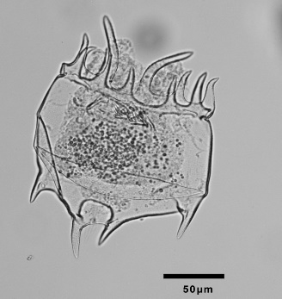
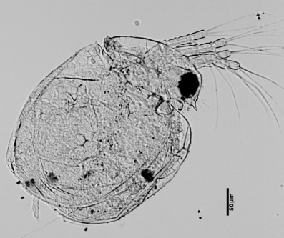
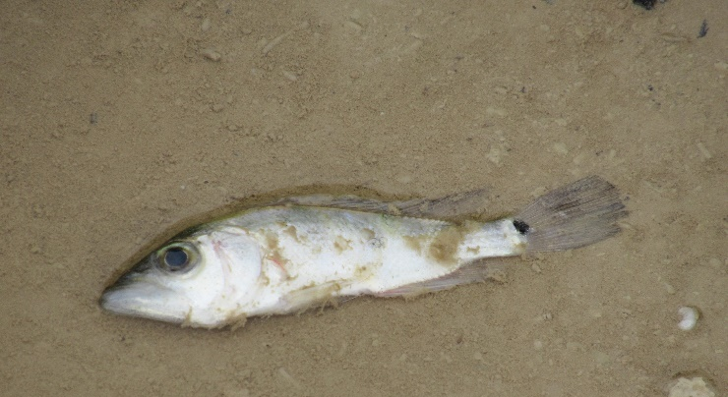
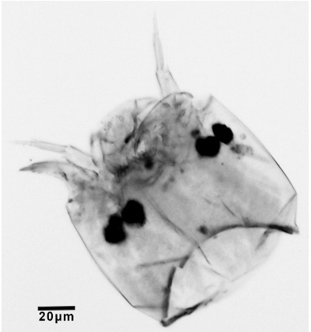
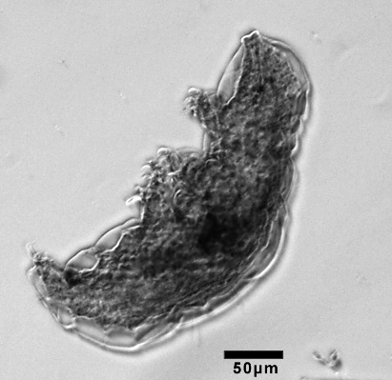
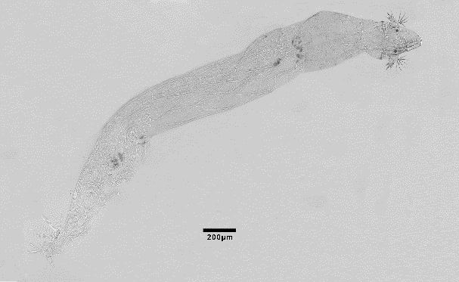
Ecological effects on freshwater communities
Fish communities declined
Plankton and microinvertebrate communities increase
Copepoda
Rotifera
Cladocera
Resultados de ahora…en barras? Pie?
https://noticieros.televisa.com/ultimas-noticias/laguna-metzabok-retoma-su-cauce-tras-sequia/
Chironomidae
Tardrigrada
Chaoboridae
Ostracoda
Image: T. Lauke, 2019
Images: M. Bonilla, 2019

Slide 15
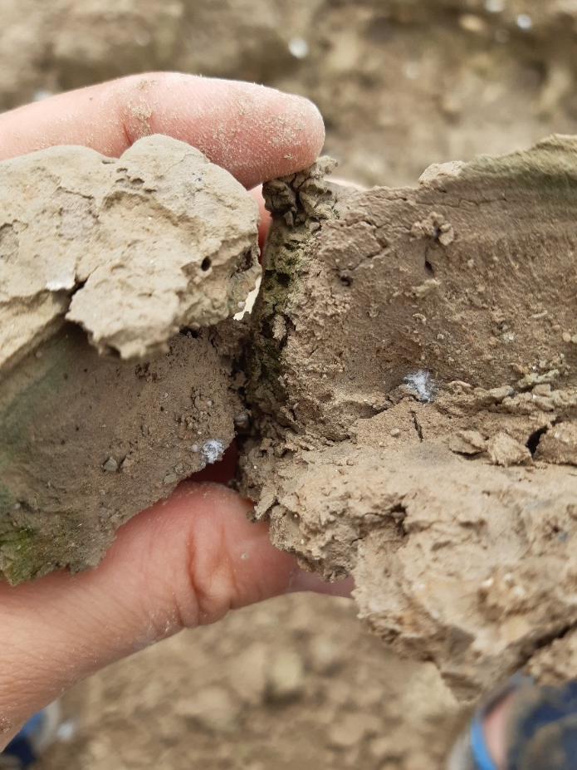
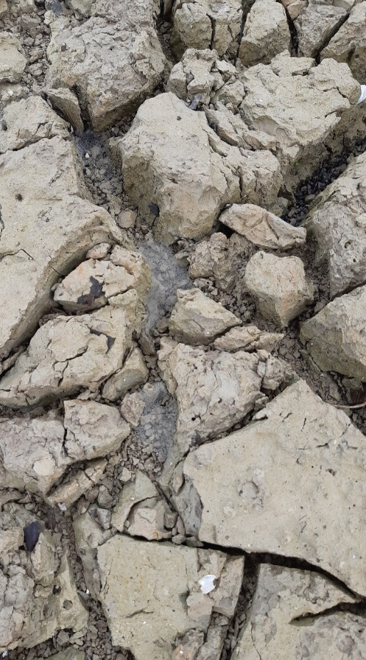
Commencing transition to a terrestrial habitat
First plants colonizing: Poaceae, Amarantaceae and Fabaceae
Abundant spiders and beetles from different species colonized cracks in the dry sediment
Images: L. Pérez, 2019

Slide 16
How are rapid lake drainages (lake level decreases) archived in lake sediments in the Lacandon Forest?

Slide 17
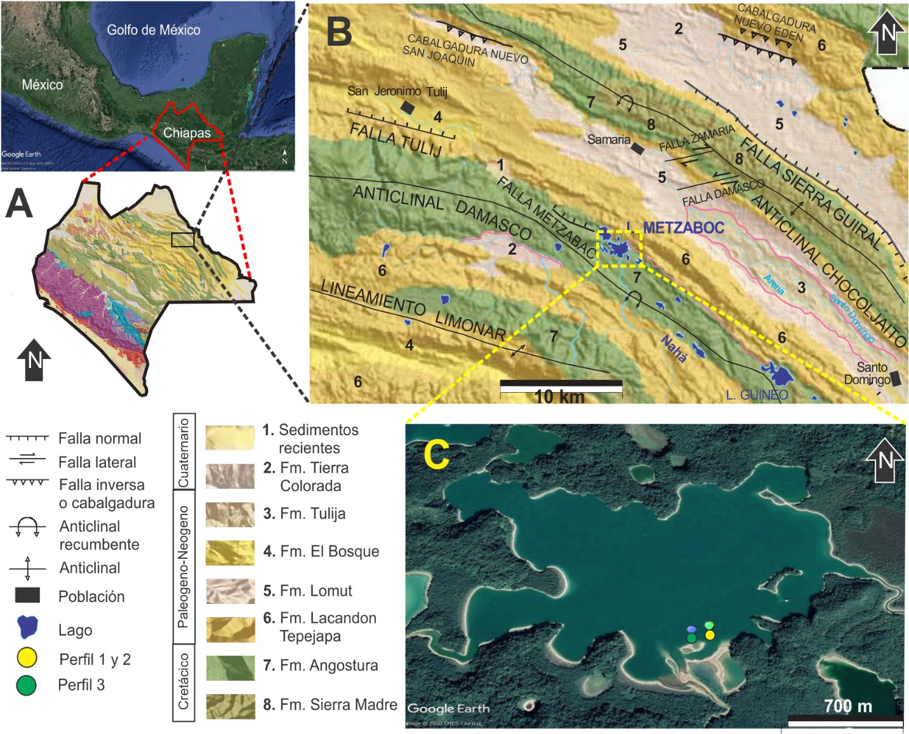
Results: Stratigraphy and facies analysis of exposed lake sediment profiles in Lake Tzibaná
Past abrupt lake level decreases?
(Martínez et al. in prep.)

Slide 18
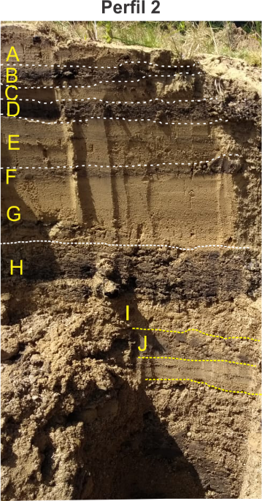
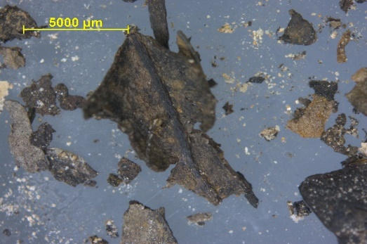
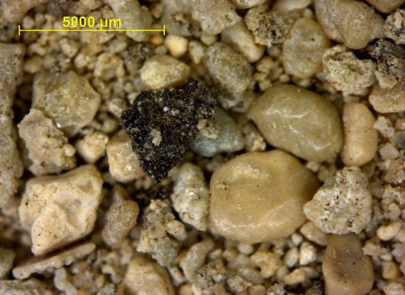
Lake Tzibaná: exposed lake sediment profile 2
Facies:
Massive clayey silts
High lake levels
Black leaf litter
Low lake levels
Laminated fine sand
Transition
Massive coarse sands
Sandbanks
(Martínez et al. in prep.)

Slide 19
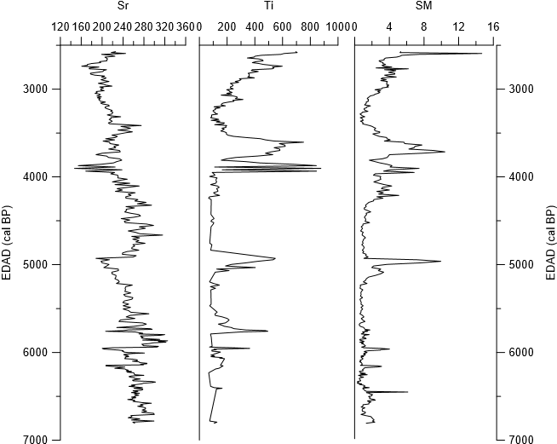
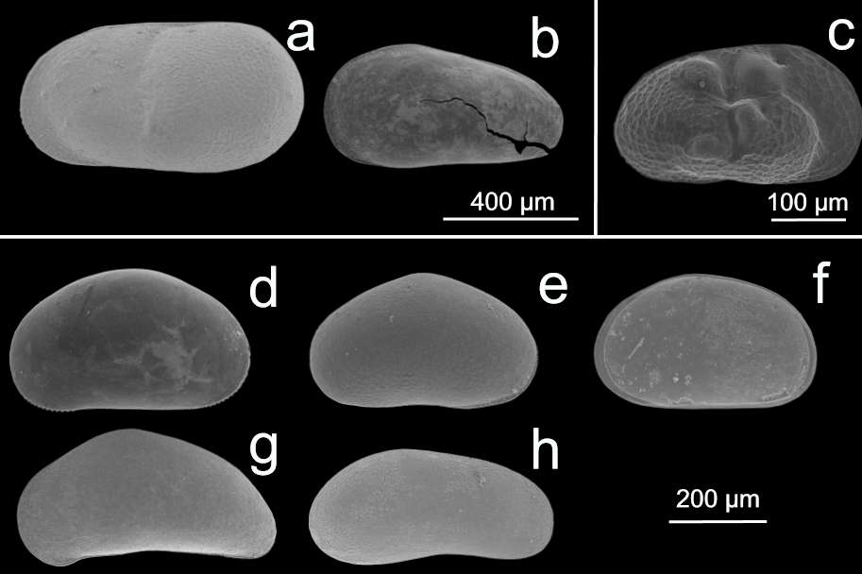
The Lake Tzibaná record: Geochemical and biological evidences of previous abrupt lake level decreases (similar past lake drainages?)
Water depth
(Cisneros et al. in prep.)
(ppm)
(ppm)
(SI)
DCA axis 2 (SD)
based on fossil ostracode abundances

Slide 20
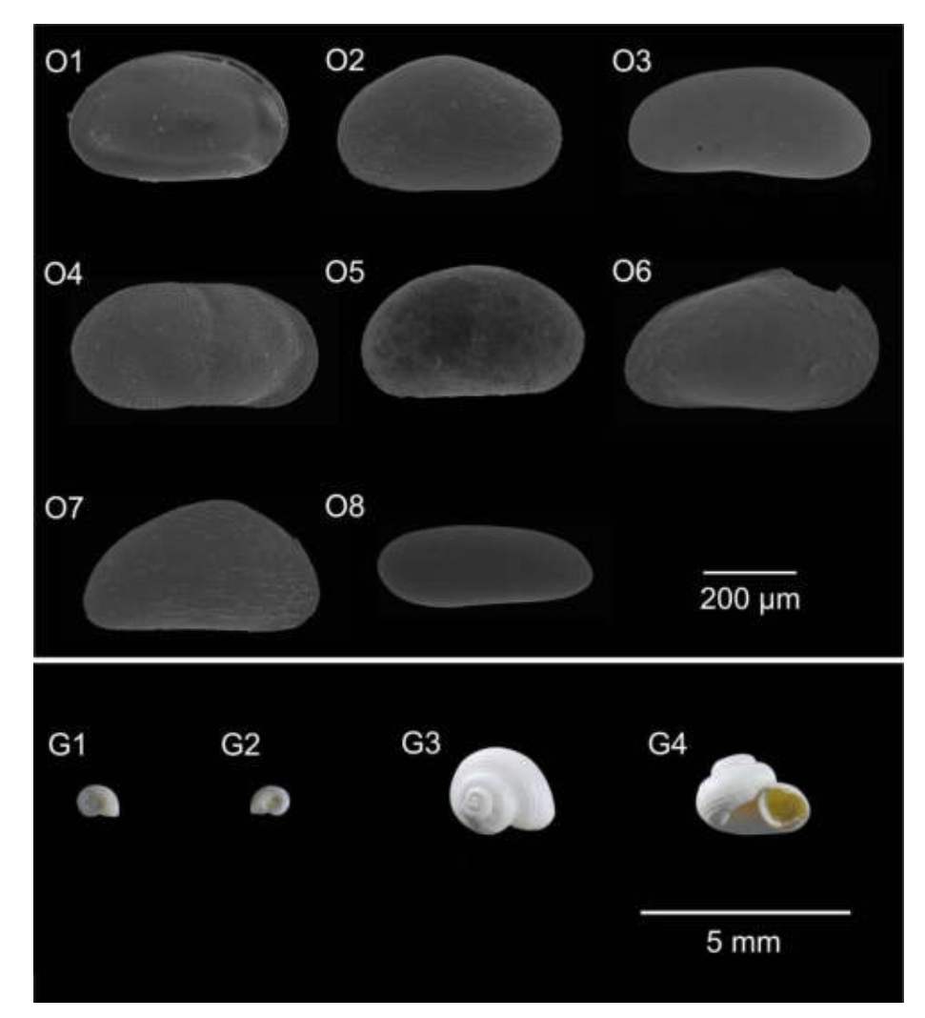
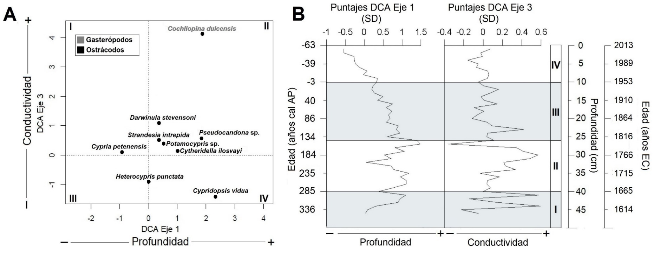
The Lake-Metzabok record: Geochemical and biological evidences of previous abrupt lake level decreases (similar past lake drainages?)
DCA axis 1 and 3 (SD)
based on fossil ostracode abundances
Conductivity
Age (years BP)
Age (years CE)
Water depth
Water depth
Conductivity
(Rubio et al. in prep.)
See Poster: D1085 |EGU2020-10897 | A 500-year record of paleoclimate and paleoenvironment from the Lacandon Forest, southern Mexico |
Rubio et al.

Slide 21
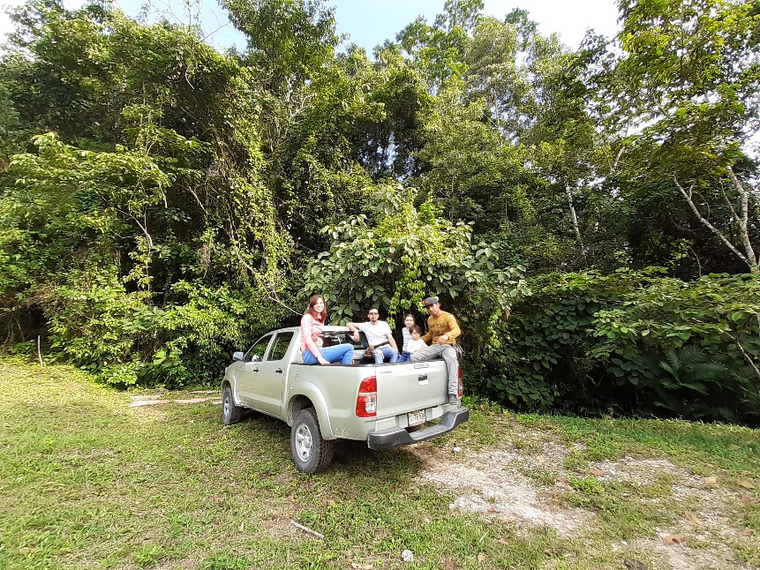
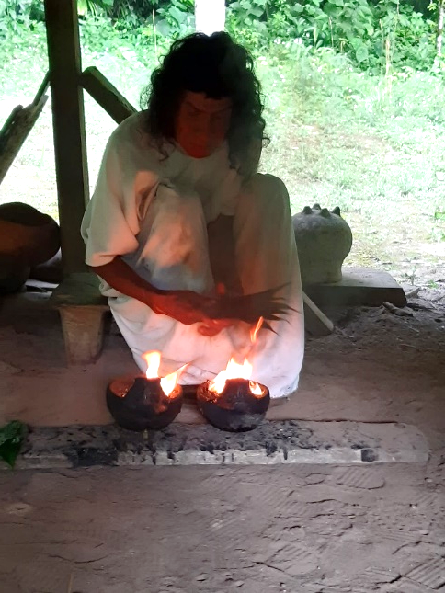
Conclusions
The karst system of the Lacandon Forest is highly dynamic.
Sudden lake drainage during July 2019 had profound ecological effects.
Fast re-colonization of terrestrial and freshwater species.
Similar events ocurred during the Holocene.
Local stakeholders, government agencies and environmental NGOs should consider the special characteristics of water bodies in karst areas when selecting potential areas for conservation, especially under a scenario of future climate warming.
Images: L. Pérez, 2019

Slide 22
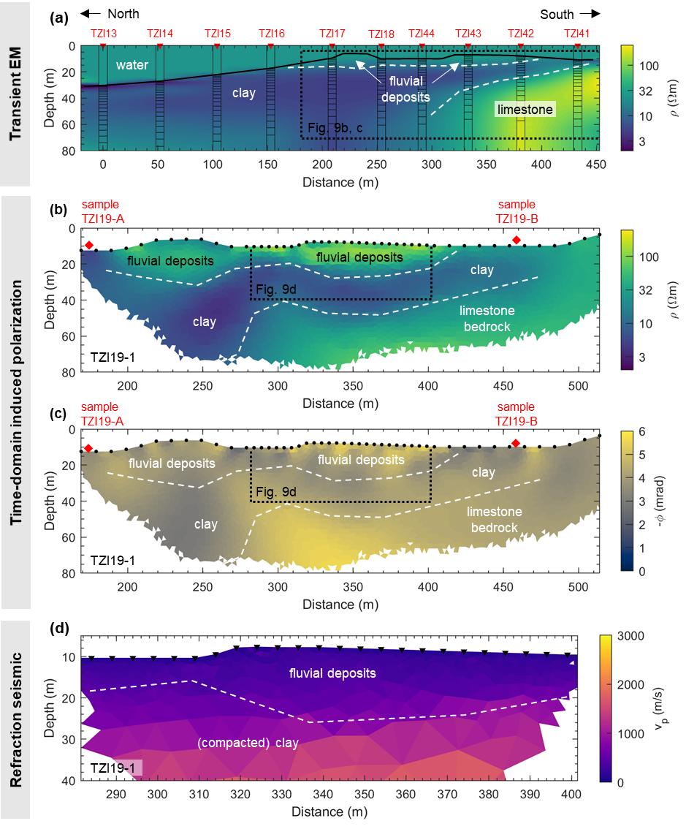
Future work
We continue to analyze surface sediments (short cores) collected right after the drainage event (age model, XRF, stable isotopes, microfossils).
Until now we were able to recover a 4 m sedimentary sequence from Lake Tzibaná.
Geophysical studies in 2018 and 2019 revealed a ca. 50 m lake sediment thickness.
Longer sediment cores will be retrieved in a future project.
(Bücker et al. in prep.)
See Poster: EGU2020-11031| SM4.2 |Water- and land-borne geophysical measurements before and after the sudden drainage of large karst lakes in southern Mexico | Bücker et al.

Slide 23
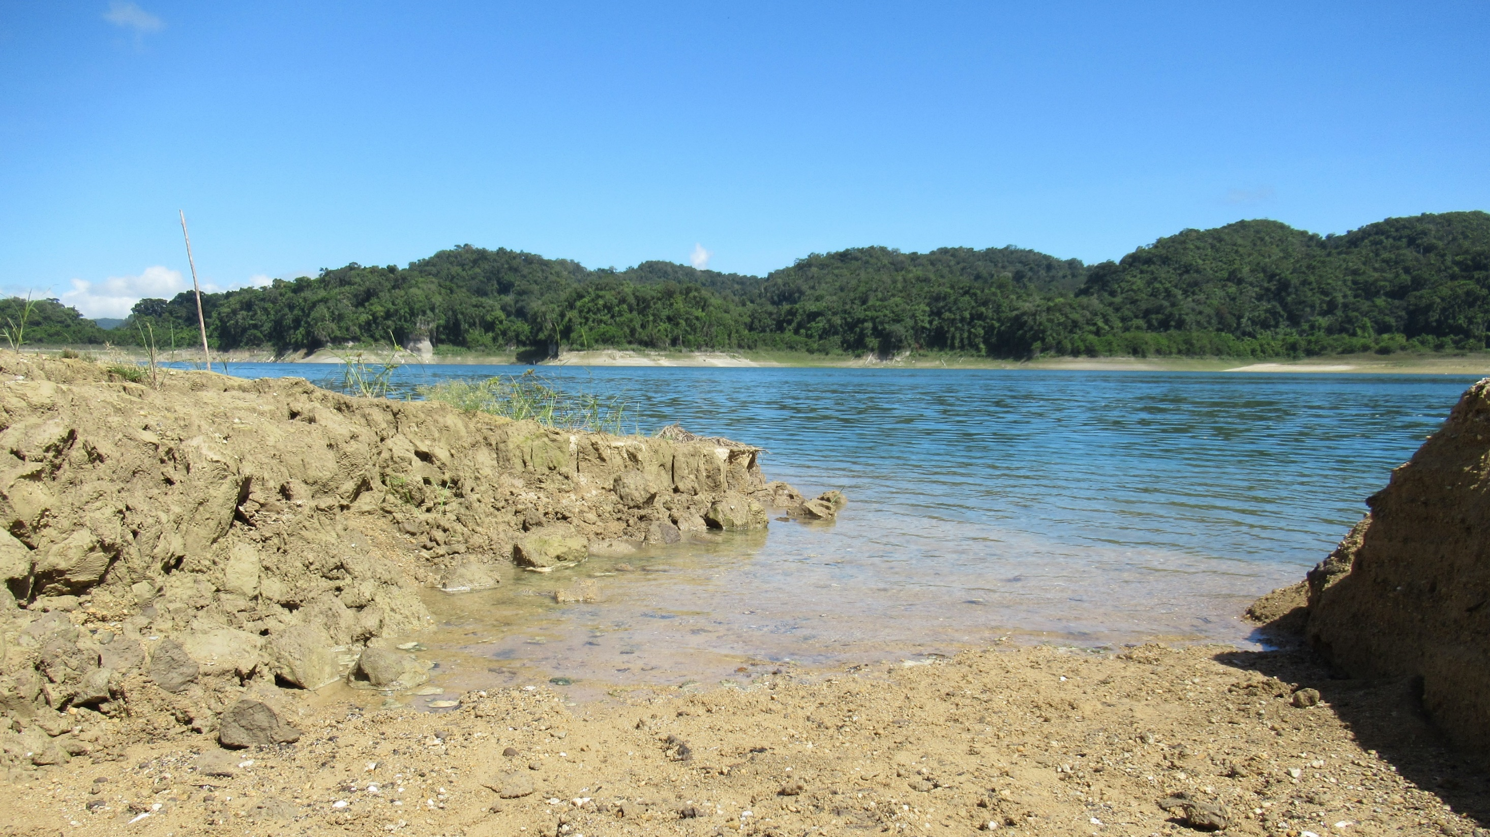
The cause and effects of this recent lake level lowering event will be revealed by interdisciplinary studies of the limnology, paleolimnology, structural geology, geophysics, hydrology, geochemistry, genomics and geodesy of lakes and rivers in the region, as well as traditional environmental knowledge of the Lacandon Maya.
Image: T. Lauke, 2019

Slide 24
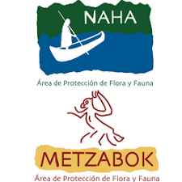
Acknowlegements

Slide 25
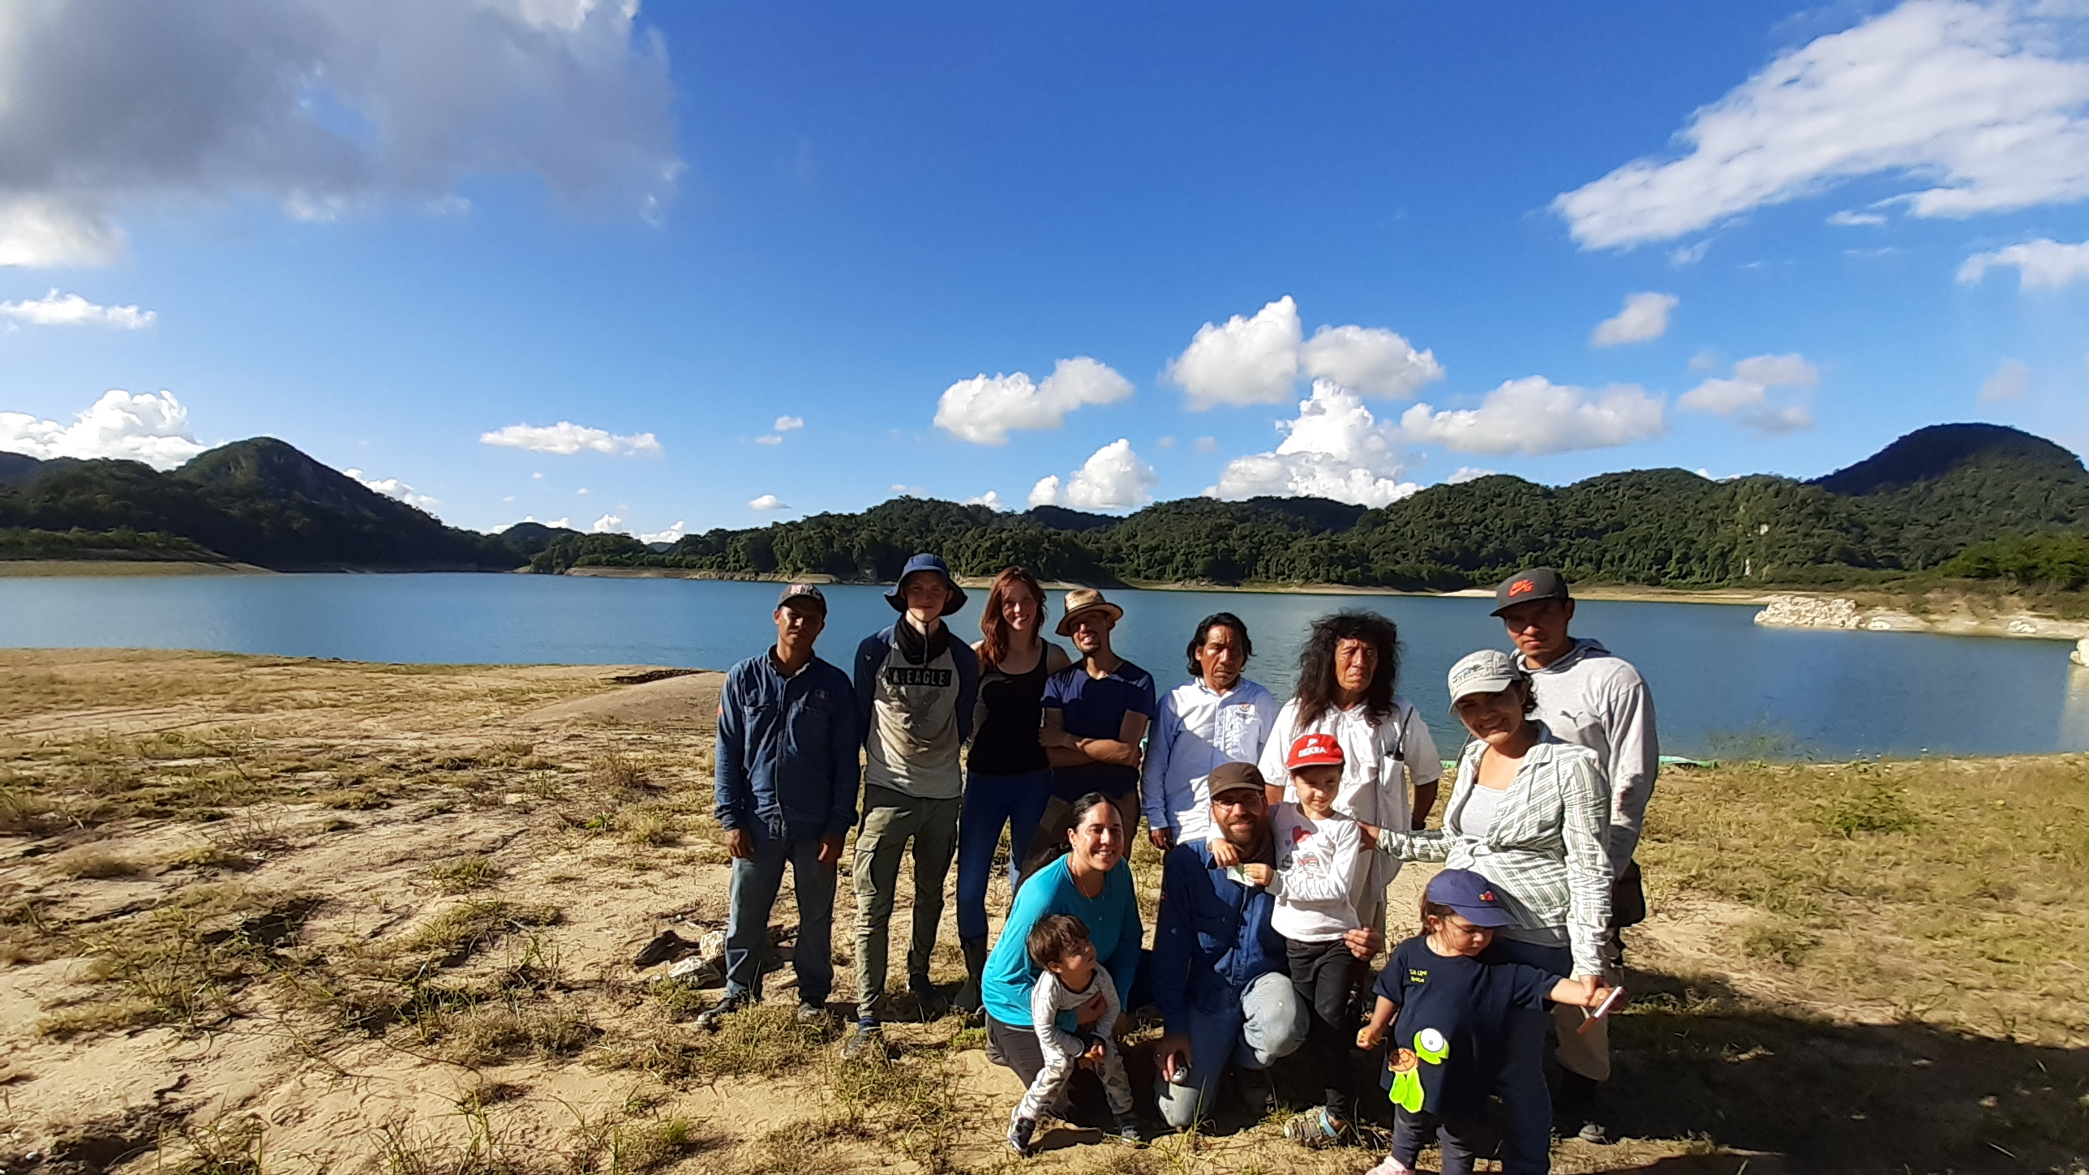
The Selva Lacandona science team
Matthias Bücker¹ │ Antje Schwalb² │ Andreas Hördt¹ │ Johannes Buckel¹ │ Theresia Lauke² │ Johannes Hoppenbrock¹ │ Alexander Correa-Metrio³ │ Mauricio Bonilla⁴ │ Rodrigo Martínez Abarca⁵ │ Sergio Rodríguez³ │ Wendy Morales³ │ Óscar Escolero³ │ Margarita Caballero⁶│ Socorro Lozano³ │ Francisco Romero³ │ Carlos Pita⁷ │ Adrián Flores⁸│ Bárbara Moguel⁹ │ Mark Brenner^{10,11} │ Jason Curtis¹¹ │ William Kenney¹⁰ │ Robert van Geldern¹² │ Christoph Mayr¹³ │ Philipp Hoelzmann¹⁴ │ Julieta Massaferro¹⁵ │ Fernanda Charqueño¹⁵ │ Karla Rubio-Sandoval¹⁶ │ Paula Echeverría² │ Daniel Ochoa⁴│ Claudia Romero Oliva¹⁷ │ Jorge García Polo¹⁷ │ Santiago Landois¹⁸ │ Miguel García¹⁸ │ Arturo Chorley¹⁸ │ Björn Riedel¹⁹ │ Matti Altmann¹⁹ │ Liseth Pérez²
(1) TU Braunschweig, Institute for Geophysics and Extraterrestrial Physics, Germany, (2) TU Braunschweig, Institute of Geosystems and Bioindication, Germany, (3) Universidad Nacional Autónoma de México, Instituto de Geología, Mexico, (4) Universidad Nacional Autónoma de México, Posgrado en Ciencias Biológicas, Mexico, (5) Universidad Nacional Autónoma de México, Posgrado en Ciencias de la Tierra, Mexico, (6) Universidad Nacional Autónoma de México, Instituto de Geofísca, Mexico, (7) Geotem Ingeniería S.A. de C.V., Mexico, (8) TU-Wien, Department of Geodesy and Geoinformation, Research Group Geophysics, Austria, (9) Universidad Nacional Autónoma de México, LIIGH, Mexico, (10) Land Use and Environmental Change Institute (LUECI), University of Florida, Gainesville, USA, (11) Department of Geological Sciences, University of Florida, Gainesville, USA. (12) Geozentrum Nordbayern, Friedrich-Alexander-Universität Erlangen-Nürnberg, Germany, (13) Institut für Geographie, Friedrich-Alexander-Universität Erlangen-Nürnberg, Germany, (14) Institut für Geographische Wissenschaften, Freie Universität Berlin, Germany, (15) CENAC, Bariloche, Argentina, (16) Marum, Center for Marine Environmental Sciences, Bremen, Germany, (17) Centro de Estudios Atitlán, Universidad del Valle de Guatemala, Guatemala, (18) Consejo Nacional de Áreas Naturales Protegidas, Mexico., (19) IGP, TU-Braunschweig, Germany.

Slide 26
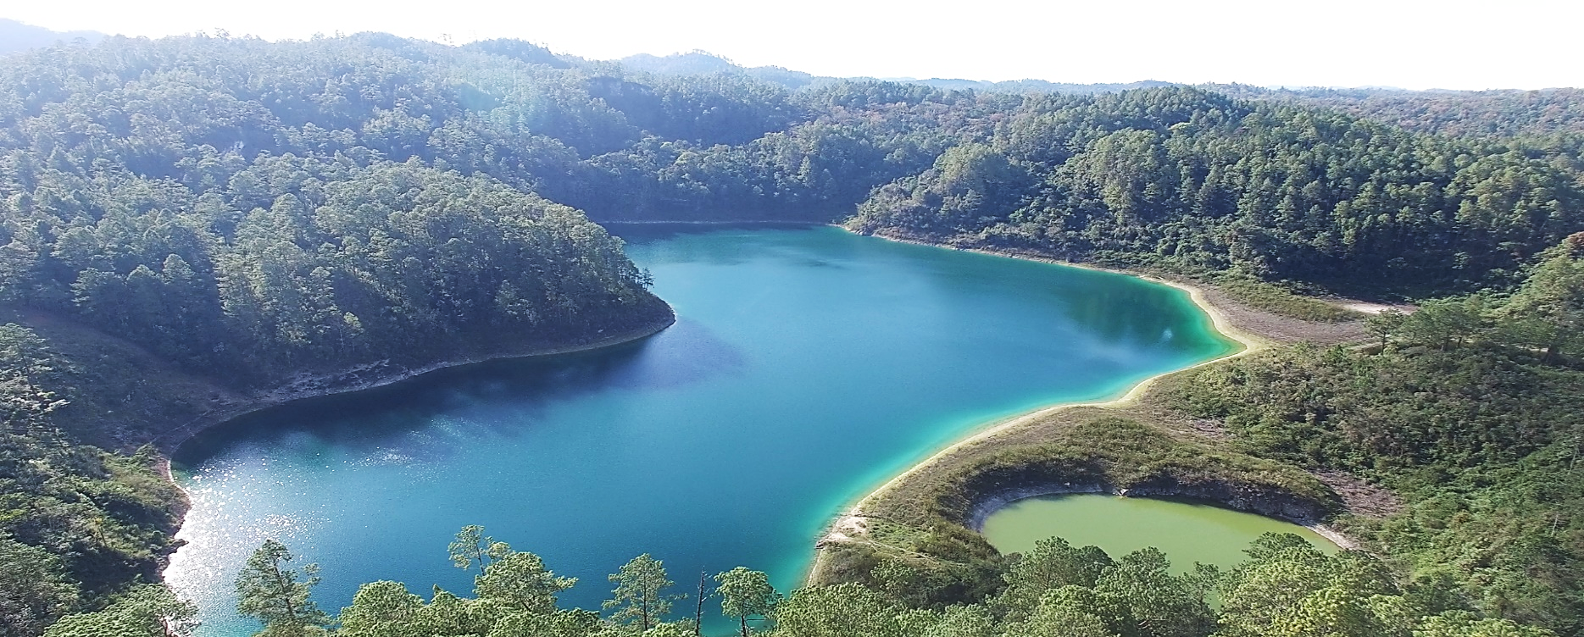
Thank you!
Liseth Pérez │ l.perez@tu-bs.de

