Slide 1
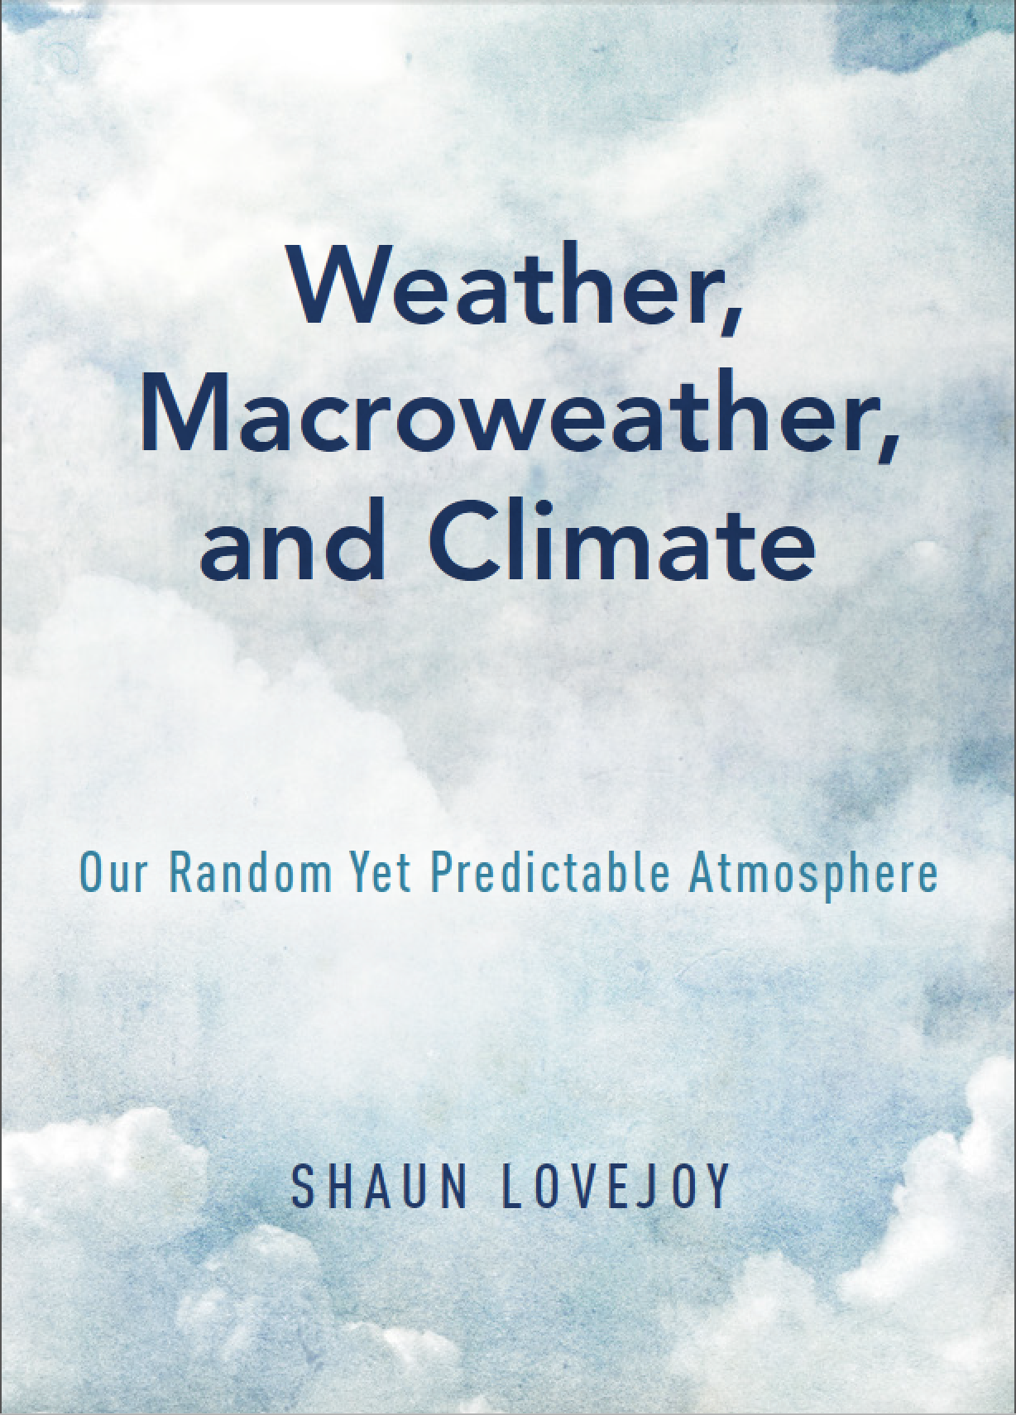

EGU
NP1.1
4 May, 2020
Correcting
Budyko-Sellers boundary conditions:
The Half-order Energy Balance Equation (HEBE)
McGill, Montreal,
Canada
S. Lovejoy, L. Del Rio Amador, R. Procyk
Notes:
Thank you for the kind introduction.
I would like to thank professor Yi Huang for this invitation.
This is an update on a seminar I gave on April 9th when, I was invited to give the Richardson lecture by the nonlinear processes division of the European Geosciences Union.
As it happened, Richardson has strongly influenced my work over the last decades, he initiated the two fundamental strands of atmospheric science that I will discuss today. In the 1920’s he proposed two apparently contradictory ways of apprehending the atmosphere: deterministic and stochastic.
My aim today is to convince you that although for a long time these approaches have been separate, that today they can be reunited; a reunification that enriches our theoretical understanding of the atmosphere while giving us new ways of predicting and projecting it’s future state.
So what is the problem that we are facing?

Slide 2
Correcting Budyko-Sellers boundary conditions: The Half-order Energy Balance Equation (HEBE)
S. Lovejoy, L, Del Rio Amador, R. Procyk
Physics dept., McGill University, Montreal, Que. H3A 2T8, Canada
Corresponding author: Shaun Lovejoy (lovejoy@physics.mcgill.ca)
Abstract
The conventional 1-D energy balance equation (EBE) has no vertical coordinate so that radiative imbalances between the earth and outer space are redirected in the horizontal in an ad hoc manner. We retain the basic EBE but add a vertical coordinate so that the imbalances drive the system by imposing heat fluxes through the surface. While this is theoretically correct, it leads to (apparently) difficult mixed boundary conditions. However, using Babenko’s method, we directly obtain simple analytic equations for (2D) surface temperature anomalies T_{s}(x,t): the Half-order Energy Balance Equation (HEBE) and the Generalized HEBE, (GHEBE) [Lovejoy, 2019a]. The HEBE anomaly equation only depends on the local climate sensitivities and relaxation times. We analytically solve the HEBE and GHEBE for T_{s}(x,t) and provide evidence that the HEBE applies at scales >≈10km. We also calculate very long time diffusive transport dominated climate states as well as space-time statistics including the cross-correlation matrix needed for empirical orthogonal functions.
The HEBE is the special H = 1/2 case of the Fractional EBE (FEBE) [Lovejoy, 2019b], [Lovejoy, 2019c] and has a long (power law) memory up to its relaxation time τ. Several papers have empirically estimated H ≈ 0.5, as well as τ ≈ 4 years, whereas the classical zero-dimensional EBE has H = 1 and τ ≈ 4 years. The former values permit accurate macroweather forecasts and low uncertainty climate projections; this suggests that the HEBE could apply to time scales as short as a month. Future generalizations include albedo-temperature feedbacks and more realistic treatments of past and future climate states.
References
Lovejoy, S. (2019): Fractional relaxation noises, motions and the fractional energy balance equation, Nonlin. Processes Geophys. Discuss., https://doi.org/10.5194/npg-2019-39.
http://www.physics.mcgill.ca/~gang/eprints/eprintLovejoy/neweprint/npg-2019-39-manuscript-version3.pdf
Lovejoy, S., Weather, Macroweather and Climate: our random yet predictable atmosphere, 334 pp., Oxford U. Press, 2019b.
Lovejoy, S., 2020: The Half-order Energy Balance Equation, Part 1: The homogeneous HEBE and long memories, Earth Syst. Dyn. Disc., https://doi.org/10.5194/esd-2020-12
https://www.earth-syst-dynam-discuss.net/esd-2020-12/esd-2020-12.pdf
Lovejoy, S., 2020: The Half-order Energy Balance Equation, Part 2: The inhomogeneous HEBE and 2D energy balance models, Earth Syst. Dyn. Disc., https://doi.org/10.5194/esd-2020-13
https://www.earth-syst-dynam-discuss.net/esd-2020-13/esd-2020-13.pdf
Lovejoy, S. 2020: The Fractional Heat Equation and Earth’s energy balance, submitted to Nonlin. Proc. In Geophys. (April 7) http://www.physics.mcgill.ca/~gang/eprints/eprintLovejoy/esubmissions/FHE.NPG.7.4.20ter.pdf

Slide 3
The classical continuum Heat Equation
Heat transport
Energy storage equation
(energy continuity) equation.
Fickian Diffusive heat flux
specific heat
temperature
density
thermal diffusivity
Advection velocity
Advective flux
Classical heat equation (3D)
Homogeneous equation
(The forcing is by the Boundary Conditions)

Slide 4
The classical continuum Heat Equation:
Forcing
Heat equation (3D)
T(t,x,y,z)
2-D
T(t,x,y)
3-D
1-D
T(t,y)
Conductive - Radiative
surface boundary condition
Budyko-Sellers (latitudinally averaged)
Climate sensitivity
Forcing
Mean Meridional heat flux
F = Forcing
(vertical flux imbalance)
Vertical Radiative imbalance
z
=Radiative imbalance
y
x
1-D
Conductive heat flux into subsurface
Diffusion depth
T(t,y)
2-D
T(t,x,y)
Half-order Energy Balance Equation HEBE
EBE

Slide 5
Surface temperatures:
Reduction of spatial dimensionality
Forcing
Forcing
Conductive – Radiative BCs
(correct)
Radiative imbalances redirected
(ad hoc)
3-D
1-D
2-D
0-D
Generalized Half- order EBE (GHEBE)
Energy Balance Equation (EBE)
(equivalent to box models)
Horizontal transport operator
2-D Half - order EBE (HEBE) (High frequencies)
2-D
0-D
H =1/2
H = 1

Slide 6
The HEBE is 100% Classical!
Demonstration with nondimensional 0-D equations
Zero-dimensional classical heat Equation
Radiative-Conductive BC
Laplace transform
Solve ODE
Semi-infinite geometry (we require the temperature at depth (z<<0) to remain finite - implies B=0 and:
Impulse forcing
Green’s function

Slide 7
FEBE for the surface temperature
For the surface (z = 0), the Green’s function satisfies:
Inverse Laplace
H=1/2
Hence
The Green’s function for the surface temperature is also the Green’s function for the HEBE
So that for the surface temperature T_{s}(t) = T(t,0)
0-D HEBE

Slide 8
Where does the energy go?
…into the subsurface
T/(λ F)
Step forcing
F
Diffusion depth
(≈10 – 100m)
Conduction into subsurface:
Q_{s} = F – T/λ
surface
0
0.5
1
Depth
1.5
2
2.5
Radiative losses
3
3.5
4
4.5
5
Depths increasing from zero (black) to 5 in units of 0.5 (top to bottom)
Relaxation time

Slide 9
The Fractional Heat Equation (FHE),
Fractional EBE (FEBE)
Change the order of the time derivative
(Implies storage in subsurface and in volume elements)
FHE
(H = 1/2 is the classical heat equation)
Conductive-Radiative BC
Solution:
FEBE for the surface temperature T_{s}(t,x,y) :
With “Generalized Exponential” (Mittag-Leffler) impulse response
2-D: the Generalized FEBE (GFEBE):

Slide 10
Applications

Slide 11
Newton’s Law of Cooling (NLC)
Z= Thermal impedance
FEBE
Box models
(ad hoc)
Classical value: H=1/2
(from surface BCs)
Conclusion: a) The Box models (H=1) and FEBE obey NLC but
b) box models are not consistent with conductive-radiative surfaces
c) long memory storage is generic

Slide 12
Step Response
Equilibrium
Step function response
1.0
Exponential storage: H=1
Power law storage H<1
H = 0.9
0.8
H = 0.5
0.6
H = 0.1
Forcing
0.4
0.2
0
2
4
6
8
t/τ
10
Box storage (H=1):
Scaling storage (0≤H<1):

Slide 13
The annual cycle:
Complex climate sensitivities
Fourier FEBE
Complex thermal impedance
Phase lag
H=1 (box model)
H=0.7
T-F Phase lag
H=1/2 (HEBE)
H=0.4
North et al 1981, Donohoe et al 2020
H=0.1
Empirical τ estimates
Notes:
Fig. 4: The (negative) phase lag of the temperature with respect to the forcing (the negative of the argument of l) Lag in days for H = 1/10, 3/10, ½, 7/10, 9/10 (black), 4/10 (dashed middle), 1 (dashed top) as a function of t measured in years. The horizontal lines are for 25 and 30 days, we see that the dashed H = 4/10 falls in this range for between one and 5 years. This range of lags is close to the typical extra-tropical lags found in [Donohoe et al., 2020].

Slide 14
System memory: TCR/ECS
TCR/ECS
τ =1.1 years
2.2
4.4
8.8
Procyk
Relaxation time
17.5
τ =35 years
IPCC AR5
Notes:
Δt/τ by powers of =2 : 2 - 64 , bottom ot top ratio Dt/t varying as before from 64 to 2, but using Dt=70 years
TCR/ECS 0.56±0.12 Yoshimori et al., 2016] Roman: median: 0.73, range 0.70-0.78 AerRCP, H: 0.33-0.44 median 0.38

Slide 15
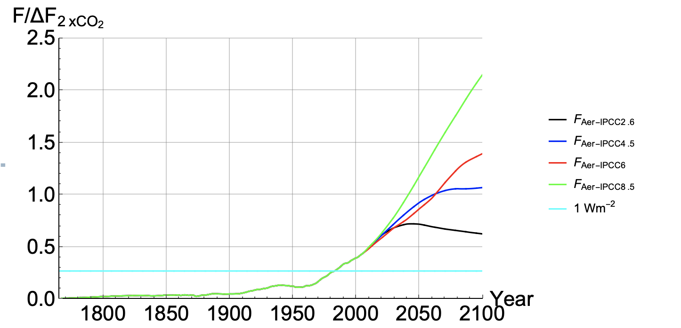
Using the FEBE for climate projections
FEBE
 | τ (yrs) Relaxation time | H | λ Climate sensitivity (ºC/CO₂ doubling)
Upper 5% | 7.0 | 0.44 | 2.4
Median | 4.7 | 0.38 | 2.0
Lower 5% | 2.4 | 0.33 | 1.6
IPCC AR5 | 8.4, 410 | 1 | 3.2±1.3
RCP 8.5
Anthropogenic forcings (CMIP5)
RCP 6
RCP 4.5
RCP 2.6
1 W/m²
+ solar forcing (Wang et al) and then volcanism using Sato and extending back using Crowley
Procyk, Lovejoy, Hebert 2020

Slide 16
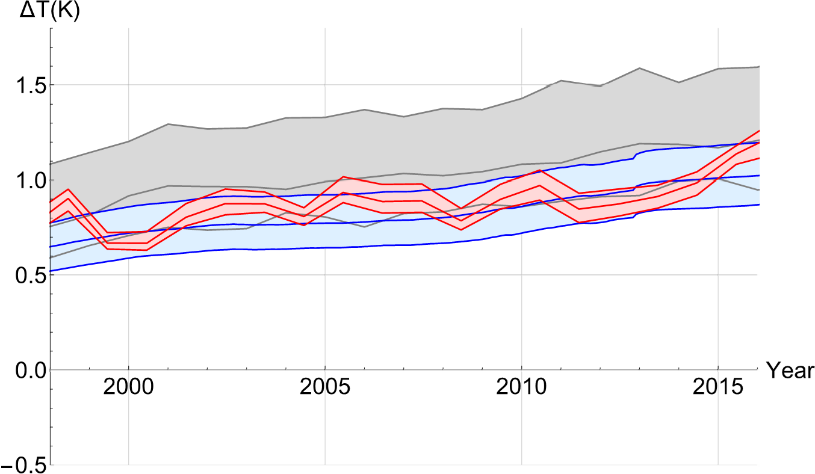
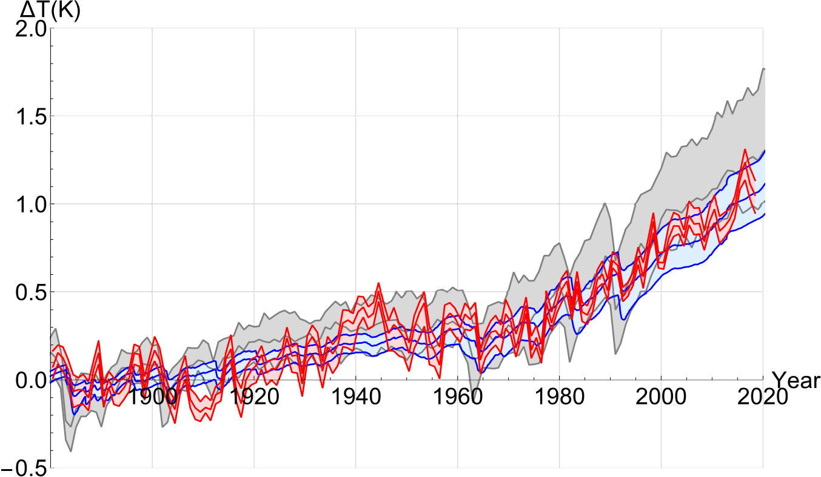
FEBE Hind projections: from 1880
CMIP5
MME
CMIP5
90%
confidence
Historical data (5 series)
FEBE
90%
confidence
baseline
FEBE hind-projection
“Pause”

Slide 17
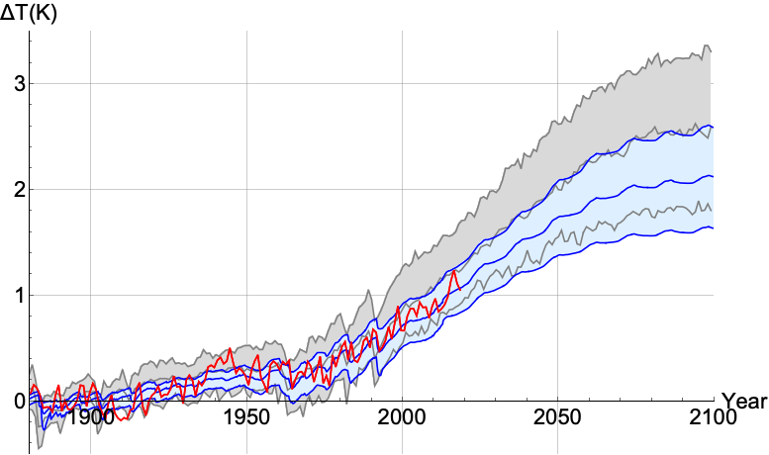
FEBE versus CMIP5 models
90%
confidence
Moderate mitigation scenario (RCP 4.5)
FEBE 1.5ºC
CMIP5
MME
CMIP5 MME 1.5ºC
FEBE
90%
confidence
10 year delay in crossing 1.5C threshold
….Lower uncertainties
With Roman Procyk
Notes:
FEBE parameters:
H = 0.37±0.03,
= 5.0±1.7 yrs
ECS= λ =2.43±0.25 ºC/CO₂ doubling
IPCC AR5: λ =3±1. 5 ºC/CO₂ doubling

Slide 18
Validation: the historical method reproduces the past and predicts the GCMs
Projection of the Mean of the GCM’s using scaling
RCP 4.5
Mean of 32 GCMs (numerical integration)
Hybrid
Temperature with respect to 1880-1900 average (ºC)
Projection of historical data using scaling
historical
projections
Conclusion: GCMs (nearly) linearly project the past… but their climates are unrealistic. Better to project the observations
With R. Hébert,
B. Tremblay

Slide 19

Using scaling for macroweather
(long range) forecasts
http://www.physics.mcgill.ca/StocSIPS/
Stochastic Seasonal to Interannual Prediction System
Based on high frequency response of the Fractional Energy Balance Equation
t<<τ
τ ≈ 5yrs
H ≈ 0.4
New stochastic predictability limits… achieved on GCM control runs
With L. Del Rio Amador

Slide 20
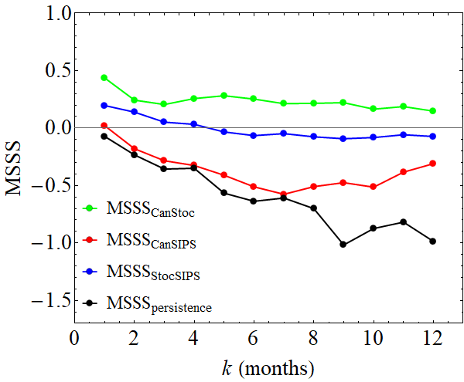
Mean skill Hindcasts of Global Mean Temperature Anomalies
Perfect forecast
CanStoc = hybrid
StocSIPS (stochastic)
skill
CanSIPS (GCM)
Based on fGn model
StocSIPS = Stochastic Seasonal and Interannual Prediction System
Negative skill
persistence
GCMs
CanSIPS = Canadian Seasonal and Interannual Prediction System
0
2
4
6
8
10
12
Lead time (months)
Hybrid
CanStoc = CanSIPS -StocSIPS hybrid
Training: 1980-2000
Verification : 2001-2010
Notes:
Skip
MSSS = Mean Square Skill Score =
1 -(Mean Square Error/ Anomaly Variance)

Slide 21
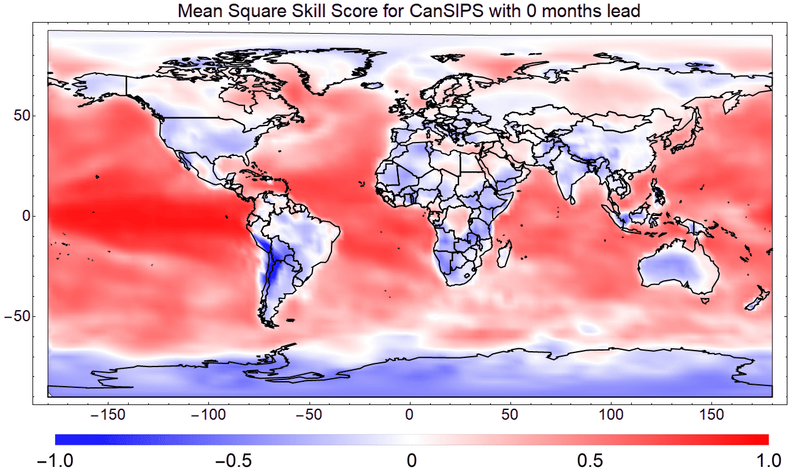
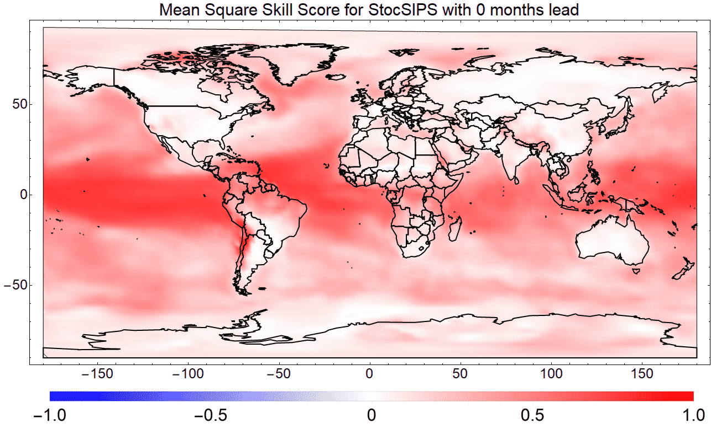
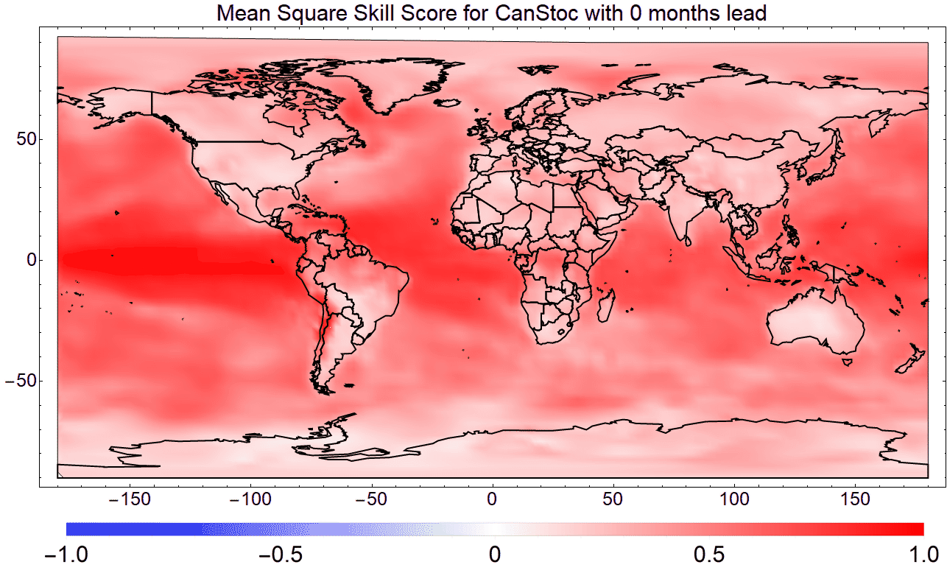
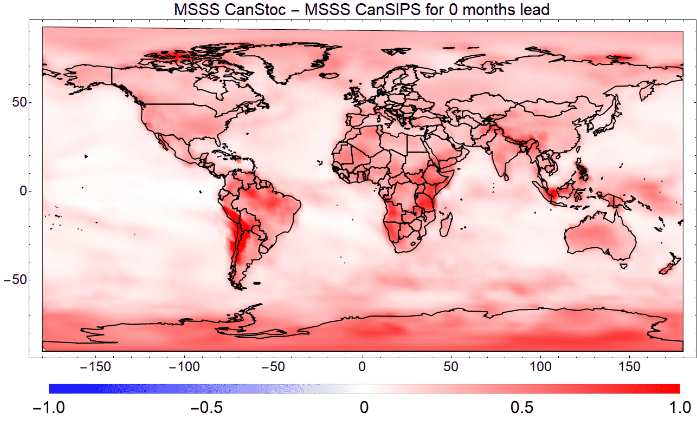
0-months lead Skill (hindcasts 1980-2010)
CanSIPS (GCM)
StocSIPS
Red: high skill, blue, low skill
CanStoc - CanSIPS
Red: CanStoc higher skill than CanSIPS
CanStoc (hybrid)

Slide 22
Conclusions
1. Budyko-Sellers (classical Heat Equation) + correct conductive-radiative BC’s imply:
Fractional derivative equation for the surface temperature (Half-order EBE= HEBE)
Generic long-memory (power law, scaling) subsurface storage
2. The Fractional Heat Equation implies Fractional EBE (FEBE) for surface temperatures
3. Gives realistic prediction of annual cycle (temperature phase lag)
4. Realistic ratio Transient Climate Response to Equilibrium Climate Sensitivity (TCR/ECS)
5. 0-D FEBE Can be used for new (low uncertainty) climate projections to 2100.
6. 2-D FEBE Can be used for monthly, seasonal (macroweather) forecasts.
The 2D FEBE is a promising basis for new, stochastic linear macroweather, climate models … Nonlinear extensions possible

