Slide 1
Effect of forest soil warming on the rate and temperature sensitivity of microbial C and N processes in a temperate mountain forest
Carolina Urbina Malo, Ye Tian, Chupei Shi, Shasha Zhang, Marilena Heitger, Steve Kwatcho, Werner Borken, Jakob Heinzle, Andreas Schindlbacher, and Wolfgang Wanek

Slide 2
Site
Achenkirch, Austria
warming experiment with 6 x warmed plots (2.5 x 2.5 m) since 2005 and 2008 by heating cables
6 x control plots – disturbed (dummy cables), paired with warmed plots
Experiment
24 hours incubation at 3 temperatures per treatment, and 2 depths TOP (0-10 cm)/SUB (10-20 cm)
+ 0 °C / + 4 °C / + 10 °C
Control: 10 °C / 14 °C / 20 °C
Heated: 14 °C / 18 °C / 24 °C
Aim
Compare the Q₁₀ function of different soil processes
Methods
CUE, ¹⁸O incorporation into DNA / respiration
NUE, ¹⁸O incorporation into DNA / gross N mineralization
Gross protein depolymerization and nitrification
Potential enzyme activities, fluorimetric and photometric methods

Slide 3
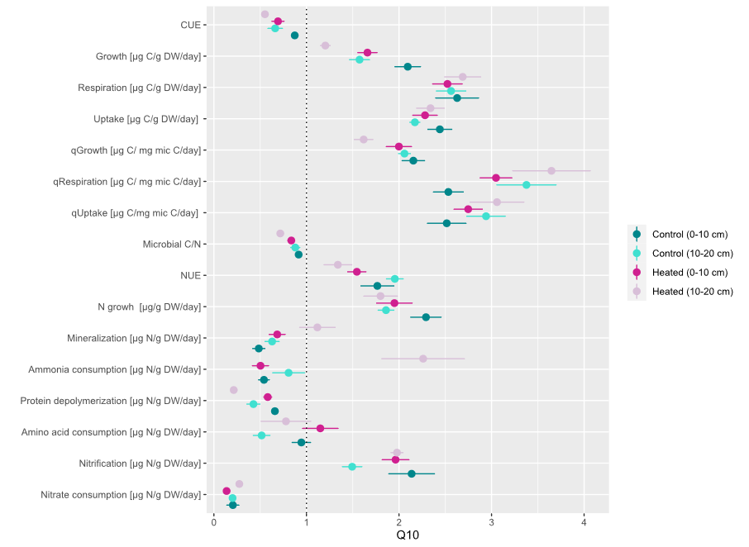
CUE decreased in the short-term due to the higher Q10 of respiration relative to microbial growth.
Q10 of microbial growth decreased with warming while for C uptake and respiration Q10 increased in warmed plots.
NUE showed increase in the short term (opposite pattern as CUE).
Negative response of gross N mineralization to short-term temperature increases.
Increased N conservation in warmed soil.

Slide 4
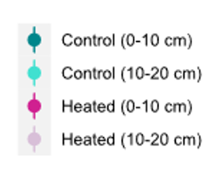
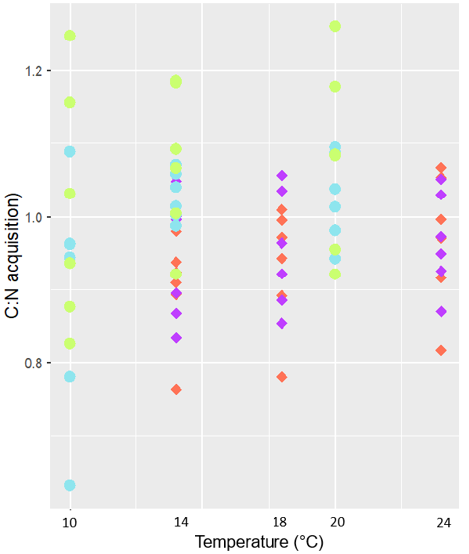
+0 °C
(B-gluocosidase)
P limitation
(Chitinase)
Length
(Aminopeptidase)
Angle
(Phosphatase)
Q10 for LAP, NAG and BG at both depths significantly higher in control plots.
R10 shows higher potential enzyme activities in warmed plots.
Vector angle shows relative P limitation, P might be constraining micr. growth.
C:N acquisition ratio higher in control plots, more stable in warmed soils.
There was a differential response in the Q10 of C and N processes to short term warming between chronically warmed and control soils.

