Slide 1
Multi-scale Analysis of Electromagnetic Energy Input using Swarm: Quantifying Key Scales in Magnetosphere-Ionosphere Coupling
I. P. Pakhotin¹, I. R. Mann¹, K. Xie¹, D.J. Knudsen^{2,} J. K. Burchill²
¹ University of Alberta, Edmonton, AB, Canada
² University of Calgary, Calgary, AB, Canada
May 6, 2020, European Geophysical Union General Assembly

Slide 2
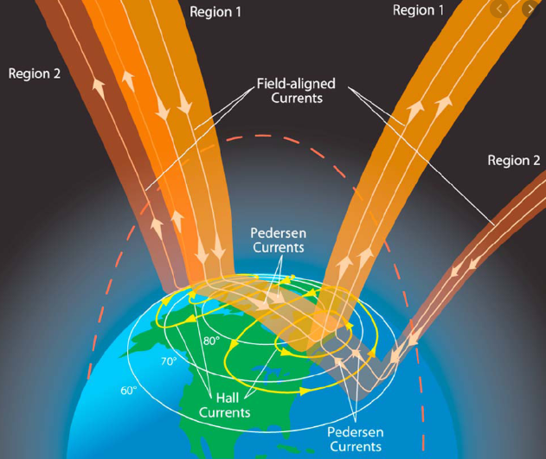
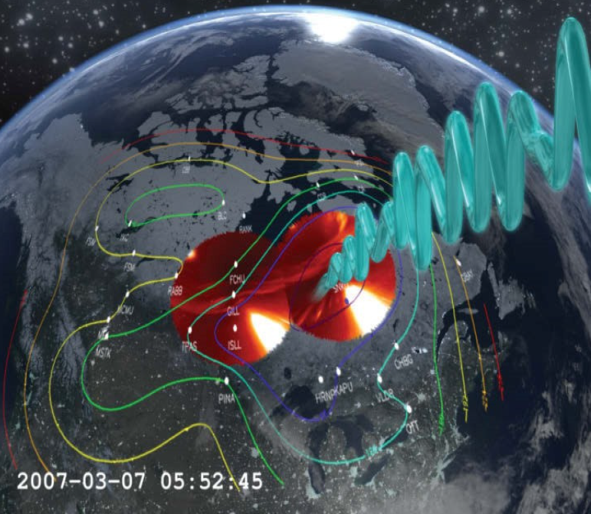
Introduction
Magnetosphere-ionosphere-thermosphere (MIT) coupling is a multi-scale process
Which scales are quantitatively the most important?
Small-scale ‘Alfvenic’ electromagnetic disturbances on scale sizes <150 km transverse scale are often ignored in e.g. global FAC models

Slide 3
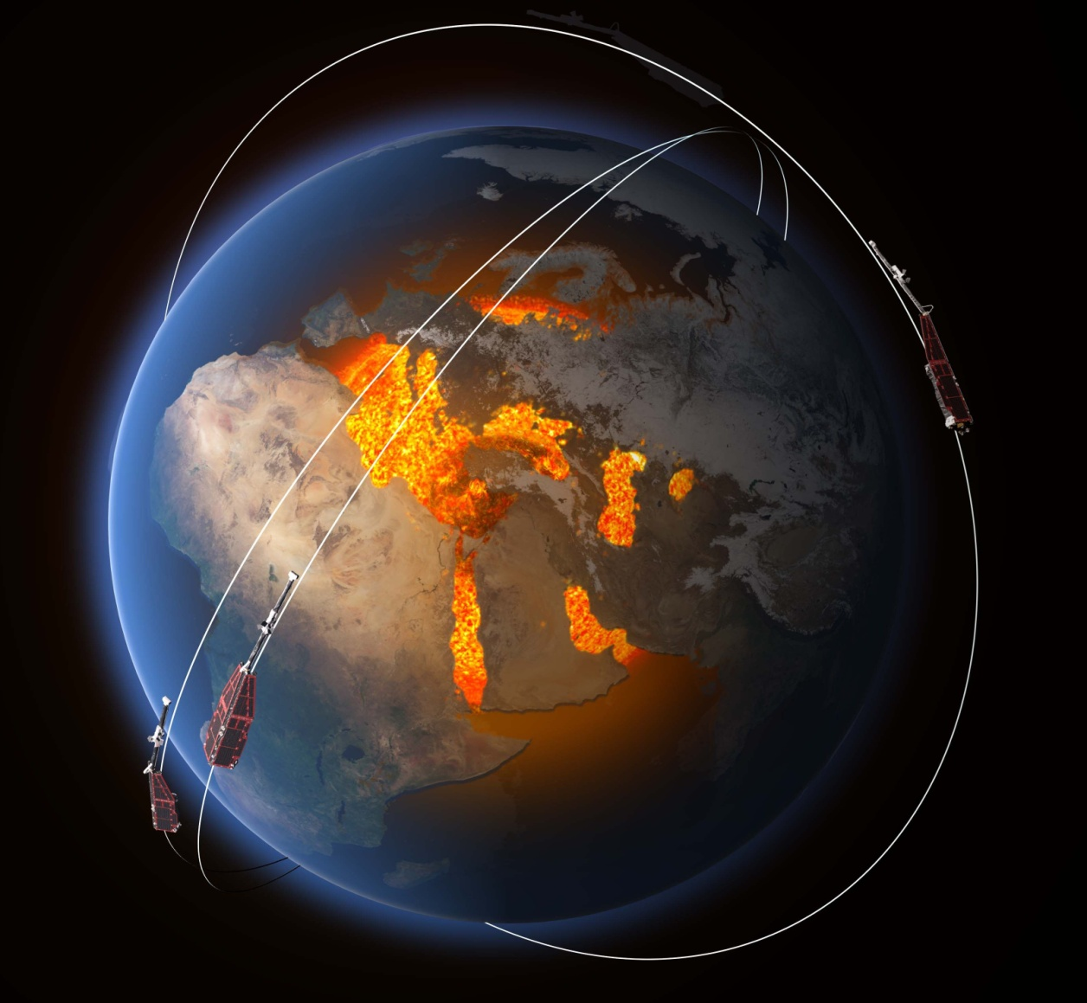
ESA Swarm mission
Launched in 2013 into polar low-Earth orbit at 450 km (SwA and SwC) and 520 km (SwB)
Swarm 2 Hz E- and B-field datasets statistics span several years, allowing for long-duration statistical analysis of Poynting flux
Courtesy of earth.esa.int

Slide 4
Poynting flux analysis methodology
Selects data within certain MLAT range, focusing on auroral zone. Excludes equatorial (e.g. plasma bubbles) and near-polar (e.g. polar cap traversal) effects
For event selection, E- and B-fields are high-pass filtered, then Poynting flux vs time is obtained for each pass
A low pass filter is applied to the Poynting flux time series to get its envelope
If the maximum of the envelope is over empirically determined threshold, flag event, extend backwards and forwards in time until a second, lower, threshold is reached. This forms the boundaries of the event
For each event, transform into mean-field aligned coordinates, then high-pass to remove baseline and main field effects at scales larger than those under consideration
Finally, apply increasingly strong low-pass filters to the E- and B-field time series, calculate resulting Poynting flux as function of low-pass filter window

Slide 5
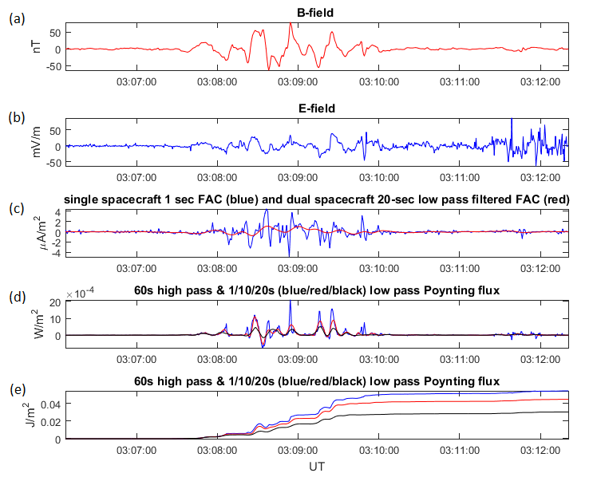
Statistical analysis using 2 Hz E- and B-field data
B-field
E-field
FAC
Poynting flux
Integrated Poynting flux

Slide 6
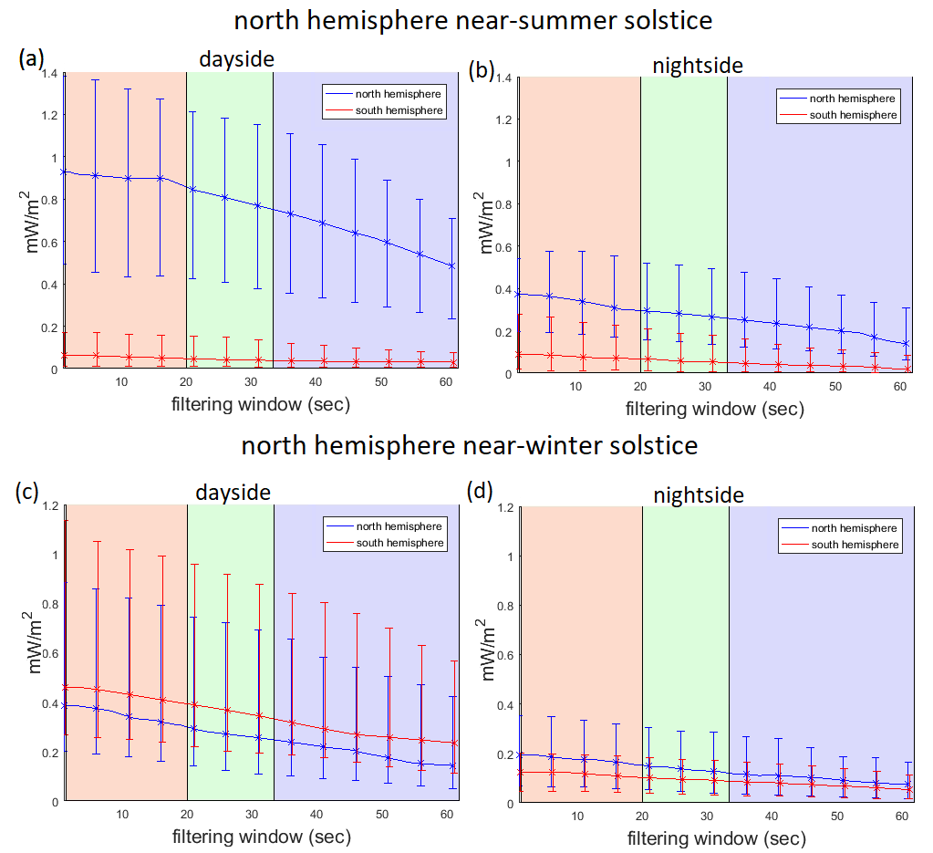
Summer/winter Poynting flux asymmetry
Submitted to Nature Communications (2020)

Slide 7
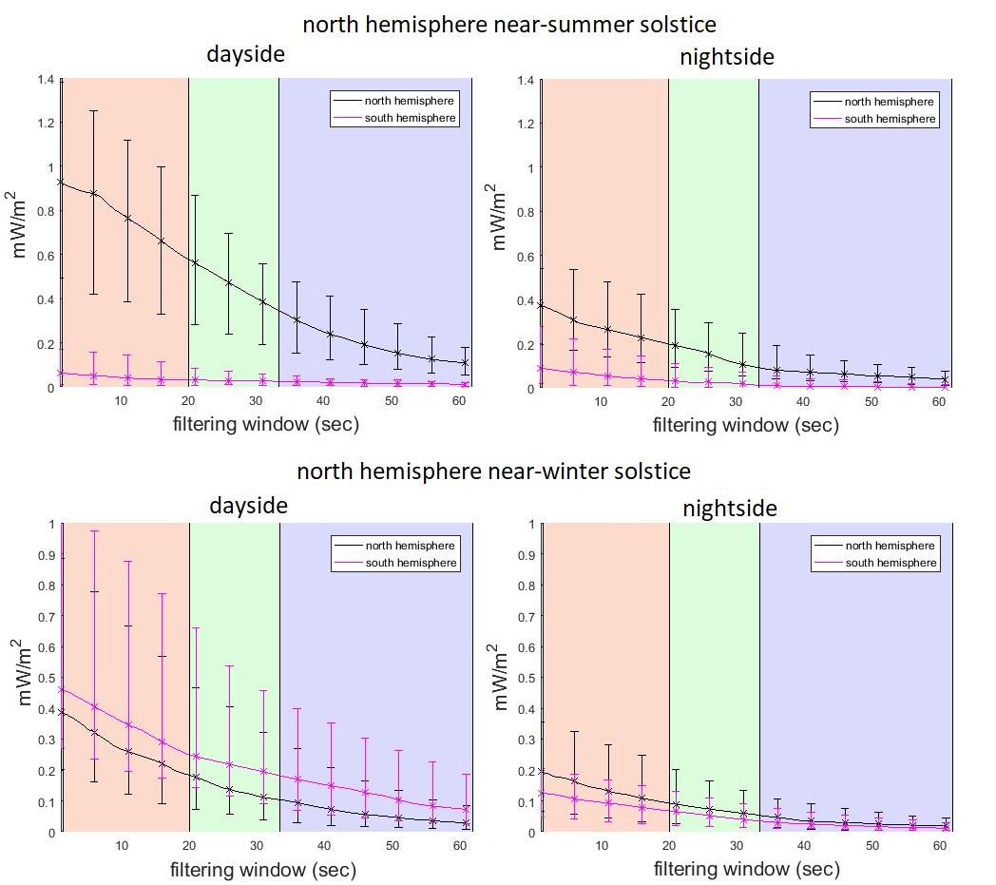
Scale dependence with a moving average filter
Up to half the Poynting flux can be lost by the application of a 20-sec moving average filter

Slide 8
Poynting flux scale dependence
Northern preference for Poynting flux energy input into the ionosphere, both on dayside and on nightside
If using a 2nd order Savitzky-Golay filter, around 10% of energy may be missed if a 20-second low pass filter is applied
With a moving average filter, up to 50% of the Poynting flux may be missed if a 20-second low pass filter is applied
No strong evidence of energy loss at any one particular scale in statistics – energy drops off fairly smoothly. Possible evidence for a cascade

Slide 9
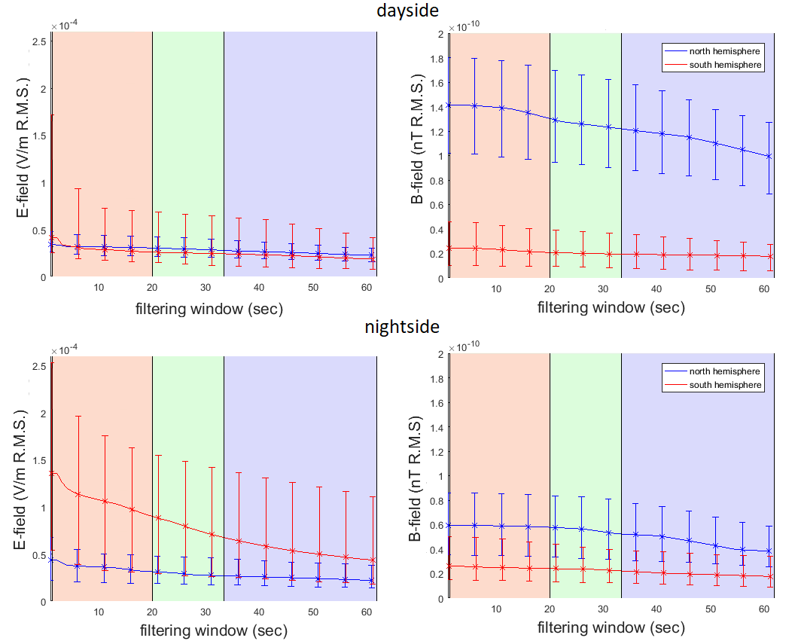
RMS E-and B-field data – near northern summer solstice

Slide 10
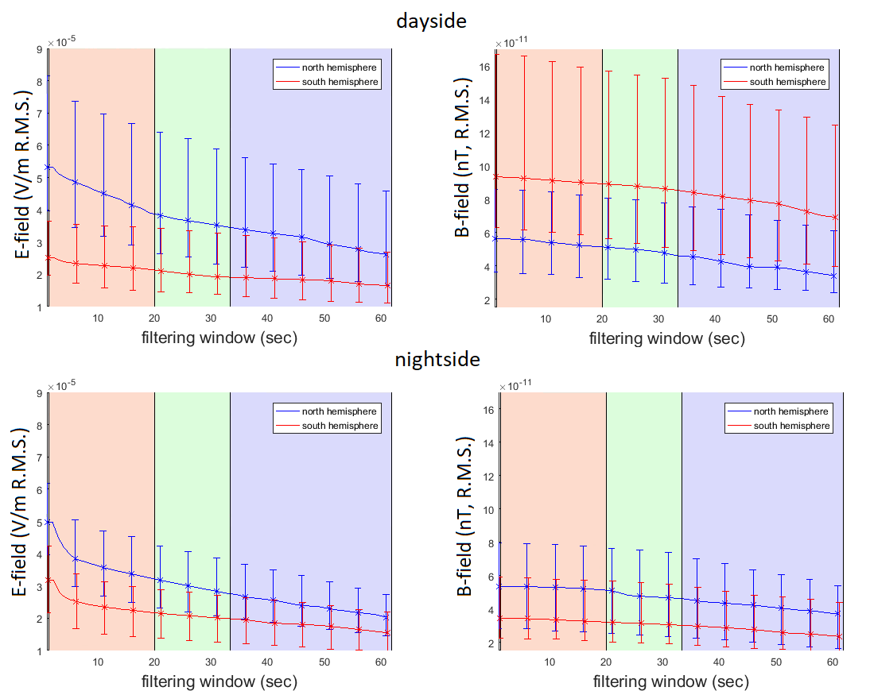
RMS E-and B-field data – near northern winter solstice

Slide 11
E- and B-field statistics
Magnetic field disturbances appear to follow the Poynting flux scale dependence and inter-hemispheric asymmetry statistics
Electric field disturbances appear to have different dynamics, in particular strong dE energy at scales smaller than 5 sec (0.2 Hz)
Instrumental caveats cannot be ruled out
Since Poynting flux is proportional to E x B, if E and B are not in phase, no Poynting flux will arise
Magnetosphere-ionosphere energetics involve a complex interplay of electric and magnetic perturbations as well as wave reflection and interference

Slide 12
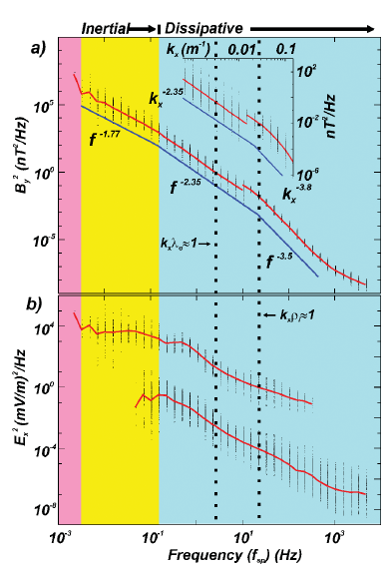
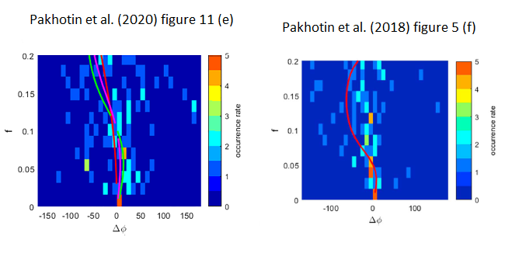
Inertial and dissipative Alfven regimes
- Prior literature e.g. Chaston et al. (2008), Lotko & Zhang (2018) suggest a break around 0.1 Hz
- Swarm observations (e.g. Pakhotin et al., 2018, 2020, Wu et al., 2020) suggest a break in phase difference from nearly in-phase to off-phase around 0.1-0.2 Hz
- If dE and dB out of phase, rise in dE or dB will not lead to rise in Poynting flux
Chaston et al. (2008)
Figure 2

Slide 13
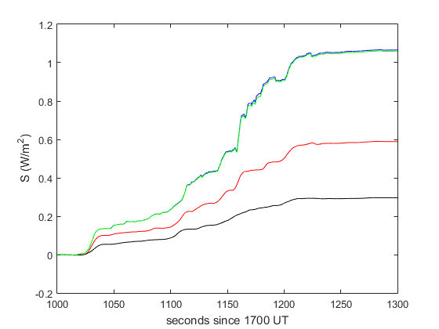
High-resolution Poynting flux analysis
Blue = 16 Hz, green = 2 Hz, red = 0.1 Hz, black = 0.05 Hz

Slide 14
Conclusions
Small and mesoscale disturbances carry statistically significant energy. Ignoring this energy can lead to significant global under-estimations of Poynting flux and associated effects e.g. Joule heating
About 10% of Poynting flux energy can be missed by applying 2nd order Savitzky-Golay filter at 20 sec (150 km) scale. Other filters e.g. moving average, have even more severe impact (up to half the Poynting flux can be missed!)
Energy content appears to decrease with scale in a smooth manner, suggesting that energy loss processes above are self-similar with scale and/or that a cascade spreads energy loss across scales
Power content above about 1-2 Hz does not appear to be globally significant. Individual events may feature strong dynamics at Alfvenic scales. It is possible that by the time residual energy gets to Swarm, loss is spread over a range of scales

Slide 15
Acknowledgements
This work was supported in part by the ESA Living Planet Fellowship
The work was supported in part by the Canadian Space Agency

Slide 16
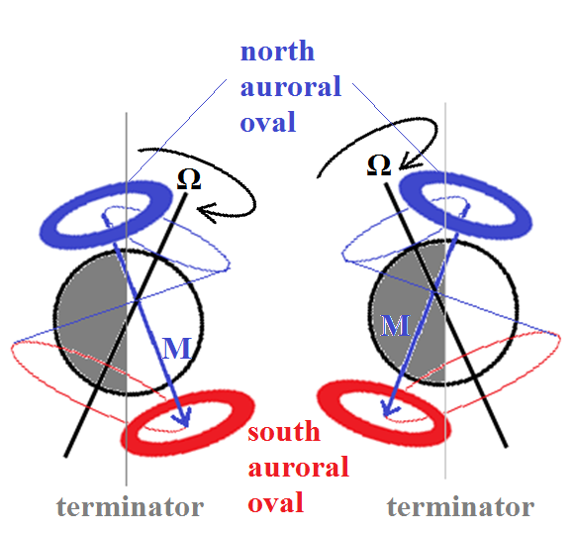
Appendix: Earth’s eccentric magnetic dipole generates differential illumination of the two auroral ovals
Summer Winter
- the center of the magnetic dipole is ~ 500 km northwards of Earth’s center
- As such, the effective surface offset of south mag pole from rotation axis is ~8.5 deg more than north mag pole
- the south oval extends further into both light and dark illumination regions
Summer Winter

